Slide 1

CADENCE
Practice with
useful feedback.
A speech rehearsal coach for students and job seekers.
Live URL: https://cadenceproject.vercel.app
Notes:
0:00–0:10. Introduce Cadence and point out the live URL on screen. Say that this is a speech rehearsal app for students and job seekers.

Slide 2

“It was great” leaves
the speaker guessing.
Students and job seekers need specific feedback before a class talk, interview, research defense, or pitch.
Cadence points to delivery habits and gives the speaker a concrete way to practice them.
The goal is a clearer next attempt, not a generic score.
Notes:
0:10–1:00. Explain the problem and users: students and job seekers often hear vague encouragement, but need specific feedback before a class talk, research defense, interview, or pitch.

Slide 3

One rehearsal.
Three useful outputs.
01 Record or upload a short talk
02 Review the transcript and delivery metrics
03 Open coaching, then try a targeted drill
Transcript • Metrics • Practice plan
Live URL: https://cadenceproject.vercel.app
Notes:
1:00–1:10. Summarize the loop: record, inspect transcript and delivery metrics, then use a coaching recommendation or targeted drill. Transition directly into the live app.

Slide 4
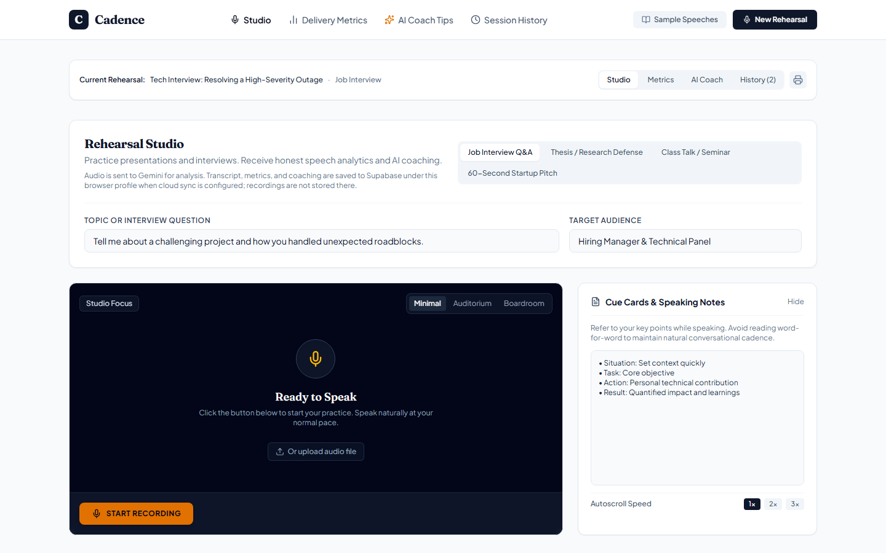
Live app: rehearsal studio
Current production UI · cadenceproject.vercel.app
Notes:
1:10–1:25. Open the actual production URL. Point out the rehearsal setup, recording/upload controls, and cue cards. This slide is a current screenshot; continue with the live app for the demonstration.

Slide 5
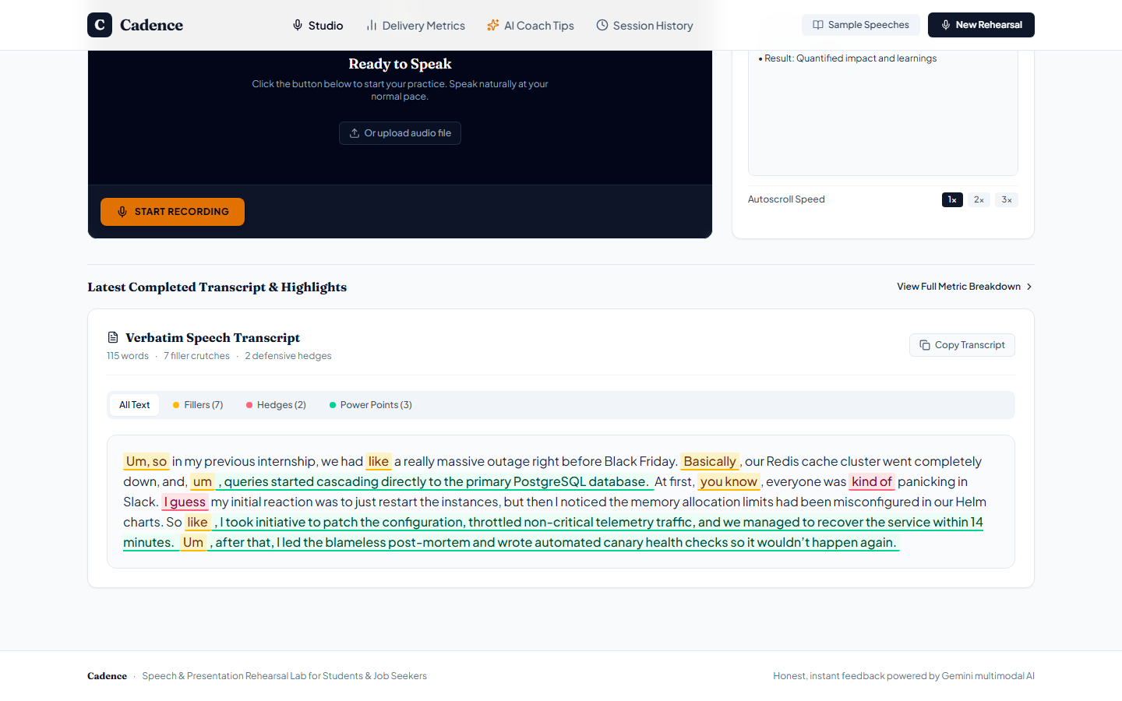
Live app: sample transcript
Clearly labeled sample session · not a microphone recording
Notes:
1:25–1:40. State clearly that this is a sample session, not a live recording. Use this only if Gemini is unavailable or as a quick preview of transcript highlights. Do not claim it came from the presenter.

Slide 6
Two flows for a live demo
Open the deployed app and drive it live; no video replacement.
01
02
REHEARSE
PRACTICE AGAIN
Record a short answer. Show the verbatim transcript, filler highlights, pace, and delivery feedback.
Open a coaching tip or targeted drill, then show the saved rehearsal in Session History.
If Gemini is temporarily unavailable, use Sample Speeches and explain that live analysis is unavailable.
Notes:
1:40–4:00. Flow one: open New Rehearsal, record a short answer, finish, wait for audio preparation, request AI feedback, then show the transcript and metrics. Flow two: open AI Coach or a targeted drill and show Session History. Keep the two flows concise. If live Gemini is unavailable, use Sample Speeches as a clearly labeled fallback; do not present sample content as a live recording.

Slide 7
A small full-stack loop
BROWSER
EXPRESS
GEMINI + SUPABASE
→
→
Record, upload, and review the session.
Validate requests and keep service keys on the server.
Gemini returns coaching; Supabase stores session analysis.
React • TypeScript • Vite
Node.js • Express • Supabase Postgres
Session analyses persist as JSONB. Audio is sent to Gemini and is not saved in the session table.
Notes:
4:00–4:15. Explain the stack in one breath: React and TypeScript in the browser, an Express API on Vercel, Gemini for analysis, and Supabase Postgres for saved session analysis. API keys stay server-side; recordings are sent to Gemini and are not saved in the session table.

Slide 8
The API behind the demo
Five routes connect the browser, Gemini, and saved sessions.
POST /api/analyze-speech
Transcription, delivery metrics, and coaching
POST /api/analyze-drill
Feedback on a targeted speaking drill
POST /api/coach-voice
Spoken coaching audio
GET / POST /api/sessions
Load and save browser-profile history
DELETE /api/sessions/:sessionId
Remove one saved rehearsal
Supabase stores analysis as JSONB; audio is sent to Gemini, not stored in the session table.
Notes:
4:15–4:30. Name the main APIs quickly: speech analysis, drill analysis, voice coaching, session load/save, and session delete. Supabase stores the analysis as JSONB. The browser uses a random profile ID for this demo; it is not an authenticated account.

Slide 9
What failed, and what we changed
GEMINI AVAILABILITY
RECORDING
HISTORY DELETE
Model outages return a retry message. The demo can fall back to Sample Speeches.
Analysis stays disabled until audio is prepared. Generic placeholder transcripts are rejected.
The UI removes a saved rehearsal only after the server confirms deletion.
Keys stay on the server. A live microphone and phone check is still required.
Notes:
4:30–4:45. Be transparent about two limits: Gemini can be temporarily unavailable, and the demo profile is tied to one browser rather than a sign-in account. Reliability changes now wait for audio preparation, reject the known generic transcript placeholder, keep failed deletions visible, and return retryable API errors.

Slide 10
Lessons learned
and next steps
01 Lesson: keep API keys on the server.
02 Challenge: Gemini availability can interrupt analysis.
03 Next: test on phones and add account sign-in.
Build and TypeScript checks pass; one live recording and phone test remain.
Live demo: https://cadenceproject.vercel.app
Notes:
4:45–5:00. Close with the main learning: useful feedback should point to evidence and a next action. State the next steps honestly: verify the microphone and phone flow, then add authenticated accounts. Do not claim the device checks are complete until you have run them.

