Slide 1
Progress in each week of the smart room project (After proposal to the final week)
Members:
Dineenath Romphoyen, EPE
Pratimakorn Fupol, EPE
Sahassawat Posungnern, COM

Slide 2
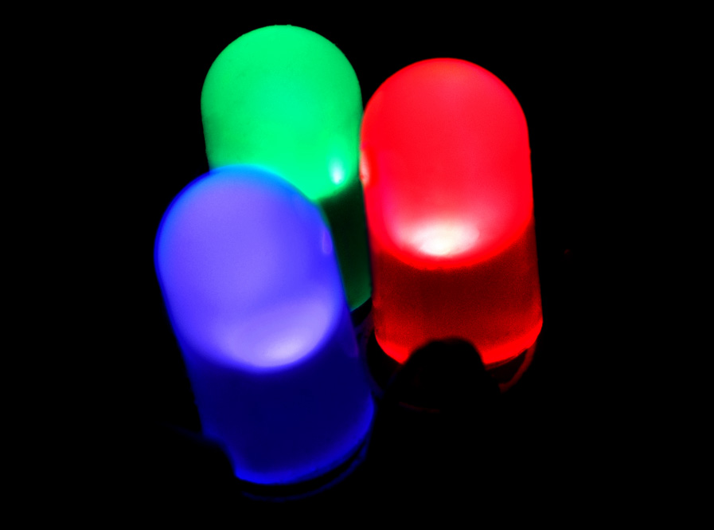
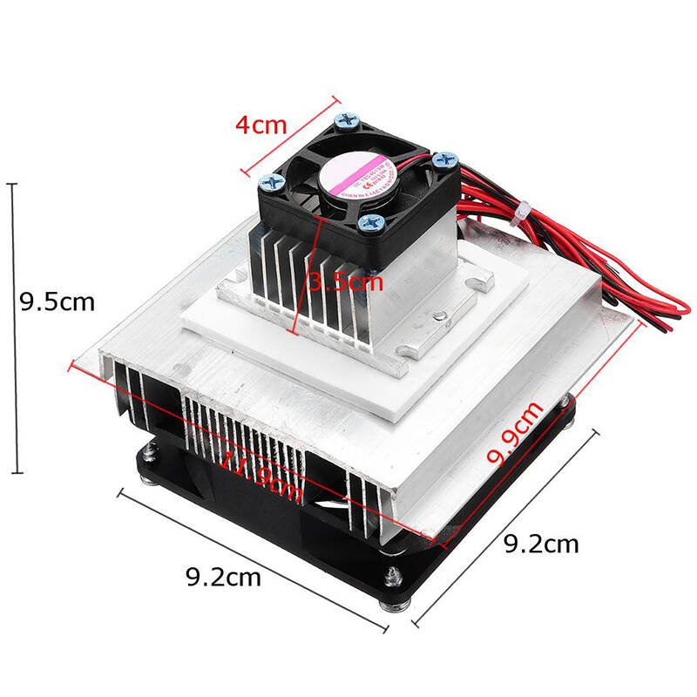
Week 8-9 (22 Febuary - 7 March)
Prepare equipments for a project.
LED
represent the lighting and plug
Cooler system
Motion sensor
Clock module
Manual switch
LED
Cooling system

Slide 3
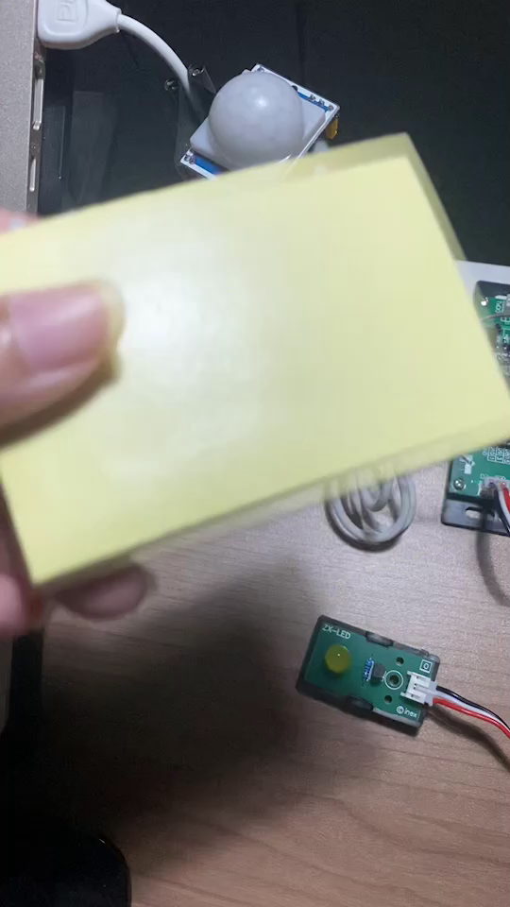
Week 10 (8 - 14 March)
Create lighting and smart plug system with motion sensor.
When the coding process is finished, the system was test by bringing an object moving through the sensor. Once the motion is detected, the LED (representing the light and plug) will light up. After that, a 5-second delay will occur to detect the motion again. If motion cannot be detected again, the light will turn off.

Slide 4
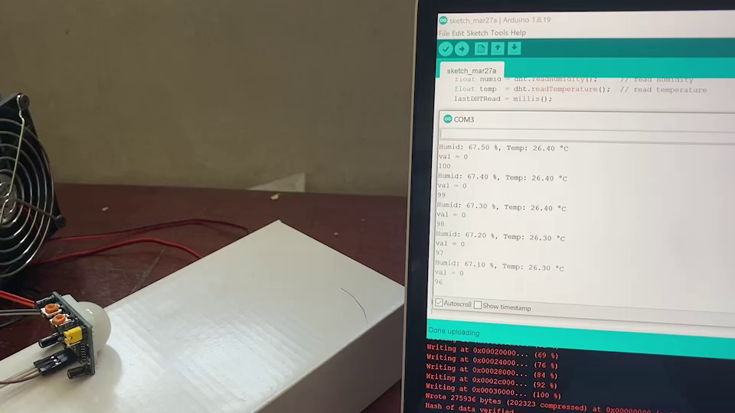
Week 11 (15 - 21 March)
Create Air-conditioner system with motion sensor

Slide 5
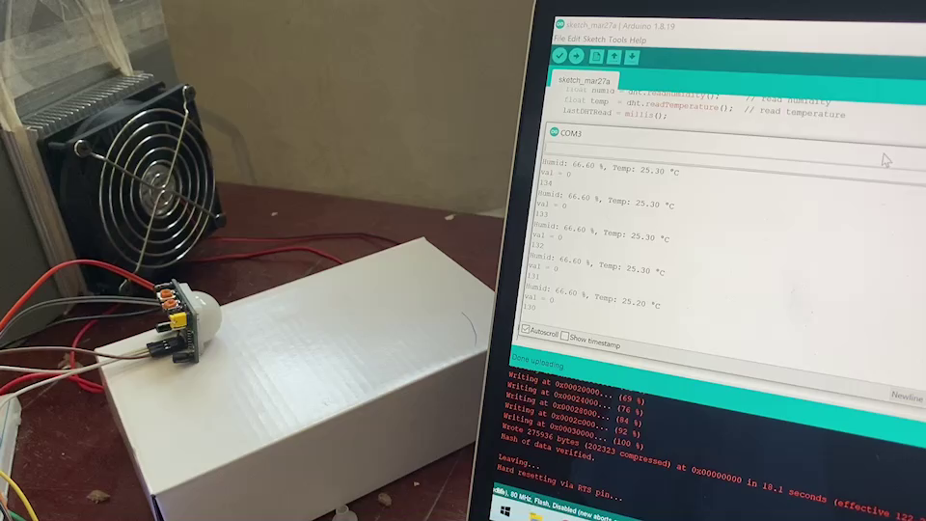
Week 12 (22 - 28 March)
Create Air-conditioner system with temperature sensor.

Slide 6
Week 13 (28 March - 4 April)
Re-design conceptual and prepare equipment for building model room.

Slide 7
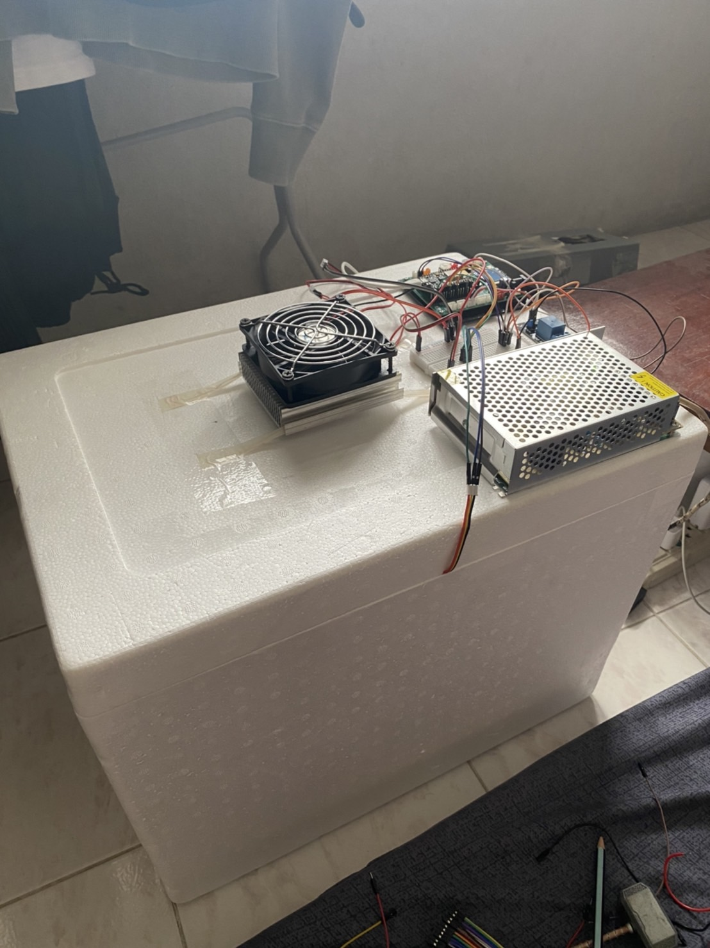
Week 14 (28 March - 4 April)
Assemble a model room with equipment installation.

Slide 8
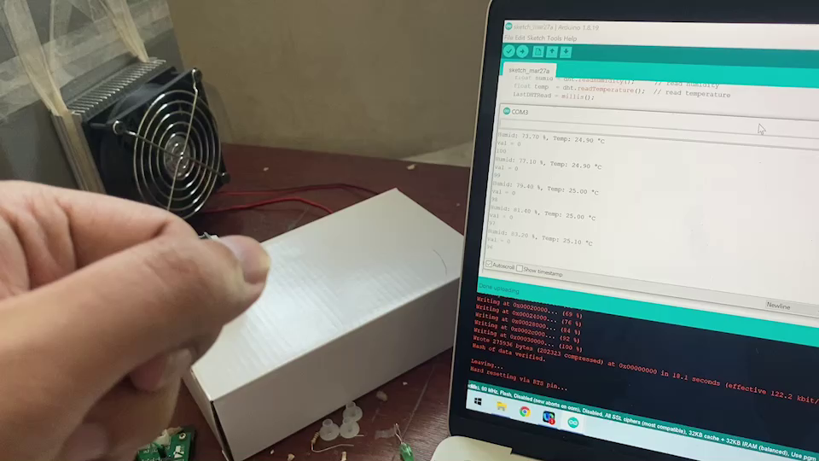
Week 15 (5 - 18 April)
Combine all code together and test the result.

Slide 9
Week 16 (19 - 25 April)
Connect the system with the Netpie

Slide 10
Week 17 (25 - 29 April)
Project’s result recording.

