Slide 1
IBM University Engagement Project Submission
“Exploring the Power of Machine Learning with IBM Cloud”

Slide 2

Project Tile – Crop Recommendation and Crop Disease Detection using Machine Learning
Domain of Project – Agriculture
Student Name | Recent Passport Photo | Email ID | Mobile number [WhatsApp]
Recommended font style and size:
Font Style: Arial
Font Size (Heading): 28
Font Size (Content): 20

Slide 3
Problem Statement -
Problem Statement: Crop Recommendation and Crop Disease Detection using Machine Learning
Indian agriculture is highly dependent on selecting the right crop for a field's soil and climate conditions, and on detecting crop diseases early enough to act. Farmers often rely on experience or generic advice rather than data-driven analysis of soil nutrients (Nitrogen, Phosphorus, Potassium), temperature, humidity, pH, and rainfall — leading to suboptimal yields. Separately, crop diseases such as leaf blight and leaf rust are frequently identified late, by visual inspection alone, causing avoidable yield loss. This is a time-sensitive and consequential challenge. Your task is to design, build, and evaluate (1) a multi-class classification model that recommends the most suitable crop for a given set of soil and climate parameters, and (2) an image-based classification model that detects whether a crop leaf is healthy or affected by a specific disease. Together these form a decision-support tool that can help farmers and agricultural extension workers make faster, more accurate decisions, improving yield and reducing crop loss.

Slide 4
Proposed Solution -
(IBM watsonx.ai Studio – AutoAI):
We propose an AI-powered Crop Advisory System using IBM watsonx.ai Studio and AutoAI.
Soil and climate data (Nitrogen, Phosphorus, Potassium, temperature, humidity, pH, rainfall) is uploaded to watsonx.ai for the crop recommendation model.
AutoAI will automatically perform data preprocessing, feature engineering, algorithm selection, and hyperparameter optimization across multiple candidate pipelines.
Multiple classification models are generated and evaluated on a leaderboard, and the best-performing pipeline is selected and further tuned for crop recommendation.
In parallel, a crop-disease detection module extracts visual features from leaf images and classifies them as Healthy, Blight, or Rust, giving farmers an early warning before disease spreads.

Slide 5
Technology Used
IBM Cloud – It provides the infrastructure to build, deploy, and scale the Crop Advisory system efficiently. IBM Cloud enables a reliable, secure, and scalable environment for deploying the Crop Advisory agent
ML Algorithm/ Model Used: Random Forest (tuned, GridSearchCV) — Crop Recommendation; Random Forest (image-feature based) — Crop Disease Detection
Accuracy Obtained: 95.2% (Crop Recommendation, 12 classes); 88.9% (Crop Disease Detection, 3 classes)
Enhancements and Hyperparameter tuning: GridSearchCV over n_estimators, max_depth, min_samples_split (Crop Recommendation); color-ratio & texture feature engineering (Disease Detection)

Slide 6
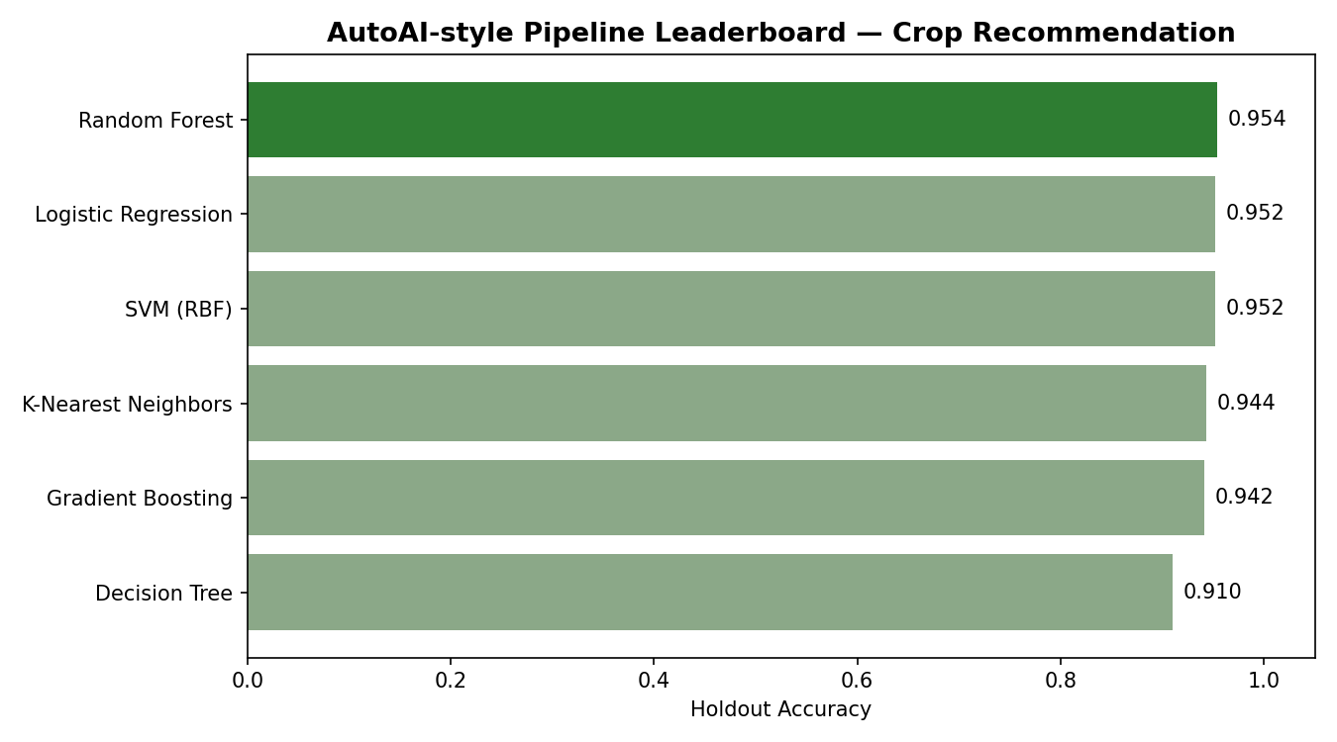
Training Screenshots-

Slide 7
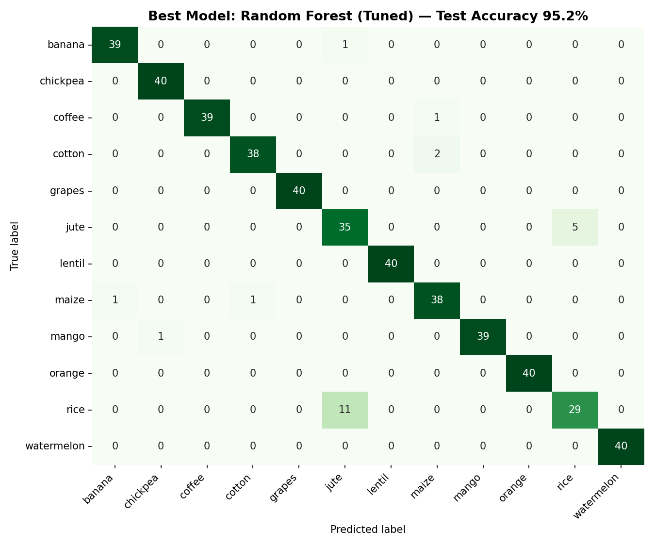
Best Model Screenshot:

Slide 8
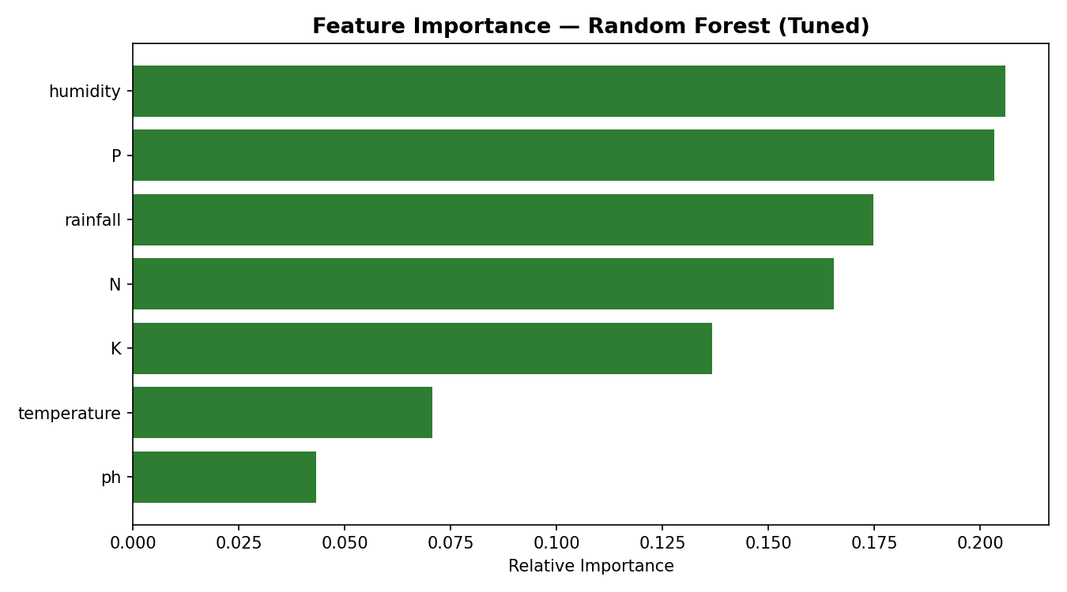
Testing Screenshot:

Slide 9
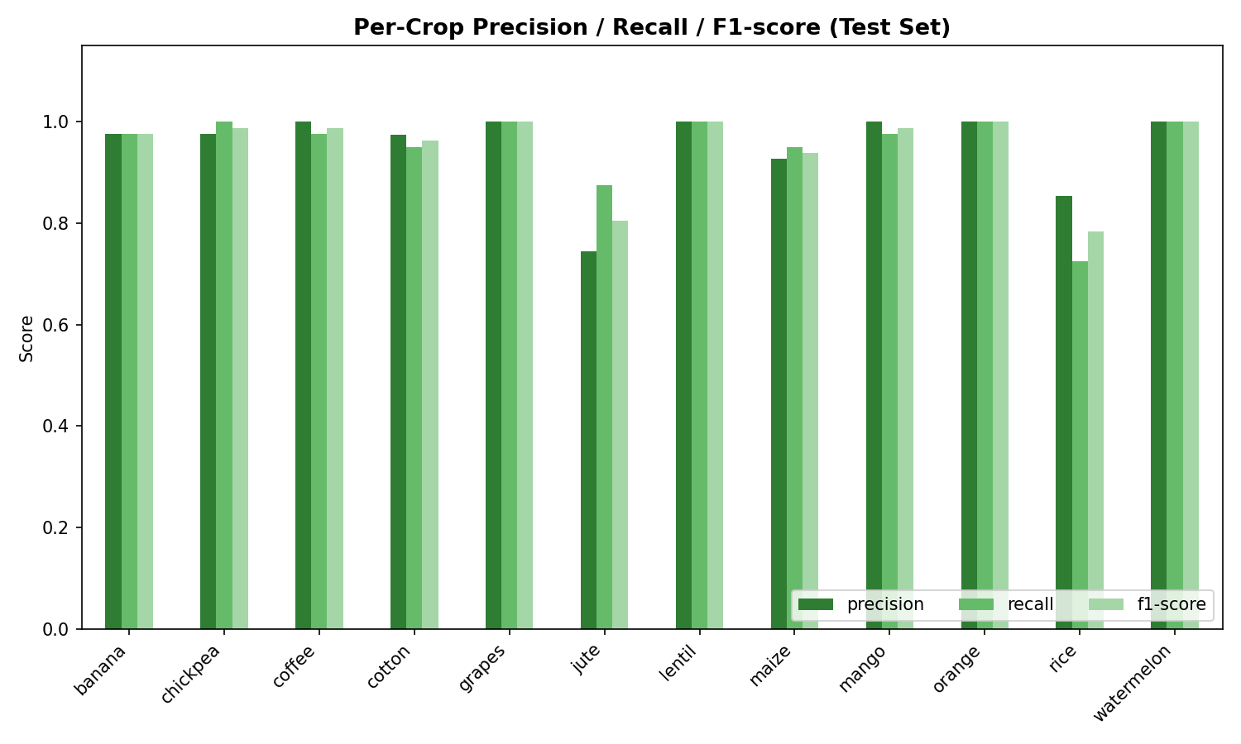
Testing Screenshot:

Slide 10
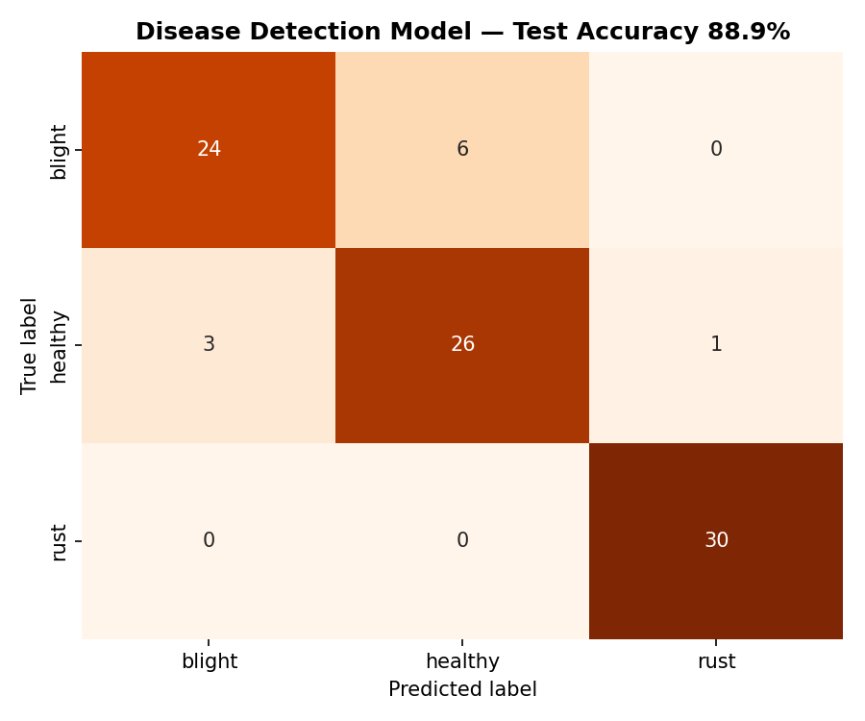
Crop Disease Detection – Model Results:

Slide 11
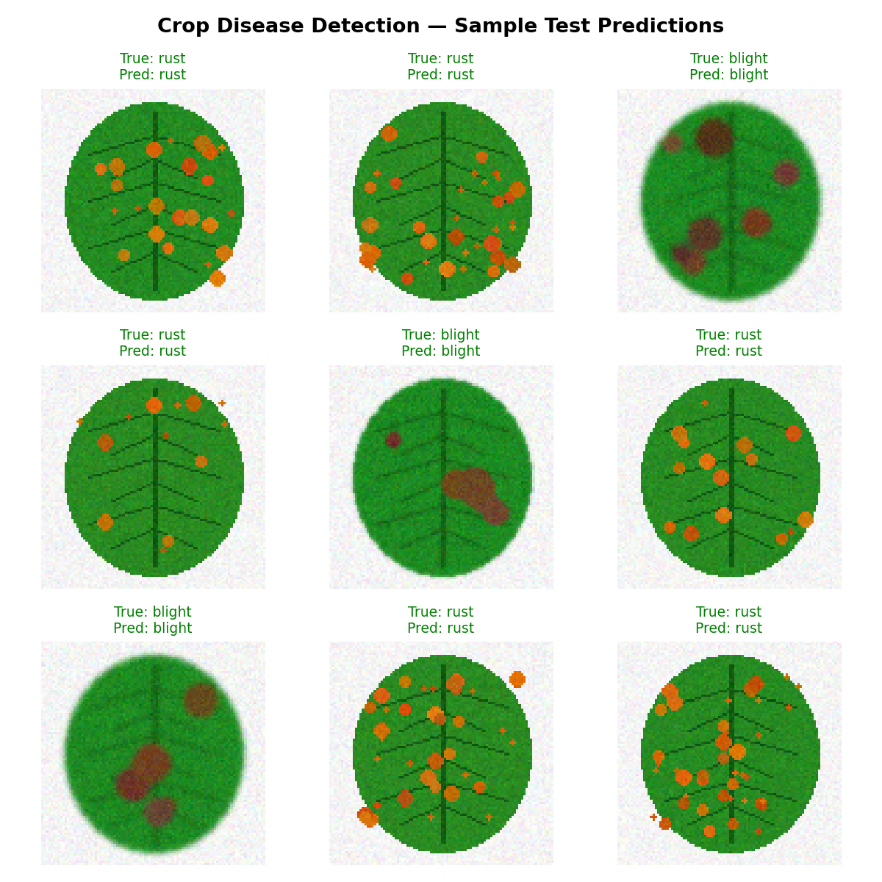
Crop Disease Detection – Sample Predictions:

Slide 12
Novelty and Uniqueness
The solution combines soil/climate-based crop recommendation with image-based disease detection in a single advisory pipeline.
It uses IBM watsonx.ai AutoAI to automatically discover the best machine learning pipeline via a multi-model leaderboard, without extensive manual coding.
The system accurately recommends among 12 crop types and detects 3 leaf-health conditions through a single intelligent platform.
Automated feature engineering helps identify hidden patterns in soil-nutrient, climate, and leaf-image data.
The model ensures consistent, unbiased crop and disease recommendations, minimizing reliance on ad-hoc farmer experience alone.

Slide 13
Git Hub Link
Please create public github repository (Enable Add README button while creating repository) with format –
Please test and Paste the working Github URL –
Make sure you have Uploaded following three files into your github repository
1) Data.csv file, 2) Problem_Statement.pdf file 3) your project presentation .pptx file 4) Crop_ML_Project.ipynb (Jupyter Notebook)
·
·
·

Slide 14
Future Scope
The system can be integrated with government agricultural portals and Kisan Call Centers for real-time advisory delivery.
The disease-detection module can be expanded with a full CNN trained on field-collected image datasets for higher accuracy.
Real-time weather-API integration can enable dynamic, season-aware crop recommendations.
Advanced AI models in IBM watsonx.ai can be used to continuously improve prediction accuracy as more field data becomes available.
The solution can be scaled nationwide with regional crop-calendar and market-price overlays to support faster, transparent, data-driven farm advisory
·
·
·

Slide 15
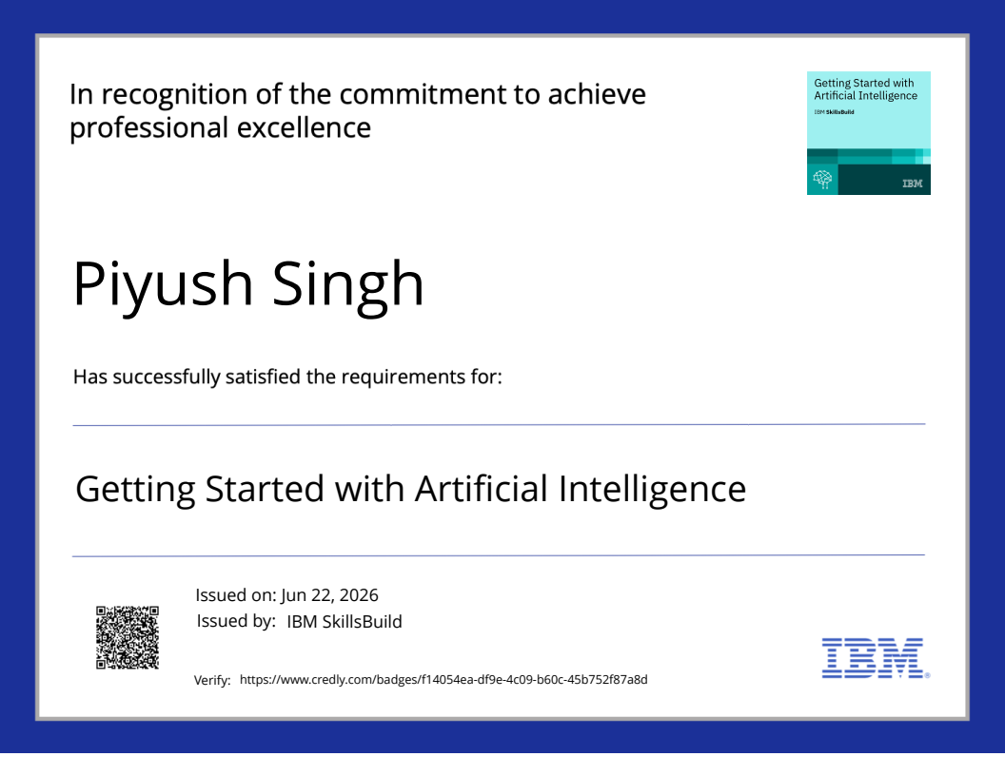
Certificates Earned:

Slide 16
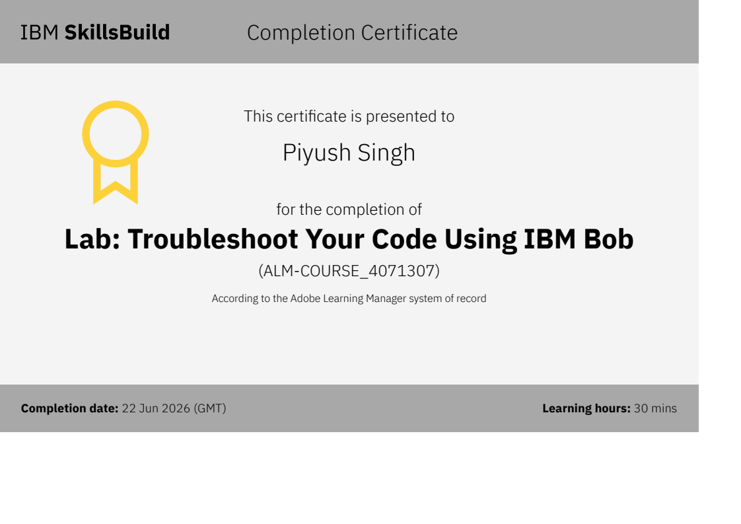
Certificates Earned:​
Add your IBM BOB Certificate

Slide 17


