Slide 1
Research Update
Darshan Zala

Slide 2
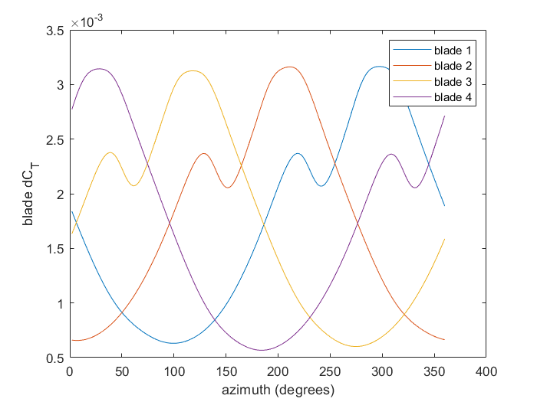
Rotor thrust coefficient time history for one revolution
Total thrust coefficient
of the rotor = 0.008126

Slide 3
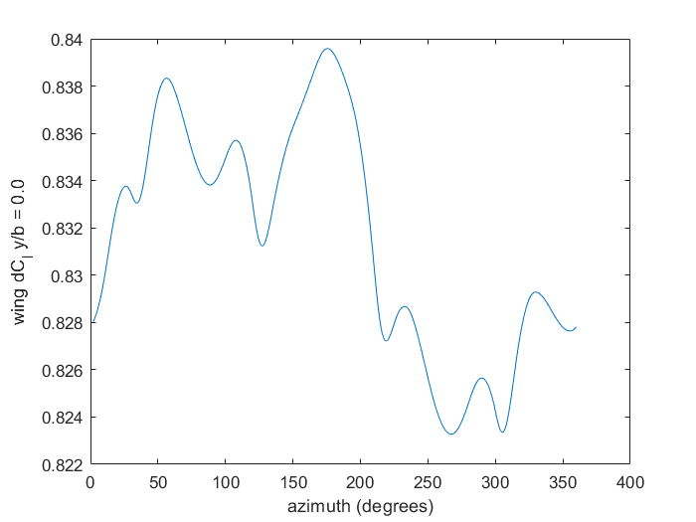
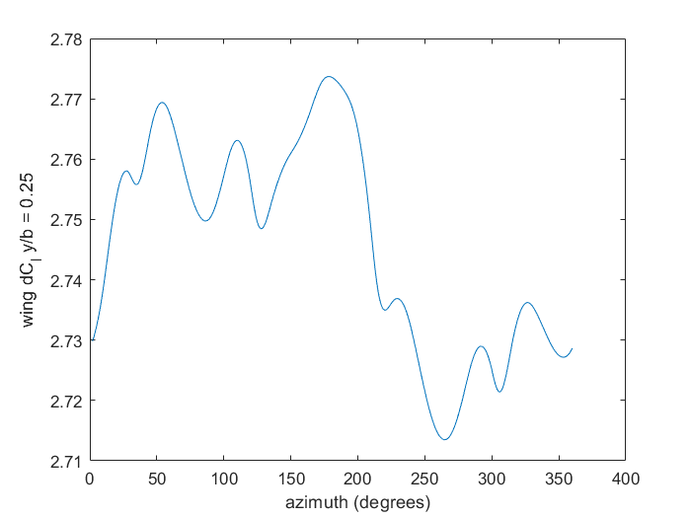
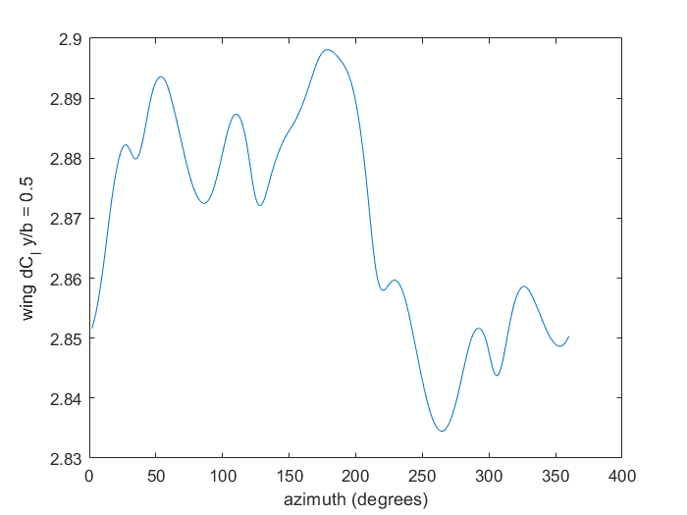
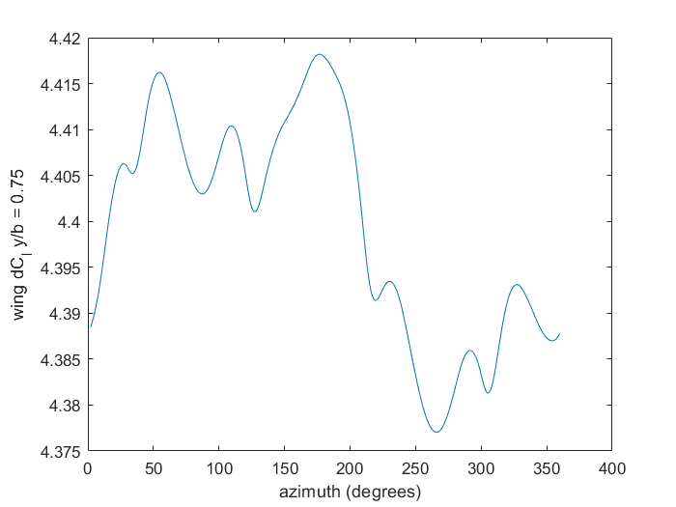
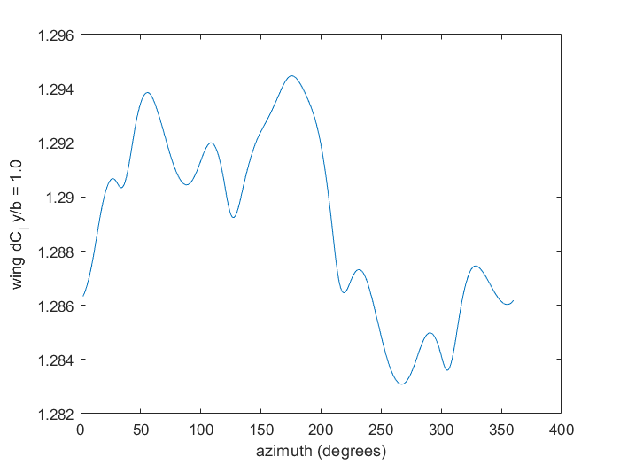
y/b = 0.0
y/b = 0.25
y/b = 0.50
y/b = 0.75
y/b = 1.0

Slide 4
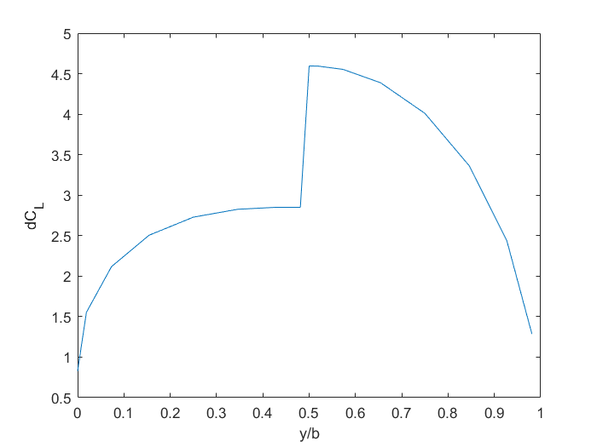
Spanwise distribution of wing sectional lift coefficient

Slide 5
Single bladed rotor and wing
Rotor
wing

Slide 6
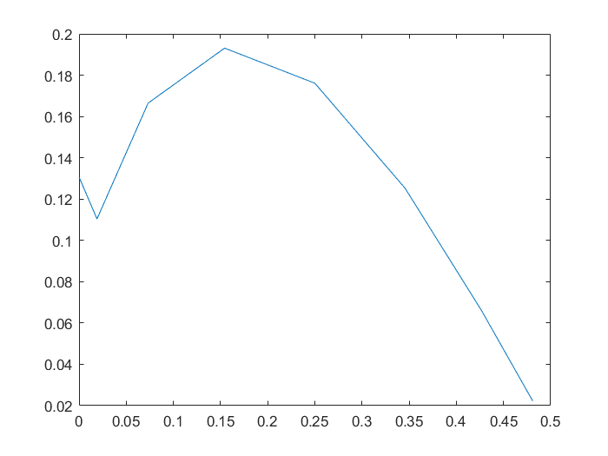
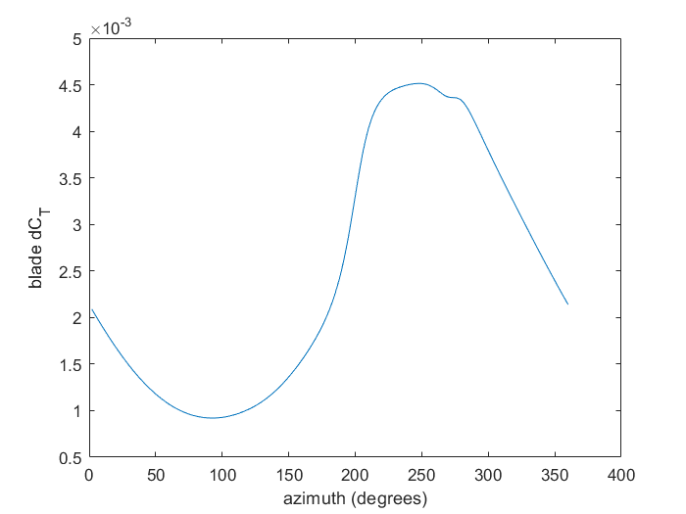
Single bladed rotor and wing
Spanwise distribution of wing sectional lift coefficient
Rotor thrust coefficient time history for one revolution

Slide 7
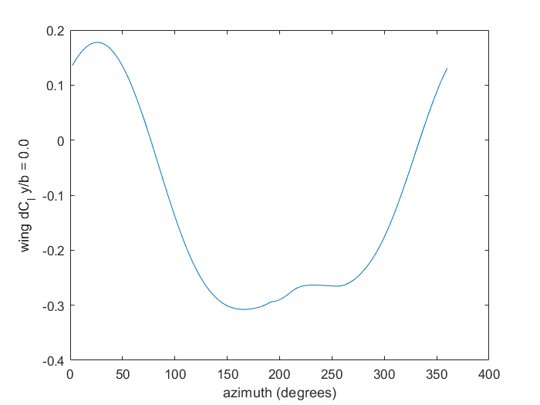
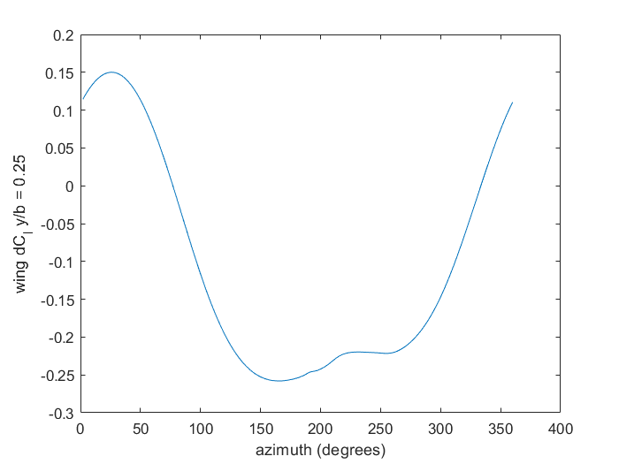
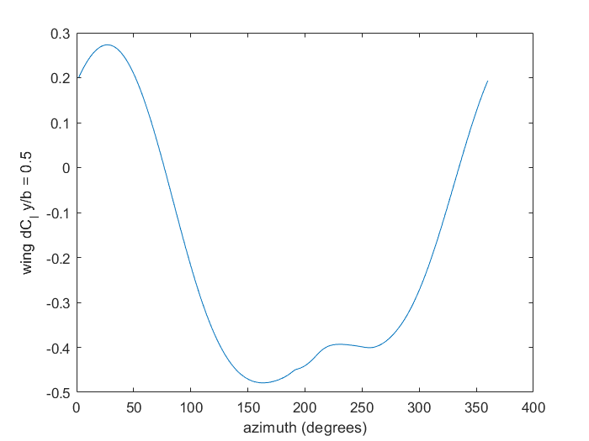
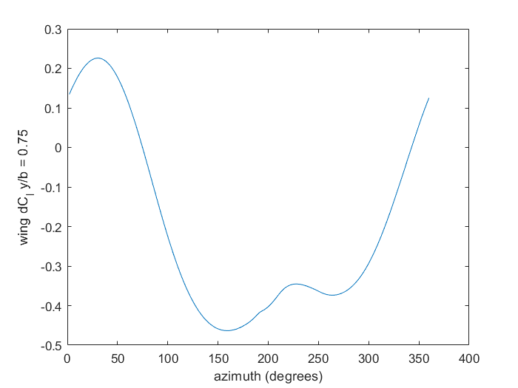
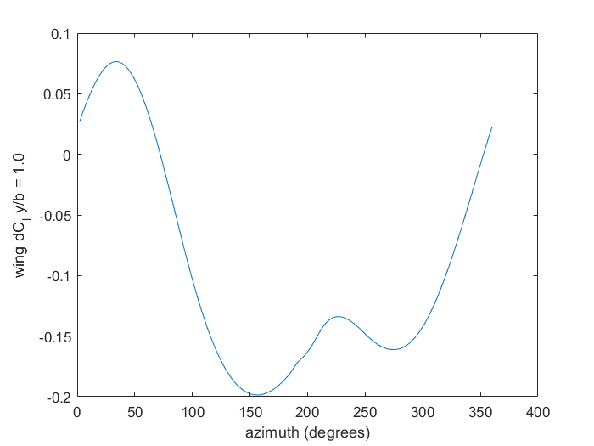
y/b = 0.0
y/b = 0.25
y/b = 0.50
y/b = 0.75
y/b = 1.0

Slide 8
Single bladed rotor
wing + rotor
Rotor only

Slide 9
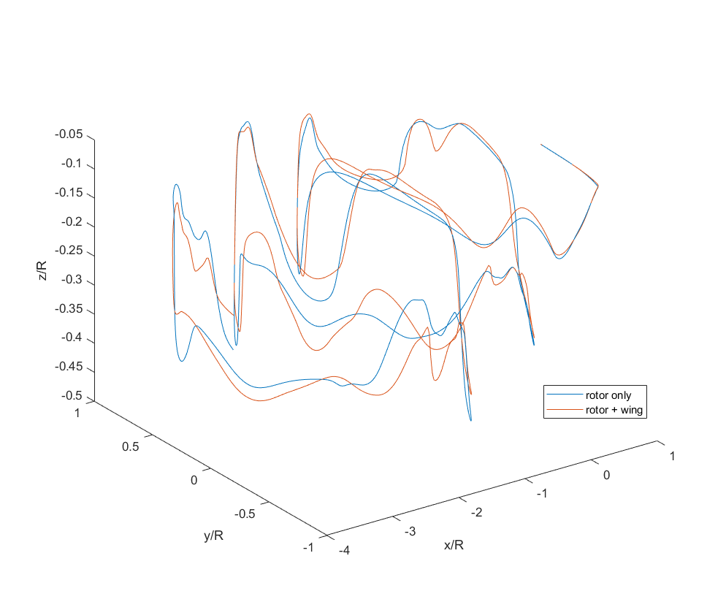
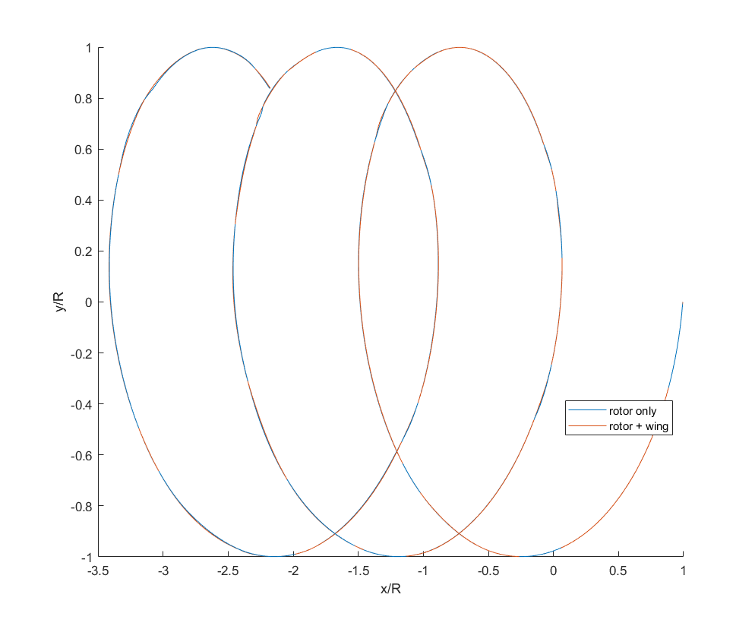
Wake Trajectory

Slide 10
y/b = 0.0
y/b = 0.25
y/b = 0.50
y/b = 0.75
y/b = 1.0

