Slide 1
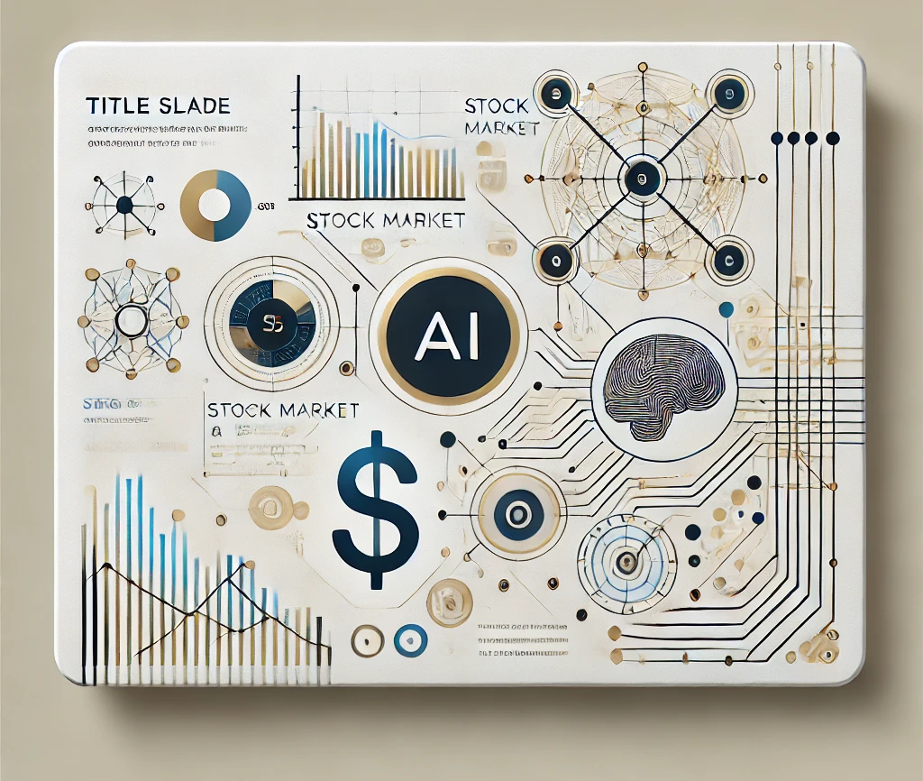
Smart Wealth Insights: AI-Powered Financial Investment Newsletter Generator
Group 6
Jill Karia
Anjaneya Padwal
Aakanksha Maheshwari
Sudhanshu Pawar

Slide 2
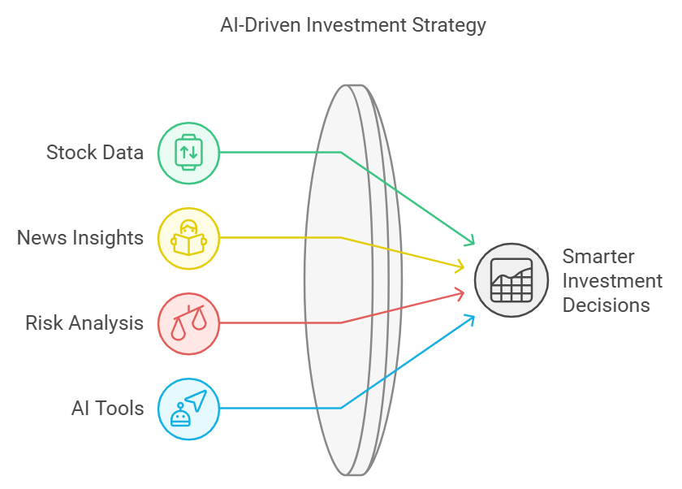
What is the Goal?
To simplify and speed up investment analysis, helping people and teams make better decisions.
To offer clear, reliable, and accurate suggestions for investment decisions, supported by scores that show how trustworthy the analysis is

Slide 3
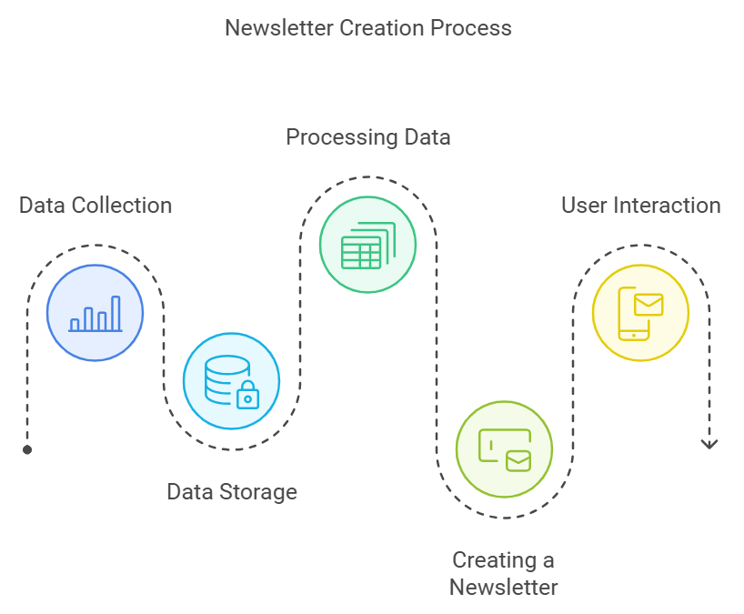
What is our Project About?
Our project is about creating a system to help people make smarter investments in the stock market.
It combines data about stocks, news, and risks to give recommendations using advanced AI tools.

Slide 4
Key Features
Multi-Agent System
Think of this as a team of four AI bots working together
Each bot does a specific job, like analyzing stock trends or calculating risks.
Chatbot
This is a chatbot where users can ask questions about the data the system collects
Portfolio
Analysis of personal portfolio
How the System Works

Slide 5

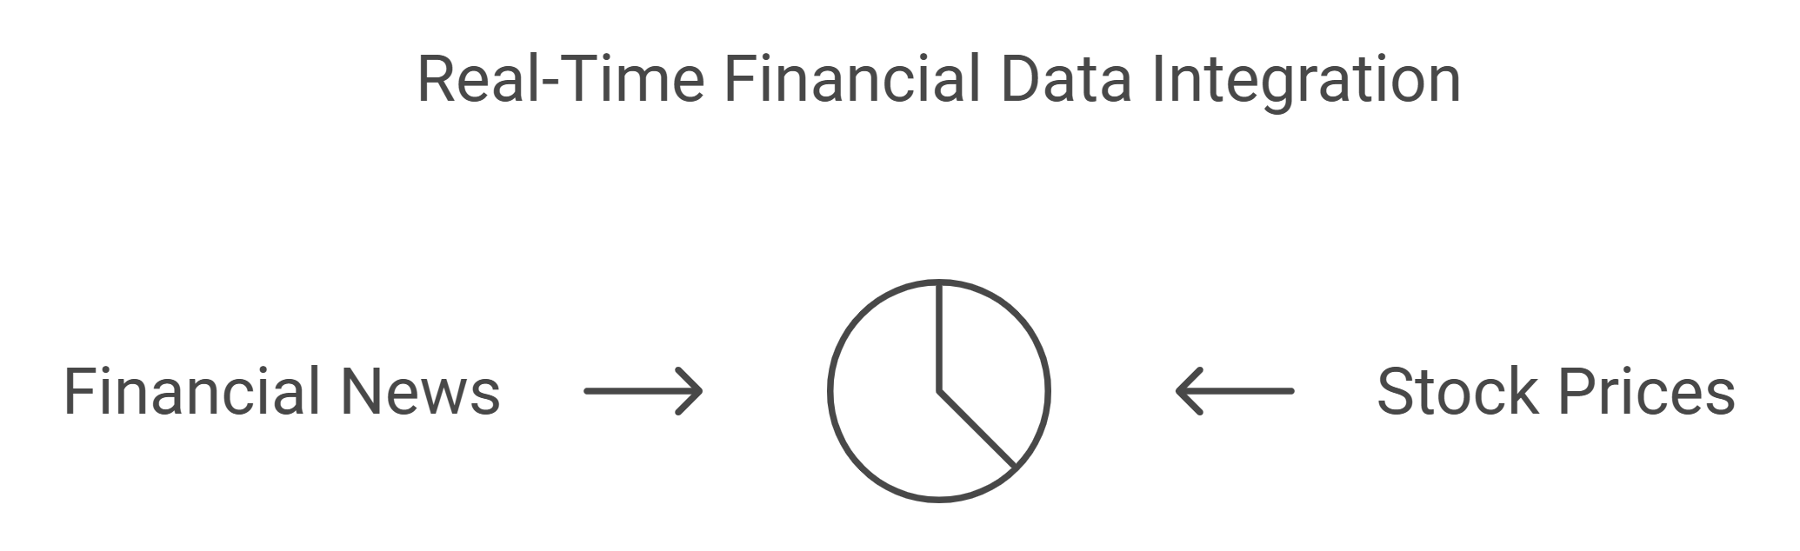
How does the system work step-by-step?
STEP 1
STEP 2
Data Storage
Data Collection
The data is kept in a smart storage space, where it can be quickly found when needed.

Slide 6
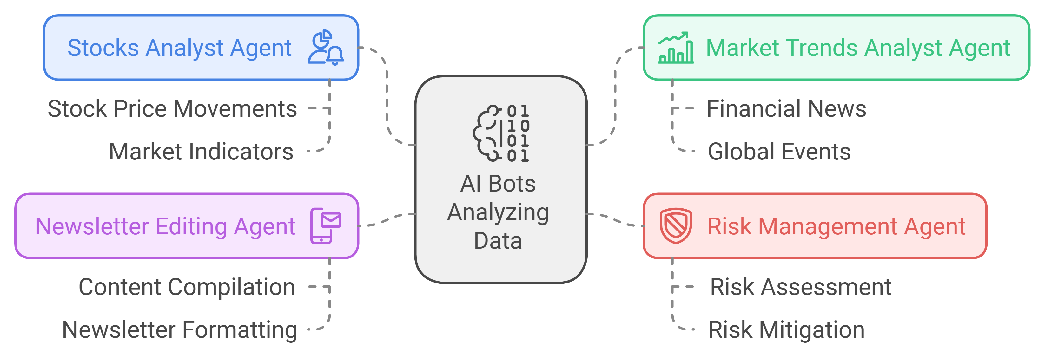
Step 3
Processing Data
The four AI bots analyze the data:
One looks at stock trends. (Stocks analyst agent)
Another checks news that impacts the trends. (Market Trends analyst agent)
Another calculates risks based on the trends and news. (Risk management agent)
The last bot brings it all together. (Newsletter Editing Agent)

Slide 7
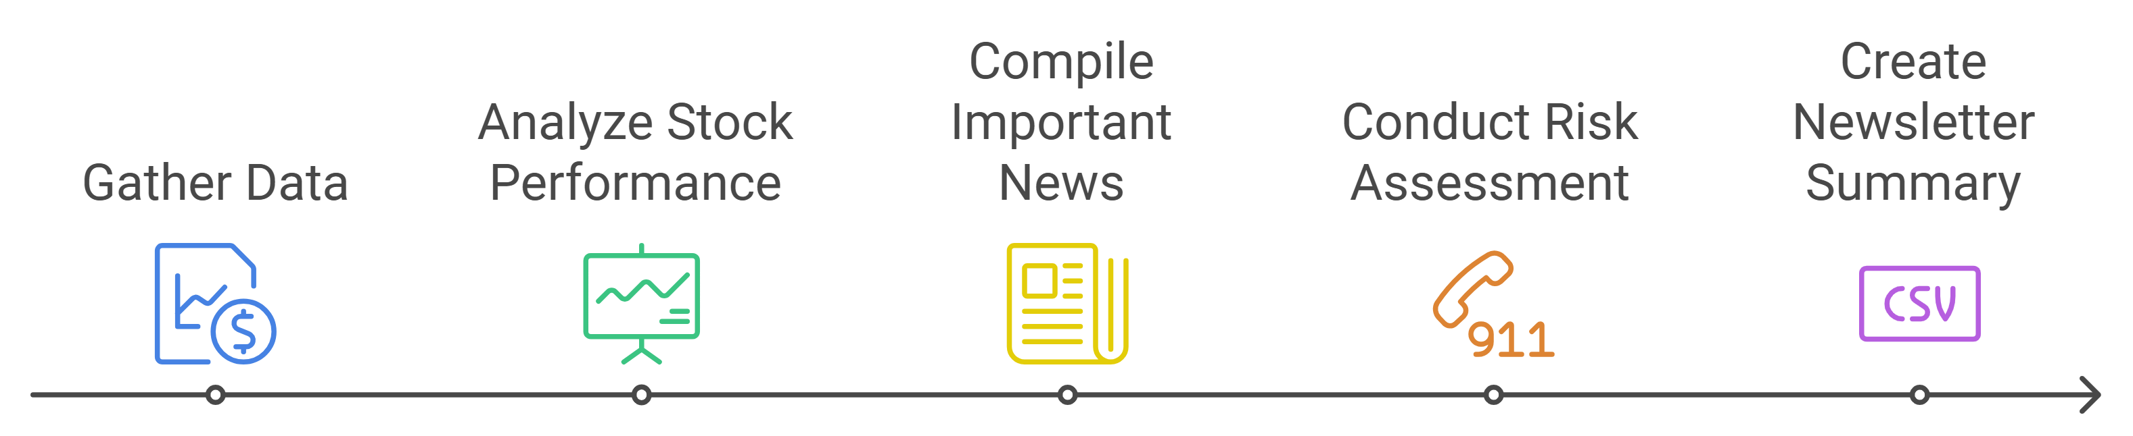
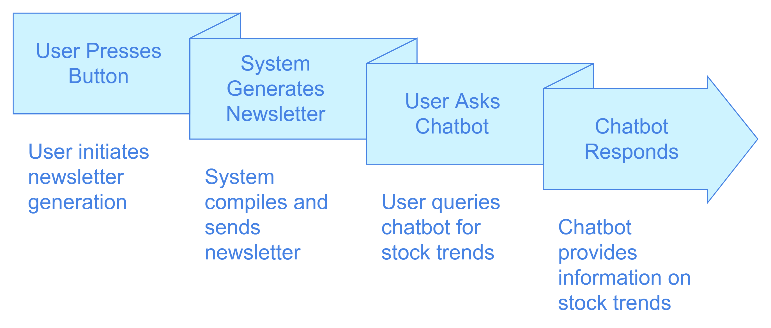
STEP 4
STEP 5
Creating a Newsletter
User Interaction
The results are turned into a summary called a newsletter, which includes :
Stock performance.
Important news.
Risk assessment.
Users can :
Press a button to generate the newsletter.
Ask the chatbot questions like "What are today’s stock trends?"

Slide 8
Demo

Slide 9
Key insights and Lessons learned
The system makes sure the answers are real, not made up. It can grow and add more team members if needed. The newsletter is simple and gives you all the important things: news, trends, and risks. It only takes information when it's needed, so it doesn't waste space.
The project uses just one team member (OpenAI). If that team member has a problem, the system might not work. It also gets information from just one place (Alpha Vantage). If that place gives wrong information, the advice might be wrong.
The old stock data might be unfair and make big, famous companies look better while ignoring smaller ones. If the data is missing or unfair, the system might give wrong advice.

Slide 10
Questions

