Slide 1
Z
AskMyZotero
RAG-Powered Q&A for Your Local Zotero Library
Advanced Al / TeamX / Presenter Zhang Y / Date 05.10
github.com/PsyLinkist/AskMyZotero

Slide 2
Research Context
How to build a controllable, evidence-grounded academic RAG system over a personal Zotero library,
enabling paper-level retrieval, section-aware evidence selection, and citation-backed scholarly Q&A.
Background
&
Motivation
Research Questions
Which papers use a specific method? How do several papers differ? What related work have I read on a topic?
Where is the key evidence — and is a method just mentioned, or is it the paper’s core contribution?
Project Goal
Local literature ingestion Scan Zotero storage PDFs; enrich with SQLite metadata (title, authors, year, tags, collections).
Academic retrieval pipeline Section-aware chunking, FAISS retrieval, metadata hard-filter, query rewrite & intent routing.
Paper-level answer generation Aggregate chunk hits into paper-level candidates with title, authors, year, evidence & citation [n].
Toward Agentic scholarly workflow Auto-select tools by question type: search, summarize, compare, locate evidence; support multi-turn Q&A.

Slide 3
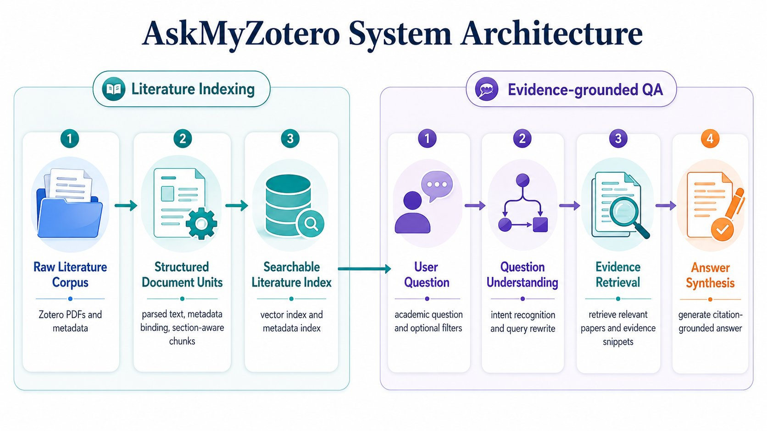

Slide 4
Core Features
✓
PDF scanning & metadata enrichment
(title / authors / tags / collections / year / venue)
✓
Five intent types:
fact_qa / comparison / definition / survey / paper_lookup
✓
Section-aware chunking
stable chunk_id
✓
Query rewrite retrieval mode & answer style inference
✓
FAISS build / load / rebuild
(incl. background rebuild & progress query)
✓
Chunk → paper aggregation,
evidence snippets and citations [n]
citation cleanup & remapping
✓
Pre-retrieval metadata hard-filter
(Collection / Tag / Author / date range…)
✓
Frontend:
Sources panel, local PDF open, top-k filter controls

Slide 5
Retrieval & QA Pipeline
Scanner
z
1
2
Parser
3
Indexer + MetadataStore
Scan & bind metadata
Read Zotero storage match SQLite metadata
PDF cleaning, segmentation, section detection
Section-aware chunking stable chunk_id
Embedding generation
FAISS vector index
Metadata DB persistence (metadata.db)
4
QA Agent
5
Aggregator
6
Server + HTML
3-stage intent detection:
rules → LLM → rule fallback
Query rewrite + retrieval mode inference
Paper-level aggregation
evidence ranking
Citation cleanup
remapping [n]
FastAPI endpoints
frontend display
Sources panel
local PDF open

Slide 6
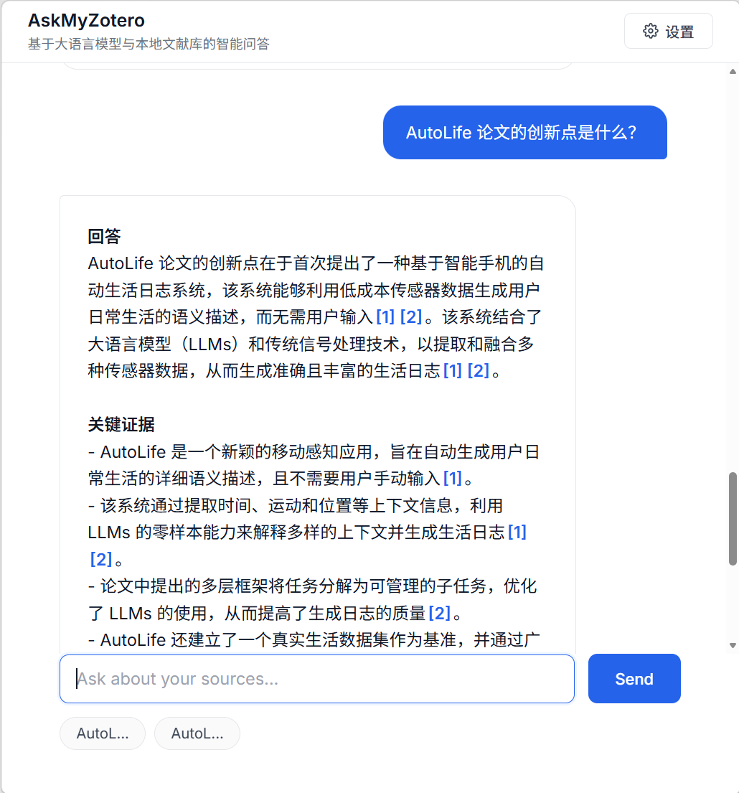
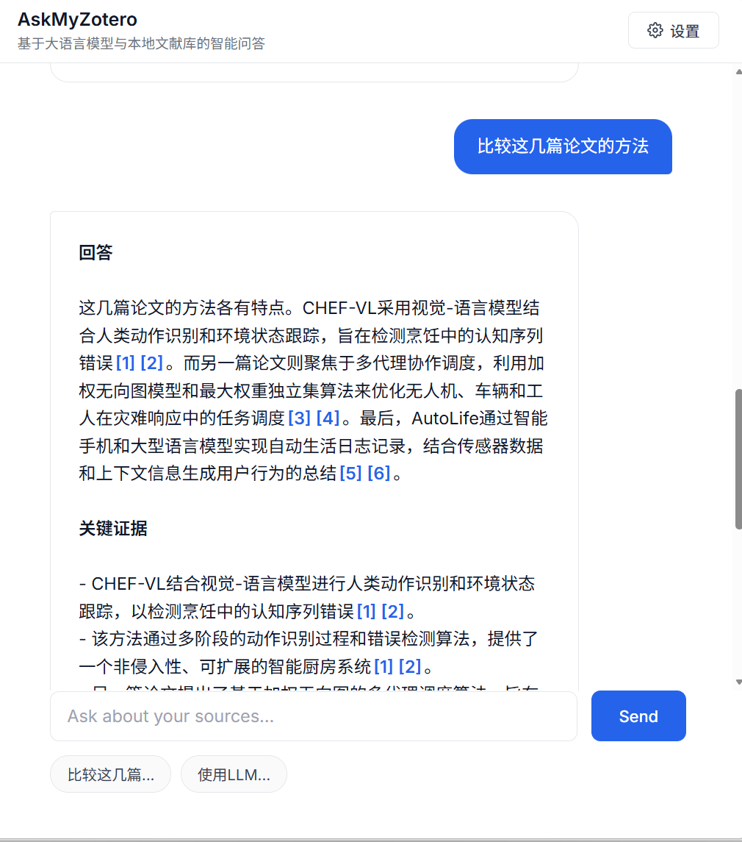
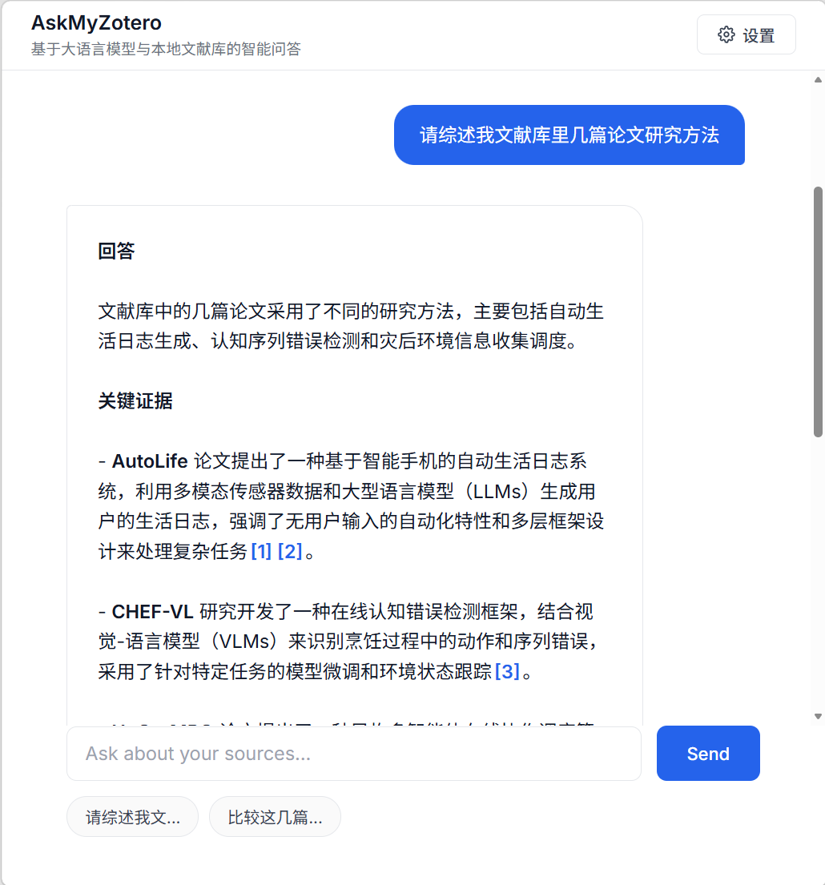

Intent Types & Answer Formats
Highlights: Five intent types
fact_qa
comparison
definition
Single/cross-paper fact Q&A
Direct answer + evidence citations
Multi-paper comparison
Structured framework per-item citations
Concept definition
Concise definition + source papers
survey
paper_lookup
Survey-style questions
Multi-angle summary + grouped citations
Paper retrieval
Paper list + key evidence snippets

Slide 7
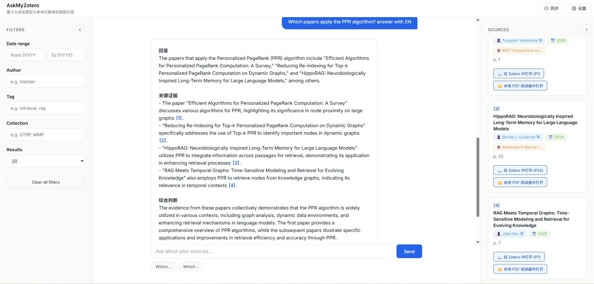
Intent Types & Answer Formats
⭐ Citation Trustworthiness Guarantee
Citations [n] correspond only to evidence actually used in the answer — candidate papers may exceed cited count
All sources are traceable; the Sources panel shows full context for every snippet

Slide 8
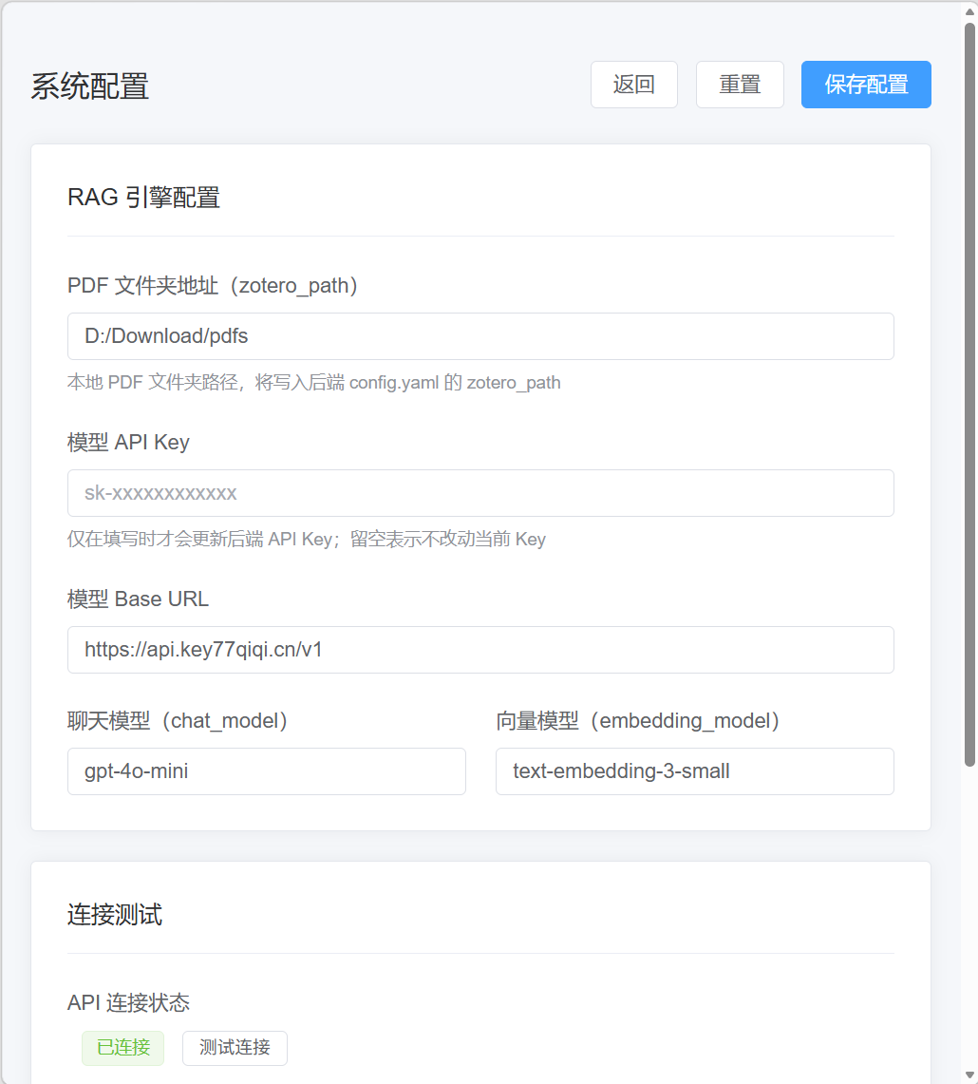
Engineering & Productization
Config Management
config.yaml / ASKMYZOTERO_CONFIG env var
Settings page persistence, hot-reload
API Key never returned in plaintext
API Endpoints
/health status check (ready / init_error)
/api/config — read & write config
/api/init — trigger index initialization
/api/ask — main Q&A endpoint
Packaging & Deploy
launcher + build_exe / PyInstaller
One-click launch + auto-open browser
Fully local, data never leaves device

Slide 9
Summary
Delivered
Complete local Zotero RAG loop: data scan → vector index → intent retrieval → cited answer → web frontend
Project Value
Controlled Q&A with traceable evidence for personal literature libraries
Helps researchers ask questions across local papers — citations trusted, data stays local
🔗 github.com/PsyLinkist/AskMyZotero

Slide 10
Q & A
Questions Welcome

