Slide 1
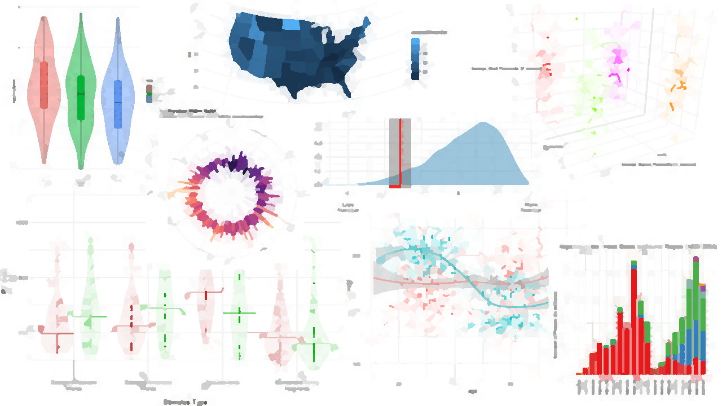

DATA VISUALISATION
(QUANTITATIVE)

Slide 2
Visualising Data
More important than statistical tests!(?)
Telling a story in a graph
R has some great packages for visualising your data, especially ggplot

Slide 3
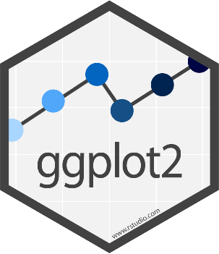
ggplot2
Part of (and complementary to) the tidyverse collection
Beautiful and informative code, for beautiful and informative graphs
Expects tidy data; one observation per row
(See tidyverse introduction from this morning)

Slide 4
Plan for the Session
Introduce ggplot2
Explain how it works, and show some example output
Practice on some data we’re interested in

Slide 5
ggplot2 Syntax
Load in packages
library(tidyverse)
iris %>%
ggplot(aes(x=Sepal.Length, y=Petal.Length)) +
geom_point()
Data
Pipe data into the plot
Build ggplot object
Add feature to ggplot object
Plot feature

Slide 6
ggplot2 Syntax - Pipes
library(tidyverse)
iris %>%
ggplot(aes(x=Sepal.Length, y=Petal.Length)) +
geom_point()
Remember, this is equivalent to…

Slide 7
ggplot2 Syntax - Pipes
library(tidyverse)
ggplot(iris, aes(x=Sepal.Length, y=Petal.Length)) +
geom_point()

Slide 8
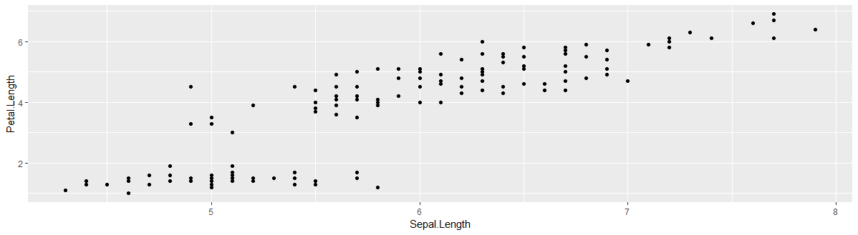
ggplot2 syntax
iris %>%
ggplot(aes(x = Sepal.Length, y = Petal.Length)) +
geom_point()

Slide 9
geom_x
Multiple possible “geoms”
Which geom you want will depend on what your variables are like:
How many?
Are they discrete (categorical) or continuous (numerical)?
Most useful geoms can be found on the ggplot cheat sheat
A full list of geoms is available on the ggplot reference page
Google to find the geom you want, e.g.:
“ggplot scatter graph” will return results showing that you want geom_point()

Slide 10
ggplot2 syntax
iris %>%
ggplot(aes(x = Sepal.Length, y = Petal.Length)) +
geom_point()

Slide 11
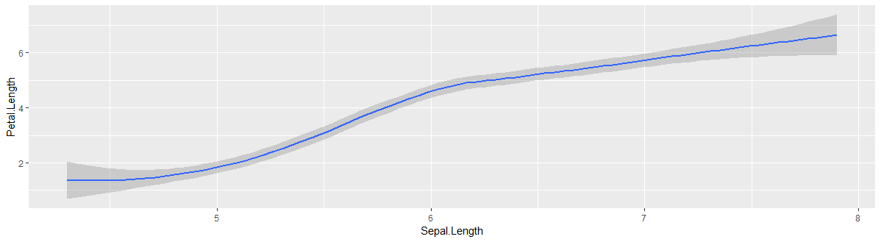
ggplot2 syntax
iris %>%
ggplot(aes(x = Sepal.Length, y = Petal.Length)) +
geom_smooth()

Slide 12
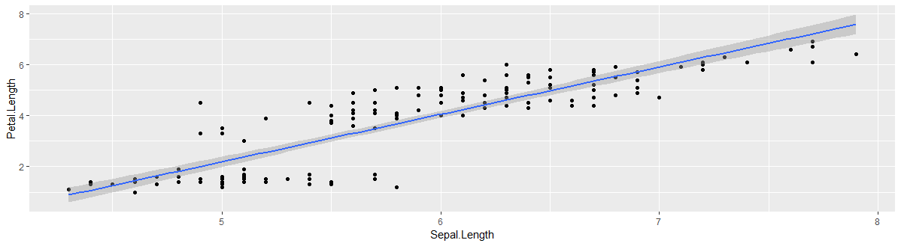
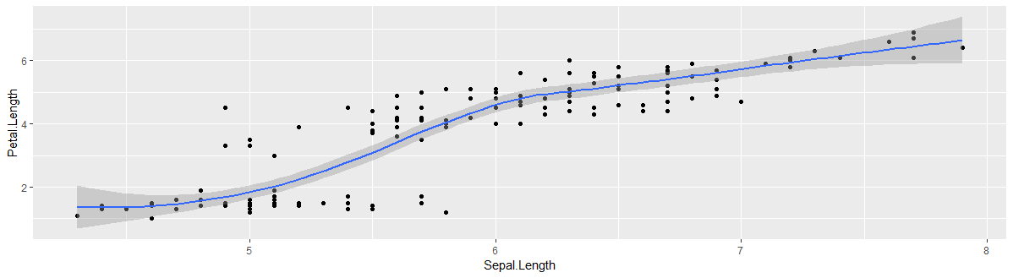
ggplot syntax
iris %>%
ggplot(aes(x = Sepal.Length, y = Petal.Length)) +
geom_point() +
geom_smooth()

Slide 13
ggplot syntax
iris %>%
ggplot(aes(x = Sepal.Length, y = Petal.Length)) +
geom_point() +
geom_smooth(method = “lm”)

Slide 14
Aesthetics: aes()
Tells ggplot what variables to plot, and which visual features should represent them
Possible aesthetics include:
x
y
colour / color
fill
shape

Slide 15
ggplot2 syntax
iris %>%
ggplot(aes(x = Sepal.Length, y = Petal.Length)) +
geom_point()

Slide 16
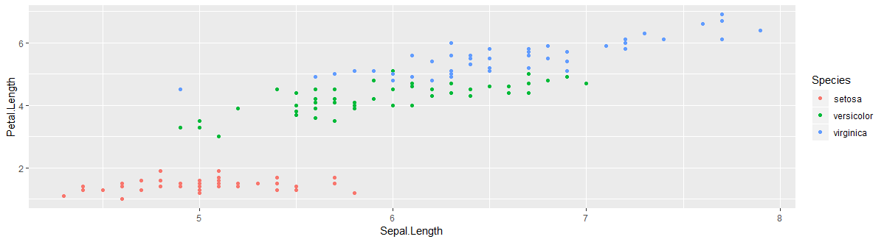
ggplot2 syntax
iris %>%
ggplot(aes(x = Sepal.Length, y = Petal.Length, colour = Species)) +
geom_point()

Slide 17
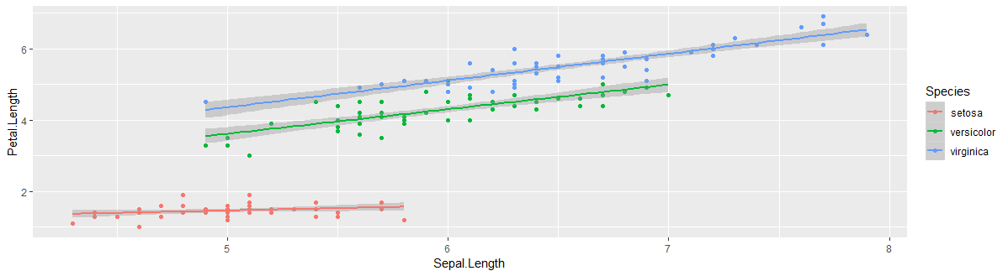
ggplot2 syntax
iris %>%
ggplot(aes(x = Sepal.Length, y = Petal.Length, colour = Species)) +
geom_point() +
geom_smooth(method = “lm”)

Slide 18
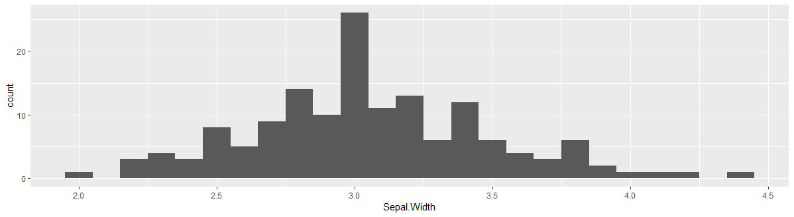
Visualising Distributions - Histograms
iris %>%
ggplot(aes(x = Sepal.Width)) +
geom_histogram(binwidth = 0.1)

Slide 19
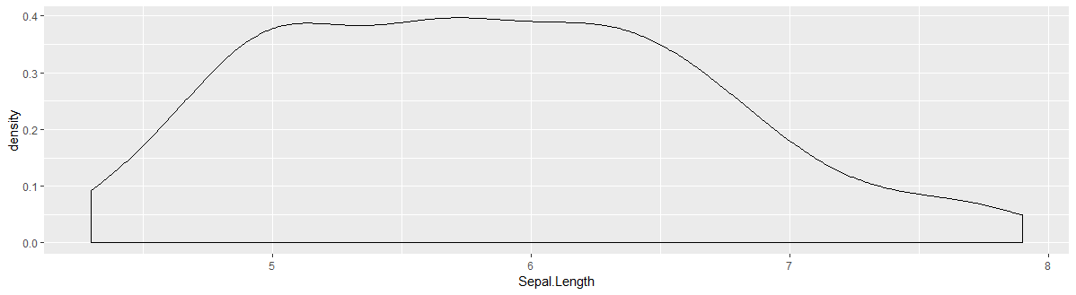
Visualising Distributions – Density Plots
iris %>%
ggplot(aes(x = Sepal.Length)) +
geom_density()

Slide 20
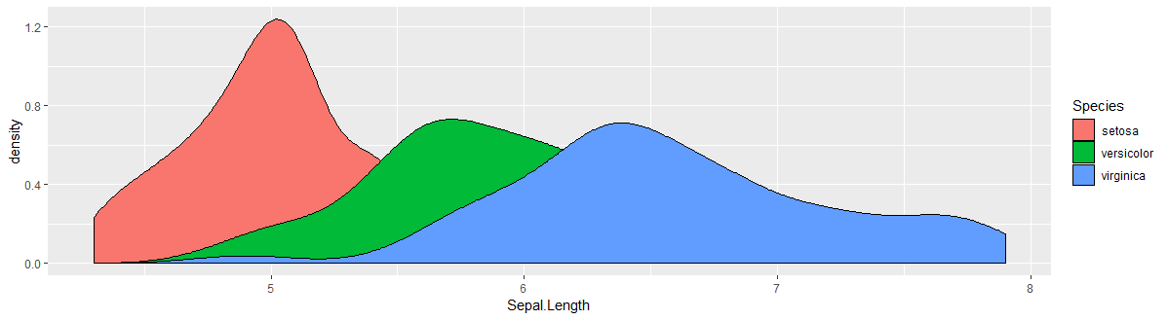
Visualising Distributions – Density Plots
iris %>%
ggplot(aes(x = Sepal.Length, fill = Species)) +
geom_density()

Slide 21
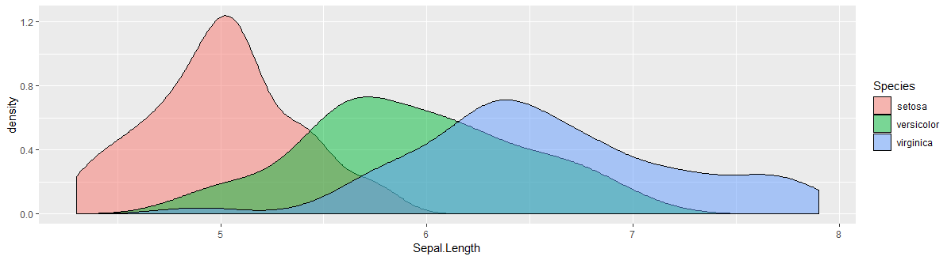
Visualising Distributions – Density Plots
iris %>%
ggplot(aes(x = Sepal.Length, fill = Species)) +
geom_density(alpha = 0.5)

Slide 22
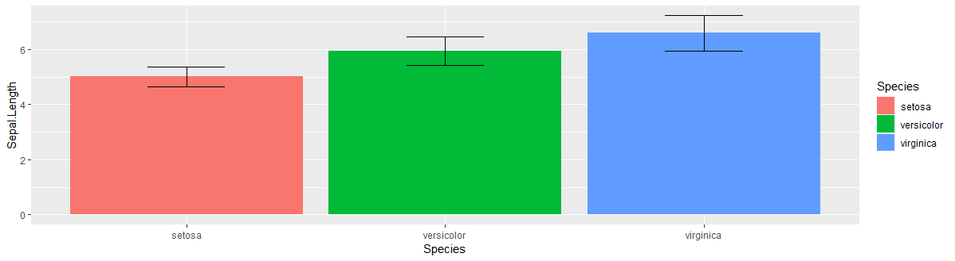
Ban the Bar Graph!
Bar graphs can show us summaries about our data, but don’t tell us much about the underlying distributions.

Slide 23
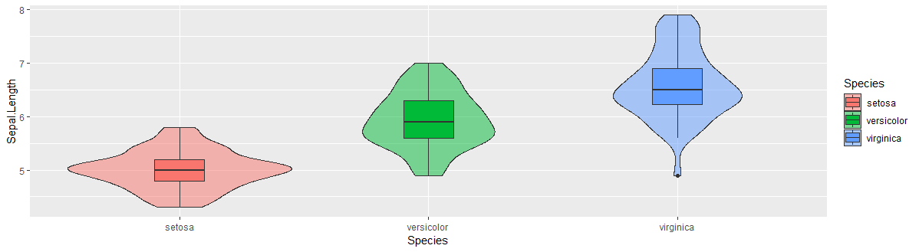
One Alternative – Violinbox Plots
iris %>%
ggplot(aes(x = Species, y = Sepal.Length, fill = Species)) +
geom_violin(alpha = 0.5) +
geom_boxplot(width = 0.2)

Slide 24
Time to Practice!

Slide 25
Example data
Available in the .zip folder: haggis.csv
Heights for two groups, based on lifetime breakfast habits:
Porridge eaters
Haggis eaters
64 Participants in each group (128 participants in total)
Who will be taller?

Slide 26


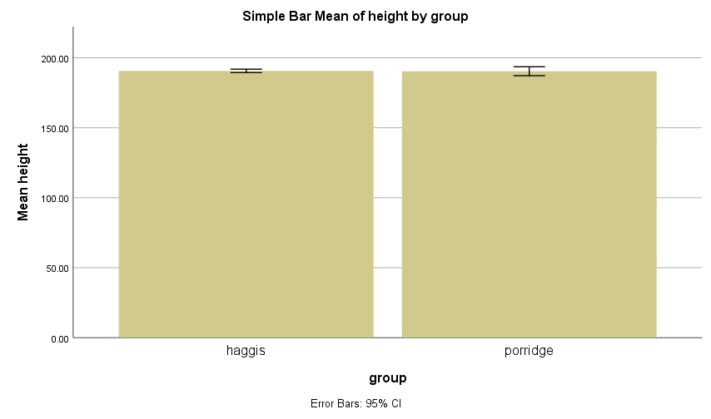
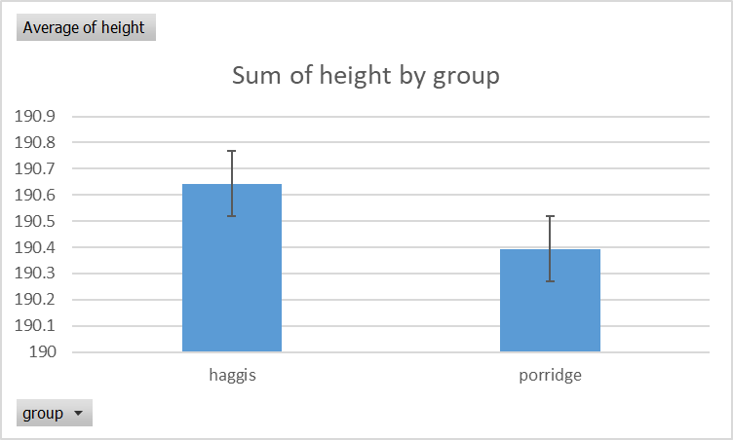
SPSS and Microsoft Excel – Bar Graphs (Yuck!)
*Error bars show SEM

Slide 27
So Haggis Eaters are Taller than Porridge Eaters, right?
Well, let’s load the data and have a gander!
TASK 1:
Create a new (or use an existing) .Rmd file to make notes in
Load in the tidyverse packages
Load in the dataset hint: read_csv()
Have a go, and then we’ll go through it together

Slide 28
So Haggis Eaters are Taller than Porridge Eaters, right?
Well, let’s load the data and have a gander!
TASK 1:
Create a new (or use an existing) .Rmd file to make notes in
Load in the tidyverse packages
Load in the dataset hint: read_csv()
Have a go, and then we’ll go through it together

Slide 29
Task 1 – Solution
haggis <- read_csv("haggis.csv")

Slide 30
Task 2 – Visualise Height by Breakfast Group
Create a violinbox plot, showing how height differs between haggis and porridge eaters.
Have a go, and then we’ll go through it together

Slide 31
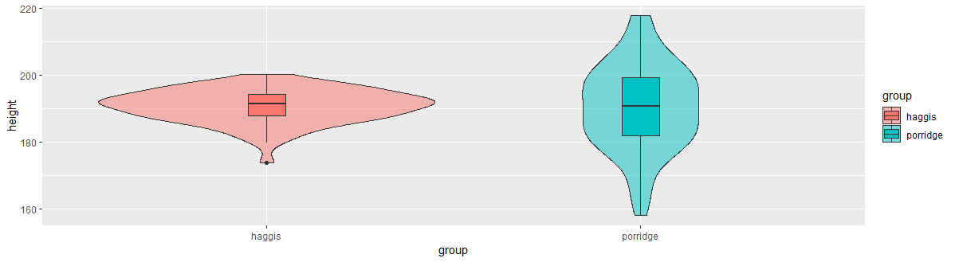
Task 2 – Solution
haggis %>%
ggplot(aes(x = group, y = height, fill = group)) +
geom_violin(alpha = 0.5) +
geom_boxplot(width = 0.1)

Slide 32
Task 3 – Check the Distributions
Create two density plots to see:
How the distribution of height differs between pop fans and classical fans
How the distribution of age differs between pop fans and classical fans
Have a go, and then we’ll go through it together

Slide 33
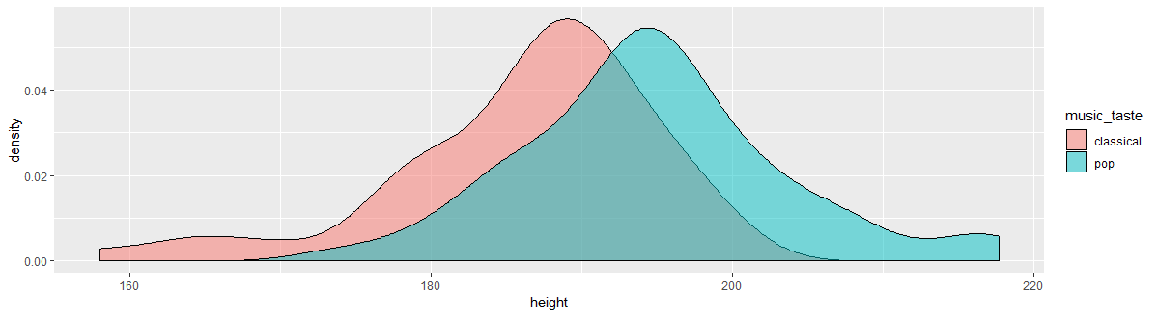
Task 3 – Solution a)
haggis %>%
ggplot(aes(x = height, fill = music_taste)) +
geom_density(alpha = 0.5)

Slide 34
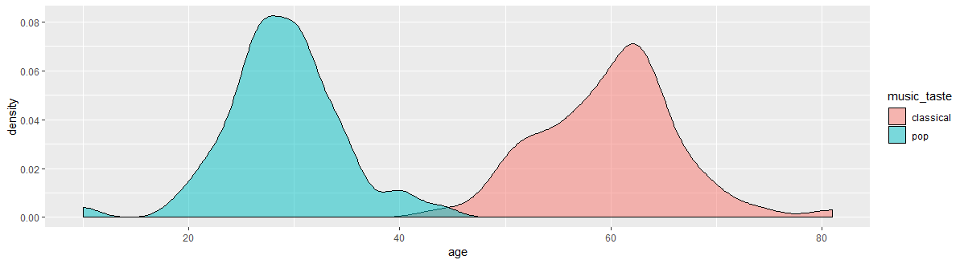
Task 3 – Solution b)
haggis %>%
ggplot(aes(x = age, fill = music_taste)) +
geom_density(alpha = 0.5)

Slide 35
Task 4 – Does Age predict Height?
Draw a scatter plot to see how age predicts height. Add a line showing the linear relationship between age and height.
Have a go, and then we’ll go through it together

Slide 36
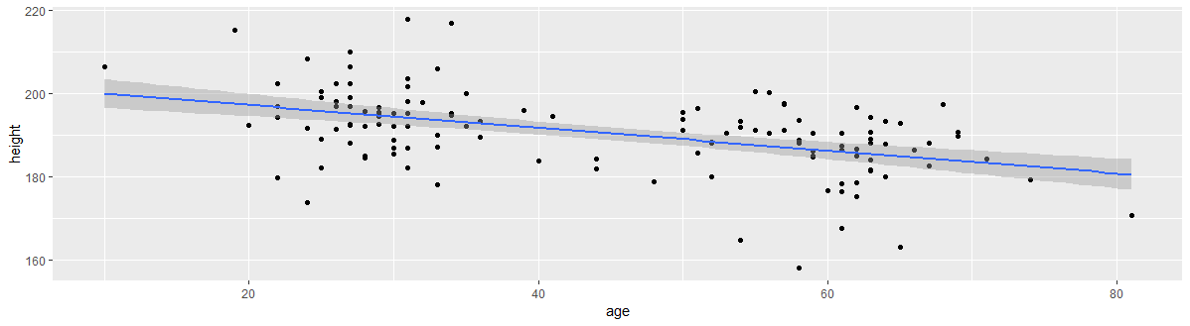
Task 4 – Solution
haggis %>%
ggplot(aes(x = age, y = height)) +
geom_point() +
geom_smooth(method = "lm")

Slide 37
Task 5 – Does Age interact with Music Taste?
Recreate the previous graph, but colour the points and line by participants' breakfast habits.
Have a go, and then we’ll go through it together

Slide 38
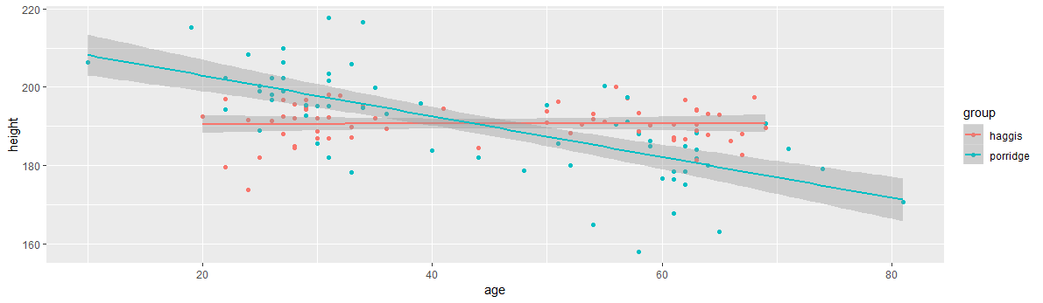
Task 5 – Solution
haggis %>%
ggplot(aes(x = age, y = height, colour = group)) +
geom_point() +
geom_smooth(method = "lm")

Slide 39
Task 6 – Does Music Taste interact with Breakfast Preference?
Create a violinbox plot as you did in Practice Question 2, but split by music taste *as well as* breakfast group.
Have a go, and then we’ll go through it together

Slide 40
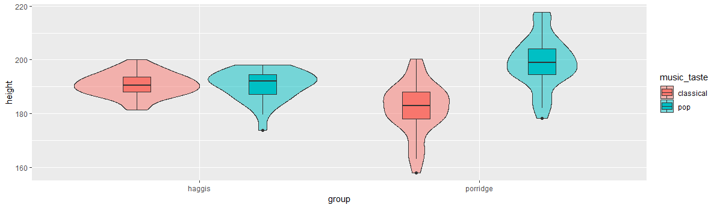
Task 6 – Solution
haggis %>%
ggplot(aes(x = group, y = height, fill = music_taste)) +
geom_violin(alpha = 0.5) +
geom_boxplot(width = 0.2, position = position_dodge(width = 0.9))

Slide 41
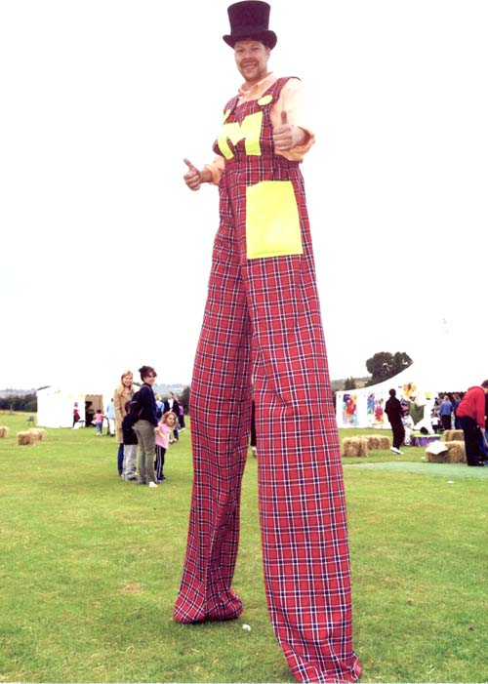

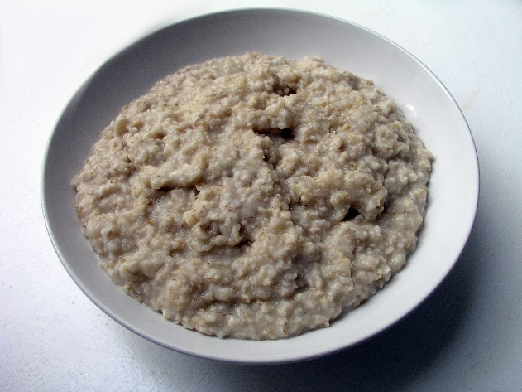
Conclusion
+
=
?

Slide 42
Conclusion
Well… no.
We don’t know anything about the possible causal relationships, and only looked at our data in an exploratory way
Also, the data was kind of made up.

Slide 43
Real Conclusion
Data Visualisation in R is fun, easy, and informative!
If we’re looking at differences between groups, it’s important to not hide the distributions behind bar graphs and summary statistics.
Googling for R solutions is a skill in itself.

