Slide 1
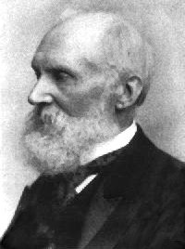
What knowledge is valuable?
Epistemology: Branch of philosophy concerned with knowledge: “how can we know what can we know?”
“I often say that when you can measure what you are speaking about, and express it in numbers, you know something about it; but when you cannot measure it, when you cannot express it in numbers, your knowledge is of a meagre and unsatisfactory kind;" (1883)
Lord Kelvin (Chair of Natural Philosophy at the University of Glasgow)
Notes:
In qualitative methods we run into problems by attempting to adhere strictly to the principles underpinning a hypothetico-deductive method in psychology. Underpining this tension is the difference in Epistemologies. Broadly epistemology refers to a branch of philosophy that is concerned with theory of knowledge; how we can know and what we can know
Epistemology determines and is made visible through method, particularly in the; participant- researcher relationship, measures of research quality, and form, voice, and representation in analysis and writing (Carter and Little, 2007: 1316)
This tension is summarised clearly by Lord Kelvin, one of University of Glasgow;s most distinguished scholars and most famous scientists of his age. Lord Kelvin was Chair of Natural Philosophy at the University of Glasgow – born in 1846 he earned international acclaim for proposing an absolute scale of temperature now known as the Kelvin Scale and for his pioneering research in the fields of mechanical energy and heat – in this quote he assigns value to different types of knowledge……
“I often say that when you can measure what you are speaking about, and express it in numbers, you know something about it; but when you cannot measure it, when you cannot express it in numbers, your knowledge is of a meagre and unsatisfactory kind;" (1883)
This tension is still evident today, even within our own discipline, and something which we as qualitative researchers need to acknowledge and challenge through adherence to high quality qualitative research.

Slide 2
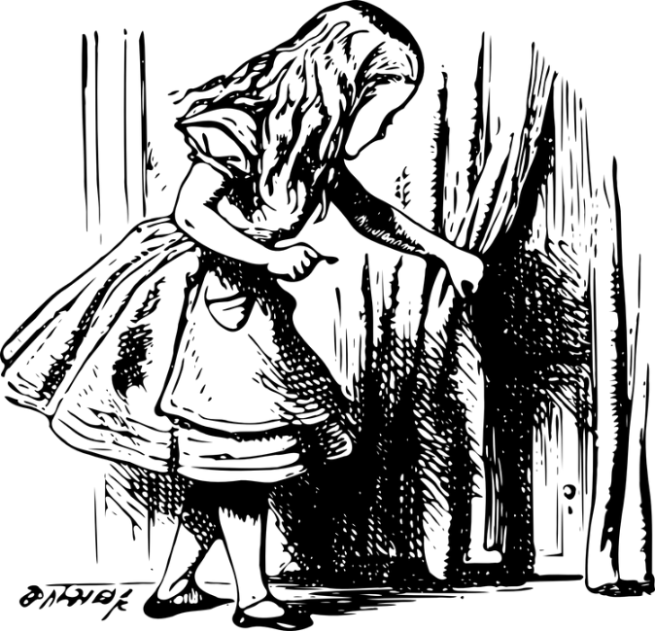
Sneaking a ‘keek’ behind the curtain (rationale for keeking)

Slide 3

Research Question help to inform method
Notes:
Qualitative researchers may be interested in capturing the voice of their participants to provide a detailed interpretation of events or experiences; to develop theory in an under-researched area, to identify discourses or demonstrate the discursive features of a text, and or engage in social critique. It is important to know that qualitative research and its associated data does not represent one thing, not all qualitative data is drawn from interviews and equally, not all researchers qualitatively analyse interview data in one way. How you choose to gather and analyse qualitative data will be depended on a number of central issues. The first and perhaps most important issue that we would like to explore is getting you to think about the assumptions you already have about research and more specifically the ‘knowledge’ that research brings forth– what counts as legitimate knowledge in the field of social science? Do you already have some ideas, implicit or explicit, about the status and preference for the types of research that are produced in this discipline?

Slide 4

Transparency rather than replicability in qualitative research
scienceonapostcard
@etsy

