Slide 1




A GTA’s perspective
Jaimie Torrance & Holly Scott

Slide 2
Ideas for getting started teaching R
Consider the audience
Be relevant
Foster good habits early
Explain simply
What can and can’t you teach in a class
Additional considerations

Slide 3
Consider your audience
Coding experience? Stats experience?
Did they know this was coming?
Sometimes
L1 = Postgrad
L1 < Postgrad
L2 > Postgrad

Slide 4

Use relevant examples early
Why are we doing this?
No.1 question;
“Fun” ≠ Useful
Start with relevant – end with fun
Their own data?

Slide 5

Foster good habits early
Difference between Console/ Scripts/ R Markdown
Save old scripts
Work smart not hard!
Notes! Comment everything
Coding conventions and consistency

Slide 6

Explain all the things!
Assignment operator? Element? Vector? Variable? Etc.
Reading code in simple language
Take the abstract/ arbitrary and make it meaningful
What does the “sentence” mean?

Slide 7



What can you do in the time you have?
Prep In class Homework
Take it and break it
They can use other sources
What happens when I change this…
OH GOD! UNDO! UNDO!!

Slide 8
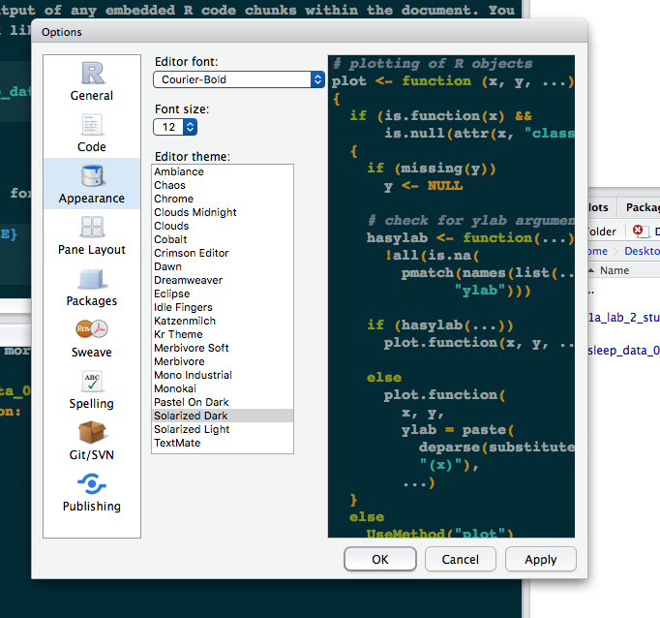
Additional considerations
Good documentation
especially for start up
Reference material
Dyslexia etc.
Editor environment
Tidiness
Consistency / meaningful
Keyboard shortcuts
Functions

Slide 9





5 tips from our experience as GTAs
Calming nerves
Don’t be an expert
Talk through the code
Don’t touch the keyboard
Joint problem solving

Slide 10
Calming nerves
Not just technical support with R – also reassuring anxious students
Very new type of software/skill – can be daunting at first

Slide 11

Don’t be an expert
Fine to make mistakes – let students see the whole process
Honesty is encouraging for students:
I always make that same mistake in my code too!

Slide 12
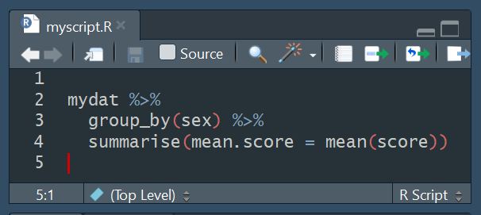
Talk through the code
I want to…
1) take the data in ‘mydat’
AND THEN
2) group it together based on ‘sex’
AND THEN
3) create a summary variable called ‘mean.score’ with the mean value of ‘score’ for each sex

Slide 13
Don’t touch the keyboard
Slower process but worth it – positive student feedback
Sense of ownership, achievement and confidence

Slide 14
Joint problem solving
Encourage trial and error: challenge fear of doing something wrong
Work through strategies together:
Let’s see if we have a similar script we could edit
Let’s look at the help documentation for this function

Slide 15
5 tips from our experience as GTAs
Calming nerves
Don’t be an expert
Talk through the code
Don’t touch the keyboard
Joint problem solving

