Slide 1
What can students gain by switching to R?
Transitionary Student Perspective | Rebecca Lai

Slide 2
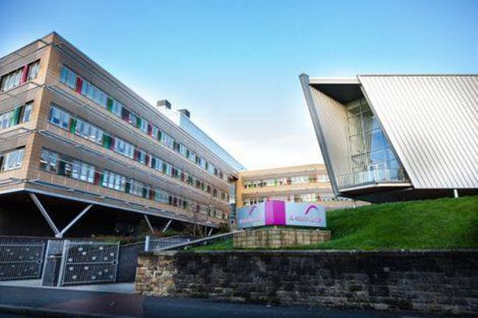
About Me
Adult returner to education:
Left school at 16
Non-conventional path to my degree
Scared of maths!
Undergraduate at Glasgow
Current Postgraduate:
MSc Research Methods of Psychological Science
ESRC funding nominee, Psychology Pathway
Notes:
I left school at age 16 and worked for a bit, returned to education at 25 coming up through Langside college to gain entry to Glasgow when I was 27, where I completed my undergraduate degree in 2017.
I am a current Research methods of psychological science student and recently accepted an offer of a phd place- pending ESRC and Carnegie funding applications.
Coming back to education was a bit of a shock, and being confronted with statistics after nearly 11 years without having to do anything mathematical- so I was a bit scared of the statistics aspect of the course.

Slide 3

SPSS Period
Awareness of the tests underlying the tasks we were asked to perform.
Point-and-click method- disconnected from the tests.
Learning SPSS with cookbook style statistics.
Notes:
During first and second year we were required to use SPSS
Every lab session we were handed a 10 to 20 page booklet with instructions on how to perform a given operation in excel or SPSS… which I still have because I throw nothing away.
It was very point and clicky, open this menu, click that, uncheck this box etc.
I spent more time focusing on memorising the steps and assumptions of each individual test recipe, without any real understanding of what these things actually meant, or how to properly communicate them.
Also provided with standard SPSS graphs- or if you were feeling fancy you could redo them in excel. Not a lot of engagement with the data and results.
Also given pre-sanitised data! No idea what real, raw data looked like and the steps required to get to that point.

Slide 4
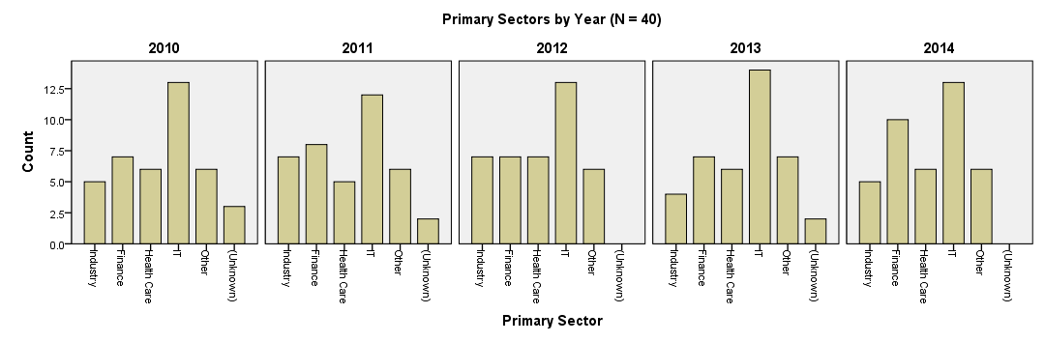
SPSS Period
Results:
Mediocre performance, little understanding and beige graphs.
Notes:
No surprise- I didn’t do particularly well in stats or communicating results in lab reports due to a lack of knowledge and visualisation skills.
Nothing sexy or exciting about beige graphs.
Still had the fear.

Slide 5

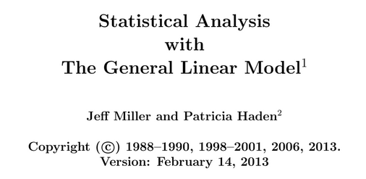
Transition to R
Department transition started around 2015/2016.
Our junior honours given the choice between SPSS and R.
Reproducibility: can see all the steps!
Teaching the GLM, not individual “recipes”.
Increased demand from students for statistics!
Notes:
The actual departmental transition to R started around 2015/16- my cohort’s junior honours year.
Dale gave us the choice of R or SPSS- I chose R because I felt I actually knew as much about the operation of SPSS- and he did a good job selling it.]
I preferred it. We could see previous examples of code for tests, completely transparently, and examine what was going on step by step.
It also matched Dale’s style of teaching statistics- teaching the general linear model instead of individual recipes in isolation.
It became a set of interconnected ideas with easier to follow rules- not some amorphous, obscure terror lurking about in the background.

Slide 6
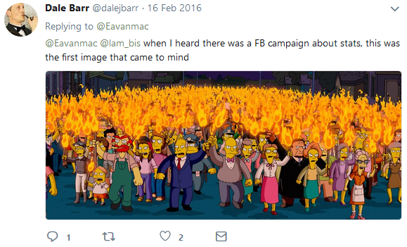
Transition to R
Notes:
People wanted more!
How many students do you know have wanted more? Maybe a few… probably not enough to petition for EXTRA MORE ADVANCED stats.
Dale obliged us, probably to his detriment… seemed like a lot of work and there were some 3am emails.

Slide 7
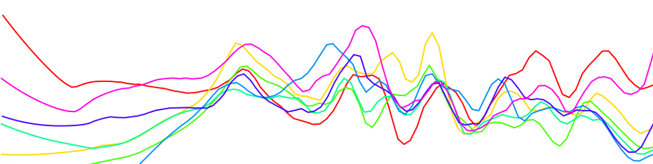
Transition to R
Results:
An understanding of the framework that underlies the statistical tools we use. Got a bit better. No more beige.
Notes:
It helped me get to grips with what was going on, better understanding of data and tests led to better communication and better grades.
And less crappy graphs!

Slide 8
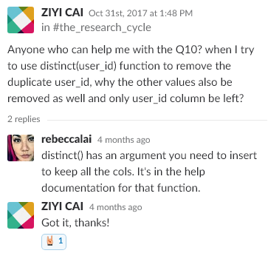
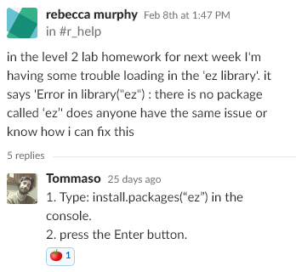

Transition to R
Extra work for staff (in the short term).
Alleviated by encouragement of peer-support:
Collaborative learning.
Learning by teaching.
Large online support community.
Peer Assisted Learning (PAL).
Slack.
Notes:
Like I said before Dale put in extra work, but so did other staff- re-writing course materials and retraining.
It also led to an upsurge in students requiring help- as you can imagine it was a bit of a shock to the system for some folks.
Dale and Lisa have been very keen to engage other students in peer support too to help deal with this.
Peer Assisted Learning has been a staple feature at Glasgow for a long time, but Slack has been instrumental.
Posting questions to the group, you can get answers from students (also seen by staff members) or staff themselves.
A more efficient use of staff consultation time, and easier access to their expertise.

Slide 9
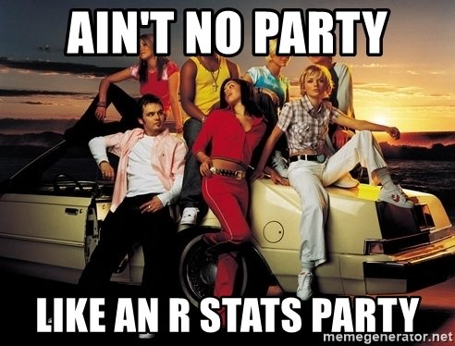
Altered Perceptions
A whole system of interconnected principles that could be understood.
Reflected in the R, not completely compartmentalised.
Re-engagement with the material with a positive attitude and less fear.
Fun challenge, not inescapable horror!
Great preparation for postgrad:
Getting used to coding!
Teaching and communication.
Notes:
Also good for building graduate attributes such as communication.
And for those of us that have teaching aspirations a good dip of your toe into the water through peer support.

Slide 10
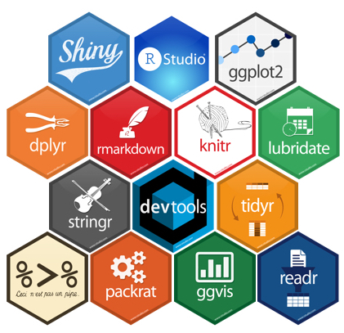
Conclusions
Better statistics skills:
GLM teaching supported by R and Open Science.
Increased engagement with materials.
More efficient use of staff time through Slack.
Learning through teaching and discussion with peers.
Better communication skills:
Written and verbal communication skills developed through peer support.
Scientific communication through better understanding of stats, Open Science and data visualisation.

Slide 11
Appendix A: Model Formulae

Slide 12
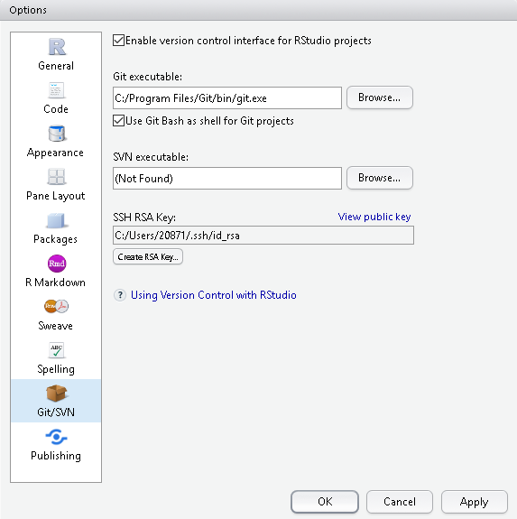
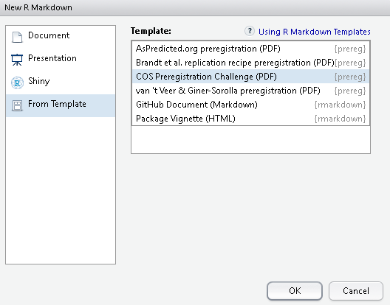
Appendix B: Open Science Ready!

Slide 13
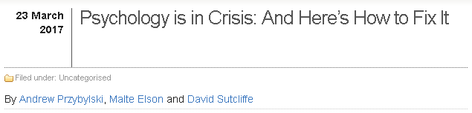
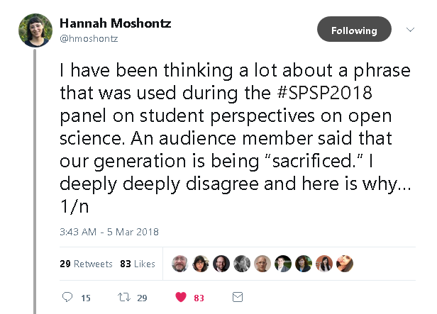
Appendix C: Open Science Ready!
Misunderstanding of our goals.
Ways of working evolve. Some tools are more compatible with other ways of working.
Choosing to do ethically right things can have detrimental affects on young careers.
Changes to incentive structures.

