Slide 1
Making Tools for Science
PsyTeachR Shiny Tutorials
https://psyteachr.github.io/shiny-tutorials/

Slide 2
Reactivity
UI is mostly static html
Sometimes we want to change the UI in response to user input (or processes in server)
Examples
Updating plots (e.g. number of bins)
Only showing relevant survey questions based on earlier responses

Slide 3
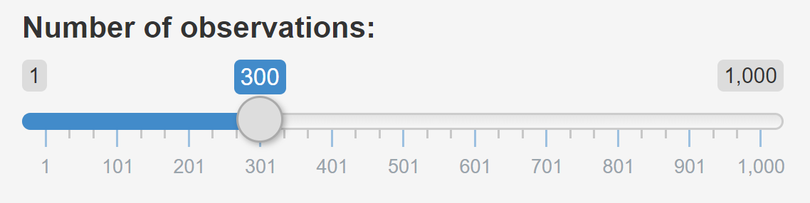
How does it Work?
1) Get value from user via control widget in UI
sliderInput(
inputId = “n_obs", label = "Number of observations:",
min = 1, max = 1000, value = 300
)

Slide 4
How does it Work?
2) Create output object in server
output$normal_plot <- renderPlot({
input$n_obs %>%
rnorm() %>%
enframe(value = "obs_val") %>%
ggplot(aes(x = obs_val)) +
geom_density()
})

Slide 5
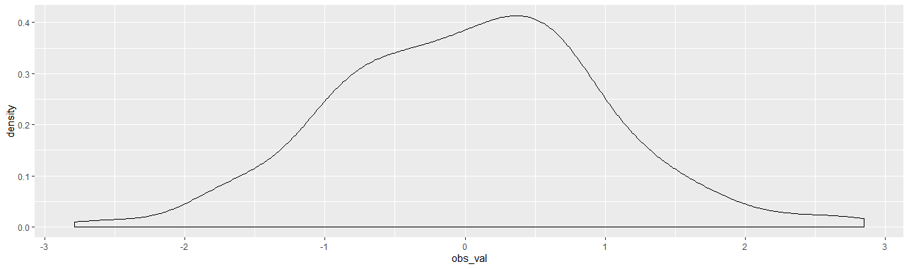
How does it Work?
3) Render in UI
plotOutput("normal_plot")

Slide 6
How does it Work?
UI
Server
sliderInput(
inputId = “n_obs",
...
)
output$normal_plot <- renderPlot({
input$n_obs %>%
...
})
plotOutput("normal_plot")

Slide 7
Render & Output Functions
Different reactive output functions exist for different kinds of object.
These tell UI what to do with the data it receives from server.
renderPlot()
renderDataTable()
renderImage()
renderText()
renderUI()
renderUI()
plotOutput()
dataTableOutput()
imageOutput()
textOutput()
htmlOutput()
uiOutput()

Slide 8
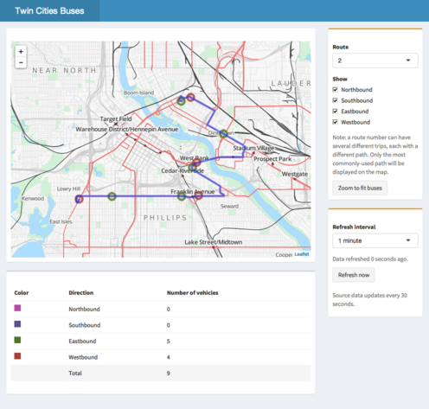
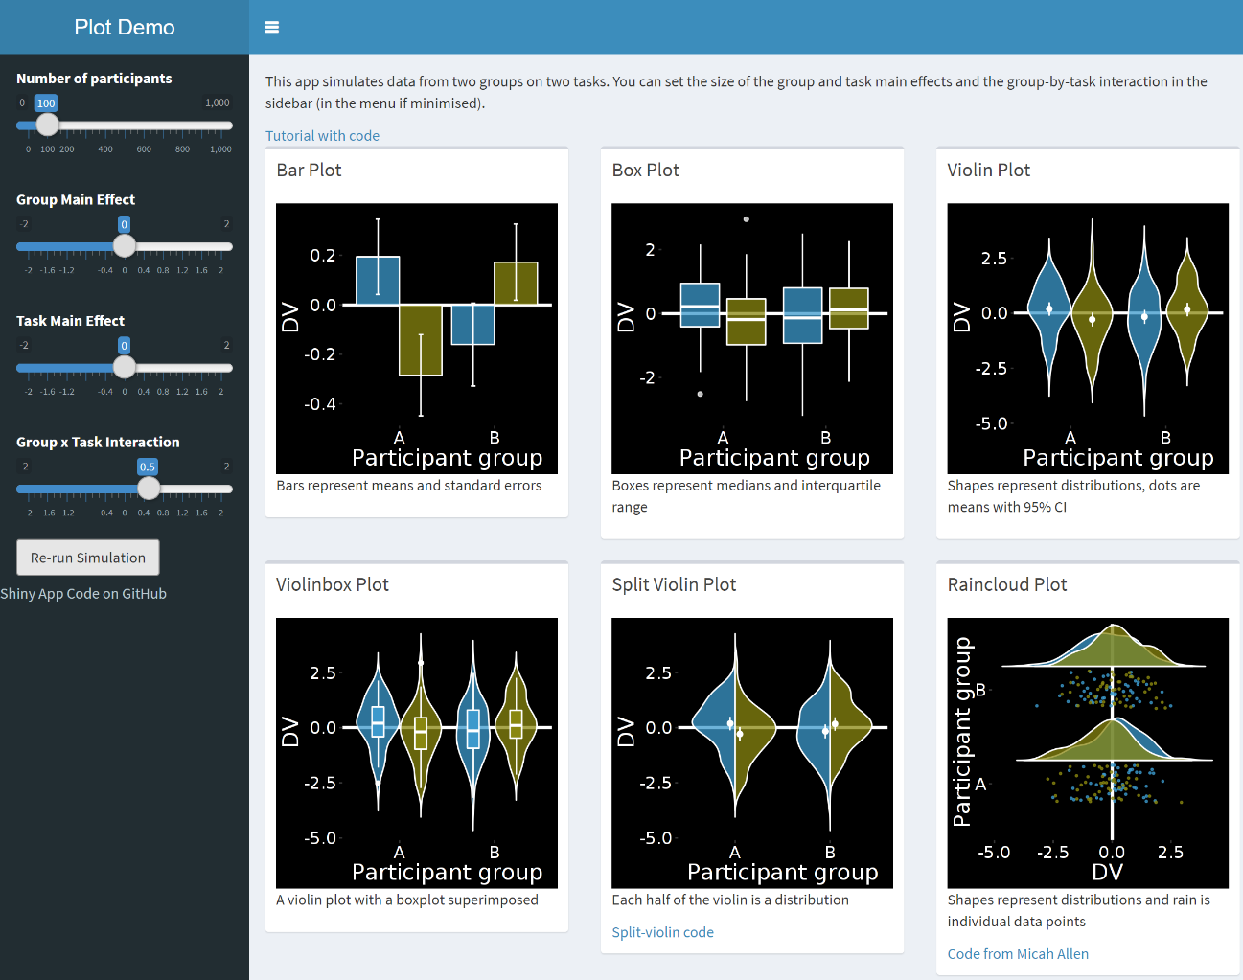
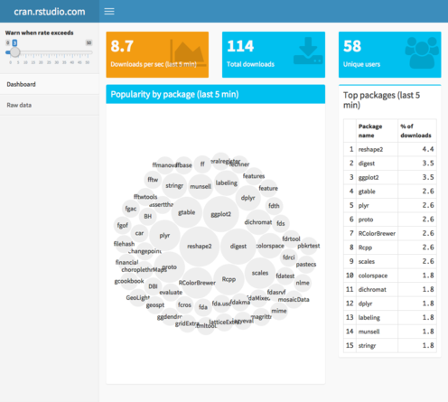
shinydashboard
Professional-looking UIs with minimal code.

Slide 9

Visual Angle
Visual angle ~ Size / Distance
Size of stimulus subtended (via pupil) on retina
distance
θ
size

