Slide 1
April 2018 ICT 5307 : Embedded System Design
Lecture 1
Introduction
S.M. Lutful Kabir
BUET

Slide 2
Introduction
Microprocessor and microcontroller have revolutionized various industries and our day-to-day life
Their use in control, monitoring, measurement and signal processing has made a breakthrough in electronic industry
Now-a-days you won’t be able to name one electronic device in which microprocessor/ microcontroller or their derivatives have not been used
This course is designed to make you familiar with these remarkable pieces of wonder

Slide 3
Microprocessor
ALU
By microprocessor we mean that all the components one finds in a CPU (ALU, Register, Timing & Control Unit and the Interfacing circuits) are put together in a single chip
That is a uP can be considered as “CPU in a Chip”
Interfaces
Registers
Timing & Control Circuit
Microcontroller
I/O Port
CPU
Microcontroller is somewhat different from microprocessor in a sense that not only the CPU but also RAM, ROM, I/O Ports, Timer & Counter, Serial Port all put together in a single chip
So, it is called “Computer on a chip”
Timer Counter
RAM
Serial Port
ROM

Slide 4
Why uP and uC are so popular?
Small Size
Lower Cost
Higher Reliability
Lower Power Consumption
Higher Versatility
More Powerful

Slide 5
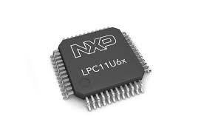
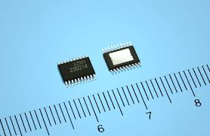
Smaller Size
A tiny chip can contain hundreds of thousands of transistors and components
The size of present day microprocessor has now reduced to less than an inch
With the advent of VLSI technology the microprocessors now come with a large numbers of pins

Slide 6
Lower Cost
With the advent of complex technology, microprocessor cost does not increase proportionally
Rather its cost per function has decreased gradually
As the material cost is negligible in comparison with the initial masking cost, per unit cost decreases as the volume of production increases

Slide 7
Higher Reliability
With the advent of more sophisticated fabrication technology and testing system microprocessor manufacturing process is now very reliable
Moreover, the microprocessor based system now-a-days requires less number of chips and so wiring requirement is less making the overall system more reliable

Slide 8
Power consumption
Present day microprocessors consume very low power in the order of milliwatt
This is because of the fact that they are manufactured by transistors using CMOS technology which requires very low power

Slide 9
Versatility
Since the program stored in a microprocessor system is rewritable hence one system can be reused by loading a new program
This is especially useful when a new system is being developed. Frequent change in programming is necessary to fix bugs if any

Slide 10
More powerful
Present day microprocessor is more powerful than the previous one, w.r.t processing speed, memory and I/O pins
This becomes possible because of increase in data addressible bit size
Now 32 bit processor is common in the market
A 32 bit microprocessor is powerful than the then main frame computer

Slide 11
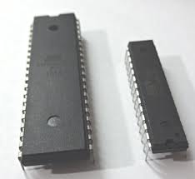
Microprocessor/Microcontroller and some of their applications

Slide 12
Typical Applications of uP
Microprocessor is basically a CPU, using CPU general purpose computer can be built
Desktop computers, PCs, Laptops, Workstations, Servers, Supercomputers
We are in the era of 32- and 64-bit microprocessor, so we can produce very powerful computers

Slide 13
Typical Application of uC
Using microcontrollers embedded systems are produced
An embedded system is a combination of hardware and software built for a specific application
Consumer electronics making toys, cameras, camcorders, robots
Consumer products - washing machines, microwave ovens etc.
Instrumentation - oscilloscopes, various medical equipments,
Process control - data aquisition, controlling various industries
Communication – Telephone, answering machines
Office equipments – Fax, printer, small PABX
Micromedia application – Cell phones, PDAs, teleconferencing equipment

Slide 14
Under What Circumstances We Should Use Microcontroller?
In many applications, the points of consideration are:
Space
Cost
Power consumption
Price
Computing power gets less consideration
Choice of microcontroller is obvious

Slide 15

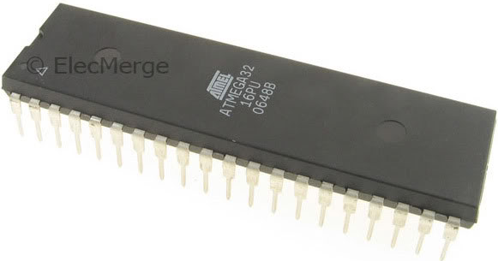
Introduction to Atmel AVR
Atmel Corporation is a manufacturer of semiconductors, founded in 1984.
Atmel introduced the first 8-bit flash microcontroller in 1993, based on the 8051 core.
In 1996, a design office was started in Trondheim, Norway, to work on the AVR series of products.
Its products include microcontrollers (including 8051 derivatives and AT91SAM and AT91CAP ARM-based micros), and its own Atmel AVR and AVR32 architectures.

Slide 16
AVR features
The AVR is an 8-bit RISC single-chip microcontroller with Harvard Architecture
They come with some standard features
Program (code) ROM
Data RAM
Data EEPROM
Timers
I/O ports
Most AVRs have some additional features like
ADC
PWM
Different Serial Interface such as USART, SPI, I2C (TWI)
CAN
USB, etc

Slide 17
Simplified View of an AVR Microcontroller
Program
ROM
RAM
EEPROM
Timers
CPU
Program
Bus
Data Bus
Interrupt Unit
Ports
Other Peripherals
OSC

Slide 18
Focus of the Course
To teach the students the basics of implementing processor based control systems.
AVR microcontroller will be used in the course.
Both hardware implementation and software simulation will be demonstrated in the class
You should be conversant in programming
Two books will be used as reference as the course materials
Two software will be used in the course
All presentation slides will be available in google group and so you should join the group immediately

Slide 19
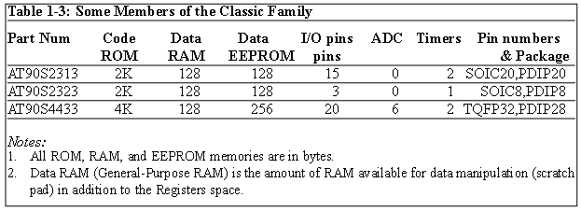
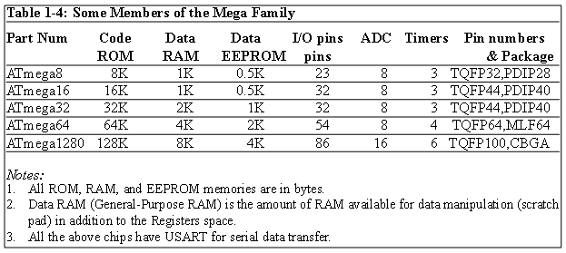
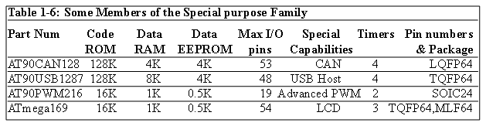
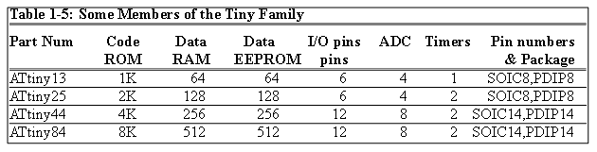
AVR different groups
Classic AVR
e.g. AT90S2313, AT90S4433
Mega
e.g. ATmega8, ATmega32, ATmega128
Tiny
e.g. ATtiny13, ATtiny25
Special Purpose AVR
e.g. AT90PWM216,AT90USB1287

Slide 20
Let’s get familiar with the AVR part numbers
ATmega128
Atmel
group
Flash =128K
ATtiny44
AT90S4433
Atmel
Tiny group
Flash =4K
Atmel
Classic group
Flash =4K

Slide 21
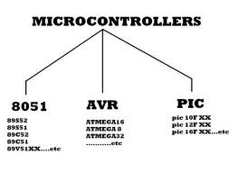
Other Microcontrollers
Besides AVR chips there are other 8-bit microcontrollers
A list containing some examples is provided below:
Part Name | Manufacturer
8051 | Intel and a number of Companies
HCS08 | Freescale (Formerly MOTOROLA)
PIC | Microchip
Z8 | Zilog
Among all microcontrollers, 8051, AVR and PIC are widely used.

Slide 22
A Comparison between 8052, PIC and AVR
Features | 8052 | PIC 18F452 | ATmega32
Program ROM | 8K | 32K | 32K
Data RAM (max^{m} space) | 256 bytes | 2K | 2K
EEPROM | 0 bytes | 256 bytes | 1K
Timers | 3 | 4 | 3
I/O pins | 32 | 35 | 32

Slide 23
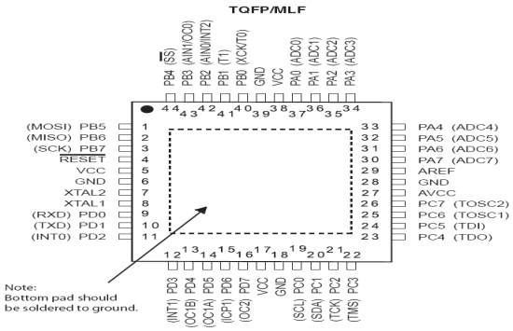
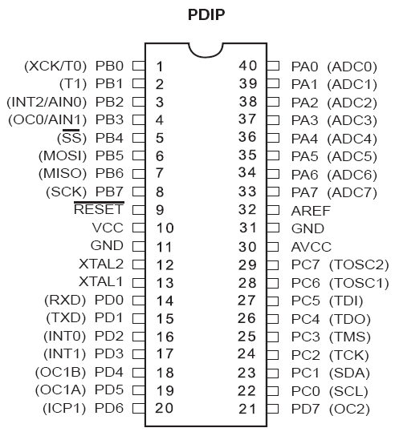
ATMega32 Pin out & Descriptions
Clears all the registers and restart the execution of program
Provides supply voltage to the chip. It should be connected to +5
Port B
Reference voltage for ADC
Port A
These pins are used to connect external crystal or RC oscillator
Supply voltage for ADC and portA. Connect it to VCC
Port C
Port D

Slide 24
ATMega32 Programmer Model: Memory
2KB SRAM
For temporary data storage
Memory is lost when power is shut off (volatile)
Fast read and write
1KB EEPROM
For persistent data storage
Memory contents retain when power is off (non-volatile)
Fast read; slow write
Can write individual byte
32KB Flash Program Memory
Used to store program code
Memory contents retain when power is off (non-volatile)
Fast to read; slow to write
Can only write entire “blocks” of memory at a time
Organized in 16-bit words (16KWords)

Slide 25
ATMega32 Programmer Model: Memory
Type | Flash |  | RAM |  | EEPROM
 | F_END | Size, kB | RAM-END | Size, kB | E_END | Size, kB
ATmega8 | $0FFF | 8 | $045F | 1 | $1FF | 0.5
ATmega32 | $3FFF | 32 | $085F | 2 | $3FF | 1
ATmega64 | $7FFF | 64 | $10FF | 4 | $7FF | 2
ATmega128 | $FFFF | 128 | $10FF | 4 | $FFF | 4

Slide 26
ATMega32 Programmer Model: Data Memory
EEPROM
ATmega32 contains 1024 bytes of data EEPROM memory.
It is organized as a separate data space, in which single bytes can be read and written.
The EEPROM has an endurance of at least 100,000 write/erase cycles.
Different chip have different size of EEPROM memory
Chip | Bytes | Chip | Bytes | Chip | Bytes
ATmega8 | 512 | ATmega16 | 512 | ATmega32 | 1024
ATmega64 | 2048 | ATmega128 | 4096 | ATmega256RZ | 4096
ATmega640 | 4096 | ATmega1280 | 4096 | ATmega2560 | 4096

Slide 27
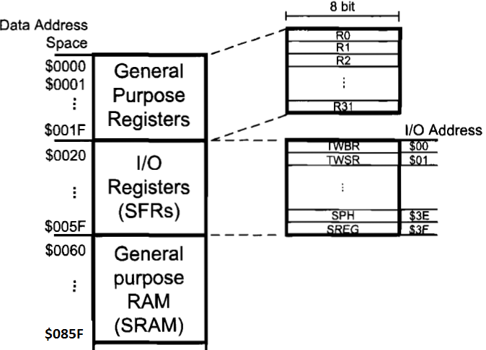
ATMega32 Programmer Model: Data Memory
The data memory is composed of three parts:
GPRs (general purpose registers),
Special Function Registers (SFRs), and
Internal data SRAM.

Slide 28
ATMega32 Programmer Model: I/O Registers (SFRs)
The I/O memory is dedicated to specific functions such as status register, timers, serial communication, I/O ports, ADC and etc.
Function of each I/O memory location is fixed by the CPU designer at the time of design. (because it is used for control of the microcontroller and peripherals)
AVR I/O memory is made of 8 bit registers.
All of the AVRs have at least 64 bytes of I/O memory location. (This section is called standard I/O memory)
In other microcontrollers, the I/O registers are called SFRs (Special Function Registers)

Slide 29
ATMega32 Programmer Model: I/O Registers (SFRs)

Slide 30
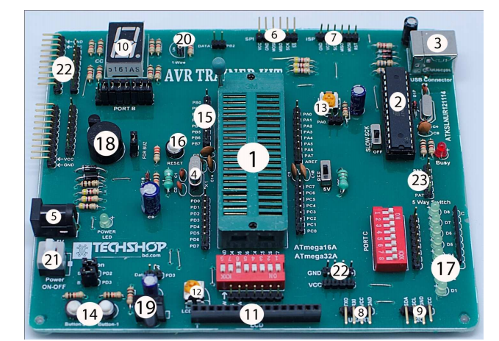
Hardware Implementation : AVR Trainer Board

Slide 31
Software Simulation
Simulation of a Circuit in the software called Proteus.
Development of the Program in CodeVisionAVR.
The compiled code (the .hex file) can be linked from the Proteus.
The program may be run in Proteus.
Although there may be some problem in actual practical implementation but as an initial development we get a first hand feedback from the output of the simulation.
Therefore all students must be able to use the two software and there project should be implemented at least in Proteus.

Slide 32
Distribution of Marks for Assessment of this course
Attendance – 5%
Class Tests (best 3 out of 4) – 20%
Mid Term – 20%
Mini Project – 25%
Final – 30%

Slide 33
Special NOTES
Course materials
In the google group “IICT_April2018_ESD”
Book Reference
Richard H. Barnett, Sarah Cox, Larry O'Cull-”Embedded C Programming and the Atmel AVR” – 2nd Edition, Delmar Cengage Learning, 2007
M. A. Mazidi, S. Naimi and S. Naimi : “The AVR microcontroller and embedded System – Using Assembly and C”, Prentice Hall (PEARSON), 2011.

Slide 34
How to join the Google group
In a browser type mail.google.com or
www.gmail.com
Log in with a gmail account (if you don’ have a gmail account, create one)
Now type the following url in the browser
groups.google.com/group/IICT_April2018_ESD
Now click
Join the group

Slide 35
How to download the software and books
After logging on to the google group in a different tab open https://drive.google.com/drive
In the Manu there is a option called “Shared with me”
The folder called “Books_AVR” and “Software_AVR” are shared folder for that group members.
So you should be able to download the books and the software

Slide 36
Installation Guideline for CodeVisionAVR software
1) Unzip the Files. 2) Run setup.exe 3) Complete the recommended installation process. After 80% completion of the installation a dialog box will appear “Atmel Studio couldn’t find…”, click OK then NEXT then Finish button.
4)Before clicking the final “finish” button uncheck the “launch now” option.
5) Copy and replace Cracked cvavr.exe file from Crack Directory to BIN directory of installation (Usually C:\cvavr\BIN).
6) Double click on the cvavr icon on desktop to run the software.

Slide 37
Installation Guideline for Proteus software
1) If you have any previous versions of Proteus then you need to uninstall it first. 2) Then run the Setup.exe file from the package and the installation will start.
3)Use the suggested settings and once it is done, it will ask about the key. The default key is given in the package. So browse the Grassington North Yorkshire.lxk file and upload it in the software.
4)Once the key is uploaded, now complete the setup.

Slide 38
Installation Guideline ……..
5) After the completion, one more thing you need to do is to copy the LXK Proteus 7.10 SP0 ENG v1.0.1.exe file from the package folder and paste it to installation directory (Usually -C:\Program Files\Labcenter Electronics\Proteus 7 Professional). After pasting right click on the LXK Proteus 7.10 SP0 ENG v1.0.1.exe file and run as administrator. 6) Remember that the antivirus program should be disabled during the installation. 7) Following the above steps, you can easily install the Proteus on your windows 7.

Slide 39
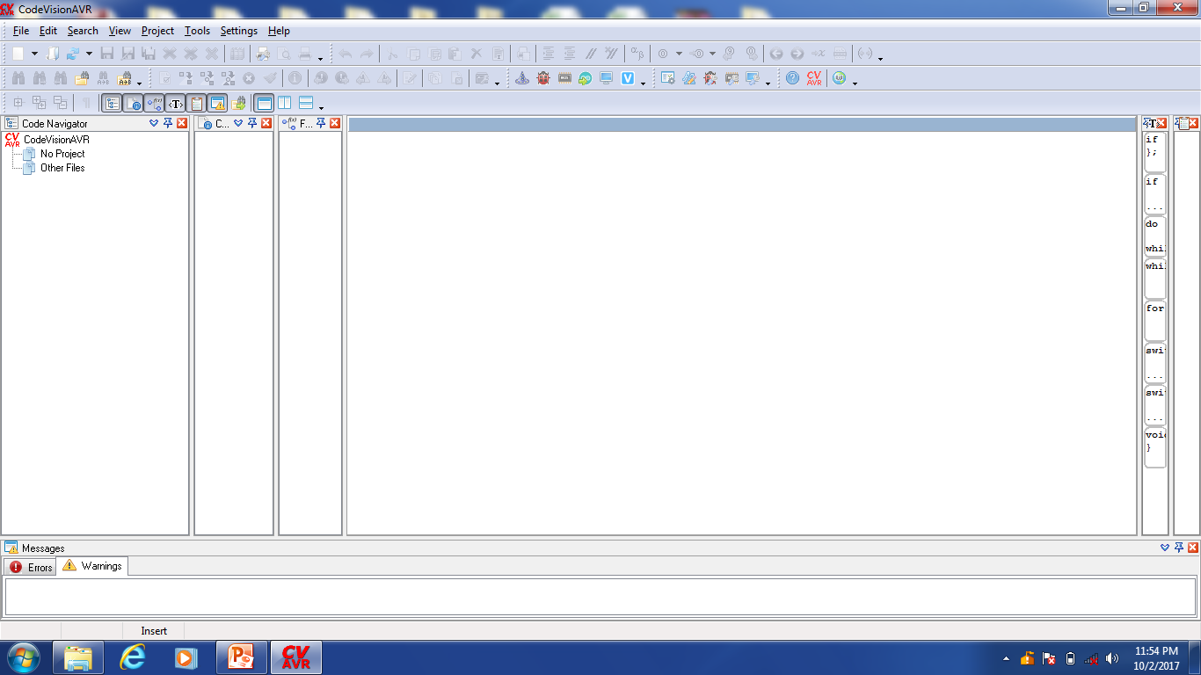
Screenshot of CodeVisionAVR

Slide 40
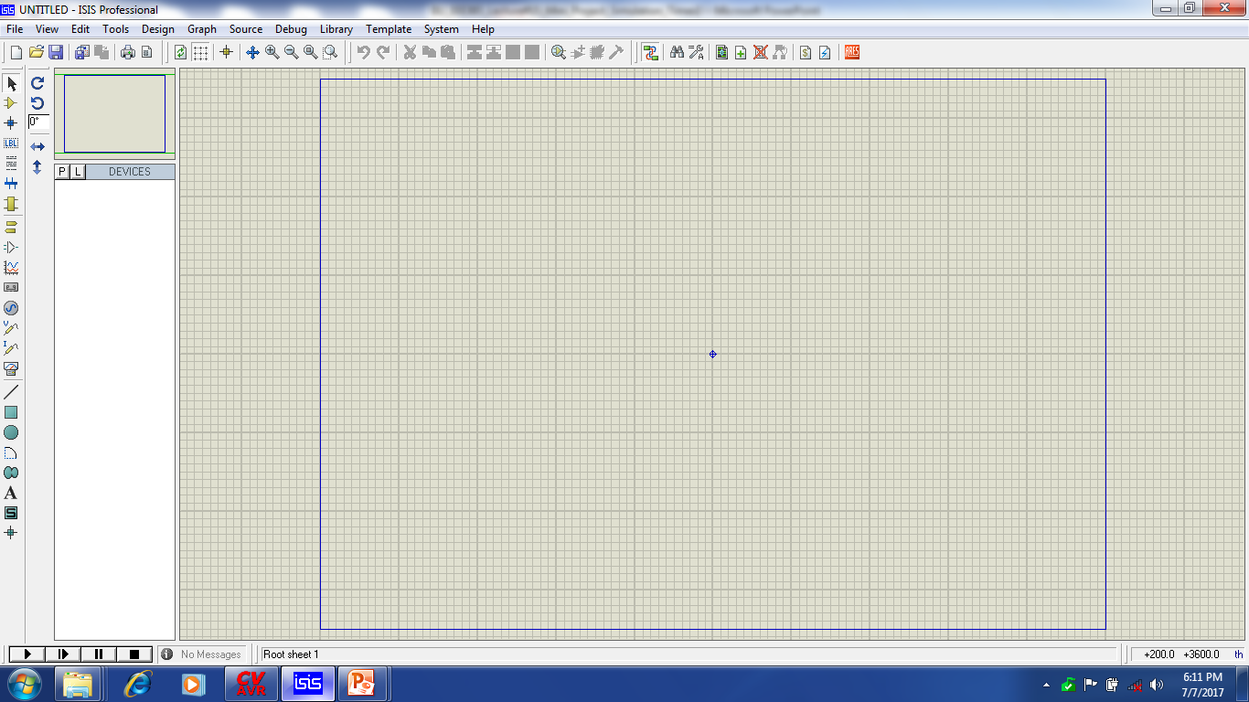
Use of Proteus for Simulating uC based Projects
Area to be used
In the vertical left and horizontal upper menu you will find different symbols indicating some options for drawing your circuit.

Slide 41
Thanks

