Slide 1
April-2018
ICT 5307 : Embedded System Design
Lecture 10
Serial Communication
S.M. Lutful Kabir
IICT, BUET

Slide 2
Need for Serial Communication
Computer transfers data in two ways: Parallel & Serial
In parallel data transfer, eight or more lines (wire conductors) are used to transfer data to a device.
Devices that uses parallel data transfer include printers, IDE Hard disk etc.
Although a lot of data can be transferred in a short amount of time, by using many wires in parallel.
To transfer many meters away, parallel method is costly, so serial method is used.

Slide 3
Serial Versus Parallel Data Transfer
In serial communication, the data is sent one bit at a time.
Parallel: expensive - short distance – fast Serial :cheaper– long distance-slow
Serial Data Transfer
Parallel Data Transfer
D0
Sender
Receiver
Sender
Receiver
D7

Slide 4
Serial Data Transfer
For serial communication to work, the bytes of data must be converted to serial bits using a parallel-in-serial-out shift register.
This also means that at the receiving end there must be a serial-in-parallel-out shift register in order to receive the serial data and pack them into a byte.
For serial transfer, if the distance is short, the 1s and 0s are transferred directly from one device to other.
For long distance the signal is modulated so that signal does not attenuate.
This is done by a peripheral device called MODEM (stands for modulation/demodulation).

Slide 5
Methods of Serial Communication
Serial Communication uses two methods, Synchronous and Asynchronous.
The Synchronous method transfers a block of data (character) at a time.
Whereas Asynchronous method transfers a single byte at a time.
It is possible to write software to use either of the methods, the program can be tedious and long.
That is why, special IC chips is made by many manufacturers for serial data communication.
These chips are commonly referred to as Universal Asynchronous Transmitter/Receiver (UART) or Universal Synchronous- Asynchronous Transmitter/ Receiver (USART)
AVR has built-in USART .

Slide 6
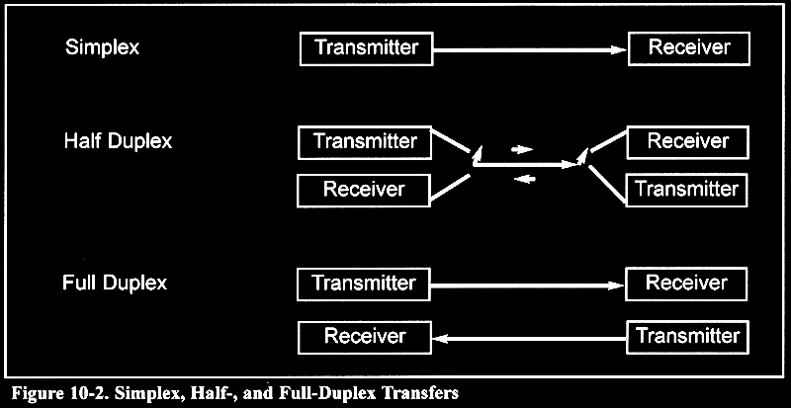
Simplex and Duplex Communication

Slide 7
Protocol
The data coming in at the receiving end of the data line in a serial data transfer is all 1s and 0s.
So, it is difficult to make sense of the data unless the sender and the receiver agree on a set of rules, called Protocol, on
how the data is packed,
how many bits constitute a character, and
how the data begins and ends.

Slide 8
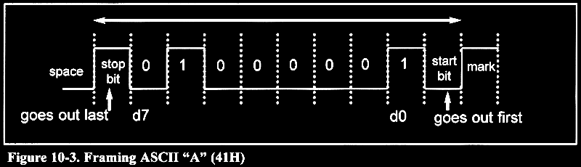
Asynchronous Communication and Data Framing
When there is no transfer the signal is high
Transmission begins with a start (low) bit
LSB first
Finally 1 stop bit (high)
Data transfer rate (baud rate) is stated in bps

Slide 9
Data Frame
In Asynchronous serial communication, peripheral chips or modem can be programmed for data that is 7 bit or 8 bit wide.
This is in addition of stop bits, 1 or 2.
In present days, 10 bits for each character is transmitted: 8 bits for each ASCII code, and 1 bit for each start and stop bits.
Therefore each 8 bit requires 2 extra bits, which gives 25% overhead.

Slide 10
Parity Bit
In some systems, the parity bit of the data byte is included in the data frame in order to maintain data integrity.
This parity bit is odd or even.
In the case of odd parity number of 1s in the data byte including the parity bit is odd.
Similarly for even parity, number of 1s in the data byte including the parity bit is even.
UART/USART chips can be programmed for odd, even or no-parity options.

Slide 11
Data Transfer Rate
The rate of data transfer in serial communication is called bits per second (bps).
Another widely used terminology is called baud rate.
As far as conductor wire is concerned, the baud rate and bps are the same and for this reason we shall use them interchangeably.

Slide 12
RS232 Standard
In order to allow compatibility among data communication equipment made by various manufacturer, an interfacing standard called RS232 was set by Electronic Industries Association (EIA) in 1960.
RS232 is one of the most widely used serial I/O interfacing standards.
This standard is used by PCs and numerous types of equipment.

Slide 13
RS 232 Standard
Logic 1 : -3 to -25 volt
Logic 0 : 3 to 25 volt
To Connect TXD to RXD and RXD to TXD from pc to AVR you must use MAX232 IC (or equivalent IC) to convert signal from TTL level to RS232 level
The baud rate of the AVR must match the baud rate of the pc
Standard baud rates are
2400-4800-9600-14400-19200-28800-33600-57600
1 | DCD
2 | RD
3 | TD
4 | DTR
5 | GND
6 | DSR
7 | RTS
8 | CTS
9 | RI

Slide 14
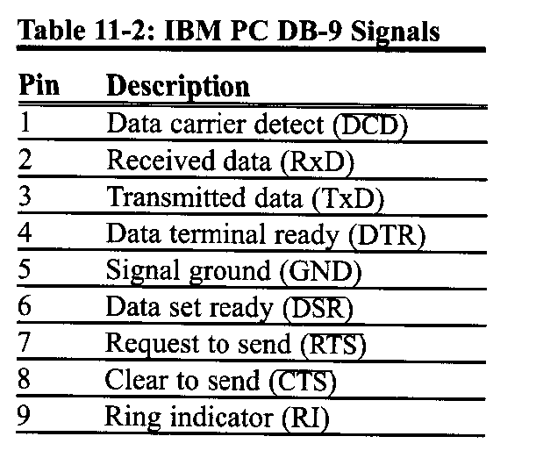
DB-9 Port

Slide 15
Rx and Tx Pins in ATmega32 uC
The ATmega32 has 2 pins that are used specially for transferring and receiving data.
These pins are called Rx and Tx pins and part of group portD (PD0 and PD1) of the 40-pin package.
Pin 15 is assigned to Tx and Pin 14 as Rx.
These Pins are TTL compatible that is why they require a line driver to make them RS232 compatible.

Slide 16
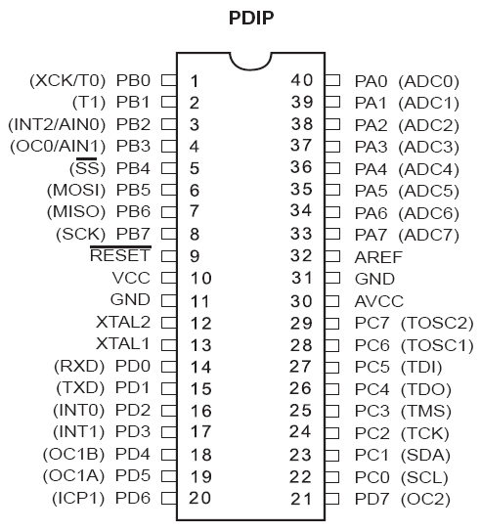
Rx and Tx pins

Slide 17
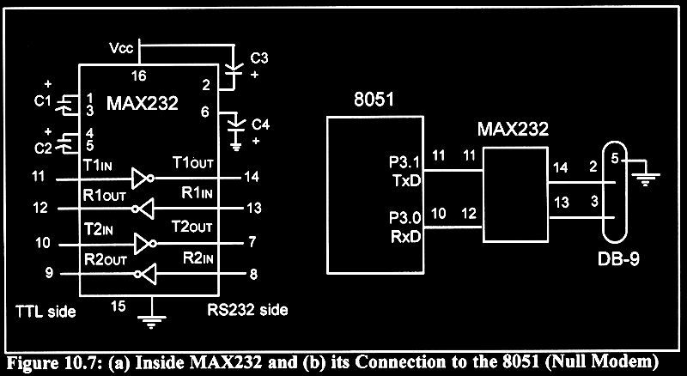
MAX 232 or 233
ATmega32
PD1 (TX)
14
15
PD0 (RX)

Slide 18
USART modes in AVR
In four mode:
Normal asynchronous
Double-speed asynchronous
Master synchronous
Slave synchronous

Slide 19
Registers used for Serial Communication
UDR (USART Data Register)
UCSRx (USART Control and Status Register);
[x=A, B or C]
UBRR (USART Baud Rate Register)

Slide 20
UBRR Register and Baud Rate in AVR
Some of the baud rates supported by PC are 1200, 2400, 4800, 9600, 19200, 38400, 57600, and 115200
AVR transfers and receives data in different baud rate and its baud rate is programmable.
This is done by USART Baud Rate Register (UBRR).
For a given crystal frequency, the value of UBRR decides the baud rate.

Slide 21
The Relationship Between Baud Rate and the Value in UBRR register
The relationship between the baud rate and the UBRR register value is given by:
Where, X=Value in UBRR Register
In order to get the values of ‘X’ for different baud rate we can solve the above equation, it gives,

Slide 22
UBRR Values corresponding to Baud Rate (F_{osc}=16MHz)
Baud Rate | UBRR (Decimal Value) | UBRR (Hex Value)
38000 | 25 | 19
19200 | 51 | 33
9600 | 103 | 67
4800 | 207 | CF
2400 | 415 | 19F
1200 | 831 | 33F

Slide 23
UBRR Register
U2X
UBRR (X)
Prescaling Down Counter
/2
/4
/2
0
1
With the selection of U2X bit (of UCSRA register - will be discussed later) the last block can be bypassed. That means the baud rate can be doubled.

Slide 24
UBRR Register
UBRR11
UBRR10
UBRR9
UBRR8
URSEL
--
--
--
UBRR7
UBRR6
UBRR5
UBRR4
UBRR3
UBRR2
UBRR1
UBR00
UBRR is a 16-bit register but only 12 bits are used to set baud rate of USART of AVR
Bit 15 is URSEL used for selection between UBRRH and UCSRC;
0-UBRRH & 1-UCSRC

Slide 25
UCSRx Registers
UCSRx are 8-bit Control registers used for controlling serial communication in the AVR.
There are three USART Control registers in the AVR.
They are UCSRA, UCSRB and UCSRC.
UCSRA
RXC TXC UDRE FE DOR PE U2X MPCM

Slide 26
UCSRA Register
UCSRA Register
RXC TXC UDRE FE DOR PE U2X MPCM
RXC – USART receive complete
TXC – USART transfer complete
UDRE : USART data register is empty.
FE – Frame Error
DOR – Data Overrun
PE – Parity Error
U2X – Double the USART transmission speed
MPCM – Multi- Process Communication Mode

Slide 27
RXC and TXC bits in USCRA register
RXC – USART Receive Complete
This flag is set when there are new data in the receive buffer that are not read yet.
It is cleared when the receive buffer is empty.
TXC – USART Transmit Complete
This flag is set when entire frame in the transmit shift register has been transmitted and there are no new data available in the transmit data buffer register.
It can be cleared by writing a 1 in its bit location.
Also it is automatically cleared when a transmit complete interrupt is executed.

Slide 28
UDRE and FE bits in USCRA register
USRE – USART Data register empty
This flag is set when the transmit data buffer is empty and it is ready to receive new data.
If this bit is cleared, you should not write to UDR because it overrides your last data.
This flag can generate a data register empty interrupt.
FE – Frame Error
This bit is set if a frame error has occurred in receiving next character in the receive buffer.
A frame error is detected when the first stop bit of the next character in the receive buffer is zero.

Slide 29
DOR and PE bits of USCRA register
DOR – Data Overrun
This bit is set if data overrun is detected.
A data overrun occurs when the receive data buffer and receive shift register are full and a new start bit is detected.
PE – Parity Error
This bit sets if the parity checking was enabled (UPM1=1 in USCRC register) and the character in the receive buffer had a parity error when received

Slide 30
U2X and MPCM bits in USCRA register
U2X – Double the USART transmission speed
Setting this bit will double the transfer rate in asynchronous communication.
MPCM – Multi-processor Communication mode
This bit enables the multi-processor communication mode.
To understand this feature you may consult the data sheet.

Slide 31
UCSRB Register
UCSRB Register
RXCIE TXCIE UDRIE RXEN TXEN UCSZ2 RXB8 TXB8
RXCIE – Receive Complete Interrupt Enable
TXCIE – Transfer Complete Interrupt Enable
UDRIE : USART Data Register Empty interrupt.
RXEN – Receive Enable
TXEN – Transfer Enable
UCSZ2 – Character Size
RXB8 – Receive Data bit 8
TXB8 – Transmit Data bit 8

Slide 32
RXCIE and TXCIE bits of USCRB Register
RXCIE – Receive Complete Interrupt Enable
To enable the interrupt on the RXC flag in USCRA register you should set this bit to one.
TXCIE – Transmit complete Interrupt Enable
To enable the interrupt on the TXC flag in USCRA register you should set this bit to one.

Slide 33
UDRIE, REN and TEN bits in USCRB Register
UDRIE – USART Data Register Empty Interrupt Enable
To enable the interrupt on UDRE flag in USCRA register you should set bit to one.
RXEN – Receive Enable
To enable USART Receiver enable you should set this bit to one.
TXEN – Transmit Enable
To enable USART transmitter enable you should set this bit to one.

Slide 34
UCSZ2, RXB8 and TXB8 bits in USCRB Register
UCSZ2 – Character Size
This bit combined with UCSZ0:1 bits in USCRC register sets the number of data bits (character size) in a frame.
RXB8 – Receive data bit 8
This is the 9th bit of received character when using serial frame with 9 data bits. This case will not be discussed in our course.
TXB8 – Transmit data bit 8
This is the 9th bit of the transmitted character when using serial frame with 9 data bits. This case will not be discussed in our course.

Slide 35
UCSRC Register
UCSRC Register
URSEL UMSEL UPM1 UPM0 USBS UCSZ1UCSZ0 UCPOL
URSEL – Register Select
UMSEL – USART mode Select
UPM1:0 – Parity Mode
USBS – Stop bit select
UCSZ1:0– Character Size
UCPOL – Clock Polarity

Slide 36
URSEL and UMSEL bits of USCRC Register
URSEL – Register Select
This bit used to access either the USCRC register or UBRRH register.
UMSEL – USART Mode Select
This bit selects either to operate in Asynchronous or in Synchronous mode.
0 = Asynchronous and
1 = Synchronous

Slide 37
UPM1:0 and USBS bits in USCRC Register
UPM 1:0 – Parity Mode
00 = Disabled
01 = Reserved
10 = Even parity
11 = Odd parity
USBS – Stop bit select
0 = 1 bit
1 = 2 bits

Slide 38
UCSZ1:0 and UCPOL bits in USCRC Register
UCSZ1:0 – Character Size
These two bits along with UCSZ2 in USCRB register are used for setting the character size.
UCSZ2 | UCSZ1 | UCSZ0 | SIZE
0 | 0 | 0 | 5
0 | 0 | 1 | 6
0 | 1 | 0 | 7
0 | 1 | 1 | 8
1 | 1 | 1 | 9
UCPOL – Clock Polarity
This is for Synchronous mode only, will not be covered.

Slide 39
Summary of the Registers
Data
UDR7
UDR6
UDR5
UDR4
UDR3
UDR2
UDR1
UDR0
Baud Rate
UBRR11
UBRR10
UBRR9
UBRR8
URSEL
--
--
--
UBRR7
UBRR6
UBRR5
UBRR4
UBRR3
UBRR2
UBRR1
UBR08
Control
USCRA Register
RXC TXC UDRE FE DOR PE U2X MPCM
UCSRB Register
RXCIE TXCIE UDRIE RXEN TXEN UCSZ2 RXB8 TXB8
UCSRC Register
URSEL UMSEL UPM1 UPM0 USBS UCSZ1UCSZ0 UCPOL

Slide 40
Programming for transmitting data
Step #1: The UCSRB register is loaded with 08H, enabling the USART transmitter. The transmitter will override normal port operation of the TXD pin when enabled.
Step #2: The UCSRC register is loaded with 86H, indicating asynchronous mode with 8-bit data frame, no parity and one stop bit.
UCSRB
RXCIE TXCIE UDRIE RXEN TXEN UCSZ2 RXB8 TXB8
UCSRC
URSEL UMSEL UPM1 UPM0 USBS UCSZ1UCSZ0 UCPOL

Slide 41
Programming for transmitting data
Step #3: The UBRR register should be loaded with one of values required to set a desired baud rate.
Step #4: Monitor the UDRE bit of UCSRA register to make sure that UDR is ready for sending a byte.
Step #5: The character byte to be transmitted serially should be written in UDR register
Step#6: To transmit next character go to step #4
UCSRA
RXC TXC UDRE FE DOR PE U2X MPCM

Slide 42
Programming for receiving data
Step#1: The UCSRB register is loaded with 10H, enabling USART receiver. The receiver will override normal port operation for the RXD pin when enabled.
Step#2: The UCSRC register is loaded with 86H, indicating asynchronous mode with 8-bit frame, no parity and one stop bit.
Step #3: The UBRR is loaded with appropriate value for setting the baud rate
UCSRB
RXCIE TXCIE UDRIE RXEN TXEN UCSZ2 RXB8 TXB8
UCSRC
URSEL UMSEL UPM1 UPM0 USBS UCSZ1UCSZ0 UCPOL

Slide 43
Programming for receiving data
Step#4: The RXC flag bit of UCSRC register is monitored for a HIGH to see if an entire character has been received yet.
Step#5: When RXC is raised, the UDR register has the byte. Its content is read and saved.
Step#6: To receive the next data go to step 4.
UCSRA
RXC TXC UDRE FE DOR PE U2X MPCM

Slide 44
An Example Program for Receiving data (using USART’s Receive Interrupt)
Write a C program for the AVR to receive data at baud rate of 9600 baud, continuously. Use 8-bit data, 1 stop bit and no parity. Assume XTAL=16 MHz.
8-bit data so, UCSZ2:0=011
1 stop bit, so, USBS=0
No parity. So, UPM1:0=00;
Baud rate=9600, so, for f_{osc}=16MHz, X=0x0067; So, UBRRH=0x00 and UBRRL=0x67
We have to enable Receive, so, RXE=1
We have to enable Receive Interrupt, so, RXCIE=1

Slide 45
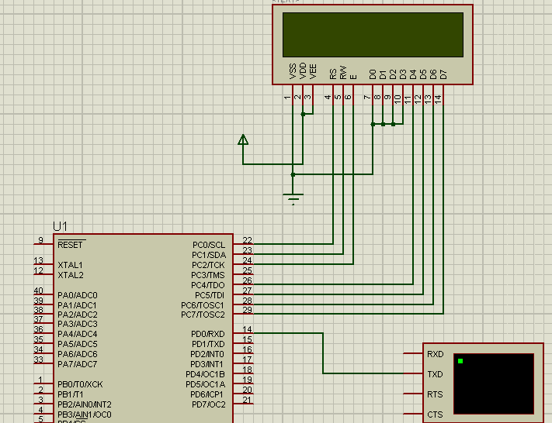
Proteus Drawing

Slide 46
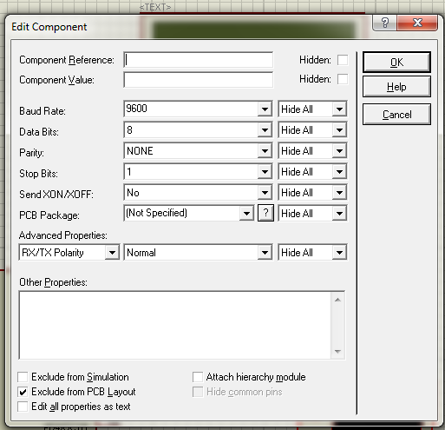
Settings in the Virtual Terminal

Slide 47
The Code
#include <mega32.h>
#include <delay.h>
#include <alcd.h>
#include <stdio.h>
char mychar;
bit i;
// Interrupt Serial Receive
interrupt [USART_RXC] void usart_rxc_isr(void)
{
mychar=getchar();
i=1;
}
void main(void)
{
DDRC=0xFF;
UCSRA=(0<<RXC) | (0<<TXC) | (0<<UDRE) | (0<<FE) | (0<<DOR) | (0<<UPE) | (0<<U2X) | (0<<MPCM);
UCSRB=(1<<RXCIE) | (0<<TXCIE) | (0<<UDRIE) | (1<<RXEN) | (0<<TXEN) | (0<<UCSZ2) | (0<<RXB8) | (0<<TXB8);
UCSRC=(1<<URSEL) | (0<<UMSEL) | (0<<UPM1) | (0<<UPM0) | (0<<USBS) | (1<<UCSZ1) | (1<<UCSZ0) | (0<<UCPOL);
UBRRH=0x00;
UBRRL=0x67;

Slide 48
Code (continued…)
# asm("sei"); //to enable Global Interrupt bit
lcd_init(16);
while (1)
{
if(i==1)
{
lcd_putchar(mychar);
i=0;
}
}
}

Slide 49
Thanks

