Slide 1
April-2018
ICT 5307 : Embedded System Design
Lecture 11
Serial Peripheral Interface (SPI) and Intra-Integrated Circuit (I2C) Data Transfer
S.M. Lutful Kabir
IICT, BUET

Slide 2
Project Presentation
Date : 16th August, 2018 (Thursday)
No class on 11th Aug, 2018 (Saturday)
Time: 5:15 PM
Power Point Presentation : total 5/7 minutes, each of the group members will present a part of the presentation.
Question/Answer – 2/3 minutes.
Bring your laptop with all software setup for your presentation.

Slide 3
What is SPI
SPI (Serial Peripheral Interface) is a bus interface connection incorporated into many devices such as ADC, DAC and EEPROM.
SPI bus was originally started by MOTOROLLA (now FreeScale), but in recent years has become widely used standard adapted by many semiconductor chip companies.
SPI devices has only four pins for data communication

Slide 4
Four pins for SPI
Among the four lines, two lines are for data transfer, called SDI (Din) and SDO (Dout).
SPI bus has the SCLK (shift clock) pin to synchronize the data transfer between two chips.
The last pin in SPI bus is CE (Chip Enable), which is used to initiate and terminate the data transfer.
These four pins SDI, SDO, SCLK and CE make SPI a 4-wire interface.

Slide 5
Connection Diagram
SDI
SDI
SDO
SDO
SCLK
SCLK
CE
CE
uC
Device

Slide 6
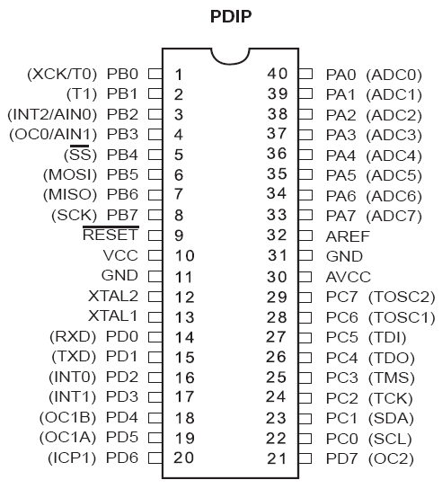
Like AVR, in many chips SDI, SDO, SCLK and SS are termed as MISO, MOSI, SCK and SS
AVR ATmega32

Slide 7
How SPI Works?
SPI consists of two shift registers, one in the master side and other in the slave side.
Also, there is a clock generator in the master side that generates clock for the shift registers.
The Clock works for the shift registers both in the master and slave devices.
The clock input to the shift registers can be falling- or rising-edge triggered.

Slide 8
SPI Architecture
DATA BUS
DATA BUS
SPI SHIFT REGISTER
MOSI
SPI SHIFT REGISTER
MISO
CLOCK GENERATOR
SCLK
SS
MASTER
SLAVE

Slide 9
Data Communication
In SPI, the shift registers are 8-bit long.
When Master wants to send a byte of data, it places the byte in its shift register and generates 8 clock pulses.
After 8 clock pulses the data is shifted to the shift register of the slave.
When Master wants to receive a data, the Slave should place the data on its shift register and after 8 pulses, the Master will receive the data in its shift register

Slide 10
SPI Read and Write
In connecting a device having SPI interface with a microcontroller, we use microcontroller as Master while the SPI device as Slave
This means that microcontroller generates the clock at the SCLK pin of the microcontroller which is fed to Slave through its SCLK pin.
During the transfer CE must remain low.
The information (Address and Data) is transferred between SPI devices in a group of 8 bits., where address byte is followed immediately by the data byte.

Slide 11
SPI Read and Write…..
To distinguish between Read and Write, D7 of the address byte is used. If D7=1, it is for write and if D7=0, it is for read.
In SPI communication, the master and the slave must agree on CPOL(Clock Polarity) and CPHA (Clock Phase).

Slide 12
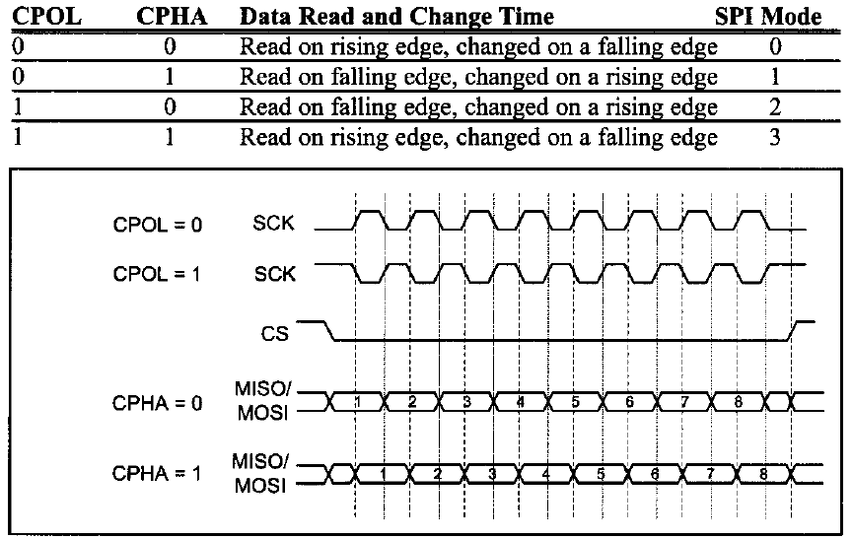
SPI Clock Polarity and Phase

Slide 13
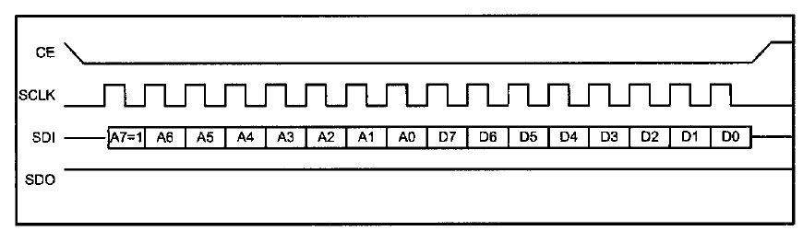
Single byte write
Make CE=0 to begin writing.
8-bit address is shifted in, one bit at a time, with each edge of SCLK. Notice that A7=1 for write operation.
Then 8-bit data is shifted in one bit at a time, with each edge of SCLK.
Make CE=1 to indicate the end of the write cycle

Slide 14
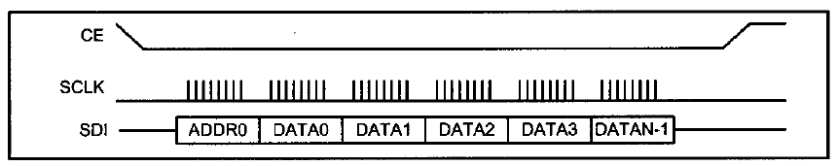
Multibyte burst write
Make CE=0 to begin writing.
8-bit address is shifted in, one bit at a time, with each edge of SCLK. [ A7=1 for write operation].
Then 8-bit data of the first location is provided and shifted in one bit at a time, with each edge of SCLK.
From then on, we simply provide the consecutive bytes of data to be placed in the consecutive memory locations.
In the process CE must stay low.
Make CE=1 to indicate the end of the write cycle

Slide 15
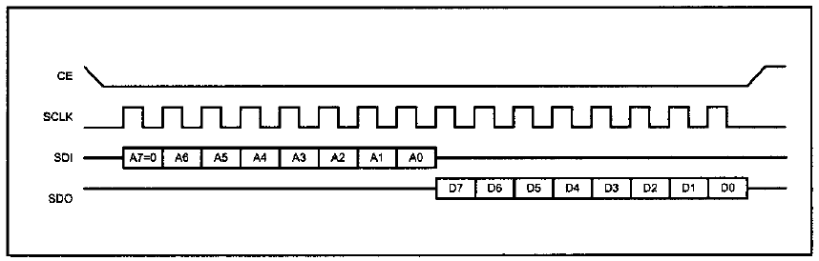
Single byte read
Make CE=0 to begin reading.
8-bit address is shifted in, one bit at a time, with each edge of SCLK Notice that A7=0 for read operation.
Then 8-bit data is shifted out one bit at a time, with each edge of SCLK.
Make CE=1 to indicate the end of the read cycle

Slide 16
Multibyte burst read
Make CE=0 to begin reading.
8-bit address is shifted in, one bit at a time, with each edge of SCLK Notice that A7=0 for read operation.
Then 8-bit data of the first location is provided and shifted out one bit at a time, with each edge of SCLK. From then on, we simply keep getting consecutive bytes of data belonging to the consecutive memory locations. In the process CE must stay low.
Make CE=1 to indicate the end of the read cycle

Slide 17
AVR Programming in AVR
Most AVRs, including ATmega family members, supports SPI protocol.
In AVR, three registers are associated with SPI.
They are SPSR (SPI Status Register), SPCR (SPI Control Register) and SPDR (SPI Data Register).

Slide 18
SPSR Register
SPIF
WCOL
-
-
-
-
-
SPI2X
SPIF ( SPI Interrupt flag)
In master mode, this bit is set in two situations: when a serial transfer is completed, or when SS pin is an input pin and is driven low by an external device.
Setting the SPIF flag will cause an interrupt if SPIE in SPCR is set and global interrupt is enabled.
WCOL (Write COLlition flag)
The WCOL bit is set if you write on SPDR during a data transfer.
SPI2X(Double SPI Speed)
When the SPI is in master mode, setting this bit to one doubles the SPI speed.

Slide 19
SPCR Register
SPIE
SPE
DORD
MSRT
CPOL
CPHA
SPR1
SPR0
SPIE ( SPI Interrupt Enable)
Setting this bit to one enables the SPI Interrupt.
SPE (SPI Enable)
Setting this bit one enables the SPI.
DORD(Data Order)
This bit let you choose to either transmit MSB and then LSB or vice versa. LSB is transmitted first if DORD is one; MSB is transmitted first if DORD is zero.
MSRT (Master/Slave Select)
If you want to work in Master Mode, then set this bit to one; otherwise Slave Mode is selected.

Slide 20
SPCR Register (Continued….)
SPIE
SPE
DORD
MSRT
CPOL
CPHA
SPR1
SPR0
CPOL (Clock polarity)
CPHA (Clock Phase)
SPR1 and SPR0 (SPI Clock rate selection)
SPR1 SPR0 Clock
0 0 Fclock/4
0 1 Fclock/16
1 0 Fclock/64
1 1 Fclock/128
As discussed earlier

Slide 21
SPI Data Register
MSB
LSB
The SPI Data Register is a Read/Write Register.
To write data into SPI Shift Register, data must be written in SPDR Register.
To read from SPI Shift Register you must read from SPDR register.
Writing to SPDR register starts data transmission.
Notice that you can not write SPSR register before the last byte is transmitted completely, otherwise a collision will happen.
You can read the received data before another byte is received completely.

Slide 22
SPI Programming in AVR
Before you start data transmission, you should set SPI Mode (Clock Polarity and Clock Phase) by setting the values of the CPOL and CPHA bits in SPCR
In AVR you can operate in either master or slave modes.
CPOL | CPHA | Mode
0 | 0 | 0
0 | 1 | 1
1 | 0 | 2
1 | 1 | 3

Slide 23
Master Operating Mode
You should set MSTR bit of SPCR to one before you start data transmission.
Also you should set SCK by setting the values of SPR1 and SPR0 along with SPI2x.
And then you should set SPE bit to one before you start data transmission.
Writing a byte to the SPI Data Register (SPDR) starts data exchange by starting the SPI clock generator.

Slide 24
Master Operating Mode
After shifting the last (8th) bit, the SPI clock generator stops and the SPIF flag changes to one.
The byte in the master shift register and the byte in slave shift register are exchanged after the last clock.
SPIF is monitored by the microcontroller itself to know when a byte is exchanged. If it is found to high program control automatically goes to the specific ISR corresponding to SPI.

Slide 25
Master Operating Mode
As we mentioned before, in case of multibyte burst write, the master continues to shift the next byte by writing it into SPDR register.
If you want to signal end of the packet, you should pull high the SS pin.
When AVR is configured as a master, the SPI will not control the SS pin.
If you want to make SS pin high or low, you have to do it by writing 1 or 0 respectively to SS bit of Port B.

Slide 26
Slave Operating Mode
When AVR is operating as a slave, the function of SPI interface depends on the SS pin.
When SS is driven high, the SPI interface sleeps.
Only the contents of SPDR may be updated, in this state.
When SS is driven low, the data will be shifted by the incoming clock pulses on the SCK pin.
SPIF changes to one, when the last bit of a byte has been shifted completely.

Slide 27
Slave Operating Mode
In slave mode, you need not to set SCK frequency because SCK is generated by the master.
But you must select the SPI mode (Clock polarity and Clock Phase) and Data Order of the other side (master device).
Finally you should enable SPI by setting SPE bit of SPCR register.

Slide 28
I²C Communication
The I2C bus is a very popular and powerful bus used for communication between a master (or multiple masters) and a single or multiple slave devices.
Figure on the next slide illustrates how many different peripherals may share a bus.
A number of peripherals can be connected to a processor through only 2 wires.
This is one of the largest benefits that the I2C bus can give when compared to other interfaces.

Slide 29
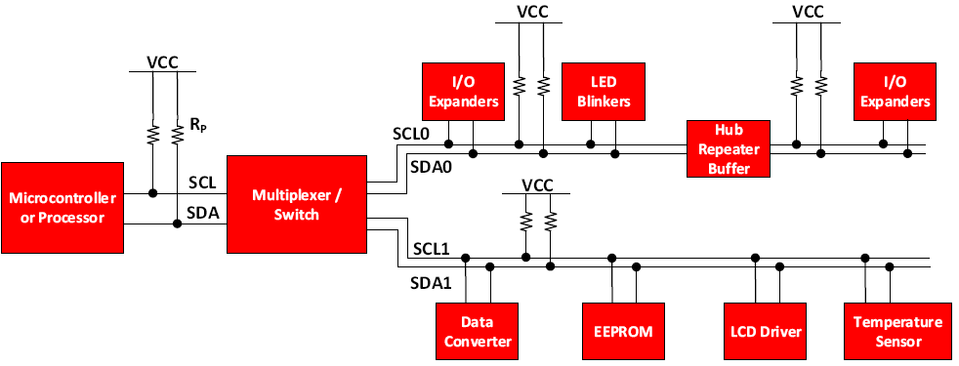
A Number of Devices Connected….

Slide 30
AVR ATmega32

Slide 31
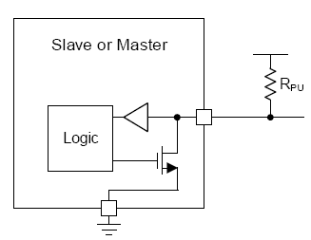
Basic Internal Structure of SDA/SCL line
I2C uses an open-drain/open-collector with an input buffer on the same line.
It allows a single data line to be used for bidirectional data flow.
Open-drain refer to a type of output which can
either pull the bus down to a voltage (ground, in most of cases),
or “release” the bus and let it be pulled up by a pull-up resistor.

Slide 32
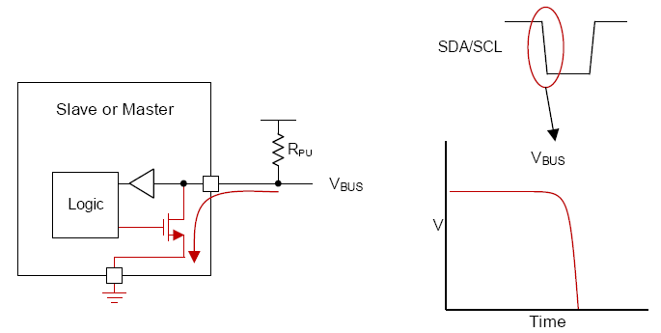
Pulling the bus low with an open-drain interface

Slide 33
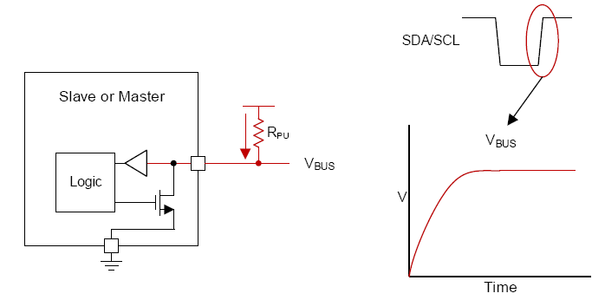
Releasing the bus with an open drain interface

Slide 34
General I²C Operation
The I²C bus is a standard bidirectional interface that uses a controller, known as master, to communicate with the slave devices.
A slave may not transmit data unless it has been addressed by the master.
Each device on the I²C bus has a specific address to differentiate between other devices that are on the same I²C bus.
A device can have one or multiple registers where data is stored, written or read.

Slide 35
General I²C Operation (continued……)
The physical I²C interface consists of the serial clock (SCL) and serial data (SDA) lines.
Data transfer may be initiated only when the bus is idle.
A bus is considered idle if both SDA and SCL lines are high after a STOP condition.

Slide 36
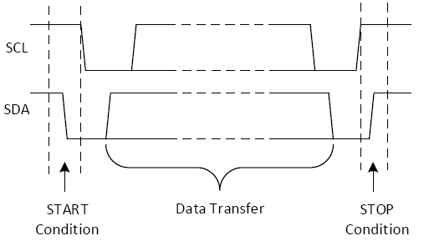
START and STOP Conditions
I2C communication is initiated by the master sending a START condition and terminated by the master sending a STOP condition.
A high-to-low transition on the SDA line while the SCL line is high defines a START condition.
A low-to-high transition on the SDA line while the SCL line is high defines a STOP condition.

Slide 37
Repeated Start Condition
A repeated START condition is similar to a START condition
But it differs from a START condition because it happens before a STOP condition (when the bus is not idle).
This is useful when the master wishes to start a new communication, but does not wish to let the bus go idle with the STOP condition.
Because if it does so, it has the chance of the master losing the control of the bus to another master (in multi-master environments)

Slide 38
Data Validity and Byte Format
One data bit is transferred during each clock pulse of the SCL line.
The byte may be either device address, register address, or data written to or read from a slave.
Data is transferred Most Significant Bit (MSB) first.
A number of data bytes can be transferred from the master to slave between the START and STOP conditions.
Data on SDA line must remain stable during high phase of the clock period, as changes in line data when the SCL high are interpreted as control command (START or STOP).

Slide 39
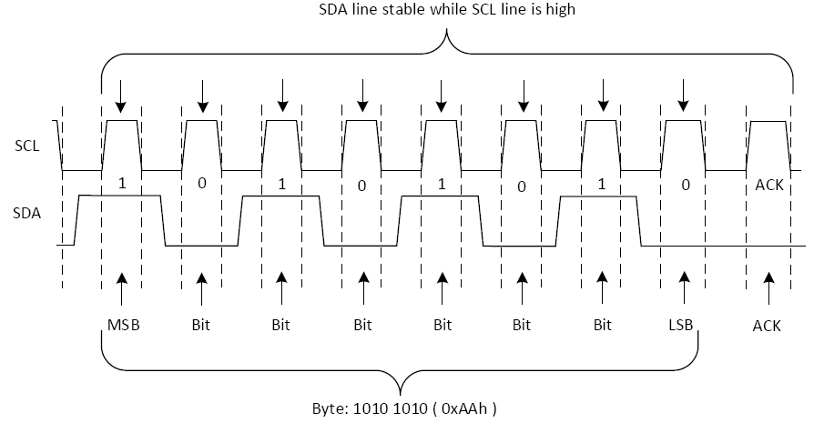
Example of a Single Byte Data Transfer

Slide 40
Acknowledge and Not Acknowledge Bit
Each byte of data (including address byte) is followed by one ACK bit from the receiver.
The ACK bit allows the receiver to communicate to the transmitter that the byte was successfully received and another byte may be sent.
Before the receiver can send an ACK, the transmitter must release the SDA line.
To send ACK bit, the receiver shall pull down the SDA line during the low phase of ACK/NACK –related clock period (period 9) so that the SDA line is stable low during high phase of the ACK/NACK-related clock period.
When the SDA line remains high during the ACK/NACK-related clock period, this is interpreted as NACK.

Slide 41
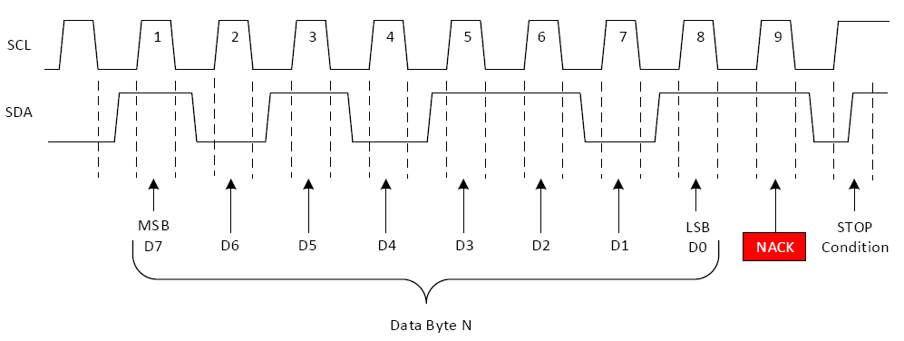
Example NAK Waveform

Slide 42
Address and Data together
The FIRST transmission is the address of the device with a write signal.
The SECOND transmission is the address of the memory location within the device in which the data should be written or from which data should be read.
If the master wants to write data into the memory location (indicated), it will send the data (to be written) in the THIRD transmission.
But if the master wants to read the data from the memory location (indicated) it will send REPEATED START signal and in the THIRD transmission send address of the device again with a read signal.
The slave will sends the data in FORTH transmission

Slide 43
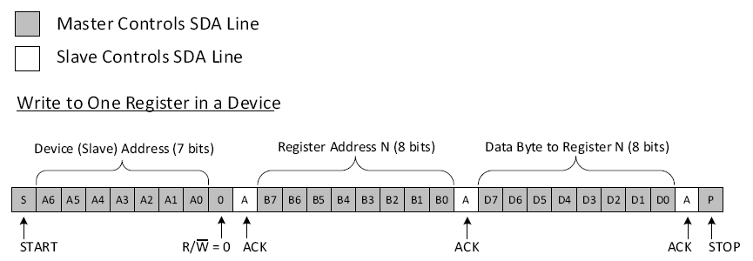
Example I2C Write to Slave Device’s Address

Slide 44
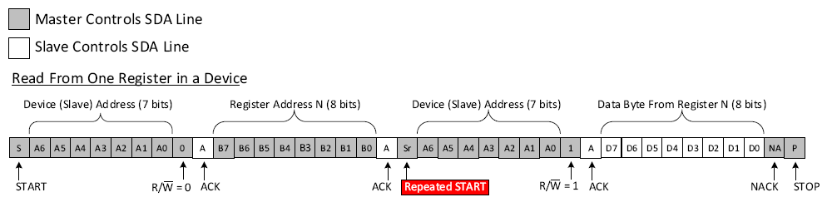
Example I2C Read from Slave Device’s Address

Slide 45
Thanks

