Slide 1
April-2017
ICT5301: Embedded System Design
Lecture 7
Timer-Part1
S.M. Lutful Kabir
Professor, IICT, BUET

Slide 2
Timer/ Counter: Basic Concept
There are counter registers in microcontrollers for counting events or measuring time.
When we want to count an event, we connect the external event source to the clock pin of the counter register.
Then when an event occurs externally, the content of the counter increments; in this way the content of the counter represents how many times an event has occurred.

Slide 3
Timer/ Counter: Basic Concept
When we want to measure time, we connect the oscillator to the clock pin of the counter
So, when the oscillator ticks, the content of the counter increases and since we know the time period of the clock so from the content of the counter we can measure how much time has been elapsed.

Slide 4
Block Diagrammatic Representation
Clock of the Counter Register
Oscillator
Counter Register
External Source
Registers involved
Flag
Counter/ Timer
TCNTx
OCRx
TIMSK
TIFR

Slide 5
NORMAL MODE : Value Increases in TCNT0 Register at Every Pulse and Resets When it Overflows
Value increases in TCNT0 Register
TOV0 flag is set
Max^{m} value, 255
Your Set Value in OCR0
Pulses
OCF0 flag is set
255
3
WGM00:WGM01 = 00
COM01:COM00 = 00
2
1
0
0

Slide 6
To measure time
One of the ways to generate a time delay is to first clear the counter register and wait until the counter reaches a certain number.
For example, the oscillator frequency of a microcontroller is 1 MHz. It means that every clock is of 1 uSec width.
In other words, the content of the counter register increments at every 1 uSec.
If we want to measure 100 uSec then we have to clear the counter register and make the timer ON and wait until the register reaches 100.

Slide 7
Another method of time measurement
In microcontrollers, there is a flag for each of the counters.
The flag is set when the register overflows.
The second method of generating time delay is to counter register with an appropriate value and wait until the counter register overflows and the flag is set.
For example, if we want to make 3uS delay with a 1 MHz microcontroller we have to load the register with 253.
With first tick, it will become 254, with the second tick, 255 and with the third tick, the register will overflow and the flag will be set.

Slide 8
Timers in ATmega32
Different microcontrollers have different numbers of timers.
In ATmega32, there are three timers, namely Timer0, Timer1 and Timer2
Timer0 and Timer2 are 8-bit timers while Timer1 is a 16-bit timer.

Slide 9
Programming the timer
In AVR, for each of the Timers, there is a counter register called TCNTn (Timer/CouNTer). That is, in ATmega32, there are TCNT0, TCNT1 and TCNT2 registers.
Upon reset TCNTn registers contains zero.
It counts up with each pulse (external or internal)
You can write values to TCNTn registers or you can also read them.

Slide 10
Programming the Timers
Each timer/counter has a Timer OVerflow Flag called TOVn.
When a Timer/Counter overflows, TOVn flag is set.
Each Timer/Counter has also Timer/Counter Control Register called TCCRn for setting modes of operation.
For example, you can specify Timer0 to work as TIMER or COUNTER by loading proper values in TCCR0 register.

Slide 11
Programming the Timer
Each timer has also OCRn (Output Compare Register) and OCFn (Output Compare Flag) in TCCRn register.
The content of TCNTn register is compared with OCRn register, when they are equal OCF flag is set.
Let us say TCNT0 register is cleared (set zero). And OCR0 register is loaded with 100.
If the timer is started, TCNT0 register will start increasing.
When TCNT0 register becomes equal to OCR0 register, OCF0 flag is set.

Slide 12
Timer0 Programming
TCCR0 Register
FOC0
WGM00
COM01
COM00
WGM01
CS02
CS01
CS00
FOC0 – Bit 7 – Force Compare Match. This is a write only bit, writing 1 to it causes to act as if a compare match has occurred.
WGM00, WGM01 – Bit 6 and 3 – Mode Selector
0 0 – Normal
0 1 – CTC (Clear Timer on Compare Match)
1 0 – PWM, Phase Correct
1 1 – Fast PWM

Slide 13
Timer0 Programming (Contd.)
TCCR0 Register
FOC0
WGM00
COM01
COM00
WGM01
CS02
CS01
CS00
COM 01:00 – Bit 5 and 4
Compare output mode This mode controls the waveform generator (will be discussed in another lecture)
CS02:00 – Bit 2, 1 and 0 – Timer clock selector
(see the next slide)

Slide 14
Block Diagram for Timer0
CLk_{I/O}
STOP
0
CLK
1
WGM01
WGM00
CLK/8
2
CLK/64
3
PRESCALER
CLK/256
MUX
CONTROL UNIT
4
CLK/1024
5
Falling Edge
EDGE DETECTOR
6
Rising Edge
COUNT
UP/ DOWN
CLEAR
7
0
OCR0
2
1
TCNT0
TOV0
COMPARATOR =
T0
CS00
CS01
CS02
OCF0

Slide 15
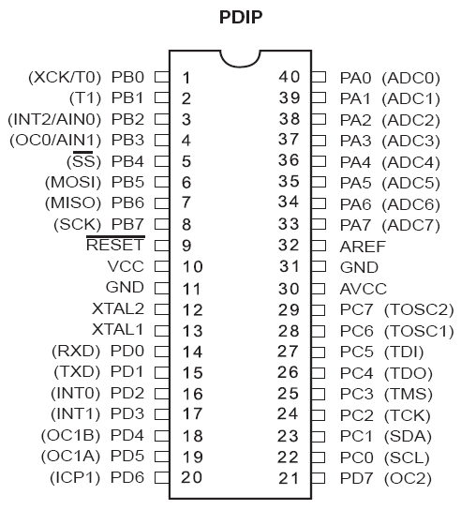
T0/T1 Pins
For Timer0
For Timer1

Slide 16
Timer0 Clock Selector (CS02 : 00)
D2 D1 D0
0 0 0 - No clock source (Timer/ Counter Stopped)
0 0 1 - Clock (No Prescaling)
0 1 0 - Clock/8
0 1 1 - Clock/64
1 0 0 - Clock/256
1 0 1- Clock/1024
1 1 0 - Ext. Clk on T0 pin, Clk on Falling Edge
1 1 1 - Ext. Clk on T0 pin, Clk on Rising Edge

Slide 17
TIFR (Timer/Counter) Interrupt Flag Register
TIFR Register
OCF2
TOV2
ICF1
OCF1A
OCF1B
TOV1
OCF0
TOV0
Timer 2
Timer 1
Timer 0
TOV0 Timer0 flag bit; 0- did not overflow, 1-has overflowed (FF->00)
OCF0 Timer0 output compare flag bit; 0-did nor match, 1-matched
TOV1 Timer1 flag bit;
OCF1B Timer 1 output compare B match flag
OCF1A Timer 1 output compare A match flag
ICF1 Input Capture flag
TOV2 Timer2 flag bit
OCF2 Timer2 output compare flag bit

Slide 18
An exercise on generation of time delay
Let us assume that it is required to generate a square wave having 20 mS time period and 50% duty cycle.
Since time period is 20 mS so half of the time period is 10 mS.
In a output pin if we can send high for 10 mS and low for next 10mS and repeat it, the output will be a square of 20 mS (TP).
We shall send a high in a pin say PC.0 and start Timer0 of ATmega32.
As soon as the time counting of 10 mS is finished we shall toggle the same pin.
And start the timer again and do the same repeatedly.
Now the question is how to generate 10 mS time interval.

Slide 19
An exercise on generation of time delay (contd.)
Now to measure 10 mS accurately, we have to choose a slower clock (in the order of kHz).
Let us choose a prescaler of 1024.
Hence clock frequency will be 16MHz/1024 or 15.625 kHz.
So the time period of the clock pulse will be (1/15.625) mS or 0.067 mS.
So to measure 10 mS we need 10 ms/0.064 mS or 156 number of clock pulse.
That means if we load TCNT0 with 0 and Compare register, OCR0=156, after 156 number of clock pulses OCF0 flag will be raised.
Then the flag bit will be monitored by the uC. When it is found to be set program will go to its ISR.
In the ISR. we shall write code to toggle the output pin.

Slide 20
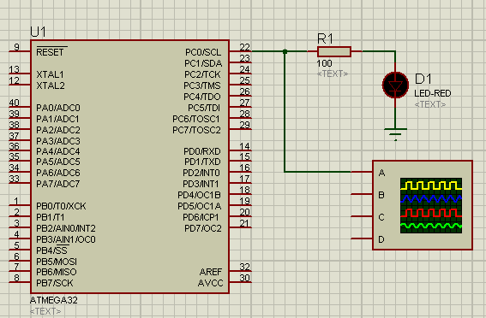
Simulation Setup

Slide 21
Timer0 in Output Compare mode
#include <mega32.h>
// Timer 0 output compare interrupt service routine
interrupt [TIM0_COMP] void timer0_comp_isr(void)
{
PORTC.0=~PORTC.0;
TCNT0=0;
}
void main(void)
{
TCCR0=(0<<WGM00) | (0<<COM01) | (0<<COM00) | (0<<WGM01) | (1<<CS02) | (0<<CS01) | (1<<CS00);
TCNT0=0;
OCR0=156;
TIMSK=(0<<OCIE2) | (0<<TOIE2) | (0<<TICIE1) | (0<<OCIE1A) | (0<<OCIE1B) | (0<<TOIE1) | (1<<OCIE0) | (0<<TOIE0);
// Global enable interrupts
#asm("sei")
PORTC.0=0;
while (1)
{
}

Slide 22
Timer1 Programming
Timer1 is a 16-bit timer and has lots of capabilities.
It is split into two bytes. These are referred to TCNT1L and TCNT1H.
Timer1 has two control registers, namely TCCR1A (8-bit) and TCCR1B (8-bit).
TOV1 flag bit goes high when overflow occurs.
There are two OCR registers, namely OCR1A(16-bit) and OCR1B(16-bit).
There are two separate flags for each of two OCR registers, which acts independently. The figure in the next slide explains how they work.

Slide 23
Comparisons and Overflow in Timer1
Ref. Reg. B
OCR1BH OCR1BL
=
OCF1B
flag
Timer Reg.
TCNT1H TCNT1L
flag
TOV1
=
OCF1A
flag
Ref. Reg. A
OCR1AH OCR1AL

Slide 24
TIFR (Timer/Counter) Interrupt Flag Register
TIFR Register
OCF2
TOV2
ICF1
OCF1A
OCF1B
TOV1
OCF0
TOV0
Timer 1
TOV1 Timer1 overflow flag bit;
OCF1B Timer 1 output compare B match flag
OCF1A Timer 1 output compare A match flag
ICF1 Input Capture flag

Slide 25
TIMSK (Timer/Counter) Interrupt Enable Register
TIMSK Register
OCIE2
TOIE2
TICIE1
OCIE1A
OCIE1B
TOIE1
OCIE0
TOIE0
Timer 1
TOIE1 Timer1 overflow ENABLE bit;
OCIE1B Timer 1 output compare B match ENABLE
OCIE1A Timer 1 output compare A match ENABLE
TICIE1 Input Capture ENABLE

Slide 26
TCCR1A & TCCR1B (Timer Counter Control Registers)
TCCR1A Register
COM1A1
COM1A0
COM1B1
COM1B0
FOC1A1
FOC1B1
WGM11B1
WGM10B1
TCCR1B Register
ICNC1
ICES1
-
WGM13
WGM121
CS12
CS11
CS10
FOC1A, FOC1B – Related to force compare
ICNC1, ICES1 – Related to Input Capture
COM1A1, COM1A0, COM1B1, COM1B0
– Related to Waveform Generation
WGM13, WGM12, WGM11, WGM10 – Mode Selection
CS12, CS11, CS10 – Clock Selection

Slide 27
Block Diagram for Timer1
CLk_{I/O}
STOP
0
CLK
1
CLK/8
2
CLK/64
3
PRESCALER
CLK/256
MUX
4
CLK/1024
5
Falling Edge
EDGE DETECTOR
6
Rising Edge
7
1
0
2
T1
CS10
CS11
CS12

Slide 28
An Exercise
Write a program to toggle only the PORTB.5 bit continuously every second. Use timer 1, Normal mode, and 1:256 prescaler to create the delay. Assume XTAL=8 MHz.
Solution:
Prescaler=1:256 → f_{timer}=(8/256) MHz
T_{timer} = 256/8 uS = 32 uS
So, number of clock necessary to make a delay of 1sec is (1s/32uS)=31250
Therefore, the number to be loaded in the timer register is (65535-31250+1)=34286=0x85EE
So, TCNT1L=0xEE and TCNT1H=0x85

Slide 29
The Program Using Timer1
#include ….
interrupt [TIM1_OVF] void timer1_ovf_isr (void)
{
PORTB.5=~PORTB.5;
TCNT1L=0XEE;
TCNT1H=0X85;
TCCR1A=0x00;
TCCR1B=0x04;
}
void main(void)
{
TCNT1L=0XEE;
TCNT1H=0X85;
TCCR1A=0x00;
TCCR1B=0x04;
TIMSK=0x04;
DDRB.5=1;
while (1) {
}
}

Slide 30
Thanks

