Slide 1
April 2018 ICT5307 : Embedded System Design
Lecture 8
Timer 1 and Timer2
S.M. Lutful Kabir
Professor, IICT, BUET

Slide 2
Timer1 Programming
Timer1 is a 16-bit timer and has lots of capabilities.
It is split into two bytes. These are referred to TCNT1L and TCNT1H.
Timer1 has two control registers, namely TCCR1A (8-bit) and TCCR1B (8-bit).
TOV1 flag bit goes high when overflow occurs.
There are two OCR registers, namely OCR1A(16-bit) and OCR1B(16-bit).
There are two separate flags for each of two OCR registers, which acts independently. The figure in the next slide explains how they work.

Slide 3
Comparisons and Overflow in Timer1
Ref. Reg. B
OCR1BH OCR1BL
=
OCF1B
flag
Timer Reg.
TCNT1H TCNT1L
flag
TOV1
=
OCF1A
flag
Ref. Reg. A
OCR1AH OCR1AL

Slide 4
TIFR (Timer/Counter) Interrupt Flag Register
TIFR Register
OCF2
TOV2
ICF1
OCF1A
OCF1B
TOV1
OCF0
TOV0
Timer 1
TOV1 Timer1 overflow flag bit;
OCF1B Timer 1 output compare B match flag
OCF1A Timer 1 output compare A match flag
ICF1 Input Capture flag

Slide 5
TIMSK (Timer/Counter) Interrupt Enable Register
TIMSK Register
OCIE2
TOIE2
TICIE1
OCIE1A
OCIE1B
TOIE1
OCIE0
TOIE0
Timer 1
TOIE1 Timer1 overflow ENABLE bit;
OCIE1B Timer 1 output compare B match ENABLE
OCIE1A Timer 1 output compare A match ENABLE
TICIE1 Input Capture ENABLE

Slide 6
TCCR1A & TCCR1B (Timer Counter Control Registers)
TCCR1A Register
COM1A1
COM1A0
COM1B1
COM1B0
FOC1A1
FOC1B1
WGM11B1
WGM10B1
TCCR1B Register
ICNC1
ICES1
-
WGM13
WGM121
CS12
CS11
CS10
FOC1A, FOC1B – Related to force compare
ICNC1, ICES1 – Related to Input Capture
COM1A1, COM1A0, COM1B1, COM1B0
– Related to Waveform Generation
WGM13, WGM12, WGM11, WGM10 – Mode Selection
CS12, CS11, CS10 – Clock Selection

Slide 7
Block Diagram for Timer1
CLk_{I/O}
STOP
0
CLK
1
CLK/8
2
CLK/64
3
PRESCALER
CLK/256
MUX
4
CLK/1024
5
Falling Edge
EDGE DETECTOR
6
Rising Edge
7
1
0
2
T1
CS10
CS11
CS12

Slide 8
An Exercise
Write a program to toggle only the PORTB.5 bit continuously every second. Use timer 1, Normal mode, and 1:256 prescaler to create the delay. Assume XTAL=8 MHz.
Solution:
Prescaler=1:256 → f_{timer}=(8/256) MHz
T_{timer} = 256/8 uS = 32 uS
So, number of clock necessary to make a delay of 1sec is (1s/32uS)=31250
Therefore, the number to be loaded in the timer register is (65535-31250+1)=34286=0x85EE
So, TCNT1L=0xEE and TCNT1H=0x85

Slide 9
The Program Using Timer1
#include ….
interrupt [TIM1_OVF] void timer1_ovf_isr (void)
{
PORTB.5=~PORTB.5;
TCNT1L=0XEE;
TCNT1H=0X85;
TCCR1A=0x00;
TCCR1B=0x04;
}
void main(void)
{
TCNT1L=0XEE;
TCNT1H=0X85;
TCCR1A=0x00;
TCCR1B=0x04;
TIMSK=0x04;
DDRB.5=1;
while (1) {
}
}

Slide 10
Timer2
Time2 is very similar to Timer0 as this is also a 8-bit Timer.
The only difference is that Timer2 cannot be used as Counter [i.e. for counting external event].
Rather, it can count the pulses of external clock.
The external clock has to be connected to specific two pins of the microcontroller.
The frequency of the external clock is set as such a value that making real time clock is facilitated.
And the frequency of the crystal has to be 32.768 kHz.

Slide 11
Registers Related to Timer2
TCNT2 register - the number of pulse Timer2 counts
bit7
bit6
bit5
bit4
bit3
bit2
bit1
bit0
OCR2 register - the value with which the comparison is made
bit7
bit7
bit6
bit5
bit4
bit3
bit2
bit1
bit0
TIMSK register – all INTERRUPT ENABLE BITS (all Timers)
OCIE2
TOIE2
TICIE1
OCIE1A
OCIE1B
TOIE1
OCIE0
TOIE0
TIFR registers - all INTERRUPT FLAGS (all Timers)
OCF2
TOV2
ICF1
OCF1A
OCF1B
TOV1
OCF0
TOV0

Slide 12
TIFR (Timer/Counter) Interrupt Flag Register
TIFR Register
OCF2
TOV2
ICF1
OCF1A
OCF1B
TOV1
OCF0
TOV0
Timer 2
TOV2 Timer2 flag bit
OCF2 Timer2 output compare flag bit

Slide 13
TIMSK Register
OCIE2
TOIE2
TICIE1
OCIE1A
OCIE1B
TOIE1
OCIE0
TOIE0
Timer 2
TOIE2 Timer2 Overflow interrupt Enable
OCIE2 Timer2 output compare Interrupt Enable

Slide 14
Real Time Clock using Timer2
Timer2 can be connected to real time counter. For that, we should connect a crystal of 32.768 kHz to TOSC1 and TOSC2 terminals and set AS2 bit of ASSR register.
Timer2 can NOT be used as counter of external events. Rather all setting of CS22:CS20 (3bits of TCCR2 register) are for internal frequency select. Of course the meaning of some of the combinations have different meaning than that of Timer0.

Slide 15
Block Diagram for Timer2
STOP
0
CLK
1
WGM21
WGM20
CLK/8
2
CLK/32
3
CLK/64
CONTROL UNIT
PRESCALER
MUX
4
CLK/128
5
CLK/256
6
CLK/1024
COUNT
UP/ DOWN
CLEAR
7
0
OCR2
2
1
TCNT2
CLK
AS2
TOV2
COMPARATOR =
CS21
CS20
T/C Oscillator
CS22
CLK_{I/O}
OCF2
TOSC1
TOSC2

Slide 16
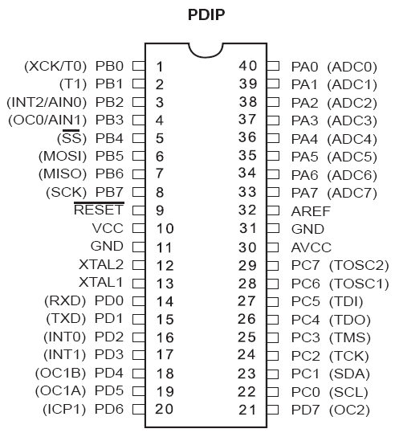
TOSC1 & TOSC2 Pins

Slide 17
Timer2 Programming
TCCR2 Register
FOC2
WGM20
COM21
COM20
WGM21
CS22
CS21
CS20
FOC2 – Bit 7 – Force Compare Match. This is a write only bit, writing 1 to it causes to act as if a compare match has occurred.
WGM20, WGM21 – Bit 6 and 3 – Mode Selector
0 0 – Normal
0 1 – CTC (Clear Timer on Compare Match)
1 0 – PWM, Phase Correct
1 1 – Fast PWM

Slide 18
Timer2 Programming (Contd.)
TCCR2 Register
FOC2
WGM20
COM21
COM20
WGM21
CS22
CS21
CS20
COM 21:20 – Bit 5 and 4
Compare output mode This mode controls the waveform generator (will be discussed in another lecture)
CS22:20 – Bit 2, 1 and 0 – Timer clock selector
(see the next slide)

Slide 19
TIFR (Timer/Counter) Interrupt Flag Register
TIFR Register
OCF2
TOV2
ICF1
OCF1A
OCF1B
TOV1
OCF0
TOV0
Timer 2
TOV2 Timer2 Overflow flag bit
OCF2 Timer2 output compare flag bit

Slide 20
ASSR (Asynchronous Status Register)
ASSR Register
AS2
TCN2UB
OCR2UB
TCR2UB
AS2 – When it is zero, Timer2 is clocked from CLK_{I/O},
When it is set Timer2 works as RTC

Slide 21
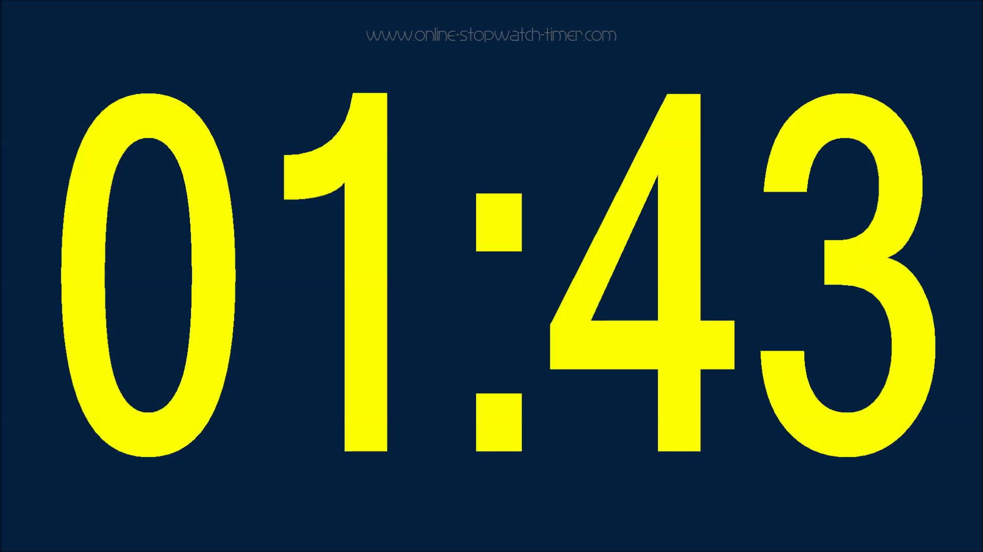
A simulation of a stop watch
Let us develop a stopwatch using Timer2
At the beginning it will display 00.00
When the control button is pressed once, the stopwatch will start
On second press it will stop
On third press it will reset to 00.00
On fourth press it will start again and so on
minutes
seconds
Start/Stop/Reset

Slide 22
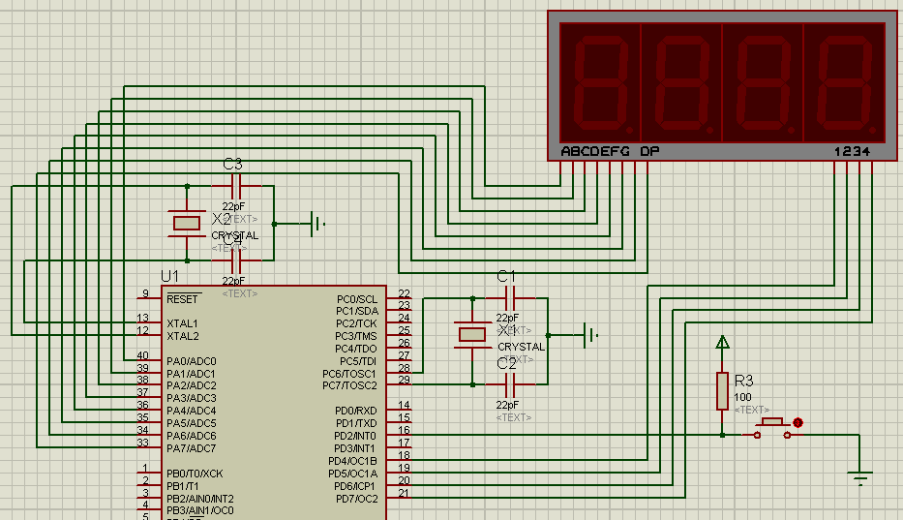
The Circuit for a Stopwatch

Slide 23
Connection of the Port Pins
digit1
digit2
digit3
digit4
Values for digits
(without decimal)
0 – 3E h
1 – 06 h
2 – 5B h
3 – 4F h
4 – 66 h
5 – 6D h
6 – 7D h
7 – 07 h
8 – 7F h
9 – 6F h
To enable a certain digit you have to send ‘0’ in the corresponding control pin and ‘1’ in other pins
0 1 2 3 4 5 6 7
Port A
4 5 6 7
Port D
Control Values
0111 – 7 h
1011 – B h
1101 – D h
1110 – E h
data bits
7 6 5 4 3 2 1 0
data bits
7 6 5 4 3 2 1 0
Out
X

Slide 24
Header files and variable declaration
#include <mega32.h>
#include <delay.h>
int second=0;
int minute=0;
int second0=0;
int second1=0;
int minute0=0;
int minute1=0;
Int press=0;
int digit_cathod[10]={0X3F,0x06,0x5B,0x4F,0x66,0x6D,0x7D,0x07,0x7F,0x6F};
int digit_cathod_decimal[10]={0XBF,0x86,0xDB,0xCF,0xE6,0xED,0xFD,0x87,0xFF,0xEF};

Slide 25
Separation of 2 digits for minute and 2 digits for second
void separated_digits(void)
{
second1=second/10;
second0=second%10;
minute1=minute/10;
minute0=minute%10;
}

Slide 26
Displaying the separated digits
void display_digits(void)
{
PORTD=0x7F;
PORTA=digit_cathod[second0];
delay_ms(1);
PORTD=0xBF;
PORTA=digit_cathod[second1];
delay_ms(1);
PORTD=0xDF;
PORTA=digit_cathod_decimal[minute0];
delay_ms(1);
PORTD=0xEF;
PORTA=digit_cathod[minute1];
delay_ms(1);
}

Slide 27
Int0 ISR (for resetting/starting stopwatch)
interrupt [EXT_INT0] void ext_int0_isr(void)
{
press++;
if (press==4)
press=1;
if (press==3)
{
second=0;
minute=0;
separated_digits();
}
}

Slide 28
Timer2 output compare interrupt service routine
interrupt [TIM2_COMP] void timer2_comp_isr(void)
{
TCNT2=0;
if (press==1)
{
second++;
if (second>59)
{
second=0;
minute++;
if (minute>59)
minute=0;
}
separated_digits();
}
}

Slide 29
Settings for Timer2
// Timer/Counter 2 initialization
// Clock source: TOSC1 pin
// Clock value: PCK2/1024
// Mode: Normal top=0xFF
// OC2 output: Disconnected
ASSR=1<<AS2;
TCCR2=(0<<PWM2) | (0<<COM21) | (0<<COM20) | (0<<CTC2) | (1<<CS22) | (1<<CS21) | (1<<CS20);
TCNT2=0x00;
OCR2=0x20;
// Timer(s)/Counter(s) Interrupt(s) initialization
TIMSK=(1<<OCIE2) | (0<<TOIE2) | (0<<TICIE1) | (0<<OCIE1A) | (0<<OCIE1B) | (0<<TOIE1) | (0<<OCIE0) | (0<<TOIE0);

Slide 30
Setting for the Interrupt, Global Interrupt and DDRx decleration
// External Interrupt(s) initialization
// INT0: On
// INT0 Mode: Falling Edge
// INT1: On
// INT1 Mode: Falling Edge
// INT2: On
// INT2 Mode: Falling Edge
GICR|=(0<<INT1) | (1<<INT0) | (0<<INT2);
MCUCR=(0<<ISC11) | (0<<ISC10) | (1<<ISC01) | (0<<ISC00);
MCUCSR=(0<<ISC2);
GIFR=(0<<INTF1) | (1<<INTF0) | (0<<INTF2);
// Global enable interrupts
#asm("sei")
DDRA=0xFF;
DDRD=0xF0;

Slide 31
The infinite while() loop
while (1)
display_digits();
}

Slide 32
Thanks

