Slide 1
April 2018
ICT 5307 : Embedded System Design
Lecture 9
Square Wave and PWM Generation
S.M. Lutful Kabir
IICT, BUET

Slide 2
How Does Timer Register Increases and Reset?
Clock frequency
= Crystal freq / Prescaling factor
TCNTn Registers
(8bit or 16 bit)
The TCNTn Register resets when Overflows
Value increases in TCNTn Register
Max^{m} value, 255 or 65535
Pulses

Slide 3
Discussion Made So far…..
Our previous discussions of three timers were limited to NORMAL operation.
All WGM and COM bits in the control register (TCCR) were set zero.
Let us revisit the control register (for example TCCR0)
TCCR0 Register
FOC0
WGM00
COM01
COM00
WGM01
CS02
CS01
CS00
 | WGM00 | WGM01
NORMAL | 0 | 0
----------------- | 0 | 1
----------------- | 1 | 0
----------------- | 1 | 1
 | COM01 | COM00
NORMAL | 0 | 0
----------------- | 0 | 1
----------------- | 1 | 0
----------------- | 1 | 1

Slide 4
NORMAL MODE : Value Increases in TCNT0 Register at Every Pulse and Resets When it Overflows
Value increases in TCNT0 Register
TOV0 flag is set
Max^{m} value, 255
Your Set Value in OCR0
Pulses
OCF0 flag is set
255
3
WGM01:WGM00 = 00
COM01:COM00 = 00
2
1
0
0

Slide 5
Variation # 1 of WGM and COM bits in TCCR Register
TCCR0 Register
FOC0
WGM00
COM01
COM00
WGM01
CS02
CS01
CS00
 | WGM00 | WGM01
NORMAL | 0 | 0
----------------- | 0 | 1
----------------- | 1 | 0
----------------- | 1 | 1
 | COM01 | COM00
NORMAL | 0 | 0
TOGGLE…. | 0 | 1
----------------- | 1 | 0
----------------- | 1 | 1
Variation 1: If we keep WGM values at NORMAL and COM values in “Toggles OC0 at Compare Match” [2nd choice]
WGM bits at NORMAL means Timer0 Counting Register, TCNT0 will reset normally. When its content becomes FF, it will roll over to 00 in next pulse.
There is a pin in ATmega32, called OC0 pin. If you set that pin as output, the pin will automatically toggle at every COMPARE MATCH

Slide 6
Variation # 1 Explained
Value increases in TCNT0 Register
Max^{m} value, 255
Your Set Values in OCR0
WGM = NORMAL & COM = TOGGLE…….
Pulses
Output at OC0 pin
Time Period, T₁
Note that The Time Period is Constant, It depends on the Clock frequency and Prescaler
And The duty cycle is always fixed at 50%

Slide 7
Calculation of Time period
Let us use a Prescaling factor of P.
So, the frequency of timing will be f_{timer}=f_{osc}/P
Therefore each pulse will be of duration T_{pulse}=1/f_{timer}
Overflow will occur when FF+1 or 256 number of pulses appears.
So, the time period of the output pulse will be T_{out}=2*256*P/f_{osc}.
Say we use f_{osc}=16 MHz, P=1024, then T_{out}= 32.768 ms
Output frequency=1/T_{out}=30.52 Hz
For Timer0, the value of P can be 1, 8, 64, 256 or 1024, so the possible output frequencies are 31.25 kHz, 3.91 kHz, 488.28 Hz, 122.07 Hz and 30.52 Hz.
Notes:
1

Slide 8
Code in CodeVisionAVR [NORMAL]
Prescaling
WGM bits
FOC0
WGM00
COM01
COM00
WGM01
CS02
CS01
CS00
#include <mega32.h>
void main(void)
{
DDRB.3=1;
TCCR0=(0<<WGM00) | (0<<COM01) | (1<<COM00) | (0<<WGM01) | (1<<CS02) | (0<<CS01) | (1<<CS00);
TCNT0=0x00;
OCR0=0x1B;
while (1)
{
}
}
COM bits
TCCR0 Register
WGM=00 – NORMAL
COM=01 – TOGGLE…..
Prescaling=101 – > factor of 1024

Slide 9
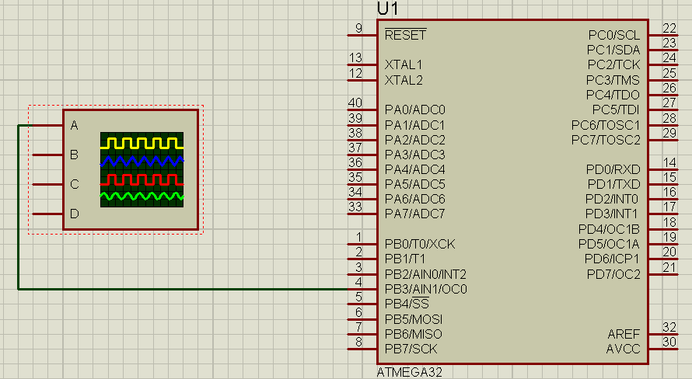
Simulation in Proteus

Slide 10
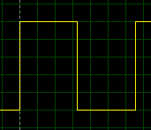
Output in the Virtual Oscilloscope
6.6 div, 1 div = 5ms, T = 33ms

Slide 11
Variation # 2 of WGM and COM bits in TCCR Register
TCCR0 Register
FOC0
WGM00
COM01
COM00
WGM01
CS02
CS01
CS00
 | WGM00 | WGM01
NORMAL | 0 | 0
CTC | 0 | 1
----------------- | 1 | 0
----------------- | 1 | 1
 | COM01 | COM00
NORMAL | 0 | 0
TOGGLE…. | 0 | 1
----------------- | 1 | 0
----------------- | 1 | 1
Variation 2: If we change WGM values at CTC [2nd choice] and COM values in “Toggles OC0 at Compare Match” [2nd choice]
WGM bits at CTC (Clear on Compare Match) means Timer0 Counting Register, TCNT0 will reset at COMPARE MATCH Point. When its content becomes equal to the value of OCR0, it will roll over to 00 in next pulse.
The OC0 pin will automatically toggle at every COMPARE MATCH

Slide 12
Variation # 2 Explained
Value increases in TCNT0 Register
Your Set Values in OCR0
Pulses
WGM = CTC and COM = TOGGLE ……….
Output at OC0 pin
Time Period, T₂
T₂ < T₁
Note that The Time Period is Variable, depends on the Clock frequency, Prescaler and the value of OCR0. But The duty cycle is always fixed at 50%

Slide 13
Calculation of Time period
Let us say we used a Prescaling factor of P.
So, the frequency of timing will be f_{timer}=f_{osc}/P
Therefore each pulse will be of duration T_{pulse}=1/f_{timer}
Overflow will occur when OCR0 will be x in Hex or y in decimal
So, the time period of the output pulse will be T_{out}=2*(y+1)*P/f_{osc}.
Say we use f_{osc}=16 MHz, P=256, then
T_{out}=2*(y+1)*256*10⁻⁶/16 sec
If we load 0x1B or 27D,
T_{out}=2*(27+1)*256/16 usec=896 usec
Output frequency=1/T_{out}= 1.116 kHz

Slide 14
Code in CodeVisionAVR [CTC]
Prescaling
WGM bits
FOC0
WGM00
COM01
COM00
WGM01
CS02
CS01
CS00
#include <mega32.h>
void main(void)
{
DDRB.3=1;
TCCR0=(0<<WGM00) | (0<<COM01) | (1<<COM00) | (1<<WGM01) | (1<<CS02) | (0<<CS01) | (0<<CS00);
TCNT0=0x00;
OCR0=27;
while (1)
{
}
}
COM bits
TCCR0 Register
WGM=01 – CTC
COM=01 – TOGGLE…..
Prescaling=100–> factor of 256

Slide 15
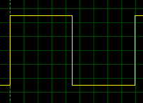
Output in the Virtual Oscilloscope
1 div = 100 uS, 9 div = 900 uS

Slide 16
Physical Output PIN Related to All Timers
Each Timer (Timer0, Timer1 and Timer2) has a waveform generator (WG).
The waveform generator gives output to different pins of the microcontroller for different timers.
OC0 (PB.3) ← Timer 0, Output Compare
OC1A (PD.5) ← Timer 1, Output Compare A
OC1B (PD.4) ← Timer 1, Output Compare B
OC2 (PD.7) ← Timer 2, Output Compare
WGMn and COMn bits of TCCR register determine how the waveform generator will work.

Slide 17
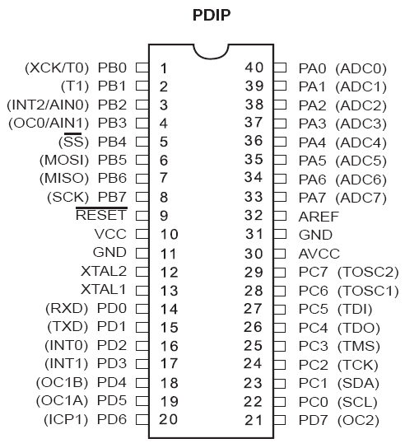
OC0, OC1A, OC1B and OC2 Pins
For Timer0
For Timer1B
For Timer1A
For Timer2

Slide 18
Generation of PWM Wave
PWM stands for Pulse Width Modulation.
Let us say we apply continuous 5V DC to a motor. The motor will rotate at a certain speed.
If you apply 5V DC for 50% of the time and 0V for another 50% time and repeat it. The average value of the voltage will be 2.5 volt. So the speed will be halved.
Average Voltage=2.5V
5V
0
T_{ON}
T_{OFF}
T_{PERIOD} = T_{ON} + T_{OFF}
By modifying the ON/OFF time within a time period, one can vary the average value and the speed of the motor may be varied.

Slide 19
Duty Cycle=80% Average Voltage=4.0V
5V
0
T_{ON}
T_{OFF}
Duty Cycle=50% Average Voltage=2.5V
5V
0
T_{ON}
T_{OFF}
Duty Cycle=20%
Average Voltage=1.0V
5V
0
T_{ON}
T_{OFF}

Slide 20
Variation # 3 of WGM and COM bits in TCCR Register
TCCR0 Register
FOC0
WGM00
COM01
COM00
WGM01
CS02
CS01
CS00
 | WGM00 | WGM01
NORMAL | 0 | 0
CTC | 0 | 1
P.C. PWM | 1 | 0
FAST PWM | 1 | 1
 | COM01 | COM00
NORMAL | 0 | 0
Reserve | 0 | 1
CLEARS…. | 1 | 0
SETS…. | 1 | 1
Variation 3: If we choose WGM values at FAST PWM and COM values in “CLEARS at COMPARE MATCH and sets at BOTTOM” [3rd choice]
With WGM bits at FAST PWM, Timer0 Counting Register, TCNT0 will reset normally. When its content becomes FF, it will roll over to 00 in next pulse.
The OC0 pin will automatically CLEARS at every COMPARE MATCH and SETS at 00 in TCNT0 Register.
Notes:
E

Slide 21
How PWM works in ATmega32
Value increases in TCNT0 Register
Max^{m} value, 255
Your Set Values in OCR0
Pulses
WGM = FAST PWM & COM = OC0 CLEARs at COMPARE MATCH & SETs at BOTTOM
Output at OC0 pin
Time Period, T

Slide 22
The Calculation
Crystal frequency = 16 MHz
Prescaler, P=1024.
Hence the clock frequency = (16/1024) uS
Time of one clock (tick), Ttick =(1024/16) uS=64 uS.
Time period of the output wave
= 256 * Ttick =256*64 uS = 16.4 mS
The value of OCR0 = duty cycle * 256/100
For 20% duty cycle OCR0=51d = 33 h.

Slide 23
A Program for Generating PWM with Variable Duty Cycle
Let us connect an LED at OC0 pin and a square wave of gradually increasing and decreasing duty cycle will be applied at that pin.
Let us choose P=1024, WGM at “FAST PWM” and COM at “Clears at COMPARE MATCH and sets at BOTTOM”
It means CS02:00=101, WGM00:01=11 and COM01:00=10.

Slide 24
The Code [FIXED_FREQ]
#include <mega32.h>
#include <delay.h>
int duty=0;
float Fosc=0;
long int P=0;
float Ttick=0;
float Tp=0;
void main(void)
{
DDRB.3=1;
TCCR0=(1<<WGM00) | (1<<COM01) | (0<<COM00) | (1<<WGM01) | (1<<CS02) | (0<<CS01) | (1<<CS00);
TCNT0=0x00;
Fosc=16e6;
P=1024;
Ttick=P/Fosc;
Tp=256*Ttick;
Fast PWM
CLEARs at COMPARE MATCH & SETs at BOTTOM
// System clock=16MHz
// Prescaler=1024
// Time period of each clock (tick)
// Time period of the output wave

Slide 25
The Code (continued)
while (1)
{
for (duty=10;duty<90;duty++)
{
OCR0=duty*256/100;
delay_ms(50);
}
for (duty=90;duty>10;duty--)
{
OCR0=duty*256/100;;
delay_ms(50);
}
}
}
// 256 no. of clocks make 100% of one time period

Slide 26
TCCR1A & TCCR1B (Timer Counter Control Registers)
TCCR1A Register
COM1A1
COM1A0
COM1B1
COM1B0
FOC1A1
FOC1B1
WGM11B1
WGM10B1
TCCR1B Register
ICNC1
ICES1
-
WGM13
WGM121
CS12
CS11
CS10
FOC1A, FOC1B – Related to force compare
ICNC1, ICES1 – Related to Input Capture
COM1A1, COM1A0, COM1B1, COM1B0
– Related to Waveform Generation
WGM13, WGM12, WGM11, WGM10 – Mode Selection
CS12, CS11, CS10 – Clock Selection

Slide 27
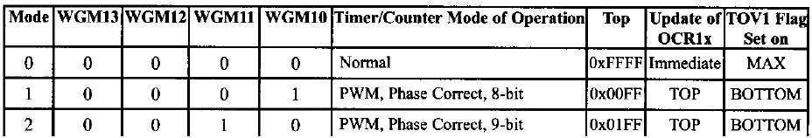
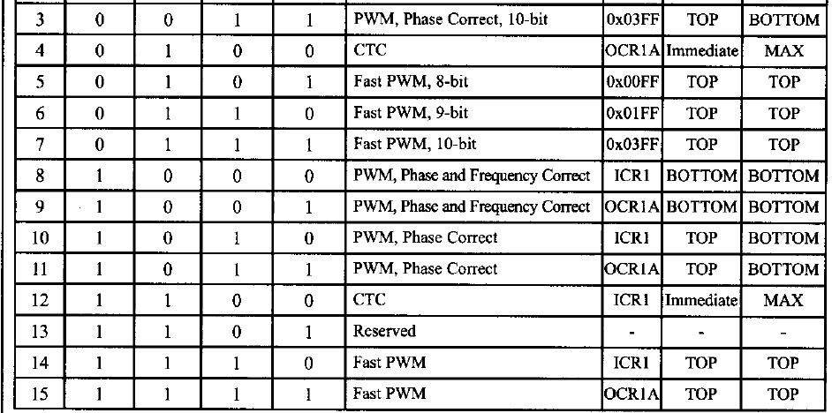
Modes in Timer 1
New – Green one

Slide 28
Generation of PWM having Variable Frequency
Previously we discussed about fixed frequency PWM
It was fixed frequency because the Timer register Resets at TOP value
In order to obtain variable frequency PWM we need to have a choice of WGM where Timer Register Resets at ICR1 register value.
Let us follow the diagram of the next slide.

Slide 29
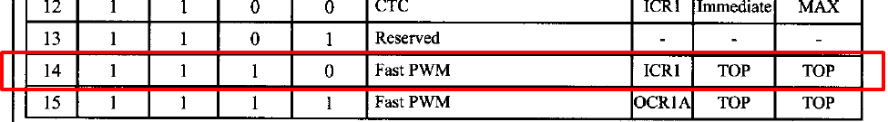
Value increases in TCNT0 Register
TOP
Value in ICR1
Your Set Values in OCR1A
WGM = FAST PWM with ICR1A as RESET Value
Pulses
Output at OC1A pin
T_{ON}
Time Period, T

Slide 30
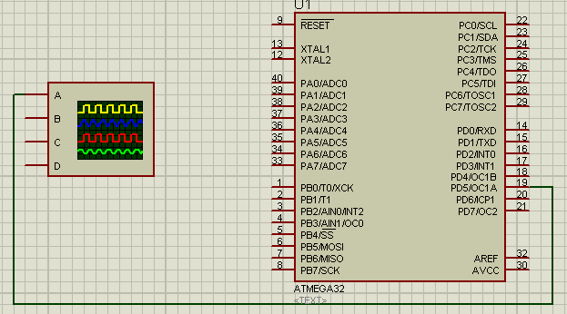
Connection at OC1A (PD.5) pin

Slide 31
Calculation
Let us say that we want to generate a PWM signal having a frequency of 500Hz and 15% duty cycle
Fosc=16MHz
Ttick=(1/16) uS
Tout=1/500=2mS
TON=0.15X2mS=0.3mS
To generate Tout of 0.2mS number of pulse required will be 2mS/(1/16)uS=2X16X1000=32000
ICR1=32000 D= 0x7D00; ICR1H=0x7D and ICR1L=0x00;
Since TON/Tout=OCR1A/ICR1,
So, OCR1A=ICR1 X TON/Tout = 32000 X 0.3/2=4800

Slide 32
The Code
#include <mega32.h>
void main(void)
{
DDRD.5=1;
TCCR1A=(1<<COM1A1) | (0<<COM1A0) | (0<<COM1B1) | (0<<COM1B0) | (1<<WGM11) | (0<<WGM10);
TCCR1B=(0<<ICNC1) | (0<<ICES1) | (1<<WGM13) | (1<<WGM12) | (0<<CS12) | (0<<CS11) | (1<<CS10);
TCNT1H=0x00;
TCNT1L=0x00;
ICR1H=0x7D;
ICR1L=0x00;
OCR1A=4800;
OCR1B=0;
while (1)
{
}
}

Slide 33
Home Exercise
Draw a Proteus diagram for the system described. Also write down the code in CodeVisionAVR.
Run the simulation and observe the output in an oscilloscope connected in OC1A pin.

Slide 34
Thanks

