Slide 1
Training on AVR Microcontroller for Automation in Power Sector
Module: M#1
Introduction
Professor S.M. Lutful Kabir
IICT, BUET
March, 2018

Slide 2
Focus of the Training
To teach the participants the techniques of implementing processor based automated control systems in Power Sector.
AVR microcontroller will be used in the training.
Both hardware implementation and software simulation will be demonstrated in the class
You should be conversant in programming
Two books will be used as reference as the course materials
Two software will be used in the course
All presentation slides will be available in google group and so you should join the group immediately

Slide 3
Hardware Implementation : AVR Trainer Board
The board that is given to you will be used in the laboratory exercises.
You are advised to take away the board with you everyday for your home practice.
But do not forget to bring the board when come for next day.
At the end of the training the board will be your property.

Slide 4
Software Simulation
Simulation of a Circuit in the software called Proteus.
Development of the Program in CodeVisionAVR.
The compiled code (the .hex file) can be linked from the Proteus.
The program may be run in Proteus.
Although there may be some problem in actual practical implementation but as an initial development we get a first hand feedback from the output of the simulation.
Therefore all students must be able to use the two software and there project should be implemented at least in Proteus.

Slide 5
Training Schedule
Date | 3:00-4:30 | 5:00-6:30 | 7:00-8:00
11/03 | Registration & M#1: Introduction | M#2: Installation and familiarization with Software | M#3: Input and Output
12/03 | M#4: Input and Output (continued) | M#5: Expt. On Input and Output | M#6: Interrupts
13/03 | M#7: Interrupts (continued) | M#8: Expt. on Interrupts | M#9: Analogue to Digital Converters (ADC)
14/03 | M#10: Timers/Counters | M#11: Expt. on ADC | M#12: Timers (contd.)
15/03 | M#13: Timers/Counters | M#14: Expt. on Timers & Project Assignment | M#15: USART Communication
18/03 | M#16: SPI Communication | M#17: Expt. on SPI Communication | M#18: I2C Communication
19/03 | M#19: Serial Communication (contd.) | M#20: Expt. on I2C Communication | M#21: Controlling Motors and Drives
20/03 | M#22: Automation in Power Sector-1 | M#23: Expt. on Automation in Power Sector-1 | M#24: Automation in Power Sector-2
21/03 | M#25: Final Examination | M#26: Expt. on Automation in Power Sector-2 | M#27: Automation in Power Sector-3
22/03 | M#28: Project Presentation | M#29: Expt. on Automation in Power Sector-3 | M#30: Future Learning Path & Certificate Award

Slide 6
Distribution of Marks for Assessment of this training
Daily Evaluation – 10%
Lab performance – 20%
Mini Project – 30%
Final Exam.– 40%

Slide 7
Special NOTES
Book Reference
Richard H. Barnett, Sarah Cox, Larry O'Cull-”Embedded C Programming and the Atmel AVR” – 2nd Edition, Delmar Cengage Learning, 2007
M. A. Mazidi, S. Naimi and S. Naimi : “The AVR microcontroller and embedded System – Using Assembly and C”, Prentice Hall (PEARSON), 2011.

Slide 8
How to download the software and books
After logging on to the google group (BUET_IICT_AVR_TRAINING_0318) in a different tab open https://drive.google.com/drive
In the Manu there is a option called “Shared with me”
The folder called “Books_EEE423” and “Software_EEE423” are shared folder for that group members.
So you should be able to download the books and the software

Slide 9
Introduction
Microprocessor and microcontroller have revolutionized various industries and our day-to-day life
Their use in control, monitoring, measurement and signal processing has made a breakthrough in electronic industry
Now-a-days you won’t be able to name one electronic device in which microprocessor/ microcontroller or their derivatives have not been used
This course is designed to make you familiar with these remarkable pieces of wonder

Slide 10
Microprocessor
By microprocessor we mean that all the components one finds in a CPU (ALU, Register, Timing & Control Unit and the Interfacing circuits) are put together in a single chip
That is a uP can be considered as “CPU in a Chip”
ALU
Interfaces
Registers
Timing & Control Circuit
Microcontroller
I/O Port
Microcontroller is somewhat different from microprocessor in a sense that not only the CPU but also RAM, ROM, I/O Ports, Timer & Counter, Serial Port all put together in a single chip
So, it is called “Computer on a chip”
CPU
Timer Counter
RAM
Serial Port
ROM

Slide 11
Why uP and uC are so popular?
Small Size
Lower Cost
Higher Reliability
Lower Power Consumption
Higher Versatility
More Powerful

Slide 12
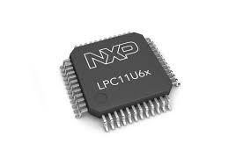
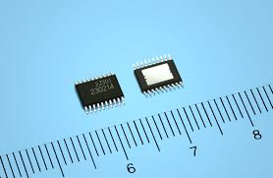
Smaller Size
A tiny chip can contain hundreds of thousands of transistors and components
The size of present day microprocessor has now reduced to less than an inch
With the advent of VLSI technology the microprocessors now come with a large numbers of pins

Slide 13
Lower Cost
With the advent of complex technology, microprocessor cost does not increase proportionally
Rather its cost per function has decreased gradually
As the material cost is negligible in comparison with the initial masking cost, per unit cost decreases as the volume of production increases

Slide 14
Higher Reliability
With the advent of more sophisticated fabrication technology and testing system microprocessor manufacturing process is now very reliable
Moreover, the microprocessor based system now-a-days requires less number of chips and so wiring requirement is less making the overall system more reliable

Slide 15
Power consumption
Present day microprocessors consume very low power in the order of milliwatt
This is because of the fact that they are manufactured by transistors using CMOS technology which requires very low power

Slide 16
Versatility
Since the program stored in a microprocessor system is rewritable hence one system can be reused by loading a new program
This is especially useful when a new system is being developed. Frequent change in programming is necessary to fix bugs if any

Slide 17
More powerful
Present day microprocessor is more powerful than the previous one, w.r.t processing speed, memory and I/O pins
This becomes possible because of increase in data addressible bit size
Now 32 bit processor is common in the market
A 32 bit microprocessor is powerful than the then main frame computer

Slide 18
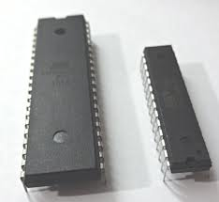
Microprocessor/Microcontroller and some of their applications

Slide 19
Typical Applications of uP
Microprocessor is basically a CPU, using CPU general purpose computer can be built
Desktop computers, PCs, Laptops, Workstations, Servers, Supercomputers
We are in the era of 32- and 64-bit microprocessor, so we can produce very powerful computers

Slide 20
Typical Application of uC
Using microcontrollers embedded systems are produced
An embedded system is a combination of hardware and software built for a specific application
Consumer electronics making toys, cameras, camcorders, robots
Consumer products - washing machines, microwave ovens etc.
Instrumentation - oscilloscopes, various medical equipments,
Process control - data aquisition, controlling various industries
Communication – Telephone, answering machines
Office equipments – Fax, printer, small PABX
Micromedia application – Cell phones, PDAs, teleconferencing equipment

Slide 21
Why microcontroller?
In many applications, the points of consideration are:
Space
Cost
Power consumption
Price
Computing power gets less consideration
Choice of microcontroller is obvious

Slide 22

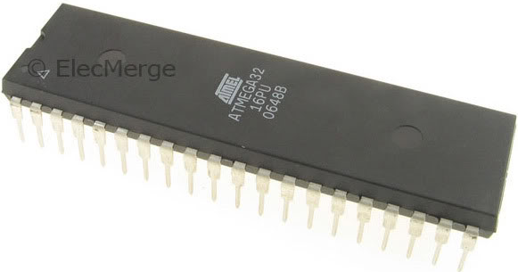
Introduction to Atmel AVR
Atmel Corporation is a manufacturer of semiconductors, founded in 1984.
Atmel introduced the first 8-bit flash microcontroller in 1993, based on the 8051 core.
In 1996, a design office was started in Trondheim, Norway, to work on the AVR series of products.
Its products include microcontrollers (including 8051 derivatives and AT91SAM and AT91CAP ARM-based micros), and its own Atmel AVR and AVR32 architectures.

Slide 23
AVR features
The AVR is an 8-bit RISC single-chip microcontroller with Harvard Architecture
They come with some standard features
Program (code) ROM
Data RAM
Data EEPROM
Timers
I/O ports
Most AVRs have some additional features like
ADC
PWM
Different Serial Interface such as USART, SPI, I2C (TWI)
CAN
USB, etc

Slide 24
Simplified View of an AVR Microcontroller
Program
ROM
RAM
EEPROM
Timers
CPU
Program
Bus
Data Bus
Interrupt Unit
Ports
Other Peripherals
OSC

Slide 25
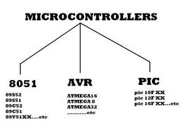
Other Microcontrollers
Besides AVR chips there are other 8-bit microcontrollers
A list containing some examples is provided below:
Part Name | Manufacturer
8051 | Intel and a number of Companies
HCS08 | Freescale (Formerly MOTOROLA)
PIC | Microchip
Z8 | Zilog
Among all microcontrollers, 8051, AVR and PIC are widely used.

Slide 26
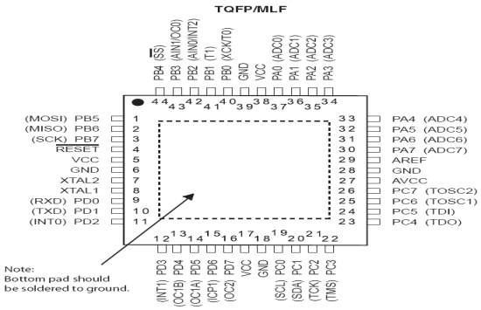
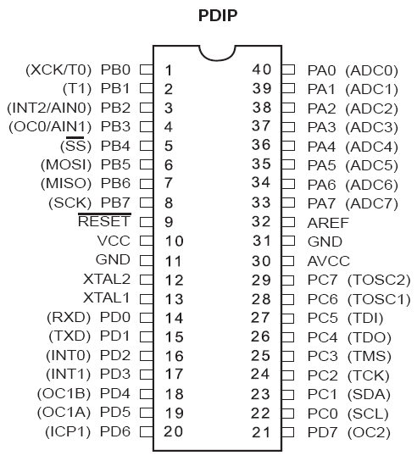
ATMega32 Pin out & Descriptions
Clears all the registers and restart the execution of program
Provides supply voltage to the chip. It should be connected to +5
Port B
Reference voltage for ADC
Port A
These pins are used to connect external crystal or RC oscillator
Supply voltage for ADC and portA. Connect it to VCC
Port C
Port D

Slide 27
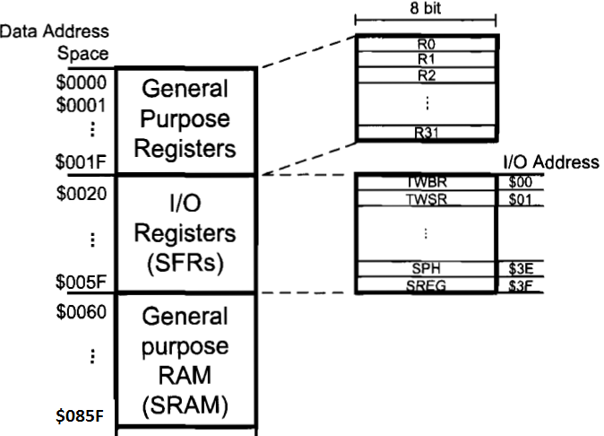
ATMega32 Programmer Model: Data Memory
The data memory is composed of three parts:
GPRs (general purpose registers),
Special Function Registers (SFRs), and
Internal data SRAM.

Slide 28
ATMega32 Programmer Model: I/O Registers (SFRs)
The I/O memory is dedicated to specific functions such as status register, timers, serial communication, I/O ports, ADC and etc.
Function of each I/O memory location is fixed by the CPU designer at the time of design. (because it is used for control of the microcontroller and peripherals)
AVR I/O memory is made of 8 bit registers.
All of the AVRs have at least 64 bytes of I/O memory location. (This section is called standard I/O memory)
In other microcontrollers, the I/O registers are called SFRs (Special Function Registers)

Slide 29
ATMega32 Programmer Model: I/O Registers (SFRs)

Slide 30
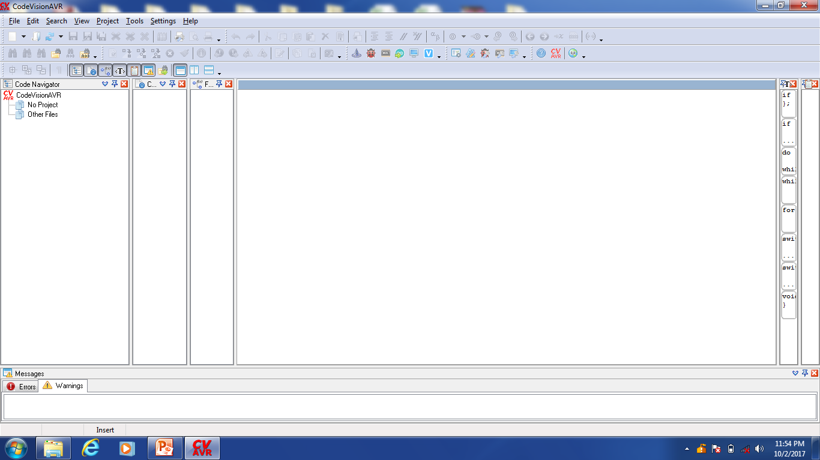
Screenshot of CodeVisionAVR

Slide 31
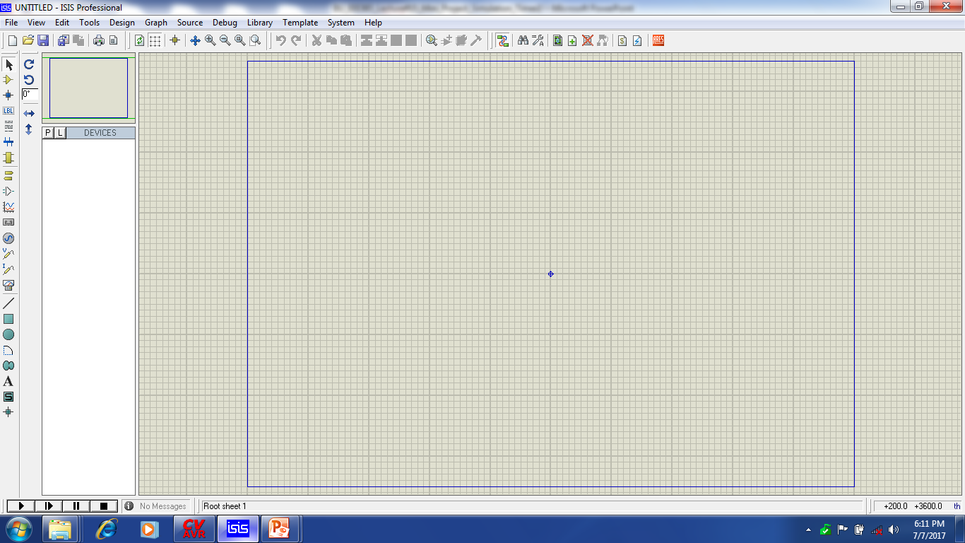
Use of Proteus for Simulating uC based Projects
Area to be used
In the vertical left and horizontal upper menu you will find different symbols indicating some options for drawing your circuit.

Slide 32
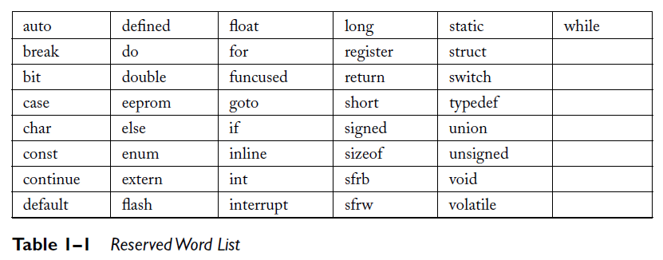
List of Reserved Word
You MUST NOT choose the name of a VARIABLE as one of the above

Slide 33
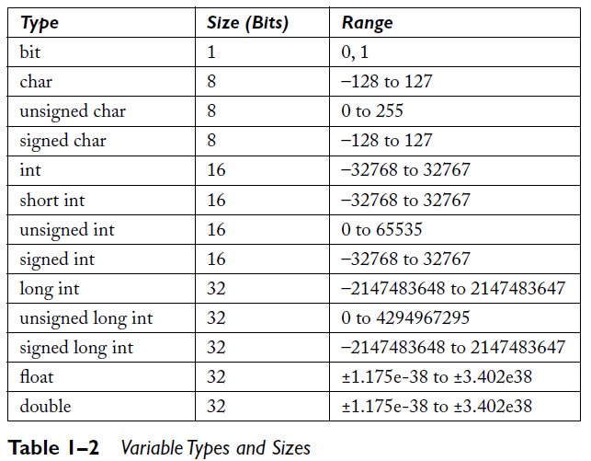
Variables

Slide 34
Variable Scope
unsigned char globey; //a global
void function_z (void)
{
unsigned int tween; //local
tween = 12; //local
globey = 47; //global
main_loc = 12; // local to main()
}
void main()
{
unsigned char main_loc; //local
globey = 34; //global
tween = 12; //local to function_z
while(1) // do forever..
{
……….
}
}

Slide 35
Constants
Numeric constants can be declared in many ways by indicating their numeric base and making the program more readable.
Integer or long integer constants may be written in
Decimal form without a prefix (such as 1234)
Binary form with 0b prefix (such as 0b101001)
Hexadecimal form with 0x prefix (such as 0xff)
Octal form with 0 prefix (such as 0777)
Identifying a variable as a constant will cause that variable to be stored in the program code space rather than in the limited variable storage space in RAM. This helps preserve the limited RAM space.

Slide 36
“Define”
Suppose you have connected a buzzer in pin 2 of Port A.
In order to make the buzzer ON you write PORTA.2=1;
Would it not better if you could write the statement like buzzer=1 because it is close to what you really meant.
To do this you define buzzer as PORTA.2 by writing
#define buzzer PORTA.2”
The “#define buzzer PORTA,2” line causes the compiler to substitute the label PORTA.2 wherever it encounters the word buzzer.

Slide 37
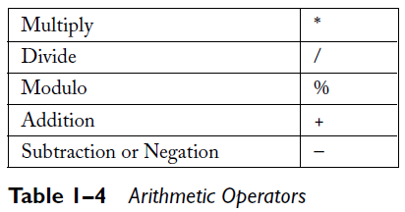
Arithmetic Operators
Table 1–4 shows the typical arithmetic operators in order of precedence.

Slide 38
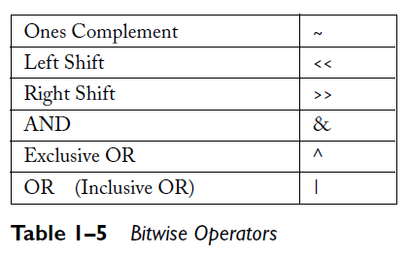
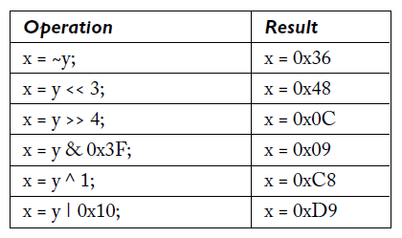
Bitwise Operators
Assume that an unsigned character
y = 0xC9.

Slide 39
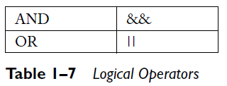
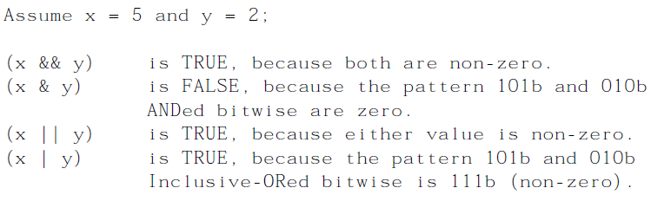
Logical Operators
Logical and relational operators are all binary operators but yield a result that is either TRUE or FALSE.
TRUE is represented by a nonzero value, and FALSE by a zero value.

Slide 40
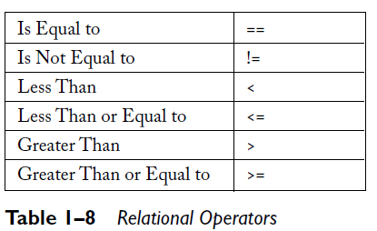
Relational Operators
Relational operators use comparison operations.
As in the logical operators, the operands are evaluated left to right and a TRUE or FALSE result is generated.
They effectively “ask” about the relationship of two expressions in order to gain a TRUE or FALSE reply.

Slide 41
Increment, Decrement and Compound Assignment
Increment or Decrement:
i = 1;
k = 2 * i++; // k = 2, i = 2
i = 1;
k = 2 * ++i; // k = 4, i = 2
A compound assignment:
a += 3; // a = a + 3
b -= 2; // b = b – 2
c *= 5; // c = c * 5
d /= a; // d = d / a
a |= 3; // a = a OR 3
b &= 2; // b = b AND 2
c ^= 5; // c = c ex-ORed with 5
PORTC &= 3;
// Write the current value on //PORTC ANDed with 3 back //to port C.

Slide 42
while loop
The while loop appears early in the descriptions of C language programming.
It is one of the most basic control elements. The format of the while statement is as follows:
while (expression) or while(expression)
{ statement;
statement1;
statement2;
...
}
NOTE:
The functioning of the while(1) statement should now be apparent.
Since the “1” is the expression to be evaluated and is a constant (1 is always non-zero and therefore considered to be TRUE),

Slide 43
do/while loop
The do/while loop is very much like the while loop, except that the expression is tested after the loop has been executed one time.
The format of the do/while statement is as follows:
do or do
{ statement;
statement1; while (expression);
statement2;
...
} while (expression);

Slide 44
for loop
A for loop can be described as an initialization, a test, and an action that leads to the satisfaction of that test.
The format of the for loop statement is as follows:
for (expr1; expr2; expr3) or for(expr1; expr2; expr3)
{ statement;
statement1;
statement2;
...
}
expr1 is typically an initialization statement.
expr2 is a conditional control statement
expr3 is an increment/decrement statement

Slide 45
A while loop equivalent to for loop
The for loop structure could be represented with a while loop in this fashion:
expr1;
while(expr2)
{
statement1;
statement2;
...
expr3;
}

Slide 46
if statement
An if statement has the following form:
if (expression) or if(expression)
{ statement;
statement1;
statement2;
...
}

Slide 47
if/else statement
if(expression) or if(expression)
{ statement1;
statement1; else
statement2; statement2;
...
}
else
{
statement3;
statement4;
...
}

Slide 48
If/else if/else statement
if(expr1)
statement1;
else if (expr2)
statement2;
else if(expr3)
statement3;
else
statement4;

Slide 49
Switch/Case Statement
switch (expression)
{
case const1:
statement1;
statement2;
break;
case const2:
statement3;
statement4;
break;
case constx:
statement5;
statement6;
break;
default:
statement7;
statement8;
}
The switch/case statement is used to execute a statement, or a group of statements, selected by the value of an expression.
The form of this statement is as shown:

Slide 50
Break Statement
while(1)
{
while(1)
{
if (c > 100)
break; // this will take us out of this while
++c; // block, clearing c..
printf("c = %d\n",c);
}
c = 0; // clear c and then things will begin again
}

Slide 51
Continue Statement
The continue statement will allow the program to start the next iteration of a while, do/while, or for loop.
The continue statement is like the break statement in that both stop the execution of the loop statements at that point.
The difference is that the continue statement starts the loop again, from the top, where break exits the loop entirely.
c = 0;
while(1)
{
if (c > 100)
continue; // This will cause the printing to
// stop when c>100,
++c;
printf("c = %d\n",c); // no code after the continue
//will be executed
}

Slide 52
Functions
A function is an encapsulation of a block of statements that can be used more than once in a program.
Some languages refer to functions as subroutines or procedures.
A function may perform an isolated task requiring no parameters whatsoever.
A function may accept parameters in order to have guidance in performing its designed task.
A function may not only accept parameters but return a value as well.
Even though a function may accept multiple parameters, it can only return one.

Slide 53
Standard form of a function
type function_name ( type param1, type param2, ... )
{
statement 1;
statement 2;
...
statement x;
}

Slide 54
Use of function
#include <alcd.h>
#include <delay.h>
#include <string.h>
void led_glow(unsigned int value)
{
PORTC=value;
delay_ms(1000);
PORTC=0;
}
void main(void)
{
DDRC=0xFF;
while (1)
{
if (PIND.2==0)
led_glow(0x04);
if (PIND.3==0)
led_glow(0x08);
}
}

Slide 55
Array
An array is a data set of a declared type, arranged in order.
An array is declared like any other variable or constant, except for the number of required array elements:
int digits[10]; // this declares an array of 10 integers
char str[20]; // this declares an array of 20 characters
The referencing of an array element is handled by an index or subscript.
The index can range from 0 to the length of the declared array less 1.
str[0], str[1], str[2], . . . . . str[19]

Slide 56
Some exercises
Find the output of the following program and show the value of the variables as they change in each loop.
int i=0, j=1, k=2;
for (i=0;i<5;i++)
{
j=j+k;
if (j>4)
k=3;
}

Slide 57
Some exercises (continued)
#include <mega32.h>
#include <alcd.h>
#include <delay.h>
#include <stdio.h>
#include <stdlib.h>
void main(void)
{
char disp[8];
unsigned int cnt, bit_mask, test_port;
bit_mask = 1;
lcd_init(16);
test_data=0b10101110;
for (cnt=0;cnt<8;cnt++) {
lcd_clear();
lcd_gotoxy(0,0);
itoa(cnt,disp);
lcd_puts(disp);
lcd_gotoxy(0,1);
if (test_data & bit_mask)
lcd_putsf("high");
else
lcd_putsf("low");
delay_ms(1000);
bit_mask <<= 1;
}
}

Slide 58
Contact Information
Mobile No. : 01819 27 69 51
Email address : lutfulkabir82@gmail.com

Slide 59
Thanks

