Slide 1
Training on AVR Microcontroller for Automation in Power Sector
Module: M# 3
Fundamentals of Embedded C and Input/Output
Professor S.M. Lutful Kabir
IICT, BUET
March, 2018

Slide 2
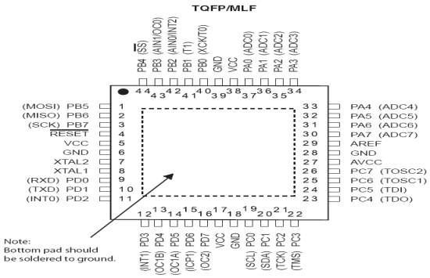
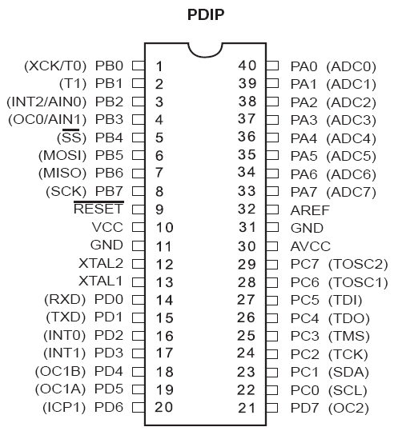
Ports of AVR ATmega32
Port B
Port A
Port C
Port D

Slide 3
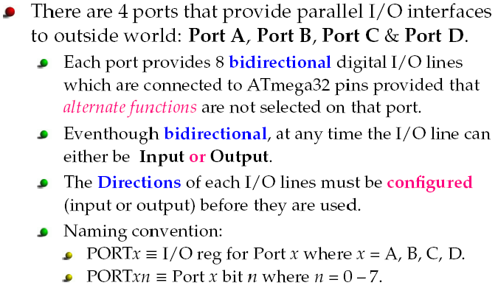
ATMega32 Pin out & Descriptions

Slide 4
ATMega32 Pin out & Descriptions

Slide 5
DDRx Register Role in Outputting Data
Each of the Ports A-D in ATmega32 can be used for Input or Output.
DDRx I/O register is used solely for the purpose of making a given port input or output port.
For example, to make a port an output, we write 1s to the DDRx register.
In other words, to output data to all of the pins of Port B, we must first put 0b11111111 (0xFF) into DDRB register to make all the pins output.

Slide 6
How data is sent to the output port?
Once you set the direction of a port as output, the data that you want to send to the output, you have to write that data into PORTx register.
If DDRC=0xFF and then PORTC=0x3B, the data at the output will also be 0x3B.
That is -
0
0
1
1
1
0
1
1
PC7
PC6
PC5
PC4
PC3
PC2
PC1
PC0

Slide 7
A Practical example of Outputting Data through a Port
Let us assume that 8 LEDs are connected to 8-pins of PortC of an Atmega32 chip
We want to glow all of the eight LEDs.
And they will be switched off after1 sec and this ON and OFF with an interval of 1 sec will be repeated continuously.
Write a C code for the above mentioned output operations.

Slide 8
Connection of LEDs with a Port
ATmega32
R
GND
PC7
PC6
PC5
PC4
PC3
PC2
PC1
PC0

Slide 9
All LEDs will be ON and off at an interval of 1 sec. And the process is repeated.
0xFF
1 | 1 | 1 | 1 | 1 | 1 | 1 | 1
0x00
0 | 0 | 0 | 0 | 0 | 0 | 0 | 0
#include <mega32.h>
#include <delay.h>
#define data_ddr DDRC #define data_port PORTC
void main(void)
{
}
data_ddr=0xFF;
data_port=0xFF;
while (1)
{
data_port=~data_port;
delay_ms(1000);
}

Slide 10
7-segment display: Introduction
Seven segment displays are very common for electronic product to display numerical output.
Many common devices like calculators, lift, watches, ovens etc. use them.
A seven-segment display is so named because it is divided into seven different segments that can be switched on or off.
It can display digits from 0 to 9 and quite a few characters like A, b, C, ., H, E, e, F, n, o, t, u, y, etc.
Knowledge about how to interface a seven segment display to a micro controller is very essential in designing embedded systems.

Slide 11
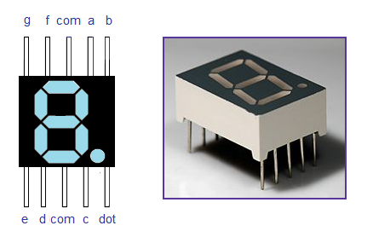
The Pin Out and Picture of a 7-segment Display
2 4 d
a
b
f
b
b
g
g
g
c
e
c
e
d
d

Slide 12
Two types of 7-segment display
Seven segment displays are of two types, common cathode and common anode.
In common cathode type , the cathode (N side) of all LEDs are tied together to a single terminal which is usually labeled as ‘com’ and the anode (P side) of all LEDs are left alone as individual pins labeled as a, b, c, d, e, f, g & h (or dot/dp) .
In common anode type, the anode of all LEDs are tied together as a single terminal and cathodes are left alone as individual pins.

Slide 13
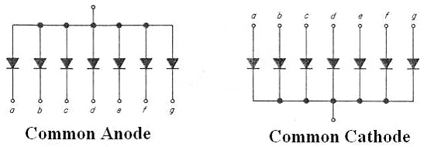
Interfacing 7 segment display
+5V
PC.0
b
c
d
e
Common Cathode
f
g
330
330
PC.7
LED ‘dp’
LED ‘a’
GND

Slide 14
7-Segment Display
a
f
g
b
e
c
d
dp
0 1 2 3 4 5 6 7 8 9
dp | g | f | e | d | c | b | a | Hex | dig
0 | 0 | 1 | 1 | 1 | 1 | 1 | 1 | 3F | 0
0 | 0 | 0 | 0 | 0 | 1 | 1 | 0 | 06 | 1
0 | 1 | 0 | 1 | 1 | 0 | 1 | 1 | 5B | 2
0 | 1 | 0 | 0 | 1 | 1 | 1 | 1 | 4F | 3
0 | 1 | 1 | 0 | 0 | 1 | 1 | 0 | 66 | 4
0 | 1 | 1 | 0 | 1 | 1 | 0 | 1 | 6D | 5
0 | 1 | 1 | 1 | 1 | 1 | 0 | 1 | 7D | 6
0 | 0 | 0 | 0 | 0 | 1 | 1 | 1 | 07 | 7
0 | 1 | 1 | 1 | 1 | 1 | 1 | 1 | 7F | 8
0 | 1 | 1 | 0 | 1 | 1 | 1 | 1 | 6F | 9

Slide 15
Code for 7-segment Display
#include <mega32.h>
#include <delay.h>
#define data_ddr DDRB
#define data_port PORTB
char digit_cathode[10]
={0x3F,0x06,0x5B,0x4F,0x66,0x6D,0x7D,0x07,0x7F,0x6F};
char i;
void main(void)
{
data_ddr=0xFF;
while (1)
{
for(i=0;i<10;i++)
{
data_port=digit_cathode[i];
delay_ms(1000);
}
}
}

Slide 16
Multiple 7-Segment Display
Suppose you need a four digit display connected to the AVR ATmega32.
Each 7 segment display have 8 pins and so a all 32 pins are to the connected to the microcontroller and there will be no pin left with the microcontroller for other input/ output applications.
More over four displays will always be ON and this consumes a considerable amount of power.
All these problems associated with the straight forward method can be solved by multiplexing .

Slide 17
Multiplexing 7-Segment Display
In multiplexing all displays are connected in parallel to one port and only one display is allowed to turn ON at a time, for a short period.
This cycle is repeated for at a fast rate and due to the persistence of vision of human eye, all digits seems to glow.
The main advantages of this method are
Fewer number of port pins are required .
Consumes less power.
More number of display units can be interfaced.
The circuit diagram for multiplexing 2 seven segment displays to the AVR ATmega32 is shown in the next slide.

Slide 18
Connection Diagram of Multiple 7-segment Display with AVR ATmega32
ATmega 32
Digit 1
Digit 2
PC.0
a
a
PC.1
b
b
PC.2
c
c
PC.3
d
d
PC.4
e
e
PC.5
f
f
g
g
PC.6
dp
PC.7
dp
PD.0
PD.1
7-segment displays are Common Cathode type

Slide 19
How does it work?
Let us see how ‘57’ is to be displayed in a 2-digit display.
Initially the first display (digit 1) is only activated by making PD.0 low and PD.1 high.
Then hex value for displaying “5″ is loaded to Port C.
‘5’ will appear in digit 1 only. Digit 2 will be blank.
This condition is maintained for around 20ms,.
Then second display (digit 2) is activated by making PD.0 high and PD.1 low.
Then hex value for displaying “7″ is loaded to Port C.
‘7’ will appear in digit 2 only. Digit 1 will be blank.
This condition is maintained for another 20ms.
This cycle is repeated and due to the persistence of vision you will feel it as “57″.
Notes:
ive

Slide 20
Code for 2 digit 7-segment Display
#include <mega32.h>
#include <delay.h>
#define data_ddr DDRC
#define control_ddr DDRD
#define data_port PORTC
#define control_port PORTD
int digit_cathode[10]={0x3F,0x06,0x5B,0x4F,0x66,0x6D,0x7D,0x07,0x7F,0x6F};
int x=0, y=0, i=0, j=0;
void main(void)
{
data_ddr=0xFF;
control_ddr=0x03;
while (1)
{
for (i=1; i<100; i++)
{
}
}
}
x=i/10;
y=i%10;
for (j=1; j<20; j++)
{
control_port=0x02;
data_port=digit_cathode[x];
delay_ms(20);
control_port=0x01;
data_port=digit_cathode[y];
delay_ms(20);
}

Slide 21
Thanks

