Slide 1
Training on AVR Microcontroller for Automation in Power Sector
Module: M#6
External Interrupts
Professor S.M. Lutful Kabir
IICT, BUET
March, 2018

Slide 2
Polling versus Interrupt : A Real Life Scenario
Polling is almost the equivalent of a real-life scenario where you hand-off to work to someone and then you keep bugging him all the time asking whether he is done.
Interrupts on the other hand are quite different.
When we hand-off some work to someone else we also ask him to let us know when he is done.
This way we do not need to keep asking him all the time whether he is done. When the work is finished he will come back and notify us.

Slide 3
Another Real Life Scenario
Consider you are reading a novel. Your elder brother calls you as he needs some help in finding a book. So you leave the task in hand by bookmarking the page you are reading and run to his help.
Now as you are helping him find the book, your mom calls you as she needs you to remove some container from the top of the shelf.
You prioritize your mother’s request over your brother’s. So you run to help her and climb up a chair to reach the rack.
As you open the cupboard, your dad arrives and knocks the door. Now this can be your highest priority, so you jump of the chair, open the door, welcome dad.
You go back climb up the chair, remove the container, and run back to help you brother. Then you resume reading the novel.
Here you kept two tasks pending, to help someone with a higher priority. This is called NESTED INTERRUPT.

Slide 4
Interrupt Flags and Enabled bits
Each interrupt is associated with two (2) bits, an Interrupt Enabled Bit and an Interrupt Flag Bit. These bits are located in the I/O registers associated with the specific interrupt.
The interrupt enabled bit is used to enable or disable a specific interrupt. Basically it tells the microcontroller whether or not it should respond to the interrupt if it is triggered.
The interrupt flag bit is set whenever the interrupt event occurs whether interrupt is enabled or not.

Slide 5
What does microcontroller do when Interrupt is enabled?
When an interrupt event occurs and interrupt is enabled the microcontroller pause its current task and attend to the interrupt by executing an Interrupt Service Routine (ISR).
At the end of the ISR the microcontroller returns to the task it had paused and continue its normal operations.

Slide 6
Interrupt Service Routine (ISR)
An Interrupt Service Routine (ISR) is a piece of code that is executed when an interrupt is triggered.
Usually each enabled interrupt has its own ISR.
ISR is also called Interrupt Handler.

Slide 7
Both bits should be high
In summary basically both the Interrupt Flag and the Interrupt Enabled are required for an interrupt service routine to be executed as shown in the figure below.
Global Interrupt Enable
Interrupt Enable
Interrupt Service
Interrupt Flag

Slide 8
Global Interrupt and Enable Bit
Apart from the enabled bits for the specific interrupts the global interrupt enabled bit MUST be enabled for interrupts to be activated in the microcontoller.
For the AVR 8-bits microcontroller this bit is located in the Status I/O Register (SREG).
Status Register, SREG
I
T
H
S
V
N
Z
C
D₇
D₆
D₅
D₄
D₃
D₂
D₁
D₀
Upon RESET all interrupts are disabled (masked).
It means that none will be responded by the microcontroller if they occur.
So, the interrupts must be enabled by software in order for the microcontroller to respond to them.

Slide 9
Internal and External Interrupt Sources
The AVR 8-bits microcontroller provide both internal and external interrupt sources. The internal interrupts are associated with the microcontroller's peripherals.
They are the Timer/Counter, Analog Comparator, etc.
The external interrupts are triggered via external pins.
On AVR ATmega32 microcontroller there are four (4) external interrupts:
RESET Interrupt - Triggered from pin 9.
External Interrupt 0 (INT0) - Triggered from pin 16.
External Interrupt 1 (INT1) - Triggered from pin 17.
External Interrupt 2 (INT2) - Triggered from pin 3.

Slide 10
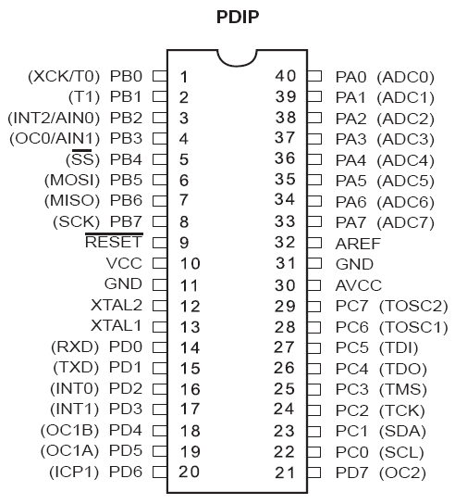
External Interrupt Pins

Slide 11
External Interrupts
The number of external hardware interrupts varies in different AVRs.
The ATmega32 has three external interrupts: pin PD2 (PORTD.2), PD3 (PORTD.3) and PB2 (PORTB.2), designated as INT0, INT1 and INT2 respectively.
Upon activation of these pins, the AVR is interrupted in whatever it is doing and jumps to the vector table to perform the interrupt service routine.

Slide 12
External Interrupts INT0, INT1 and INT2
The hardware interrupts must be enabled before they can take effect.
This is done using INTx bit located in GICR (General Interrupt Control Register).
GICR Register
INT1 | INT0 | INT2 | - | - | - | IVSEL | IVCE

Slide 13
Interrupt Sense Control bits for INT0
MCUCR (MCU Control Register)
SE | SM1 | SM2 | SM0 | ISC11 | ISC10 | ISC01 | ISC00
ISC01 and ISC00 - These bits define the level or edge on the external INT0 pin that activates the interrupts, as shown in the following table
ISC01 | ISC00 |  | Description
0 | 0 |  | The low level of INT0 generates an interrupt request
0 | 1 |  | Change on INT0 generates an interrupt request
1 | 0 |  | Falling edge of INT0 generates an interrupt request
1 | 1 |  | Rising edge of INT0 generates an interrupt request

Slide 14
Interrupt Sense Control bits for INT1
MCUCR Register
SE | SM1 | SM2 | SM0 | ISC11 | ISC10 | ISC01 | ISC00
ISC11 and ISC10 - These bits define the level or edge on the external INT1 pin that activates the interrupts, as shown in the following table
ISC11 | ISC10 |  | Description
0 | 0 |  | The low level of INT1 generates an interrupt request
0 | 1 |  | Change on INT1 generates an interrupt request
1 | 0 |  | Falling edge of INT1 generates an interrupt request
1 | 1 |  | Rising edge of INT1 generates an interrupt request

Slide 15
Interrupt Sense Control bit for INT2
Interrupt 2 (INT2) can only be configures as edge triggered mode.
In other words it can not be configured as level triggered.
ISC2 bit of MCUCSR (MCU Control and Status Register) defines whether INT2 interrupt will activate on falling or rising edge.
MCUCSR Register
JTD | ISC2 | - | JTRF | WDRF | BORF | EXTRF | PORF
IS2 |  | Description
0 |  | Falling edge of INT2 generates an interrupt request
1 |  | Rising edge of INT2 generates an interrupt request

Slide 16
Sampling the edge-triggered and level-triggered interrupts
The edge-interrupt (the falling edge, the rising edge or the change level) is latched by the AVR.
It is latched by the INTFx bits of GIFR (General Interrupt Flag Register).
This means that when an external interrupt is in an edge-triggered mode (falling edge, rising edge or level change), upon triggering an interrupt request, the related INTFx flag becomes set.
GIFR Register
INTF1 | INTF0 | INTF2 | - | - | - | - | -

Slide 17
Experiment with Int0
One push button switch (#1) is connected in INT0 (PD.2) pin and another push button switch (#2) is connected in INT1 (PD.3) pin of the ATmega32 microcontroller.
Eight numbers of LEDs are connected in Port C.
Normally the MSB LEDs will be ON and others will be OFF.
If push button 1 is pressed the position of the glowing LED will move in clockwise direction.
If push button 2 is pressed the position of the glowing LED will move in anti-clockwise direction.

Slide 18
Experiment with Int0 (continued)
The INT0 and INT1 bit in the GICR register has to be set (i.e. Interrupt 0 and Interrupt 1 will be enabled.)
At first, we set falling edge as Interrupt sense control.
We have to write an ISR which will be executed only when a falling edge (from 1 to 0) is generated at INT0 pin.
We have to write another ISR which will be executed only when a falling edge (from 1 to 0) is generated at INT1 pin.

Slide 19
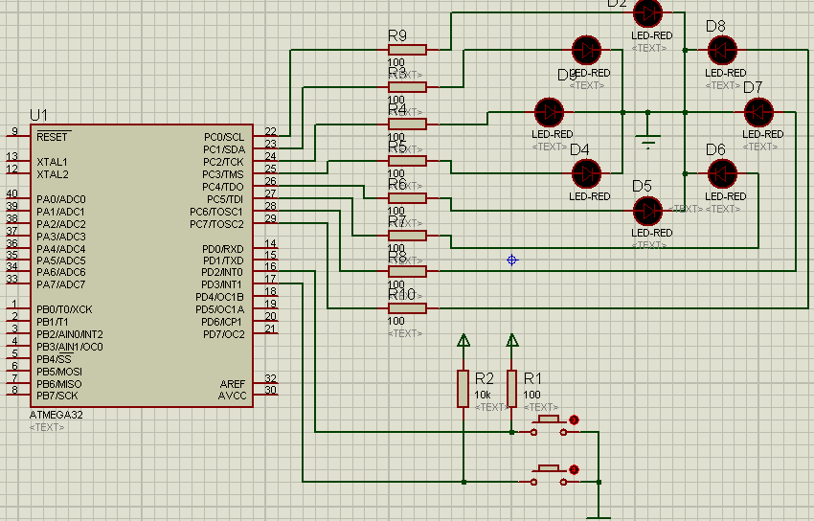
Proteus Simulation

Slide 20
The Code
#include <mega32.h>
#include <delay.h>
#define output_port PORTC
#define output_ddr DDRC
#define input_ddr DDRD
char move=0;
interrupt [EXT_INT0] void ext_int0_isr(void)
{
move=1;
}
interrupt [EXT_INT1] void ext_int1_isr(void)
{
move=2;
}
void main(void)
{
output_ddr=0xFF;
input_ddr=0x00;
output_port=0x80;
move=0;
GICR=(1<<INT1) | (1<<INT0) | (0<<INT2);
MCUCR=(1<<ISC11) | (0<<ISC10) | (1<<ISC01) | (0<<ISC00);
#asm("sei")
while (1)
{
if (move==1) { output_port=output_port>>1;
if (output_port==0)
output_port=0x80;
}
if (move==2) { output_port=output_port<<1;
if (output_port==0)
output_port=0x01;
}
delay_ms(200);
}
}

Slide 21
Thanks

