Slide 1
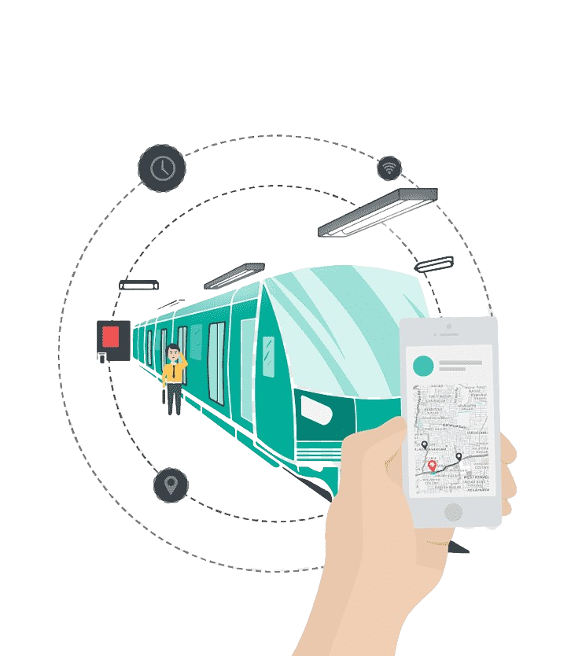

DRONA (DIGITAL RAILWAY OBSTRUCTION NOTIFYING ALARM)
SMART CITIES AND INFRASTRUCTURE

Slide 2
CONTENTS
Derailment
Motivation
Why DRONA?
Working
Conclusion
Presentation Title

Slide 3
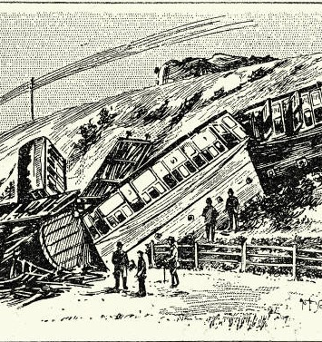
Derailment
Train derailment refers to the situation when a train leaves the track and either partially or completely loses contact with the rails. Derailments can occur due to a variety of reasons, such as equipment failure, human error, track defects, weather conditions, or a combination of these factors.
When a train derails, it can result in significant damage to the train and the surrounding infrastructure, as well as potentially serious injuries or fatalities to passengers and crew. Derailments can also cause disruptions to train services and lead to economic losses.

Slide 4
Motivation Behind Our Idea
It was midnight. A train was pacing to its destination with a howl in the silence of the night. A man was sleeping with his head on the side window of the train. Suddenly he woke up from his sleep. He jumped from his seat and pulled the chain hanging just over his head. The chain was nothing but the danger chain. The train moved for some more distance and stopped suddenly. The employees and other passengers in the train rushed to the compartment to know what had happened. Someone even suspected that the man did it in his sleeping mood. So they were angry towards this man. All surrounded the man and asked the reason behind chain pulling.“There is a crack in the rail after some more meters from here!!! If train goes over it mishaps may occur.” The man said quietly.
“What nonsense you are saying. In this dark night how did you see the crack which is far in front ?
Are you mocking us ?” That was the response of the people.“No. I have no need to mock you all and stop the train to disturb all. You just check it and then talk to me ” The man replied very gently.
The railway persons got down to rail. With the help of a torch they checked the railway track. To their surprise they saw a big crack in the rail a few meters away from the stopped train! If train passed over the crack definitely some mishap was obvious in that dark village night.
All persons again gathered around the man who predicted it correctly. He told that he heard the sound from the track while sleeping and it changed at some place . The vibrating sound changed too heavily that the man recognized that it was due to the crack in the railway line. Do you know who was that man who saved many lives from death? It was none other than the best engineer that India ever gave birth to, Mokshagundam Visvesvaraya

Slide 5
Major Factors that can cause Train Derailment
Track conditions: Poor track conditions such as broken rails, missing bolts, or worn-out ties can cause the train to derail. Track irregularities like dips, bulges, or twists can also result in derailment.
Human error: Human error can cause derailments, such as failure to properly inspect or maintain the track, train or its components, failure to set switches correctly, or not adhering to speed limits.
Mechanical failure: Train components such as wheels, axles, bearings, or brakes can fail, causing the train to derail. Mechanical failure can result from a lack of maintenance or from defective or worn-out parts.
Weather: Extreme weather conditions such as heavy rain, snow, or high winds can impact the stability of the train, cause flooding, or result in landslides.
Overloading: Overloading a train with cargo beyond its capacity can cause excessive stress on the train components, which can lead to derailment.
Poor design: Poor design of the train or the track can result in derailment, such as a mismatch between the train and track gauge, inadequate curve radius or inadequate superelevation, or inadequate clearance between the train and the track.

Slide 6
Why We Should Solve Derailment Problem?
The problem of train derailment is a critical issue that needs to be addressed due to its significant impact on public safety, economic and environmental consequences. Train derailments can cause fatalities and serious injuries to passengers and crew members, as well as damage to the surrounding communities and infrastructure.
The economic impact of train derailments is also significant, as it can result in the loss of cargo, damage to equipment, and delays in transportation. This can cause disruptions to the supply chain and affect the delivery of goods and services, leading to significant financial losses for businesses and industries.
In addition, train derailments can cause environmental damage, such as spills of hazardous materials, which can contaminate soil and water resources, and have long-lasting effects on the ecosystem.
If we do not solve the problem of train derailment, the consequences can be severe. The frequency and severity of derailments can increase, leading to more fatalities, injuries, and environmental damage. This can cause public mistrust and a negative perception of the rail industry, leading to a decline in ridership and revenue.
On the other hand, solving the problem of train derailment can have significant positive impacts. It can improve public safety, increase efficiency and reliability of transportation, reduce economic losses and environmental damage, and enhance the reputation of the rail industry.

Slide 7
Current Solution To The Problem Of Derailment
Proactive Measures
Reactive Measures
Regular maintenance and inspection of rail tracks
Implementation of safety protocols and procedures such as speed restrictions, signaling systems, and automatic train control systems
Use of high-quality materials and construction methods
Training and education of railway staff, to ensure they are aware of potential hazards
Use of derailment prevention devices such as rail anchors and rail brakes
Emergency response procedures and equipment, to minimize the impact of derailment
Investigations and analyses of derailment incidents to identify the root causes

Slide 8
An Advanced Sensing System for Early Detection of Track Faults Train derailments are a major safety concern for railways worldwide, causing loss of life, damage to property, and disruption of services. Introducing DRONA - an innovative project that aims to prevent train derailments by detecting track faults in advance and notifying the driver in real-time. DRONA will prove to be a sophisticated sensing system that combines advanced technologies such as acoustic sensing, vibration analysis, and various algorithms to detect defects in the rail tracks. The system is designed to work seamlessly with existing railway infrastructure and can be easily integrated with the driver's cabin, where an alarm and a display screen provide real-time alerts about any track faults. With DRONA, we hope to significantly reduce the number of train derailments in India, making railway travel safer and more reliable for everyone.

Slide 9


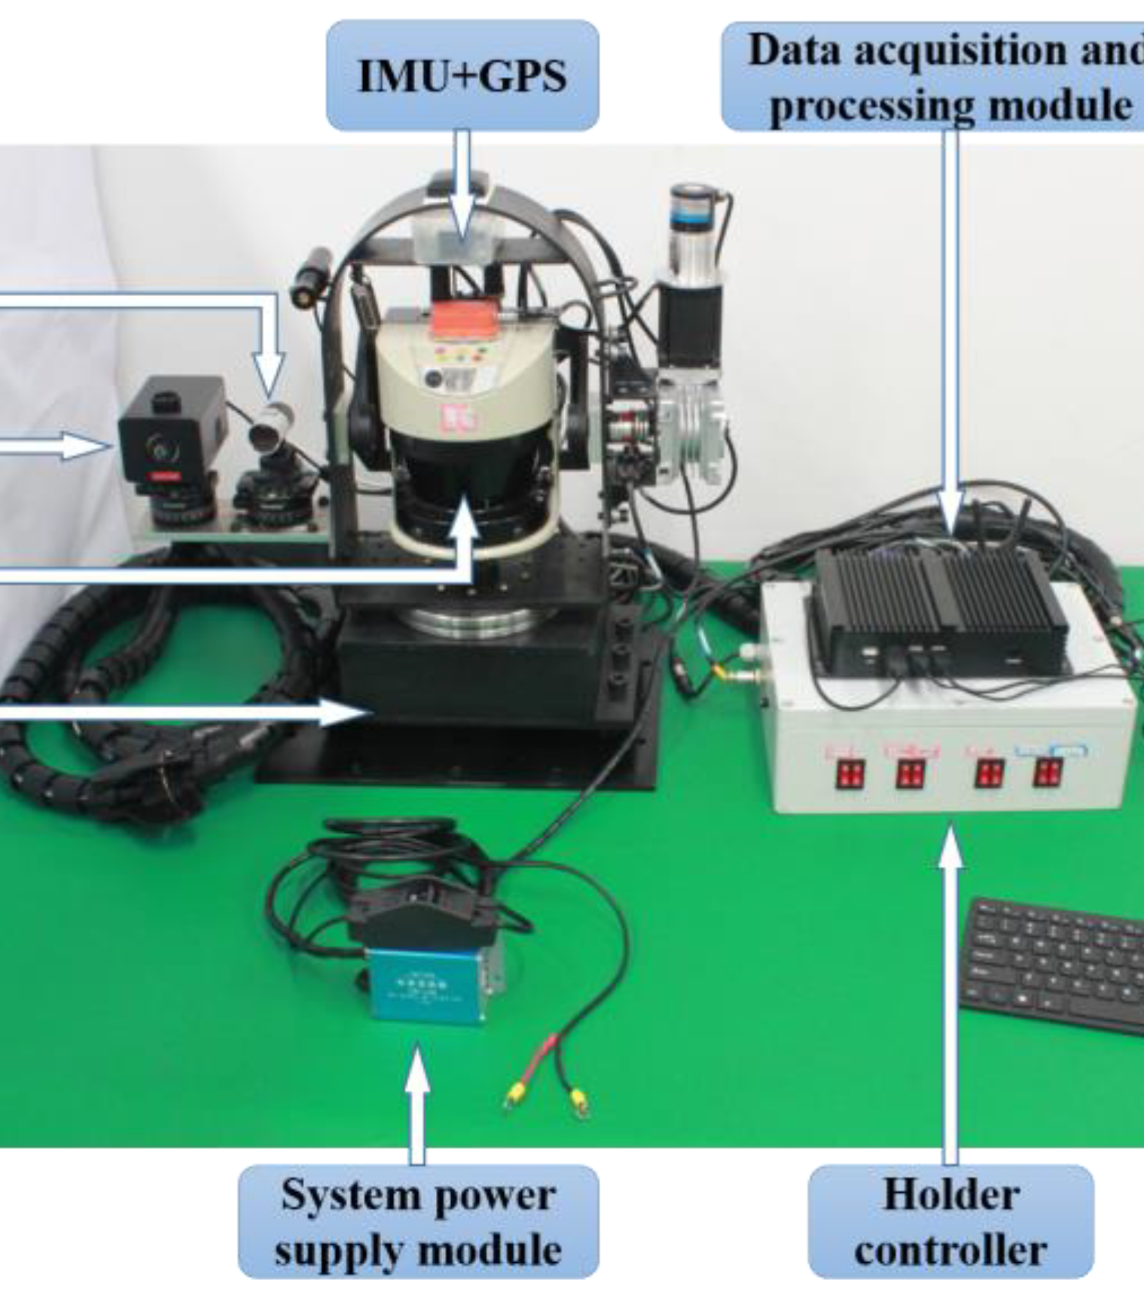


WORKING
Rail vibration Sensor Input
Processing done by our logic
Use of Multiple Sensors
Integrating different frequencies
Alert System
To measure the vibration produced by the train while running on the track
To Convert vibration produced into frequency
To measure the frequency produced due to external factors
To set Range of safe frequency and to display it on the screen
Alarming system attached with the display screen to get a prior warning

Slide 10
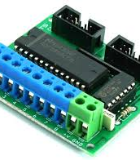
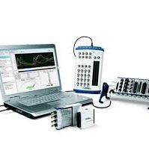
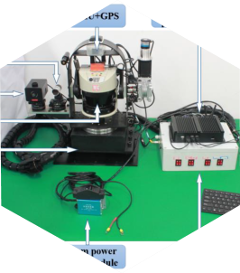

HARDWARE COMPONENTS
Rail Vibration Sensor
ADC
DAQ
Other Sensors
Alarm
Mounted underside of the train or at the axle of the wheel
Analog To Digital Converter to Obtain the discrete signal
Data Acquisition System to collect data from the rail vibration sensor mounted on the train.
Other sensors include Piezoelectric Sensor and diaphragm sensor
Alarming system attached with the display screen to inform driver priorly

Slide 11



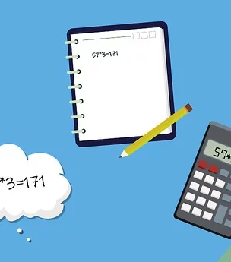
SOFTWARE AND ALGORITHMS
Data Analytics Platform
APIs
FFT Algorithm
Mathematical Formulas
To analyze large amounts of data from different sources
To enable two software components to communicate with each other using a set of definitions and protocols
Uses Sampling method to convert time domain signal into frequency domain
All mathematical calculation on which our Project is based

Slide 12
Mathematical Calculation
The presence of a crack in the rail track can lead to a change in the stiffness of the track, which in turn can affect the natural frequency of the track
f = 1/(2π) * sqrt(k/m)
where:
f is the natural frequency in hertz (Hz)
k is the stiffness of the spring in newtons per meter (N/m)
m is the mass of the object attached to the spring in kilograms (kg)

Slide 13
Mathematical Calculation
The Fourier Transform is a mathematical technique used to analyze periodic functions by breaking them down into a series of sine and cosine waves.
The formula for the Fourier Transform is as follows:
F(ω) = ∫ f(t) e^(-iωt) dt
where:
F(ω) is the frequency domain representation of the signal
f(t) is the time domain signal
ω is the angular frequency

Slide 14
Mathematical Calculation
To implement the FFT algorithm in the backend of a website, we have included "dsp.js" library.
The mathematical formula involved in converting the vibration signal to frequency using FFT algorithm is as follows:
F = n / T
where F is the frequency in Hertz, n is the number of cycles of vibration during the sampling time T, which is the time interval between two successive samples of the vibration signal.

Slide 15
Core Calculation
Measure the acceleration of the rail track using the rail vibration sensor. This can be done by converting the output voltage of the sensor to acceleration using the following formula:
a = (Vout - Voffset) / S
where a is the acceleration in m/s^2, Vout is the output voltage of the sensor, Voffset is the offset voltage of the sensor (usually zero), and S is the sensitivity of the sensor in V/m/s^2.

Slide 16
Core Calculation
Identify the peak frequency in the frequency spectrum. This peak frequency corresponds to the natural frequency of the rail track.
Calculate the natural frequency of the rail track using the following formula:
f = c / (2L), where f is the natural frequency in Hz, c is the speed of sound in the rail, and L is the distance between the two axles of the train.
c = √(E/ρ)
where c is the speed of sound in m/s, E is the modulus of elasticity of the rail in Pa, and ρ is the density of the rail in kg/m^3.

