Slide 1
CUSTOMER SEGMENTATION
Submitted in the partial fulfillment for the award of the degree of
BACHELOR OF ENGINEERING
IN
ARTIFICIAL INTELIGENCE AND MACHINE LEARNING
Submitted by:
Anshuman Pandey (21BCS10476)
Kartik Kaushik (21BCS3713)
Mukul Jain (21BCS10269) Satyam Goyal (21BCS9824)
Under the Supervision of:
Mr. Sant Kumar Maurya
Department of AIT-CSE
DISCOVER . LEARN . EMPOWER

Slide 2
Outline
Introduction to Project
Methodology
Design Selection
Feature/characteristics Identification
Constraint Identification
Analysis of Features
Result
Future Scope

Slide 3
Introduction to Project
A Customer Segmentation is a data-driven initiative aimed at dividing a company's customer base into distinct groups or segments based on shared characteristics, behaviors, preferences, and other relevant attributes. The goal of customer segmentation is to gain a deeper understanding of different types of customers and tailor marketing strategies, product offerings, and customer experiences to meet the unique needs of each segment.

Slide 4
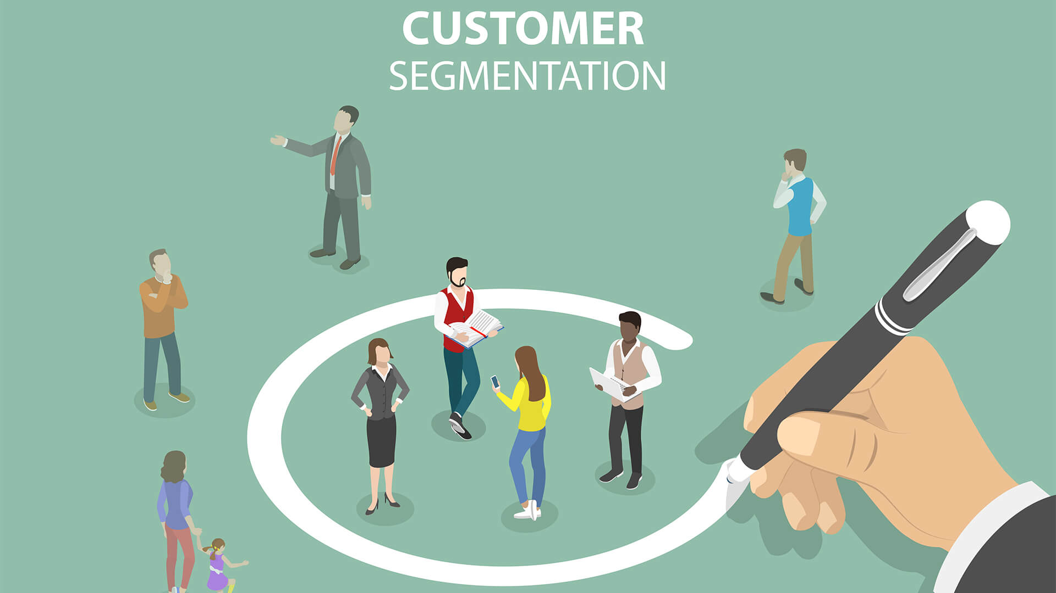
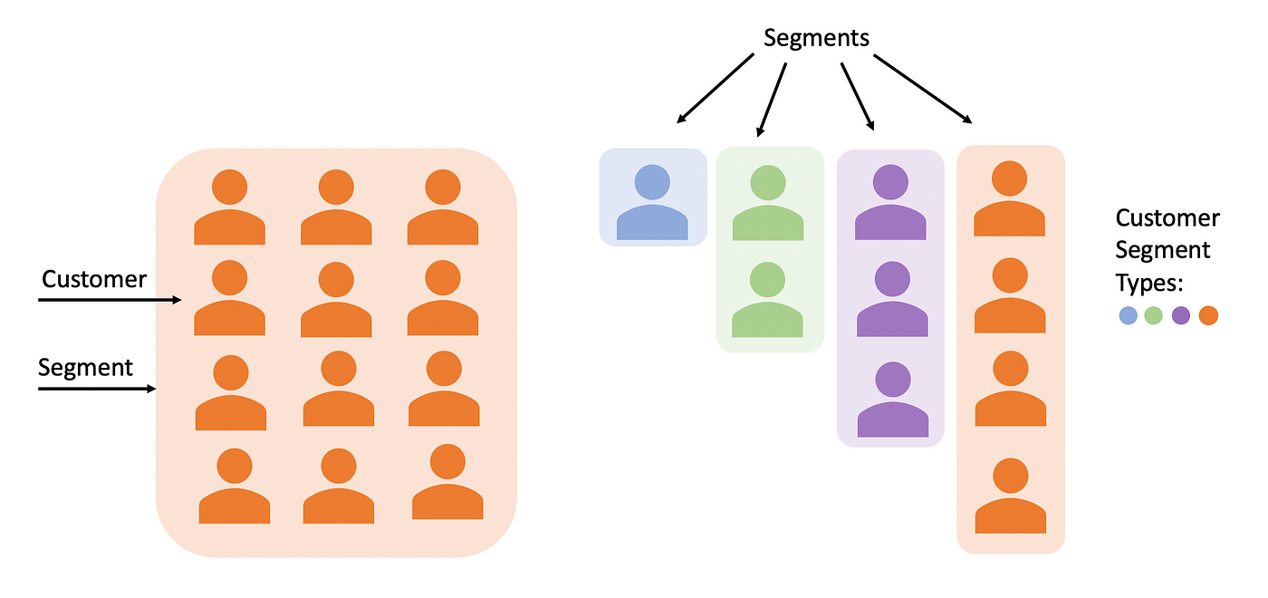
Examples
1)E-commerce:
Behavioral Segmentation: Grouping customers by their purchase history, browsing behavior, and shopping frequency. This can help tailor recommendations and promotions to specific buying patterns.
2) Financial Services:
Income-Based Segmentation: Categorizing customers based on their income levels. Banks might offer different types of credit cards or investment options to customers with varying income ranges.
And many more examples are there for customer segmentation.

Slide 5
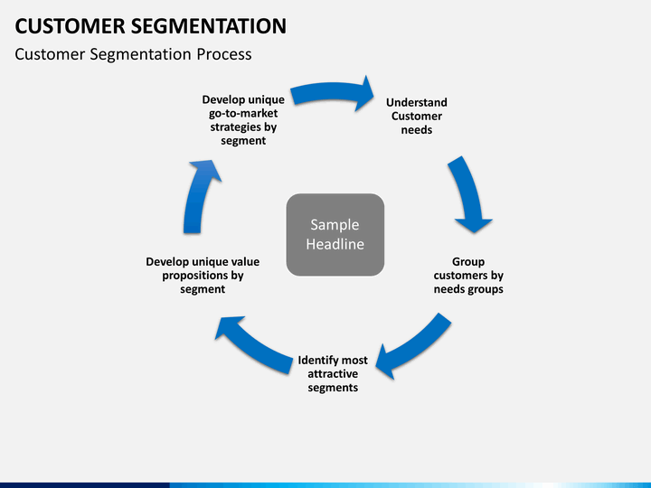
Methodology
Step 1: Data Collection and Preprocessing
Gather customer data from reliable sources, ensuring data quality and accuracy.
Clean the data by handling missing values, outliers, and inconsistencies.
Transform and structure the data for analysis.
Step 2:Applying various algorithms
We train the model using various algorithms like KNN , SVM , Decision tree and Random Forest .
After Training the model we combine or ensemble the outputs or predictions to get the final output.
Step 3: Earnings and Spending Analysis within Segments
Analyze how annual earnings and spending habits vary across different customer segments.
Use descriptive statistics and visualizations (histograms, box plots) to illustrate the differences.

Slide 6
Methodology
Step 4: Visualization of Earnings and Spending
Create visualizations that effectively display the distribution of earnings and spending within each customer segment.
Use tools like bar charts, box plots, or violin plots to showcase patterns and trends.
Step 5: Recommendations and Insights
Derive actionable insights from the analysis to guide marketing strategies.
Provide recommendations for tailored marketing campaigns targeting each customer segment.

Slide 7
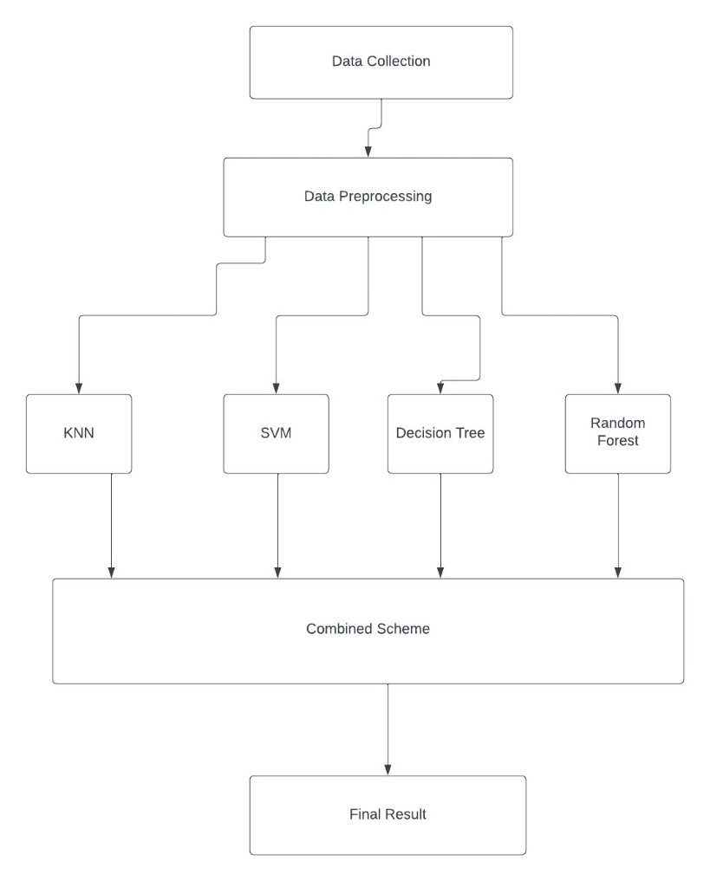
DESIGN SELECTION

Slide 8
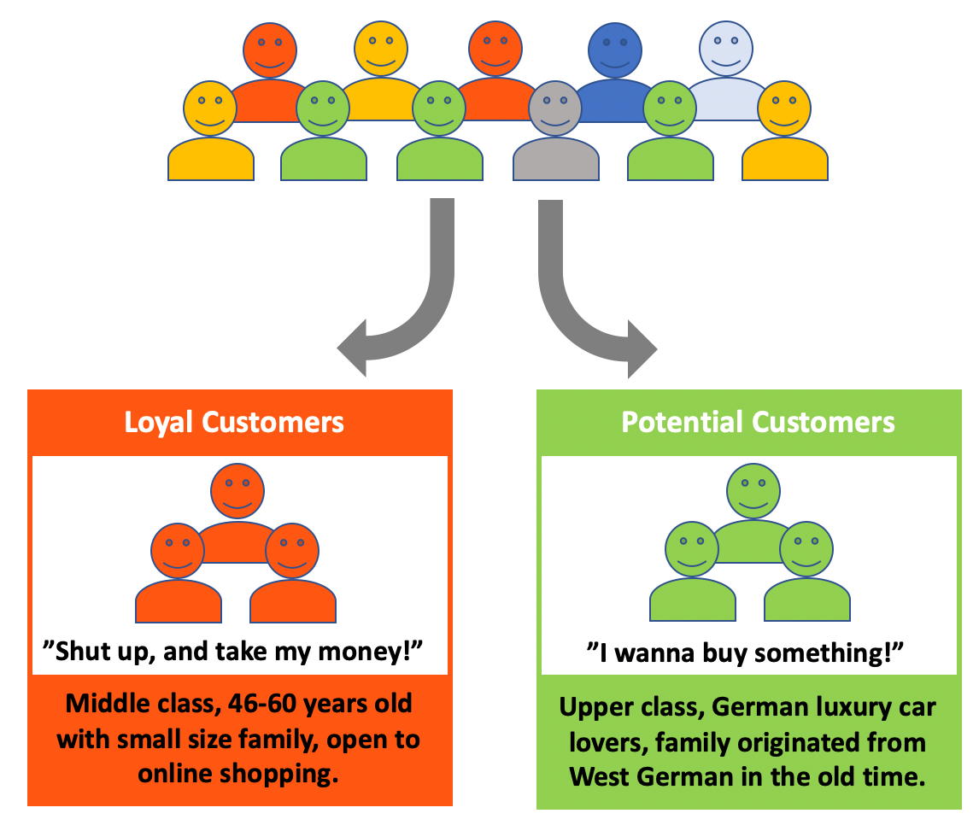
Feature/characteristics Identification
In order to segment customers, we need to identify the key features and characteristics that differentiate them. These may include demographic information such as age, gender, income, and location, as well as psychographic factors such as values, interests, and lifestyle choices.
Demographic information (age, gender, income)
Psychographic factors (values, interests, lifestyle)
Geographic Information (Location, urban/rular setting)

Slide 9
Constraint Identification
In order to effectively segment customers, it is important to identify any constraints that may impact the process.
Some of the important constraints are :
(i)Data Quality and Availability:Limited or poor-quality data can be a significant constraint.
(ii) Resource Constraints: Limited human resources, technical expertise, or infrastructure can impact your ability to conduct in-depth customer segmentation
(iii)Technological Constraints: Outdated or incompatible software and hardware can limit your ability to analyze and process customer data effectively.
(iv) Data Security and Privacy: Protecting customer data is crucial. Constraints related to data security and privacy may dictate how you can store and analyze customer information.
(v) Customer Consent: Constraints related to customer consent for data usage and marketing activities can affect how you interact with customers within specific segments.
(vi) Sample Size Constraints: If you have a small customer base, it may be challenging to create meaningful segments. Consider whether your sample size is sufficient for reliable segmentation.

Slide 10
Analysis of Features and finalization subject to constraints
Assess Features: Evaluate feature quality, relevance, and completeness.
Prioritize Smartly: Focus on high-value features aligned with project constraints.
Data Quality Matters: Invest in data preprocessing for improved quality.
Engineer Insights: Create new features to uncover hidden patterns.
Methodology Choice: Select a suitable segmentation method considering constraints.
Integrate Constraints: Align segmentation with budget, legal, and ethical constraints.
Validate for Success: Ensure segments are meaningful, actionable, and resource-aligned.
Iterate Continuously: Refine segments as needed, adapting to evolving constraints.
Document & Communicate: Clearly document decisions and communicate with stakeholders.
Test the Waters: Pilot test segmentation on a small scale before full rollout.
Manage Change: Address internal challenges and resistance effectively.
Feedback Loop: Establish ongoing feedback mechanisms for continuous improvement.

Slide 11
Analysis of Features
Age
Gender
Annual Income
Purchasing History
Spending Score
Country

Slide 12
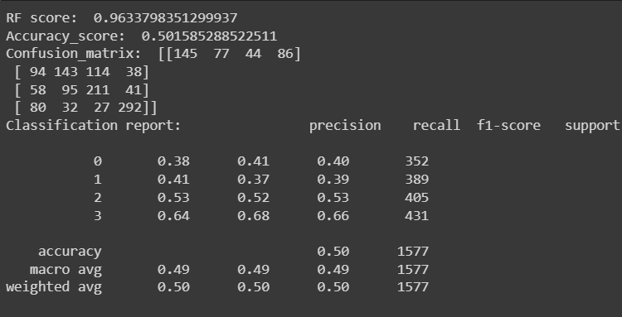
Result

Slide 13
FUTURE SCOPE
Social Media Integration:
Analyze social media data to gain insights into customer sentiment, preferences, and interactions, allowing for even more targeted marketing efforts.
Collaborative Filtering:
Implement collaborative filtering techniques to make product recommendations based on the preferences of similar customers within a segment.

Slide 14
FUTURE SCOPE
Behavioral Analysis:
Extend the segmentation beyond demographics to include behavioral data, such as purchase history, website interactions, and engagement with marketing campaigns. This can provide a more comprehensive view of customer preferences and behaviors.
Sentiment Analysis:
Integrate sentiment analysis to understand how different customer segments perceive your brand and products. This can help in fine-tuning communication strategies.

Slide 15
.
Thank You !!

