Slide 1
Processing of Telemarketing Data
May 25, 2020

Slide 2
Checking the overall balance of each feature that may affect our result
Regression Model is deployed.
Analysis of Individual factors
Data Pre preprocessing
Deploying ML Model
Analysis of results
Analysi
Data processing is done so as to remove the invalid data and
Our results are analysed so as to know the best city to expand our business.

Slide 3
Project objective:
To find the best case scenario in which the customer purchases a solar panel.

Slide 4
Dataset Description
The data is collected by the Telemarketing Team of Peacock Solar and shared to the interns so as to analyse it. The dataset contains around 1500 rows of data points and feature variables. My main objective is to use various modules provided by python to deploy a regression model so as to know the best case scenario in which we can get a customer to purchase a solar panel.

Slide 5
Analysis Of Individual Feature variables.

Slide 6
Our Feature Variables include the following
Lead Validation
Calling Time & Date
Picked the Phone
City
Valid Contact or an Invalid Contact
The time and date at which the call was made.
Whether the person picked up the call or not. If he did did he ask to call later.
The customer is from which city.

Slide 7
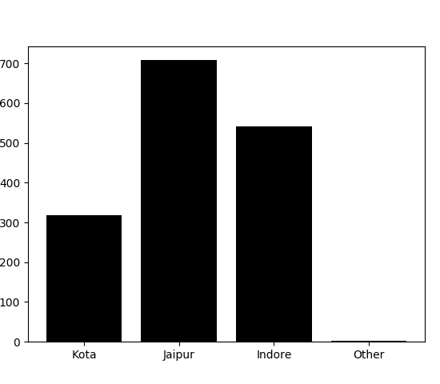
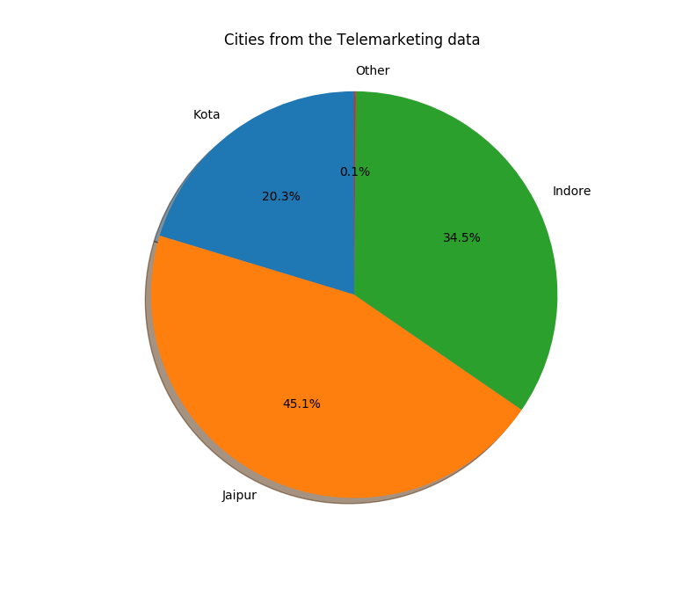
City Feature Variable

Slide 8
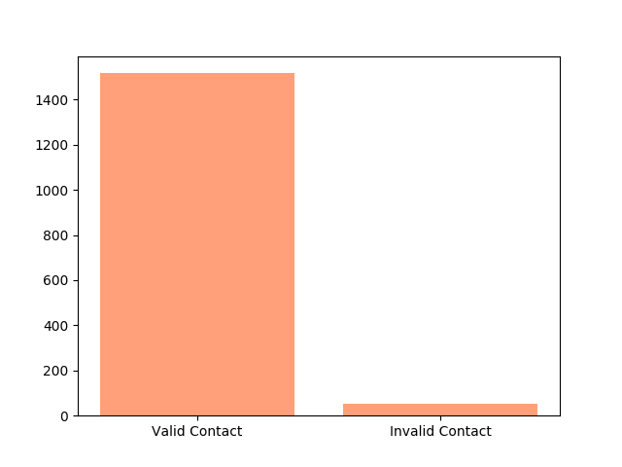
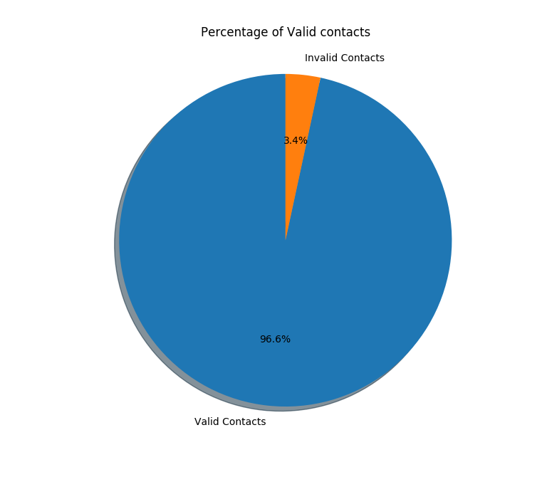
Lead Validation Feature Variable

Slide 9
Calling Time Variable

Slide 10
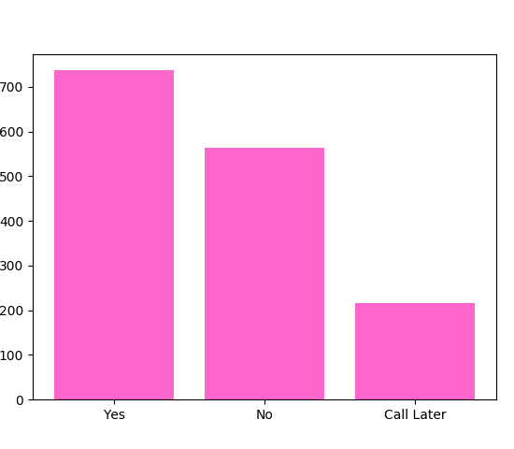
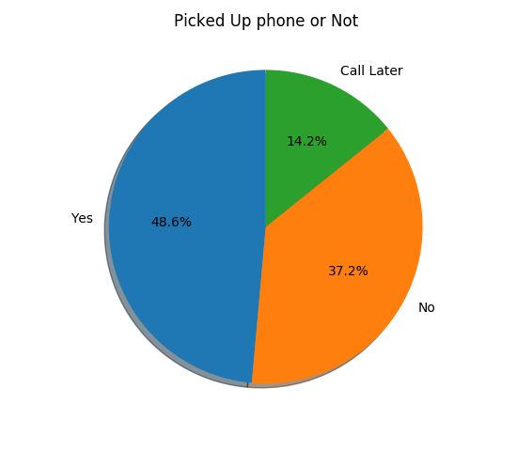
Picked up the Phone Variable

Slide 11
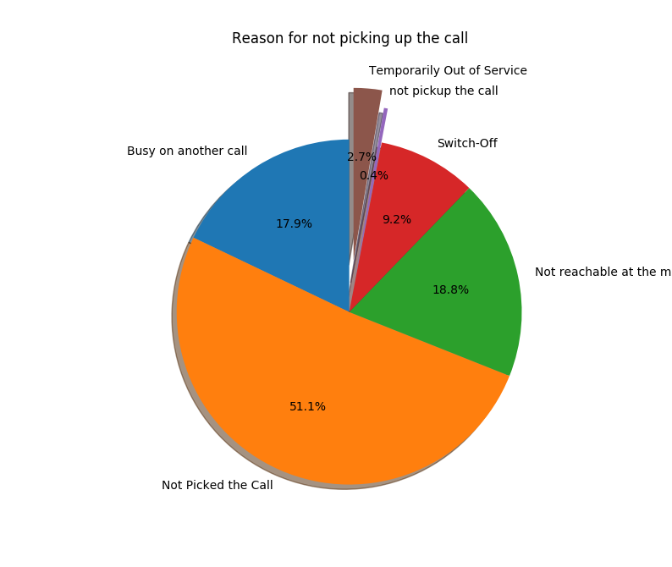
As we can see more than 35% of the calls were not picked up. So let us analyse this in greater depth.

Slide 12
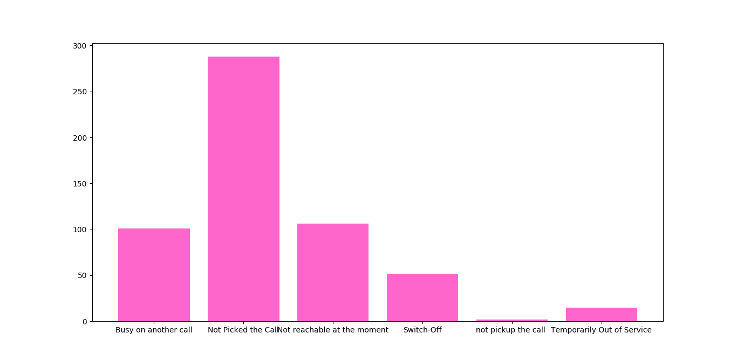
The following Histogram gives us a better understanding to why the call was not answered.

Slide 13
Feature parameters used in Machine Learning Modelling
Lead Validation : {Valid Contact : 1 , Invalid Contact : 0 },
Picked the phone : { Yes : 1 , No : 0 , Call Later : 2} ,
City : {Kota :1 , Jaipur : 2 , Indore : 3 , Other : 0 },
Class parameter
Lead Interested or Not : {Yes : 1 ,No:0}

Slide 14
The calling time and date feature variable is omitted as the data set contains only 1500 data points and the feature takes a total of around 15 values which makes the model rather unreliable.

Slide 15
Deploying the regression model with the above feature variables.

Slide 16
Tools Used :
Python and Advanced Excel

Slide 17
Necessary python libraries and packages used
import pandas as pd
import seaborn as sns
import numpy as np
import matplotlib.pyplot as plt
from sklearn import preprocessing
from sklearn.linear_model import LogisticRegression
from sklearn.model_selection import cross_val_score

Slide 18
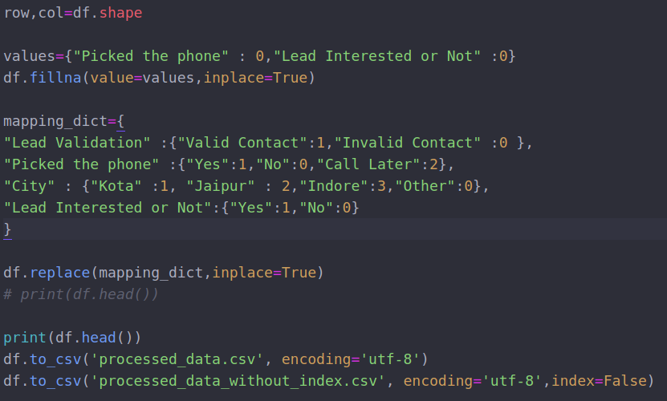
Data Preprocessing

Slide 19
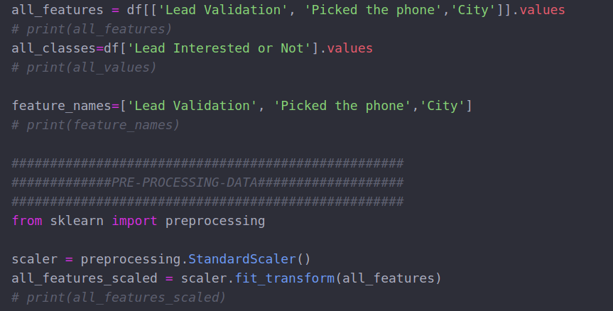
Data Preprocessing

Slide 20
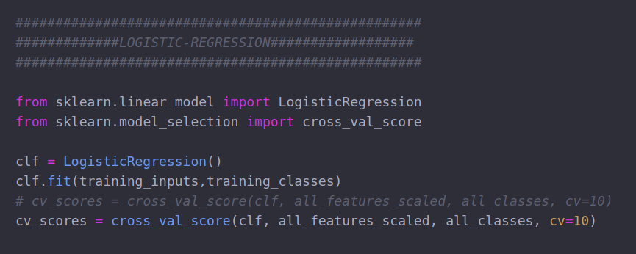
Deploying Regression Model

Slide 21
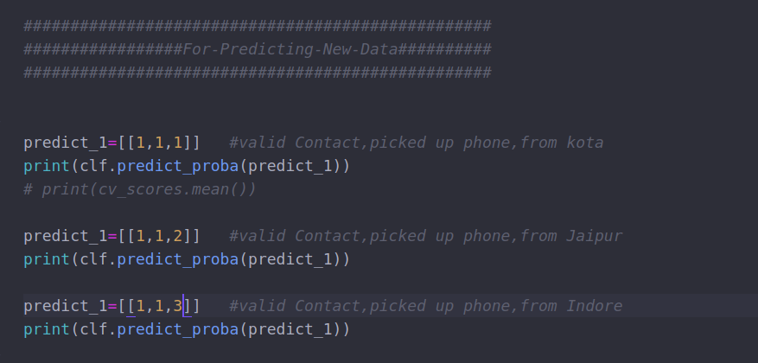
Predicting which city

Slide 22
Target audience
By applying the regression model we obtain the following data for each individual state :
Probability of not going ahead with the lead given that it’s a valid contact and they picked up the phone
Kota : 0.88195628
Jaipur : 0.8541652
Indore : 0.82115801
So the chances of a customer buying a solar panel is more in Indore when compared to the other states provided in the dataset.

