Slide 1
Task 4
PEACOCK SOLAR INTERN
FINAL PROJECT
DATA ANALYST

Slide 2
Peacock Solar Project
The goal of this project is to understand the data set, extract some insights from it and predict the states in which the company can invest and get maximum business
Some interesting insights from the given data
Most of the people work as Private Engineer
Most of the people own Independent house or Villa
733 people agree to utilize 26% to 50% of their roof tops for solar panel installation
Most of the solar panel installations were in Bangalore i.e 177
271 people already know Peacock Solar

Slide 3
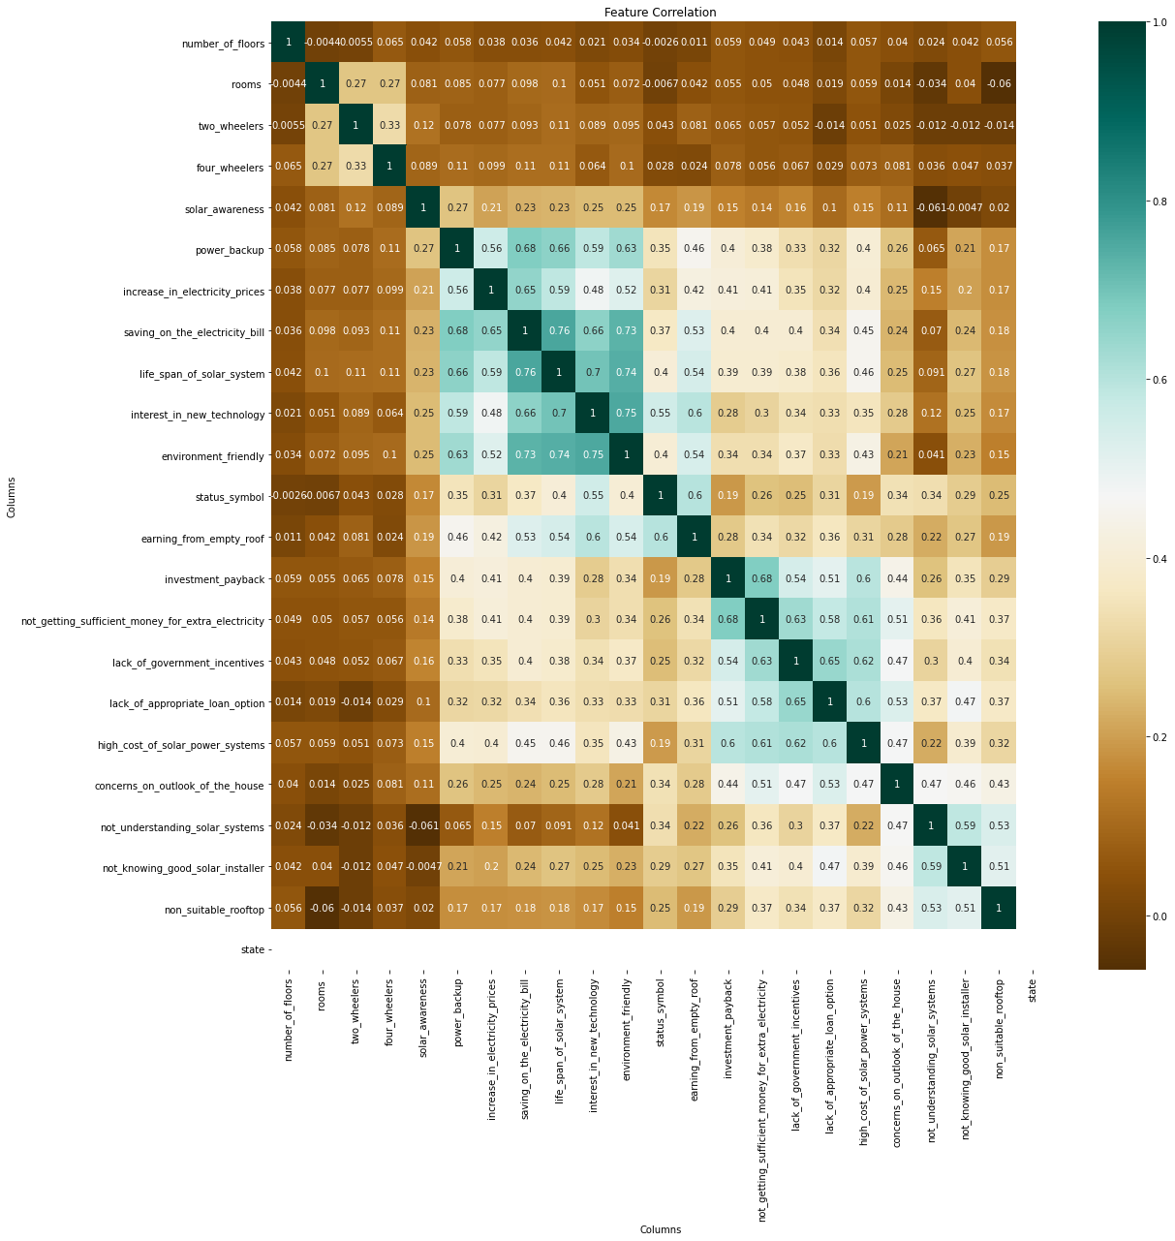
Correlational Heatmap
There is relatively stronger correlation between these factors
Expected correlation between saving_on_electricity_bill and lifespan_of_solar_system
Expected correlation between interest_in_new_technology and environment_friendly
Expected correlation between lifespan_of_solar_system and interest_in_new_technology
Unxpected correlation between saving_on_electricity_bill and envionment_friendly
Unxpected correlation between lifespan_of_solar_system and environment_friendly

Slide 4
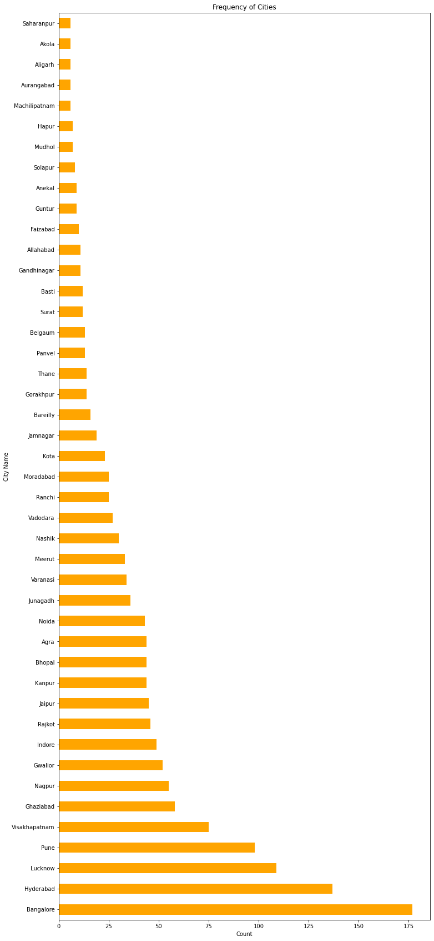
Analyzing Individual Cities
Now we have some factors that might affect purchase decisions of the customers
Encouraging factors (These are the factors which encourage the customers to install solar plants at their homes)
Discouraging factors (These are the factors which discourage the customers to install solar plants at their homes)
NOTE :
The values of each factor lies on a scale of 1 to 5 where, 1 means least important and 5 means most important

Slide 5
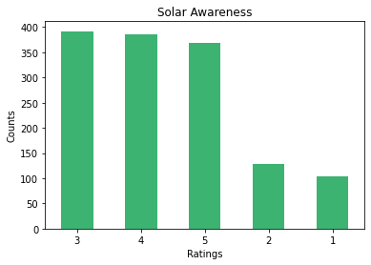
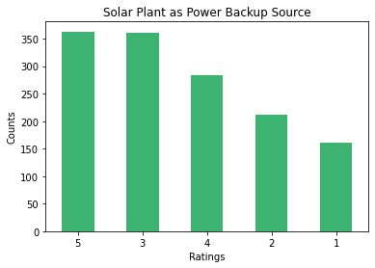
Analysis of Some Factors
Solar Awareness
Most people have rated 3, 4, and 5 for Solar Awareness
which means that they are quite aware of Solar Technology.
Solar Plant as Power Backup Source
most people have rated 3, 5, and 4 for Solar Plant as a
Power Backup Source which means people consider
Solar Technology as a reliable source for power backup.

Slide 6
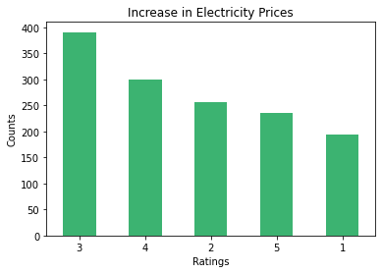
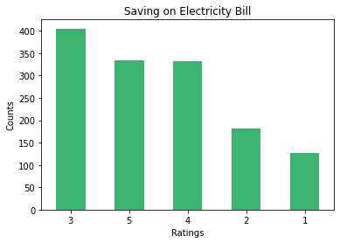
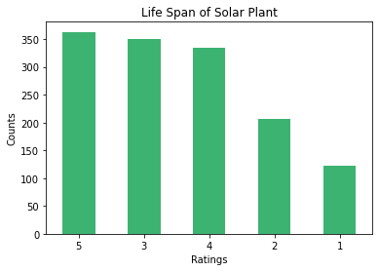
Increase in Elecricity Prices
Most people 4, 3, and 2 for Increase in Electricity Prices which means people would invest in Solar tEchnology if there is an increase in electricity prices.
Saving on Elecricity Bill
Most people have rated 3, 5, and 4 for Saving on Electricity Bill which means people would invest in Solar Technology for saving on electricity bill.
Life Span of Solar Plants
Most people have rated 5, 3, and 4 for Life Span of Solar Plant which means people will consider investing in Solar Technology if it has a longer life span.

Slide 7
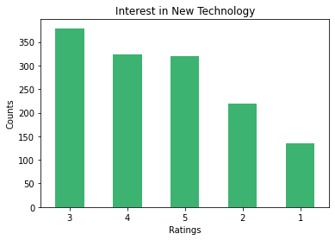
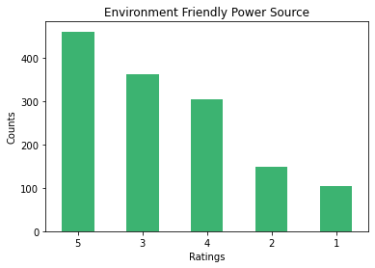
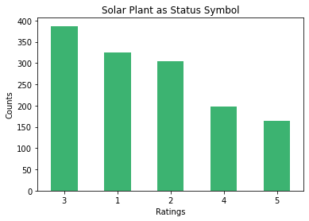
Intrest in New Technology
Most people have rated 3, 4, and 5 for Interest n New Technology which means they might invest in Solar technology if they are interested enough in it.
Environment Friendly Power Source
Most people have rated 5, 3, and 4 for Solar Plant as an Environment Friendly Power Source which means people tend to invest in Renewable and Environment Friendly Power Source
Solar Plant as Status Symbol
Most people have rated 3, 1, and 2 for Solar Plant as Status Symbol which means people do not tend to invest in Solar technology for it being a mere status symbol.

Slide 8
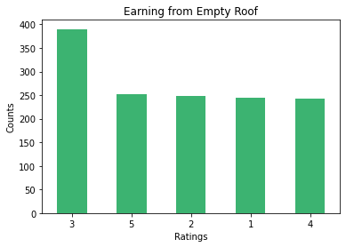
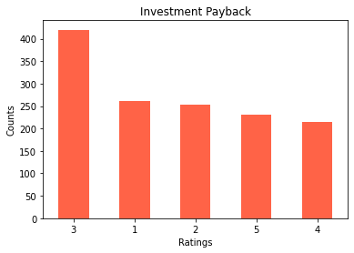
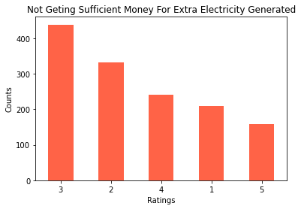
Earning From Empty Rooftop
Most people have rated 3, 5, and 2 for Earning From Empty Rooftop which means that customers consider this factor important while investing in solar technology.
Investment Payback
Most people have rated 3, 2, and 1 for Investment Payback which means this factor doesnot have a major impact on customer's purchase decision
Not getting Money For Extra Electricity Generated
Most people have rated 3, 2, and 4 for Not getting Money For Extra Electricity Generated which means this factor might have an impact on customer's purchase decision

Slide 9
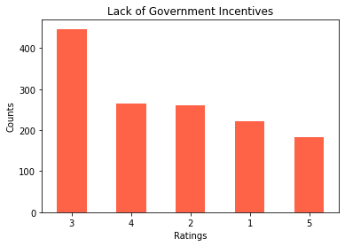
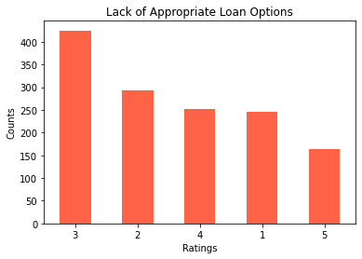
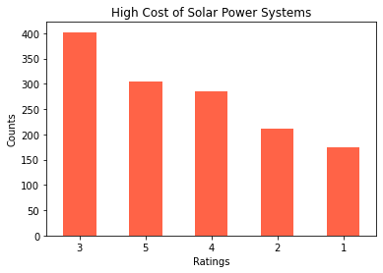
Lack of Government Incentives
Most people have rated 3, 4, and 2 for Lack of government incentives which means most people are not affected by givernment incentives for renewable energy
Lack of Appropriate Loan Options
Most people have rated 3, 2, and 4 for Lack of Appropriate Loan Options which means this factor doesnot have a major impact on customer's purchase decision
High Cost of Solar Power Plants
Most people have rated 3, 5, and 4 for High Cost of Solar Power Plants which means this factor can have a major impact on customer's purchase decision

Slide 10
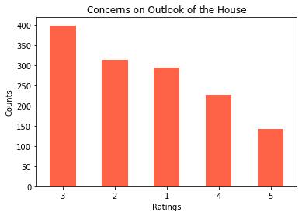
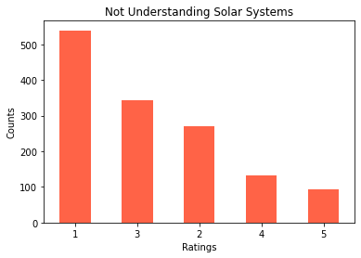
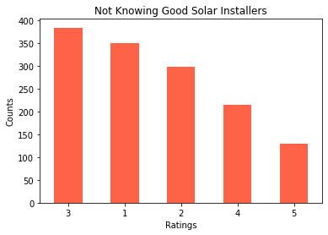
Concerns on Outlook of the House
Most people have rated 3, 2, and 1 for Concerns on Outlook of the House which means this factor doesnot have a major impact on customer's purchase decision
Not Understanding Solar Systems
Most people have rated 1, 3, and 2 for Not Understanding Solar Systems which means this factor doesnot have a major impact on customer's purchase decision
Not Knowing Good Solar Installers
Most people have rated 3, 1, and 2 for Not Knowing Good Solar Installers which means this factor doesnot have a major impact on customer's purchase decision

Slide 11
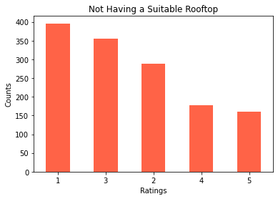
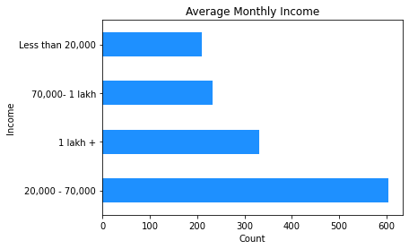
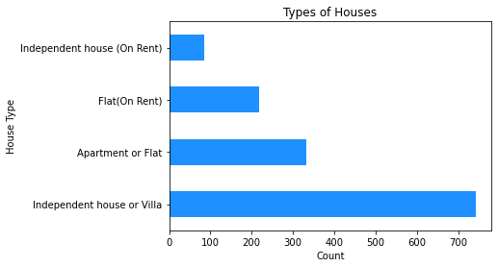
Not Having a Suitable Rooftop
Most people have rated 1, 3, and 2 for Not Having a Suitable Rooftop which means this factor doesnot have a major impact on customer's purchase decision
Average Monthly Income
Most people have 20,000+ monthly income which means people would invest in Solar Technology who have income more then 20,000.
Type of Houses
Most people have Independent Houses or Villa which means target people will be who have there own houses.

Slide 12
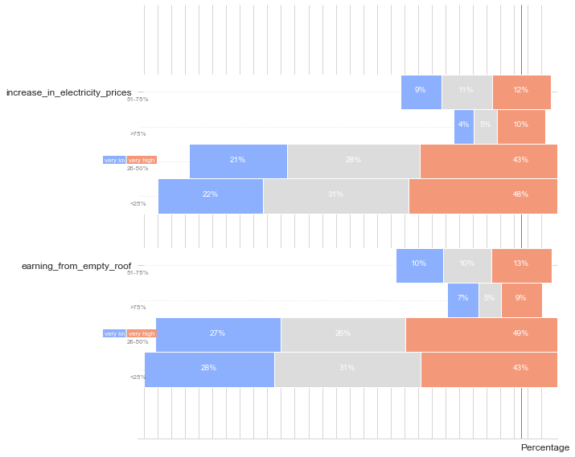
Plot for: Percentage of Roof Earning From Empty Roof Increase in Electricity Prices
1. Percentage of Roof vs Ratings for Increase in Electricity Prices
13% of the customers would consider utilizing 51% - 75% area of their roof for installing solar plant in case of Increase in Electricity Prices.
10% of the customers would consider utilizing greater than 75% area of their roof for installing solar plant in case of Increase in Electricity Prices.
44% of the customers would consider utilizing 26% - 50% area of their roof for installing solar plant in case of Increase in Electricity Prices.
47% of the customers would consider utilizing less than 25% area of their roof for installing solar plant in case of Increasing Electricity Prices.
2. Percentage of Roof vs Ratings for Earning from Empty Roof vs Ratings
13% of the customers would consider utilizing 51% - 75% area of their roof for installing solar plants if there is enough scope for Earning From Empty Roof.
9% of the customers would consider utilizing greater than 75% of their roof for installing solar plants if there is enough scope for Earning From Empty Roof.
50% of the customers would consider utilizing 26% - 50% of their roof for installing solar plants if there is enough scope for Earning From Empty Roof.
43% of the customers would consider utilizing less than 25% of their roof for installing solar plants if there is enough scope for Earning From Empty Roof.

Slide 13
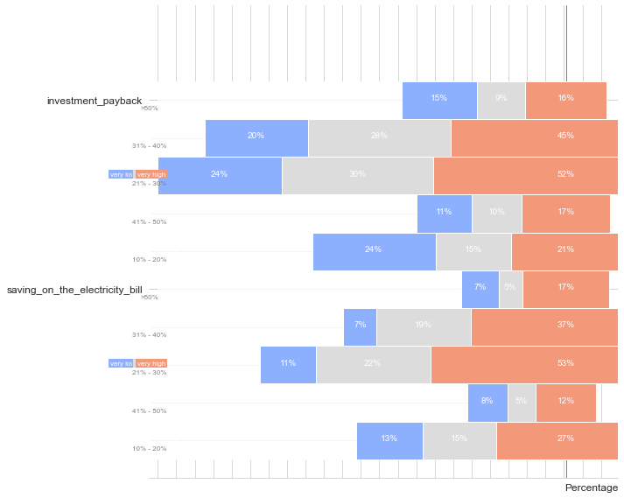
Plot for Expectation on Saving Electricity Bill Saving on Electricity Bill Investment Payback
1. Expected Percentage of Saving on Electricity Bill vs Ratings for Investment Payback
16% of the customers who expect to save more than 50% on electricity bill would consider guranteed Investment Payback as an important factor for investing in solar technology.
46% of the customers who expect to save between 31% - 40% on electricity bill would consider guranteed Investment Payback as an important factor for investing in solar technology.
53% of the customers who expect to save 21% - 30% on electricity bill would consider guranteed Investment Payback as an important factor for investing in solar technology.
18% of the customers who expect to save 41% - 50% on electricity bill would consider guranteed Investment Payback as an important factor for investing in solar technology.
22% of the customers who expect to save 10% - 20% on electricity bill would consider guranteed Investment Payback as an important factor for investing in solar technology.
2. Expected Percentage of Saving on Electricity Bill vs Ratings for Saving on Electricity Bill
18% of the customers who expect to save more than 50% on electricity bill consider Saving on Electricity Bill as an important factor for investing in solar technology.
37% of the customers who expect to save 31% - 40% on electricity bill consider Saving on Electricity Bill as an important factor for investing in solar technology.
51% of the customers who expect to save 21% - 30% on electricity bill consider Saving on Electricity Bill as an important factor for investing in solar technology.
13% of the customers who expect to save 41% - 50% on electricity bill consider Saving on Electricity Bill as an important factor for investing in solar technology.
28% of the customers who expect to save 10% - 20% on electricity bill consider Saving on Electricity Bill as an important factor for investing in solar technology.

Slide 14
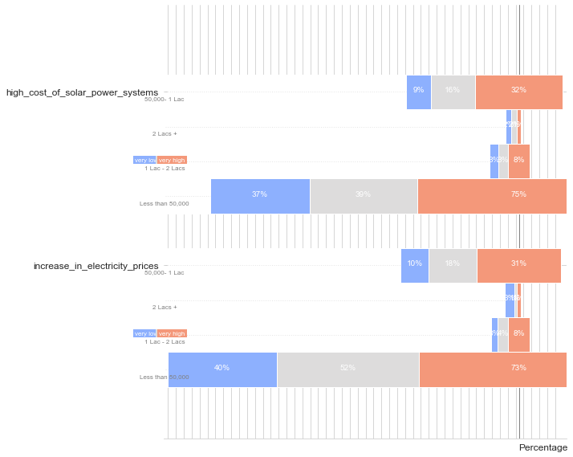
Plot for Maximum Investment in Solar Increase in Electricity Prices High Cost of Solar Power Systems
1. Maximum Investment in Solar vs Ratings for Increase in Electricity Prices
33% of the customers would invest 50,000 - 1 Lac in Solar Technology but consider High Cost of Solar Power Systems as a factor for not investing in solar technology.
8% of the customers would invest 1 Lac - 2 Lacs in Solar Technology but consider High Cost of Solar Power Systems as an factor for not investing in solar technology.
74% of the customers would invest less than 50,000 in Solar Technology but consider High Cost of Solar Power Systems as a factor for not investing in solar technology.
2. Maximum Investment in Solar vs Ratings for High Cost of Solar Power Systems
32% of the customers would invest 50,000 - 1 Lac in Solar Technology and consider Increase in Electricity Prices for their investment decision.
8% of the customers would invest 1 Lac - 2 Lacs in Solar Technology and consider Increase in Electricity Prices for their investment decision.
72% of the customers would invest less than 50,000 in Solar Technology and consider Increase in Electricity Prices for their investment decision.

Slide 15
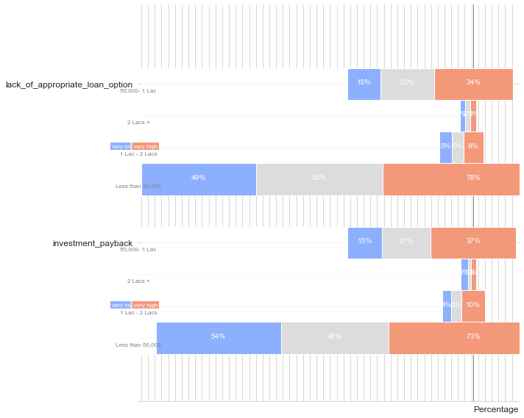
Plot for Maximum Investment in Solar Investment Payback Lack of Appropriate Loan Options
1. Maximum Investment in Solar vs Ratings for Lack of Appropriate Loan Options
34% of the customers with maximum investment between 50,000 - 1 Lac in Solar Technology will tend to show less interest in Solar Technology if there are no Appropriate Loan Options.
9% of the customers with maximum investment between 1 Lac - 2 Lac in Solar Technology will tend to show less interest in Solar Technology if there are no Appropriate Loan Options.
79% of the customers with less than 50,000 in Solar Technology will tend to show less interest in Solar Technology if there are no Appropriate Loan Options.
2. Maximum Investment in Solar vs Ratings for Investment Payback
38% of the customers would invest 50,000 - 1 Lac in Solar Technology if there is guranteed Investment Payback.
11% of the customers would invest 1 Lac - 2 Lac in Solar Technology if there is guranteed Investment Payback.
38% of the customers would invest less than 50,000 in Solar Technology if there is guranteed Investment Payback.

Slide 16
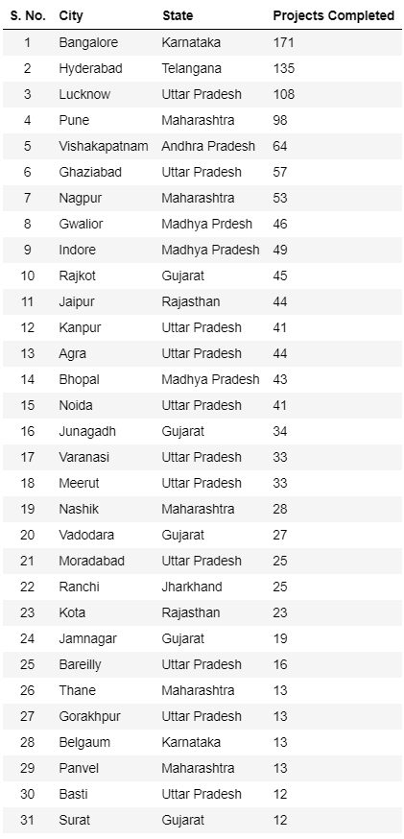
Conclusion
From our EDA we can conclude that these cities have given maximum business for the company and the analysis suggests that expanding busines further in these cities will be profitable for the company
Target People will be who have annual income 20,000+
Target People will be who have there own houses
Target People will be who has more electricity bill and want to reduce it
Bangalore , Hyderabad and Lucknow will be the next big cities company should look forward to

