Slide 1

Asynchrony for the Masses Marc Duerner
Multi-Threading is hard.
If we are not careful we get stuck, because of deadlocks, livelocks or uncooperative threads that do not respond anymore. It is shown here how to avoid these problems with a portable and productive API, that also delivers high performance, determinism and reliability.

Slide 2
Threading for the Masses
How do I stop a blocked Thread?
We know the solution is not to terminate or kill the thread:
Interrupt Politely, Dr. Dobbs Journal, April 2008, Herb Sutter, http://drdobbs.com/cpp/207100682
This is an unsolved problem so far, the only answer to this is simply not to block
Blocking is a sign of a deadly disease and the OS might simply put an end to your suffering (watchdog)
How many threads should I start?
For performance reasons: One thread per CPU
Having more threads will not make your app scale better, because of context switching
Intel TBB lets you tune the number of threads in the pool
But: The world isnt‘t perfect
We must not block the GUI main loop so we place long tasks in a worker thread
We only do this because we have no other choice
Rule 1: never block the UI thread (ok, we knew this already)
Rule 2: never block a server thread (ok, I can see why…)
Rule 3: never block a worker thread (WTF ???)

Slide 3
When Timers go wrong
void thread_function()
{
while(keepRunning)
{
sleep(interval);
observer->notify();
}
}
The code above will make experienced developers cry (…or laugh)
Timer threads are a great example of completely unneccessary threading
Can you spot all the other bugs?

Slide 4
Timers Done Right (1)
void onTimeout()
{
std::cout << „timeout“ << std::endl;
}
int main(int argc, char** argv)
{
Pt::System::MainLoop loop;
Pt::System::Timer timer;
timer.setActive(loop);
timer.timeout() += Pt::slot(&onTimeout);
timer.timeout() += Pt::slot(loop, &MainLoop::exit);
timer.start(5000);
loop.run();
return 0;
}

Slide 5
Timers Done Right (2)
Program blocks on run() with 0% CPU time if nothing happens
Please, no burning loops
Save battery (and the environment)
If something happens, we are notified by signals and delegates
Safe, fast and flexible callback mechanism (cost: twice as much as virtual call)
Signal is 1:N relationship, Delegate is 1:1 relationship
Used for notification within a thread context
Automatic disconnect when slot or signal/delegate are destructed
Timer monitored by an event loop
Deregisters automatically when loop or timer are destoyed
Easy life-time management
Notifies through timeout signal
Interval based, drift-free
Unless you block the event loop for longer than the timer inteval
Accuracy depends on OS
Cheap
Requires 64 bytes when registered in an event loop
Event loop is not slowed down when many timers are registered

Slide 6
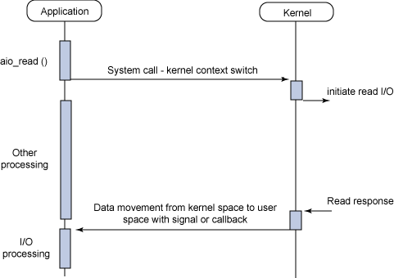
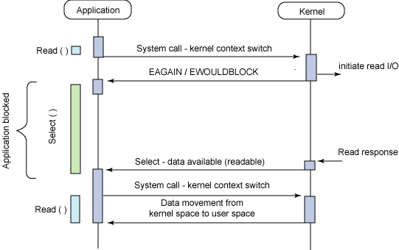
Proactors vs Reactors
Proactor (asynchronous non-blocking)
Long tasks run asynchronously
Completion handler called (or some other kind of notification)
Must be cancellable
Example: POSIX AIO (hint: buffer needed at start of operation)
Reactor (asynchronous blocking)
Block on all resources
Notifies when operation can be performed without blocking
Must be cancellable
Example: select/poll (hint: buffer is used later)
OS might offer just one or both
Application API must support both

Slide 7
Asynchronous I/O (1)
char buffer[25];
void onWrite(Pt::System::IODevice& dev)
{
size_t n = dev.endWrite();
}
void onRead(Pt::System::IODevice& dev)
{
size_t n = dev.endRead();
std::cout.write(buffer, n);
}
int main(int argc, char** argv)
{
Pt::System::MainLoop loop;
Pt::System::Pipe pipe;
pipe.in().setActive(loop);
pipe.in().beginWrite(“Hello World”, 11);
pipe.in().outputReady() += Pt::slot(&onWrite);
pipe.out().setActive(loop);
pipe.out().beginRead( buffer, sizeof(buffer) );
pipe.out().inputReady() += Pt::slot(&onRead);
loop.run();
return 0;
}
In (write to)
Pipe
Out (read from)

Slide 8
Asynchronous I/O (2)
IODevices wrap native I/O handle
File or socket descriptor
Overlapped I/O event handles
Active objects
IODevices for Files, Pipes, SerialDevices, TCP, UDP, parent/child process I/O
IODevice monitored by an event loop
Deregisters when loop or IODevice are destroyed
Notifies through inputReady and outputReady signals
Begin-notify-end pattern
Solves C10k problem
http://www.kegel.com/c10k.html
„It's time for web servers to handle ten thousand clients simultaneously, don't you think? After all, the web is a big place now. “
Renaissance of reactive I/O
In the olden days (before MT) it used to be your only choice !!!
90‘s were the dark ages of multi-threading (Hart J.M., Windows System Programming)
Some OS don‘t offer blocking API anymore (Symbian, WinRT)
Newest generation of web servers work this way: nginx, Cherokee
Blocking I/O is vulnerable to attacks such as Slowloris DOS
epoll since Linux 2.5.44
Kqueue/knotify since FreeBSD 4.1

Slide 9
Asynchronous I/O with streams (1)
void onWrite(Pt::System::IOBuffer& sb)
{
size_t n = sb.endWrite();
std::cout << „bytes left: “ << sb.out_avail() << std::endl;
if(sb.out_avail() > 0)
sb.beginWrite();
}
Pt::System::MainLoop loop;
Pt::System::Pipe pipe;
pipe.in().setActive(loop);
Pt::System::IOBuffer sb(pipe.in());
sb.outputReady() += Pt::slot(&onWrite);
std::ostream os(&sb);
os << „Hello world!“ << std::endl;
sb.beginWrite();
loop.run();

Slide 10
Asynchronous I/O with streams (2)
void onRead(Pt::System::IOBuffer& sb)
{
size_t n = sb.endRead();
std::cout << „bytes available: “ << sb.in_avail() << std::endl;
char in[20];
std::istream is(&sb);
is.readsome(in, sizeof(in));
}
Pt::System::MainLoop loop;
Pt::System::Pipe pipe;
pipe.out().setActive(loop);
Pt::System::IOBuffer sb(pipe.out());
sb.inputReady() += Pt::slot(&onRead);
sb.beginRead();
loop.run();

Slide 11
Asynchronous I/O with streams (3)
With streams we mean std::iostreams with std::streambufs
Again, begin-notify-end
IODevice works on std::streambuf‘s buffer areas
IOBuffer can work with any IODevice
Output buffer:
Enlarge buffer area on overflow
We don‘t know up-front how much data we want to write
Possible strategy: Start writing when buffer exceeds a water mark
Query buffer size with out_avail()
On successful write only part of buffer might be written out
Important to optimize write() system call
Input Buffer:
On successful read only part might be filled
Optimize read system call
Check buffer size with in_avail();

Slide 12
Asynchronous I/O - Error Handling (1)
void onRead(Pt::System::IOBuffer& sb)
{
try
{
size_t n = sb.endRead(); // throws
char in[20];
std::istream is(&sb);
is.readsome(in, sizeof(in));
}
catch(const Pt::System::IOError& e)
{
// handle I/O error, close device etc…
}
}

Slide 13
Asynchronous I/O – Error Handling (2)
All exceptions are defered until the operation is ended
IODevice::endRead
IODevice::endWrite
IOBuffer::endRead
IOBuffer::endWrite
We will see more later, fits well with begin-notify-end pattern
If exceptions were just thrown where they appear we would be kicked out of the loop
Need to deal with exceptions in the callback
IOErrors can be cured by closing the connection / device

Slide 14
Asynchronous I/O Software Stack
XML Parser/Writer
Node-based XML Processing
TextStream
Text Encoding/Decoding
IOStream/IOBuffer
I/O Buffering
IODevice
Raw I/O
OS

Slide 15
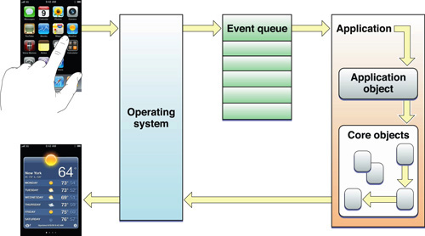
Event Driven Programming
Not a new technology
Traditionally, all UI are event-driven
Events are stored by the OS in the event queue of an application
Application wakes up and processes events in ist context
Events are routed to receivers (publish-subscribe)
Can be leveraged for inter-thread communication

Slide 16
Inter-Thread Event Handling
class ExitEvent : public Pt::Event {};
void threadFunc()
{
ExitEvent ev;
Pt::System::Application::instance().loop().commitEvent(ev);
}
void onExitEvent(const ExitEvent& ev)
{
Pt::System::Application::instance().loop().exit();
}
int main(int argc, char** argv)
{
Pt::System::Application app(argc, argv);
app.loop().eventReceived() += Pt::slot(&onExitEvent);
Pt::System::AttachedThread thread(Pt::callable(&threadFunc));
thread.start();
app.run();
return 0;
}

Slide 17
Inter-Thread Event Handling
Threads communicate through the means of events and a thread-safe loop API
Use events to cross thread borders
commitEvent() puts event into queue and wakes up loop
queueEvent() only puts event into queue
wake() forces a loop iteration
exit() quits an event loop
Signal dispatches events within a thread
No manual cast required.
Event type derived from signature: app.loop().eventReceived() += Pt::slot(&onExitEvent);
Ideal: Per-Thread event loop
Performance: one active thread per CPU
Performance: much better locality of reference
Performance: within a thread we don‘t need to lock (example: allocators)
Thread A
Main Thread
Thread B
EventQueue
EventQueue
EventQueue

Slide 18

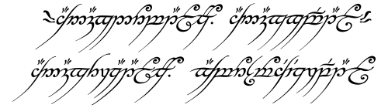
The Big Picture
Combination of asynchronous I/O, Events and Timers
Reliably stoppable service threads
Reduce total number of required threads
Less locking
Clear separation of responsibility
Events
EventLoop
I/O
Timers
One ring to rule them all, one ring to find them, One ring to bring them all and in the darkness bind them

Slide 19
Implementation Hints
DWORD WaitForMultipleObjects(DWORD nCount,
const HANDLE* lpHandles,
BOOL bWaitAll,
DWORD dwMilliseconds );
Register I/O handles (IODevice) as fd_set (non-blocking) or HANDLE (overlapped)
Begin-notify-end can handle level and edge triggering
Register windows event or pipe handle to wake up if events need to be processed
Suspend timeout is interval to next timer in timer queue
int select(int nfds,
fd_set *readfds,
fd_set *writefds,
fd_set *exceptfds,
struct timeval *timeout);
Works also for:
NSRunLoop / CFRunLoop
QNX Photon
Epoll
Poll
Kqueue/knotify
POSIX AIO
Symbian ActiveObjects/ActiveScheduler

Slide 20
Remote Procedure Calls
Client Server Communication
Client serializes arguments and sends data to server
Server deserializes arguments and calls local procedure
Server serializes return value and sends data to client
Client deserializes return value
Key issues are network I/O and serialization
Client
Server
RPC Call
Procedure Call
Procedure Return
RPC Return

Slide 21
Reliable XML-RPC Clients
void onMultiply(const Pt::XmlRpc::Result<int>& result)
{
try
{
int r = result.get();
std::cout << „result: “ << r << std::endl;
}
catch(const Pt::XmlRpc::Fault& fault)
{
std::cerr << fault.what() << std::endl;
}
catch(const Pt::System::IOError& e)
{
std::cerr << e.what() << std::endl;
}
}
int main(int argc, char** argv)
{
Pt::System::MainLoop loop;
Pt::Net::Endpoint ep("127.0.0.1", 4000);
Pt::XmlRpc::HttpClient client(loop, ep, "/calc");
Pt::XmlRpc::RemoteProcedure<int, int, int> multiply(client, „multiply“);
multiply.finished() += Pt::slot(&onMultiply);
multiply.begin(6, 7);
loop.run();
return 0;
}

Slide 22
Reliable XML-RPC Services
int multiply(int a, int b)
{
if( ckeckOverrun(a, b) )
throw Pt::XmlRpc::Fault(„integer overrun“, 40);
return a * b;
}
int add(int a, int b)
{
if( ckeckOverrun(a, b) )
throw Pt::XmlRpc::Fault(„integer overrun“, 40);
return a + b;
}
int main(int argc, char** argv)
{
Pt::System::MainLoop loop;
Pt::XmlRpc::ServiceDefinition def;
service.registerProcedure(„multiply“, &multiply);
service.registerProcedure(„add“, &add);
Pt::XmlRpc::HttpService service(def);
Pt::Http::Server server(loop, "127.0.0.1", 4000);
Pt::Http::MapUrl mapUrl(„/calc“, service);
server.addServlet(mapUrl);
loop.run();
return 0;
}

Slide 23
Reliable XML-RPC Clients and Services (1)
Maps to function or method call
Almost like calling a local function
Begin-notify-end pattern with function object
Can export any class as a service
Can register normal existing functions as service prodecures
We can throw on service side and catch on client side !!!
Fully non-blocking API available
Many remote calls from one thread
No need for synchronisation
No need for extra thread, mix with timers, events and other I/O
Cancel and immediate stop possible
Does not need WSDL or IDL etc…
Wait a minute! What about complex objects as parameters?

Slide 24
Reliable XML-RPC Clients and Services (2)
But I want this:
Pt::XmlRpc::RemoteProcedure<PositionInfo> getPosition(„getPosition“);
Does not compile until framwork knows how to serialize PositionInfo
Only need to implement two operators
Not Good: serializers as generated code according to some description language
Complicates build process, need to edit generated code
Generated code is often limited in various ways
Locked into an alien type system
What Pt does instead: generic serialization to support any kind of RPC
Compile time saftety
Requires only C++ language features

Slide 25
Reliable XML-RPC Clients and Services (3)
class PositionInfo
{
friend void operator>>=(const Pt::SerializationInfo& si, PositionInfo& p);
friend void operator<<=(Pt::SerializationInfo& si, const PositionInfo& p);
public:
PositionInfo()
: _x(0), _y(0)
{}
private:
Pt::uint32_t _x;
Pt::uint32_t _y;
};
void operator>>=(const Pt::SerializationInfo& si, PositionInfo& p)
{
si.getMember(„x") >>= p._x;
si.getMember(„y") >>= p._y;
}
void operator<<=(Pt::SerializationInfo& si, const PositionInfo& p)
{
si.setTypeName(„PositionInfo");
si.addMember(„x") <<= p._x;
si.addMember(„y") <<= p._y;
}

Slide 26
Reliable XML-RPC Clients and Services (4)
Serialization is non-intrusive
Don‘t need to derive some interface
Use your types
std::string, CString, WxString all work in the same way, none is preferred
No needless conversions from alien string, array etc…
Object graph can be build up and broken-down incrementally
Prerequisite for I/O multiplexing
Also true for parser, text encoder etc…
It gets even better: custom composer and decomposer
Use less memory
Higher performance
Handle really large objects/collections
More difficult to implement

