Slide 1


LEGO®-Inspired Modular Integration of 3D printed Microfluidic Components
Adriano Nisi
Tutors: Prof. G. Barillaro and Dr. S. Surdo
Barillaro’s Group

Slide 2
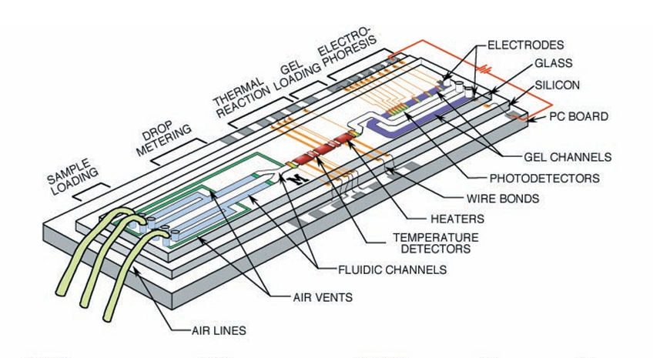
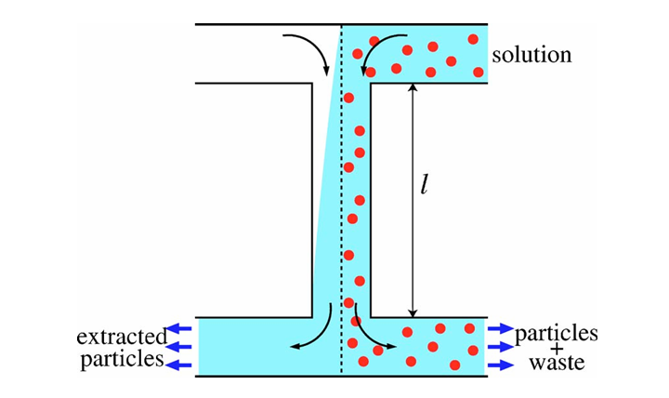
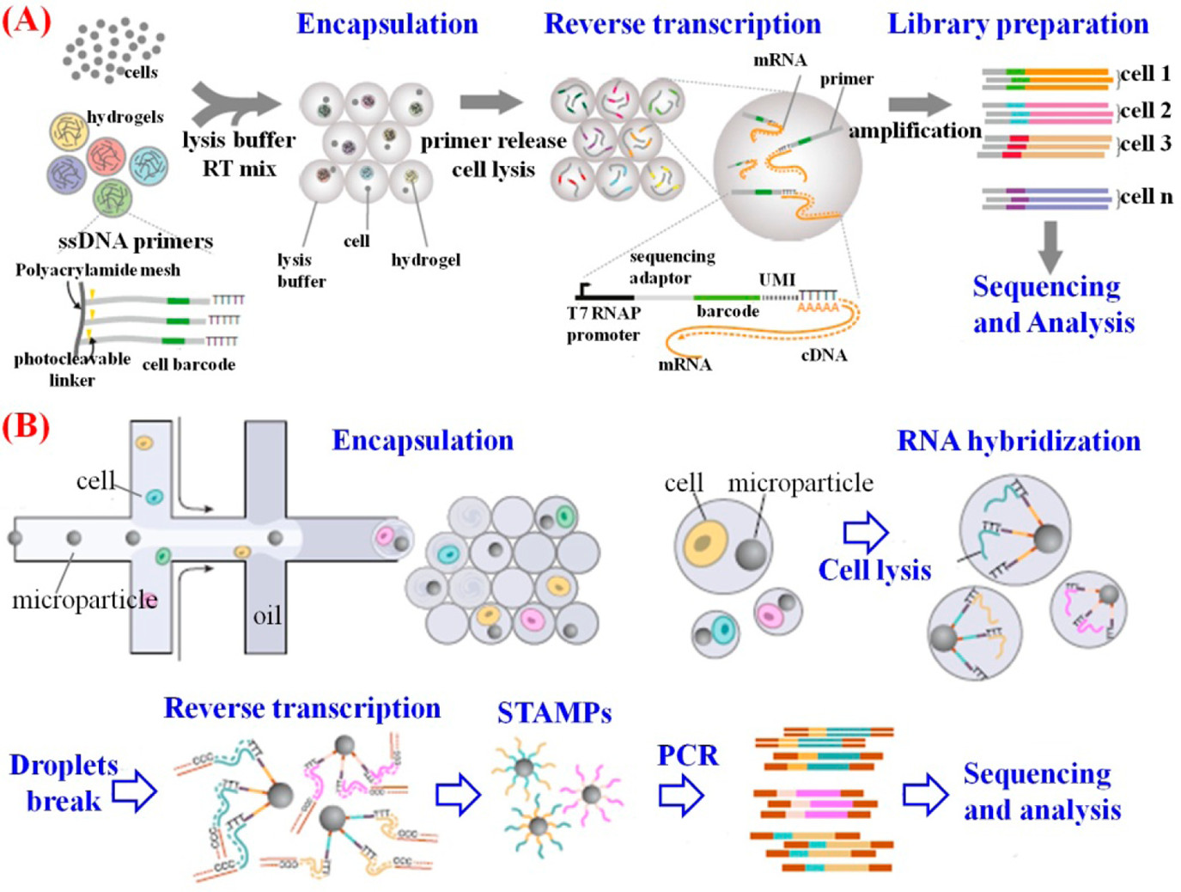
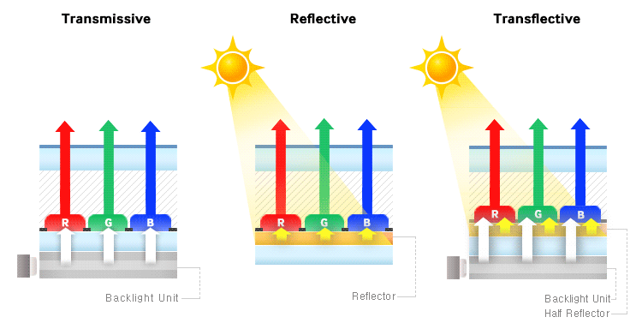
Electrophoresis
Particle filtration
Microfluidics:
A tiny fluid droplet
yet several applications
https://doi.org/10.1016/S0924-4247(97)80219-1
10.1126/science.282.5388.484
RNA analysis
Reflective displays

Slide 3
A microfluidic device has a lot of functions to do.
The more the functions, the more the complexity
Fluid input sample
Microfluidic device
Function 1
Function 2
Function 3
Function 4
Fluid output result

Slide 4
A microfluidic device has a lot of functions to do.
The more the functions, the more the complexity
Divide et impera!
One module for each function
Fluid input sample
Fluid input sample
Microfluidic device
Microfluidic device
Function 1
Module 1
Function 1
Function 2
A possible solution
Module 2
Function 2
Function 3
Module 3
Function 3
Function 4
Module 4
Function 4
Fluid output result
Fluid output result

Slide 5
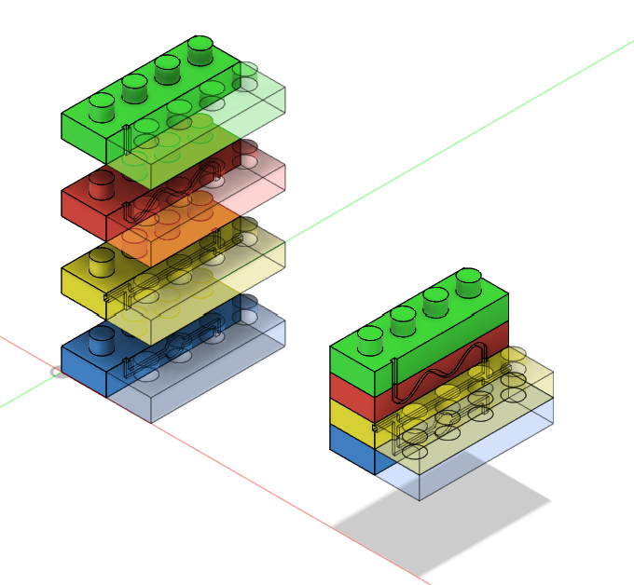
Divide et impera!
One module for each function
A modular microfluidic system
through LEGO®-like interlocks
Fluid input sample
Microfluidic device
Module 1
Function 1
Module 2
Function 2
Our solution
Module 3
Function 3
Module 4
Function 4
Fluid output result

Slide 6
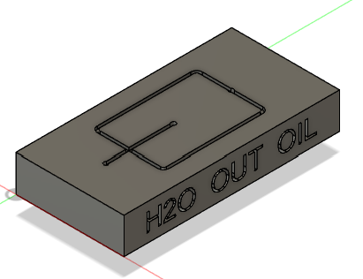
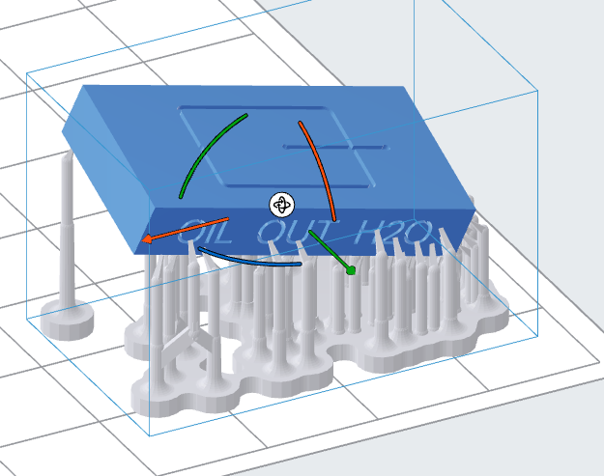
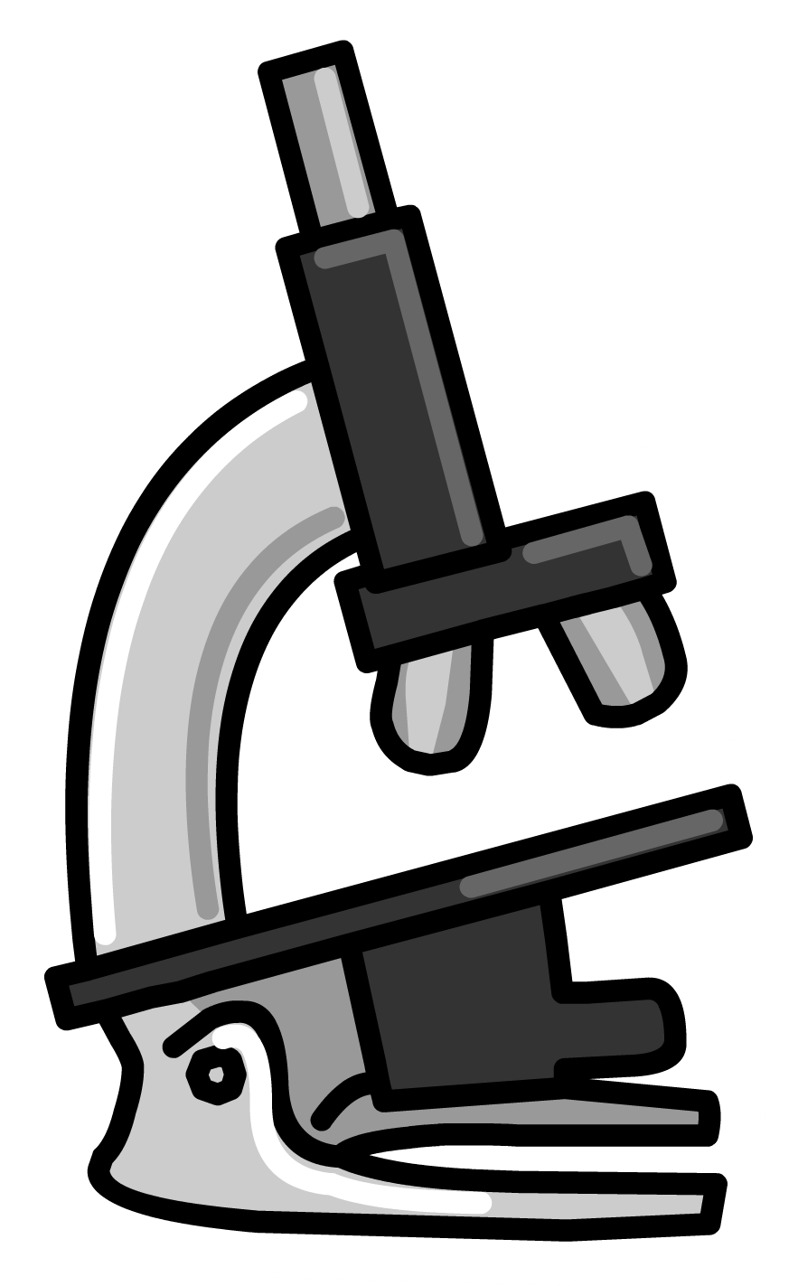


PIECES DESIGN
Goal: To optimize the interlock
SCALING
FACTOR
3D PRINTING
NO
IMAGE ACQUISITION
JOINT
YES
IMAGE ANALYSIS

Slide 7
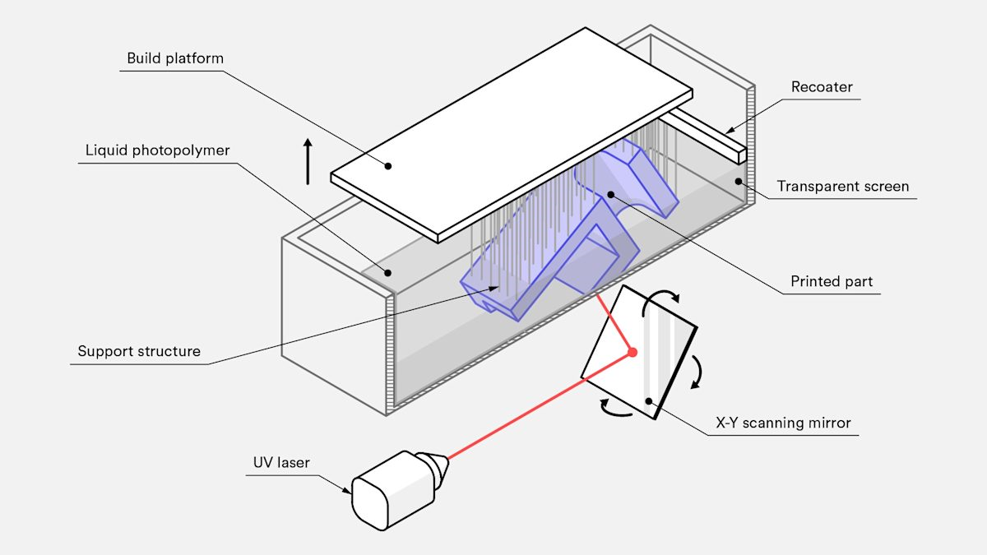
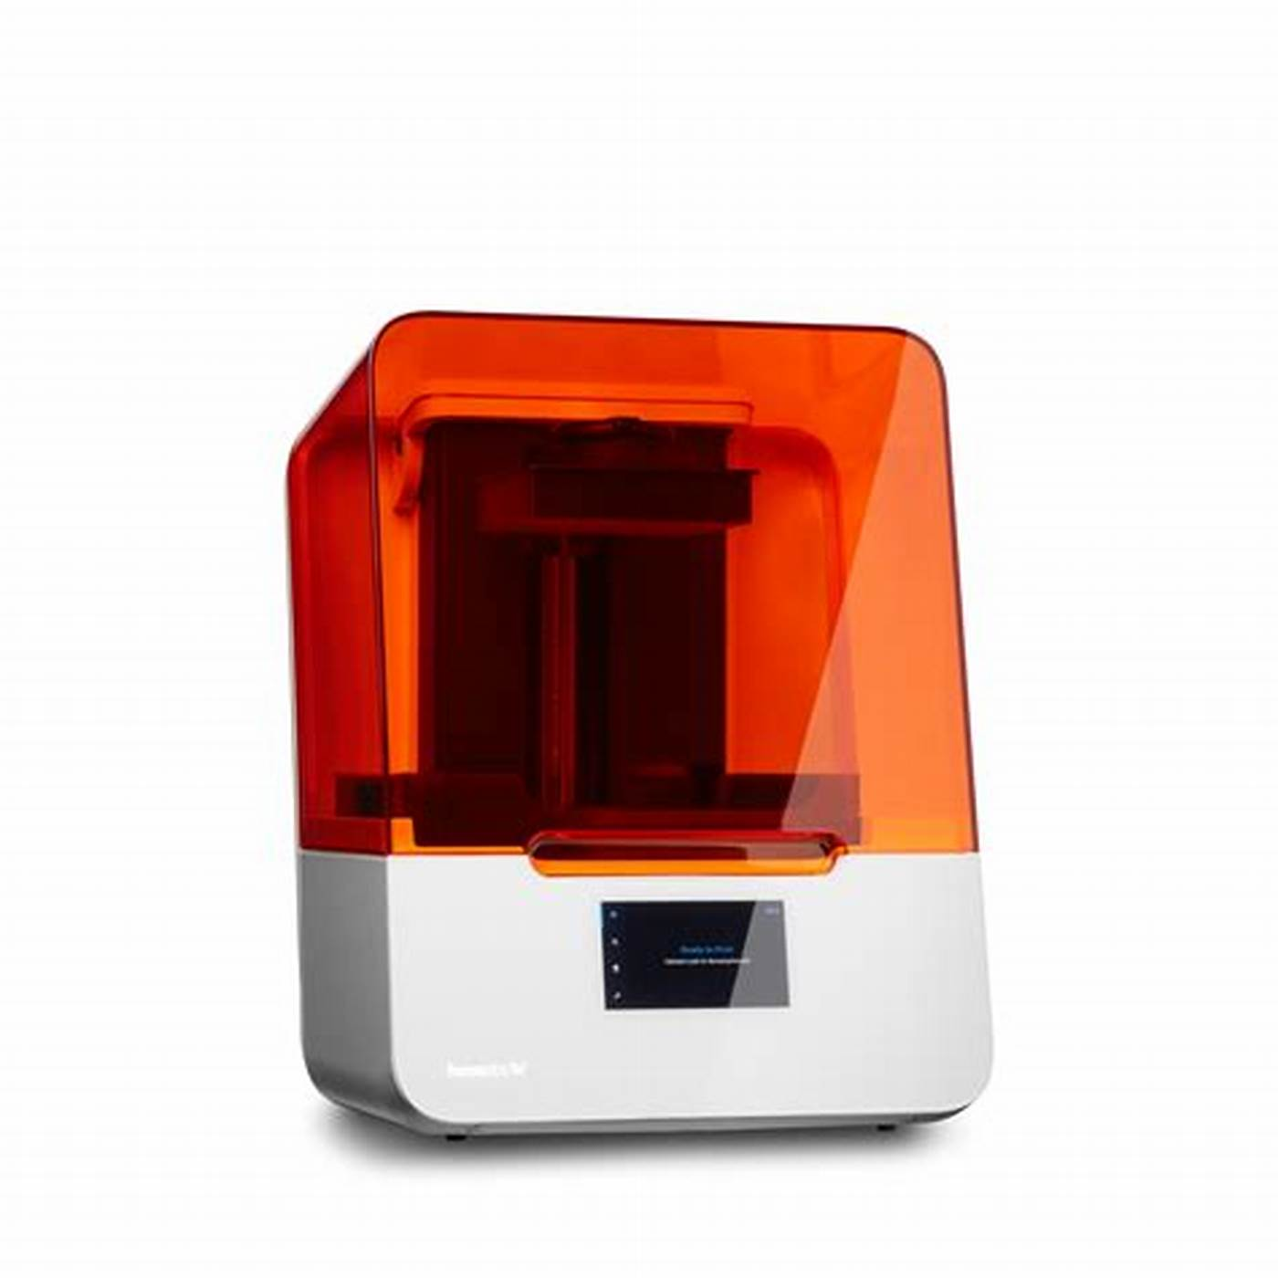
Selected Fabrication Process: Stereophotolithography (SLA)
How does SLA work?
Layer formation at fixed Z
  Point-by-point(XY plane) photopolymerization through UV laser scanning
3D object printing:
  Layer-by-layer construction at sequential Z position
Micrometric spatial resolution
  25 µm in XYZ
High speed
  10-50 mm/h (in Z)
Formlabs KhakiPytilia
Resin Type: Clear v4
Resolution: 0,025mm=25µm
Suitable for rapid and cost-effective prototyping of microfluidics chip but….

Slide 8
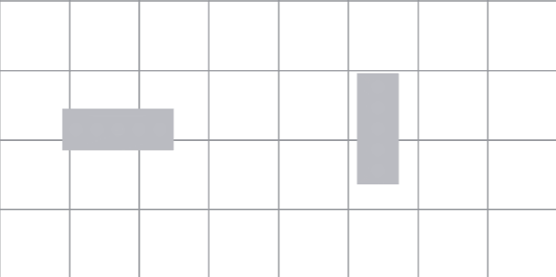
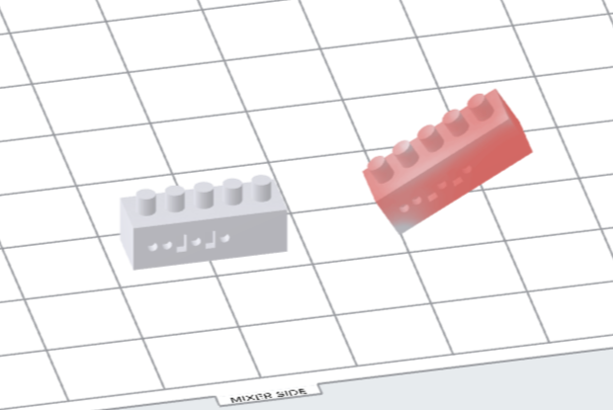
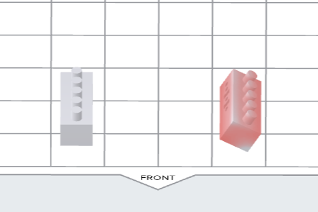
SLA: Pieces orientation issue
Printing Grid
The outcome of SLA depends on the orientation given to the pieces to be printed within the printing grid
Morphology, characteristics and functions might be affected by the angles chosen
Mixer side
Front side
1)z_Rotation:(90°)
3)y_Rotation: (ay)
2)x_Rotation: (ax)
Mixer side
Front side
Mixer side
Front side
Piece arrangement on Formlabs file
… we conducted a systematic study aimed at finding the optimal orientation,
namely the printing angles that provide the highest fidelity between the printed and designed geometries

Slide 9
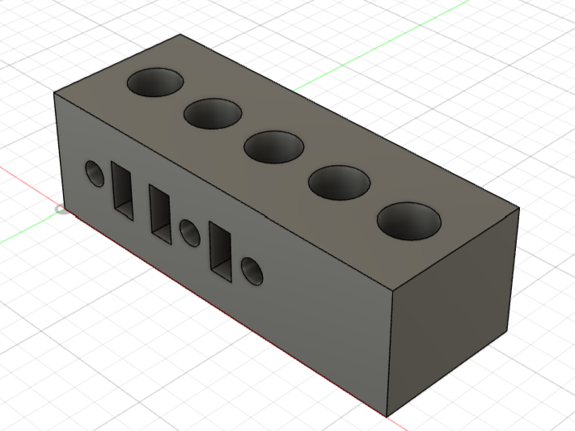
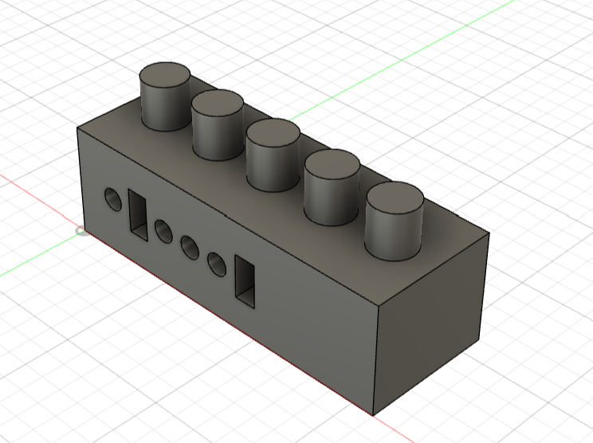
Which printing angle gives the best interlock?
Hole-block with code on it
Pillar-block with code on it
Hole-block
Dimension: 16mmx6mmx5mm
Hole type: cylindric
Hole dimension: Ø=2000µm,
depth=2mm
Pillar-block
Dimension: 16mmx6mmx5mm
Pillar type: cylindric
Pillar dimension: Ø=2000µm,
height=2mm
ax\ay | 0° | 15° | 30° | 45° | 60° | 90°
0° | (0°;0°) | (0°;15°) | (0°;30°) | (0°;45°) | (0°;60°) | (0°;90°)
15° | (15°;0°) | (15°;15°) | (15°;30°) | (15°;45°) | (15°;60°) | (15°;90°)
30° | (30°;0°) | (30°;15°) | (30°;30°) | (30°;45°) | (30°;60°) | (30°;90°)
45° | (45°;0°) | (45°;15°) | (45°;30°) | (45°;45°) | (45°;60°) | (45°;90°)
60° | (60°;0°) | (60°;15°) | (60°;30°) | (60°;45°) | (60°;60°) | (60°;90°)
90° | (90°;0°) | (90°;15°) | (90°;30°) | (90°;45°) | (90°;60°) | (90°;90°)
Population:
for each angle couple (36) we have
3 hole-blocks + 3 pillar-blocks
216 total blocks

Slide 10
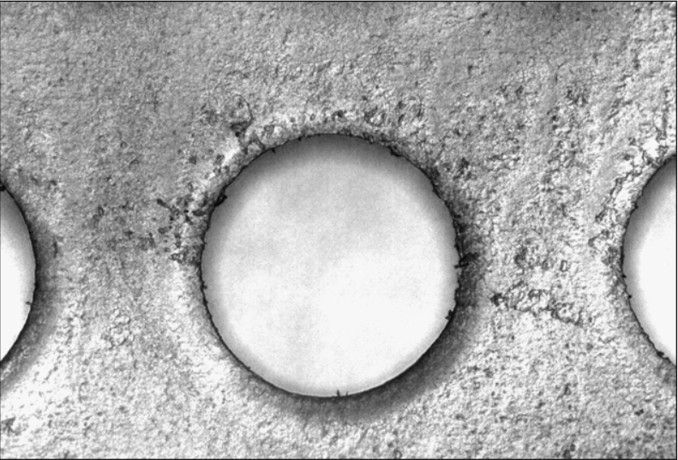
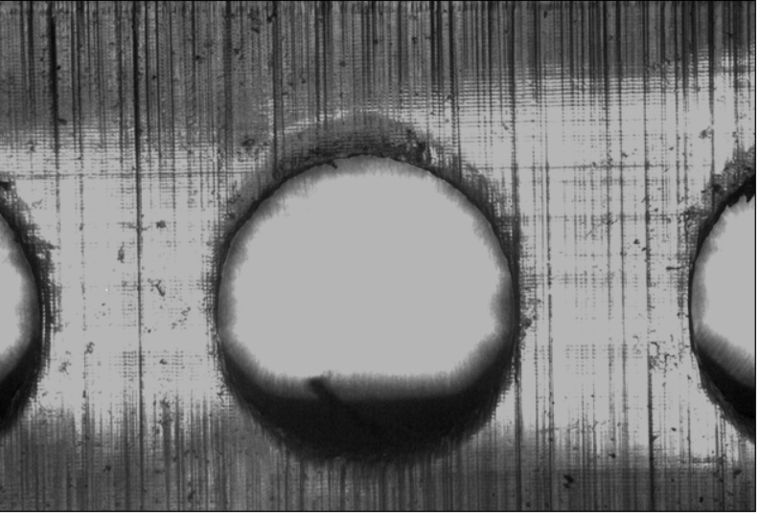
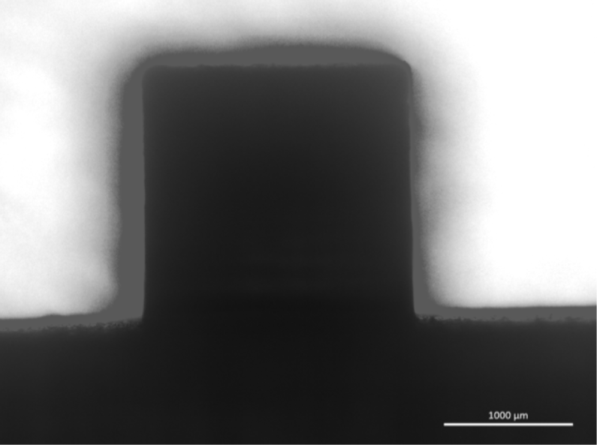
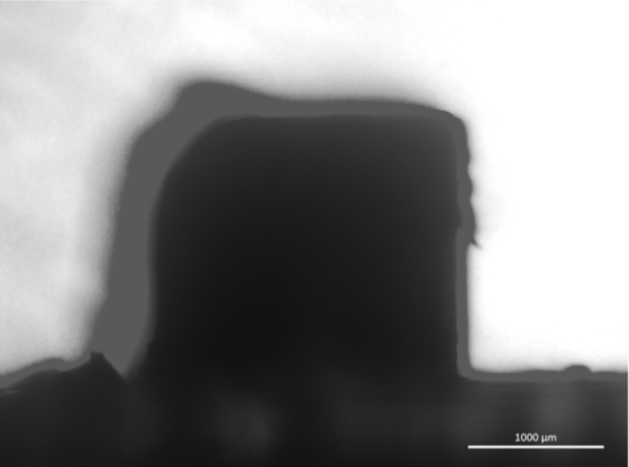
Optical Analysis of hole pieces
There are some problems
Dim-light in the holes
1000 µm
1000 µm
Pillar Outline distorted
Hole-block: ax=0°; ay=0°
Hole-block: ax=0°; ay=90°
These problems appear
when one between ax and ay tends to 90°
It could be useful to avoid these angles
36 couples of angles → 9 couples of angles
Acquisition Parameter:
-Exposure time:62,7ms
-Gain: 2,0x
-Saturation: 1,5
-Gamma:0,97
1000 µm
1000 µm
Pillar-block: ax=0°; ay=0°
Pillar-block: ax=0°; ay=90°

Slide 11
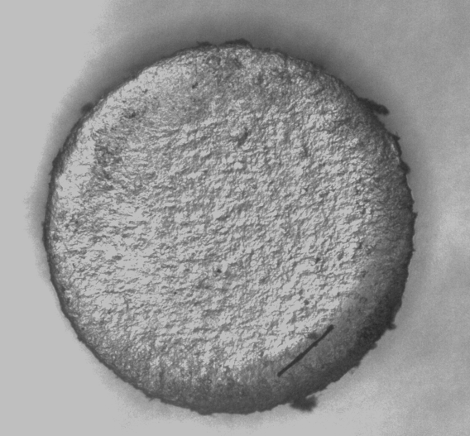
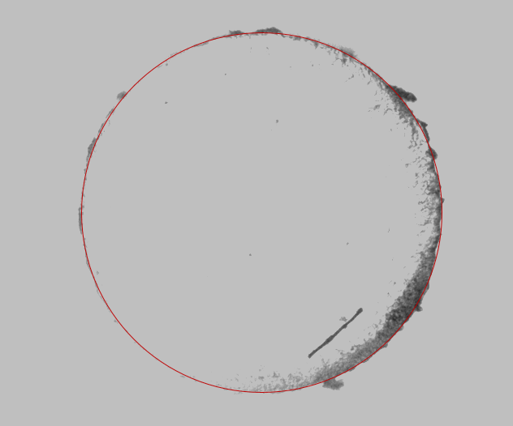
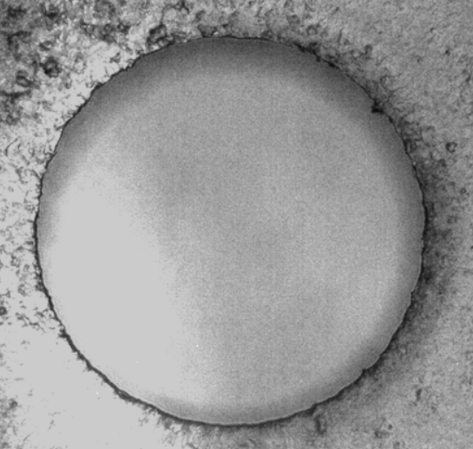
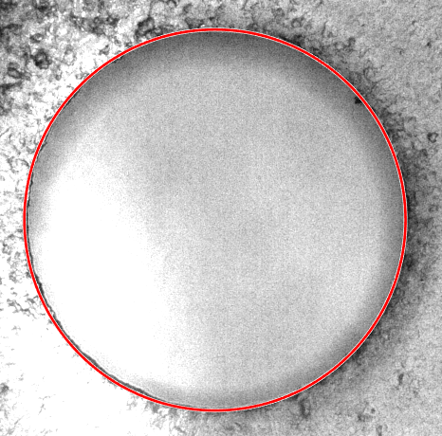
Automatized Diameter calculation through algorithm:
Diameter estimation for Pillars/Holes with ax and ay both ranging from 0° to 30°
Pillar-blocks diameter estimation
Hole-blocks diameter estimation
A custom-made MATLAB software was created to find the diameters
A Wiener filter pre-processing was used in the algorithm due to its adaptive filtering nature
making the code suitable for both the input geometries

Slide 12
Before scaling vs after scaling
1%=20µm
Both pillars and holes have a design diameter of 2000µm but…
The pillars are bigger than expected (positive tolerance)
The holes are smaller than expected (negative tolerance)
$$normalized Δd=\frac{diameter estimated−2000µm}{2000µm}×100$$
There is a mismatch between the diameters of pillars and holes
This trend is observed for each angle couple, a proper scaling is needed so
Pillars diameter need to be reduced
Holes diameter need to be increased

Slide 13
Before scaling vs after scaling
after the 5% scaling
the tolerances of the scaled pieces are negative for both pillars and holes
1%=20µm
Pillars have been reduced too much
Holes have been increased not enough
but they are smaller in value (nearer to 0) than before
$$normalized Δd=\frac{diameter estimated−2000µm}{2000µm}×100$$
There is no interlock yet
a fine tuning is needed for a perfect match

Slide 14
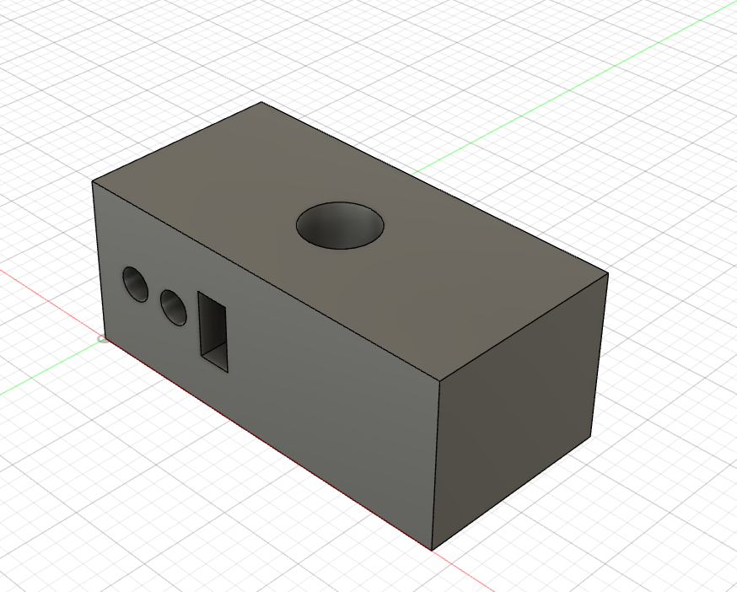
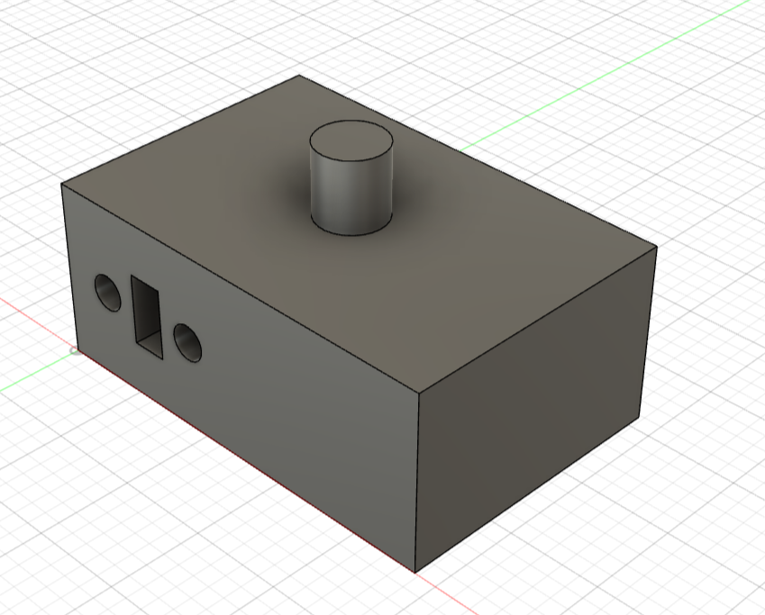
Fine tuning of the pillar and hole diameter (1/2)
After inspecting the graphs, we took the angle couple (15°;15°) as a starting point for a fine tuning
For this angle couple, the old design diameter are 1900µm (pillar) and 2100µm (hole)
The new rescaled design diameters are 1920µm (pillar) and 2180µm (hole)
Let’s printing blocks around them
Pillars are rescaled of [0.0% ; 0.5% ; 1.0% ; 1.5% ; 2.0%] (in relation to 1900µm)
Holes are rescaled of [2.8% ; 3.3% ; 3.8% ; 4.3% ; 4.8%] (in relation to 2100µm)
(30 pieces)
↓hole\pillar→ | 1900µm | 1910µm | 1920µm | 1930µm | 1940µm
2160µm | ? | ? | ? | ? | ?
2170µm | ? | ? | ? | ? | ?
2180µm | ? | ? | ? | ? | ?
2190µm | ? | ? | ? | ? | ?
2200µm | ? | ? | ? | ? | ?
Hole-block design
Pillar-block design
Will they fit?

Slide 15

Fine tuning of the pillar and hole diameter (2/2)
qualitative goodness of interlock
↓hole\pillar→ | 1900µm | 1910µm | 1920µm | 1930µm | 1940µm
2160µm | 0 | 0 | 0 | 0 | 0
2170µm | 1 | 0 | 1 | 1 | 0
2180µm | 1 | 1 | 0 | 0 | 0
2190µm | 2 | 2 | 1 | 0 | 0
2200µm | 2 | 1 | 1 | 0 | 0
1%=20µm
score | meaning
0 | Not fitting
1 | Partial fitting
2 | Good fitting
$$normalized Δd=\frac{diameter estimated−2000µm}{2000µm}×100$$

Slide 16
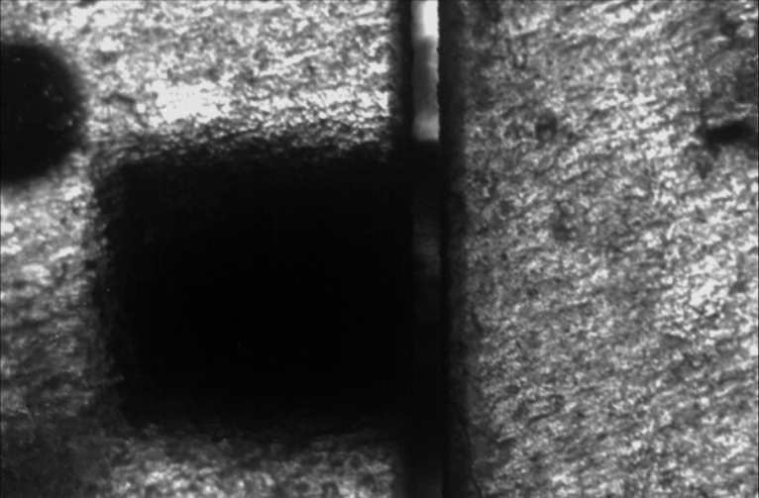
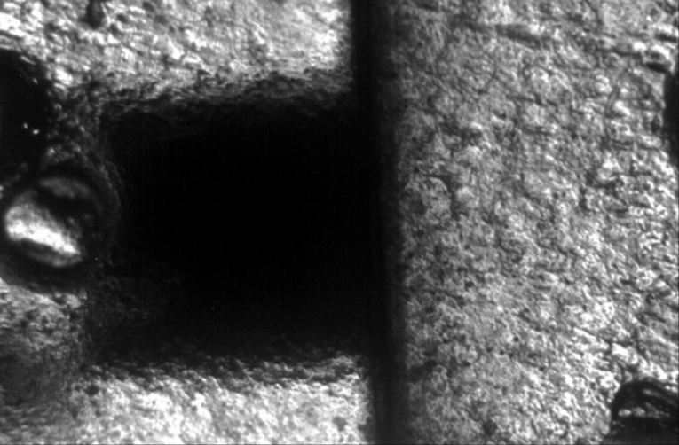
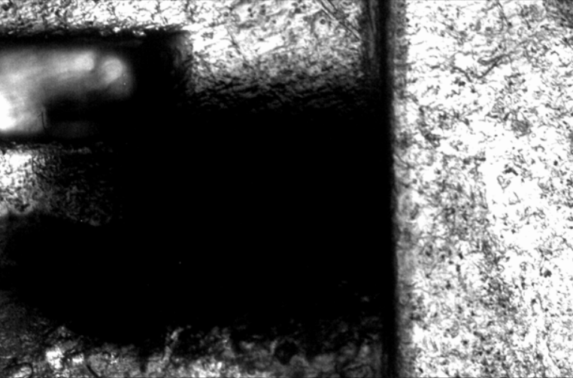
Manual testing and Fine tuning of the hole depth (1/2)
a) Manual assembly with 2mm deep hole
b) Mechanical clamp still 2mm deep hole
c) Manual fitting with 2,85mm deep hole
hole
gap
170 µm
pillar
hole
gap?
pillar
hole
gap?
pillar
1000 µm
1000 µm
1000 µm
Residuals of resin within the hole impede perfect coupling (complete insertion) between the interlocks, either manually or through mechanical clamp
Deeper holes relax fabrication constraint and enable complete interlock

Slide 17
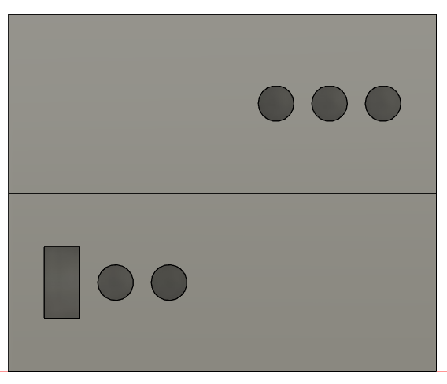
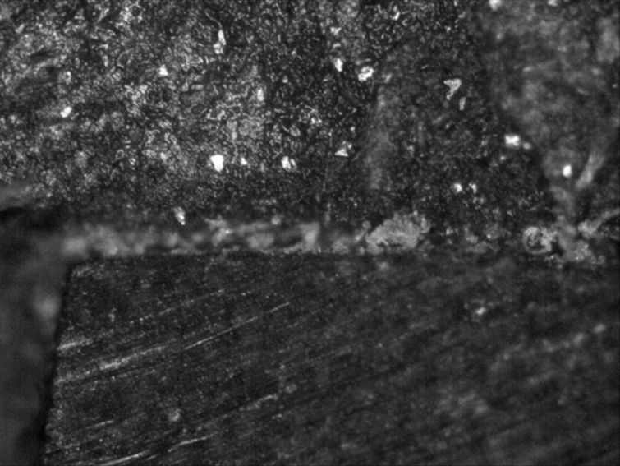
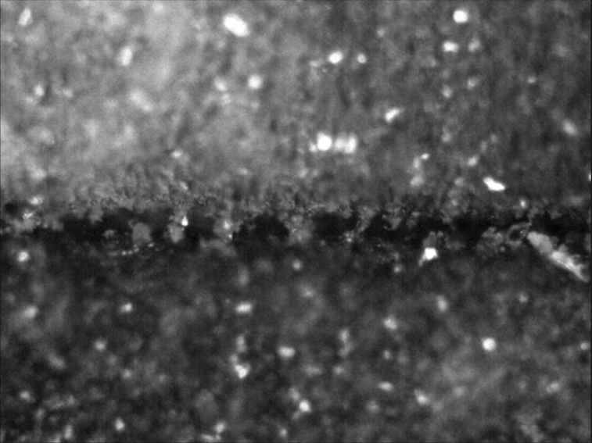
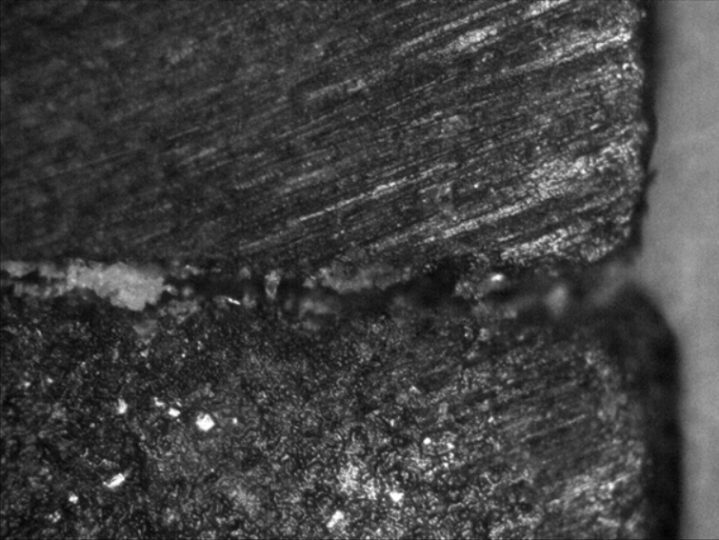
Manual testing and Fine tuning of the hole depth (2/2)
Manual fitting with 2,85mm deep hole
After the change in the hole depth,
It is possible now to interlock the two pieces
Through the use of a human generated force
No evident air gap between the pieces!
a) Initial part of interface
b) Middle part of pieces interface
c) Terminal part of pieces interface
hole
hole
hole
pillar
pillar
pillar
100 µm
100 µm
100 µm

Slide 18
Until now…
we have refined the diameter of pillars and holes
Manual fitting with 2,85mm deep hole
hole
gap?
pillar
We have refined the hole depth
1000 µm
All such effort to let the pieces interlock each other,
But it is only a geometrical result
What happens physically?
How much force is needed to insert the pillars into the holes?

Slide 19
Quantitative assessment: Force-displacement graphs
Printing angle: (15°;15°)
Parameter acquisition:
Maximum load (FS):100 N
Max measured force:90N
Travel:950µm=0.95mm
Speed: 0.2 mm/min
Max measured force:90N
Sensitivity:0.11366 mV/N
Offset:-0.10056 mV
After a time-delay required for the plate of the load cell to find the surface of the piece,
The measured force started growing not linearly, probably due to the roughness of the walls
the max force is measured (between 70 and 86 N) at the end of the travel meaning that the pieces are fully interlocked
After the travel has been completed, the measured force started decreasing faster than before
as the pieces remain attached each other

Slide 20
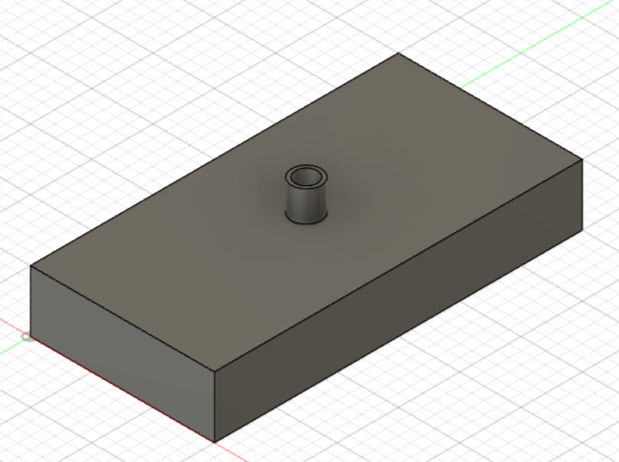
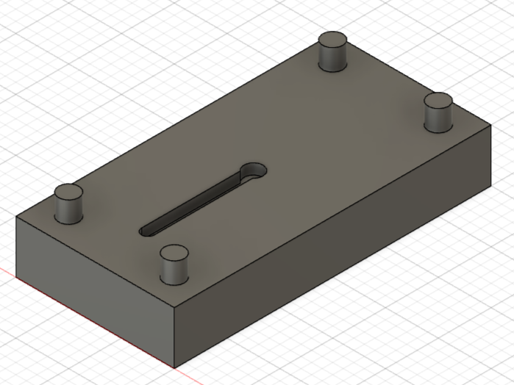
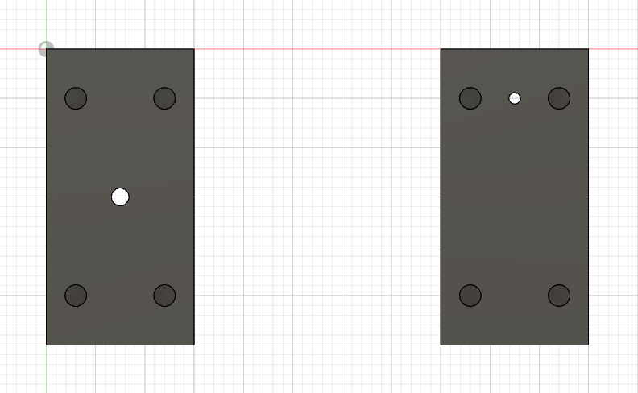
Single level study, an example of microfluidic chip
a) Inlet-block, top view
b) Channel-block, top view
c) Bottom view of inlet-block and channel-block
-Interlocking system for interfacing the two blocks present on both of them
-Inlet with cylindrical shape for “world-to-chip” WTC connection
-Microfluidic channel engraved only into the channel-block (“open channels” are easier to print)
-The channel terminates with a true-via

Slide 21
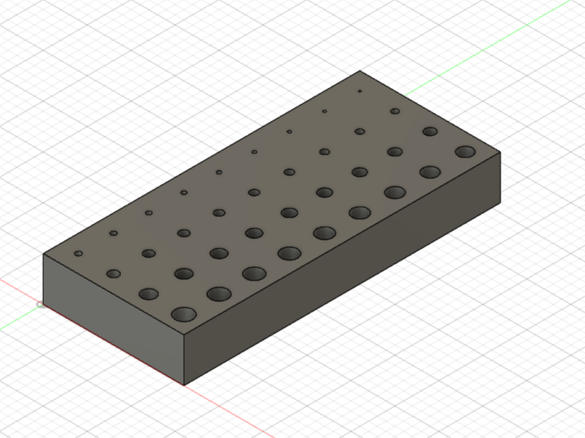
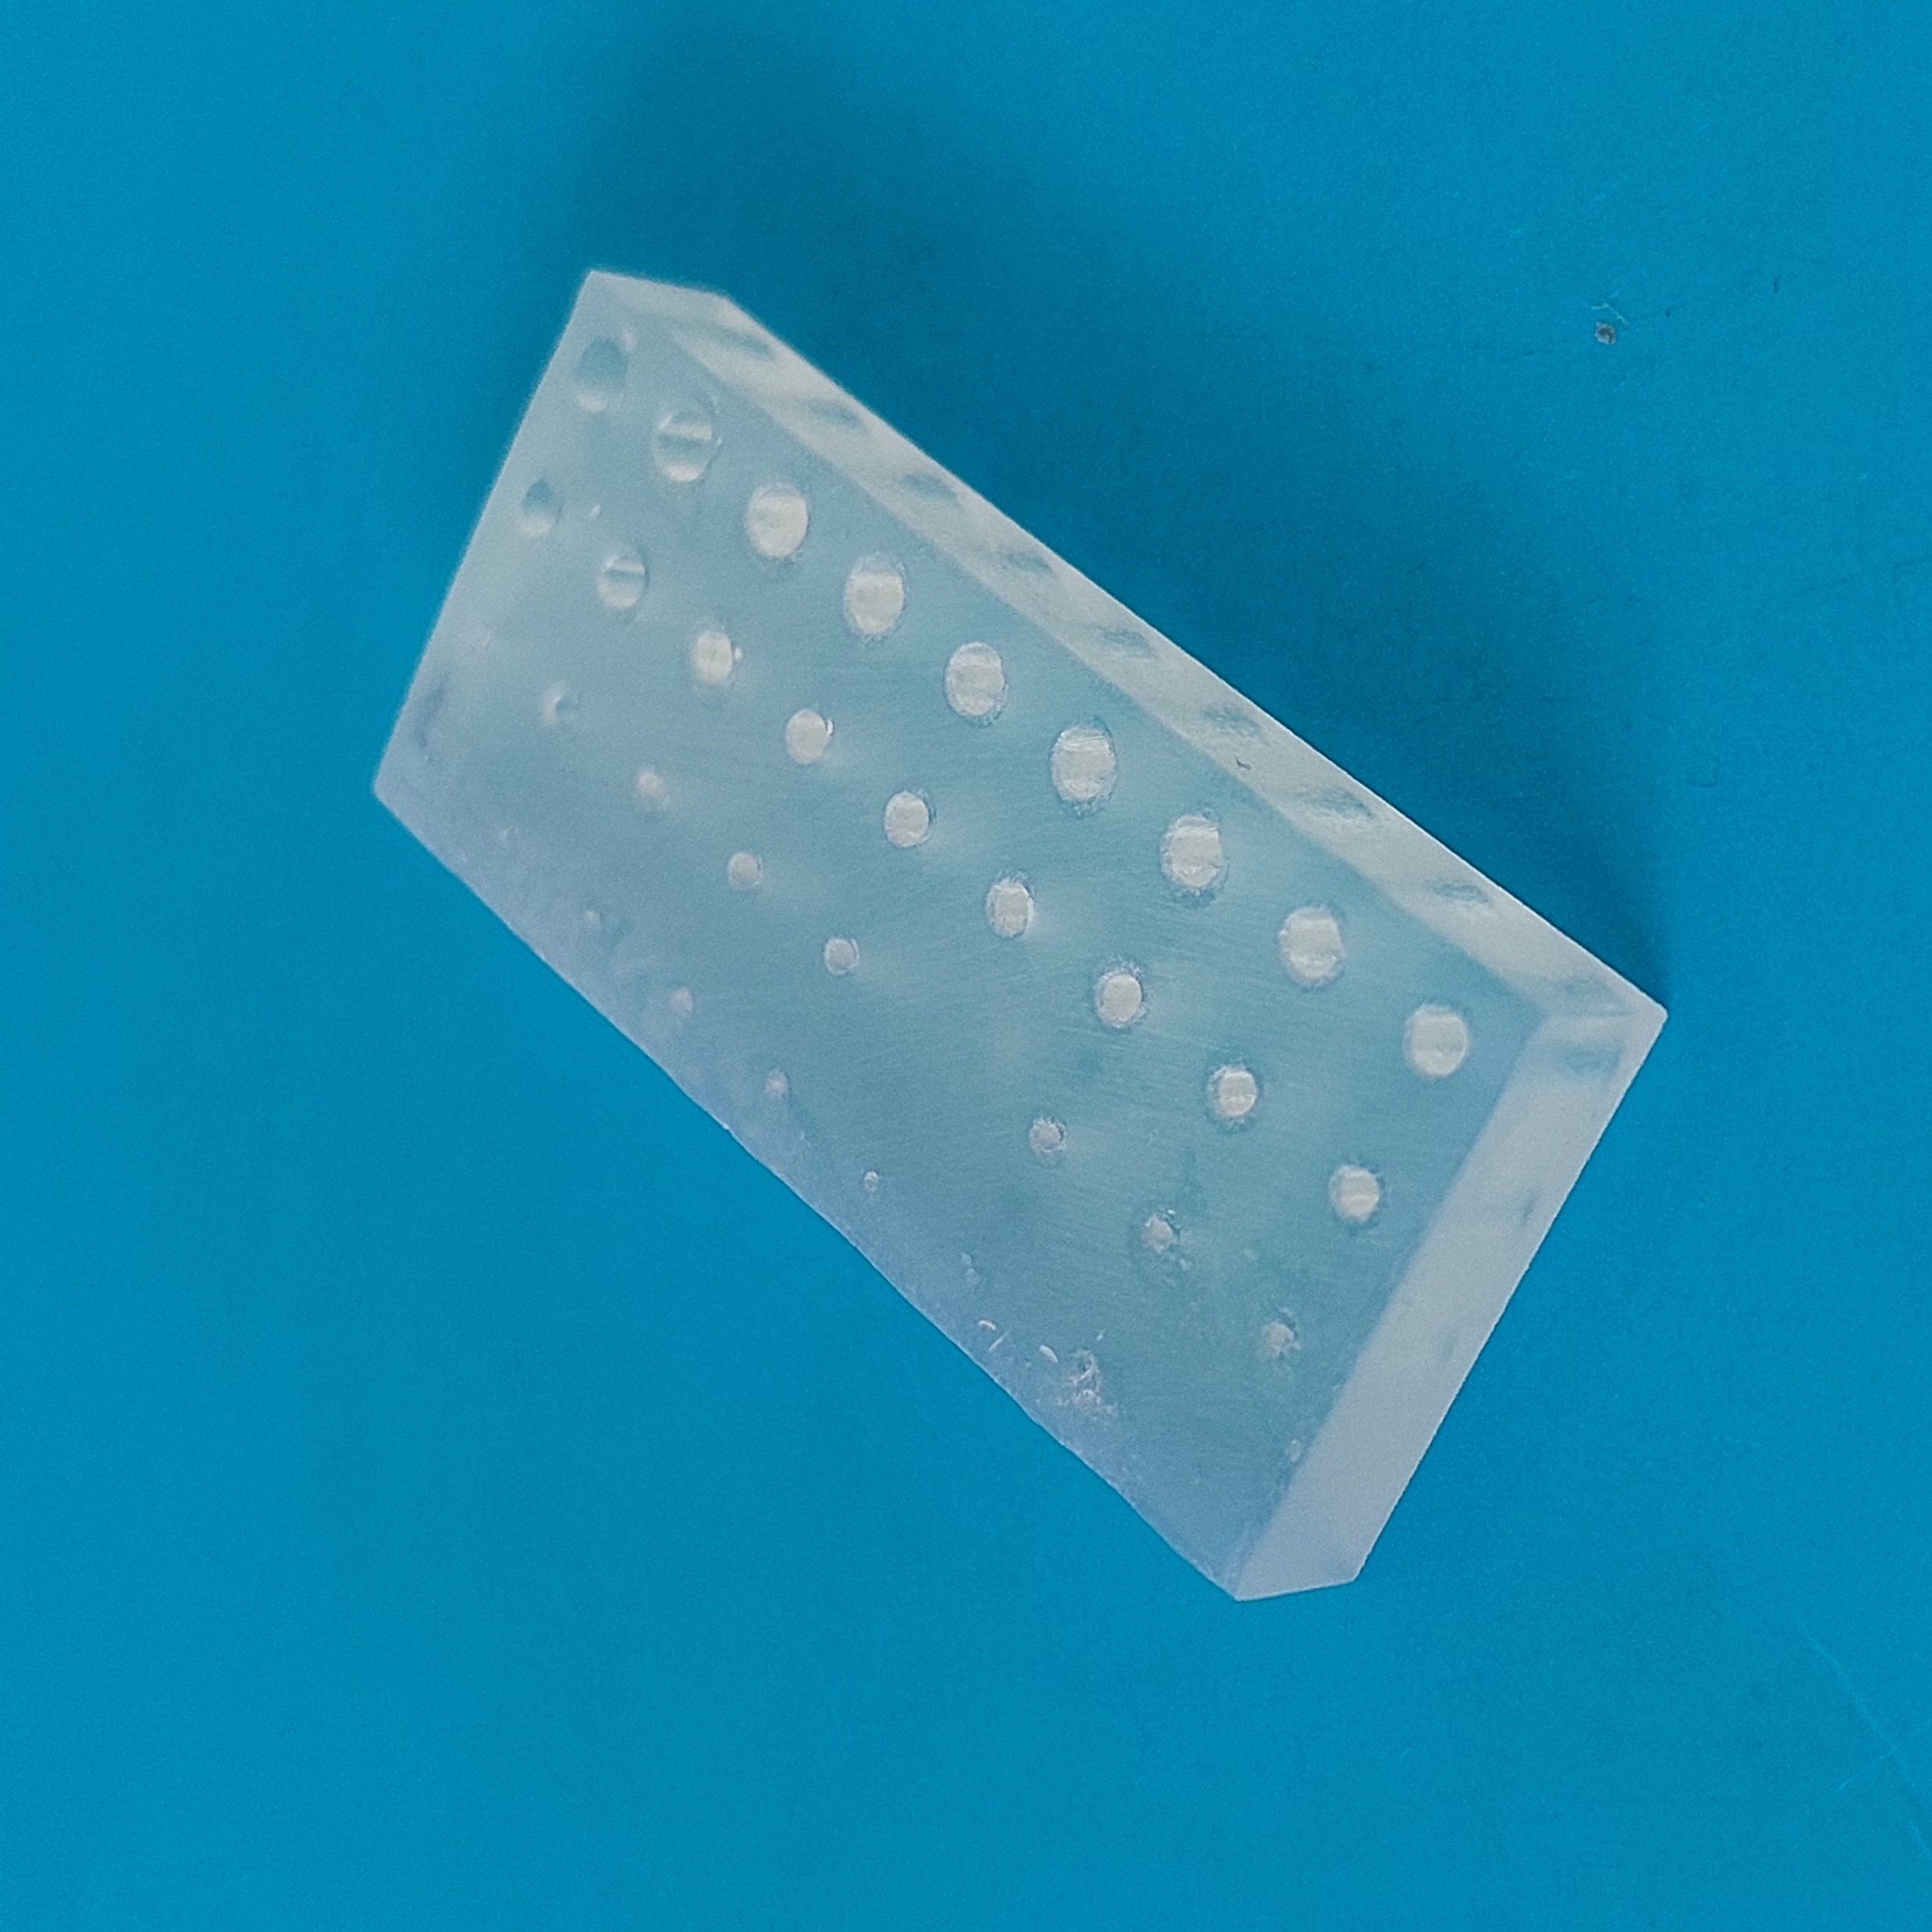
What about true-via channel diameter?
Regardless of the specific implementation, a fundamental requirement is ensuring a continuous (without clogs) and smooth (without abrupt restrictions) fluidic connection with other modules and the external world.
To fulfil this requirement, we conducted systematic experimental activities
aimed at defining the minimum diameter of a vertical, circular channel
passing through the entire 3D printed part.
Diameter range: from 250µm to 2000µm
3 pieces, each piece tests 36 diameters

Slide 22
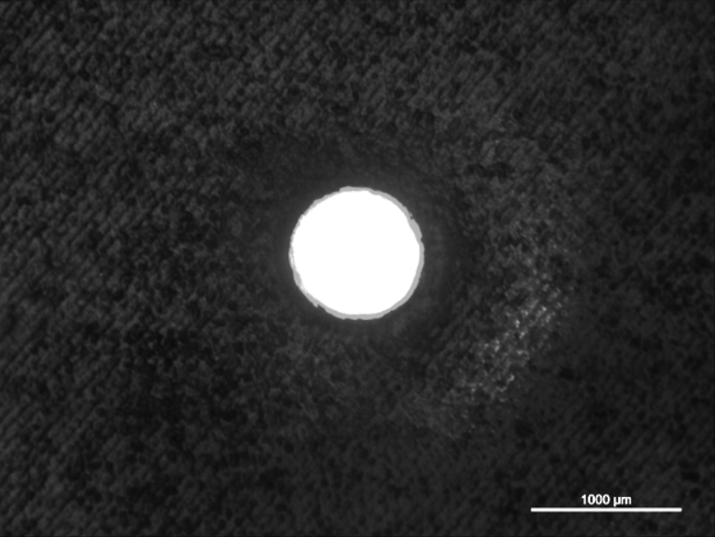
$$mean tolerance=|\frac{diameter estimated−design diameter}{design diameter}|×100$$
Green zone: best trade-off (open and small enough channel)
Diameter range: [600 ; 1200] µm
Now, we will use such result to search for a target diameter in this range…
b) 1150 µm diameter hole
…What should be done to have a 1000µm experimental diameter?

Slide 23

…What should be done to have a 1000µm experimental diameter?
Diameter range: [600 ; 1200] µm
From previous results, a design diameter of 1000µm has given a printed diameter of 840µm.
$$1000µm:840µm=diameter design:diameter printed$$
So, what is the design diameter that gives me a printed diameter of 1000µm?
$$1000µm:840µm=diameter design:1000µm$$
$$diameter design=\frac{1000µm∗1000µm}{840µm}=1190µm$$
Let’s print around it!

Slide 24
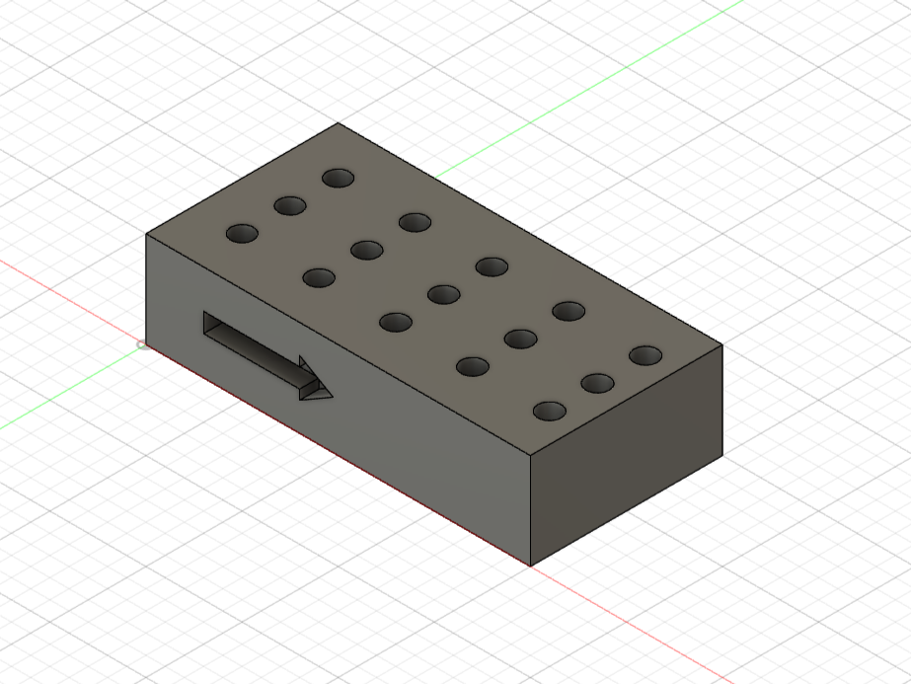
Printing of 1000µm target diameter
Diameter range: from 1170µm to 1210µm (10µm step)
$$mean tolerance=|\frac{diameter estimated−1000µm}{1000µm}|×100$$
a diameter of 1170µm gives the best results!

Slide 25
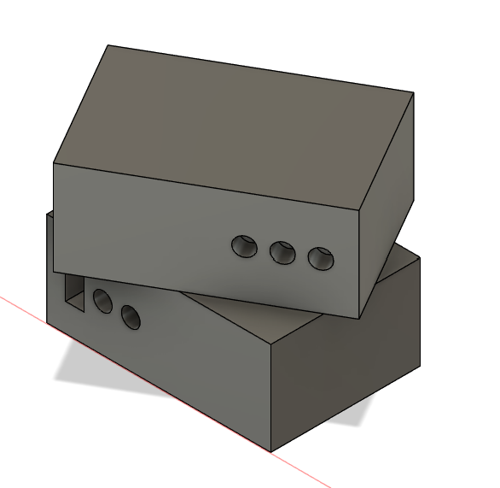


Error 404: interlock not found
Surprisingly, the inlet-block and the channel-block did not match!
How is it possible?

Slide 26
Error 404: interlock not found
In the optimization study of the interlock, the designs were over simplified, one single pillar/hole on the top face…
…While upon the single level modules there are 4 structure on it
It’s harder to align many pillars and holes at the same time
The interplay of 4 main actions is taken to solve such problem

Slide 27
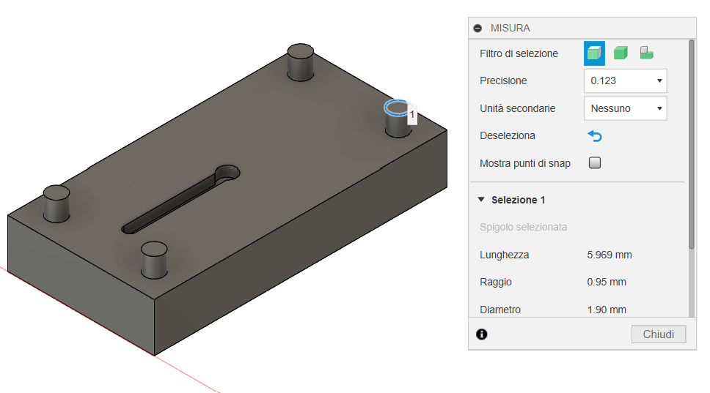
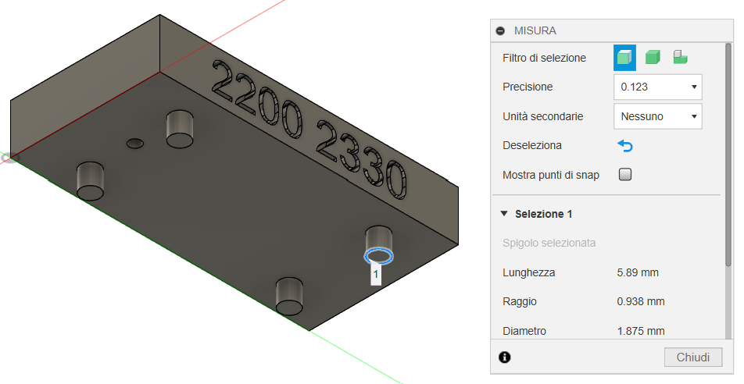
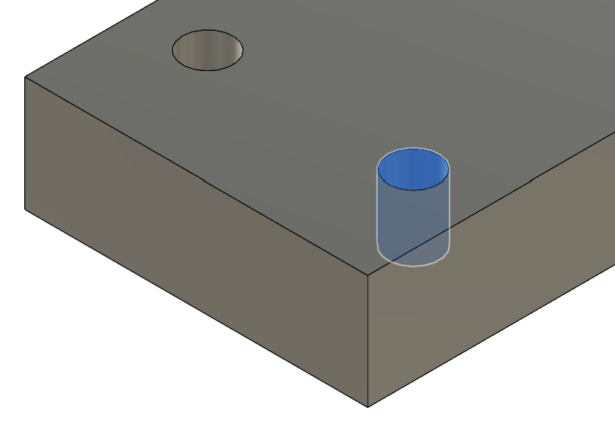
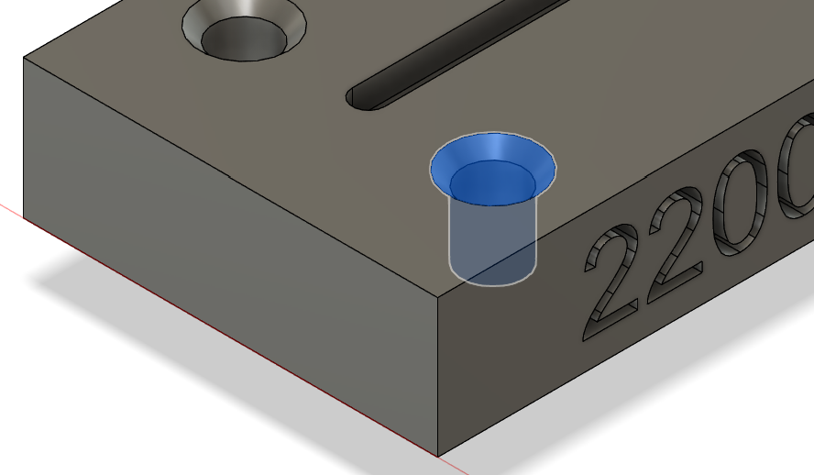
1) Fine-tuning on the pillar diameter
Diam. 1900 µm
old design
new design
Diam. 1875 µm
2) Rounding operation on the holes
old design
new design

Slide 28
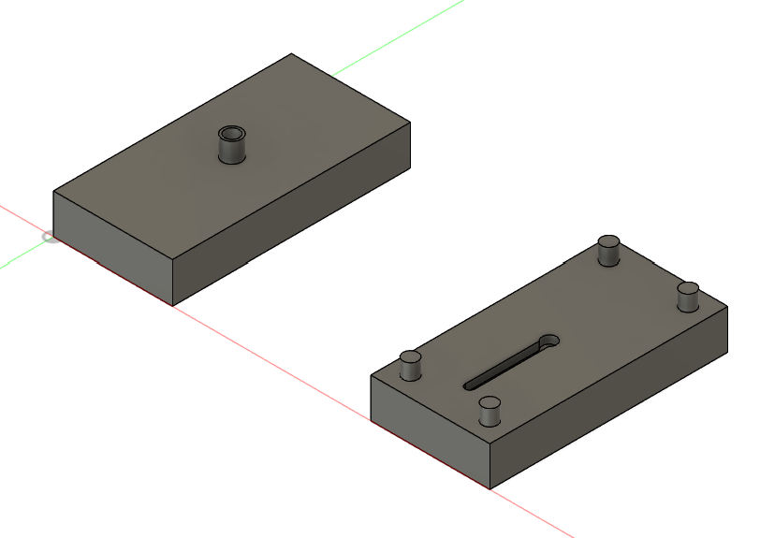
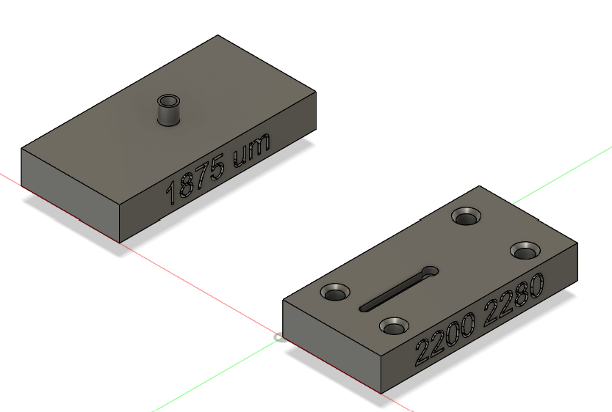
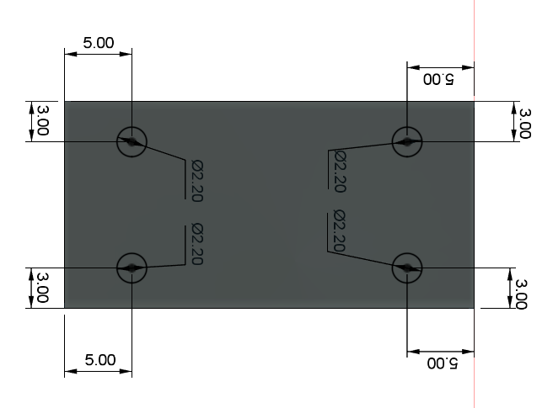
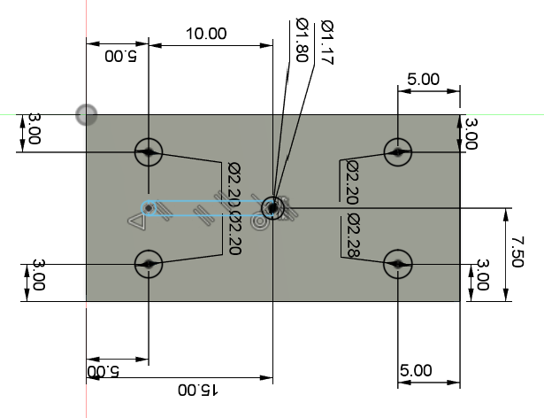
3) Swapping of belonging surfaces between pillars and holes
old design
new design
4) Use of holes with different diameters on the same module
old design
2200 µm
new design
2280 µm

Slide 29
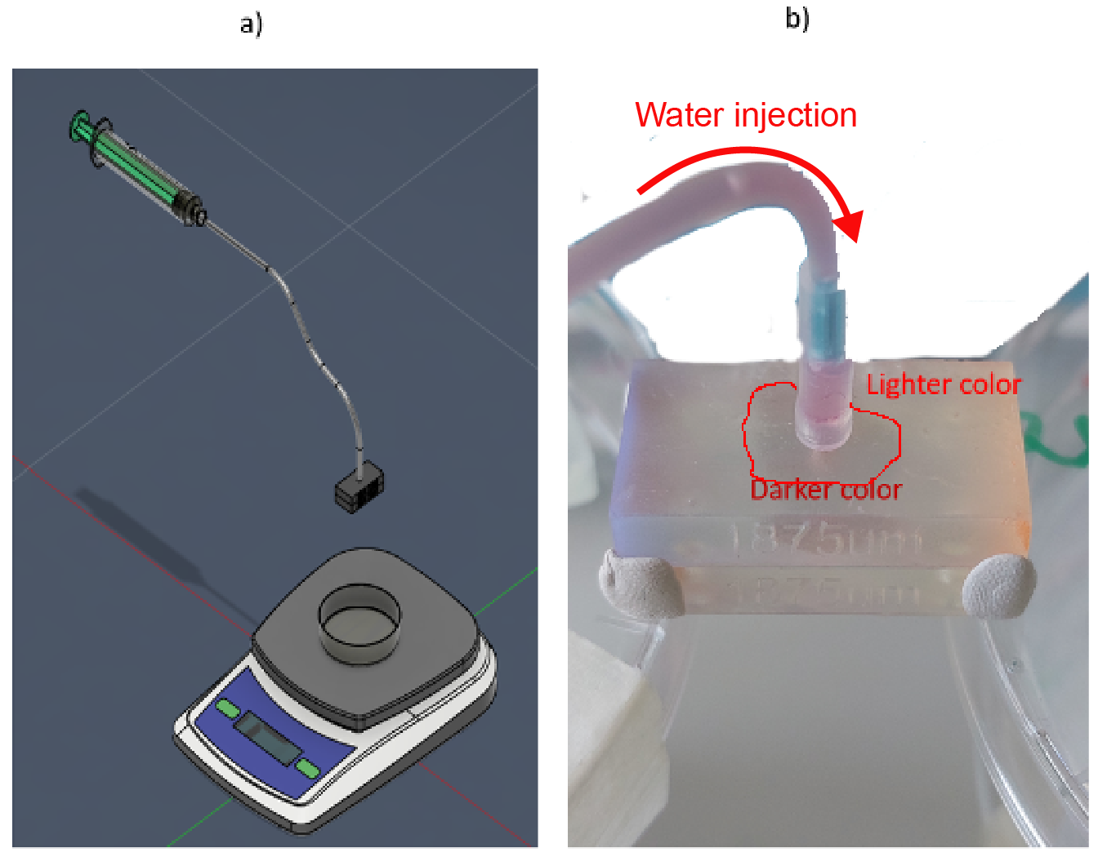
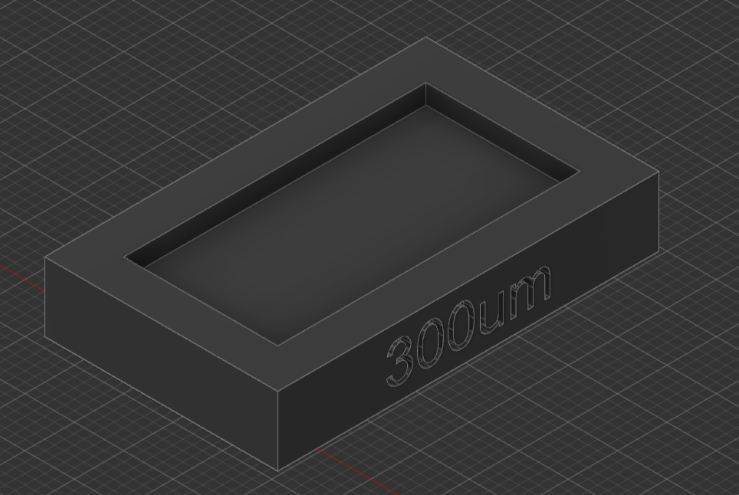



Thermal bonding to solve the single level water leakage
Now the pieces interlock well but…
Problem: there is water leakage between them
Solution: thermal bonding
Experiment sketch
Water leakage photo
Thermal bonding parameters: 120°C per 30 min

Slide 30







Single level through thermal bonding: Results
Single level chip unmounted
Single level chip mounted (thermally bounded)
Inlet optical microscopy
Channel microscopy
True via microscopy
1000 µm
1000 µm
1000 µm

Slide 31
From single level to multi-level
The thermal bonding eliminated the problem of water leakages
But at what cost…
Once the pieces are thermally bounded, they cannot be detached anymore
No more reconfigurability of the chip

Slide 32






O-ring sealing between multi-level LEGO®-like modules
Unmounted pieces
Mounted pieces
O-ring circular guide
d) O-ring inserted into the guide
1000 µm
1000 µm

Slide 33






Multi-level chip: fluidic functionalities assessment
Dismounted multi-level chip
Mounted multi-level chip
Experiment setup
Configuration studied:
-Chip without O-ring
-Chip with O-ring
-Only syringe pump as
control experiment
Interface 1:
Thermal Bonding
Level 1
Interface 2:
O-ring Sealing
Flow rates studied:
-100 µL/min (20 min)
-10 µL/min (20 min)
-1 µL/min (60 min)
Interface 3:
Thermal Bonding
Level 2

Slide 34


Water leakage tests
1 µl/min
10 µl/min
100 µl/min
1 µl/min
10 µl/min
100 µl/min

Slide 35
Linear fitting of chip with O-ring measurements
The water does not fall smoothly (linearly) from the outlet, but drop-by-drop (discretely)
Is this a real problem? Linear fitting of data
The control case and the chip with O-ring case have the same slope (on average)
and the standard deviation has the same order of magnitude
So, having the chip with an O-ring sealing is like having the syringe pump sending water straight into the Becker.
No leakage was found!

Slide 36
STRESS TEST: quantitative analysis
Is 20 minutes just luck or skill?
The chip doesn't show any loss during the time whether it’s short or long
The water continue to flow at the same rate even in the stress test

Slide 37




Droplet-generator as proof-of concept
The droplet will form at the intersection
between water and oil channel.
Several design are possible:
a)
b)
a) Rectangular oil channel
b) Circular oil channel
c) Elliptical oil channel
c)
d)
Once created the droplet, where did they will go?
d) Reservoir for storing and then easily collecting the droplets

Slide 38
Droplet generator study and time formation of droplets
Change of the design of droplet maker to enable optical study of the droplet. A glass cover was attached on the chip through double-sided tape
Oil phase
  Sunflower oil
  Flow rate: 0.1mm/min
Water phase
  DI water with 1 ppm of Triton-X
  Flow rate: 0.025mm/min
Optical microscopy confirmed that water microdroplets in oily phase can be sequentially formed within the 3D-printed generator

Slide 39
Droplet generator study and time formation of droplets
Dynamics of the microdroplet formation
Time resolved optical microscopy studies
Theoretical droplet simulation:
https://doi.org/10.1016/j.ijmultiphaseflow.2017.04.008
The observed genesis of µ-droplet into a LEGO®-like generator well agrees with the theoretical expectations

Slide 40
Considerations and achievements
Optimization of the Lego-like interlocking system between 3D SLA-printed modules,
a new fabrication approach of microfluidic devices that is easy to use
and it grants reconfigurability to the device according to the user needs
Fabrication and validation of single level microfluidic chip through thermal bonding
Fabrication and validation of multi level microfluidic chip through O-ring sealing
Development of Micro-droplet maker for the successful generation of droplets

Slide 41

Thank you for
the attention!

