Slide 1


LEGO®-Inspired Modular Integration of 3D printed Microfluidic Components
Adriano Nisi
Tutors: Prof. G. Barillaro and Dr. S. Surdo
Barillaro’s Group
Pisa 17/07/2025

Slide 2
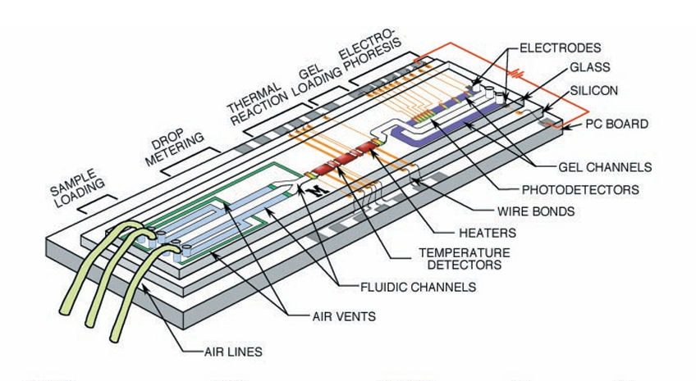
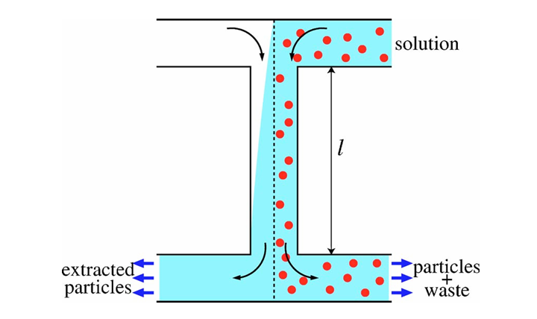
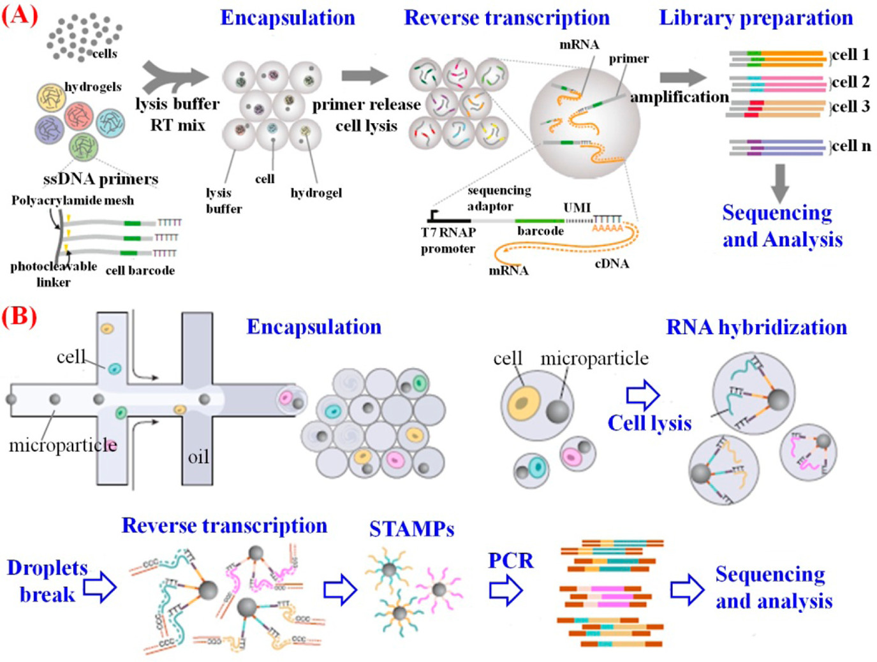
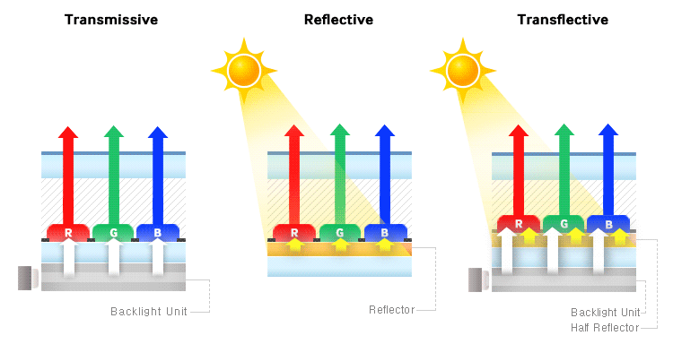
Electrophoresis
Particle filtration
Microfluidics:
A tiny fluid droplet
yet several applications
https://doi.org/10.1016/S0924-4247(97)80219-1
10.1126/science.282.5388.484
RNA analysis
Reflective displays

Slide 3
A microfluidic device has a lot of functions to do.
The more the functions, the more the complexity
Fluid input sample
Microfluidic device
Function 1
(mixing)
Function 2
(filtering)
Function 3
…
Function 4
Fluid output result

Slide 4
A microfluidic device has a lot of functions to do.
The more the functions, the more the complexity
Divide et impera!
One module for each function
Fluid input sample
Fluid input sample
Microfluidic device
Microfluidic device
Function 1
Module 1
Function 1
(mixing)
Function 2
A possible solution
Module 2
Function 2
(filtering)
Function 3
Module 3
Function 3
…
Function 4
Module 4
Function 4
Fluid output result
Fluid output result

Slide 5
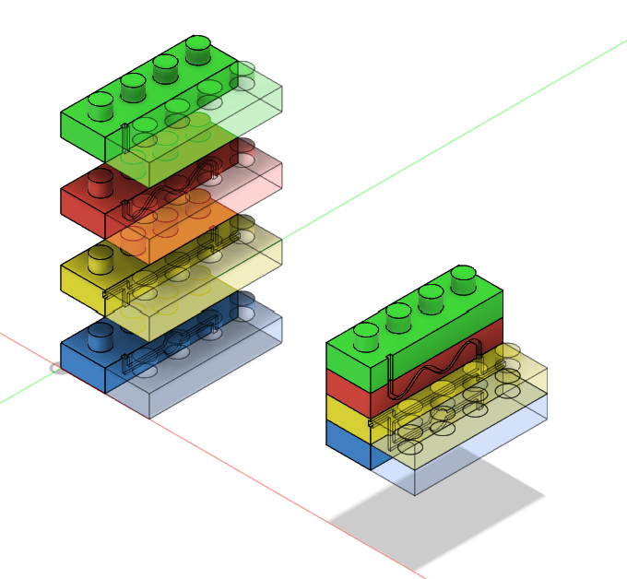
Divide et impera!
One module for each function
A modular microfluidic system
through LEGO®-like interlocks
Fluid input sample
Microfluidic device
Module 1
Function 1
Module 2
Function 2
Our solution
Module 3
Function 3
Module 4
Function 4
Fluid output result

Slide 6

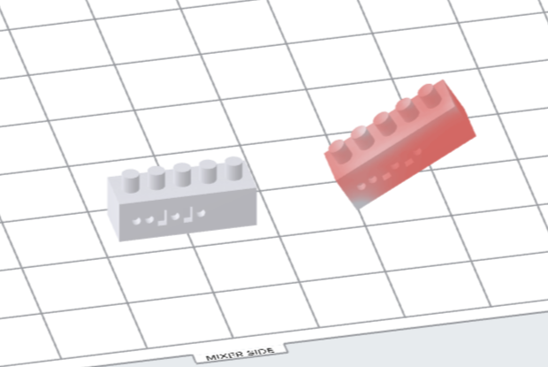
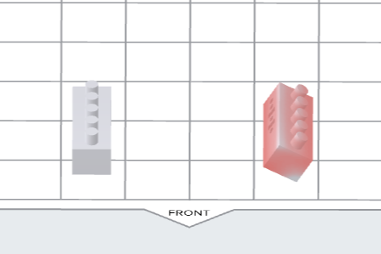
SLA: Pieces orientation issue
Printing Grid
The outcome of SLA depends on the orientation given to the pieces to be printed within the printing grid
Morphology, characteristics and functions might be affected by the angles chosen
Mixer side
Front side
1)z_Rotation:(90°)
3)y_Rotation: (ay)
2)x_Rotation: (ax)
Mixer side
Front side
Mixer side
Front side
Piece arrangement on Formlabs file
… we conducted a systematic study aimed at finding the optimal orientation,
namely the printing angles that provide the highest fidelity between the printed and designed geometries

Slide 7
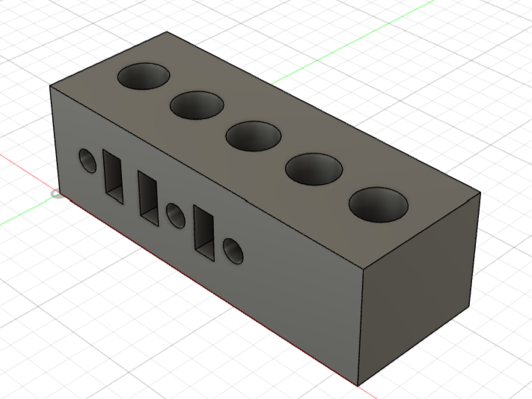
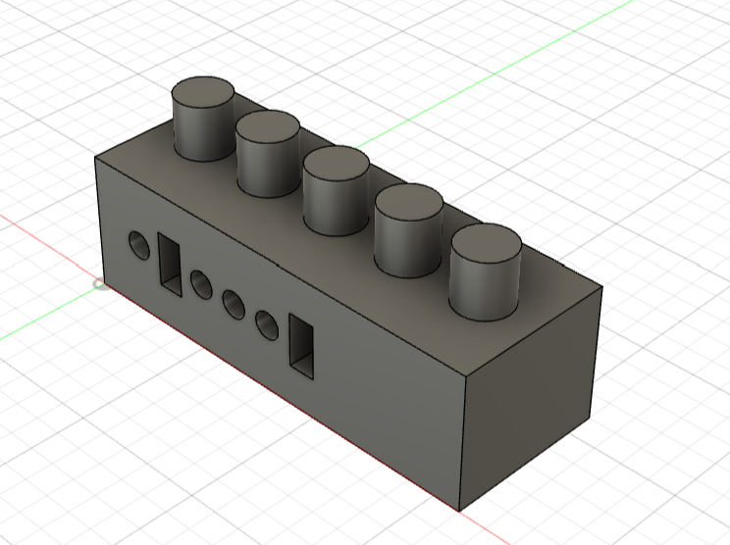
Which printing angle gives the best interlock?
Hole-block with code on it
Pillar-block with code on it
Hole-block
Dimension: 16mmx6mmx5mm
Hole type: cylindric
Hole dimension: Ø=2000µm,
depth=2mm
Pillar-block
Dimension: 16mmx6mmx5mm
Pillar type: cylindric
Pillar dimension: Ø=2000µm,
height=2mm
ax\ay | 0° | 15° | 30° | 45° | 60° | 90°
0° | (0°;0°) | (0°;15°) | (0°;30°) | (0°;45°) | (0°;60°) | (0°;90°)
15° | (15°;0°) | (15°;15°) | (15°;30°) | (15°;45°) | (15°;60°) | (15°;90°)
30° | (30°;0°) | (30°;15°) | (30°;30°) | (30°;45°) | (30°;60°) | (30°;90°)
45° | (45°;0°) | (45°;15°) | (45°;30°) | (45°;45°) | (45°;60°) | (45°;90°)
60° | (60°;0°) | (60°;15°) | (60°;30°) | (60°;45°) | (60°;60°) | (60°;90°)
90° | (90°;0°) | (90°;15°) | (90°;30°) | (90°;45°) | (90°;60°) | (90°;90°)
Population:
for each angle couple (36) we have
3 hole-blocks + 3 pillar-blocks
216 total blocks

Slide 8
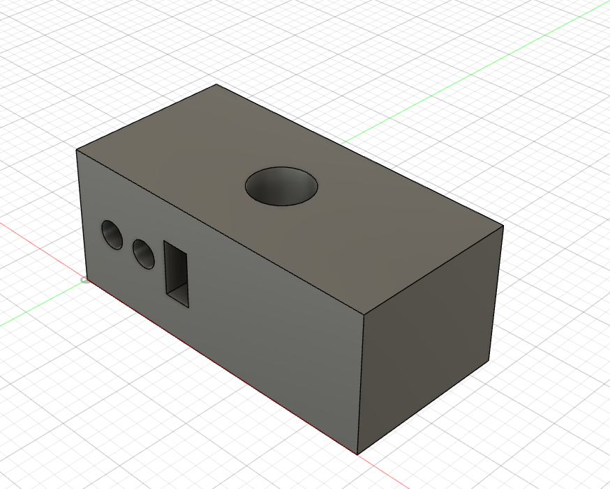
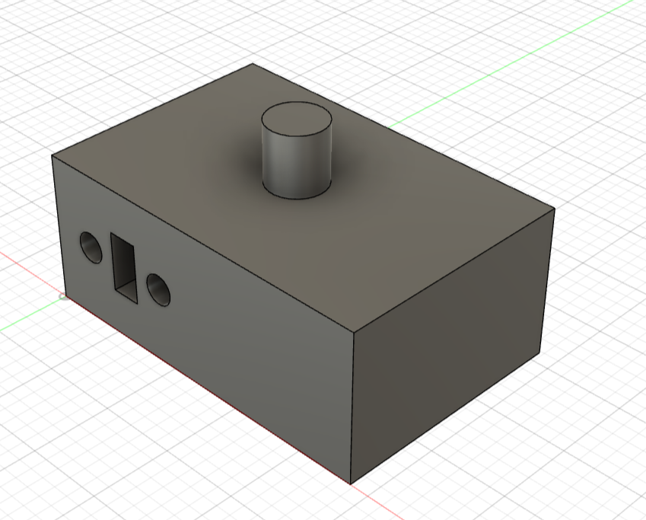
Optimization results and Quantitative assessment
Optimization study results:
-Pillar diameter = 1900µm -> -5% scaling factor
-Pillar height 2 mm
-Hole diameter = 2200µm -> +10% scaling factor
-Hole depth 2.85 mm
-Printing Angle = (15°;15°)
Quantitative assessment through Force-displacement graph
Parameter acquisition:
Maximum load (FS):100 N
Max measured force:90N
Travel:950µm=0.95mm
Speed: 0.2 mm/min
Max measured force:90N
Sensitivity:0.11366 mV/N
Offset:-0.10056 mV
Hole-block design
Pillar-block design
The max force is measured (between 70 and 86 N) at the end of the travel meaning that the pieces are fully interlocked
Is the thumb a fifth finger? A study of digit interaction during force production tasks
Comparing Isolated Thumb Force Generation, Wrist Rotation, and Clinical Measurements in Healthy and Osteoarthritic Individuals before and after Surgery

Slide 9
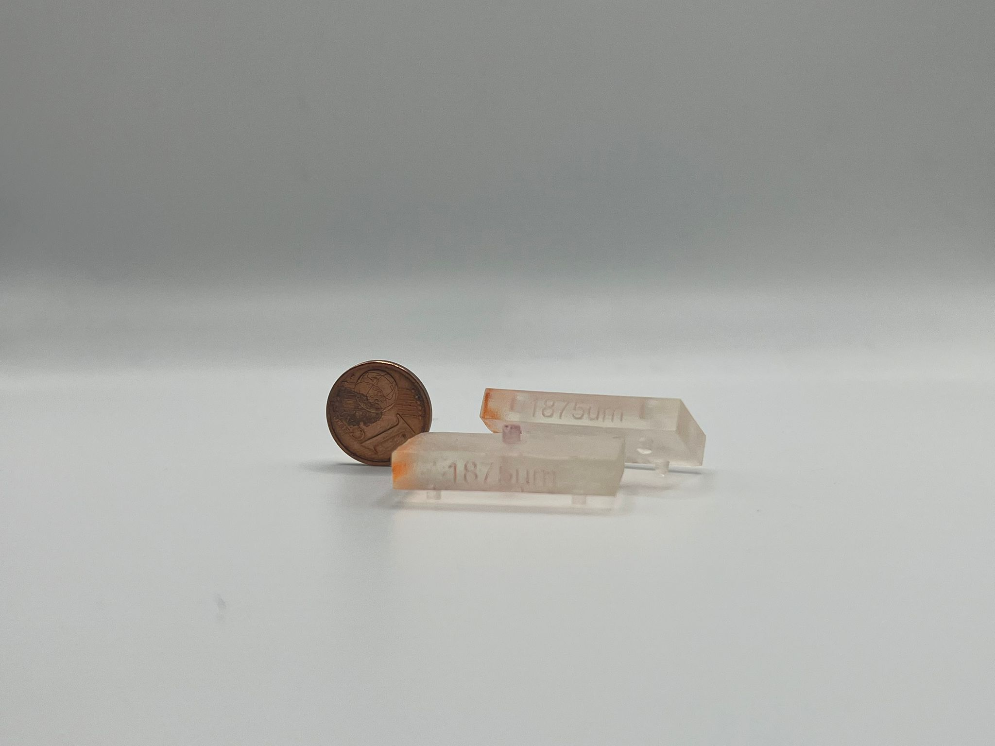
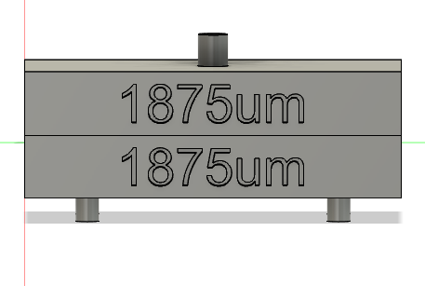
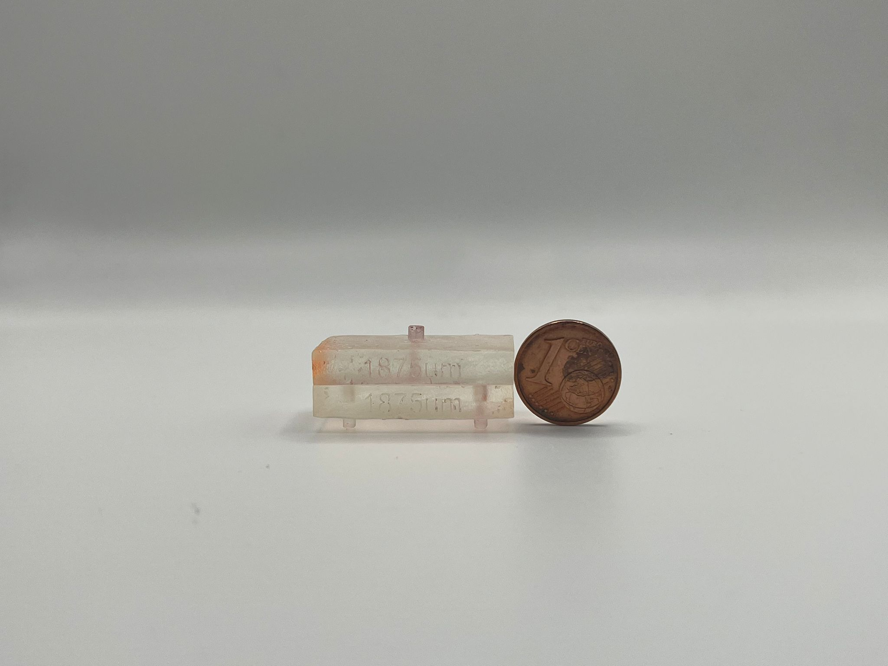
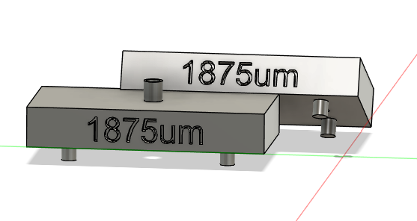
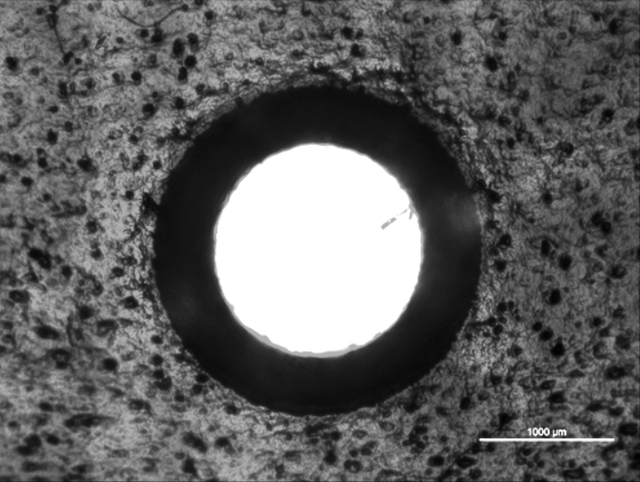
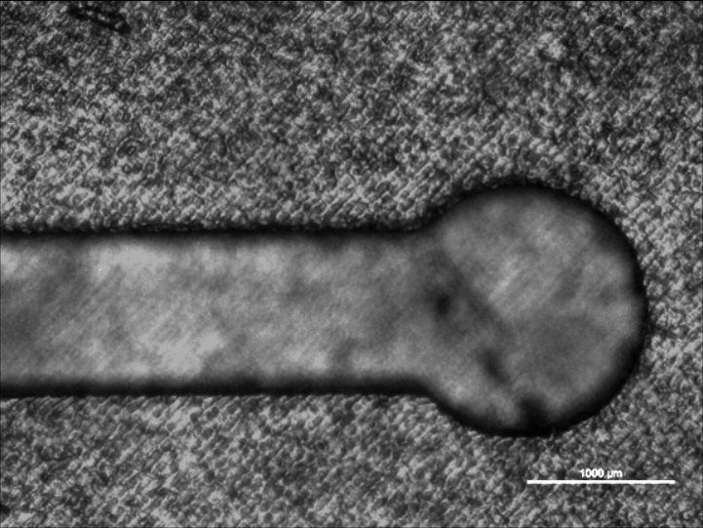
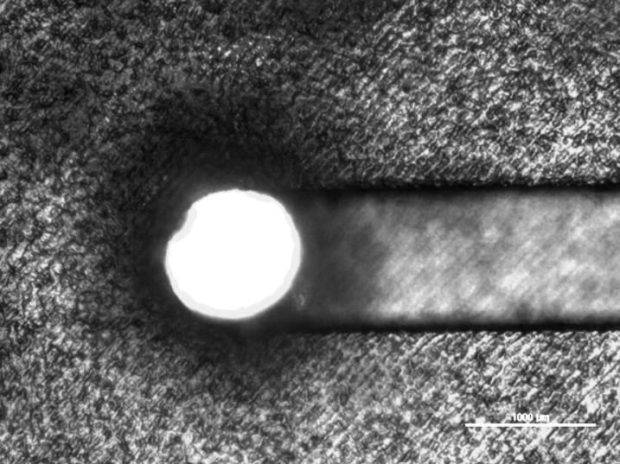
Single level through thermal bonding: Results
Single level chip unmounted
Single level chip mounted (thermally bounded)
Inlet optical microscopy
Channel microscopy
True via microscopy
1000 µm
1000 µm
1000 µm

Slide 10
From single level to multi-level
The thermal bonding eliminated the problem of water leakages
But at what cost…
Once the pieces are thermally bounded, they cannot be detached anymore
No more reconfigurability of the chip

Slide 11
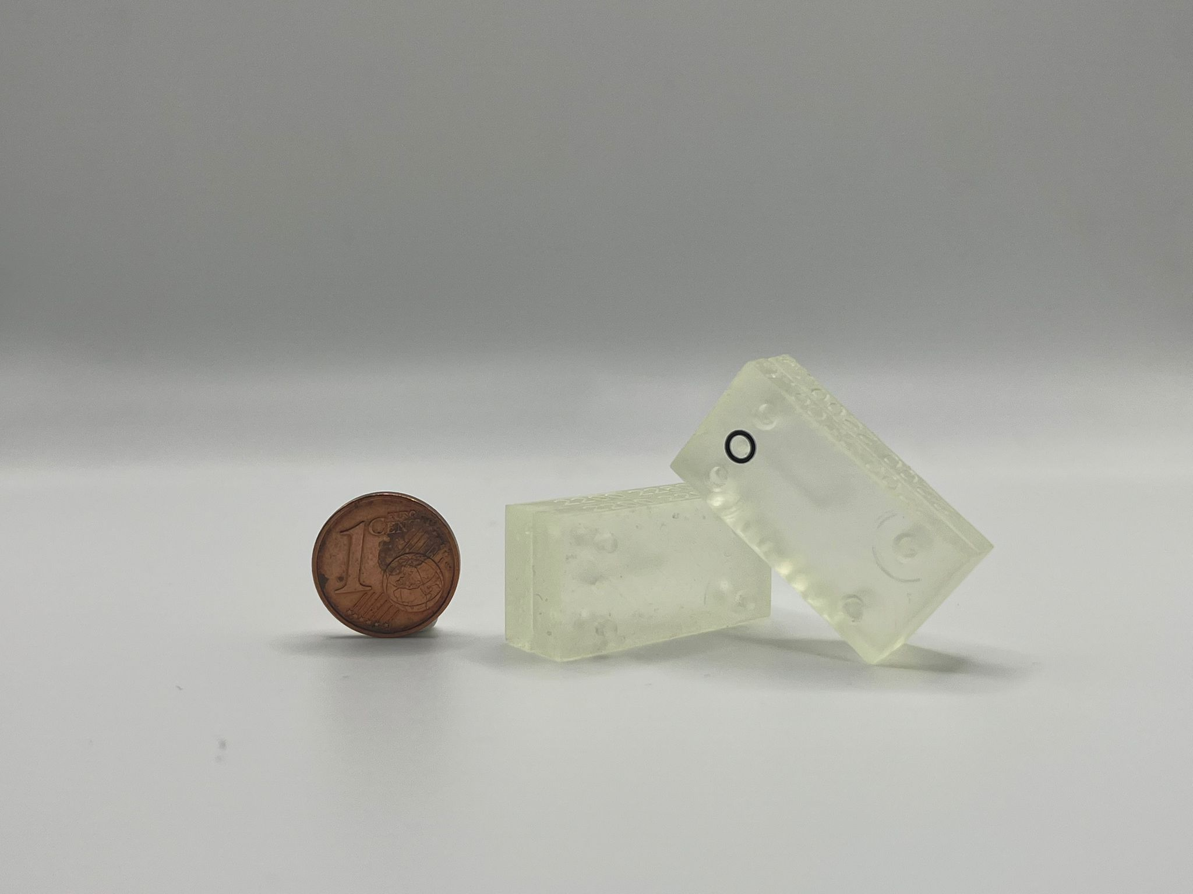
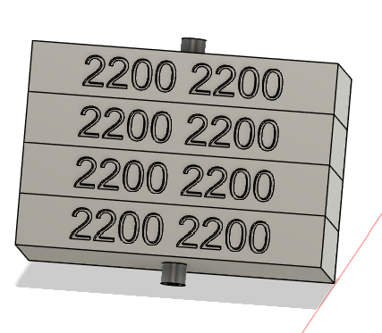
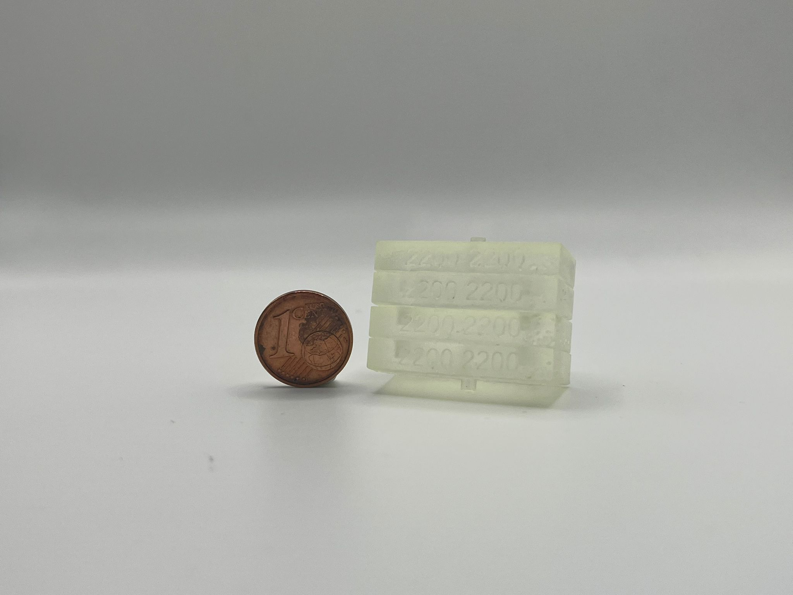
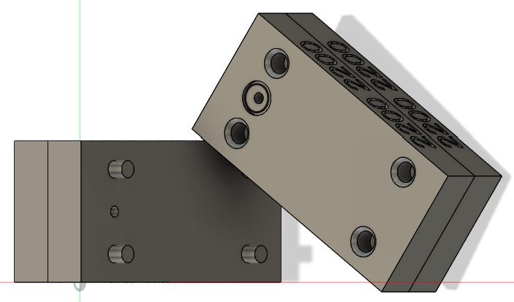
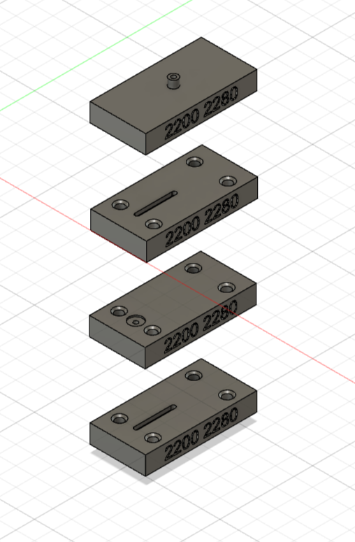
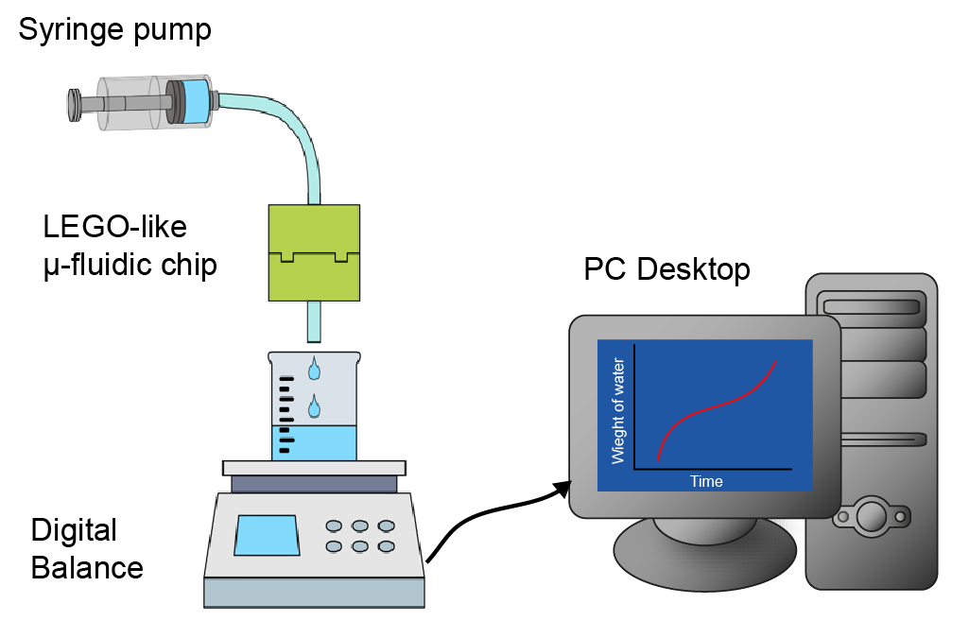
Multi-level chip: O-ring fluidic functionalities assessment
Dismounted multi-level chip
Mounted multi-level chip
Experiment setup
Configuration studied:
-Chip without O-ring
-Chip with O-ring
-Only syringe pump as
control experiment
Interface 1:
Thermal Bonding
Level 1
Interface 2:
O-ring Sealing
Flow rates studied:
-100 µL/min (20 min)
-10 µL/min (20 min)
-1 µL/min (60 min)
Interface 3:
Thermal Bonding
Level 2

Slide 12


Water leakage tests
1 µl/min
10 µl/min
100 µl/min
1 µl/min
10 µl/min
100 µl/min

Slide 13
Linear fitting of chip with O-ring measurements
The water does not fall smoothly (linearly) from the outlet, but drop-by-drop (discretely)
Is this a real problem? Linear fitting of data
The control case and the chip with O-ring case have the same slope (on average)
and the standard deviation has the same order of magnitude
So, having the chip with an O-ring sealing is like having the syringe pump sending water straight into the Becker.
No leakage was found!

Slide 14
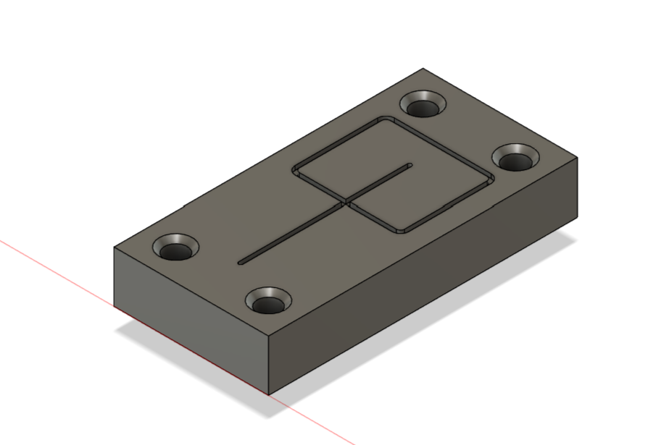
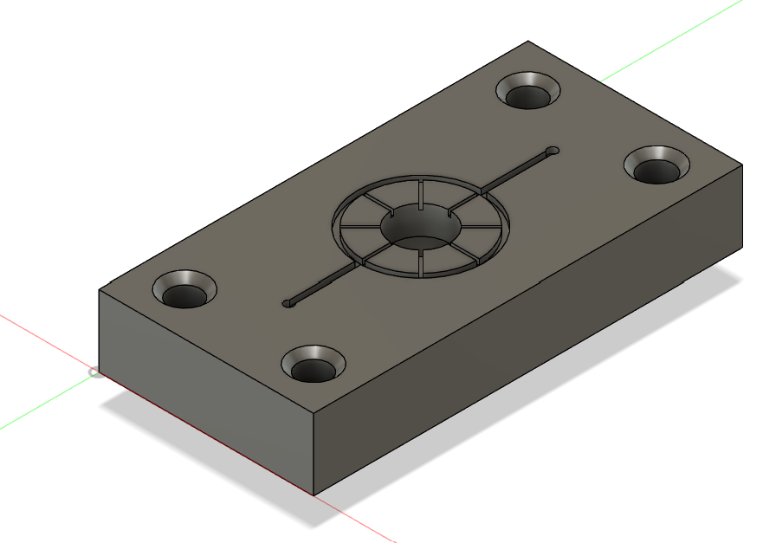
Droplet-generator as proof-of concept
a)
Droplet generator module
The droplet will form at the intersection
between water and oil channel.
Once created the droplet, where did they will go?
b)
b) Reservoir for storing and then easily collecting the droplets

Slide 15
Droplet generator study and time formation of droplets
Theoretical droplet simulation:
https://doi.org/10.1016/j.ijmultiphaseflow.2017.04.008

Slide 16
Considerations and achievements
Optimization of the Lego-like interlocking system between 3D SLA-printed modules,
a new fabrication approach of microfluidic devices that is easy to use
and it grants reconfigurability to the device according to the user needs
Fabrication and validation of single level microfluidic chip through thermal bonding
Fabrication and validation of multi level microfluidic chip through O-ring sealing
Development of Micro-droplet maker for the successful generation of droplets

Slide 17

Thank you for
the attention!

