Slide 1



Problem Statement Title : GPSC - GyanSetu (A Full-Stack GPSC Preparation Ecosystem with Generative AI Tutoring, Real-time Analytics, and Competitive Mock Assessments)
Domain : Education
Team Lead : Meet Patel
Team Name : Insight Innovators
Branch : Information Technology
Batch : D8a
Mentor : Prof. Anand Pandya
Mini Project

Slide 2
Agenda
System Architecture
Process Flow
Methodology (UI)
Tech Stack
Use Case Diagram
Challenges & Solution
Impact
Research links

Slide 3

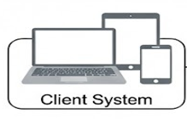


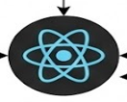











System Architecture
GPSC - GyanSetu
Data Retrieval & Storage
Client Req/Res
Supabase
Server
Req/Res
Services
Authentication
Web Application (React.js + Tailwind CSS)
Server (Python + Flask)
PostgreSQL
Users
Functional Modules
Email Service
Student
Curriculum Taxonomy Navigation
Google meet Service
Courseware Asset Exploration
Simulated Examination Execution
Storage Service
Expert
Assessment Architecture
Strategic Resource Analytics
Auth0 Service
Interviewer
Session Orchestrator
Behavioral & Soft Skill Profiling
Render - Deployment Service
Admin
Identity & Access Management
Performance Oversight

Slide 4










Data Collection
Access Modules
Analysis dashboard
AI Chatbot
API Integration
Notification
Data Storage
Process Flow
Data Processing
User Interface
FeedBack

Slide 5
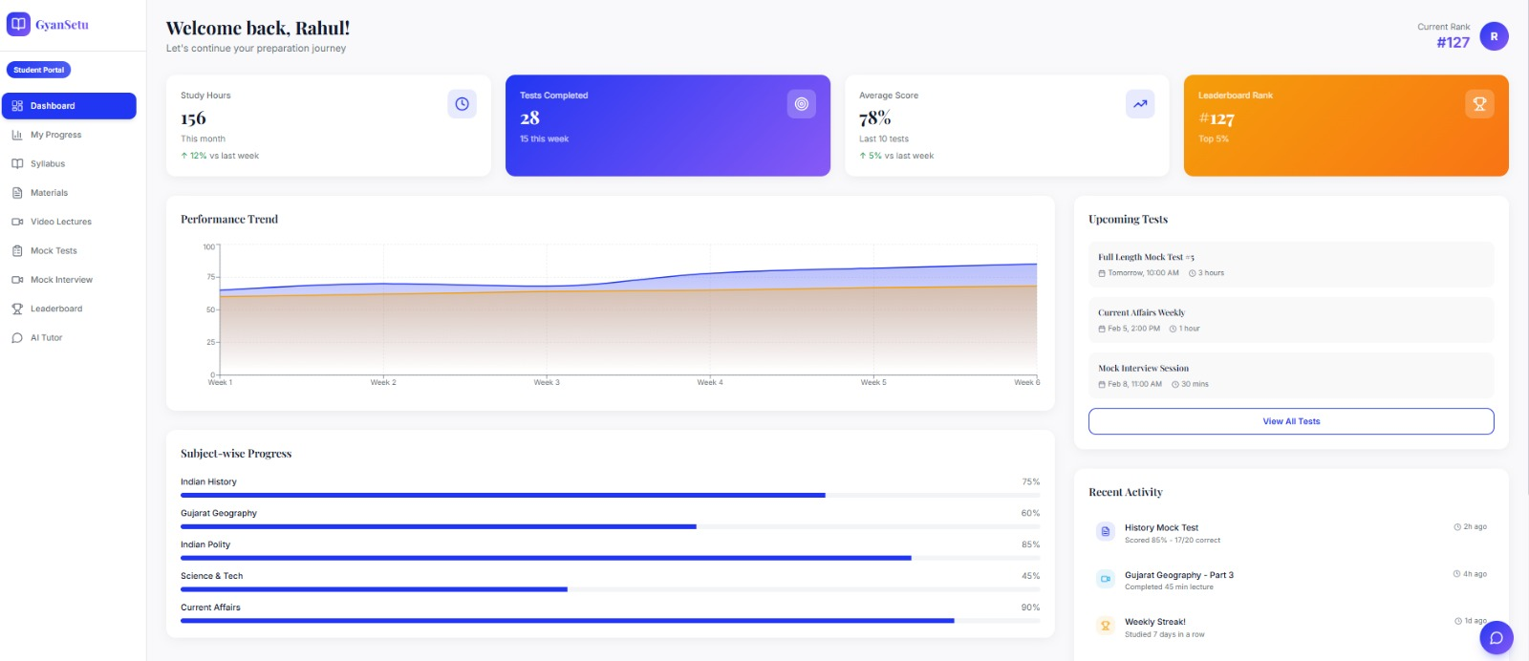
Methodology(UI)

Slide 6
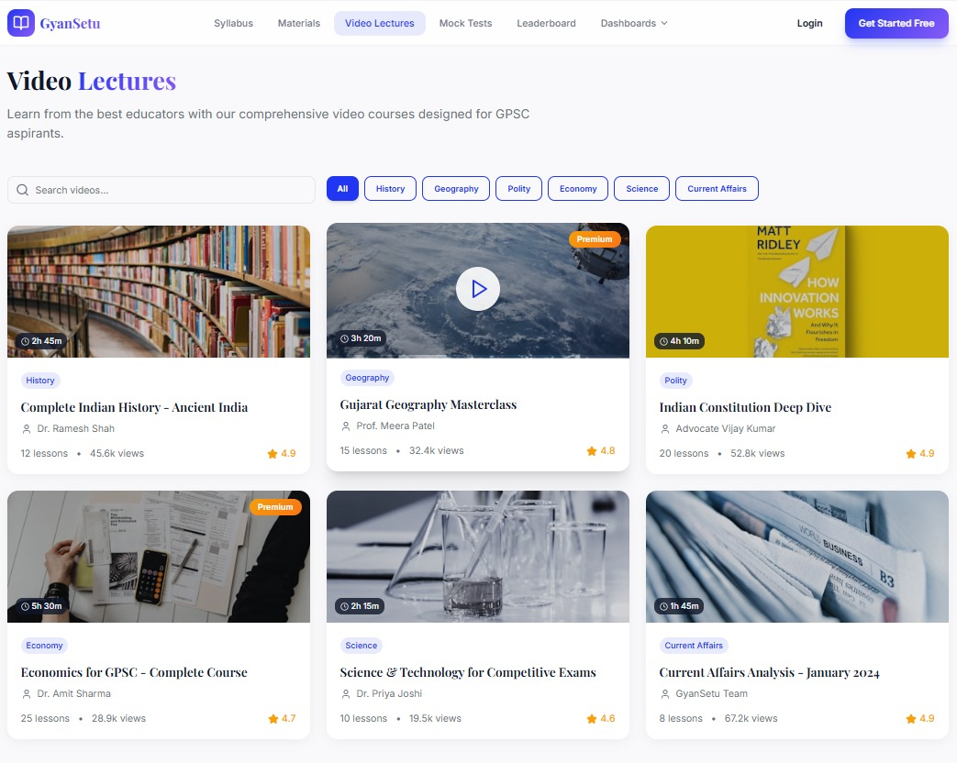

Slide 7
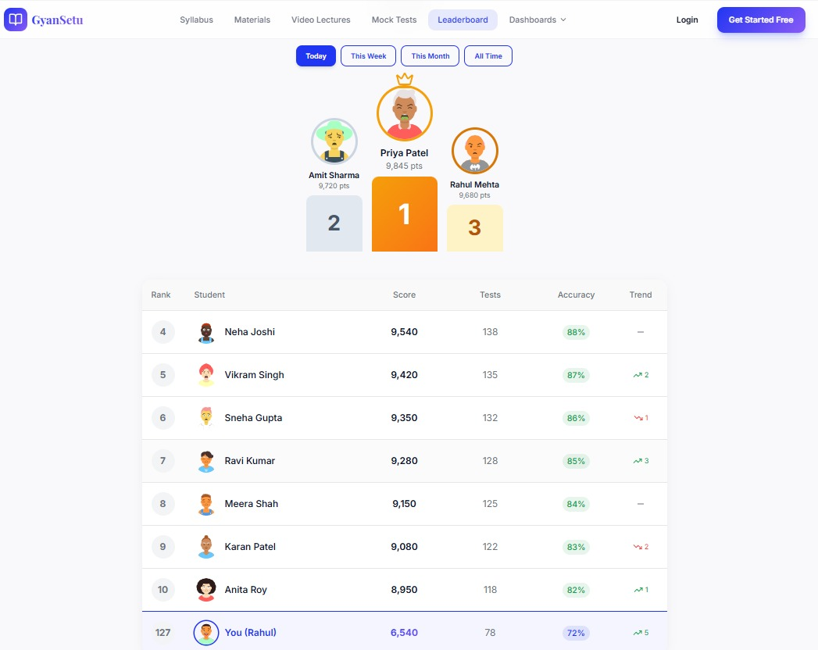

Slide 8
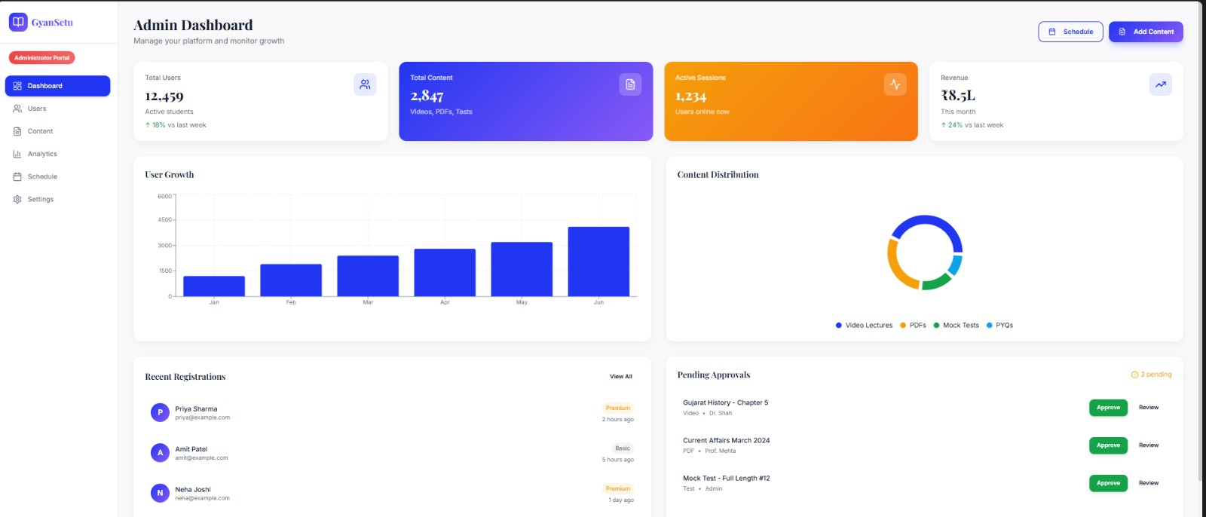

Slide 9
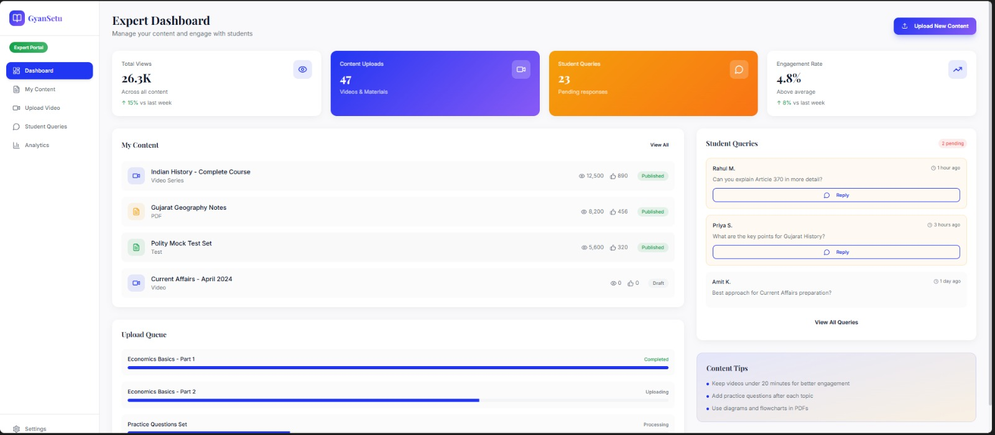

Slide 10
Tech Stack
Frontend
Backend
Database
API
React.js , Tailwind CSS , Chart.js
Python , Flask
PostgreSQL , Supabase
Gemini API, Google meet API
Deployment
Render

Slide 11
Overcoming the Roadblocks to Success
The "Hallucination" & Accuracy Hurdle
Challenge: AI-generated quizzes or doubt responses providing inaccurate or outdated GPSC information.
Content Fragmentation & Fatigue
Challenge: Students getting lost in thousands of disorganized PDFs and YouTube links.
The Scaling Bottleneck
Challenge: Difficulty in manually scheduling and tracking hundreds of 1-on-1 mock interviews.
Solution: Automated Session Orchestration. Integration with Google Meet and Calendar services to automate the booking lifecycle for Interviewers and Students.
Solution: Curriculum Taxonomy Navigation. A structured asset graph that maps every video and document to a specific sub-topic in the Prelims or Mains syllabus.
Solution: Expert-in-the-Loop Validation. All AI outputs are grounded in your specific PDF library and can be human-verified via the Expert Dashboard.
Security & Role Integrity
Challenge: Ensuring students cannot access "Expert-only" question banks or sensitive administrative analytics.
Solution: Granular IAM Implementation. Using Auth0/Firebase to enforce strict role-based access control (RBAC) across all four dashboard types.
Real-Time Pattern Evolution
Challenge: The GPSC exam pattern changes faster than static textbooks can be updated.
Solution: Student Experience Crowdsourcing. A feedback loop where recent test-takers upload insights that the AI immediately processes into new practice materials.

Slide 12






IMPACTS & BENEFITS
Socio-Economic Impact
Community & Soft Skill Growth
Precision Learning & Efficiency
Adaptive Knowledge Remediation
Administrative & Expert Optimization
End-to-End Preparation Lifecycle

Slide 13
Research links
1: Official Exam Framework
Link : GPSC Official Website - Exam Schedule & Notifications
2: Category-wise Syllabus Structure
Link : Detailed GPSC Syllabus 2026 (PDF English/Gujarati)
3: Essential Study Materials & Books
Link : GPSC Subject-wise Booklist & Reference Guide
4: Previous Year Question Papers (PYQs)
Link : Download GPSC Previous Year Papers (Free PDFs)
5: Video Lectures & Mock Interviews
Link : GPSC Topper Mock Interview Playlist (WebSankul)

Slide 14
Thank you

