Slide 1
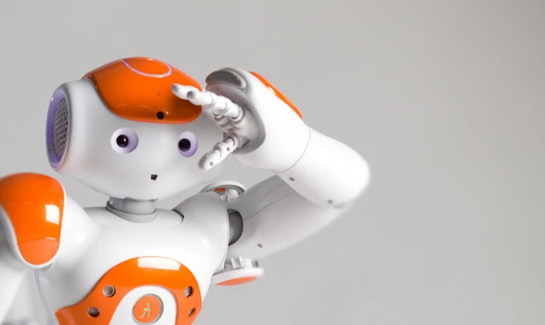
ROBOerTo Bolle
Team
Pietro Tellarini
Giorgia Bravi

Slide 2
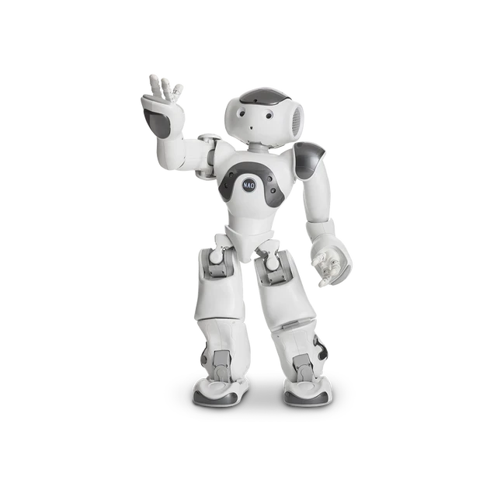
Time
Assign the time to the single moves and dived them in fast, normal and slow moves, respecting the maximum time of the choreography.
Preconditions
Check if the preconditions, standing and sitting of every move are satisfied

Slide 3
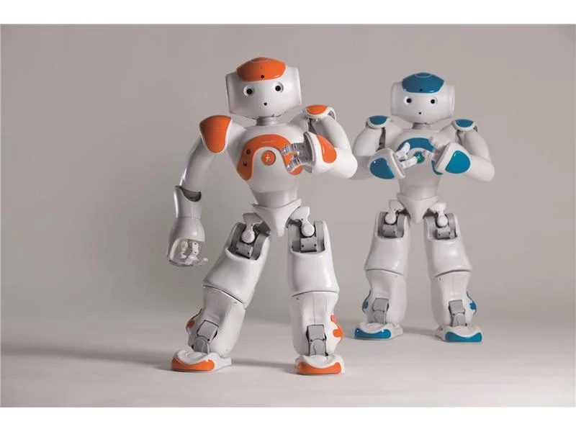
Music
Analise the intensity of the music and assign to the different fragment of intensity fast, normal or slow moves

Slide 4
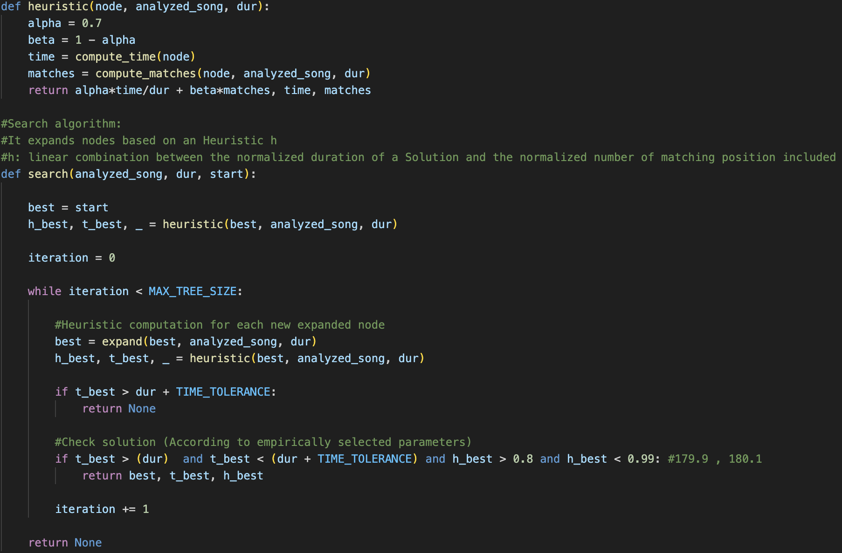
Planning Algorithm
The Algorithm return the best sequence of moves once it has analised the intensity of the music, the precondition and the history of moves. Define the heuristic and the search function to expand the nodes.

Slide 5
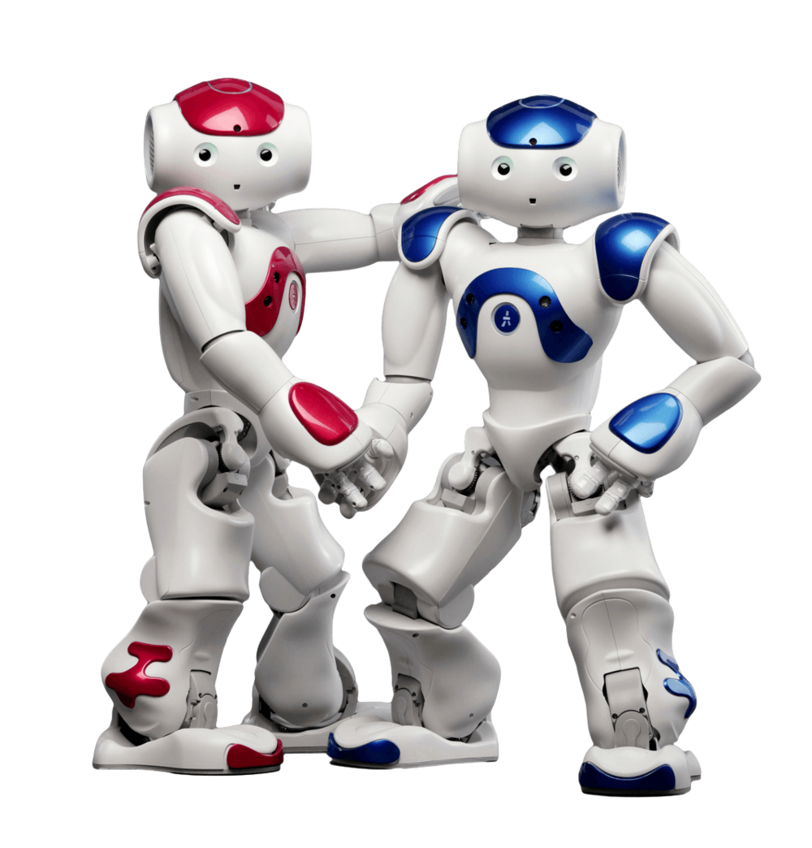
THANKS for your ATTENTION

