Slide 1
Exposing Private Information by Timing Web Applications
Mads Rogild, Patrick Krøll Brandt,
Emil Sander Bak, and Mads Gram

Slide 2
Web Application Architecture, Direct timing attacks
Underlying Modules / Data
HTTP 1.1
Content-length vs Chunked Encoding

Slide 3
Testing for Boolean Values
Testing emails
Account validity

Slide 4
Python Code Example & Demo
if ( len(request.form["password"]) == len(secretPassword)): for i in range(len(request.form["password"])): if request.form["password"][i] == secretPassword[i]: continue else: break

Slide 5
Cross-site Timing Attacks
Browser restrictions
Embedded pages using tags

Slide 6
Why it’s Difficult
Varying internet connections
Using several sources
Responses as chunks

Slide 7
Testing Boolean Values
User logged on or not

Slide 8
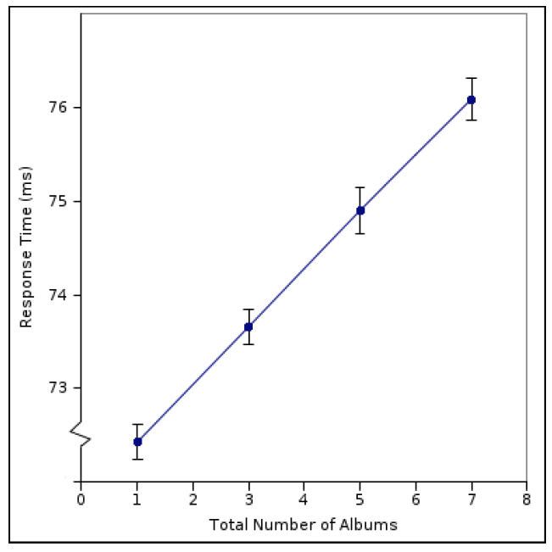
Estimating the Size of Hidden Data
Andrew Bortz, Dan Boneh, Palash Nardy Exposing Private Information by Timing Web Applications

Slide 9
Defenses
Fixed response time
Responses as chunks

