Slide 1
DAP391m | Nhom 8 | Literature Survey
Literature Survey
and Project Feasibility Assessment
Fine-grained Multi-label Emotion Detection for Vietnamese Social Media
Nhom 8: Gia Phuc / Khoa / Quy | DAP391m FA26 | Sep 2026

Slide 2
PROBLEM CONTEXT AND USE CASE
Why Fine-grained Emotion Matters for Vietnamese Social Media
Sentiment vs Fine-grained
Vietnamese Social Media Scale
Target Use Case
Sentiment: 3 labels -- positive / negative / neutral
Sufficient for star-rating aggregation
Fine-grained: 27 specific emotion labels
admiration, grief, anger, confusion...
Example: same phrase can be admiration OR surprise
"Oi troi oi sao hay the nay"
-> joy + admiration OR surprise
77M internet users in Vietnam
73% use social media (We Are Social 2024)
GoEmotions [ACL 2020]: 27-label taxonomy for English
Vietnamese: no fine-grained multi-label dataset
before ViGoEmotions in 2026
Gap: existing VN tools cover 3-class sentiment only
Customer feedback triage on Vietnamese social media
Managers need to know:
not just negative, but: angry? disappointed? worried?
Operationally important emotions:
anger, disappointment, fear, grief
(rare or difficult labels = still business-critical)
INFER:
Fine-grained emotion detection requires 27-label multi-label classification -- a significantly harder task than 3-class sentiment. Vietnamese social media has scale but lacked a suitable dataset before 2026.

Slide 3
SURVEY OBJECTIVE AND SCOPE
What This Literature Survey Covers
Objective:
Identify established findings, open gaps, and feasibility conditions for applying training-level (ASL) and decision-level (per-label threshold) interventions to ViGoEmotions.
IN SCOPE
OUT OF SCOPE
1. Datasets -- ViGoEmotions and GoEmotions taxonomy
2. Vietnamese PLMs -- ViSoBERT and PhoBERT
3. Preprocessing -- 3 scenarios from paper
4. Imbalance-aware training -- ASL loss function
5. Decision-level thresholding -- per-label vs global
Calibration methods
Multimodal inputs (image + text)
LLM-based data augmentation (Emo Pillars)
New architecture proposals
Cross-platform user study
INFER:
The survey is bounded to 4 core areas that directly feed into the project's experimental design: dataset, PLM selection, preprocessing, and loss/threshold strategies.

Slide 4
SURVEY MAP
Four Clusters: From Dataset to Applied Evaluation
Cluster 1
Cluster 2
Cluster 3
Cluster 4
Dataset and Taxonomy
Vietnamese Models
Imbalance-aware Training
Thresholding and Applied Evaluation
GoEmotions, ViGoEmotions
ViSoBERT, PhoBERT, ViLexNorm
ASL Loss, BCE + pos_weight
Per-label threshold, Decision layer
Literature -> gap identification -> design choices -> feasibility confirmation
INFER:
Each cluster answers a specific design question. Together they form the evidentiary basis for RQ2 (training-level ASL + decision-level threshold) and the feasibility claim.

Slide 5
CLUSTER 1: DATASET AND TAXONOMY
GoEmotions (EN) vs ViGoEmotions (VI)
CLUSTER ANALYSIS
Feature
GoEmotions
ViGoEmotions
Question:
Language
English
Vietnamese
Does the 27-label GoEmotions taxonomy transfer reliably to Vietnamese social media?
Source
Reddit (58k)
FB/TikTok/YT (20.6k)
Finding:
Labels
27 + neutral
27 + neutral
ViGoEmotions confirms transfer: 20,664 samples, 28 labels, LLM proposals + human verification. Only 40.82% LLM-human agreement -- human annotation is essential.
Task
Multi-label
Multi-label
Limitation:
Baseline F1-macro
BERT ~0.46
ViSoBERT 61.50%
Platform metadata incomplete. Inter-annotator Kappa reported per label but overall reliability threshold not stated in paper.
Annotation
3 annotators
LLM + human verify
Implication:
ViGoEmotions is the only dataset combining: Vietnamese + 27 fine-grained labels + multi-label + social media scale. Use as-is, do not re-annotate.
Year
ACL 2020
EACL 2026
INFER:
GoEmotions established the 27-label taxonomy; ViGoEmotions validated it for Vietnamese. The baseline gap (BERT 0.46 vs ViSoBERT 0.615) reflects both domain and language improvement.

Slide 6
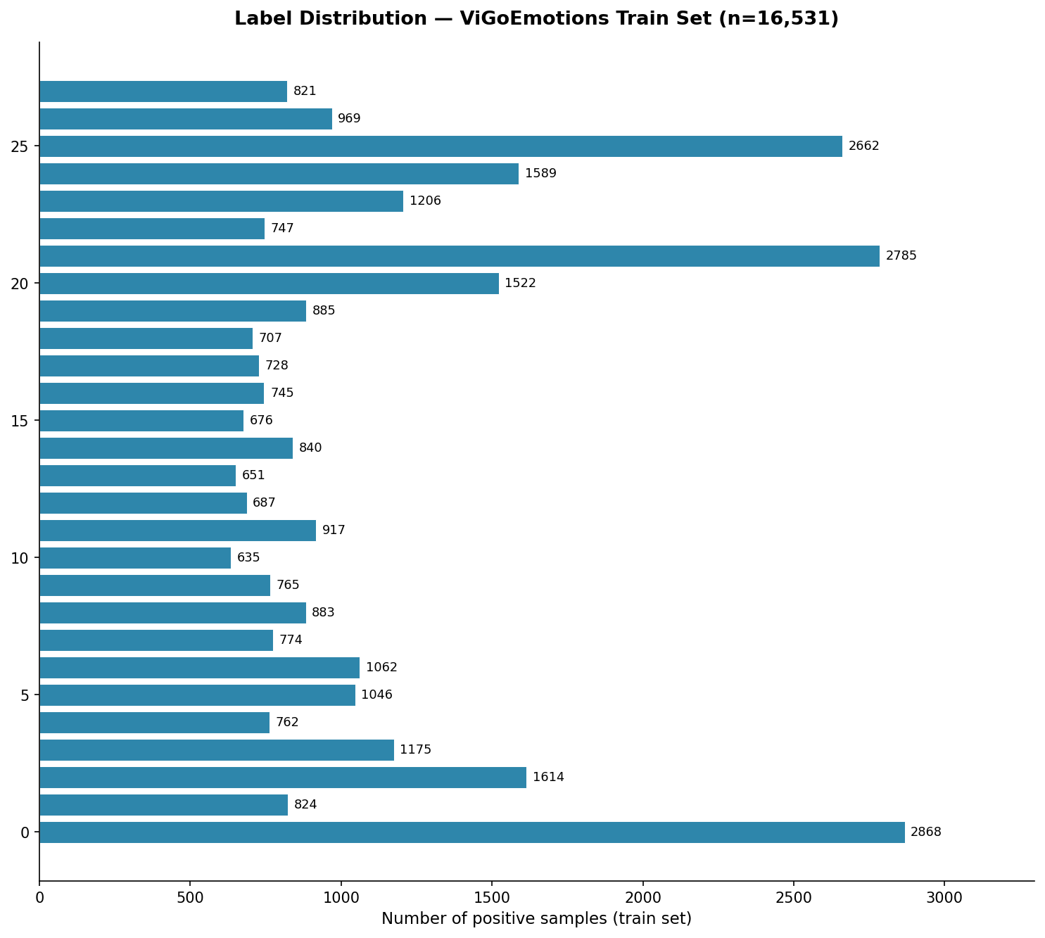
VIGOEMOTION DATASET
Key Statistics and Label Distribution
Dataset Overview
20,664 Vietnamese social media comments
28 labels: 27 fine-grained emotions + neutral
Multi-label: avg ~1.91 labels/comment
Sources: Facebook, TikTok, YouTube, Threads
Split: Train 16,531 / Val 2,066 / Test 2,067
Annotation pipeline:
3 LLMs propose labels per sample
Human verifies each proposal
LLM-human agreement: only 40.82%
=> emotion labeling requires human judgment
Baseline: ViSoBERT + Scenario 1
F1-macro: 61.50%
F1-weighted: 63.26%
INFER:
Class imbalance is severe: top 3 labels (amusement/sadness/annoyance) account for ~26% of all label instances. Bottom labels have ~3-4x fewer samples. This directly motivates ASL loss and per-label threshold.
Nguyen et al. (2026), EACL 2026 | Chart: label_distribution_barchart.png from 01_eda.ipynb

Slide 7
CLUSTER 2: VIETNAMESE MODELS
ViSoBERT, PhoBERT, ViLexNorm -- Domain Alignment Matters
ViSoBERT
EMNLP 2023
PhoBERT
EMNLP 2020
ViLexNorm
COLING 2022
Best fit for ViGoEmotions
Formal Vietnamese baseline
Preprocessing utility
Architecture: XLM-R
Training data: 1GB Vietnamese social media
Facebook, TikTok, YouTube (2016-2022)
Keeps emoji during tokenization
Achieves 61.50% F1-macro on ViGoEmotions
=> Primary backbone for ablation A0-D
Architecture: RoBERTa
Training data: 20GB formal Vietnamese
News, books, Wikipedia
Requires VnCoreNLP tokenizer
Domain mismatch: formal vs social media
=> Comparison backbone (config A only)
12,600 normalization pairs (slang -> standard)
Examples: ko->khong, mk->minh, bik->biet
Provides ViSoLex tool for auto-normalization
B2 preprocessing: apply lightly before tokenize
Caution: heavy normalization hurts ViSoBERT
=> B2 Scenario 1 applies minimal normalization
INFER:
ViSoBERT domain alignment is the core reason it outperforms PhoBERT on ViGoEmotions. Pretraining on social media + emoji retention = less preprocessing needed + better token coverage.
Nguyen et al. (2023), EMNLP | Nguyen & Tuan (2020), EMNLP | Nguyen et al. (2022), COLING

Slide 8
CLUSTER 3: IMBALANCE-AWARE TRAINING
Why BCE Fails and How ASL Addresses It
CLUSTER ANALYSIS
How ASL Works
Question:
Does replacing BCE with Asymmetric Loss (ASL) consistently improve F1-macro on fine-grained multi-label emotion data?
In multi-label: most labels are negative per sample
Finding:
BERT+ASL [2025] on GoEmotions: F1-macro 0.46->0.54 (+0.08) by changing loss only. ASL down-weights easy negatives via gamma- > gamma+, clipping low-prob negatives to 0.
BCE: all negatives get same gradient weight
Limitation:
Result is from GoEmotions (English). No test on Vietnamese or ViGoEmotions. Optimal hyperparameters may differ across datasets and backbones.
=> Easy negatives dominate, mask hard positives
Implication:
ASL is a low-effort training intervention. Start with paper defaults (gamma+=0, gamma-=4, m=0.05). Config C in ablation = isolated ASL effect.
Ablation config C = ASL only (no per-label threshold)
Ablation config D = ASL + per-label threshold
ASL: gamma- down-weights easy negatives (gamma-=4)
INFER:
ASL: gamma+ = 0, keeps positive gradient intact
ASL addresses a structural problem in BCE for multi-label: 27 classes means 26 negatives per positive. Config C isolates ASL's effect; Config A0 isolates pos_weight's effect.
Result: model focuses on true positives + hard negatives
Ramakrishnan & Babu (2025) | Ben-Baruch et al. (2021), ICCV -- Asymmetric Loss paper

Slide 9
CLUSTER 4: THRESHOLDING AND APPLIED EVALUATION
Per-label Threshold as Decision-level Intervention
CLUSTER ANALYSIS
Decision Pipeline
Question:
Model outputs: probability vector [p_0, p_1, ..., p_27]
Does per-label threshold tuning improve F1-macro compared to a global threshold of 0.5?
Finding:
Global threshold 0.5: label_i = 1 if p_i > 0.5 for ALL i
LLMs Multi-label [EMNLP 2025]: per-label threshold raises F1 from 0.27 to 0.43 (+0.16). Rare labels need lower thresholds (model under-confident); frequent labels may need higher.
=> Rare labels: p rarely reaches 0.5 => always 0 => recall=0
Limitation:
Threshold must be selected on val set ONLY. Tuning on test = data leakage. Grid search is slow for 28 labels; step 0.05 over [0.1, 0.9] = 17 values x 28 labels = 476 evaluations.
Per-label threshold: label_i = 1 if p_i > t_i
t_i tuned per label on val set (grid [0.1, 0.9], step 0.05)
Implication:
=> Rare labels get lower t_i => better recall
Configs B and D use per-label threshold. Tuning objective: per-label F1 on val. Thresholds locked in thresholds.json before test evaluation.
=> Frequent labels keep high t_i => precision preserved
INFER:
Per-label threshold is a decision-layer intervention: no retraining needed. Configs B and D use it. CRITICAL: tune only on val set; lock thresholds.json before running test evaluation.
[LLMs Multi-label, EMNLP 2025] | Lipton et al. (2014) -- threshold-moving for imbalanced classification

Slide 10
LITERATURE SYNTHESIS
What the Literature Has and Has Not Established
ESTABLISHED (by existing literature)
NOT YET ESTABLISHED (open questions)
1. Keeping emoji is best preprocessing for social media emotion (ViGoEmotions Scenario 1).
2. ViSoBERT outperforms PhoBERT on Vietnamese social media NLP due to domain alignment.
3. Per-label threshold tuning significantly improves F1-macro over global 0.5 threshold.
4. ASL loss improves F1-macro over BCE on English fine-grained emotion (GoEmotions +0.08).
5. Class imbalance in fine-grained emotion datasets does not benefit from simple oversampling (ViHateT5).
1. Whether ASL improves Vietnamese emotion detection specifically on ViGoEmotions.
2. Whether ASL + per-label threshold (combined) outperforms each individually.
3. Whether the precision-recall trade-off from thresholding is stable across 3+ random seeds.
4. Whether rare/difficult/ambiguous labels benefit differently from ASL vs threshold tuning.
5. Which preprocessing scenario is optimal when ASL loss is used (not just BCE + pos_weight).
INFER:
The literature provides strong motivation and precedent. All five 'not yet established' points are directly addressable by the A0-D ablation on ViGoEmotions -- that is the project's core contribution.

Slide 11
RESEARCH GAP
The Question This Project Addresses
Central Claim:
Training-level (ASL) and decision-level (per-label threshold) interventions induce different precision-recall trade-offs across emotion categories. Their combined effect on ViGoEmotions is unknown.
Still Unclear
This Project Addresses It By
1. Does ASL improve ViGoEmotions F1-macro?
(paper tested English GoEmotions only)
2. ASL + threshold vs each alone -- which wins?
(no controlled comparison exists)
3. Does the benefit hold across 3 random seeds?
(seed variance not reported in ASL literature)
4. Do operationally important labels (anger, grief)
benefit more from threshold or from ASL?
Ablation matrix A0, A, B, C, D on ViGoEmotions:
A0: BCE plain (isolates pos_weight effect)
A: BCE + pos_weight (paper-aligned baseline)
B: BCE + pos_weight + per-label threshold
C: ASL only
D: ASL + per-label threshold
All configs: ViSoBERT, Scenario 1, 3+ seeds
Evaluation: Macro F1, operational recall, per-label F1
INFER:
The gap is specific and testable. The ablation design is complete. No new architecture needed -- backbone is ViSoBERT throughout. Applied Data Science framing: system evaluation, not method proposal.

Slide 12
FEASIBILITY AND POSITIONING
Can We Build This? Where Does It Fit?
Technical Feasibility
Scope Feasibility
Scope Boundaries
GPU: 6-8GB VRAM needed for ViSoBERT fine-tune
Verified by 00_feasibility_check.ipynb
Runtime: ~30-40 min per config per seed
5 configs x 3 seeds = ~15 runs total
Code: transformers + torch (standard stack)
Loss: ASL implemented in 20 lines of Python
Threshold: grid search, no external library
VERDICT: Technically feasible on available GPU
Dataset: ViGoEmotions available locally
Backbone: ViSoBERT on HuggingFace
Preprocessing: underthesea + ViLexNorm
Timeline: 5 configs x 3 seeds in weeks 4-5
With 1 week buffer for reruns
Fallback if GPU OOM:
Reduce batch size + gradient accumulation
Mixed precision (fp16)
VERDICT: Achievable within 10-week timeline
NOT claiming:
- New model architecture
- SOTA on all benchmarks
- Production deployment
- Cross-platform user study
CLAIMING:
- Controlled ablation comparison
- Evidence about trade-offs
- Reproducible pipeline
- Demo prototype (Streamlit)
VERDICT: Applied Data Science framing -- evaluating trade-offs, not proposing new methods
INFER:
Feasibility is confirmed on three dimensions: technical (GPU verified), scope (dataset + backbone available), and framing (Applied DS -- no new method needed). Risk: VRAM OOM has mitigation plan.

Slide 13
RESEARCH QUESTIONS, NEXT STEPS AND REFERENCES
Summary and Q&A
Research Questions
RQ1 (B3): How are the 28 emotion labels distributed across rare / difficult / ambiguous / operationally important axes?
RQ2 (B5): How do ASL (training-level) and per-label threshold (decision-level) differ in their Macro F1 vs. operational recall trade-offs?
RQ3 (B2): How stable are these trade-offs across preprocessing scenarios and random seeds?
Q&A
Next Steps
1. Data audit: verify schema, labels, split sizes, duplicates, platform metadata
2. Feasibility check: forward + backward pass, VRAM, runtime per batch
3. Paper-aligned baseline: ViSoBERT Config A, seed 42, target ~61.50% F1-macro
Key References
Nguyen et al. (2026), EACL -- ViGoEmotions | Demszky et al. (2020), ACL -- GoEmotions
Nguyen et al. (2023), EMNLP -- ViSoBERT | Nguyen & Tuan (2020), EMNLP -- PhoBERT
[Ramakrishnan & Babu, 2025] -- BERT+ASL | [Anon, EMNLP 2025] -- LLMs Multi-label
Nhom 8 / DAP391m FA26

