Slide 1

Wikipedia - Goals
Making it happen
Quick and rewarding results
Exercise in flexibility
“Looking” for work
Notes:
Making it happen
Flexibility, coder “stretches” or “warmups”
Flexibiity in “Looking” for work
Might be looking for one thing but find another
Like looking for free software and stumbling across a play

Slide 2
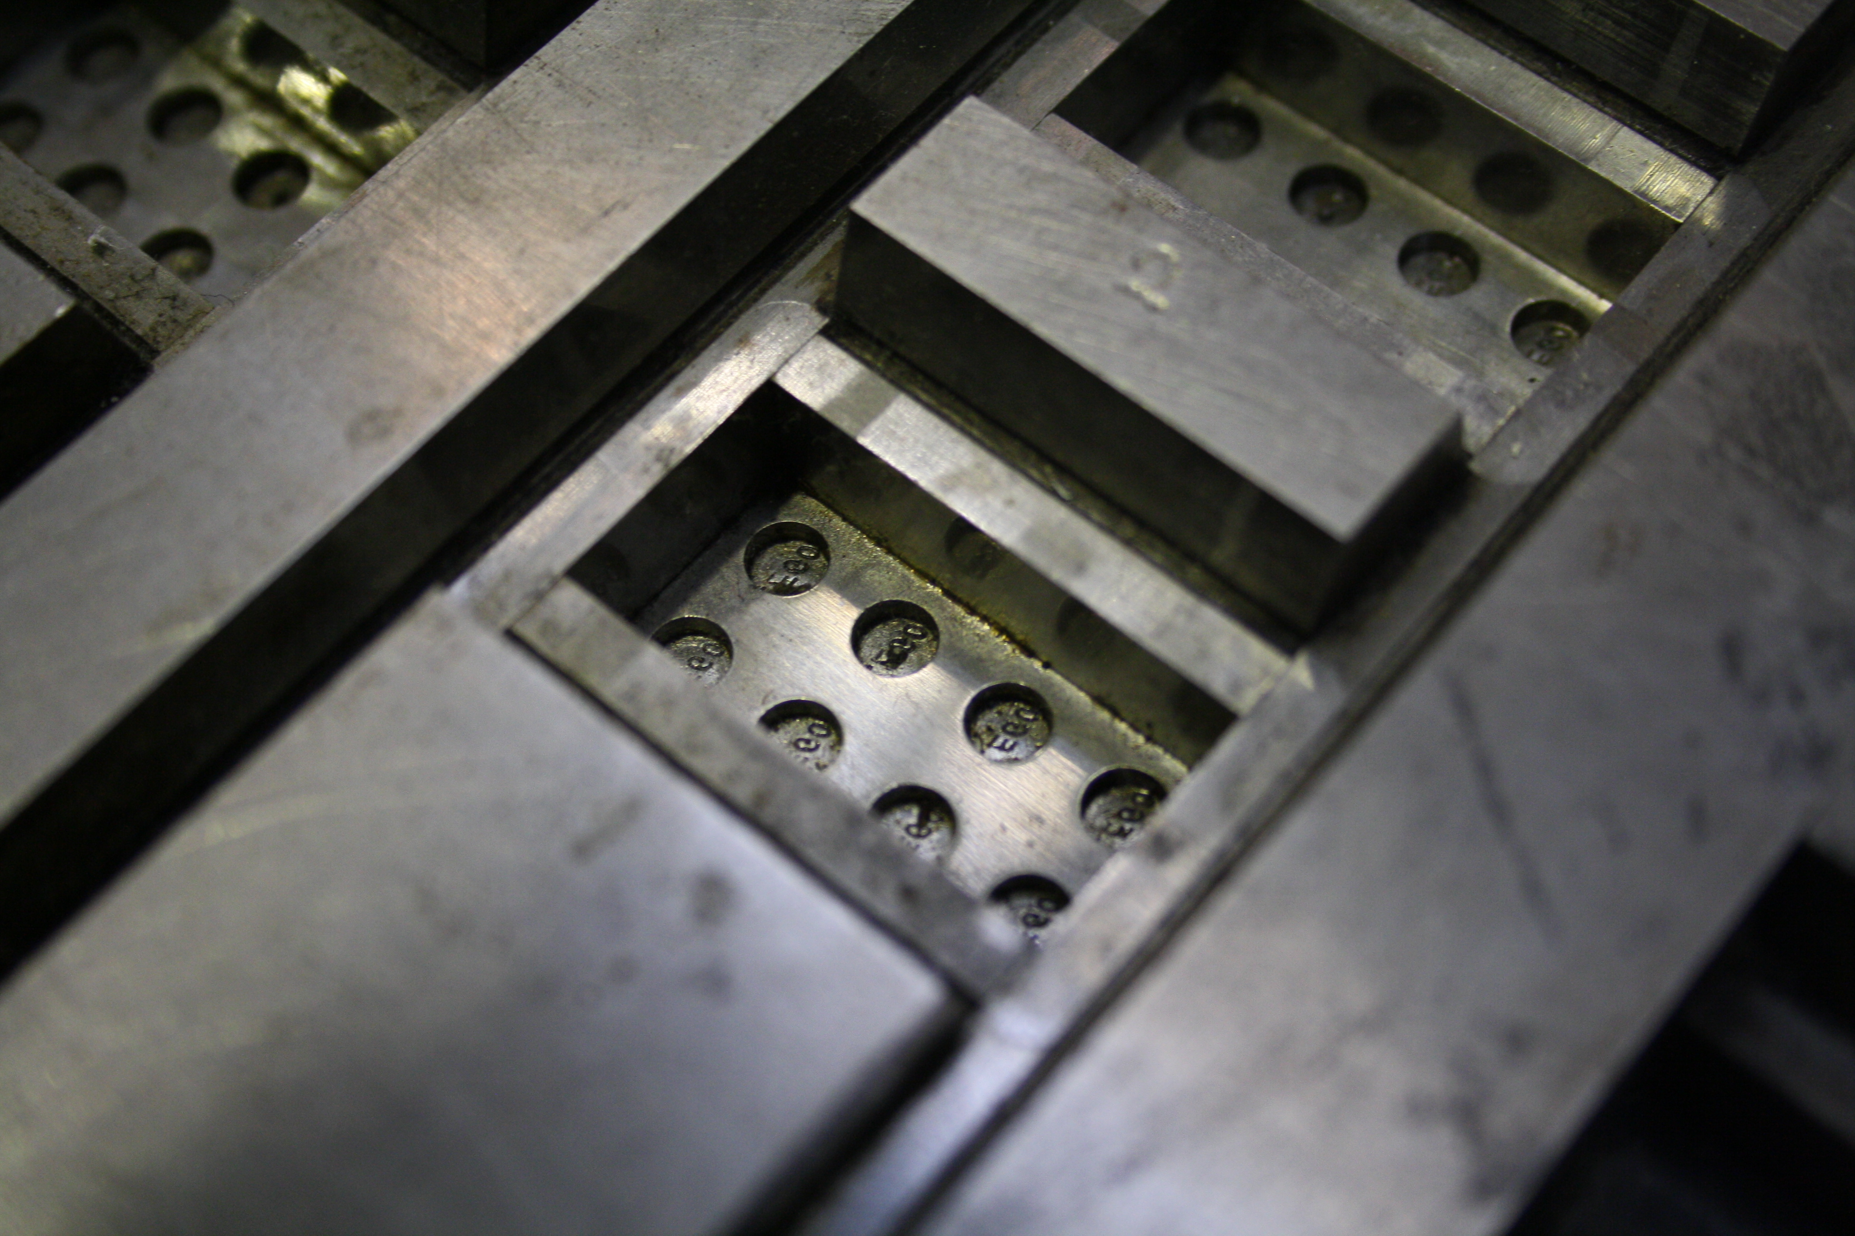

Wikipedia - Tips
Domain knowledge can be a (mild) curse
Use similar pages as templates
Perfection can be a trap
Don't get bogged down
Notes:
knowledge can create assumptions
Sometimes useful
similar pages demo for sections
And mistakes can prompt others into action
So can encouragment
Taking too long, use your talk page or sandbox

Slide 3

Wikipedia – Easy Lists
Articles Needing Sections - Layout needed
Short pages and Dead End pages
  Something simple is better than nothing
  Usually only a single word or line. Improvement is usually easy
  some dead ends just need good redirect pages
Link Fixing (disambiguation / links needed / lonely pages)
  Create direct links to be more specific
  Linking to more internal pages
  Orphans, can you find them a good home?
Notes:
Articles Needing Sections - Layout needed
TEMPLATE DEMO
Discuss dates (older is harder)
Beware the curse: null-pointer looked good
Short pages and Dead End pages
USING THE SANDBOX & TALK PAGE DEMO
Simple but can become deep
dead ends may need good redirects – templating
Link Fixing (disambiguation / links needed / lonely pages)
Light domain knowledge can be useful for some of these

Slide 4
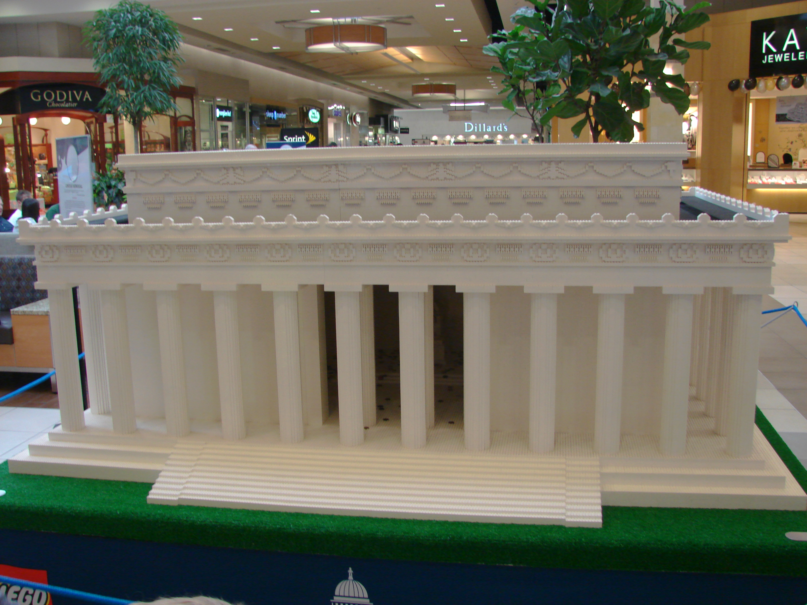
Wikipedia - Others
Geographic fixes – mostly easy lookup
Local Knowledge – search nearby
WikiMedia is also an option for the graphically inclined
  Photo challenge is a great inspiration

Slide 5
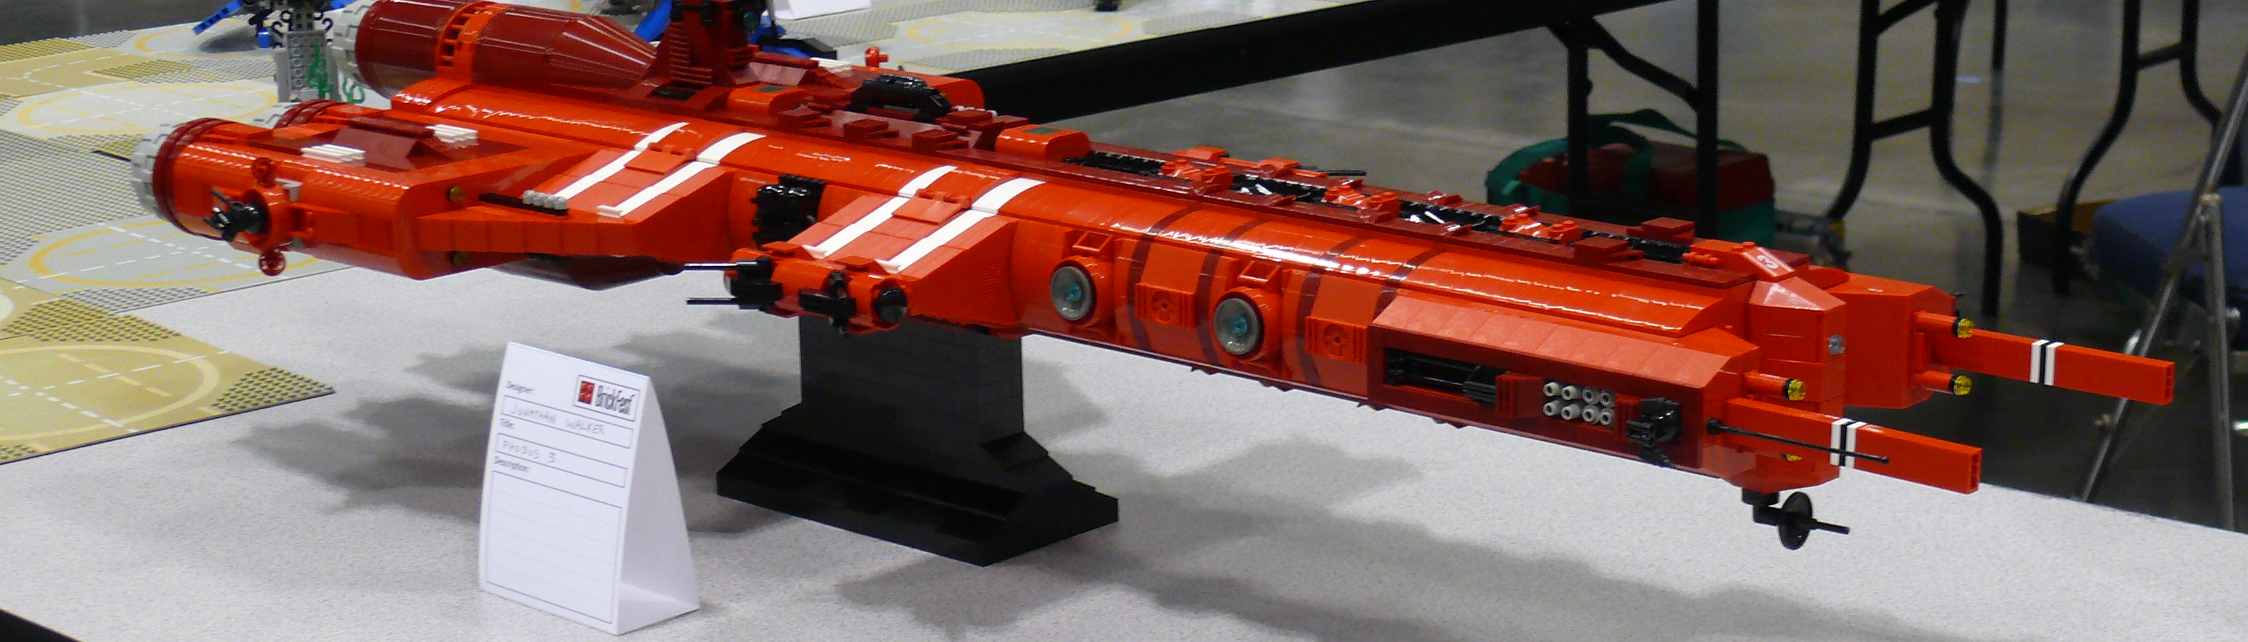
Wikipedia – A little more advanced
Longest Pages (Streamlining / Editing)
    Refinement & simplification improve the situation (No content required)
Wanted Categories / Files - Often further categorization or adding missing bits needed
    Categories partially assembled
    Aerospace engineering has Missing Files
Unconnected Pages - mostly poorly written or in first person
Empty Sections and List Sections - Content Needed or Paraphrasing (some domain knowledge ma be required)

Slide 6
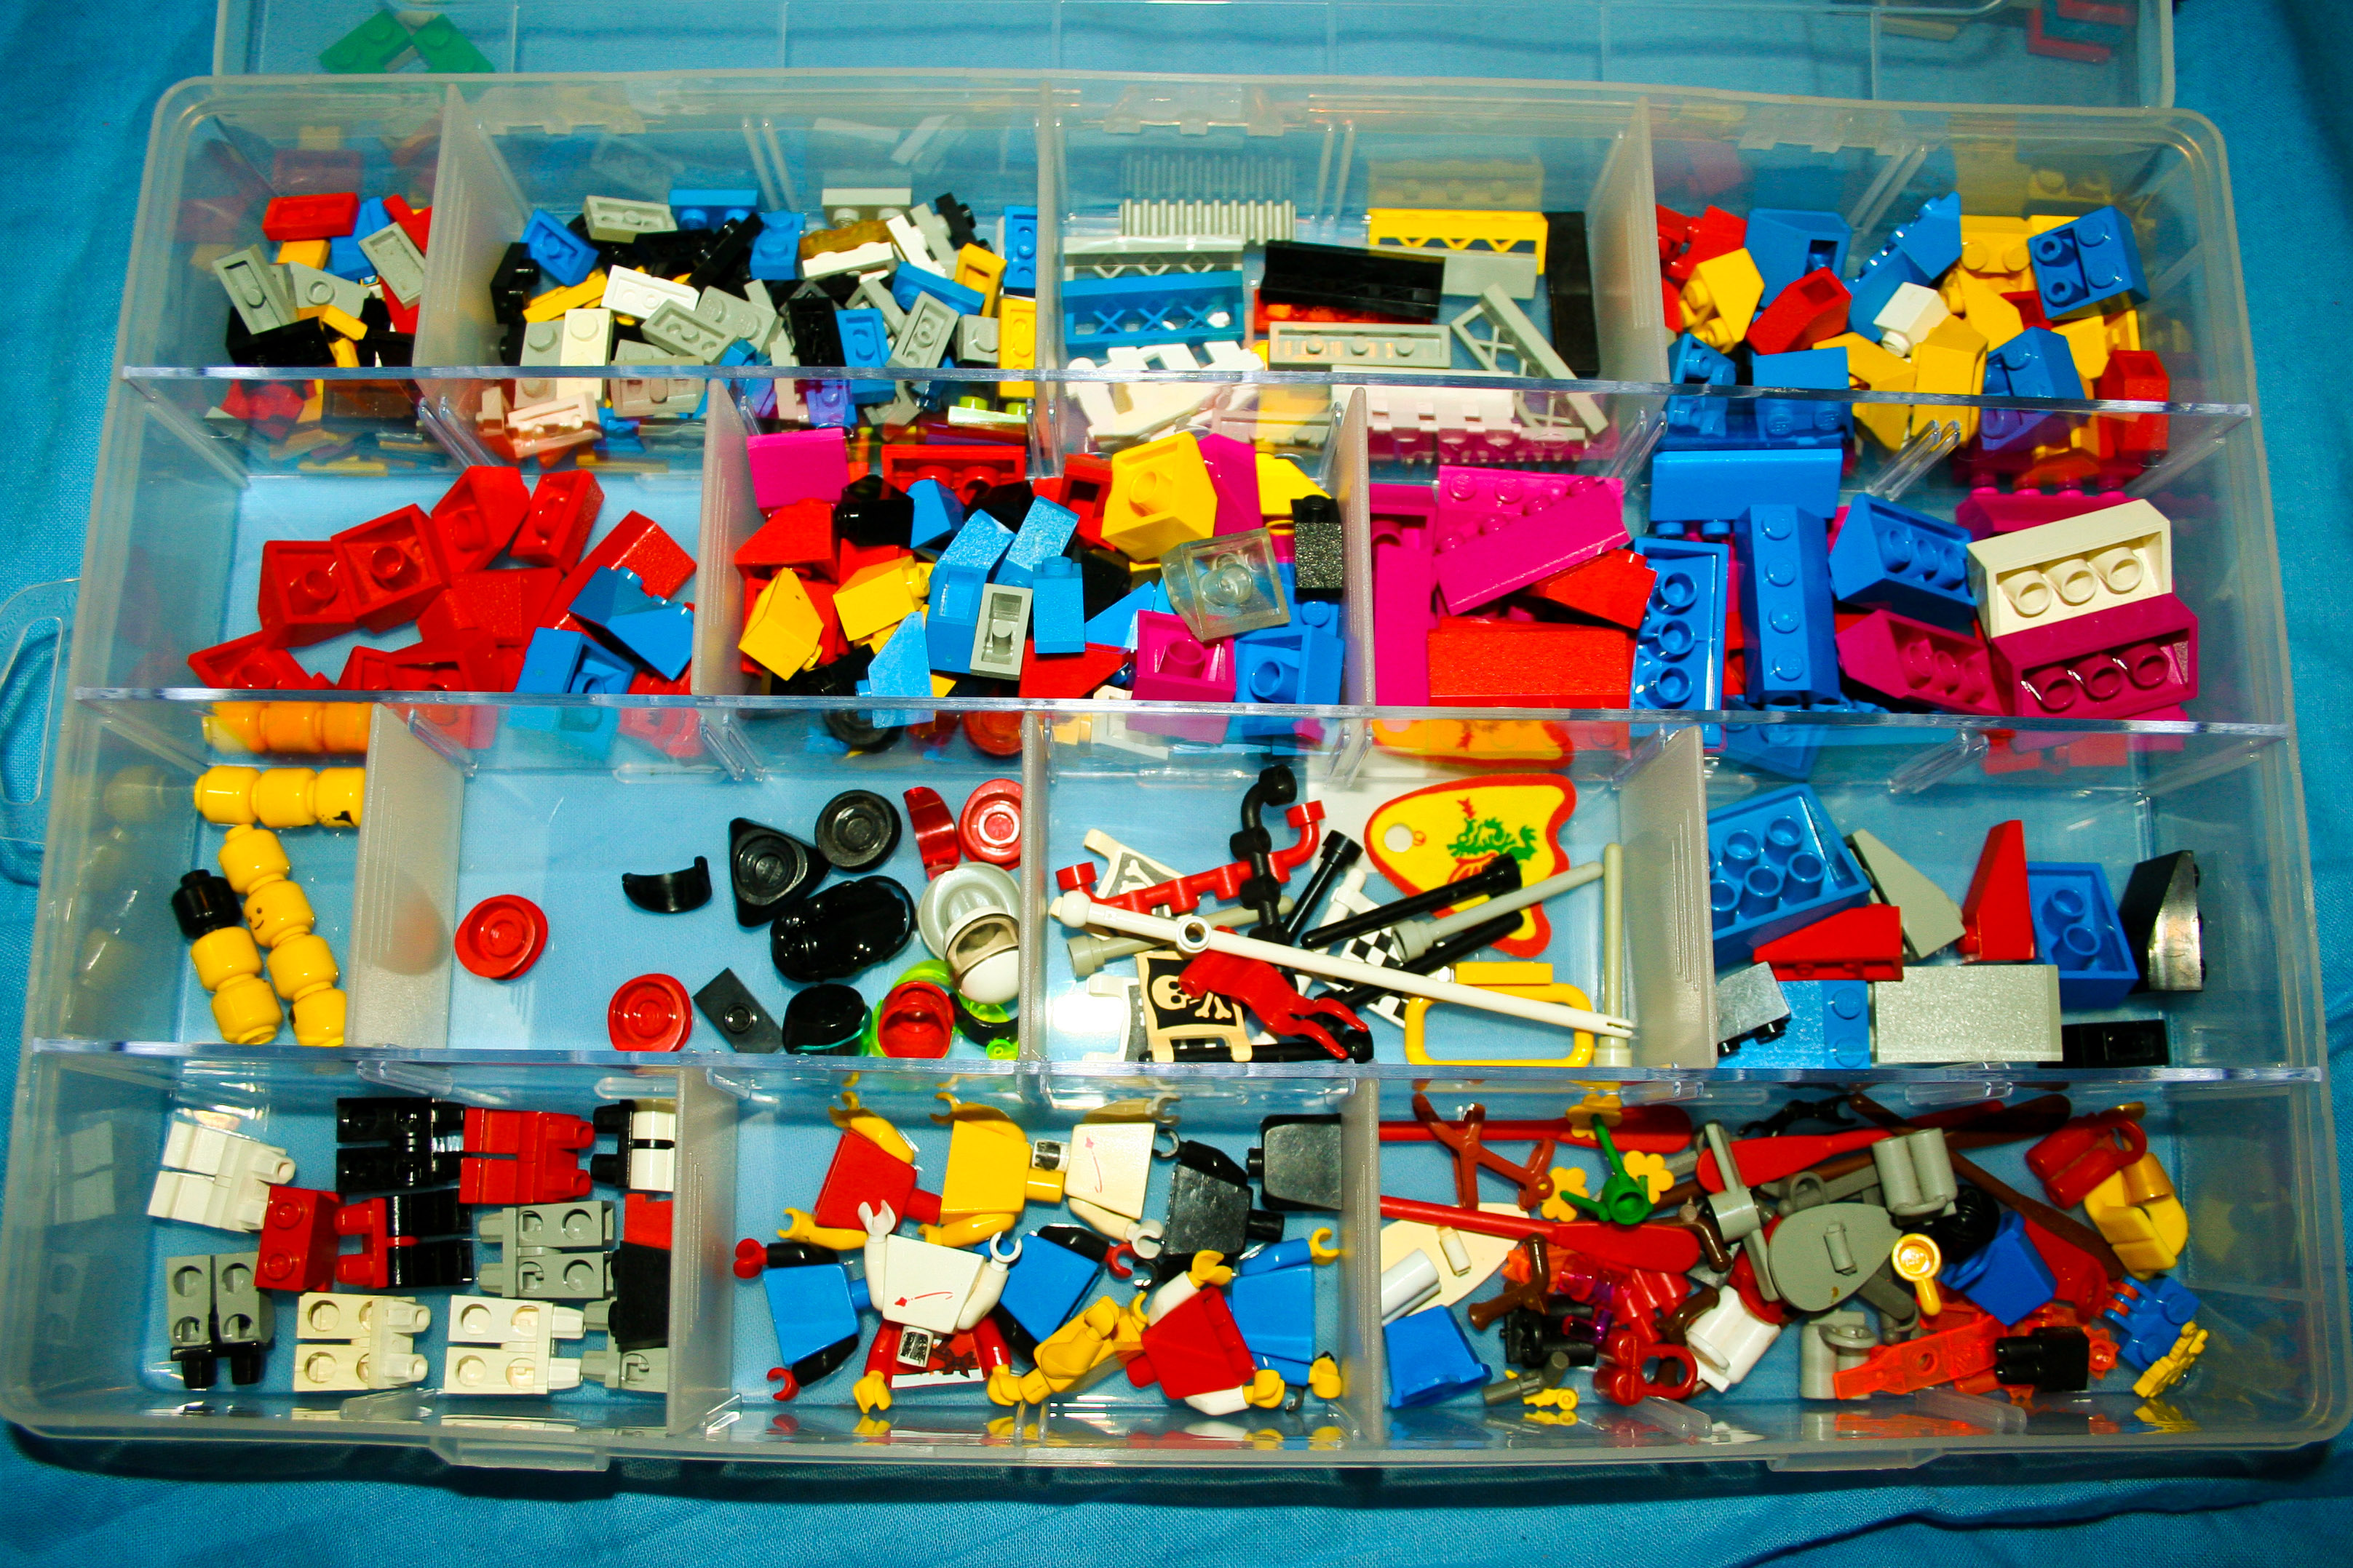
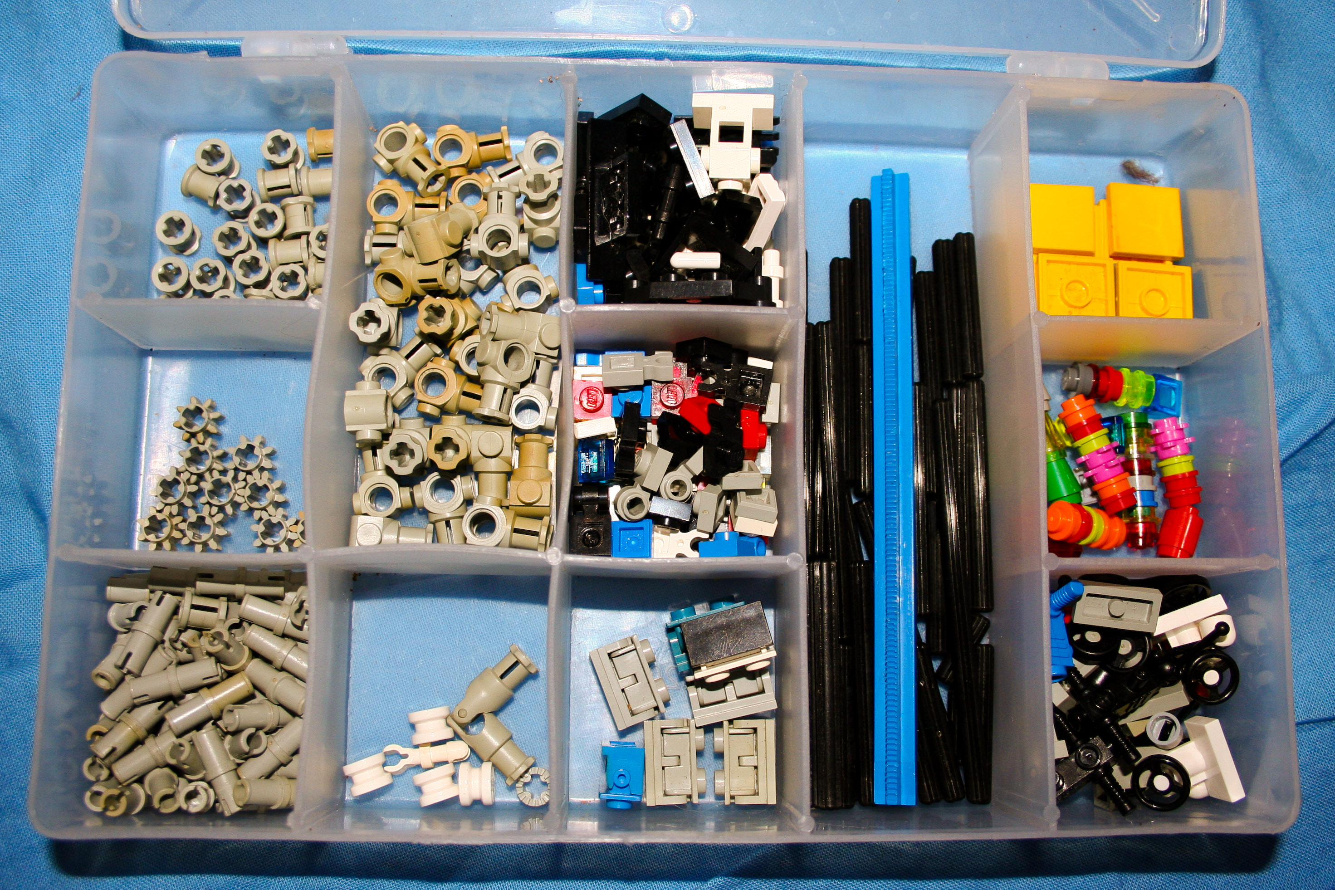
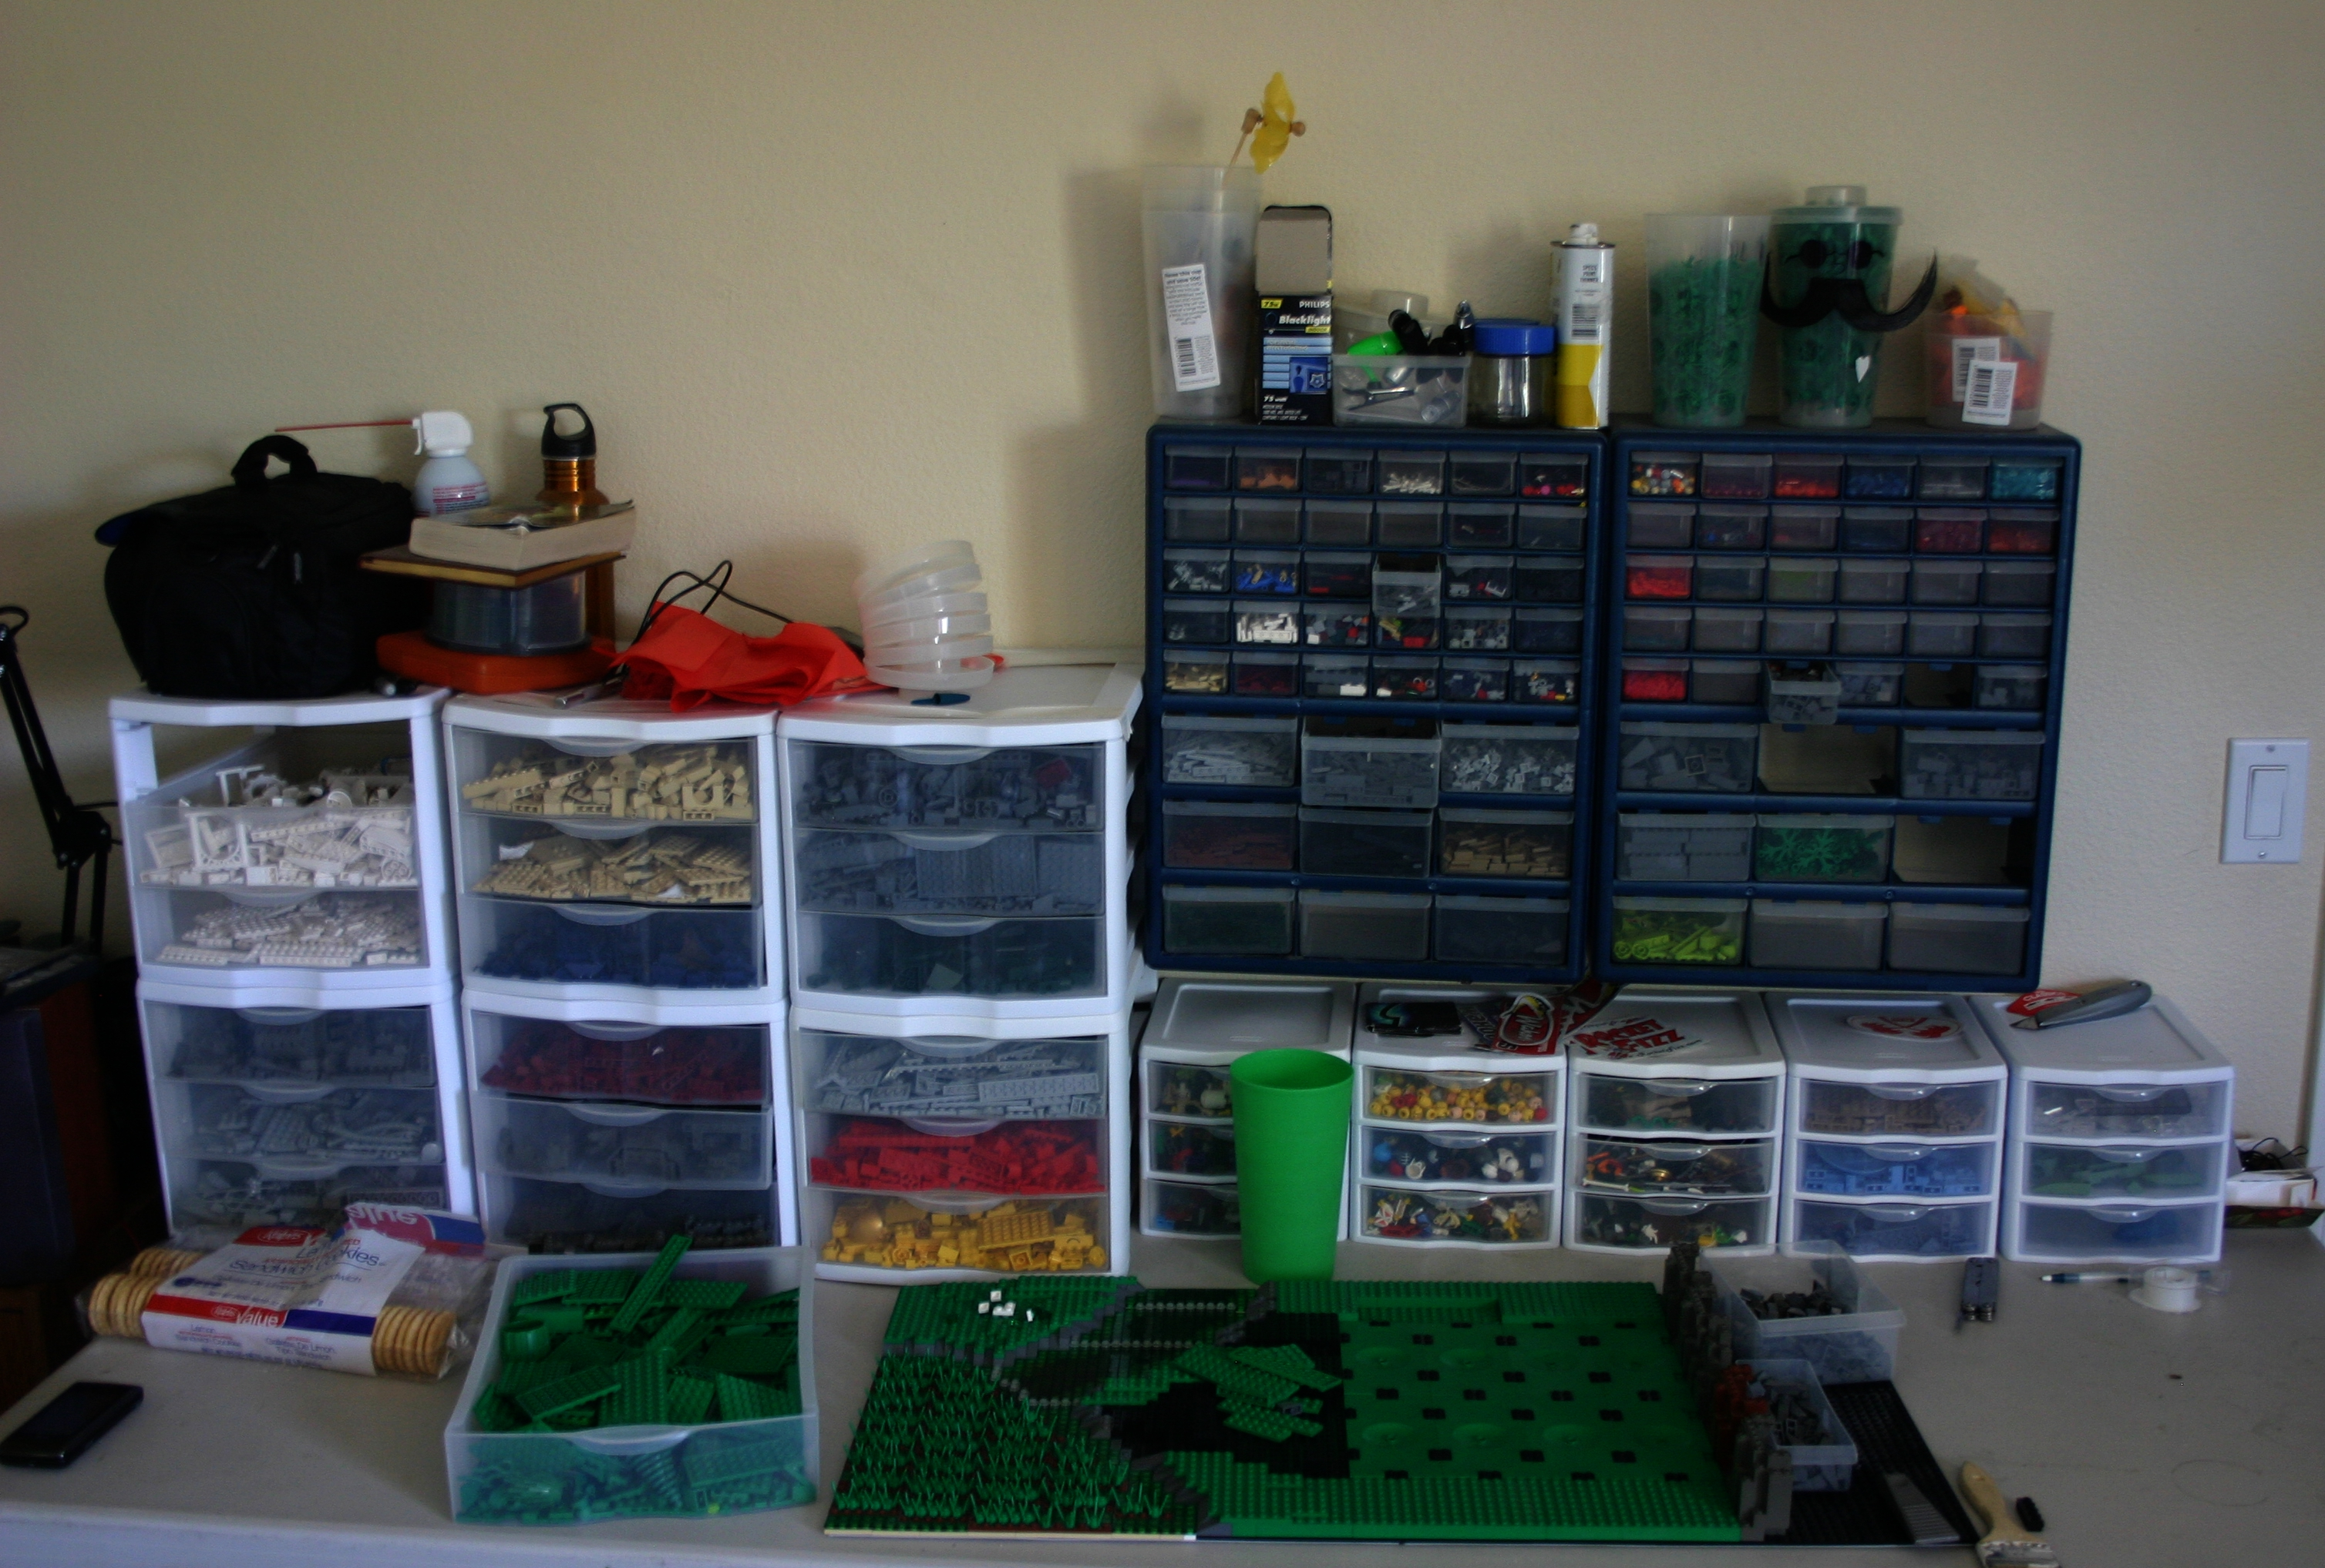
Wikipedia – All the Lists
All the Backlogs
All the Wikipedia lists

Slide 7
Wikimedia Photo Credits
-https://commons.wikimedia.org/wiki/File:LegoSpritzgussDetail1.JPG
-https://commons.wikimedia.org/wiki/File:LegoSpritzgussDetail.JPG
-https://commons.wikimedia.org/wiki/File:Legotower.jpg
-https://commons.wikimedia.org/wiki/File:Lego_Man_!_%286928700105%29.jpg
-https://commons.wikimedia.org/wiki/File:LEGO%C2%AE_Americana_Roadshow_2015_01.JPG
-https://commons.wikimedia.org/wiki/File:Lego_spacecraft_%22Phobos_3%22_at_BrickFest_on_Saturday,_March_28,_2009_in_Portland,_Oregon_-_%281%29.jpg
-https://commons.wikimedia.org/wiki/File:LEGO_Bits_Box_2.jpg
-https://commons.wikimedia.org/wiki/File:LEGO_Bits_Box.jpg
-https://commons.wikimedia.org/wiki/File:Lego_Work_Table.jpg

