Slide 1

Planning Alerts,
State Contracts then The World
Notes:
Good afternoon all, I‘m Ben Minerds and I‘m currently on a Code for Australia six month Fellowship working within the Department of Treasury and Finance looking at the state of reporting on Victorian government construction contracts.
I‘m also the President of Free Software Melbourne, an avid hackathon attendee, campaigner for Digital Liberties and advocate of Free and Open Source Software.

Slide 2
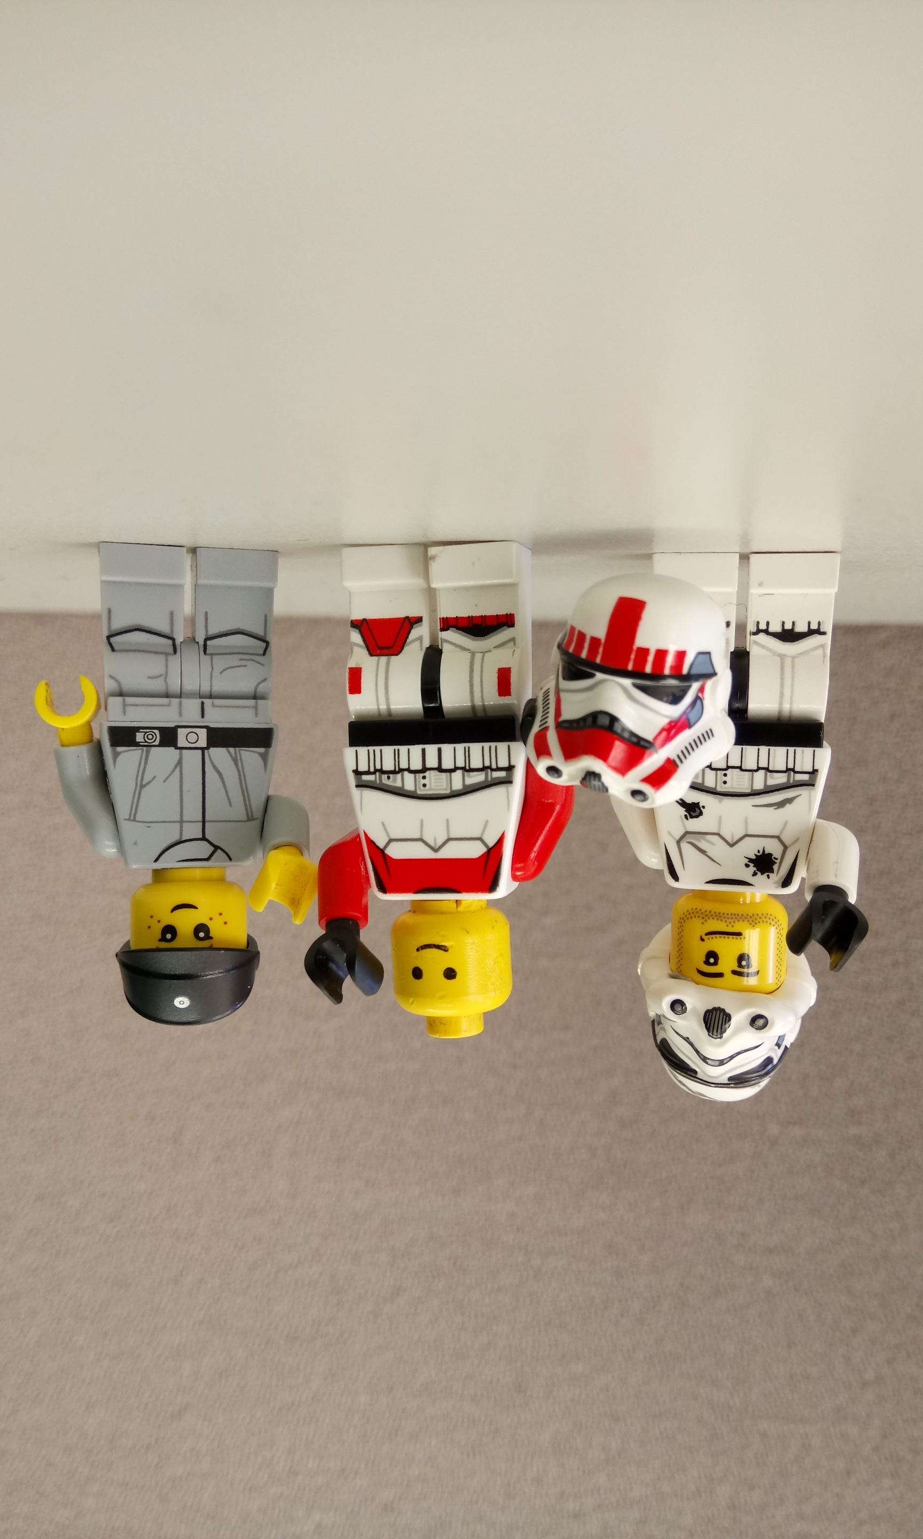
Code for Australia
Notes:
As I mentioned I work for Code for Australia and we are a small not for profit group of designers, hackers, advocates and data experts determined to help our government work better and smarter.
Code for Australia tries to achieve these goals through various programs including the Fellowship program I’m currently engaged in where three Fellows are embedded in a government department for six months, the Brigades that are just starting up in the ACT and the Civic Lab where I first got involved with Code for Australia many years ago.

Slide 3



NJC, VLA, DELwP & OEH
Notes:
Some of the other projects in the Fellowship include a system for lodging a pleas for minor offences online without having to attend court for the Neighbourhood Justice Centre and one for Victorian Legal Aid to replace a manual reminder system with an automated solution… they are now embarking on a mission to replace an intimidating and difficult to navigate web portal with a more user centric solution.
A team at DWELP has been developing a site for alerting citizens to backburning activities in their local area, and another for wildlife rescue information.
There is also a team working with the NSW Office of Environment & Heritage highlighting and encouraging engagement with cultural sites of interest in a users area.

Slide 4

Tony
Notes:
So let‘s take a quick walk in someone else's shoes to better understand the problem area Planning Alerts deals with.
Lets say hi to Tony, “hi Tony”, he lives in the outer eastern suburbs with his young son.
Tony does his best to keep up with what‘s going on in his neighbourhood and is even active in his local council.
But because of council boundaries Tony could be living right down the street from a major development without being notified.

Slide 5
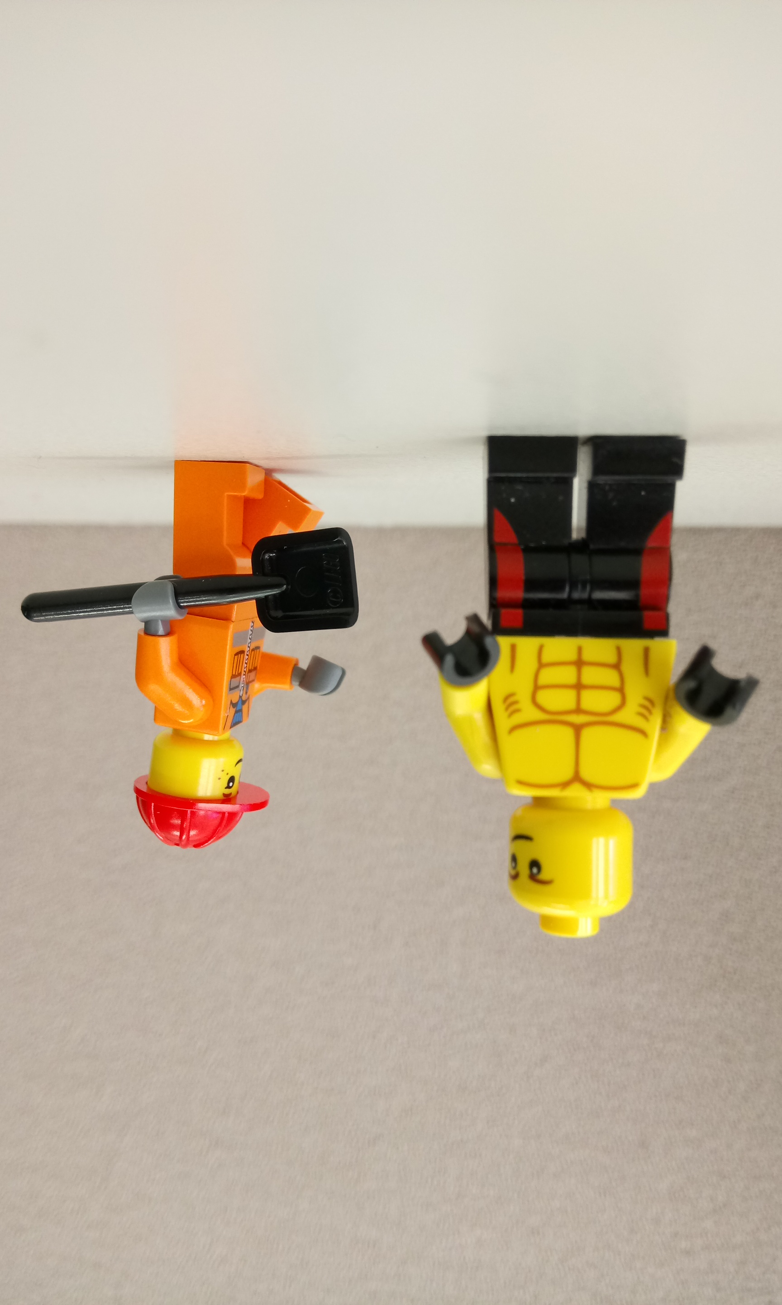
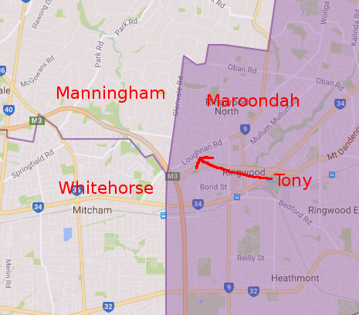
For Example
Notes:
Lets say Tony lives here on Loughnan Rd, here.
With the council boundaries as they are Tony would need to monitor 3 council planning sites to know what‘s going on within just 2 kilometres, and this situation isn‘t uncommon.
Expanding the area to include other important places in his life would also involve similar numbers of councils.
<<TRANSITION>>
Even then despite Tony being so involved in his local area he can be totally taken by surprise when the state government decides to build a new school or the federal government imposes new zoning boundaries or the like.
How can someone possibly keep up with all of this, Planning Alerts to the rescue.

Slide 6
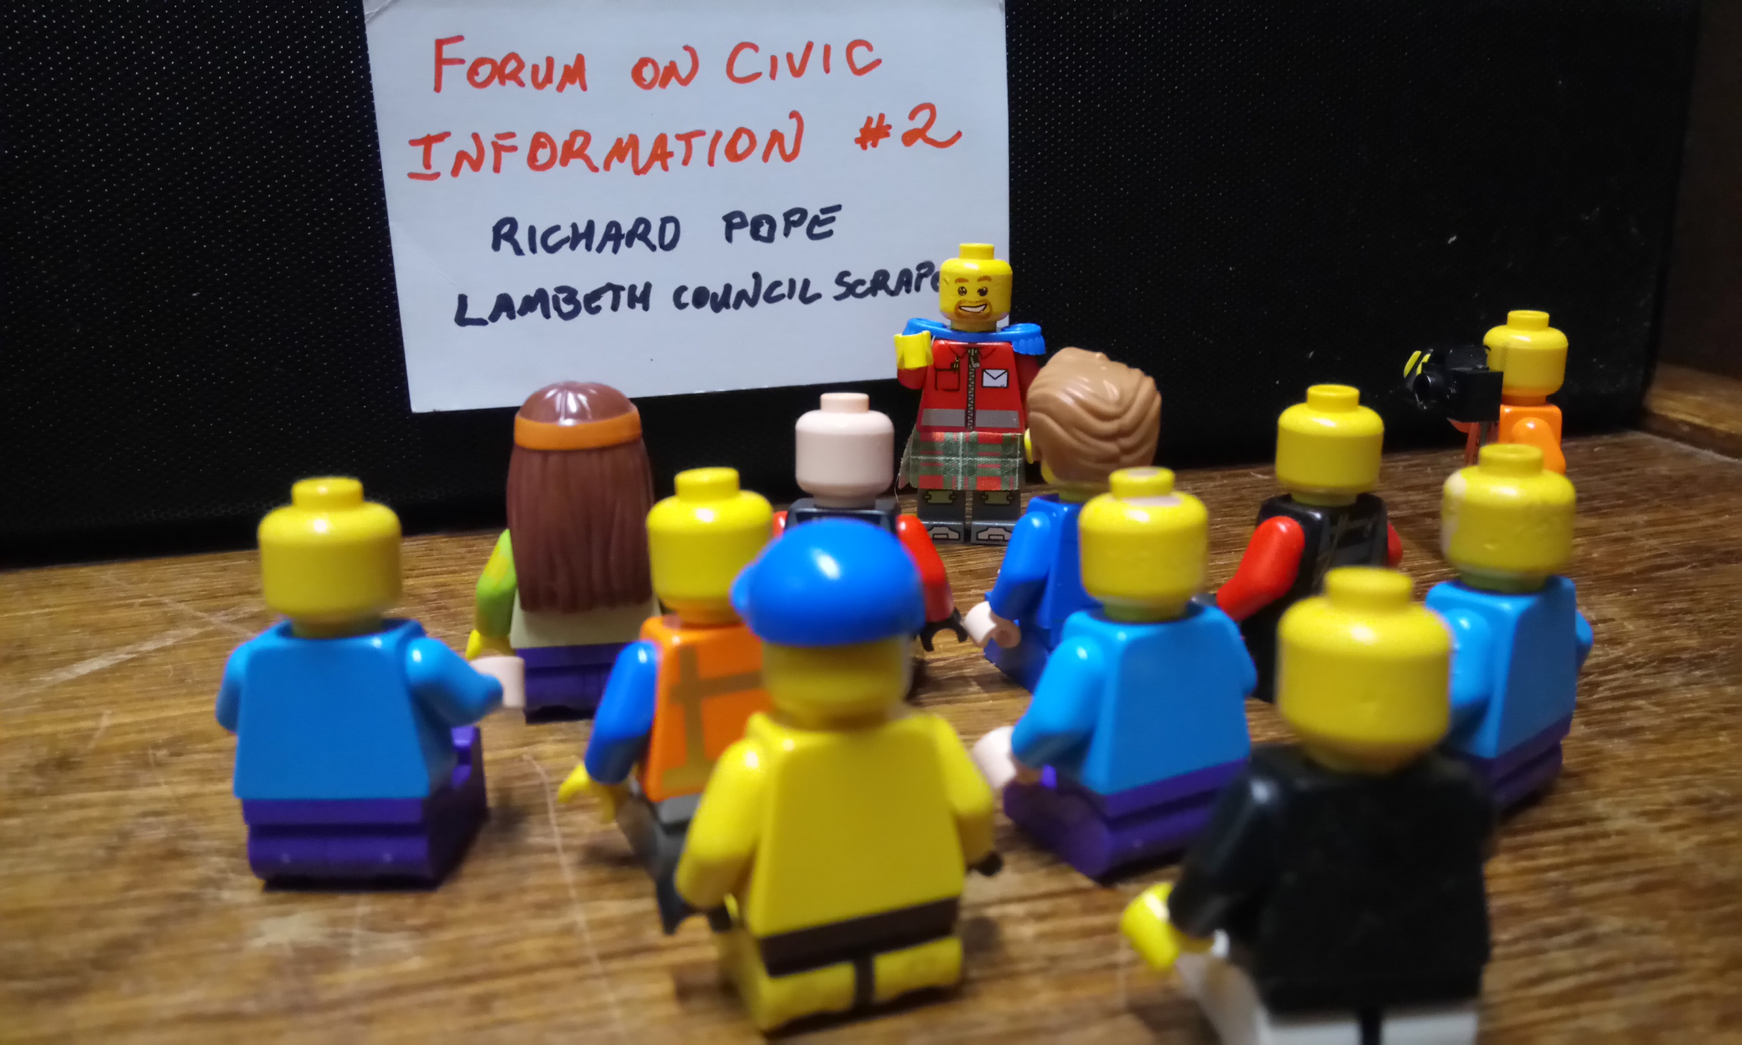

UK History
Notes:
It was around 2006 in the United Kingdom at the “Forum on Civic Information 2“ held by OKNF and UCL that Richard Pope first introduced his work on screen scraping that would go on to become planning alerts.
In Richards own words talking of his local council site.
"[it’s] good, but it requires active participation... it suffers from the Arthur Dent Syndrome".
A web scraper is a script that usually runs on a regular basis to request web pages and digest the information into a more usefull format like a database or plain text.
Initially the project was just a humble PHP scraper and covered only a single council but gradually the project gathered volunteers and followers.
Richard describes the key functionality as "PHP screen scraper grabs planning applications from the Lambeth Council website. Emails the details to a mailman mailing list with link to the council feedback form, further info link and a google map. Converts links to tinyurl's so they are email-able / blogg-able".
Over the following years with support from mysociety.org and significant contributions from Mikel Maron, Sam Smith, Duncan Parkes, Tom Hughes, Andy Armstrong and an army of scraper writers the UK version grew to cover hundreds of councils, serves thousands of users and goes on to continue to be adapted and updated and is now known as PlanningFinder.
We‘ll get back to what the UK are doing now a bit later in the piece.

Slide 7


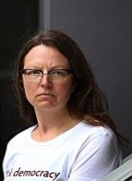
A Move to Australia
Notes:
A version was adapted for Australia by Matthew Landauer and Katherine Szuminska and by December 21, 2009 OpenAustralia Foundation were announcing the launch of their new website, Planning Alerts.
The project was funded by OpenAustralia Foundation, but also with little bit of temporary assistance from the Australian Government 2.0 Taskforce and began by targeting the most populous and significant authorities.

Slide 8
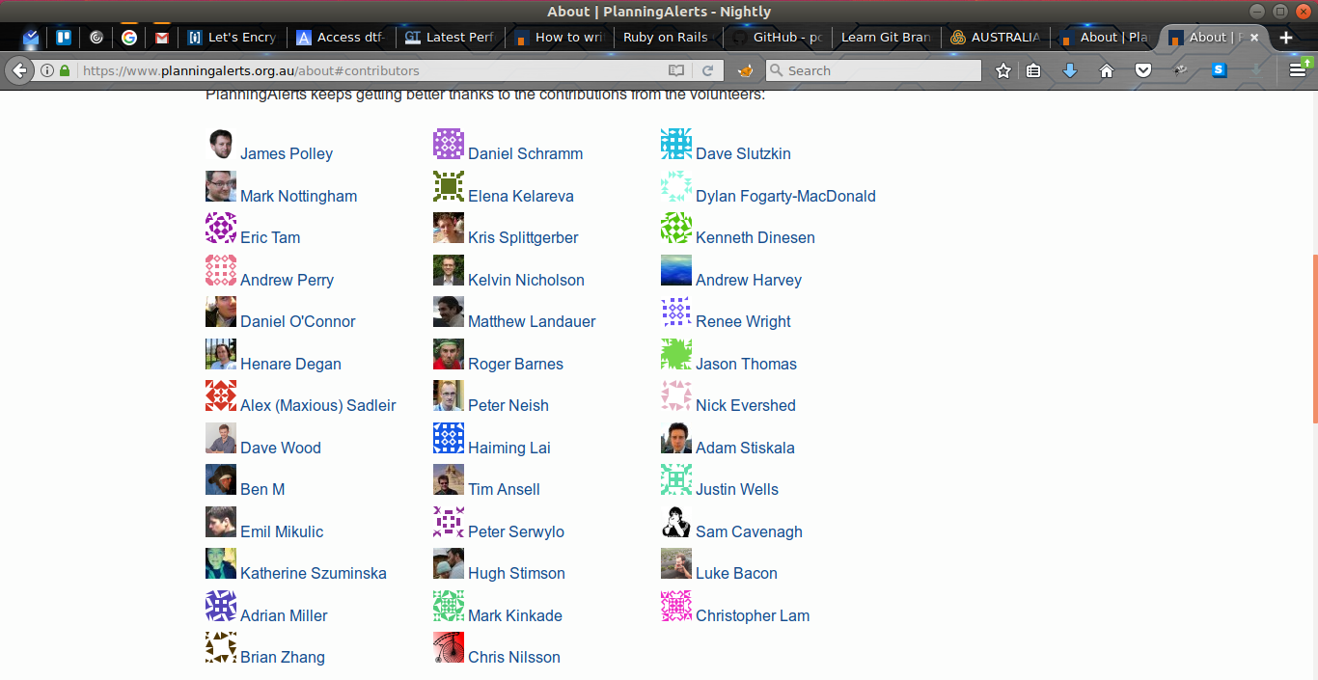
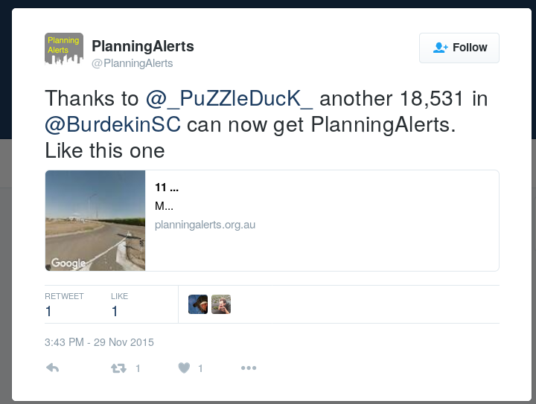
Planning alerts evolves
Notes:
It began with only 50 or so councils and authorities with the most concentrated and large population areas.
OpenAustralia have made it fun and rewarding to get involved by tweeting their thanks and noting the number of citizens serviced by a scraper, engaging with the councils involved and maintaining a neat contributor page.
There is also bulk download and APIs that we‘ll take advantage of later in the talk
An Android app was even developed by James Purser and presented at LCA a few years ago, but it appears to have fallen on hard times and is in need of some love and care (and a package for the F-Droid repository).

Slide 9
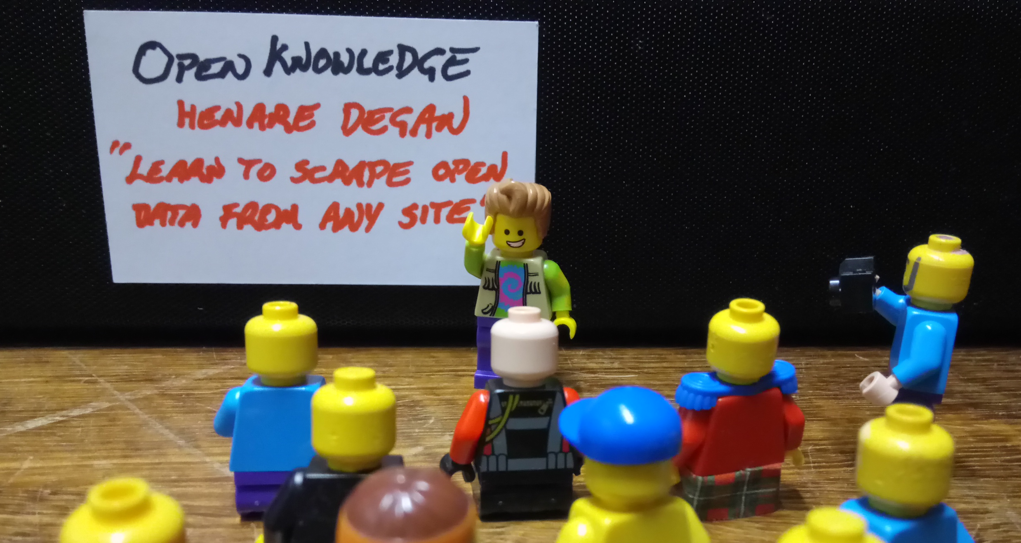

Open Australia at Open knowledge
Notes:
My introduction to planning alerts was through an Open Knowledge meetup in Melbourne in 2015.
I‘d had some interest and experience hacking together a couple of simple web scrapers in Java and so the meetup subtitled “learn to scrape open data from any web site“ caught my eye.
On the night Henare Degan took us through some OpenAustralia projects and then explained the basic functionality of a simple Ruby planning alerts scraper and walked us through the code fro a simple scraper.

Slide 10

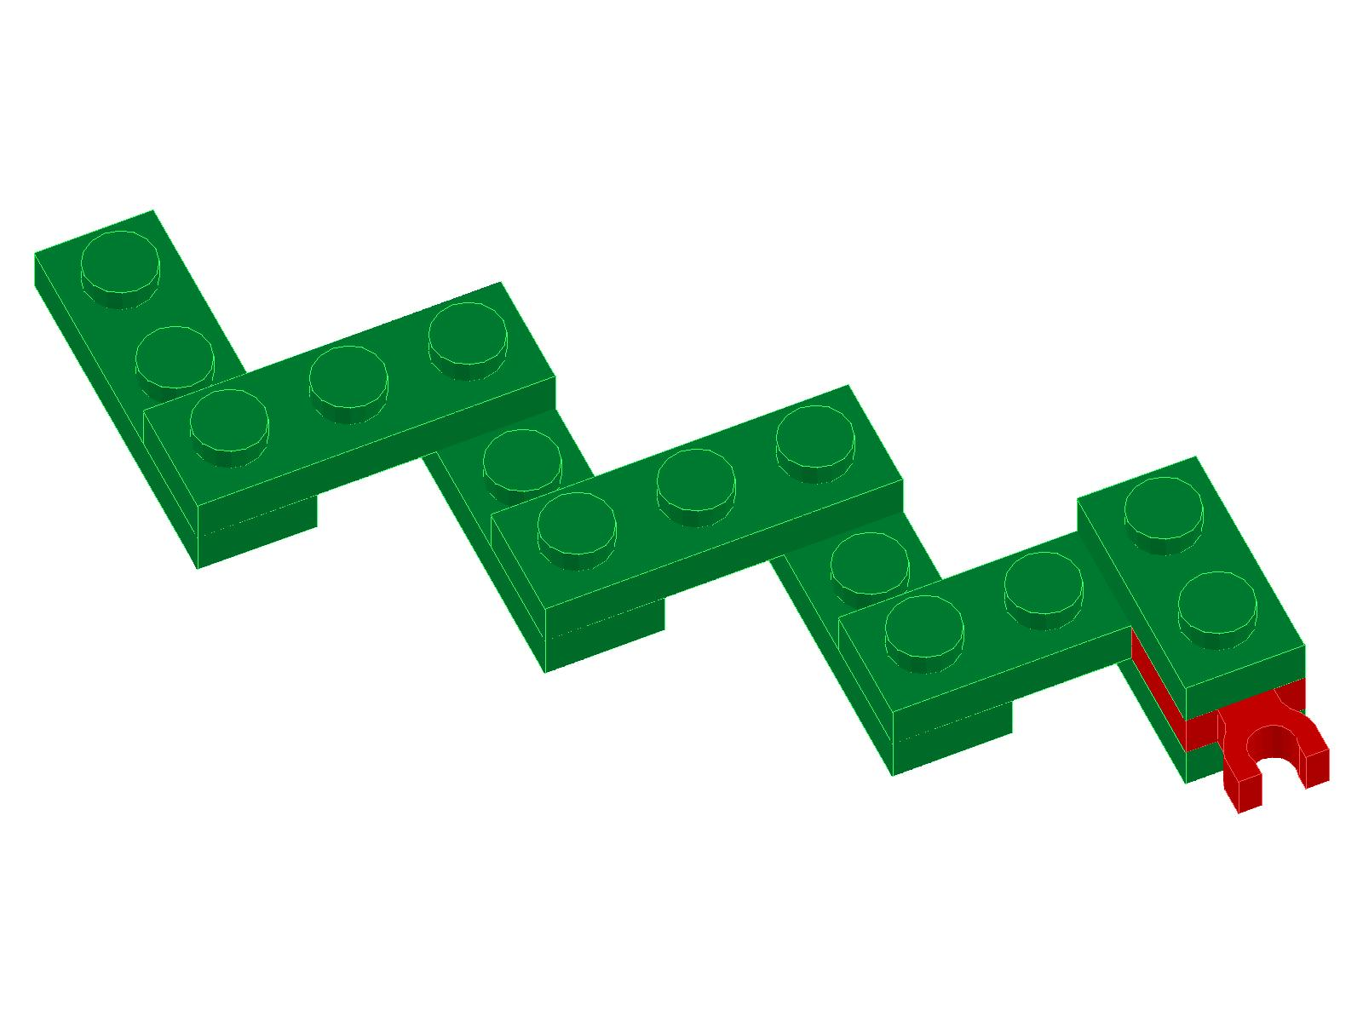



Tooling
Ruby
Python
Docker
Node js
Php
Notes:
Which brings us around to what makes Planning Alerts tick under the hood.
Originally Planning Alerts ran on Scraper wiki version 1 and then 2 in the usual manner.
The Scraper wiki platform emphasised the collaborative nature of development exposing the source code of scrapers in a wiki-like way and running them on the server whenever requested by the user, unfortunately ScraperWiki now only lives on as a ruby library used to simplify the process of scraping.
It has been superseded by Morph IO hosted by OpenAustralia Foundation (Matthew Landauer if you do a DNS lookup).
Morph.io allows for more diversity in scraping technology in addition to supporting Ruby... PHP, Python and Node are also supported.
This all runs on docker, I have no reason to bring that up but, just wow!
In Ruby land Mechanize and Phantom JS scrapers are supported along with almost anything else you can cram into a gem.

Slide 11

Hello planning alerts
Notes:
I can‘t remember why the scraper I started that night didn‘t work, however I did finish it with the comment “first run at scraper... destined to fail :/“ and it never even tries to write to the db.
but about a week later I had another go an succeeded at getting Burdekin Shires announcements on the system.
This seemed to be exactly what I was looking for, nice little bite sized chunks of code… achievable goals… plenty of similar examples… other languages to try… what more could I want.
A couple of my early attempts succeeded and I was enjoying the felling of getting something done…
and then I figured if local construction was good then state wide construction would be better, and this Hurbis lead me to my first run in with TendersVic which didn‘t end well for me the first time.

Slide 12
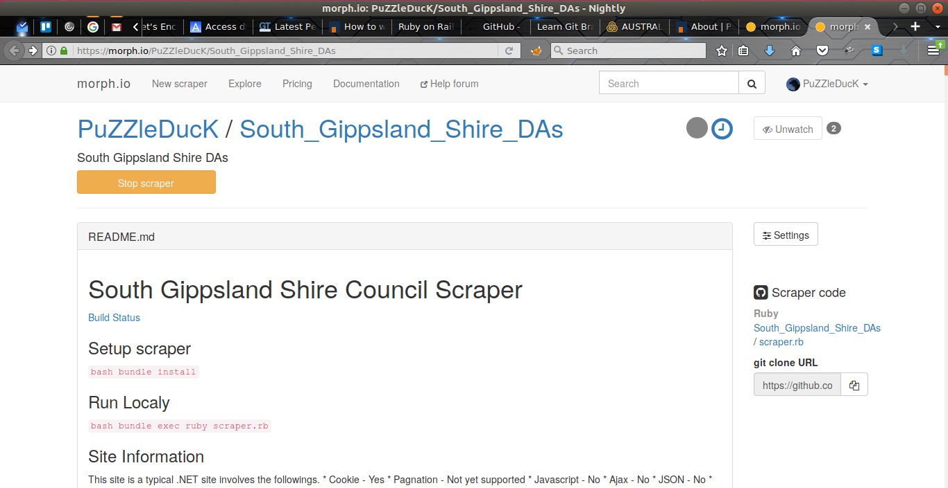
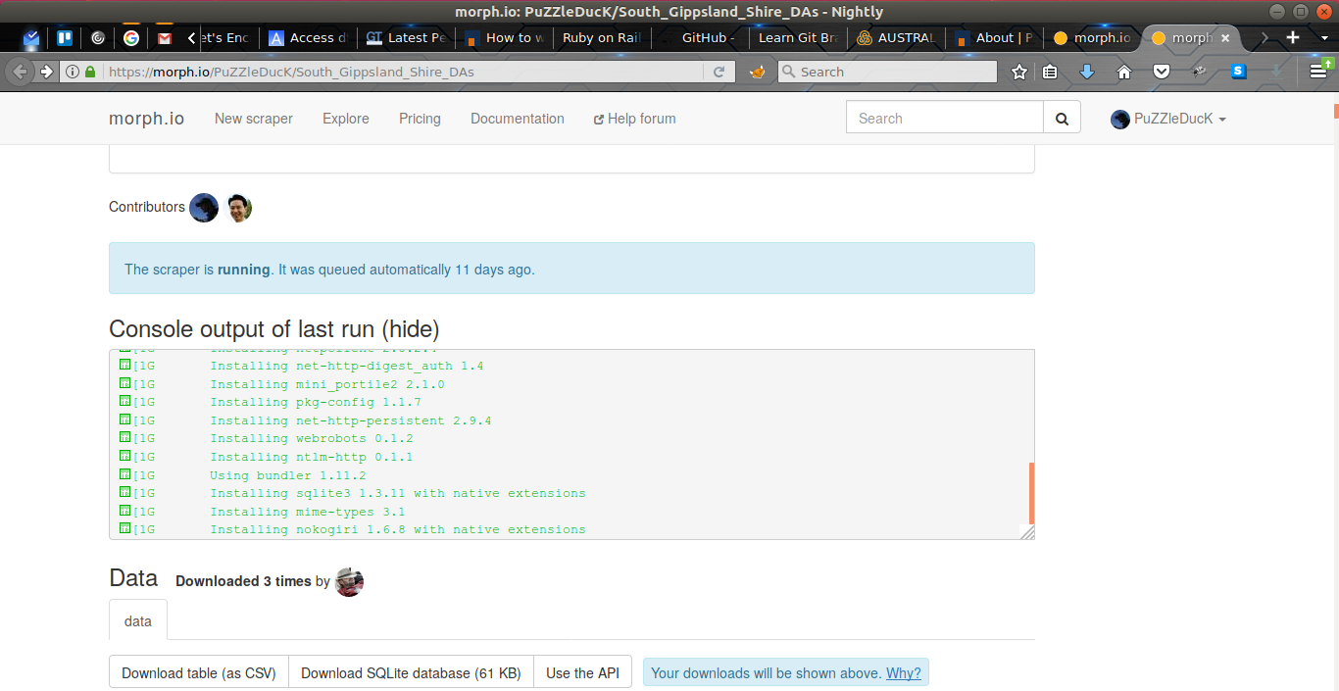
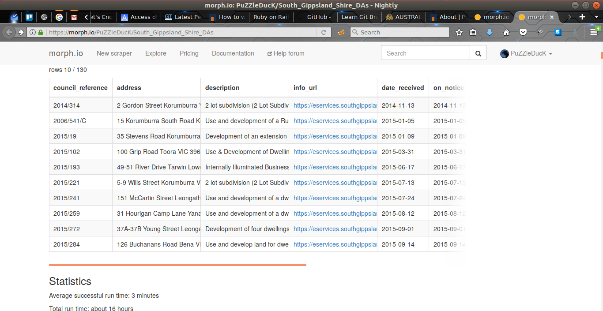
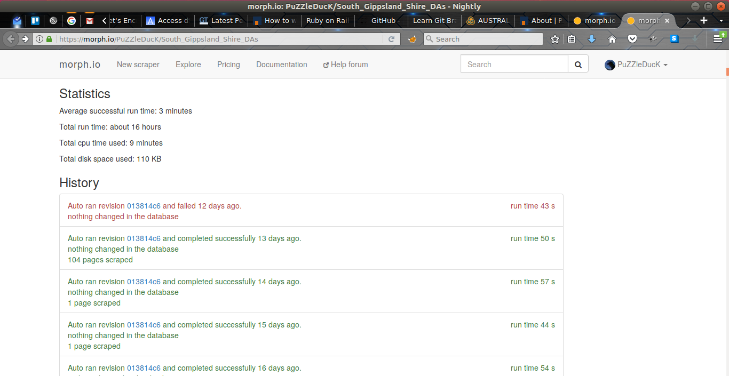
Notes:
Before we get onto some scraping details I just want to discuss some benefits of writing scrapers on Morph.io and take a look at a choice example
...describe screens…
because the code is open source anyone can get involved. Just as I was starting to scrape Tenders Vic a second time for our project at Treasury my South Gippsland shire council scraper started to error and fail… I was too distracted to get around to fixing it for a few weeks and this helpful chap (I don’t suppose Eric is with us today?) came along and fixed the scraper and even added a stack of information about the technology behind the site which may help writing a better scraper than mine.
I find the funniest thing about this scraper is that neither of the developers have ever downloaded the data and the guy who keeps downloading it has never written a scraper.
This demos a principle that is very hard to get across to our government partners… just because this data is so difficult to access you require someone with high technical skills to be able to get at it… but I‘m probably not the best person to be actually performing analysis on the data, that would be best left to a data scientist, who by the way probably has poorer web scraping skills.

Slide 13

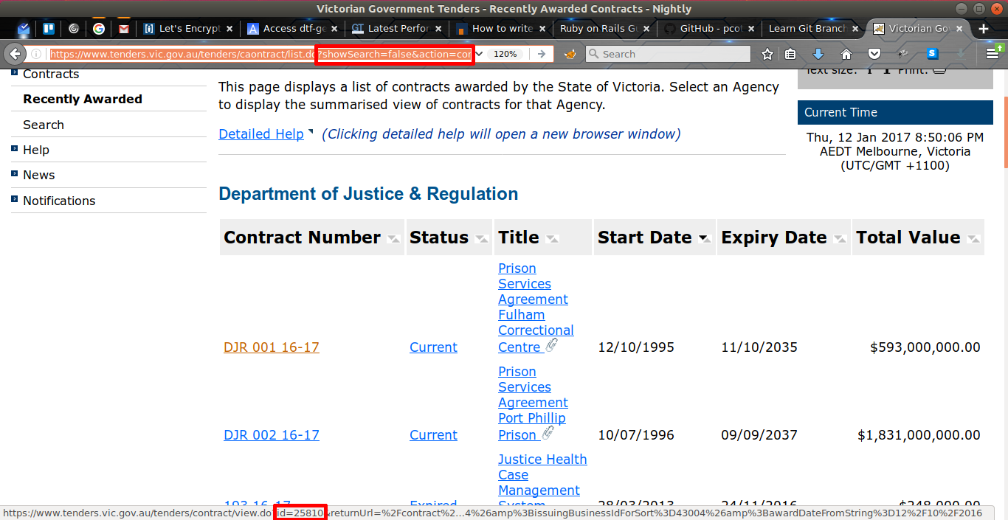
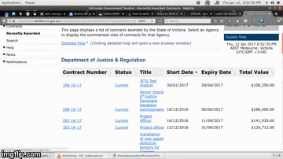
Tenders vic
Notes:
I’d like to say I was young and full of confidence and enthusiasm, and all went well, but Tenders Vic was just one of many difficult scrapers and a good example of many of the issues one can encounter while scraping.
Links often fail to function when clicked… I now know the solution to this problem can often be to rip relevant id numbers out of the url and insert them into preformatted url patterns known to work like I do here.
Links all reference dead pages until after page load when javascript populates the relevant field, like this... solution: upgrade scraping technology to a js enabled solution (phantomjs).
Listings are dynamically reordered when the page is refreshed, omg can you believe that… solution: every single request gets a new browser.
One of my repositories ends in the comment “pointless: links provided are not permanent.. not possible to provide required urls“ (I’m a naming names kinda person so it’s the Byron Shire council).

Slide 14

Other difficulties
Notes:
In addition to the technical issues when scraping council planning information… some nights I‘d just spend hours looking for council planning pages, sometimes called “Development Announcements“ sometimes “Planning Announcements“ sometimes “Notices“ or “Items on Notice“ or “Development Notices“ and so on.
Then some pages seemed impervious to scraping… the page my scraper got was just not the same as the one I was looking for … it turns out Henere has some pretty good advice about utilising IRB to create a scraper on-the-run so to speak.
It seemed like it used to be simple to skip along until you found an easy enough council to tackle, now they almost all seem to be hard, either PDFs or difficult to navigate pages or some other weird stuff that just makes you want to go bananas.
but a few months ago I think I realized why it seemed hard now, because out of about 500 councils only 150 remain on the todo list and some of those are known to be in PDF format or other non-machine readable formats.
There are still opportunities, but they usually require a bit more of an investment in time and effort or just a little bit of lateral thinking.

Slide 15
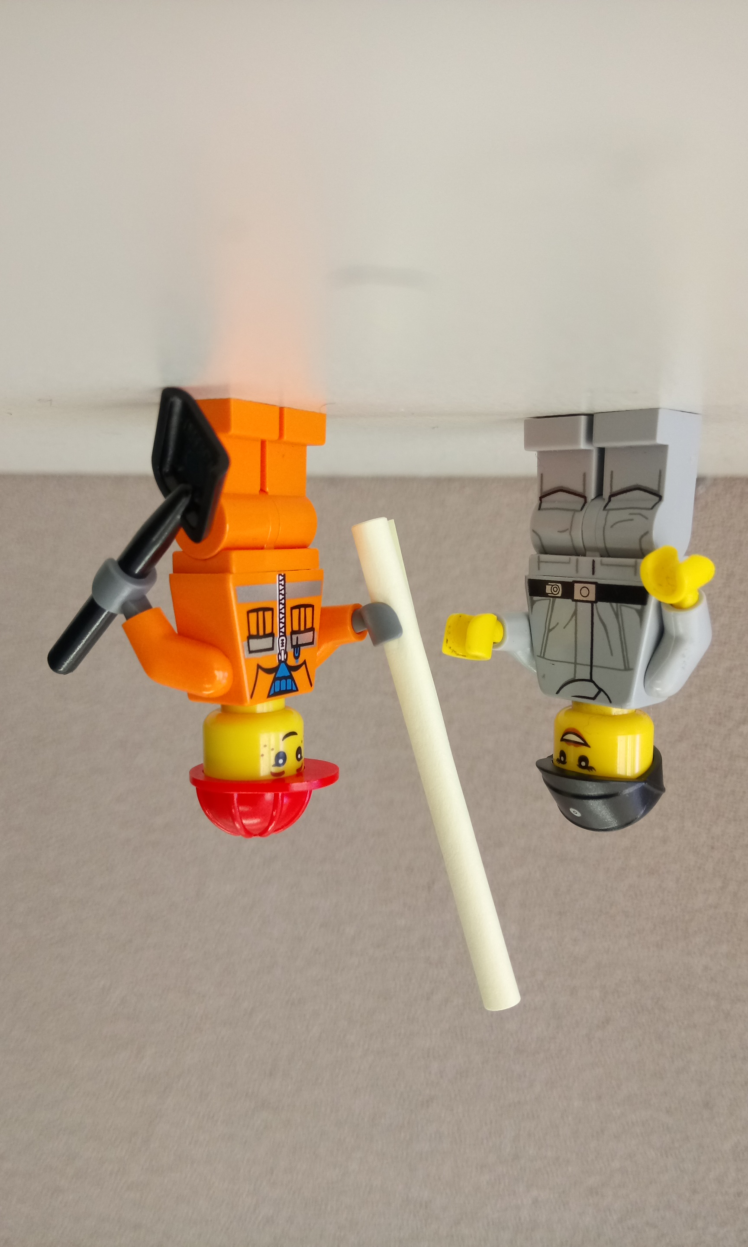
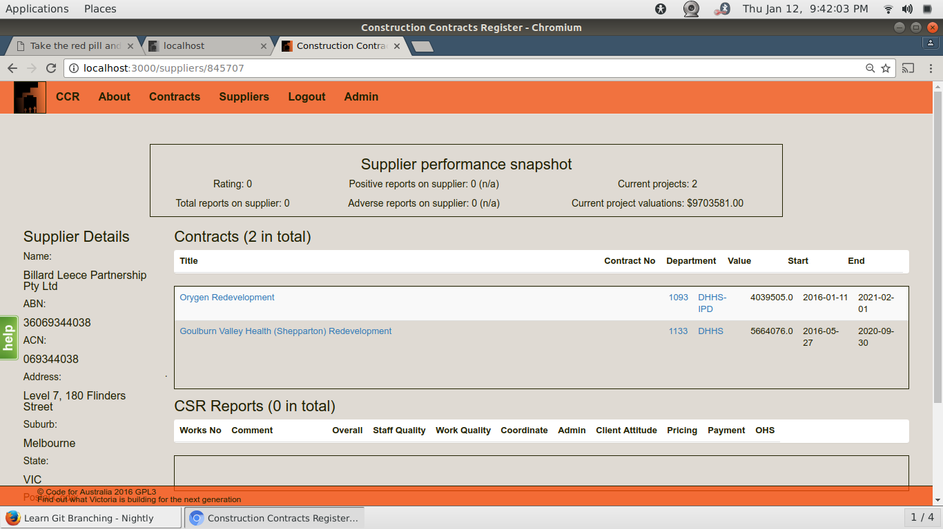
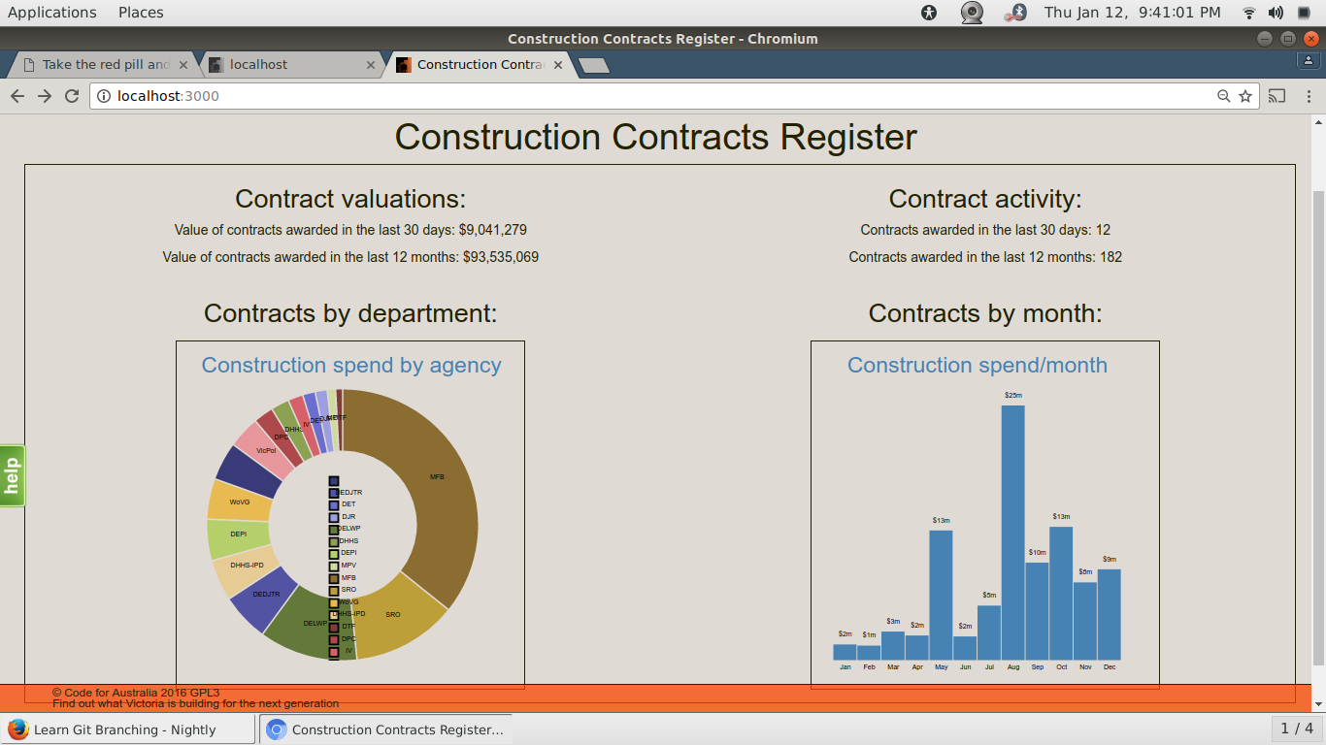
treasury and finance
Notes:
So you might be wondering what this has to do with the Department of Treasury and Finance, or you might just be thankful I haven‘t started rambling about contract law and statutory reporting requirements.
We were tasked with looking into the reporting on construction contracts in Victoria and our first realisation was that no one has a clear big-picture-view of construction being undertaken by the government as a whole. Each unit or department had a clear enough understanding of their own situation but the information is not shared or aggregated and so the old proverbial left hand didn‘t know what the right hand was doing.
With this system we‘ve created we are able to verify the capacity of a supplier across government without having to individually interrogate every department or ask the supplier nicely what there up to.
We‘ve also got a couple of these nice D3 charts like the fancy pants UK and US spending transparency sites.

Slide 16
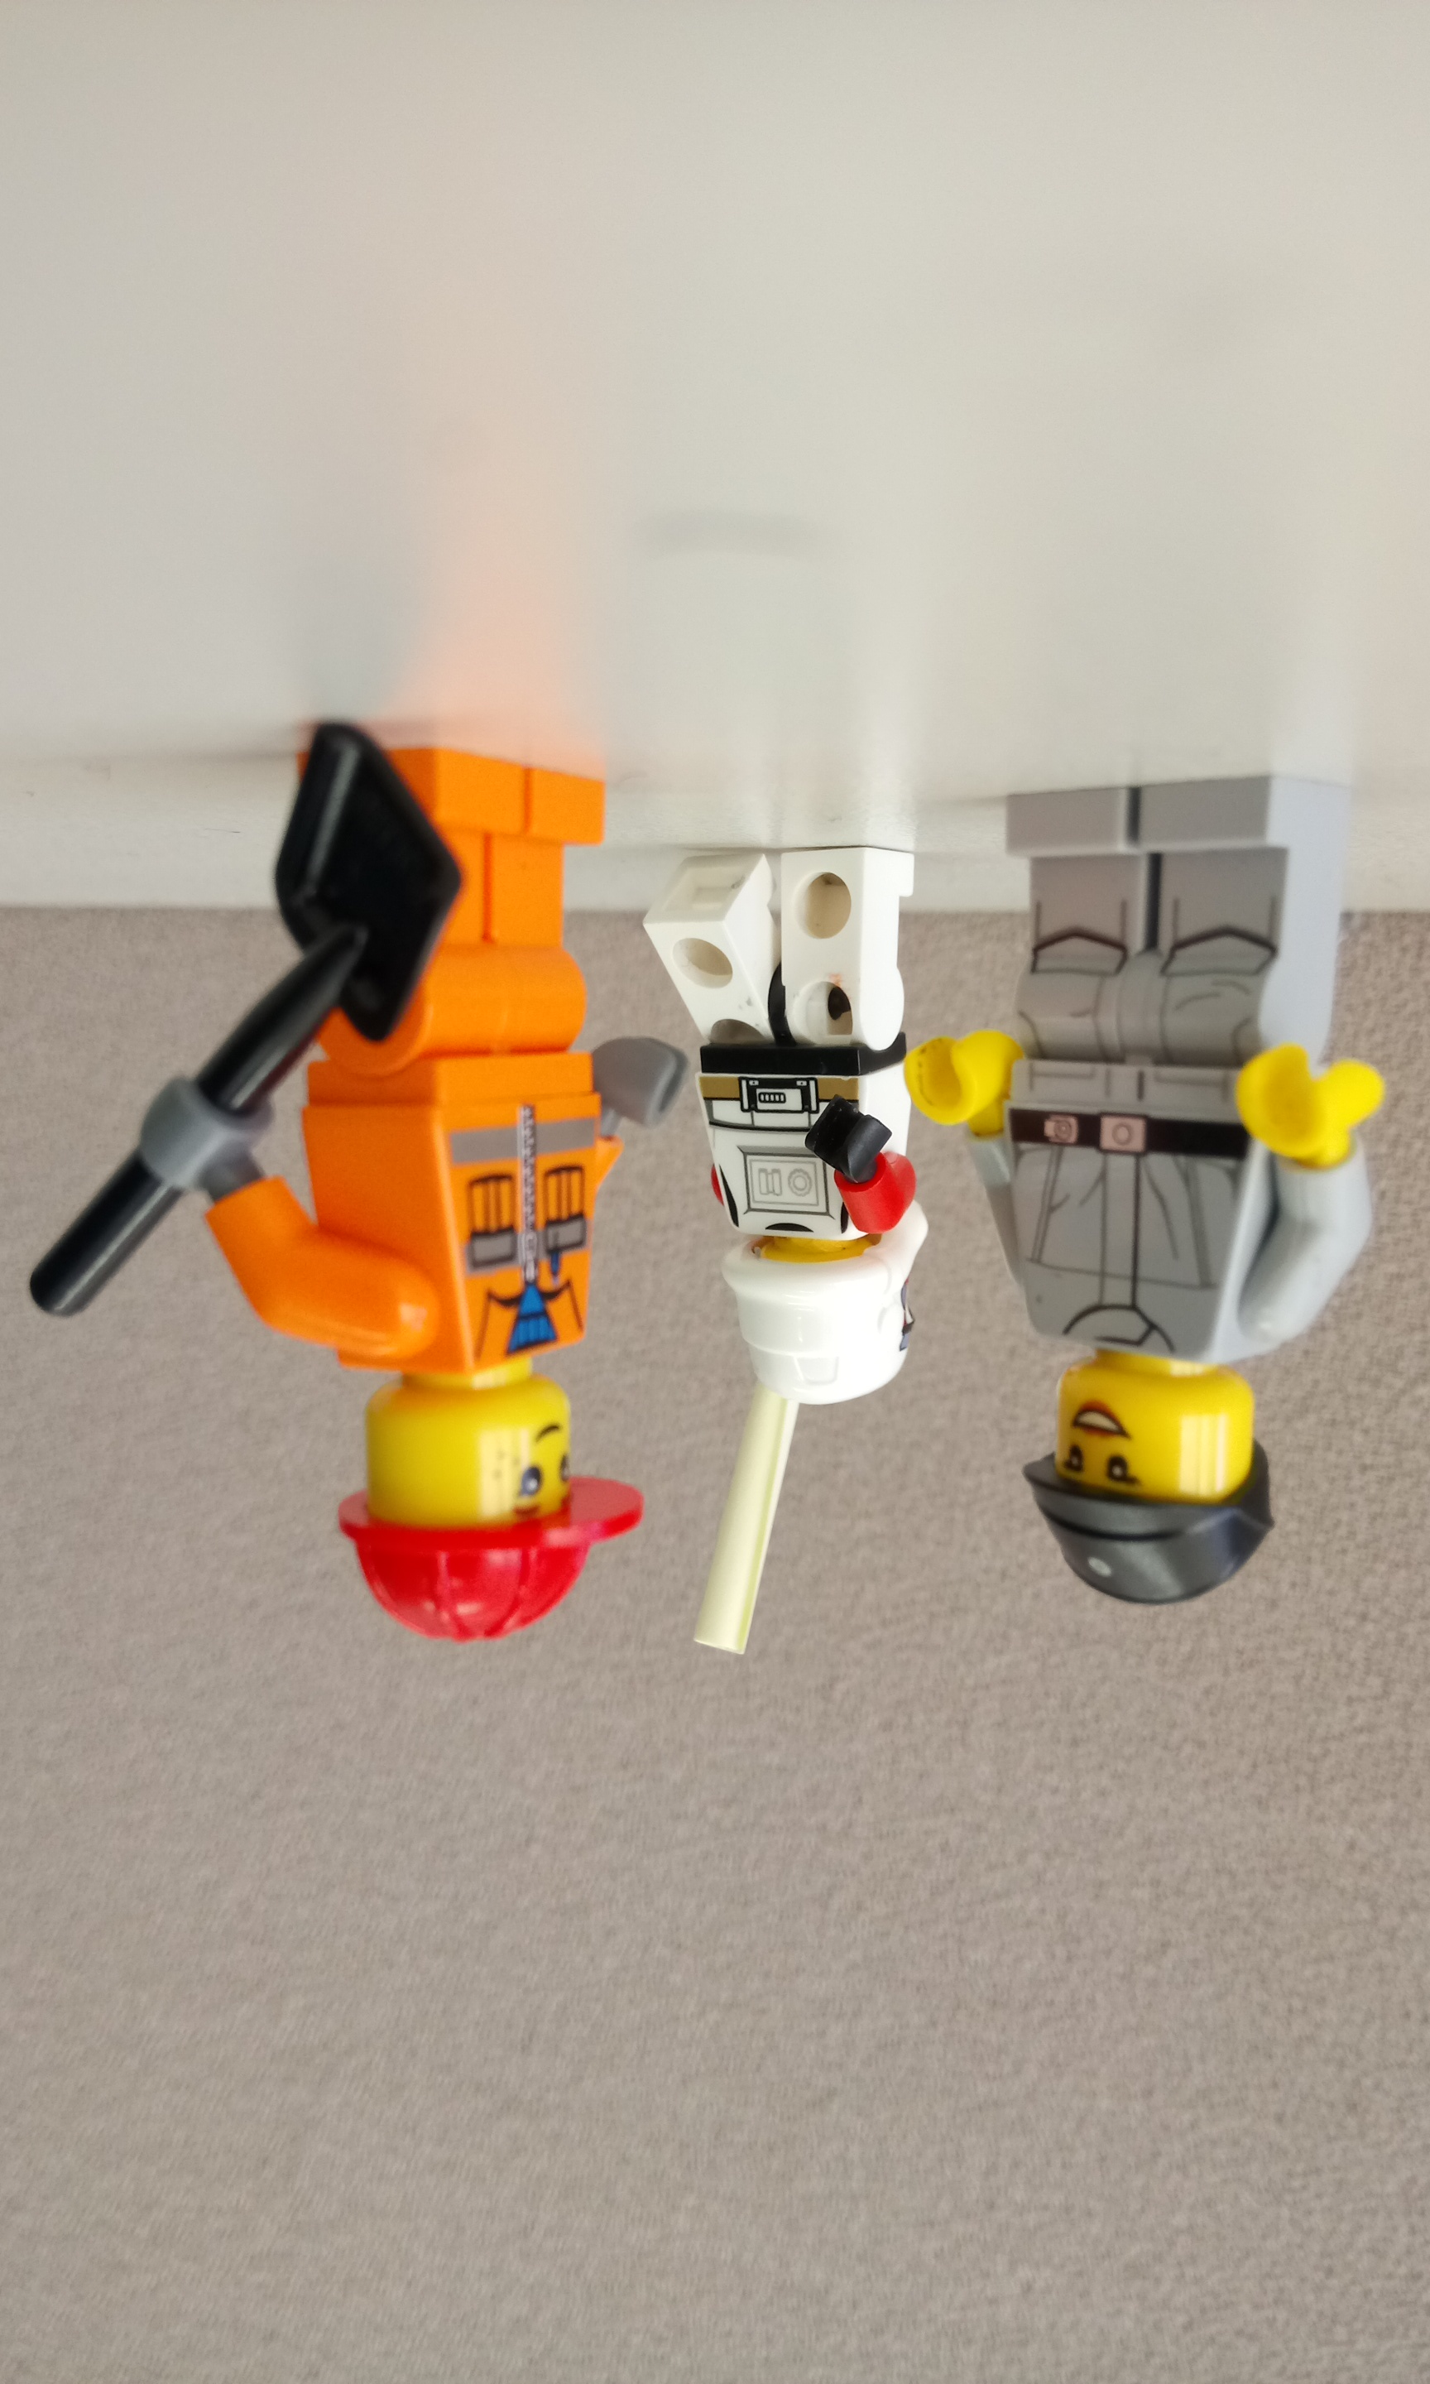
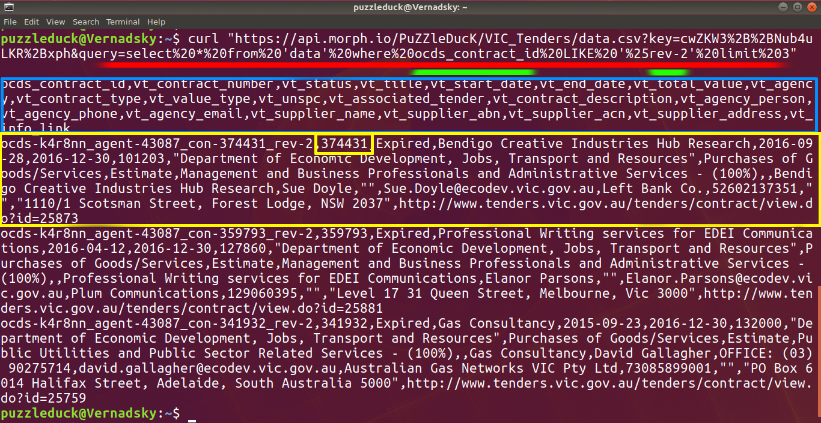
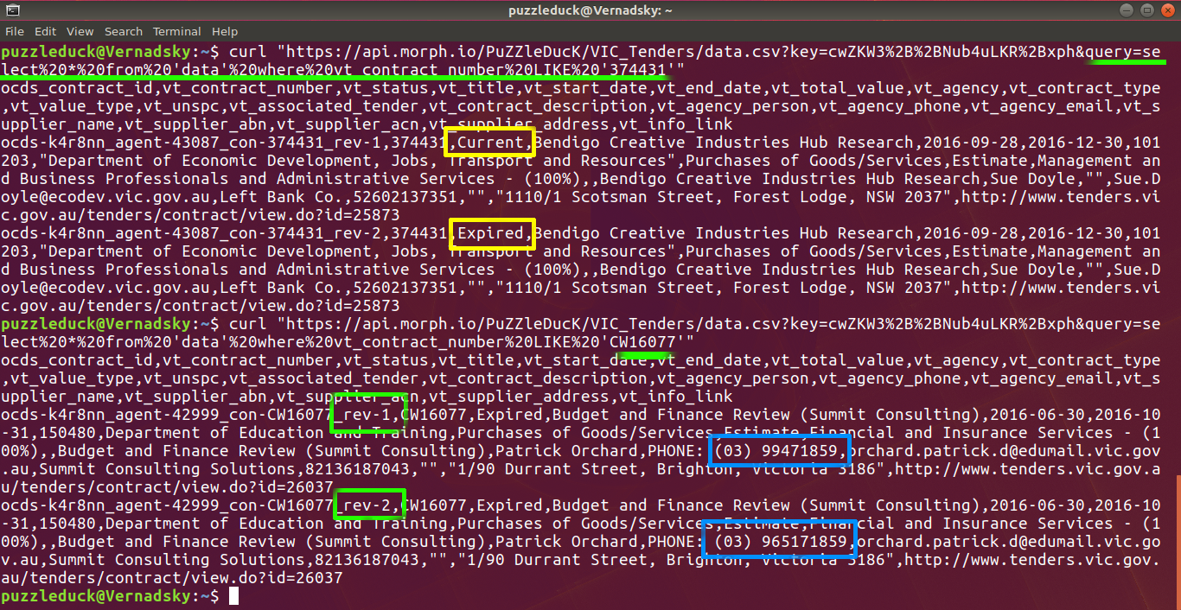
By any means necessary
Notes:
Despite the many issues with Tenders Vic, the simplest way for us to get reliable data about construction projects handled by the Victorian government was to scrape it back off of the Victorian governments own Tenders Vic contract publication system, even though we‘re working from within the Victorian government.
We were told it would be some time before Tenders Vic could release data to us for us to use on this project and they weren‘t kidding. Four months later and we‘re still waiting on an ok to use the data we‘ve been provided.
It‘s astounding to me that this is the same kind of waiting game that public servants have to face if they want to access the Vic Tenders data too.
What we‘ve done is to set up a Tenders Vic scraper on Morph.io to regularly retrieve the contracts published online and make them available for download and analysis by anyone anytime
API demonstration
Search for all copies of a contract.
Get all contracts with a second revision.

Slide 17



Get involved, but be prepared
Notes:
I do want to encourage you to get involved, but it‘s probably not going to be easy scraping as many of the councils left will probably have issues or be PDFs or tricky in some other way.
Still much help could be had by people just digging through the councils on the todo list and identifying the url of the planning announcements can help others focus on the work that needs to be done from there, and now one of my idle hobbies is to just add a url or two if I don‘t have time or mental space to spare for writing a scraper, or if you write scrapers and hate the digging through websites there are a few ready to go.
Tackling PDFs might be a significant investment in time, but would probably be achievable, and I’ve even heard that often PDFs have OCR text from the scanners the councils use to process them, so there is potential to mop up after people like Henere and myself who just run screaming at the first sight of PDFs.
But if they are Non-Machine readable formats then that’s not something scrapers can fix… we need people who can convince councils to change their ways, or outreach to councils which do not provide scrapable data in some form.

Slide 18
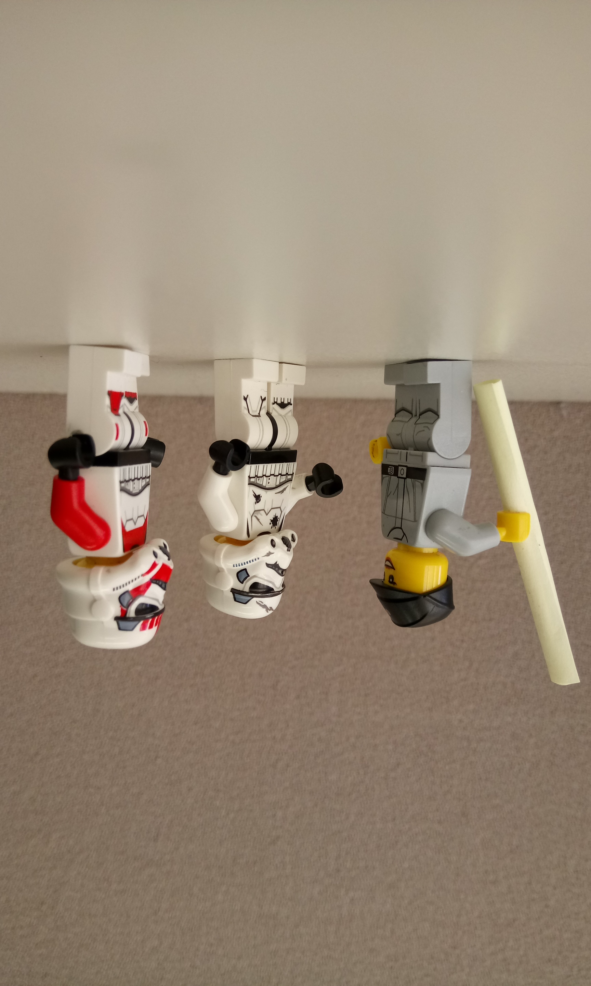
planning alerts in the Future
Notes:
So where can Planning Alerts go from here:
??? Node to the rescue, maybe ??? semi-working prototype, request nodejs help, at least this one gets around to writing the database so the omens are better than my first Ruby scraper.
As the number of councils not on Planning Alerts moves from being a majority and into being a minority this may put some pressure on remaining councils to be more cooperative.
With the UK we could even begin to assemble a global view of construction activity over time which would require coordinating between data sets. Here something like the OCDS or OpenSpending Standards may help in coordinating and combining the data.
And speaking of the UK again, remember I said I‘d get back to them… the UK is once again revamping it‘s planning alerts system, but this time with a new twist. In 2014 they announced the Hampshire Hub Partnership in conjunction with MySociety.org and I‘ll quote Mike Thompson from the project saying "we’ll be using the fabulous PlanningAlerts.org.au open source codebase as a starting point… Planning Alerts is a piece of software built in Ruby on Rails by our friends down under at Open Australia".

Slide 19
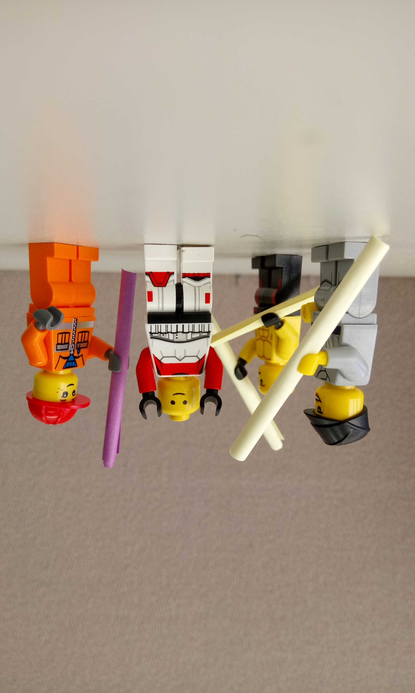
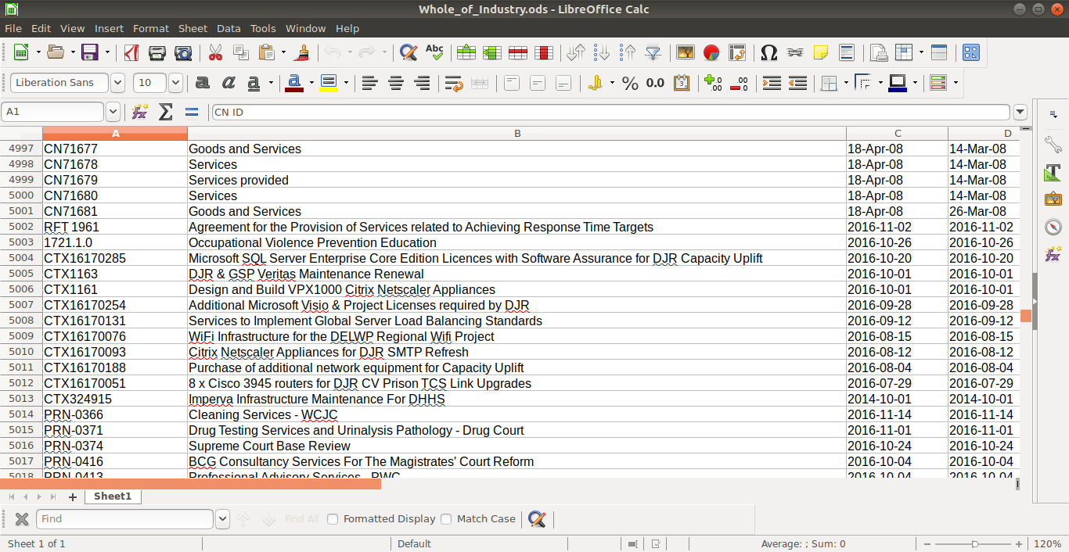
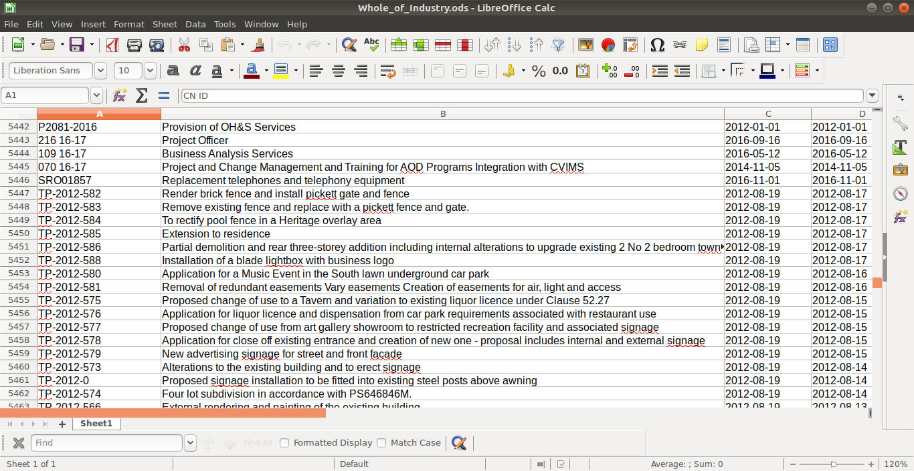
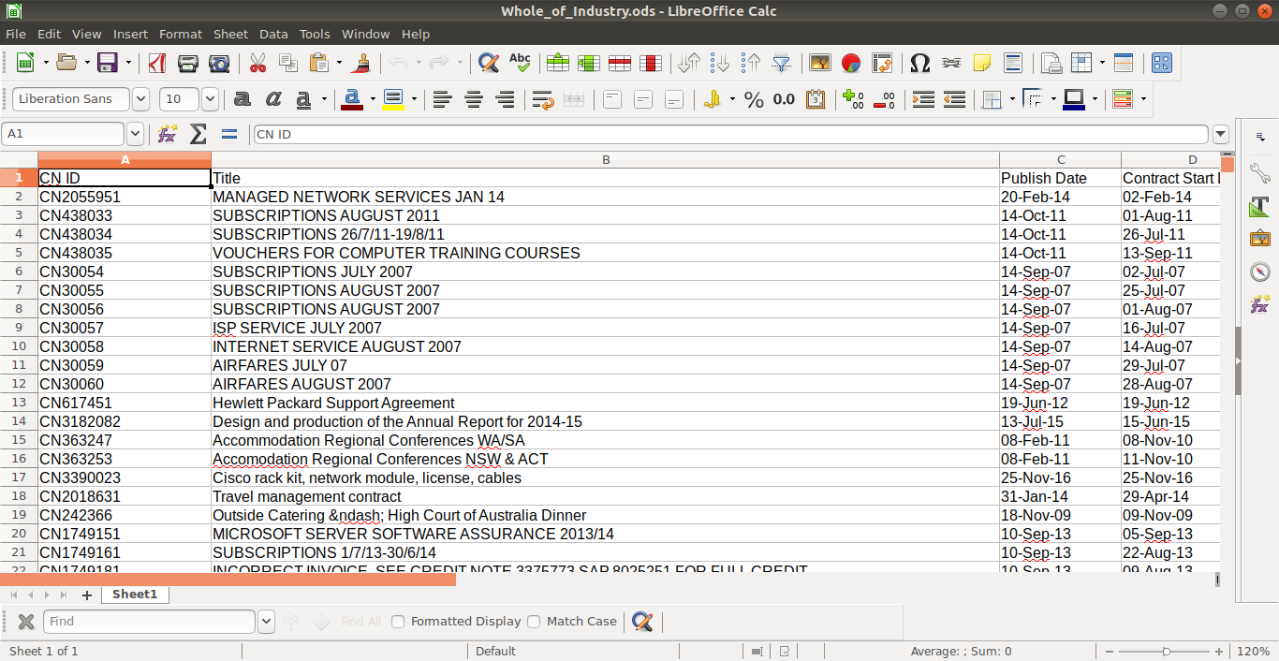
Whole of something
Warning: messy data ahead
Notes:
Incorporating Federal and State data sets would allow us the first WoG/WoIndustry picture of what is happening in Victoria.
We now have for the first time a view of construction in Victoria across all levels of government and in the commercial and private sectors. This example combines data from the Melbourne council, Vic Tenders and Aus Tenders to list all construction in the city of Melbourne and we could combine the Vic/Aus Tenders info with any council supported by Planning Alerts to get a broad view of construction in the area.
We could lead the country in a comprehensive dashboard.

Slide 20
Data quality, Address and context
Notes:
Unfortunately some contract management systems are not as comprehensive as the PA data set and not all contracts even have fixed locations let alone addresses to pin a contract to.
Some spending might just have to be “ambient background“ spending on the state as a whole, however this should not stop us from enabling the systems we use to track this information when it is relevant.
Lack of initiating project or source and no linking to the tenders submitted limits use in a budget context.
But I encourage you all to get involved and lend a hand to finish off the country writing scrapers, demanding the data from councils, developing data standard adapters, tools or writing your own apps with the planning alerts API.
And if you‘re super dedicated and motivated I‘d recommend you consider joining the Fellowship program and getting out there to make a difference in how your government works.
If you want to hear more or discuss the Fellowship or screen scrapers or if you just want some free stickers come and find me after the talk.

Slide 21

Questions?
planningalerts.org.au/getinvolved
https://docs.google.com/spreadsheets/d/1bsbBKBbxrNQGr384_oJibfadwzTE0nzdn0iNaMaXCFs
Notes:
Contact / Q&A / Credits
Croud sourced TODOs: https://docs.google.com/spreadsheets/d/1bsbBKBbxrNQGr384_oJibfadwzTE0nzdn0iNaMaXCFs
References:
https://www.mysociety.org/tag/planning-alerts/
http://blog.okfn.org/2007/04/11/planningalertscom-opening-up-uk-planning-application-data/
http://blog.okfn.org/2006/12/06/open-knowledge-forum-on-civic-information-no-2-post-event-information/
http://www.planningfinder.co.uk
https://countculture.wordpress.com/2012/03/23/planning-alerts-first-fruits/
http://www.slideshare.net/katska/openaustralia-talks-planningalerts
https://web.archive.org/web/20160416001934/https://www.openaustraliafoundation.org.au/2009/12/21/launching-our-new-website-planning-alerts/

