Slide 1
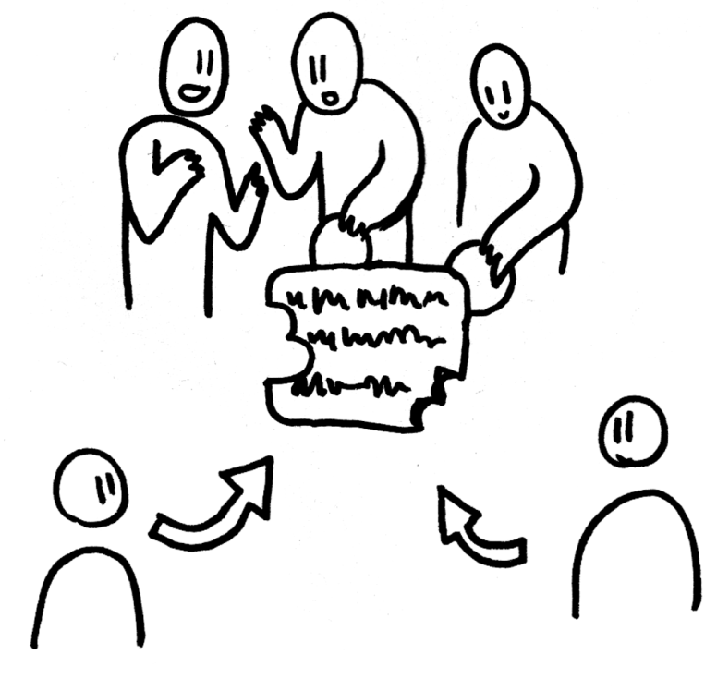
What is Free Software by Free Software Australia
Based on “FreeSoftware TEDx slides”
Copyright 2014 Christian Noguera, Valentin Pasquier, Richard Stallman
Released under CC-BY 3.0 license

Slide 2
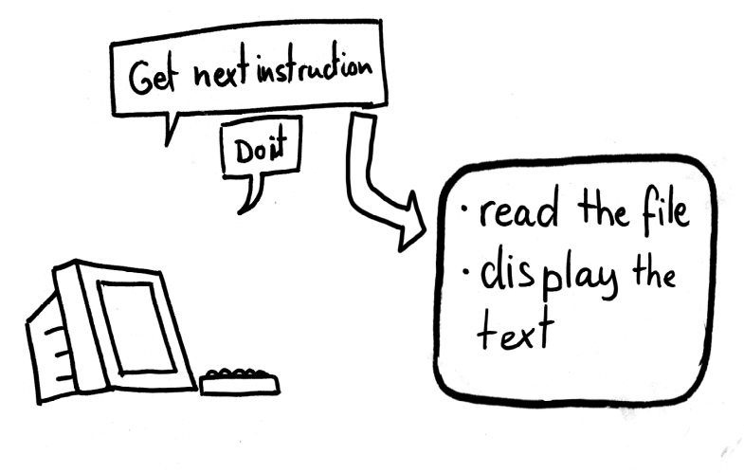
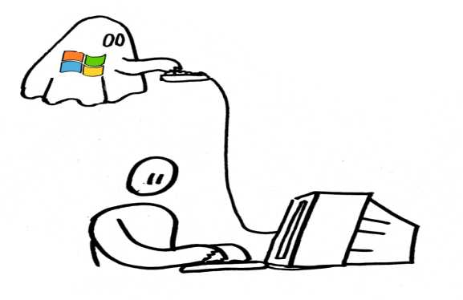

Overview
What is software?
What is proprietary software and what’s wrong with it?
What is free software and why is it important?

Slide 3
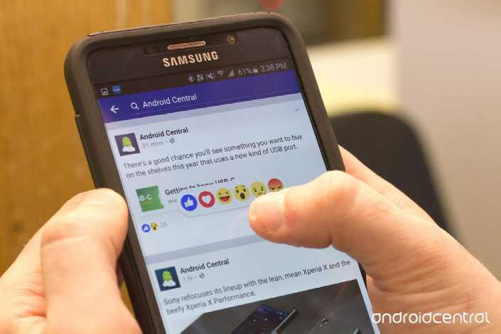
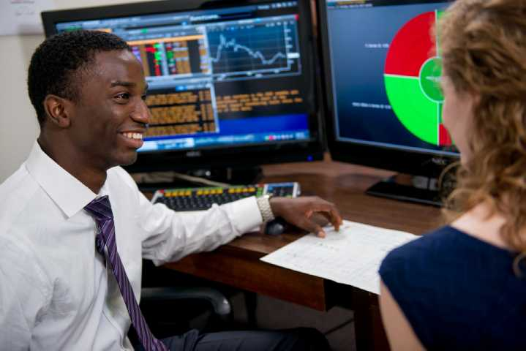
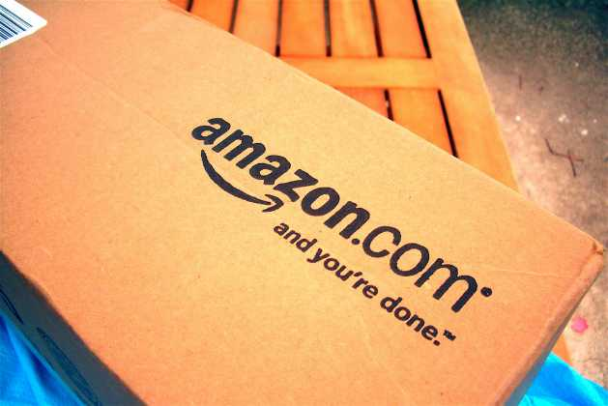
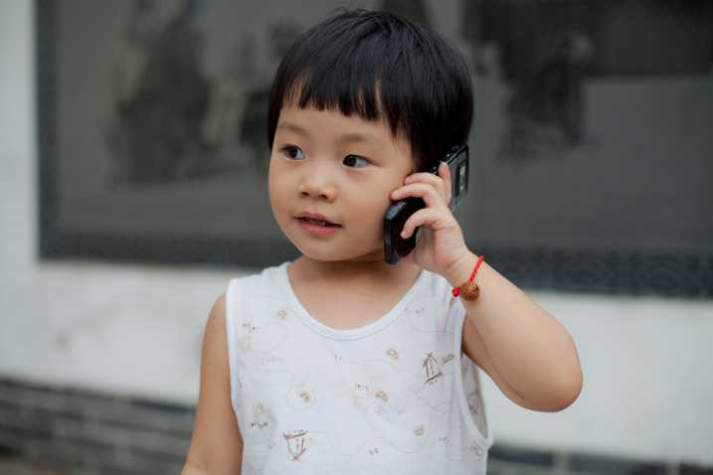
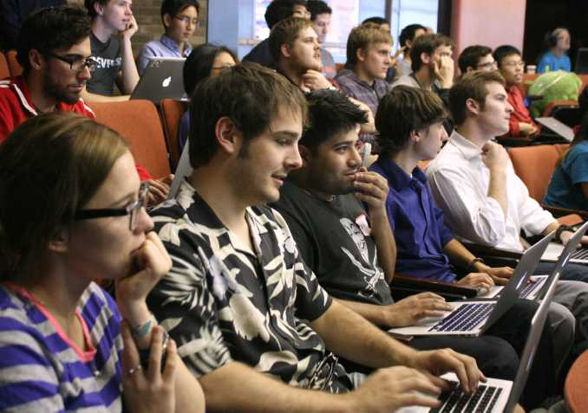
People around the world rely on computers for everything...
Photos from top left to right
1: https://www.androidcentral.com/sites/androidcentral.com/files/styles/larger_wm_brw/public/article_images/2016/02/Facebook-Reactions-Hero-Android-Phone-Web-Screen-Web-01.jpg?itok=3G8Os807
2: https://wanentrepreneur.com/wp-content/uploads/2015/09/Business-Management-101-%C3%A2%C2%80%C2%93-Using-Business-Software1.jpg
3: https://www.flickr.com/photos/70859051@N07/7698549342/in/photostream by Eason Q
4: https://www.flickr.com/photos/hackny/10165035626/
Middle: https://www.flickr.com/photos/mikeblogs/2507355507/
Notes:
Photos from top left to right
1:https://www.androidcentral.com/sites/androidcentral.com/files/styles/larger_wm_brw/public/article_images/2016/02/Facebook-Reactions-Hero-Android-Phone-Web-Screen-Web-01.jpg?itok=3G8Os807
2: https://wanentrepreneur.com/wp-content/uploads/2015/09/Business-Management-101-%C3%A2%C2%80%C2%93-Using-Business-Software1.jpg
3https://www.flickr.com/photos/70859051@N07/7698549342/in/photostream/ by Eason Q
4: https://www.flickr.com/photos/hackny/10165035626/
Middle: https://www.flickr.com/photos/mikeblogs/2507355507/

Slide 4

What does a computer do?

Slide 5
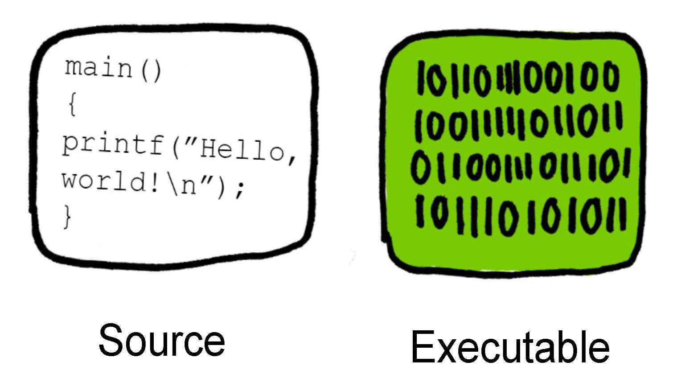
Programmers create software by writing in a high-level language.
Compiled

Slide 6
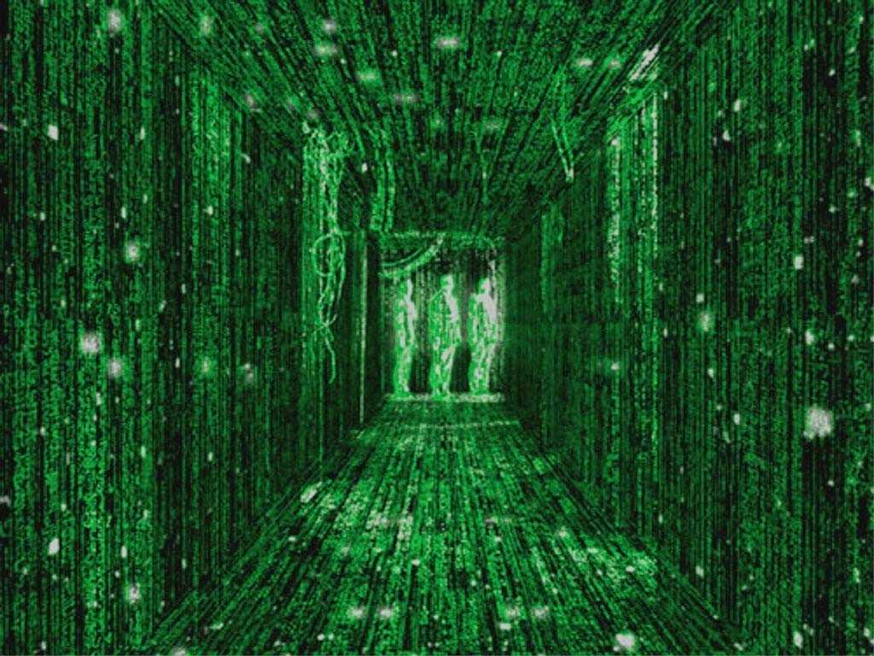
A lot of the software we use everyday is invisible to us.
Notes:
The programs and applications we use on our computers and phones are only the tip of the iceberg. The applications are usually a client that talks to the server that does the heavy processing and storage.
Image: http://images1.fanpop.com/images/photos/2200000/the-matrix-movies-2229943-1024-768.jpg

Slide 7
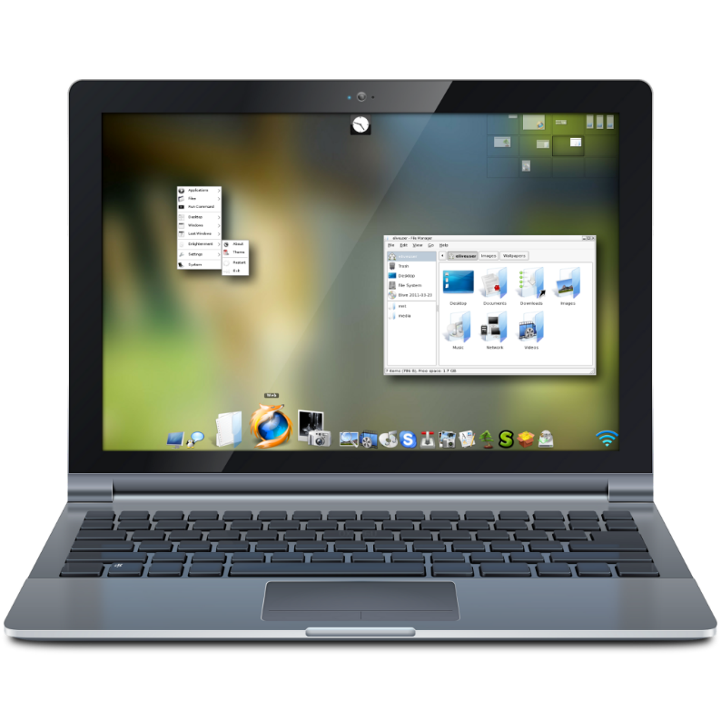
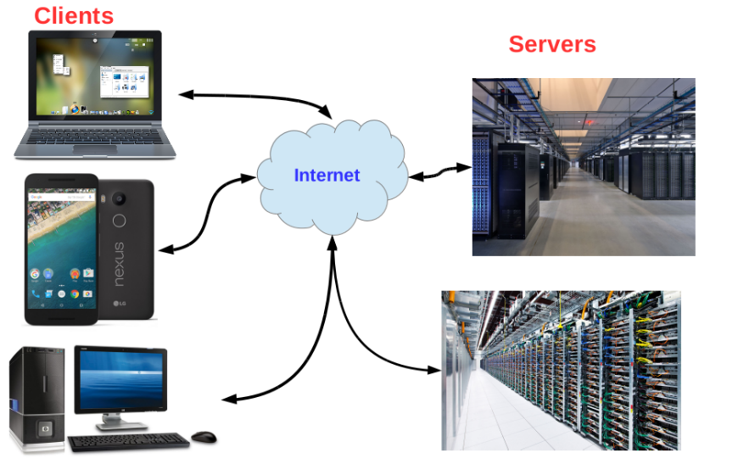
There are 2 ways we use software on our computers and smart devices.
Local computing
Networked computing

Slide 8
Locally – The program runs on and stores data on the computer or smart device you use.
Software / programs
Documents / files
HDD/
SDD
Pictures / videos

Slide 9
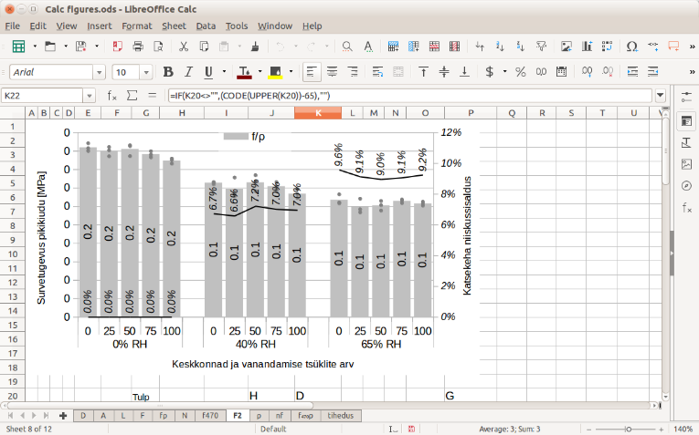
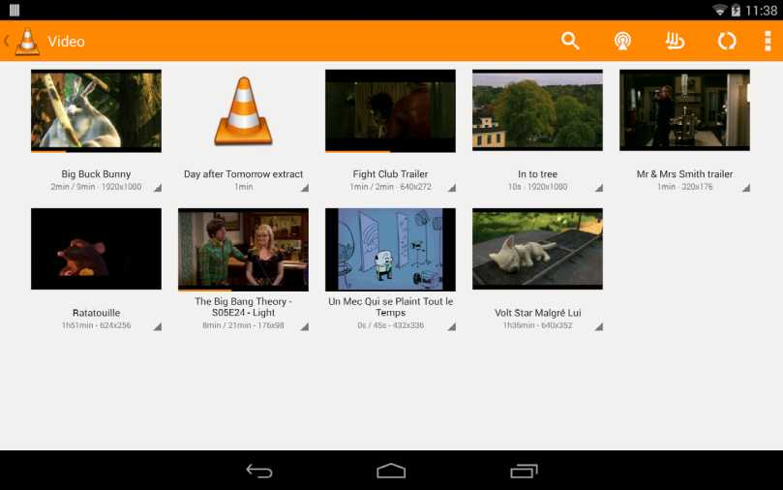
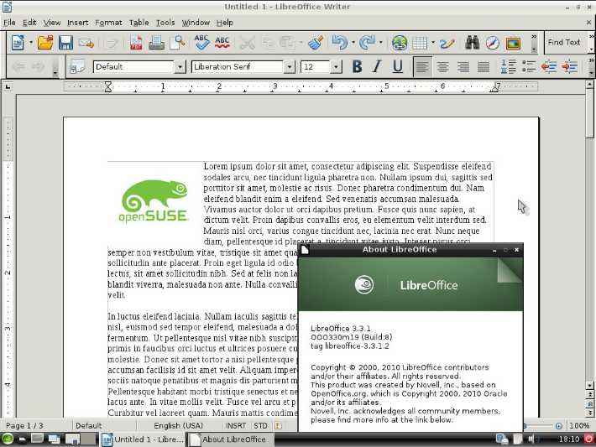
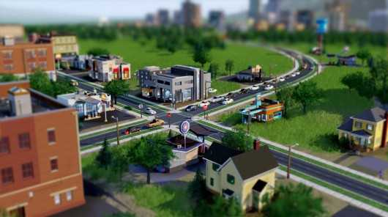
Local computing examples:

Slide 10
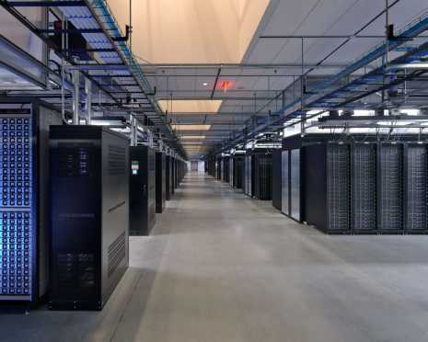
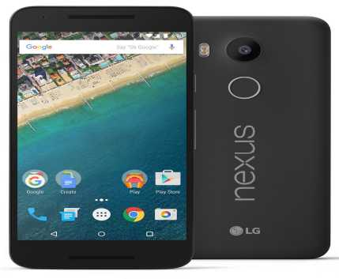
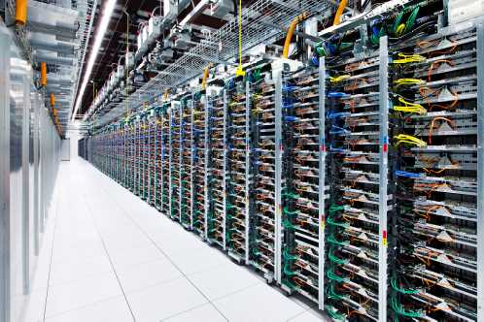
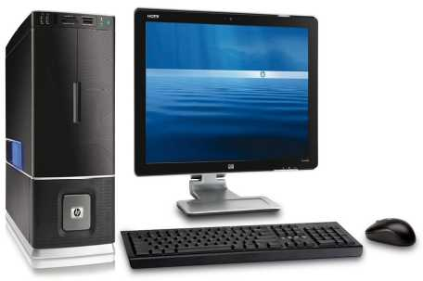
Networked – The program you use talks to other programs via the internet.
Clients
Servers
Internet

Slide 11
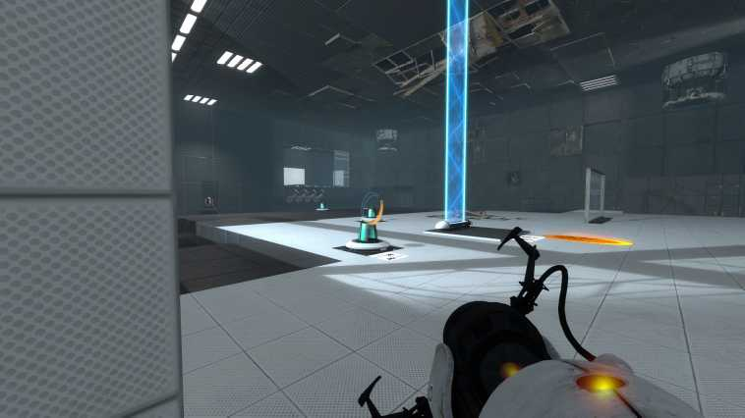
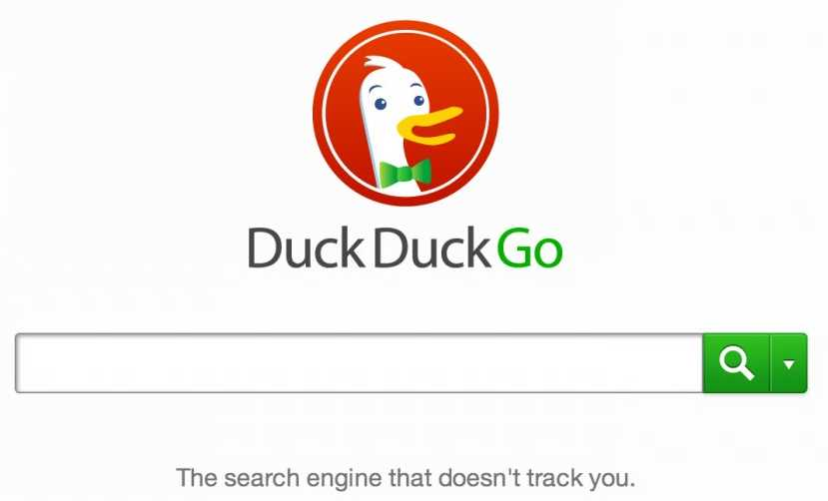
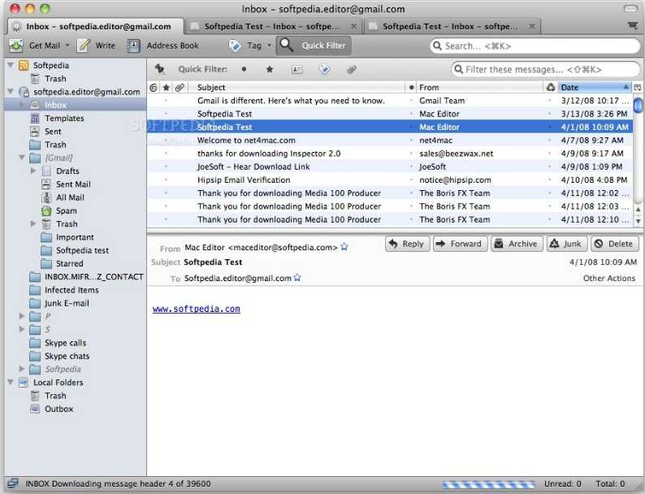
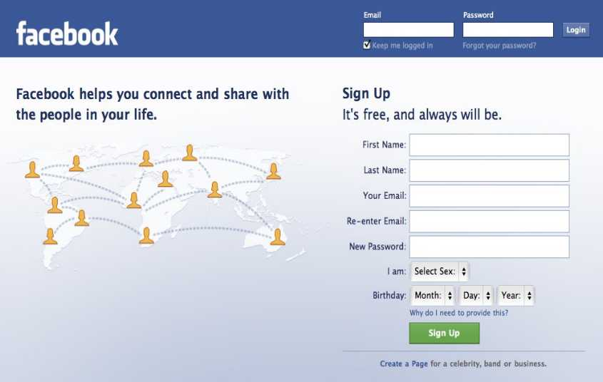
Networked computing examples:

Slide 12
What is Proprietary Software?
The creator of the software retains copyright (or patents) on the software. They can exclusively sell or distribute it.
Limits the user from legally distributing, studying or modifying the program via license agreement.
Usually no source code.
Proprietary ≠ Commercial Software

Slide 13
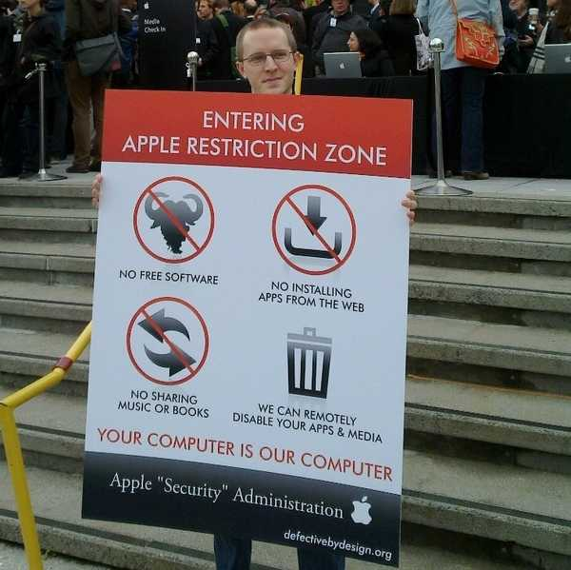
What’s wrong with proprietary software anyway?
http://bendiken.tumblr.com/post/359788001/entering-an-apple-restriction-zone

Slide 14
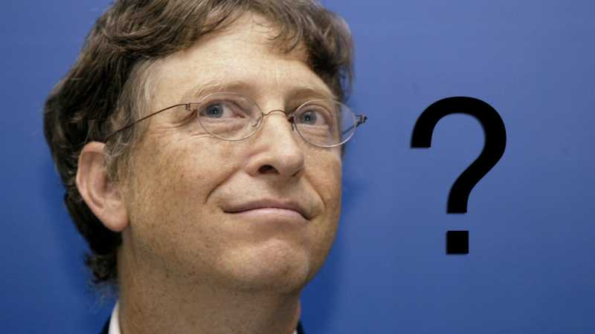
But first, who gives the instructions to your computer?
¯\_(ツ)_/¯
https://i.kinja-img.com/gawker-media/image/upload/s--Fte-7Zoc--/c_scale,fl_progressive,q_80,w_800/18fg1ozkjhev0png.png

Slide 15

You may think the computer is following your instructions….

Slide 16

However, you don’t control it if it is proprietary software.

Slide 17
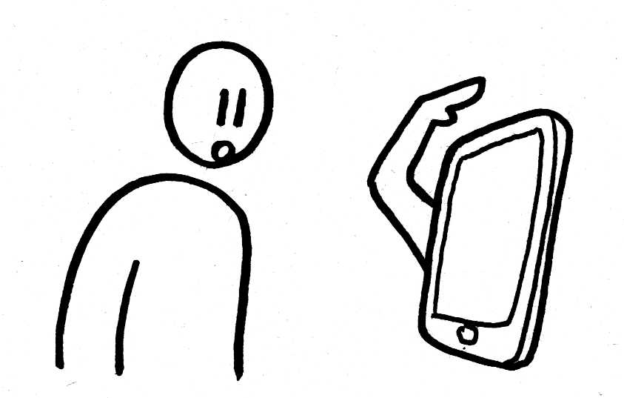
Your computer or device may not follow your instructions, rather...

Slide 18
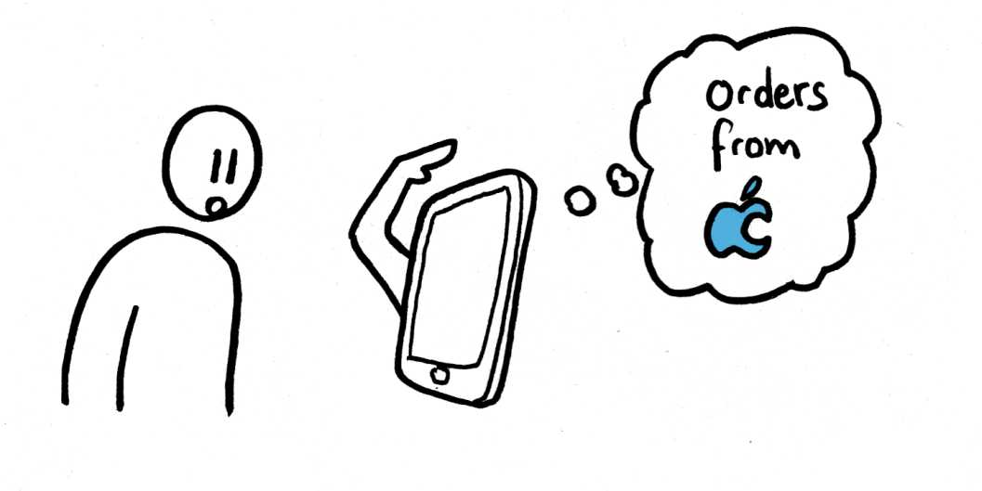
...it will follow the instructions of it’s real owner.

Slide 19
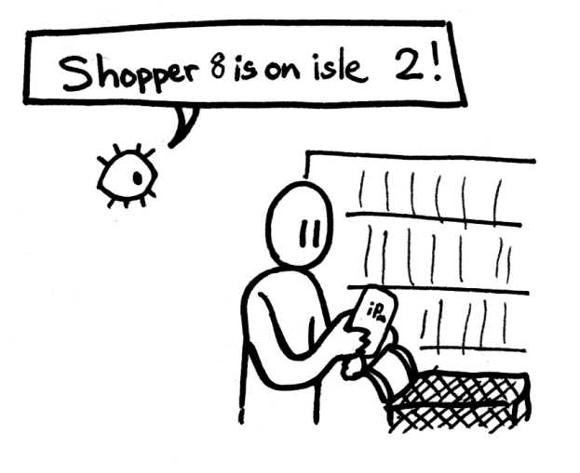
Proprietary software can be used to spy on users.

Slide 20
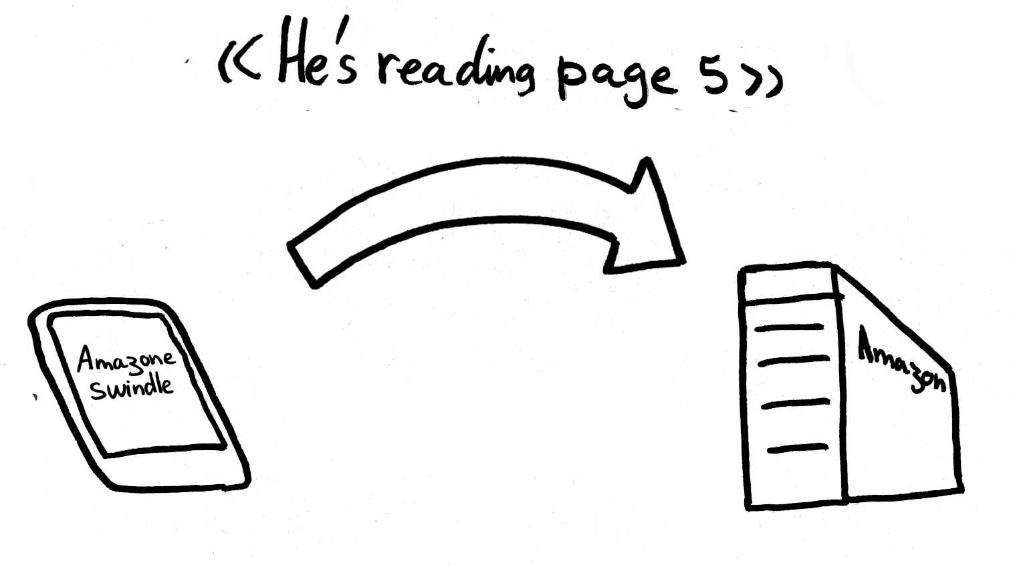
Proprietary software tracking users

Slide 21
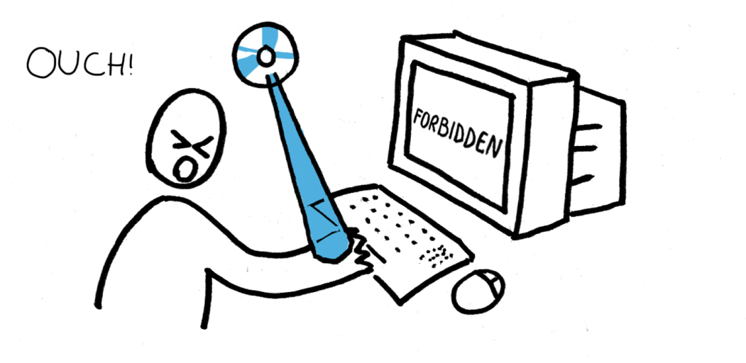
Proprietary software restricts what a user can do.

Slide 22
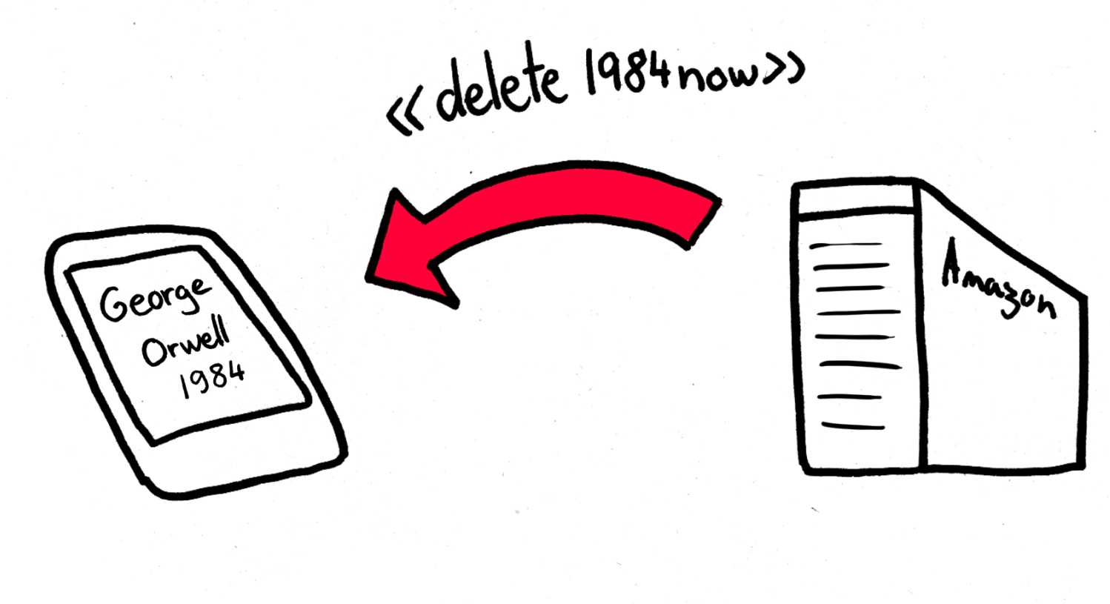
Proprietary software can be used to remotely delete users content via Digital Rights Management (DRM).
https://www.amazon.com/tag/kindle/forum/ref=cm_cd_pg_newest?_encoding=UTF8&cdForum=Fx1D7SY3BVSESG&cdPage=1&cdSort=oldest&cdThread=Tx1QUP1NLUY4Q5M&displayType=tagsDetail
https://www.wired.com/2012/10/amazons-remote-wipe-of-customers-kindle-highlights-perils-of-drm/

Slide 23
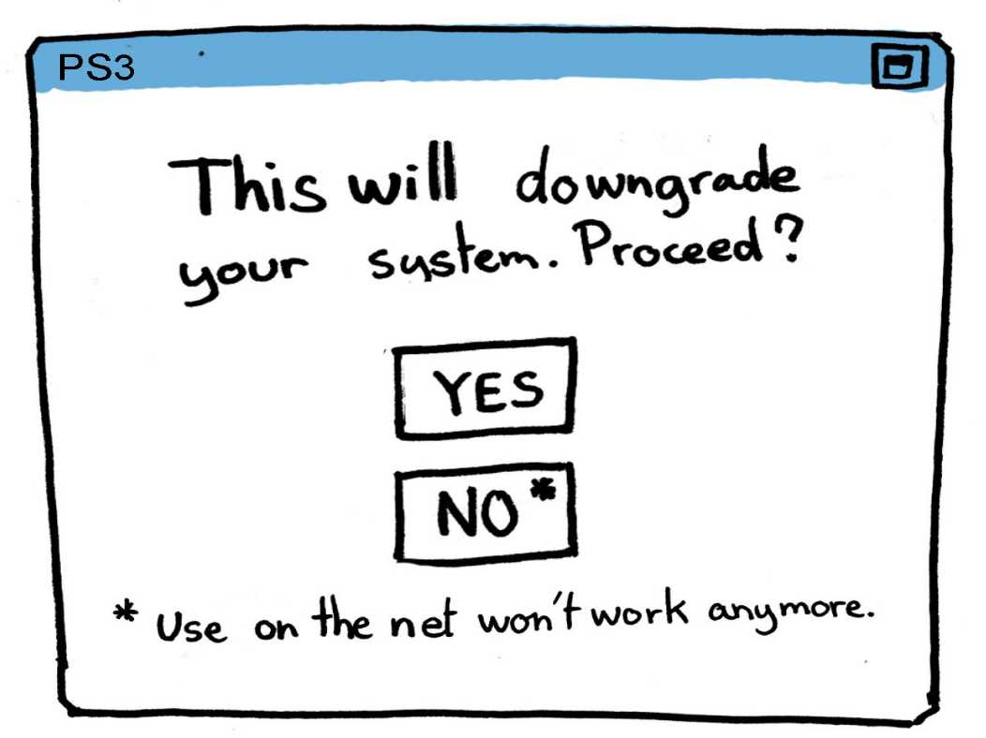
Proprietary software developers compel users to upgrade that reduces the users freedoms further.
https://www.techdirt.com/articles/20100331/0128358800.shtml
https://www.eff.org/deeplinks/2010/03/sony-steals-feature-from-your-playstation-3

Slide 24
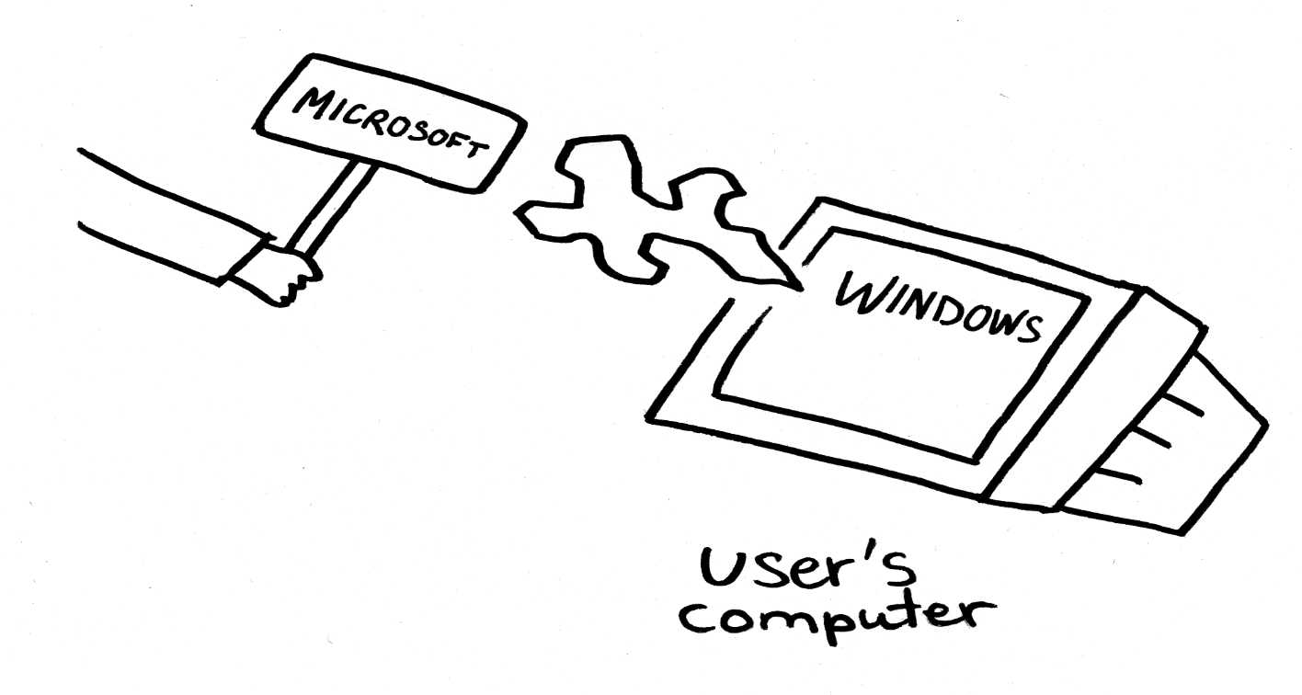
Proprietary software can install software without the users knowledge or permission.
https://www.geek.com/microsoft/microsoft-pushing-windows-10-onto-machines-even-if-they-havent-reserved-it-1633732/
http://www.computerworld.com/article/3043526/microsoft-windows/microsoft-upgraded-users-to-windows-10-without-their-ok.html

Slide 25
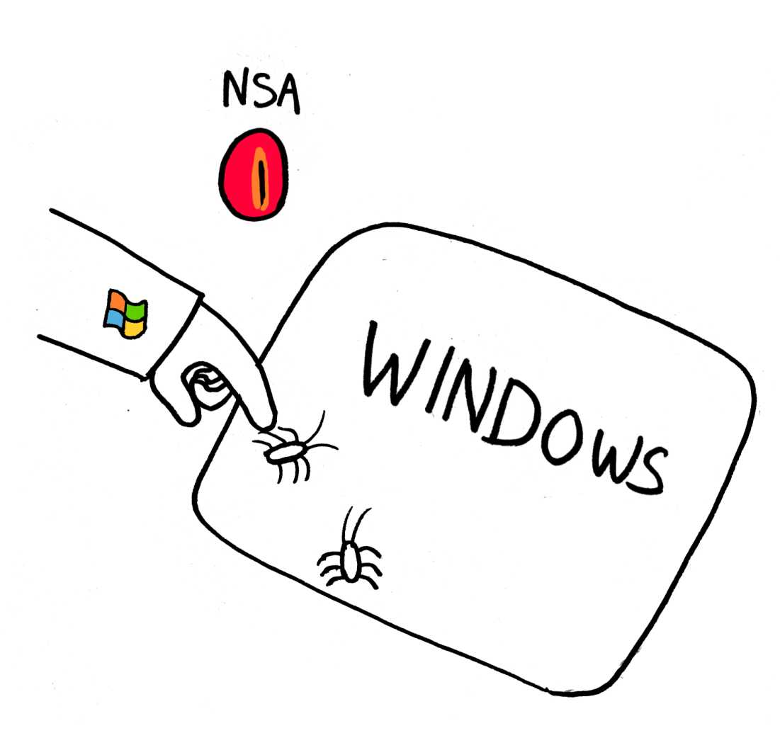
Proprietary software developers can betray the trust of users.
Microsoft and other companies worked with NSA to share bugs, without telling users.
https://www.theguardian.com/world/2013/jul/11/microsoft-nsa-collaboration-user-data
https://arstechnica.com/security/2013/06/nsa-gets-early-access-to-zero-day-data-from-microsoft-others/
http://news.softpedia.com/news/NSA-Intercepted-Microsoft-s-Bug-Report-to-Exploit-Windows-Vulnerabilities-412705.shtml
https://web.archive.org/web/20130622044225/http://blogs.computerworlduk.com/open-enterprise/2013/06/how-can-any-company-ever-trust-microsoft-again/index.htm

Slide 26
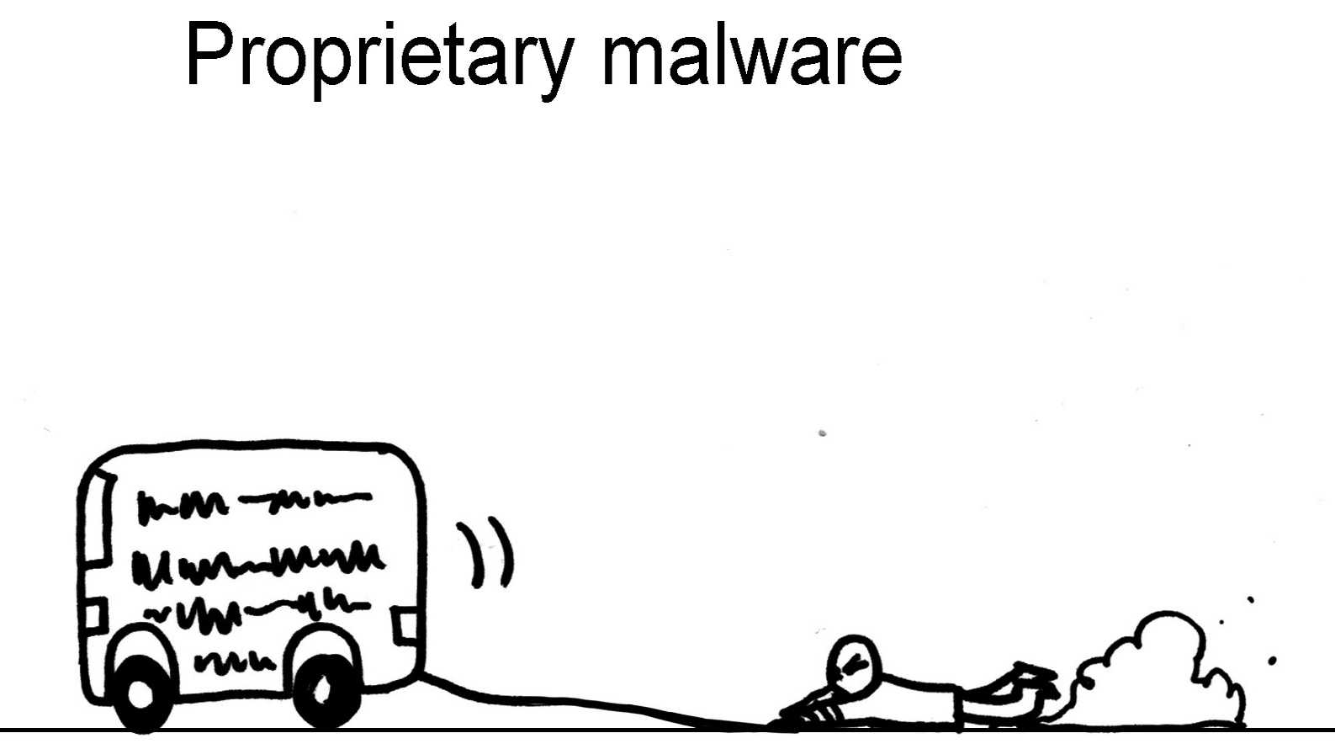
Proprietary software developers have power over the user and can take them for a ride.
Malicious software does things that are against the users interests.

Slide 27
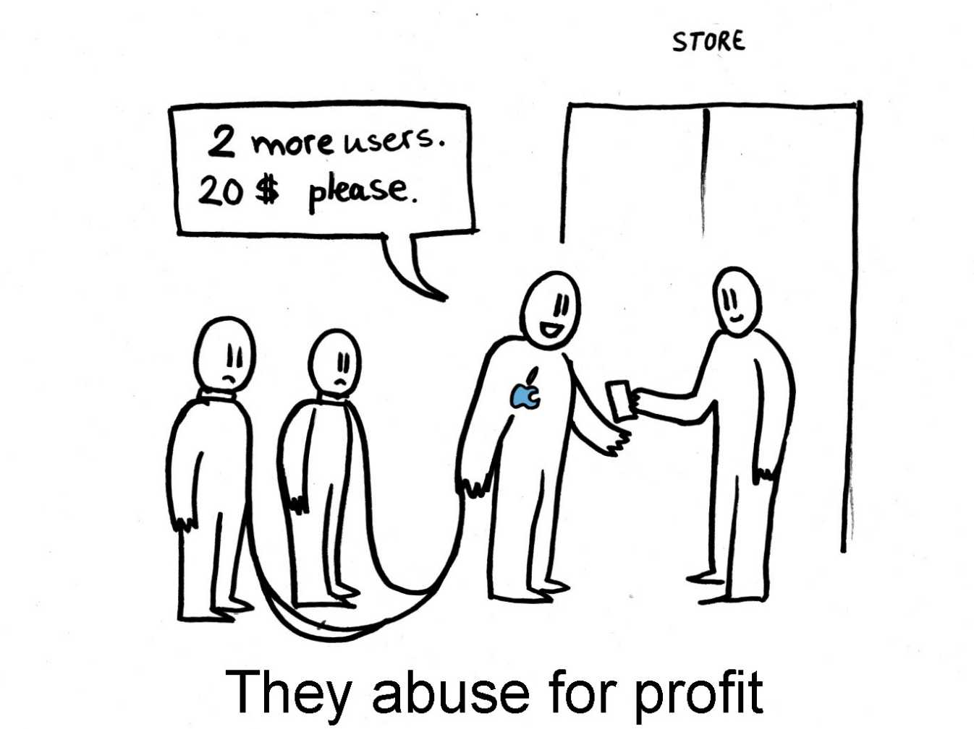
Companies don’t produce proprietary software for EVIL (...usually)

Slide 28
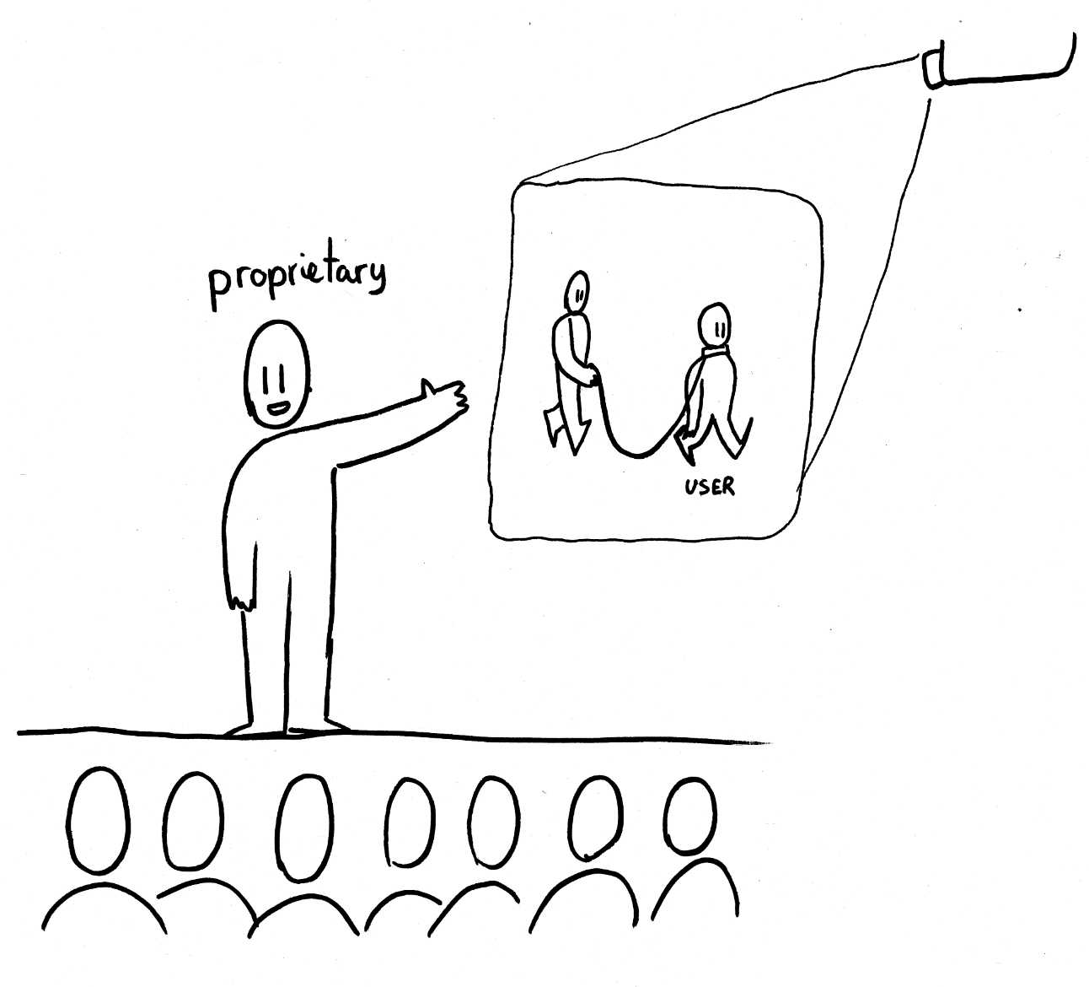
Developers have no shame about how they treat users.

Slide 29

Facebook has conducted experiments on users, without consent.
https://www.theguardian.com/technology/2014/oct/02/facebook-sorry-secret-psychological-experiment-users
https://www.theguardian.com/technology/2017/may/02/facebook-surveillance-tech-ethics
https://www.gizmodo.com.au/2017/05/facebook-handed-over-data-on-insecure-and-overwhelmed-australian-teenagers-to-advertisers/

Slide 30
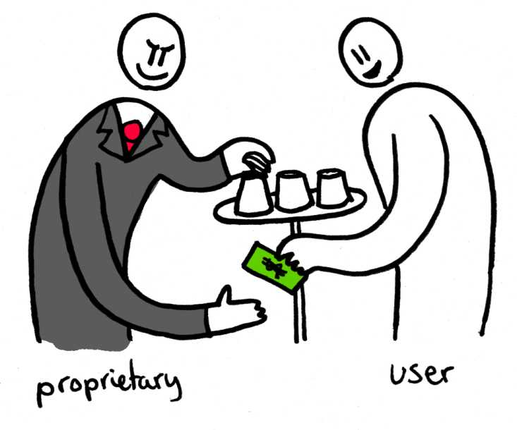
Proprietary (Malware) software takes advantage of you.

Slide 31


http://wallup.net/children-dog-animals-shiba-inu-running/
http://www.clipartbest.com/cliparts/MiL/rnp/MiLrnpgia.jpeg

Slide 32
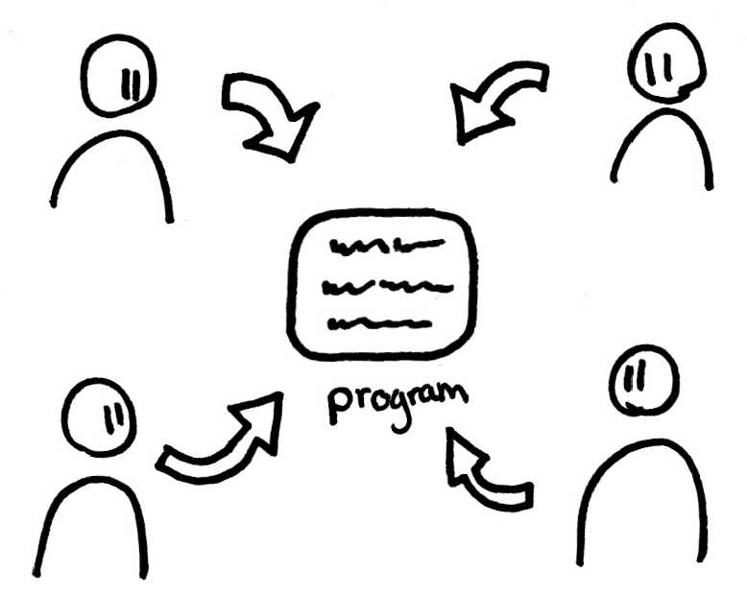
Free software gives users freedom

Slide 33
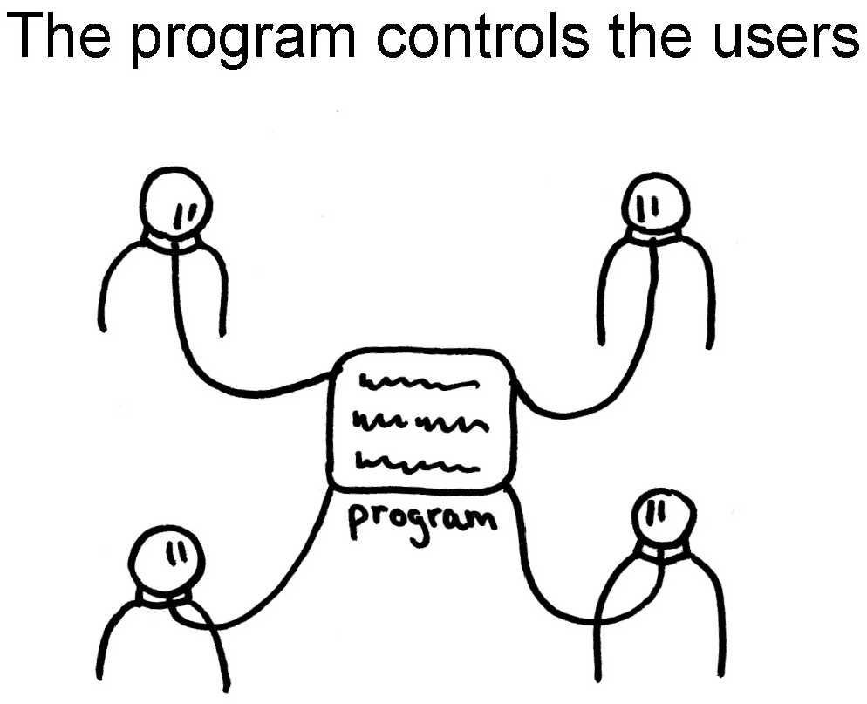
Proprietary software takes freedom away from users.

Slide 34
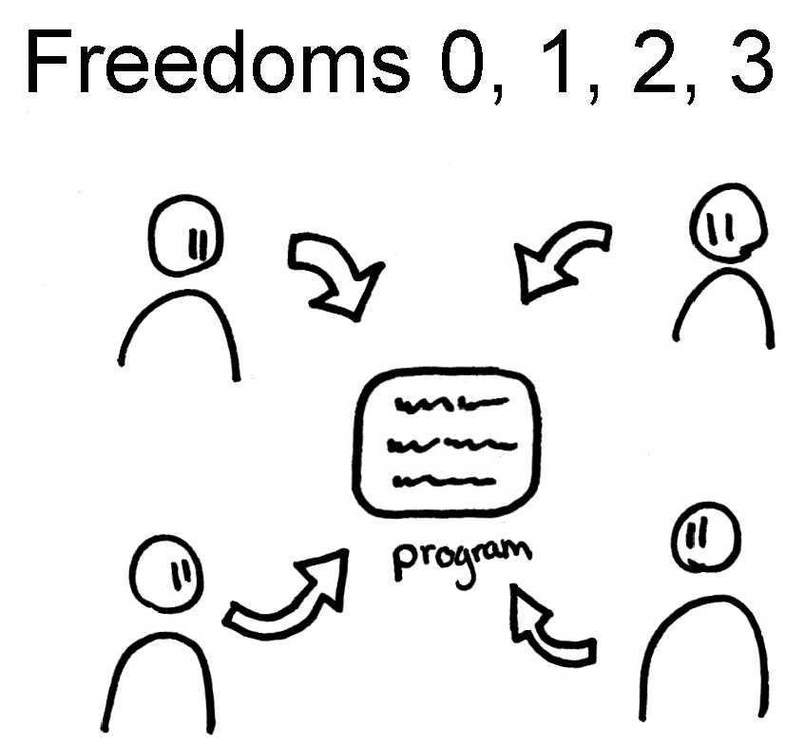
Four conditions of freedom.

Slide 35
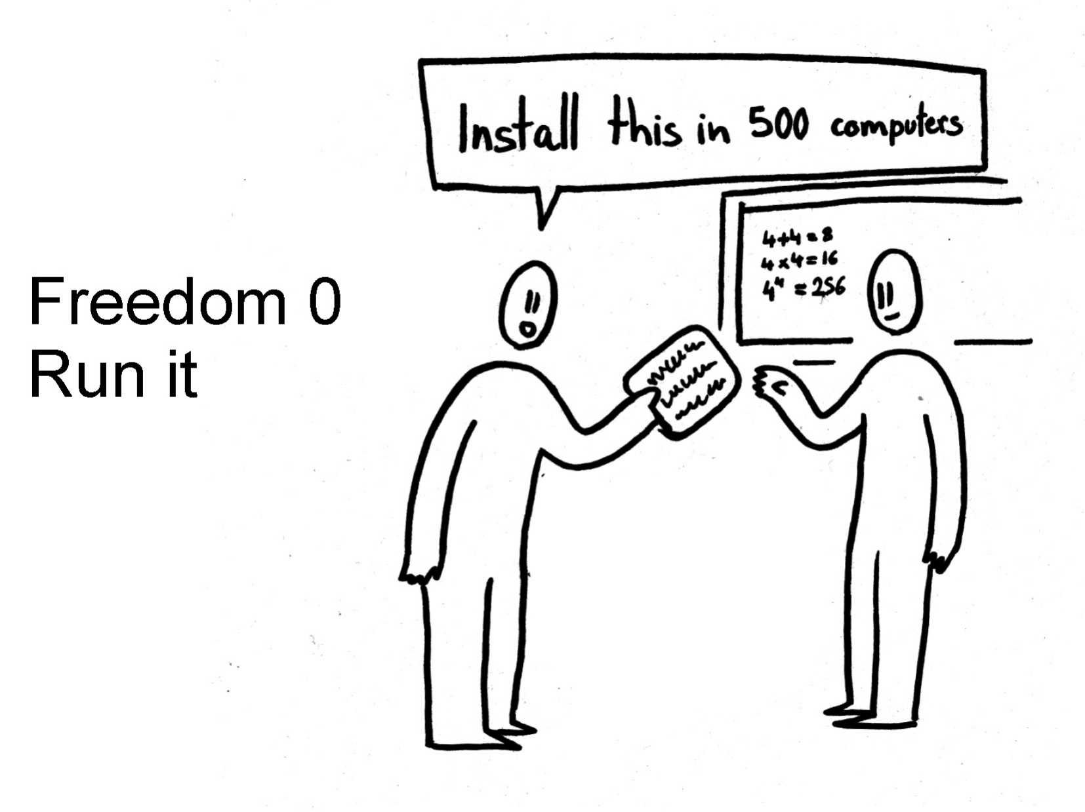

Slide 36
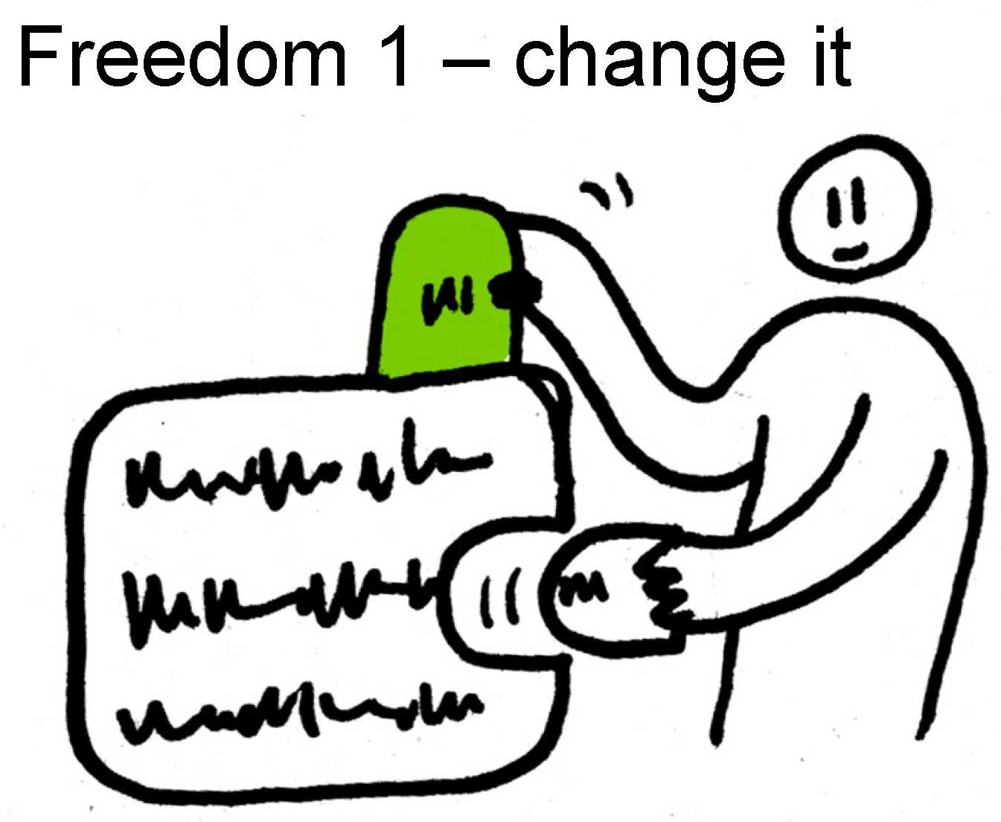

Slide 37
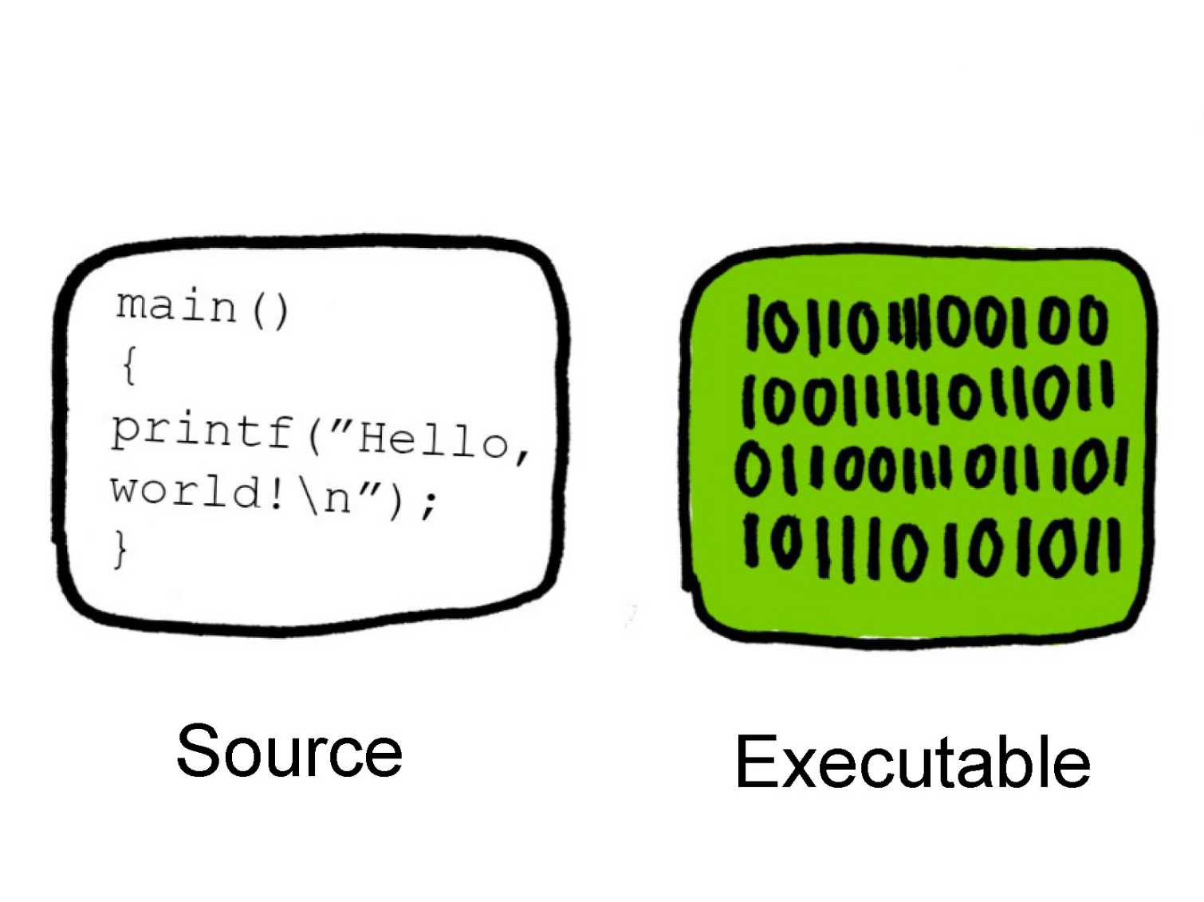
Freedom 1 – change it.
Need the source code to easily study and change the software.

Slide 38
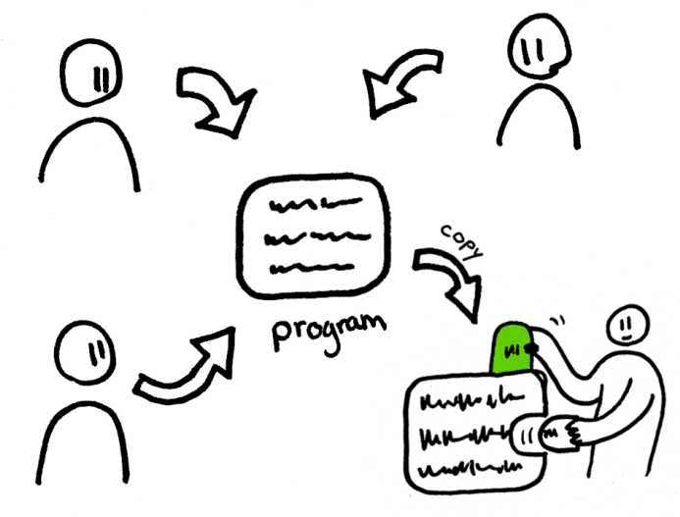
With copies, individual users can copy and modify the software.

Slide 39
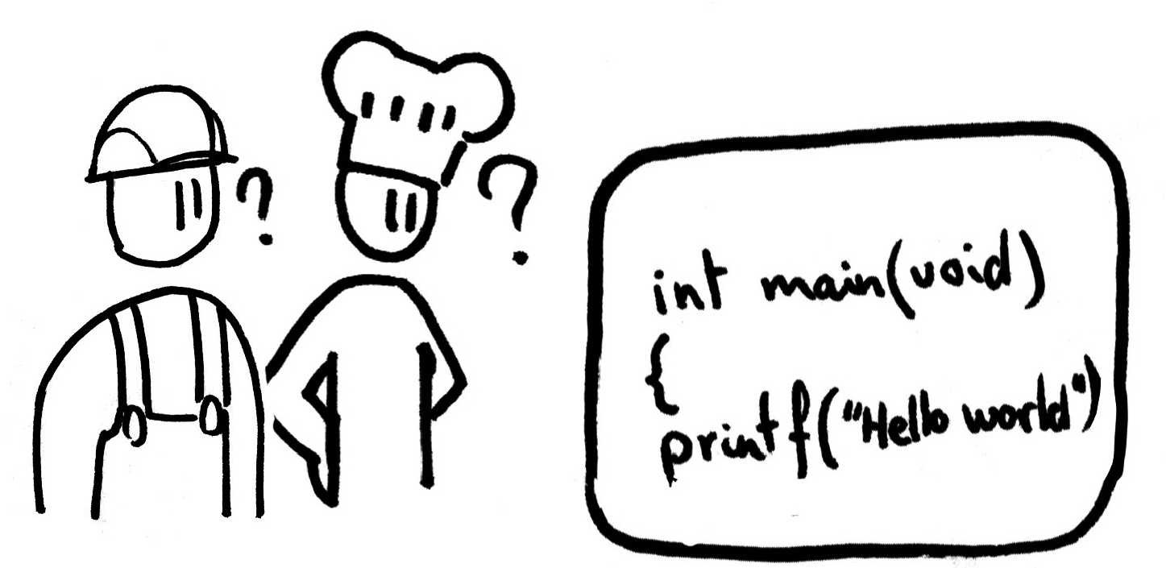
Individual freedoms are great, but what if you are not a geek or programmer?

Slide 40
Individual freedom is not enough, community needs to be free to work together.

Slide 41
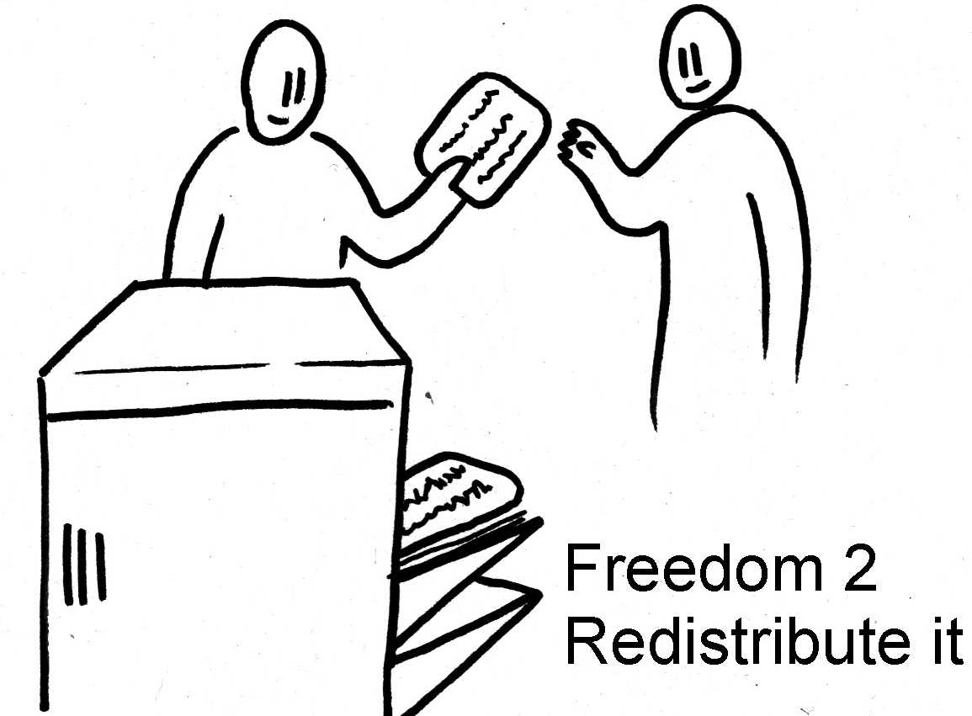
Freedom 2 - Community freedom needs freedom to redistribute.

Slide 42
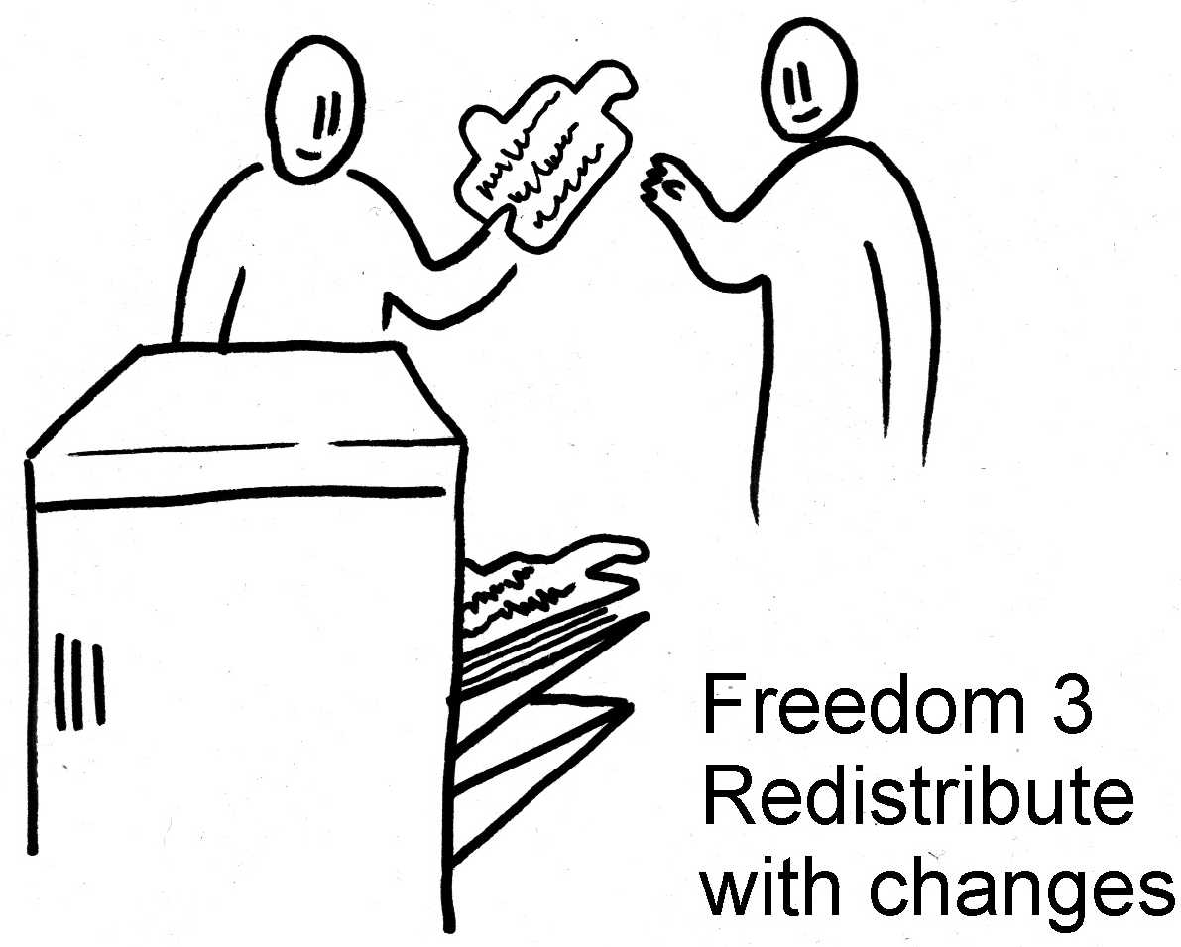
Freedom 3 - Community freedom needs freedom to redistribute modifications.

Slide 43
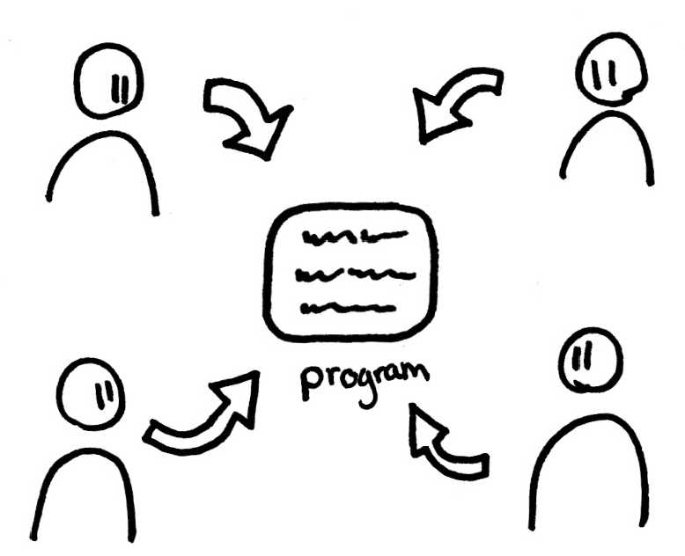
The four freedoms give users control and encourages helping helping others.

Slide 44

If users don’t have the four freedoms, then...

Slide 45

...and the developer controls the program and hence the users.
Notes:
The program is an instrument of unjust power for it’s developer over its users.

Slide 46

Why is Free Software important anyway???
Each human freedom in a society depends on the others. If one is lost, the others are weakened.

Slide 47

How to stop being a victim?
…. use Free Software and help your freedom.

Slide 48

Free Software Foundation was established by Richard Stallman in 1982
1985
1992
GNU is Not Unix (GNU)

Slide 49

There are many GNU/Linux distributions available.

Slide 50

Big sacrifices for freedom

Slide 51


Slide 52

Choosing free software can be inconvenient and difficult.

Slide 53

What are the obstacles to people using Free Software?

Slide 54

Obstacles - Corporations that make a lot of $$ from control of users.

Slide 55

What can we do? – avoid using products or working for companies that don’t respect users freedoms

Slide 56

Obstacles – media and businesses only talks about “open source”
Avoids the philosophical and ethical issues of Free Software.
Businesses also talk about “leveraging” free/open software.

Slide 57

What can we do? - Free software activists demand freedoms, not improving a product.
Actually say
“Free Software”!

Slide 58

Open Source Initiative (OSI) did not agree with the ethical questions of Free Software.
https://opensource.org/about
“… was time to dump the moralizing and confrontational attitude that had been associated with "free software" in the past and sell the idea strictly on the same pragmatic, business-case grounds ...”
This sentence was removed circa September 2012

Slide 59

Obstacles – Schools use proprietary software and hardware so kids don’t know any alternatives.

Slide 60

What can we do?
Notes:
Schools should prepare citizens to live in a strong, capable, independent, cooperating and free society.
Means teaching free software in schools.

Slide 61

Free software helps students learn and encourages curiosity

Slide 62

What can we do? - Schools should use free software to encourage goodwill, sharing and helping other people.

Slide 63

Obstacles - Manufactures of hardware (graphics chips, CPU’s) prevent users from writing Free Software drivers.
Manufactures (Intel, AMD, Nvidia, etc) want you to buy their hardware, but won’t explain how to write free software drivers.

Slide 64

What can we do? - Reverse engineer and write free-software drivers.

Slide 65
What can we do?
Everyone
Use Free software, help others to use Free Software
Report bugs
Help with documentation
Ask questions
Persuade schools/business/government to use FOSS
Stop using “free” services that spy on you for advertising.
  e.g. Uber, Facebook, Online mail, LinkedIn, Google+, Microsoft services, Dating apps (psychological profiling)
Stop using hardware that spy on you, your friends and family.
  eg. Amazon Echo, Smart TVs, Google Home, Apple products.

Slide 66
What can we do?
Programmers
Create free software
Join a free software project
Help fix bugs
Help people use free software
Electronic/software gurus
Reverse engineer hardware to write free software drivers

Slide 67
Questions and comments?
https://i.kinja-img.com/gawker-media/image/upload/s--Fte-7Zoc--/c_scale,fl_progressive,q_80,w_800/18fg1ozkjhev0png.png

Slide 68
The End….

