Slide 1


Project 2: Joint Detection of AI-Generated Images and Post-Processing Alterations in Real-World Scenarios
Course: Computer Vision A.Y. 2025/2026
Project by: Luca Del Signore 2096442

Slide 2
Outline
Problem statement: Why detecting AI-generated images after transformations is relevant.
State of the Art
Proposed Method: Extension of DRCTConvB with frequency-domain information and multi-head joint learning.
Dataset: A balanced subset of RRDataset
Experimental Setup
Model Evaluation
Conclusion
References

Slide 3
Problem Statement

Slide 4
Why the necessity of detecting post-processing AI-images?
AI-Generated Image detectors are usually trained and evaluated in idealized conditions.
In real-world scenarios, images are commonly compressed and transformed by social media platforms.
These transformations can alter image patterns and introduce artifacts, leading the detectors in error.
This is especially critical for AI-generated fake images intended to influence public opinion.

Slide 5
State of the Art

Slide 6

RRDataset/RRBench
A benchmark containing images with different transformation categories
Several state-of-the-art AI-detectors were fine-tuned on this dataset by authors
The benchmark shows that post-processing transformations can significantly reduce real/fake detection performances.

Slide 7
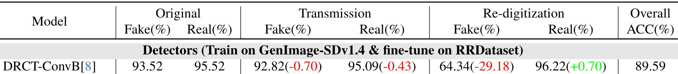
DRCTConvBase
(Our Baseline)
DRCT improves AI-generated image detection through diffusion reconstruction and contrastive training.
DRCTConvB was reported as the strongest detector among the considered models when fine-tuned and used in real world scenario.
However, its performance still drops under re-digitalization transformations.

Slide 8
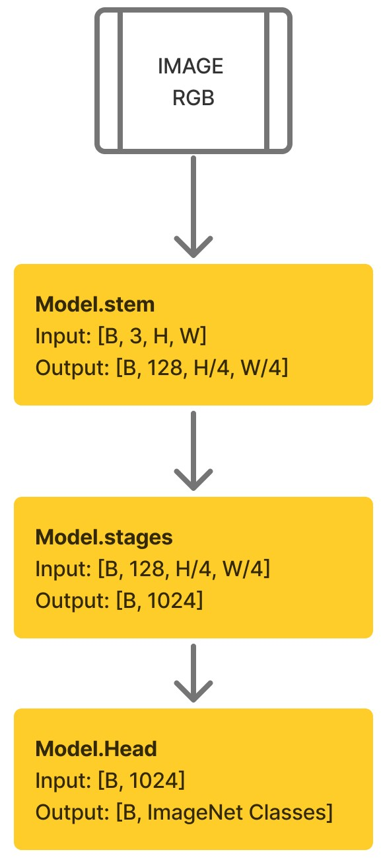
ConvNeXt
DRCTConvB is based on the ConvNeXt family.
They modernize ResNet CNNs by including and adapting design choices and ideas inspired by Vision Transformers, while preserving the simplicity of convolutional networks.

Slide 9
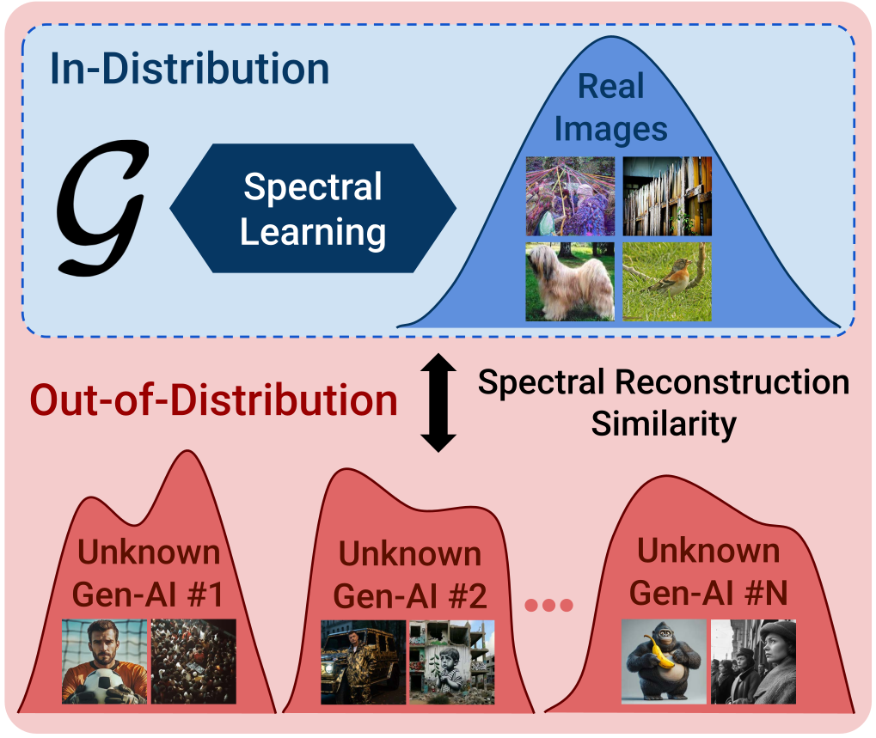
SPAI
SPAI models the spectral distribution of real images and detects AI-generated images when the spectrum is out-of-distribution.
This supports the idea that frequency-domain representations can capture artifacts not easily visible in the RGB domain.

Slide 10
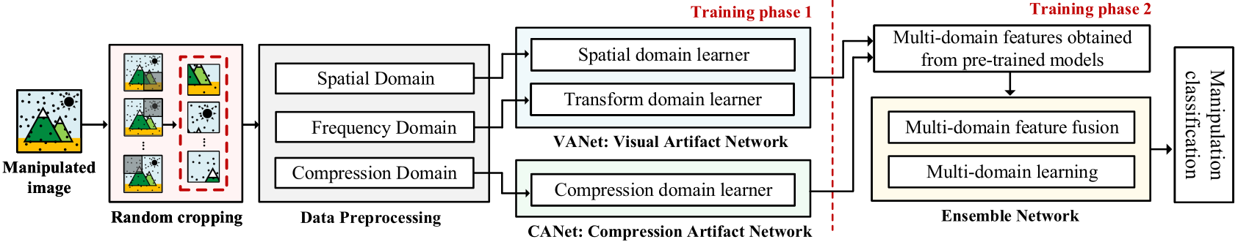
MCNet
Image forensics has also studied the classification of post-processing operations.
MCNet classifies JPEG image manipulations by combining spatial, frequency, and compression-domain features.
However, this line of work focuses on manipulation classification, not on jointly predicting AI/real class and transformation category.

Slide 11
Proposed Method

Slide 12
Base Idea
Instead of relying only on RGB spatial features, we add an initial parallel DFT Stem branch to DRCTConvB in order to use frequency-domain informations. We named it DRCTConvB-DFT
Some post-processing transformations and AI-generations can leave detectable traces in the frequency spectrum (acting like a low-pass or high-pass filter).
Explore a multi-task extension of the model that jointly predicts image authenticity and transformation category.

Slide 13
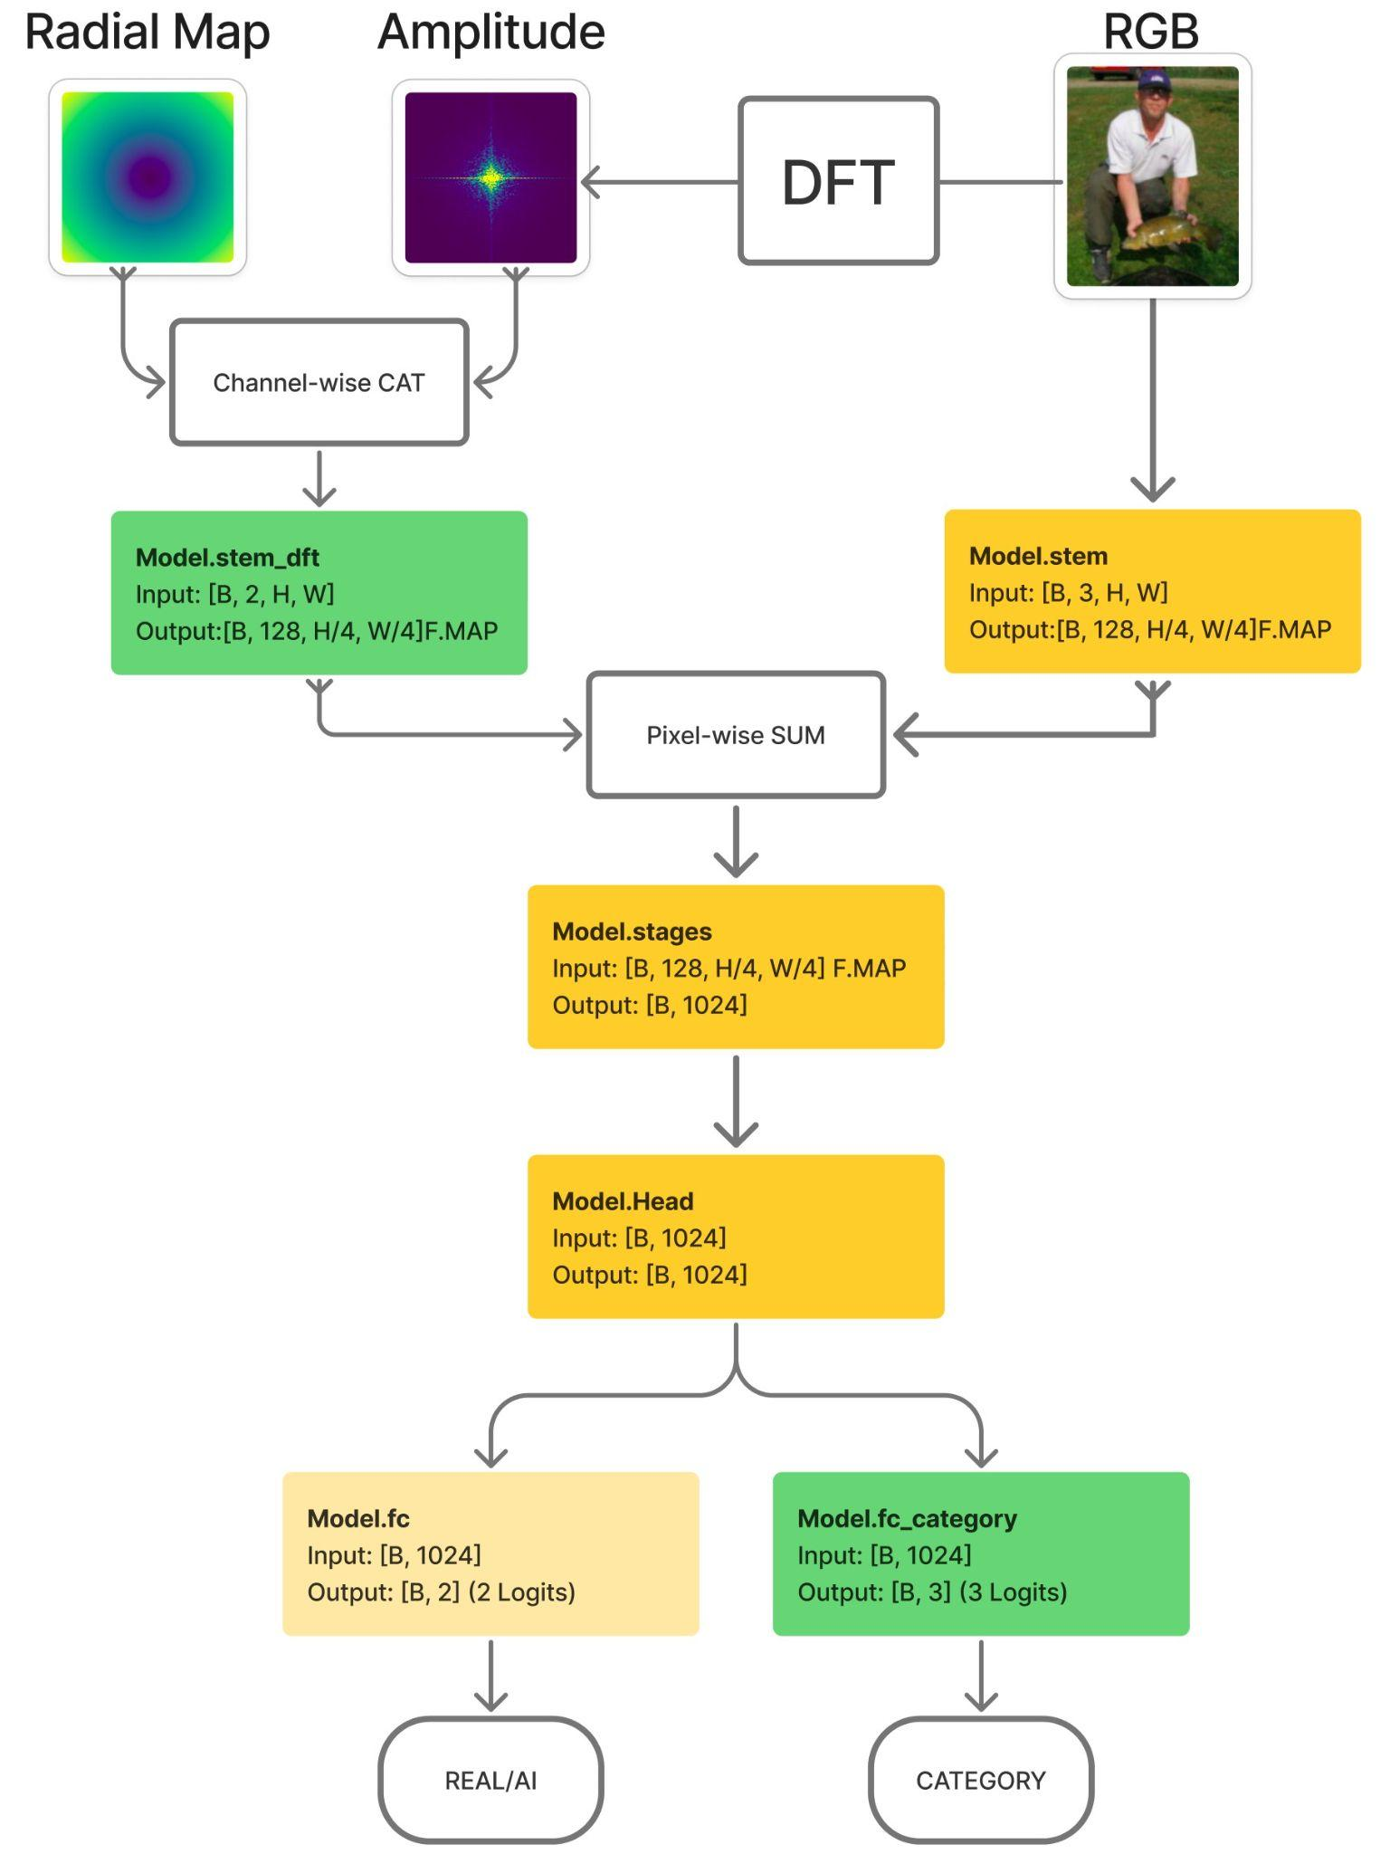
DRCTConvBase-DFT
The added blocks are marked in green
A radial map, that is an image containing in each pixel the normalized distance from the center, is concatenated channel-wise with the DFT amplitude, in order to help the CNN distinguish low and high-frequency regions.

Slide 14

Terminology

Slide 15
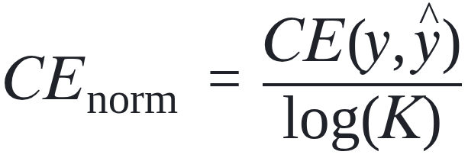

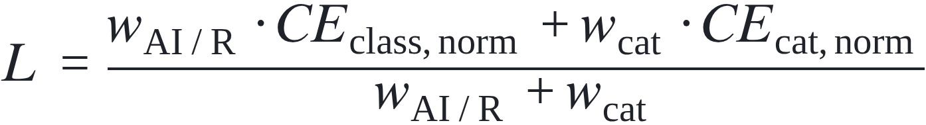
Combined Loss Function
Normalize each task loss by its own uniform probability prediction error with K classes:
With this normalization, a model with uniform prediction gives:
The combined weighted loss used for the joint tasks training is given by:

Slide 16
Dataset

Slide 17
Subset Creation
We trained the models in the Google Colab Environment (T4 and A100 GPUs)
Then it was impractical to use the whole RRDataset
We took 1,500 images for each big group:
original/ai
original/real
redigital/ai
redigital/real
transfer/ai
transfer/real
Then each macro-category is divided into three splits. This grants balance

Slide 18
Experimental Setup

Slide 19
Experimental Questions
Does the parallel DFT Stem branch improve real/AI detection?
Does the DFT branch help in recognizing transformations?
Does category classification benefit from representations and embeddings learned for real/Ai detection task?
Does joint multi-head training improve both tasks?
How do different combinations of loss weights affect the trade-off between the two tasks?

Slide 20
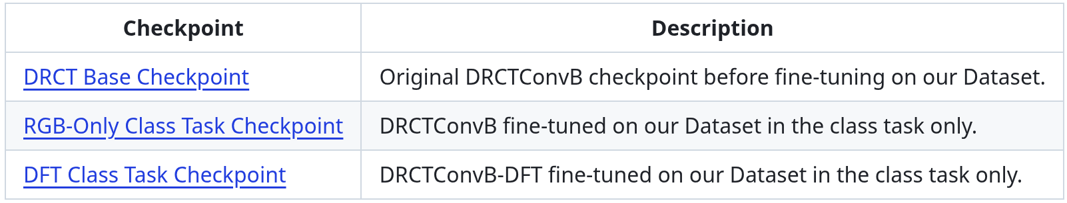
Starting Checkpoints
Three starting checkpoints used during the experiments:

Slide 21
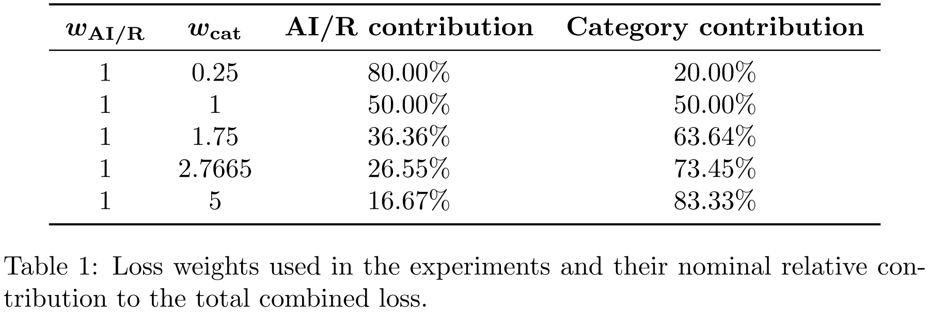
Loss-Weight Ablation

Slide 22
Model Evaluation

Slide 23
Experiment 1

Slide 24
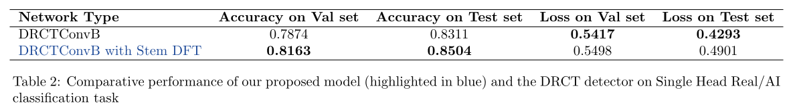
Experiment 1 (1)
Single-Head class task training
We compared:
DRCTConvB model fine-tuned on our Dataset;
DRCTConvB-DFT model fine-tuned on our Dataset.

Slide 25
Experiment 1 (2)
Does the parallel DFT Stem branch improve real/AI detection?
YES
The outputs of this experiment are the two anticipated checkpoints:

Slide 26
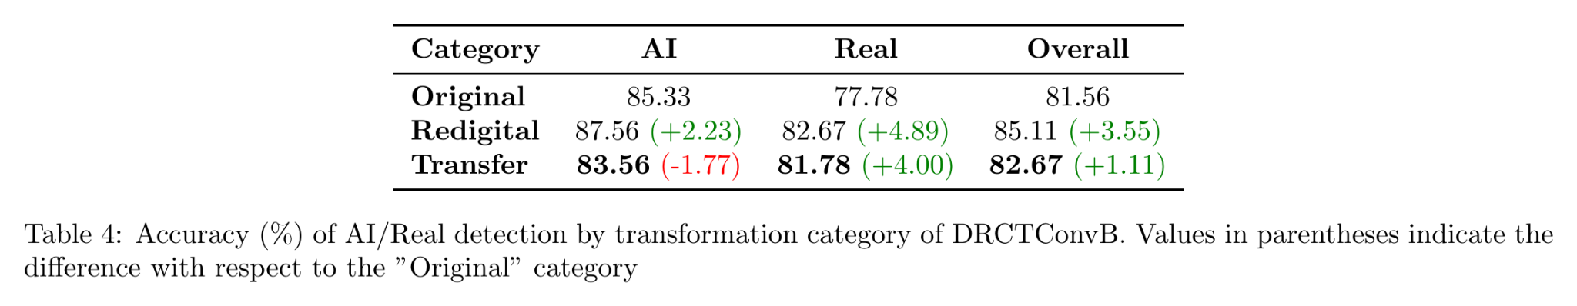
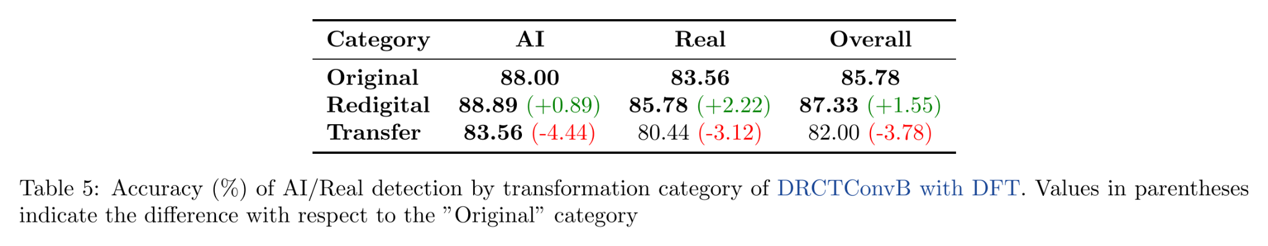
Experiment 1 (3)
By looking at the AI/Real accuracy for each transformation category, the models perform better in redigital category while perform worse on the transfer category (in particular our proposed model)

Slide 27
Experiment 2

Slide 28
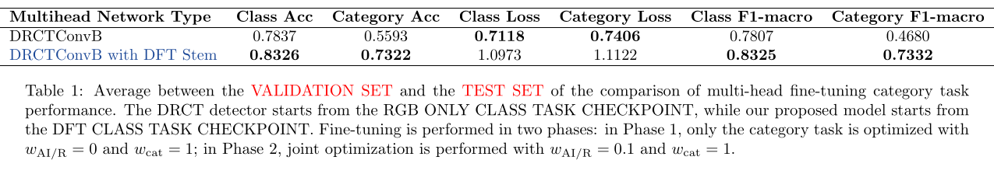
Experiment 2 (1)
Semi-Multi-Head category task training starting from checkpoints obtained after the previous experiment.
We compared:
DRCTConvB model
DRCTConvB-DFT model

Slide 29
Experiment 2 (2)
2. Does the DFT branch help in recognizing transformations?
Yes
From these first two experiments we can confirm that our proposed model is better than the base DRCT detector in both tasks, and in particular frequency-domain informations are especially useful for recognizing transformations.

Slide 30
From now on we will consider only DRCTConvB-DFT

Slide 31
Experiment 3

Slide 32
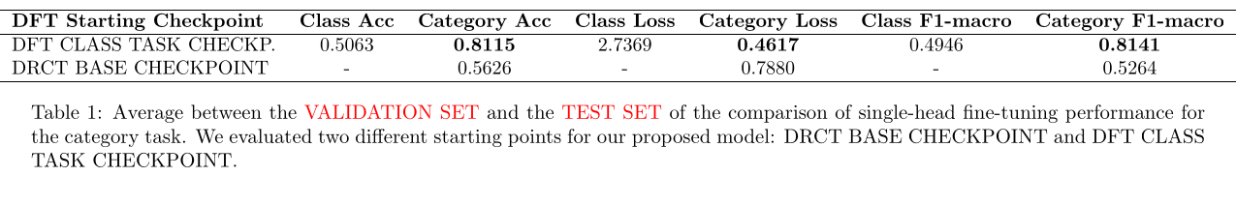
Experiment 3 (1)
Single Head category task training
Studied if the category task benefits from representations previously learned for real/AI image detection across transformations.
We compared two different starting points for DRCTConvB-DFT model:
from the DRCT Base Checkpoint;
from the DFT Class Task Checkpoint;

Slide 33
Experiment 3 (2)
3. Does category classification benefit from representations and embeddings learned for real/Ai detection task?
Yes
This motivates the use of a joint multi-head training combined loss.

Slide 34
Experiment 4

Slide 35
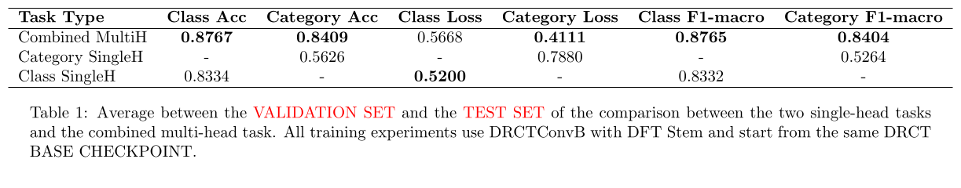
Experiment 4 (1)
Comparison between joint multi-head training and the corresponding single-head trainings, starting from the same checkpoint (DRCT Base Checkpoint)

Slide 36
Experiment 4 (2)
4. Does joint multi-head training improve both tasks?
Yes
Joint training improved both class and category tasks, suggesting that both tasks can benefit from each other and provide complementary supervision when optimized together.

Slide 37
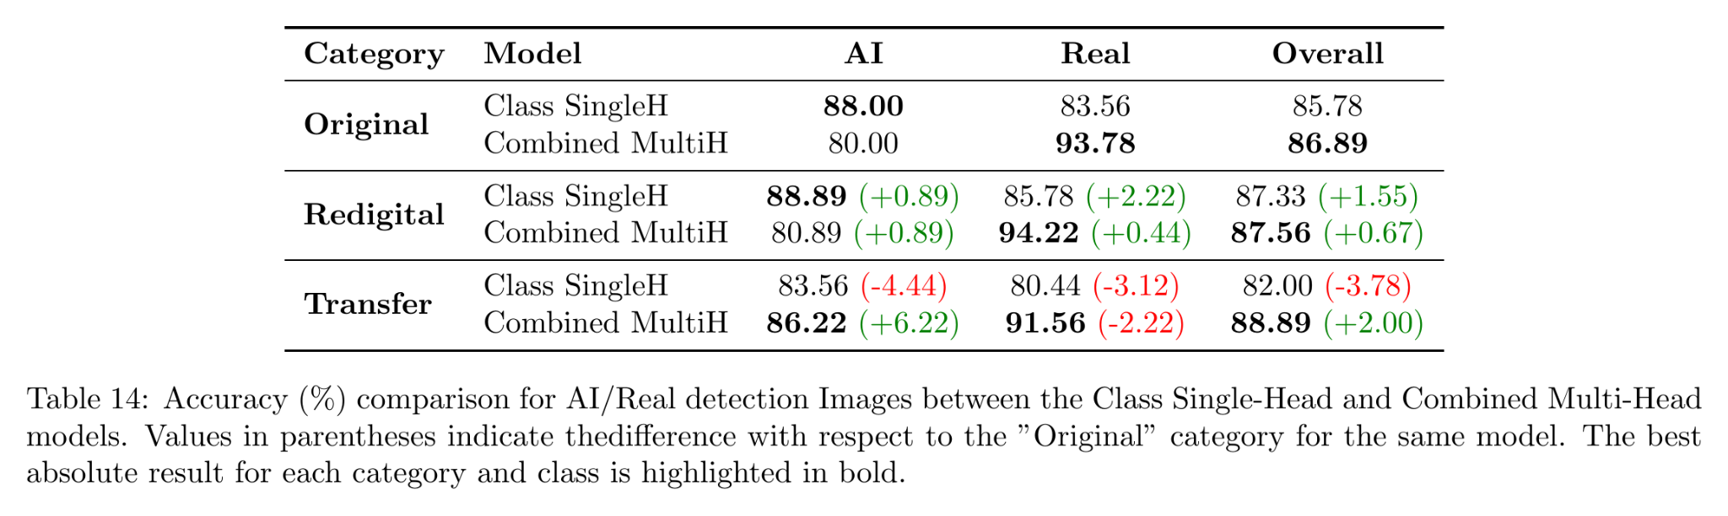
Experiment 4 (3)
The multi-head model is stronger on real image detection across transformations, while the single-head model performs better on AI images.

Slide 38
Experiment 5

Slide 39
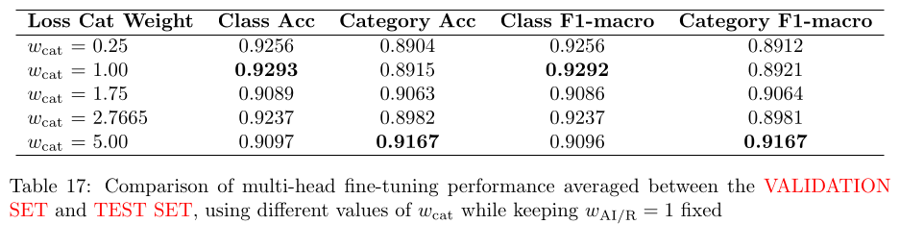
Experiment 5 (1)
Studied how the relative loss weights affect the trade-off between Real/AI detection and category classification
We kept w(AI/R)=1 fixed and varied w(cat).

Slide 40
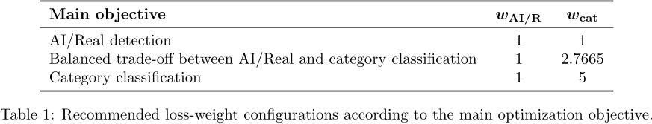
Experiment 5 (2)
5. How do different combinations of loss weights affect the trade-off between the two tasks?
The differences between configurations are not extremely large, but we can extract these practical guidelines:

Slide 41
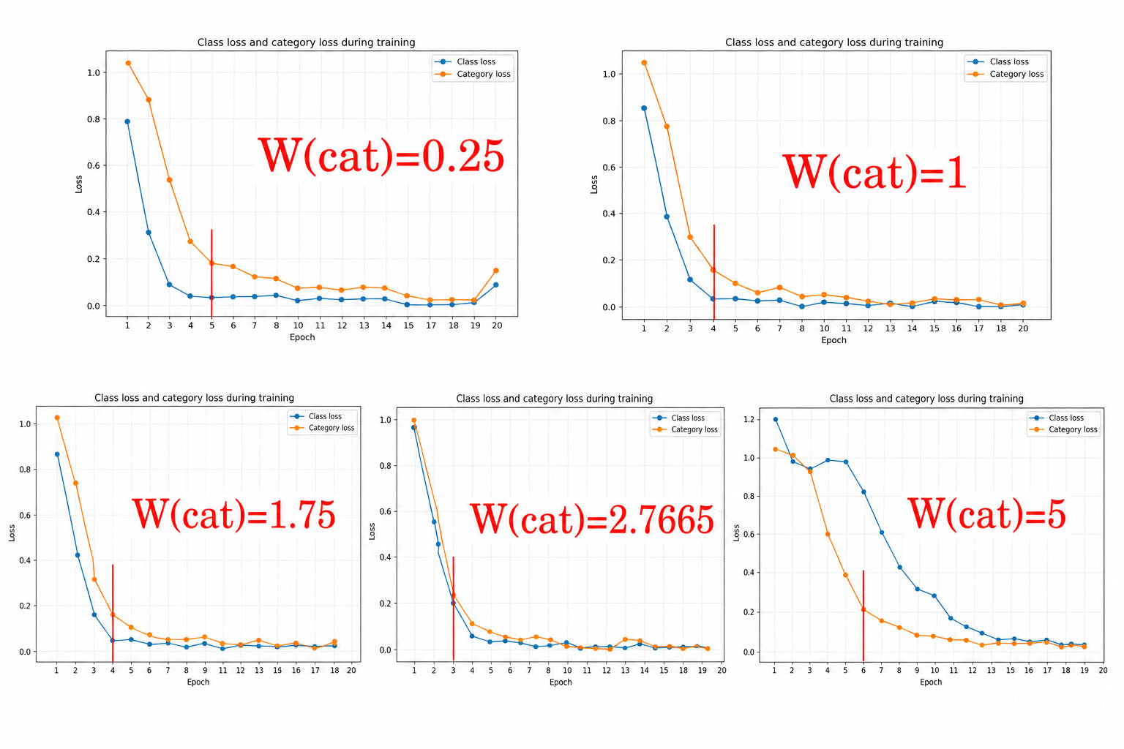
Experiment 5 (3)
The marked epoch shows when the category loss reaches 0.20.

Slide 42
Experiment 5 (4)
Regardless of the nominal weight assigned to the category loss term, it follows the learning dynamics of the real/AI detection task.
This confirms again that the category task strongly depends on the shared representation learned with the class task, and it is not driven only by its explicit loss.

Slide 43
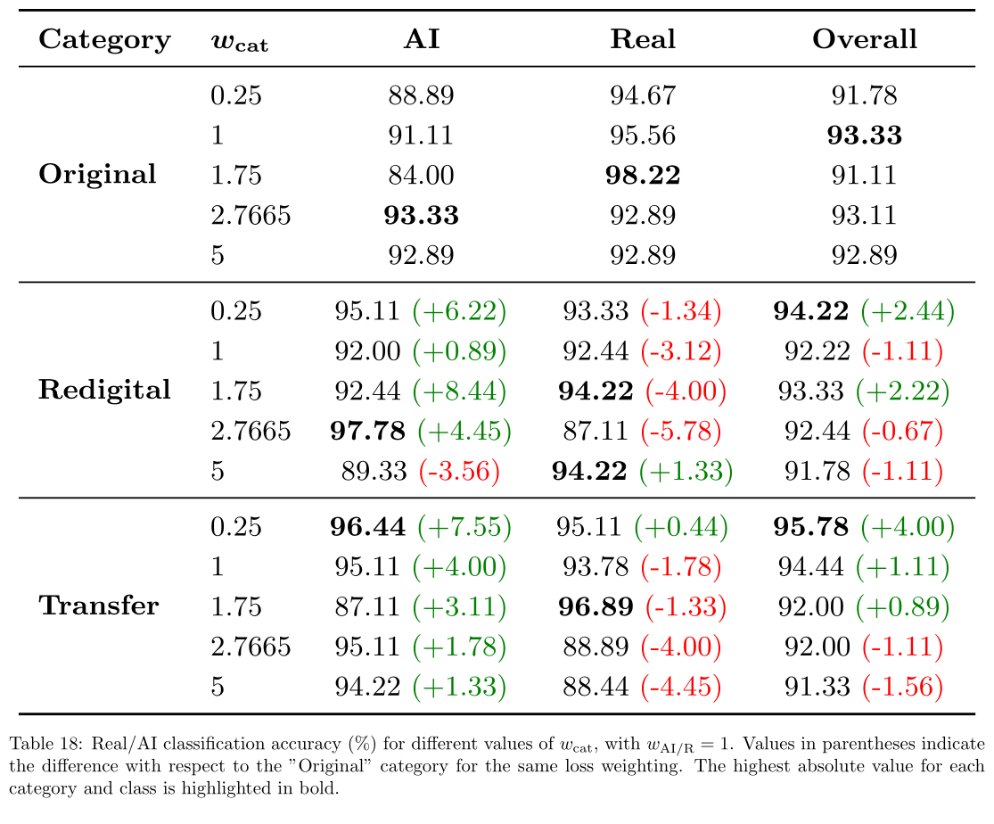
Experiment 5 (5)
Across weighting configurations there is a recurrent pattern: models detect AI-gen images better after redigital and transfer transf., but this comes with a drop in real-image detection for those categories.

Slide 44
Conclusion
Our proposed model, DRCTConvB with a parallel DFT Stem, has generally better performance than the base DRCTConvB in the detection of AI/Real Images and in the classification of post-processing transformations.
Jointly training the two tasks can achieve better results in detection of AI images and post-processing classification compared with the corresponding single-task models.

Slide 45
Thank you for your attention!

Slide 46
References
C. Li, X. Wang, M. Li, B. Miao, P. Sun, Y. Zhang, X. Ji, and Y. Zhu, “Bridging the Gap Between Ideal and Real-world Evaluation: Benchmarking AI-Generated Image Detection in Challenging Scenarios,” arXiv preprint arXiv:2509.09172, 2025.
B. Chen, J. Zeng, J. Yang, and R. Yang, “DRCT: Diffusion Reconstruction Contrastive Training towards Universal Detection of Diffusion Generated Images,” in Proceedings of the 41st International Conference on Machine Learning (ICML), vol. 235, pp. 7621–7639, 2024.
Z. Liu, H. Mao, C.-Y. Wu, C. Feichtenhofer, T. Darrell, and S. Xie, “A ConvNet for the 2020s,” arXiv preprint arXiv:2201.03545, 2022.
D. Karageorgiou, S. Papadopoulos, I. Kompatsiaris, and E. Gavves, “Any-Resolution AI-Generated Image Detection by Spectral Learning,” in Proceedings of the IEEE/CVF Conference on Computer Vision and Pattern Recognition (CVPR), pp. 18706–18717, 2025.
I.-J. Yu, S.-H. Nam, W. Ahn, M.-J. Kwon, and H.-K. Lee, “Manipulation Classification for JPEG Images Using Multi-Domain Features,” IEEE Access, vol. 8, pp. 210837–210854, 2020.

