Slide 1
EEG用于脑纹识别

Slide 2
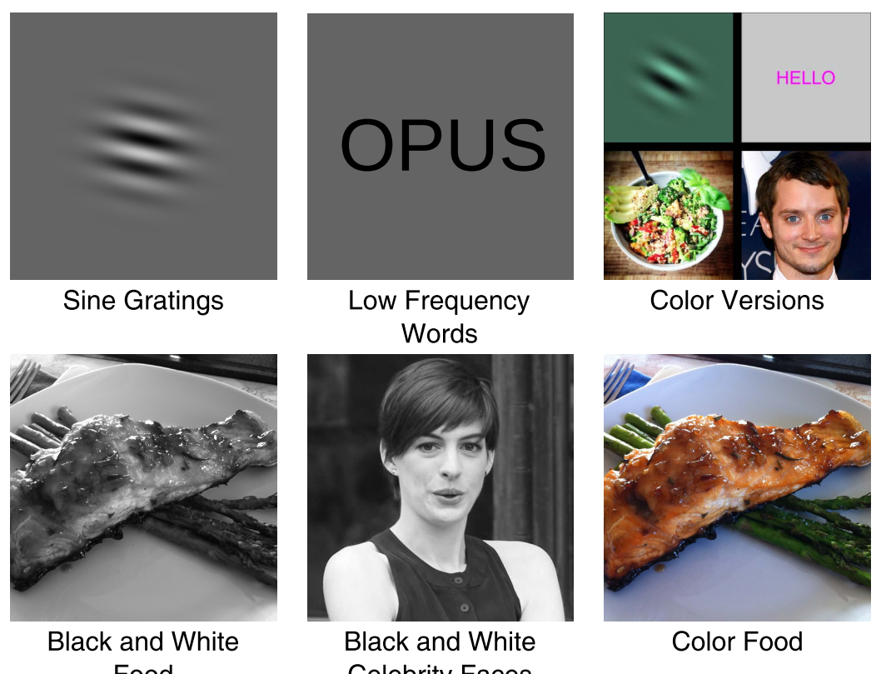
CEREBRE: A Novel Method for Very High Accuracy Event-Related Potential Biometric Identification
IEEE TRANSACTIONS ON INFORMATION FORENSICS AND SECURITY, VOL. 11, NO. 7, JULY 2016
实验方法：将如下五类
正弦波、食物、名人、生词各100张黑白图片，另外100张图片是选取的这四类的彩色图片
50位受试者
将这几类刺激结合起来分类，准确率能达到100%；单类刺激的分类准确率见下一页

Slide 3
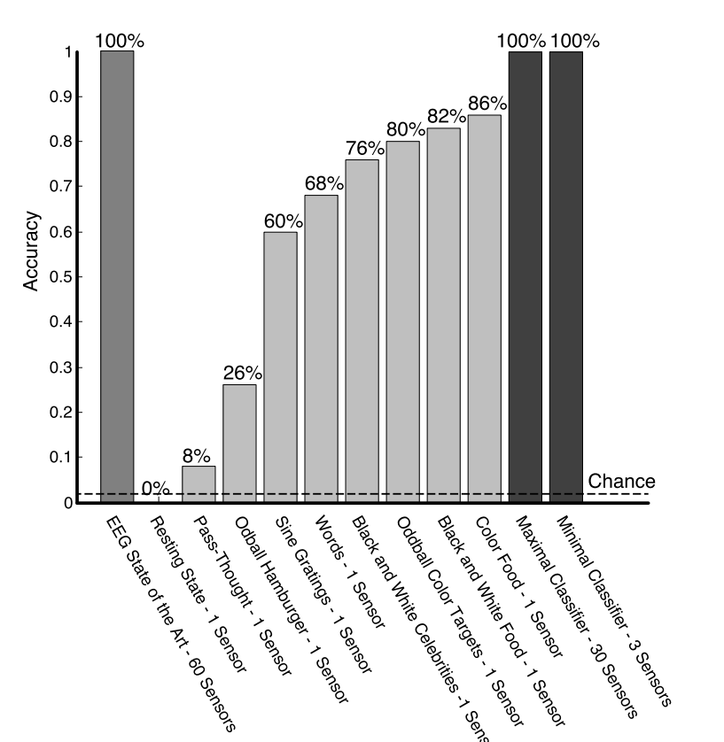
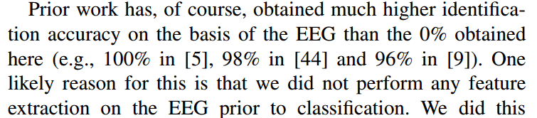
CEREBRE: A Novel Method for Very High Accuracy Event-Related Potential Biometric Identification
对于resting state，作者分析，准确率为0的原因是没有进行特征提取

Slide 4
Human Brain Distinctiveness Based on EEG Spectral Coherence Connectivity
IEEE TRANSACTIONS ON BIOMEDICAL ENGINEERING, VOL. 61, NO. 9, SEPTEMBER 2014
从神经学的角度来看，静息态的eeg数据（主要是1到40Hz的数据），反应的是人的基本认知功能的数据，研究表明[1][2]这些数据中隐藏的信息会体现出个体差异
另一方面，目前很多对个体识别的实验都面临一个问题，准确率会随着实验人数的增加而降低，作者提出，这个问题的原因可能是因为在特征提取时没有考虑不同脑区的关联。因此这篇文章解决的主要问题是相关联的各个脑区的特征提取问题
[1] F. Vogel and E. Schalt, “The electroencephalogram (EEG) as a research tool in human behavior genetics: Psychological examinations in healthy males with various inherited EEG variants,” Human Genetics, vol. 47, pp. 81–111, 1979 [2] A. J. Tomarken, R. J. Davidson, R. E. Wheeler and L. Kinney, “Psychometric properties of resting anterior EEG asymmetry: Temporal stability and internal consistency,” Psychophysiol., vol. 29, no. 5, pp. 576–592, 1992

Slide 5
Brainprint: Assessing the uniqueness, collectability, and permanence of a novel method for ERP biometrics
Neurocomputing 166 (2015) 59–67
实验：受试者来到实验室，默念一段文字，同时收集脑电数据，在接下来的数周到六个月内，一部分受试者返回实验室进行同样的实验。
45个受试者，30个人只做了一次实验，其他15个人在5到40天内又做了一次，然后这15个人里有9个人在134天到188天内又返回实验室做了一次。
实验结果见下页

Slide 6
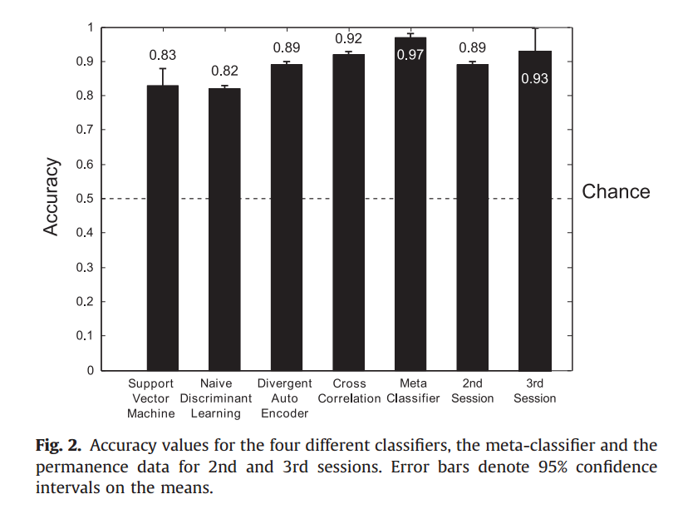
Brainprint: Assessing the uniqueness, collectability, and permanence of a novel method for ERP biometrics
这里的session2和session3指的是再次返回实验室做实验的那些人

Slide 7
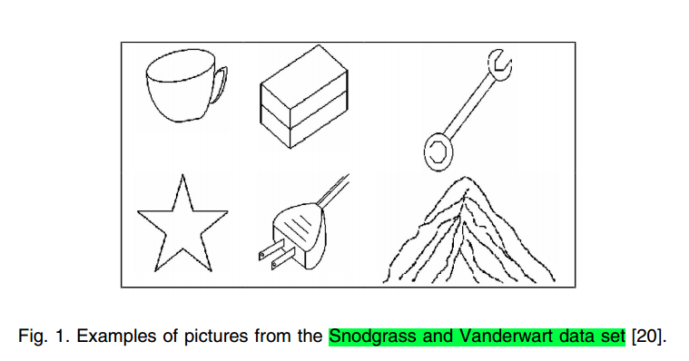
Biometrics from Brain Electrical Activity: A Machine Learning Approach
IEEE TRANSACTIONS ON PATTERN ANALYSIS AND MACHINE INTELLIGENCE, VOL. 29, NO. 4, APRIL 2007 The VEP signals were recorded from the subjects being shown black and white drawings of common objects, extracted from the Snodgrass and Vanderwart picture set
分类结果见下页

Slide 8
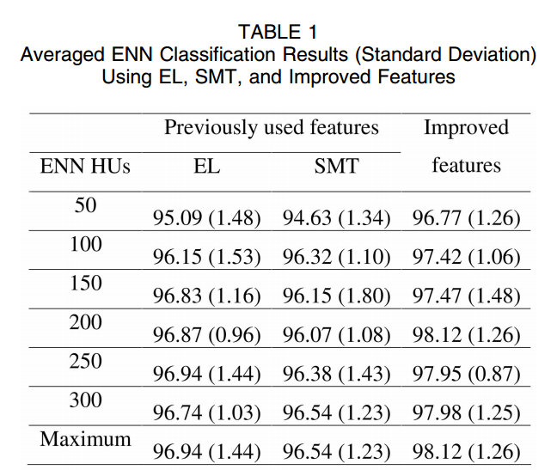
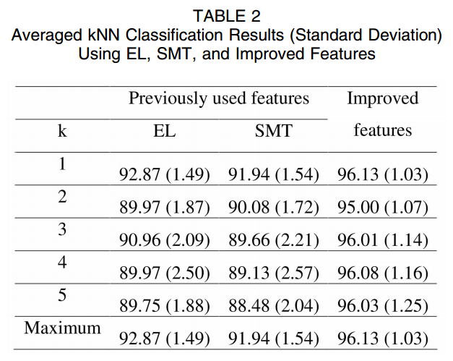
Biometrics from Brain Electrical Activity: A Machine Learning Approach

Slide 9
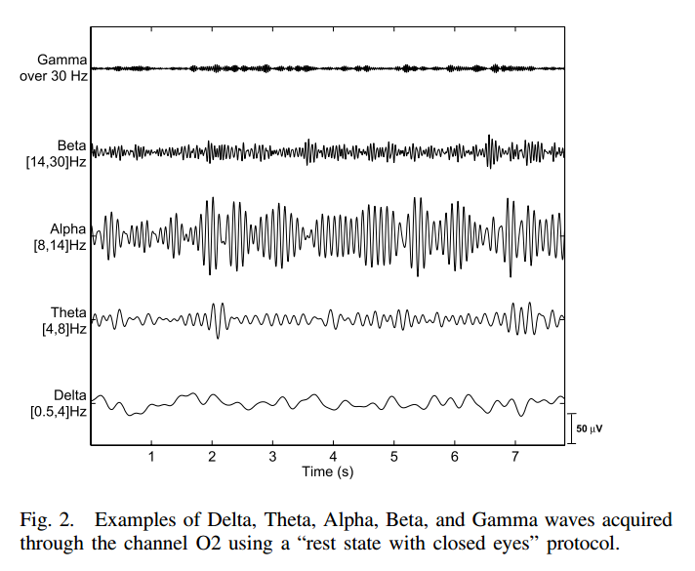
Brain Function. Neurophysiology and Cognitive Processes (Springer series in synergetics)
从EEG中可以得到五种主要频率的波：
Delta (δ) 0.5 - 4Hz
Theta (θ) 4 - 8Hz
Alpha (α)8 - 14Hz
Beta (β) 14 - 30Hz
Gamma (γ ) over 30Hz
有研究表明[1],在闭眼状态下的alpha波表现出了明显的个体差异
[1] L. Johnson and G. Ulett, Quantitative study of pattern and stability of resting electroencephalographic activity in a young adult group

Slide 10
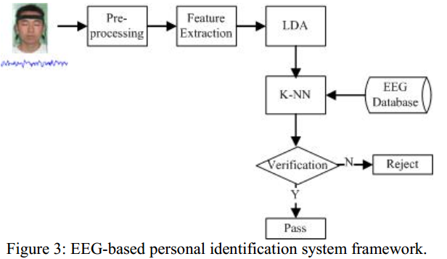
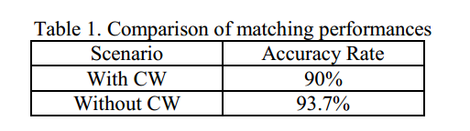
A biometric-based covert warning system using EEG
978-1-4673-0397-2/12/$31.00 ©2012 IEEE
实验：40个受试者，第一天，给受试者一杯水喝，并记录这时的脑电，第二天的同一时间段，给受试者一杯咖啡，记录脑电
这里CW的定义：
Covert Warning (CW) is a feature that allows an authorized person to secretly send out a warning message when he/she is coerced to pass a personal identification and authorization system.

Slide 11
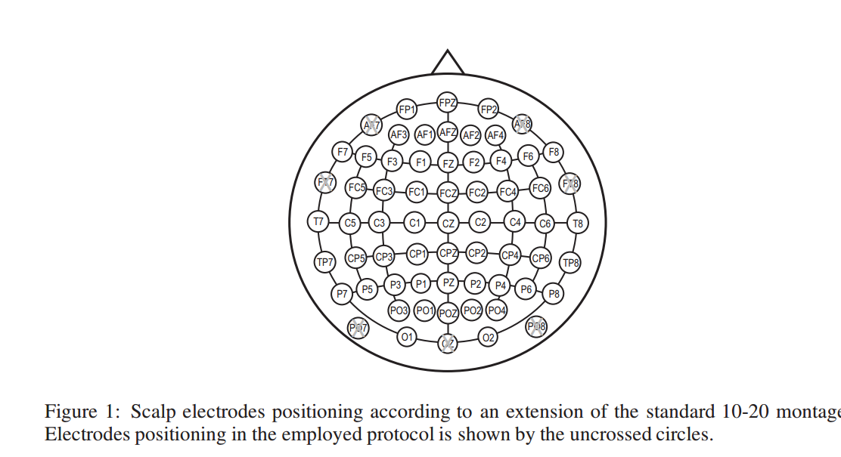
EEG Biometrics for Individual Recognition in Resting State with Closed Eyes
实验对象：45个健康受试者
实验方法：
During the experiment, the participants were comfortably seated in a reclining chair with both arms resting on a pillow in a dimly lit room properly designed in order to inimize external sounds and noise, not interfering with the attention and the relaxed state of subjects.
The subjects were asked to perform one minute of “resting state with closed eyes”
56通道采集设备

Slide 12
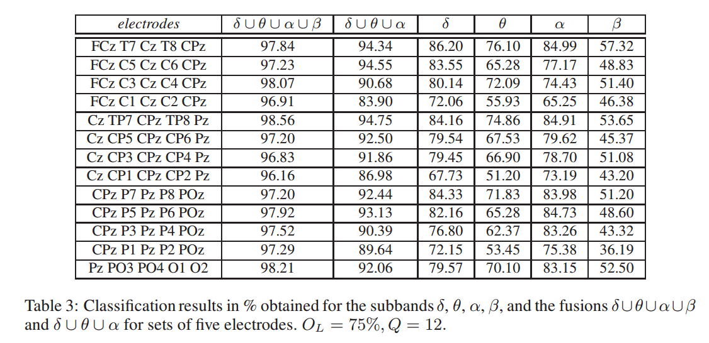
EEG Biometrics for Individual Recognition in Resting State with Closed Eyes
通过对实验的分析，作者得出两个结论：
the α rhythm can be successfully employed for recognition purposes ；这个结论和前面对alpha波的说明差不多
通过多项式回归的方法（polynomial regression），适当的选取导联数量，可以达到99%的分类准确率
上图是分类结果的一部分，由于此实验是用56个导联收集到的不同频率的eeg数据，以上实验的目的是找出用最少的导联、最有效的频率来进行分类

Slide 13
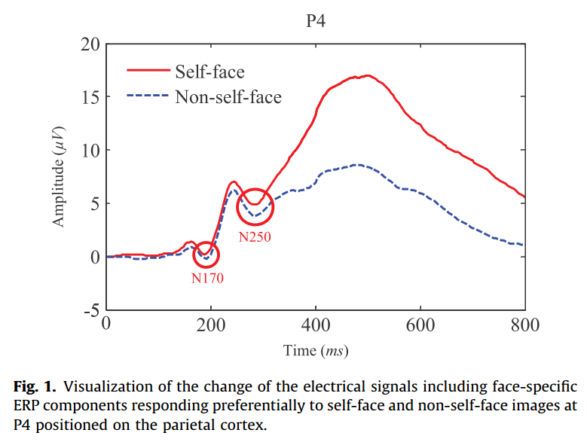
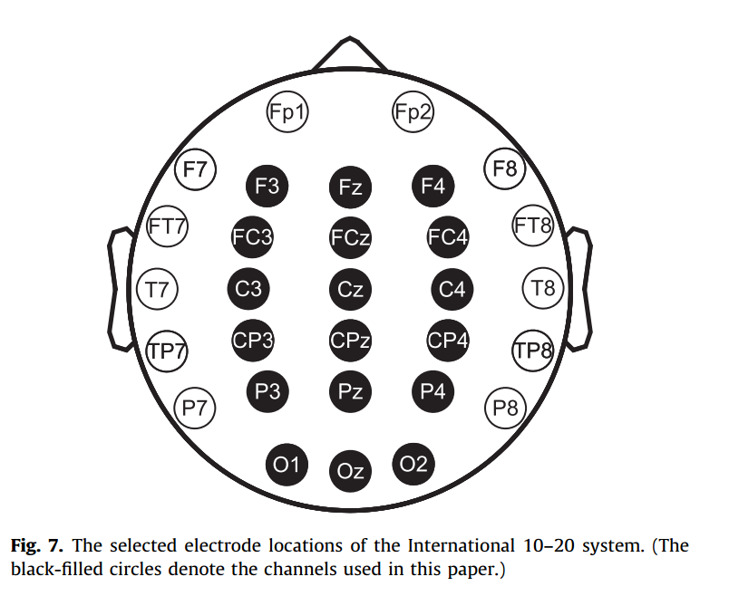
Person authentication from neural activity of face-specific visual self-representation
实验：用两种图片作为刺激，一种是自己的人脸图片，另一种是别人的人脸图片（包括他熟悉的和不熟悉的人），然后将观察到的特征与数据库中的记录进行一一对比
使用两种刺激收集到的脑电信号
实验所用导联

Slide 14
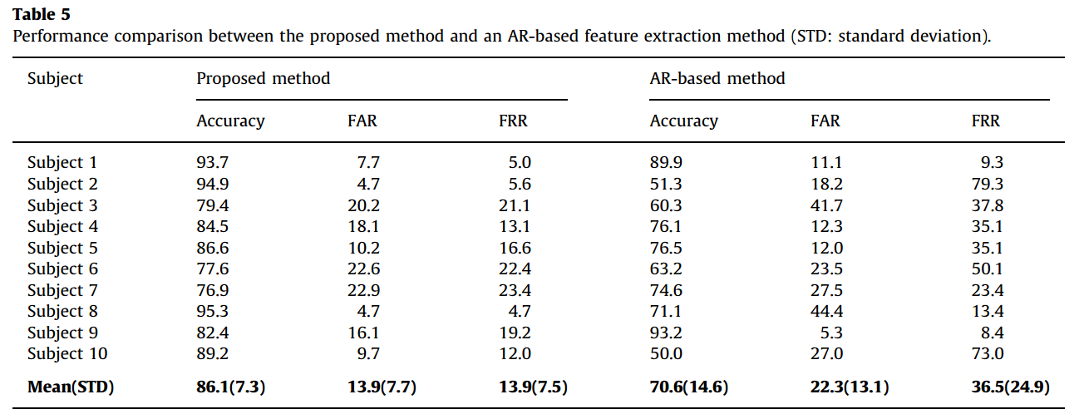
Person authentication from neural activity of face-specific visual self-representation
使用两种刺激收集到的脑电信号
所有受试者的平均准确率为86.1

Slide 15
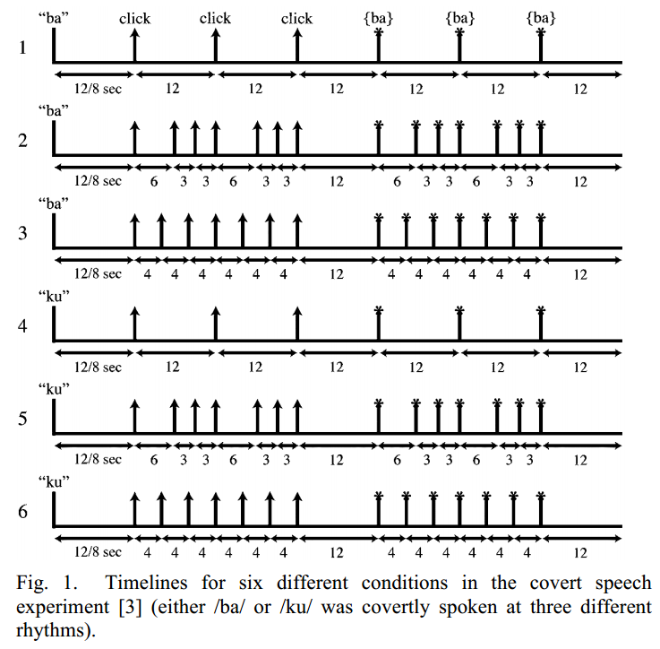
Subject Identification from Electroencephalogram (EEG) Signals During Imagined Speech
实验中用到了两个数据集，一个是自己收集的数据，另一个是用于测试作者提出的方法的通用性的数据集：EEG Database. (1999). [Online]. Available: http://kdd.ics.uci.edu/databases/eeg/eeg.html
对于自己收集的数据：6个受试者默念（ imagined speaking ）两个音节, /ba/ 或/ku/ ，同时收集他们的脑电数据；之所以选择这两个音节，是因为它们没有语义
（ classification would be performed on the imagined speech instead of the semantic contribution to imagined speech production ）
受试者被要求按一定的节奏默念这两个音节（ in each trial, a syllable (either /ba/ or /ku/) was heard through a set of Stax electrostatic earphones followed by a series of clicks at the desired rhythm for the imagined speech. Approximately 1.5 seconds after the last click, the subject was to begin to imagine speaking the spoken syllable at the given rhythm ）

Slide 16
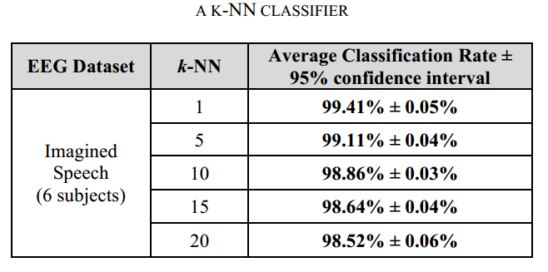
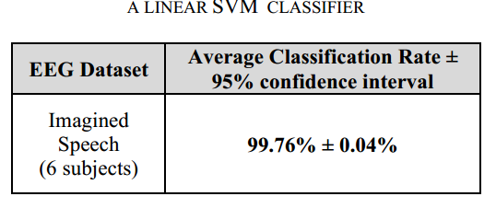
Subject Identification from Electroencephalogram (EEG) Signals During Imagined Speech
分类结果
using the linear SVM classifier for an average classification rate of 99.76%

