Slide 1
Ecopot

Slide 2
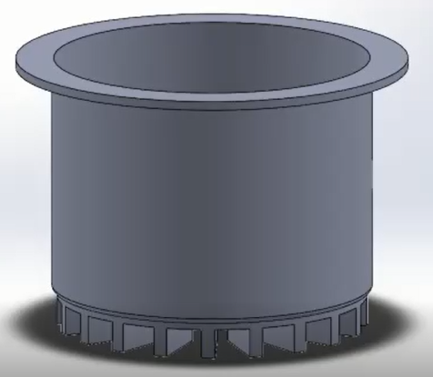
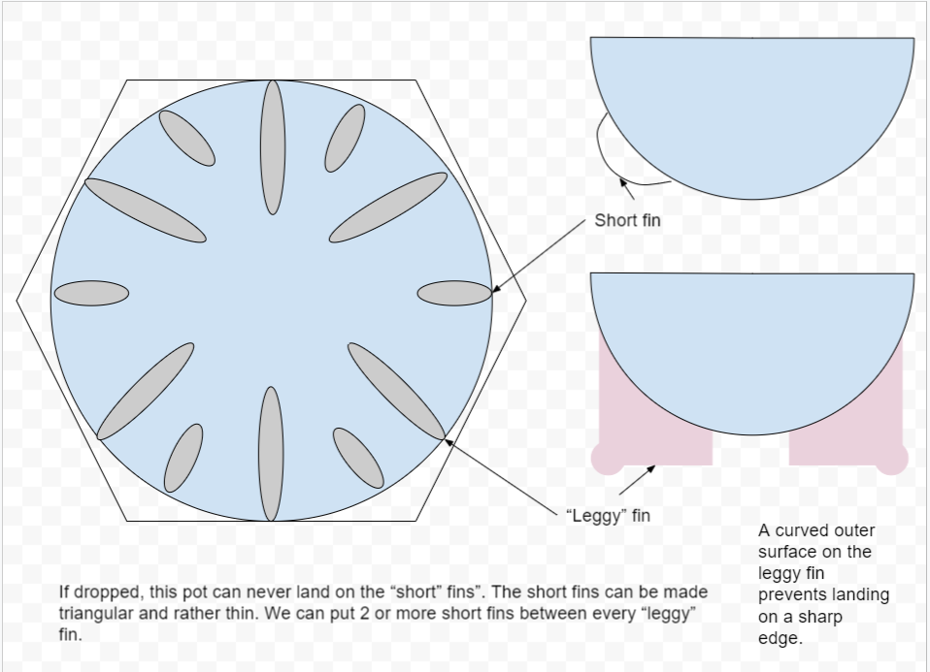
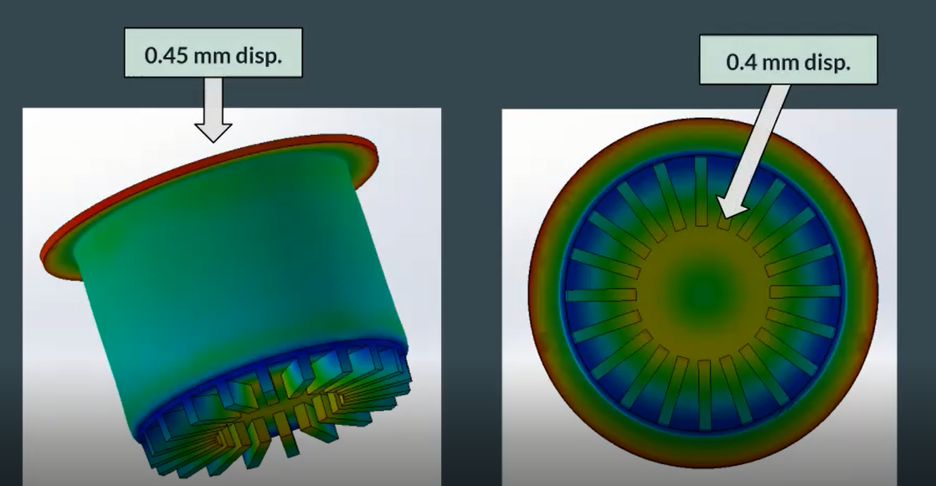

Slide 3
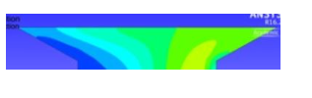
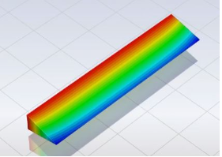
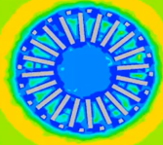
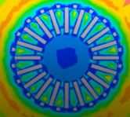

Shape of fins
Arrangement of fins
Top of the pot/handles
Heat transfer within the pot – primary and secondary air inlet
Uniform heating at the bottom of the pot
3
1
2

Slide 4
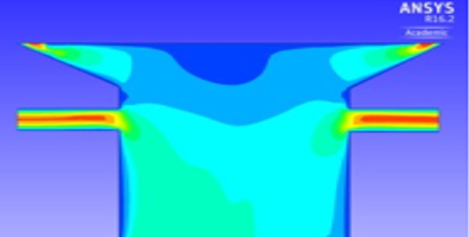
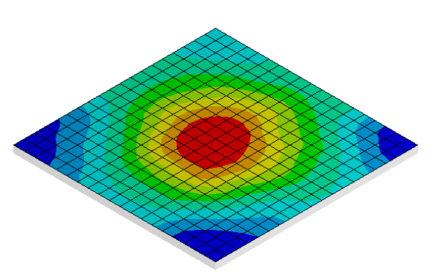
4- Modifying the pot design to prevent excess pressure buildup within the pot
5

Slide 5
To do….
1) Fin arrangement + theory
2) Lid of the pot
3) OpenSCAD

