Slide 1
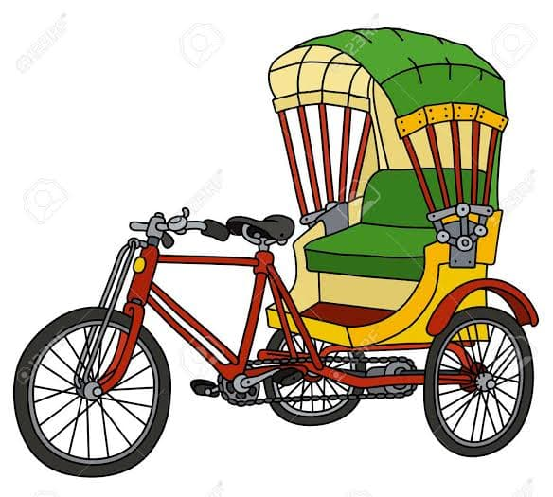
Online Rickshaw Booking Management System Informtion Gathering & Interview Presented By : Family Matters Name: Anamika Goswami Id : CSE 063 07384 Name : Parvez Ahmed Shopnil Id : CSE 063 07391 Name : Romana Khondoker Id : CSE 063 07472

Slide 2



Objetives:
interviews questins.
Easily track the information of all users.
Initialize the problem of time management.

Slide 3



Objetives:
Facility required to the passenger.
Understanding the client and organizer opinions.
Create DFD(Data Flow Diagram) & Use case diagram.

Slide 4



Questionnaires & Interview Pattern:
Interview
Questionaries
Investigation

Slide 5
Selection of Interviewe
Team: Hackers
Nahid Hasan Munna
Mostak Ahmed
Abu Adnan Joy
Stamford University Bangladesh

Slide 6
Interview structure
6 open ended question
4 close ended question

Slide 7
Interview Question:
1. What difficulty are you experiencing in your system?
Ans: The time consuming process facing trouble problems is the main problem in this system.
2. What is the purpose of reservation system?
Ans:The purpose of the reservation system is easily booking, it can save time and less trouble
3. Will there be any report or statistic generated daily?
Ans: Computerized summary reports, i.e trips of the day how many passengers about the rickshaw and the amount collected for the day.

Slide 8
Interview Question:
4. If there is a single system combining all the rickshaw operators activities, do you think it will benefit the public?
Ans: Yes, it will benefit the public.
5. Do you think by having a collaborated Online Rickshaw booking System web portal will case the ticketing process in the operation unit?
Ans: Yes, a collaborated online rickshaw booking system will case the ticketing process.
6. Does booking online cost you more?
Ans: The price of the booking is exactly what I would not from the rickshaw operator, However they do charge a nominal service free.

Slide 9
Interview Question:
7. What more benefits you want to get from such a system?
Ans: System should be much smoother online-based communication media between the authority and the customer and system should operator 24/7.
8. How can you get a returned in case you cancel your booking?
Ans: I call their call enter and confirm for cancelation.
9. Do you prefer bKash for payment system?
Ans: Yes.
10. Is this system solve the traffic problem?
Ans: Yes,may be it can.

Slide 10
Questionnaries
Total question: 9
All are specific question

Slide 11
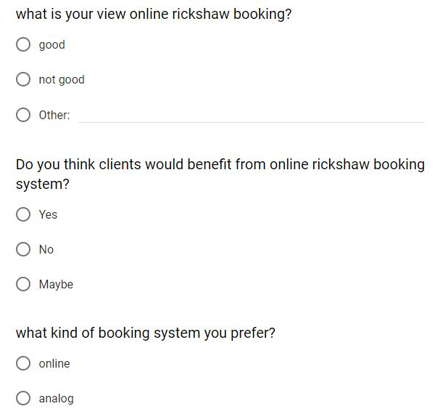
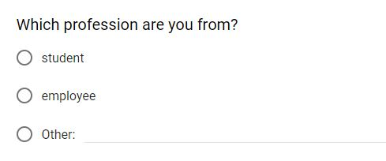
Questionnaries:

Slide 12
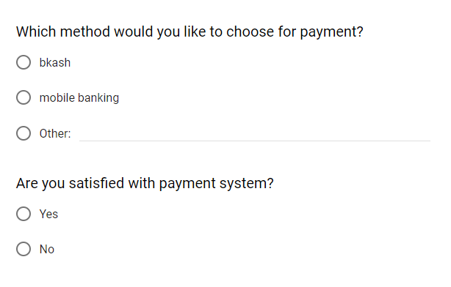
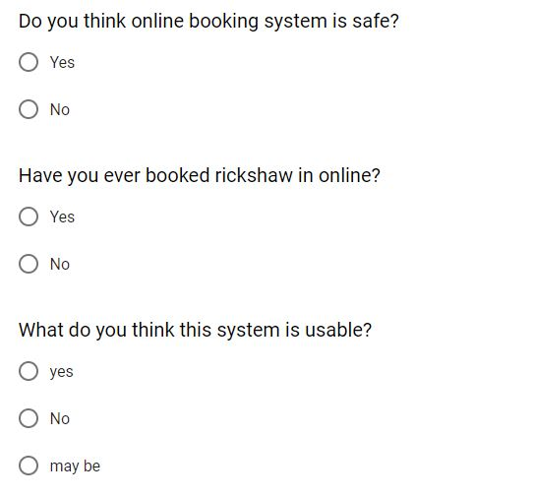
Quesinarries:

Slide 13
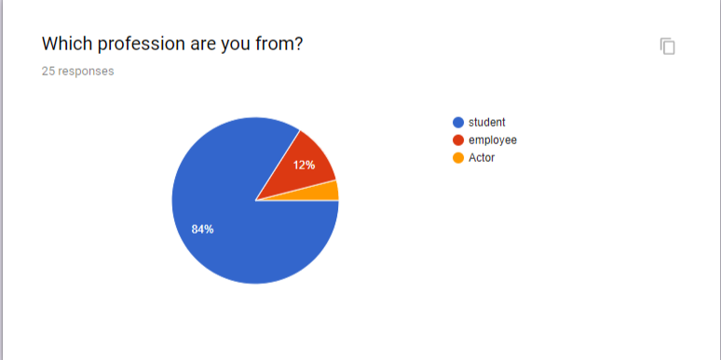
Survey Results
Which profession are you?

Slide 14
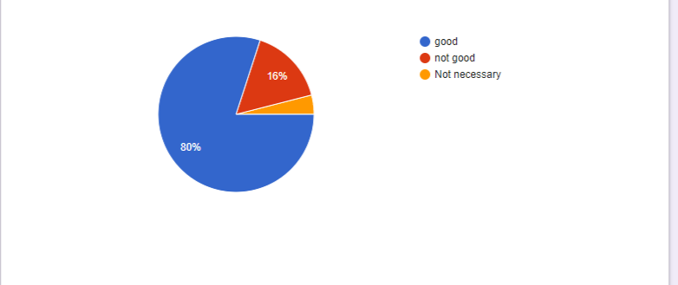
Survey Results (continued):
What is your view online rickshaw booking?

Slide 15
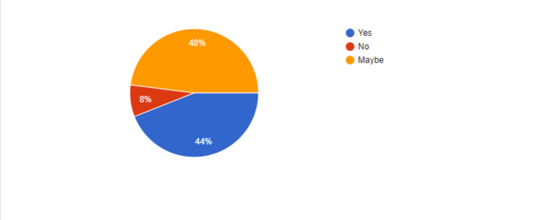
Survey Results (continued):
So you think clients would benefit from online rickshaw booking system?

Slide 16
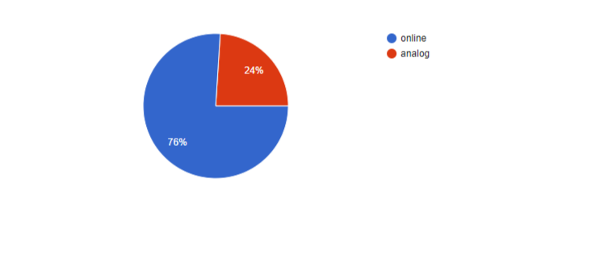
Survey Results (continued):
What kind of system you prefer?

Slide 17
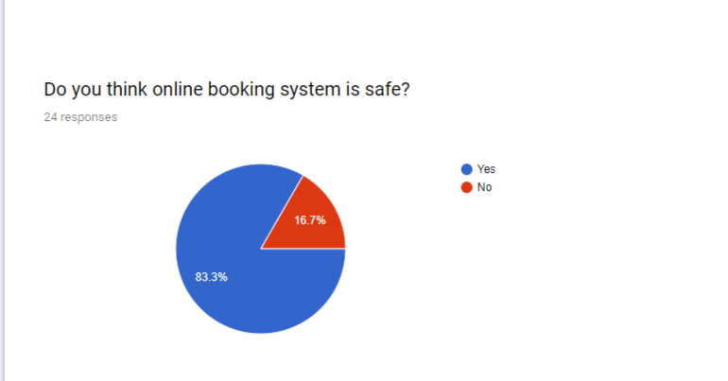
Survey Results (continued):
Do you think online booking system is safe?

Slide 18
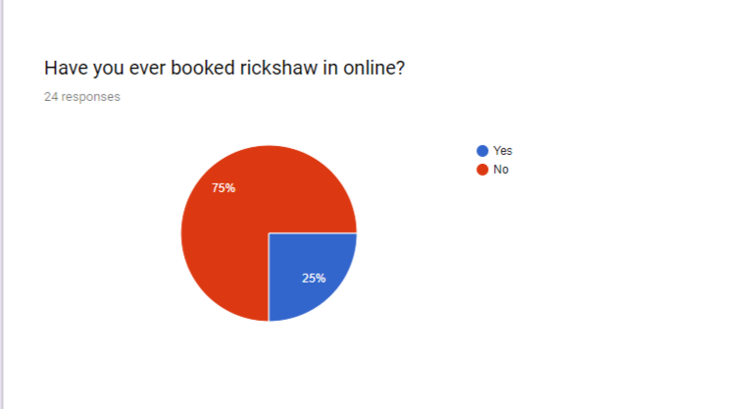
Survey Results (continued):
Have you ever booked rickshaw in online?

Slide 19
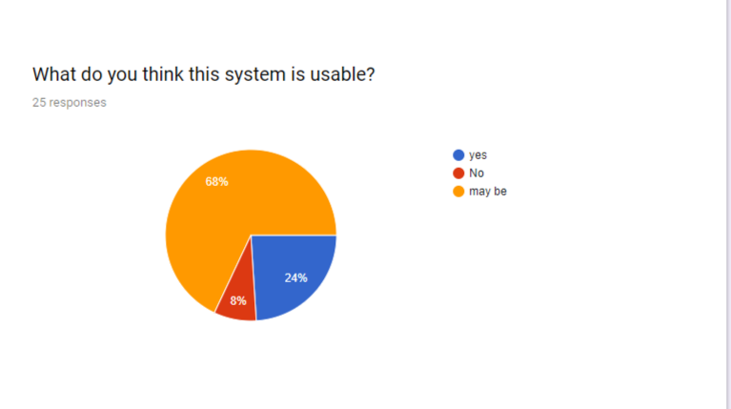
Survey Results (continued):
What do you think this system is usable?

Slide 20
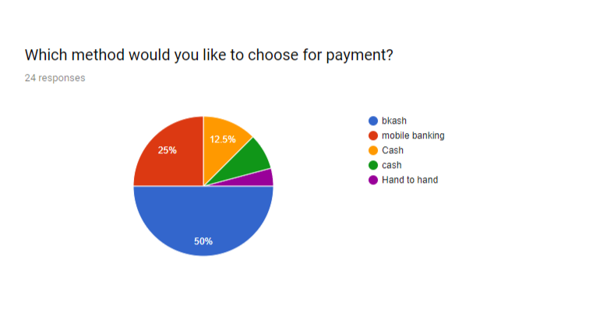
Survey Results (continued):
Which method would you like to choose for payment?

Slide 21
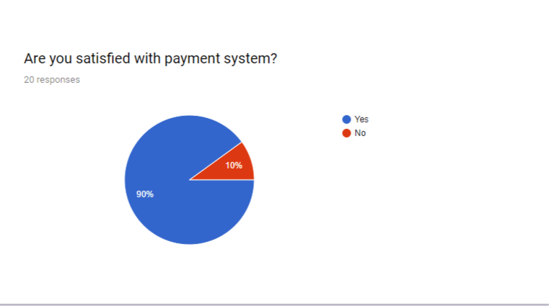
Survey Results (continued):
. Are you satisfied with payment system?

Slide 22
Investigation
In Bangladesh the capital city Dhaka, known as the “Rickshaw Capital of the world”.
Urban employment in Bangladesh also largely depended on rickshaws.
Cycle rickshaws are the most popular modes of transport in Bangladesh.
They were introduced here about 1938.

Slide 23
Requirement Analysis:
People prefer Online booking system more than Analog booking system.
The system is usable & safe.
People chose bKash for payment.
Cost will be normal.

Slide 24
Summary
Online based booking
System of evaluate performance of rickshaw puller and users.

Slide 25


