Slide 1
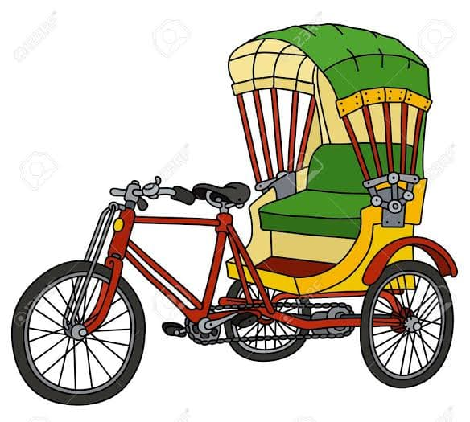
Online Rickshaw Booking Management System Presented By : Family Matters Name: Anamika Goswami Id : CSE 063 07384 Name : Parvez Ahmed Shopnil Id : CSE 063 07391 Name : Romana Khondoker Id : CSE 063 07472

Slide 2
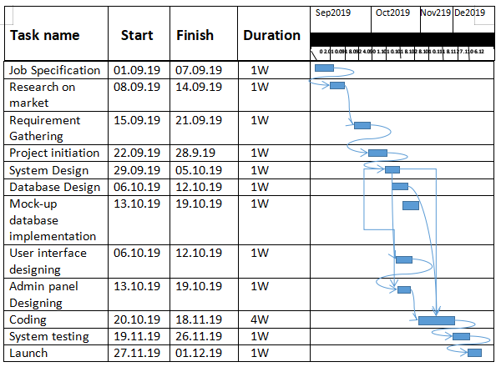
Intoduction :
What is Online Rickshaw booking management system ?
Types of a Rickshaw
Managing Web based process of this project

Slide 3

Motivation For This Project
Solve daily traffic life Problem
Keep the Environment Noise-free
Make easy for User

Slide 4


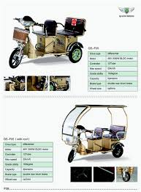
Features :
Web based User
Time schedule activities
Registration process

Slide 5



Features :
Real time Booking
Route management Source to Destination
Successfully activities

Slide 6
Feasibilites
System Feasibilities
Operational Feasibilities
Economic Feasibilities
Technical Feasibilities

Slide 7
System Feasibilities
Human and economic factor.
Possible solutions to the problems.

Slide 8
Operational Feasibilities
Existing business processes.
Maintenance
User Interface

Slide 9
Economic Feasibilities
Low Budget
Technical Cost
Other cost

Slide 10
Technical Feasibilities
Hardware
Software
Technology

Slide 11
Cost Benefit Analysis :
Client Sided
Coast & Benefit
Developer Sided

Slide 12
Cost benefit Analysis (Client)
Cost
Internet & Electrical Bill
Repair Cost
Other Cost
Benefit
Customer Satisfaction
Incensement of Customer

Slide 13
Cost benefit Analysis (Developer)
Costs
Programmer’s Time
Collecting Data & Information
Internet & Electricity Bill
Benefits
New Experience
Real Life Problem Solving
Payment

Slide 14
Project Scheduling :
Analysis
Planning
Construction
Deployment

Slide 15
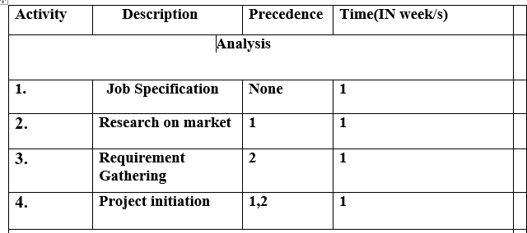
Analysis

Slide 16
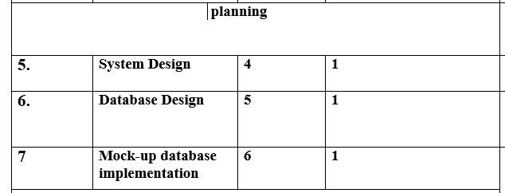
Planning

Slide 17
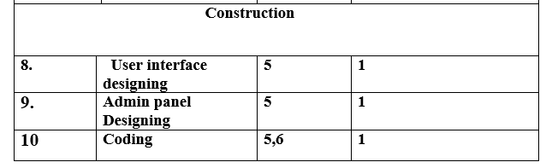
Construction

Slide 18
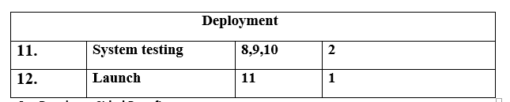
Deployment

Slide 19
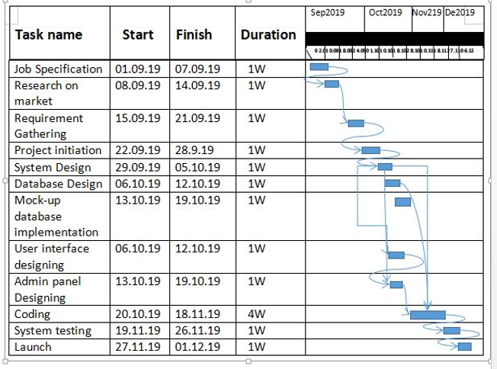
Gantt Chart

Slide 20
Risk Analysis :
Security of the database & registration.
Extra database must be initialized for back up
Security of the database & registration process will be top priority.

Slide 21

Thanks!

