Slide 1

Introduction to R Shiny
Day 1

Slide 2

Learning Outcomes – Day 1
Introduction: what is R Shiny?
Knowledge of packages often relevant to R Shiny work
Shiny app breakdown: UI, Server, Global scripts
Overall layouts – eg. sidebarLayout (sidebarPanel, mainPanel), navbarPage, tabPanel, fluidRow, column
Reading in prepared data
Creating charts and tables – ggplot, DT
shinyWidgets and Reactivity: radioButtons, drop-down menus, sliders
Multi-tab dashboards

Slide 3
What is R Shiny?
Shiny is an open source R package that allows the creation of interactive web applications straight from R
Shiny allows you to turn data analysis into interactive web applications without requirement for HTML, CSS or JavaScript knowledge
However with practice, your Shiny apps can be extended with basic CSS themes, HTML widgets and JavaScript actions
Shiny works in any R environment and comes with pre-built and customizable output widgets for displaying plots, tables, and printed output of R objects
Key point: functions associated with Shiny are generally written in CamelCase (unfortunately!)
Shiny power - check out some PHS Shiny dashboards:
ScotPHO Profiles Tool: https://scotland.shinyapps.io/ScotPHO_profiles_tool/
Covid Wider Impacts Dashboard: https://scotland.shinyapps.io/phs-covid-wider-impact/

Slide 4
R packages associated with R Shiny work
There are many packages you may find yourself using when creating a Shiny dashboard!
Some examples of key packages and their functions with R Shiny:
shiny – the package that allows all of this to be possible!
shinyWidgets – for action buttons, sliders, drop-downs, radio buttons and many more, check it out: https://shiny.rstudio.com/gallery/widget-gallery.html
shinymanager – securing and password protecting apps (great for pre-release access dashboards!)
shinyjs – for bringing basic JavaScript into R eg. enable and disable functions
shinyBS – create buttons and collapsible panels
shinycssloaders – for adding icon pictures to tabs
ggplot2, DT – for creating charts/tables
dplyr and readr – standard packages for data manipulation and reading/writing csv files

Slide 5
Shiny app breakdown
Shiny apps may either be contained within a single script (not recommended for full dashboard building) or split across multiple scripts.
Small apps are contained within a single script called app.R which requires three main components to run the app:
user interface object (defined as UI) which controls the layout and appearance of your app.
server function (defined as server) which contains the instructions your computer needs to build the app.
A call to the shinyApp function which creates Shiny app objects from an explicit UI/server pair.

Slide 6
The User Interface (UI)
The user interface (UI) controls what is displayed on the application page and how the components are laid out.
Examples:
navigation bars
text/titles
markdown elements
download buttons
plot outputs from server
user input widgets
Key point: Shiny uses the function fluidPage() to create a display that automatically adjusts to the dimensions of the users browser window. The above UI elements will generally be placed within this function.

Slide 7
The Server
The server-side controls everything that happens behind the scenes, for example, the data that will be displayed through the UI.
This part of the script defines how we generate all the plots and tables seen by the user.
It also defines how user inputs from our widgets (such as a user selecting from a drop-down menu) affects these plots and tables.
If necessary, the server section may also be used for minor data wrangling, such as filtering it in such a way that it can be fed into a plot.

Slide 8
Extra: the Global script
Although not applicable to small Shiny apps contained within one script, this section may become important when creating large dashboards where the UI and Server are placed into separate scripts of their own.
When creating a large and complex dashboard the three main components will be the UI, Server and Global scripts.
The Global script is generally used for loading packages and functions, and also prepared data files as named objects.
The Global script may also be used to define other things such as colour palettes and plot parameters.
Key point: adding this script helps to keep your code clean and tidy. When running the app, all packages, functions and data will be read in from the Global script, while the app itself is created from the UI and Server.

Slide 9

Any questions so far?

Slide 10
Code Along: the bare bones of a Shiny app
Open a new session on R Studio server
Go to File > New File > Shiny Web App…
You will be asked to give your app a name (pick anything you like eg. “Practice1”) and to set a file path (where you can save your practice scripts).
Ensure the Application type is set as “Single File (app.R)” as we are beginning with the basics.
Click “Create” and R should provide you with a basic sample Shiny app created using the classic “Old Faithful Geyser” dataset.

Slide 11
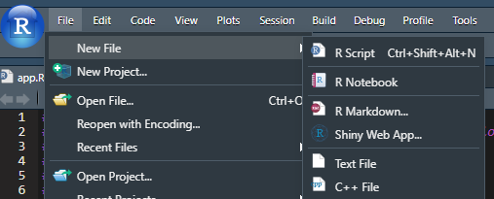
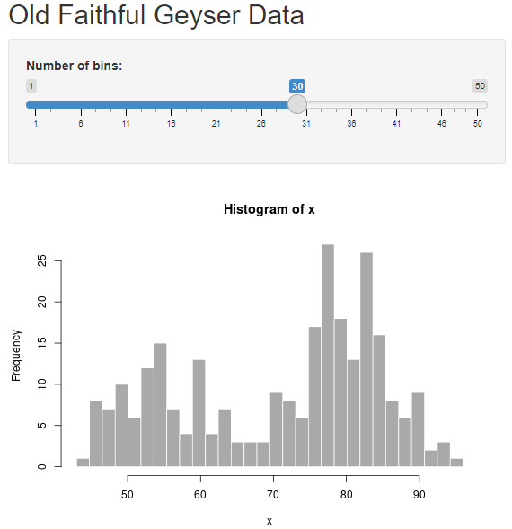
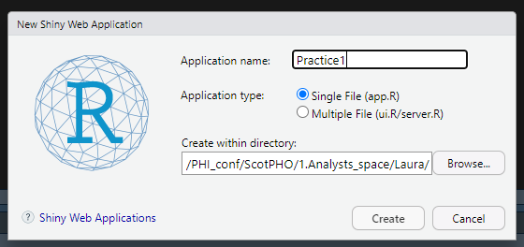
Code Along: the bare bones of a Shiny app
Upon creating the new Shiny Web App you will see some sample code related to the “Old Faithful Geyser” dataset.
Click “Run App” at the top right of the script window.
The app may run in a new window, or in the viewer pane (you can change between with the drop-down arrow at “Run App”).

Slide 12
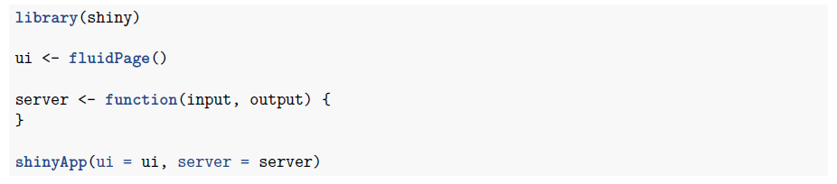
Code Along: the bare bones of a Shiny app
The Old Faithful Geyser data isn’t exactly the bare bones of a Shiny app, because it contains data and elements such as plots and slider inputs!
If we remove all code relating to Old Faithful Geyser, we are left with literally an empty app. The app will run, because we have the three components required (as defined in previous slides for Single File apps) but you won’t see anything at all.
This can be a good place to begin when starting from scratch. We can build an app up from nothing!

Slide 13
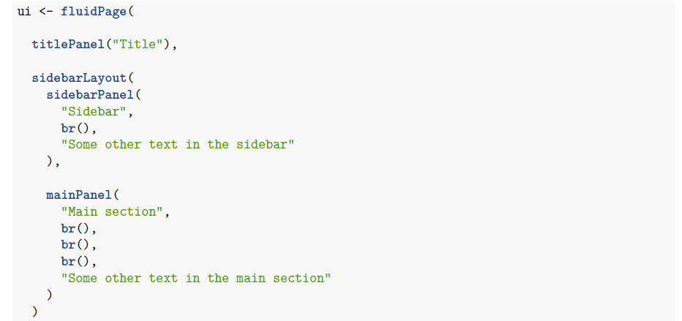
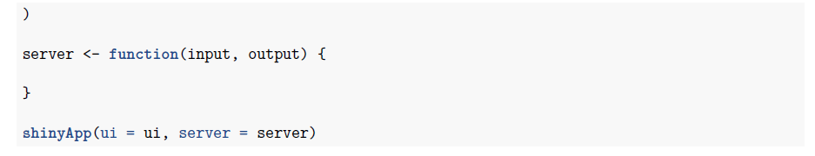
Code Along: the bare bones of a Shiny app
titlePanel() function creates text formatted as a title at the top of the app.
Let’s quickly add some gibberish to our empty app UI, just so you can see how certain Shiny functions can create new panels, sections and text which will appear in your app to the user, even when there’s no data. Try the code here, or adding whatever you want!
Remember: everything should go inside fluidPage()!
sidebarLayout() function is one of several layout options for Shiny and requires two arguments: sidebarPanel() and mainPanel() functions.
In the end, the sidebarPanel would contain user input controls (eg. slider, drop-downs) and the mainPanel would display the output (eg. chart or table).
br() function is used to separate text onto different lines.

Slide 14
Outcomes
We’ve seen from our Old Faithful Geyser sample app (and vaguely from our empty app) how the sidebarPanel() and mainPanel() functions work within sidebarLayout() to create different sections of the app, and how we can change the code in order to change what appears in these sections.
Now we’re going to load some sample data and slowly build up our own app which will include titles, radio buttons, drop-down menus, charts, tables and text. We’ll also try to split the outputs across multiple tabs using some Shiny functions you haven’t seen yet.
We’ll be using the nyc_dogs dataset which comes from the NYC department of health and contains the popularity of dog names in New York City.

Slide 15

Code Along: creating a functioning Shiny app
We’ll begin by loading the required packages and reading in our simple nyc_dogs dataset.
Next, we’ll work on forming a basic Shiny app from this dataset.

Slide 16
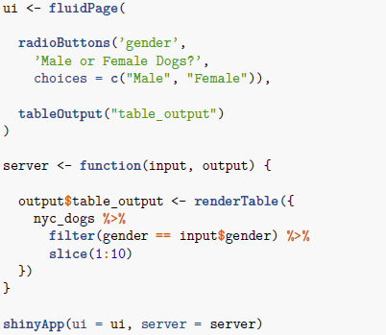
Code Along: creating a functioning Shiny app
First, we’ll add a radioButton to the UI which allows us to select the gender of the dog (either male or female), and display the output as a table. Remember that although the presence of the table output is defined in the UI, the table itself must be created in the server.
The radioButtons() function requires three arguments here:
radioButtons(inputId, label, choices = NULL)
The inputId will be used to access the value. In this case the gender column of the dataset.
The label argument is what we choose to name our radioButton. In this case “Male or Female Dogs?”.
The choices argument is a list of values to select from, from within the column we have chosen as the input. In this case we list Male and Female.
The tableOutput() function requires only one argument:
tableOutput(outputId)
We will define this outputId in the server, where we create our table.

Slide 17
Code Along: creating a functioning Shiny app
Now we’ll look at what needs to be in the server. This is where we define what should be included in the table output that will appear on the user interface.
Within the server function, we are creating a table output object. In the UI code, the table is labelled as “table_output” and this must match in the server.
To create this object we use the renderTable({}) function to select our dataset. We state that we want to filter by gender, but that this should be based on whatever the user inputs:
gender column is equal to “input$gender”.
This reflects whether the user inputs male or female to the radioButton.
We have also included slice(1:10) so we only see the first 10 rows of the data.

Slide 18
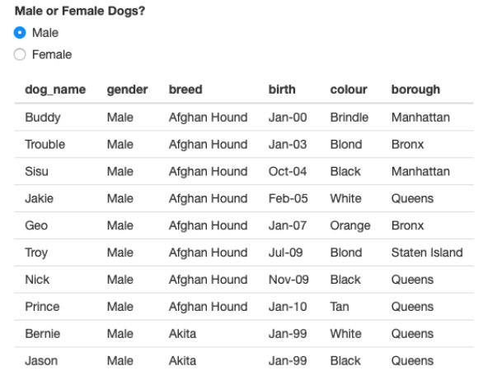
Code Along: creating a functioning Shiny app
Running your app will result in a table that looks like this, where you can select the first 10 male or female dogs using the radioButton.
However, it’s very basic and doesn’t give us any real options to sort or search the data. So let’s do that using the dataTableOutput() and renderDataTable() functions from the DT package.

Slide 19
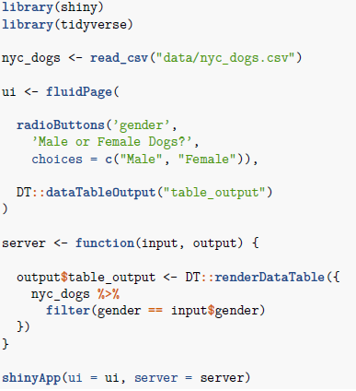
Code Along: creating a functioning Shiny app
Our code is much the same. However in the UI we are using: DT::dataTableOutput(“table_output”) instead of tableOutput(“table_output”) And in the server we are using: DT::renderDataTable({…}) instead of renderTable({…})
Using DT to sort and search our data also means we no longer need the slice(1:10) function in the server.

Slide 20
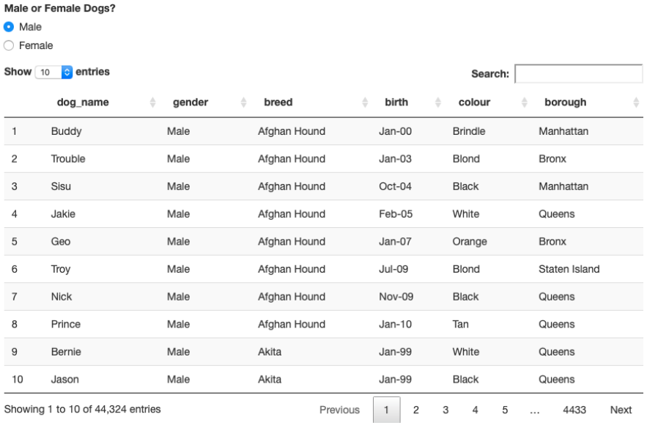
Code Along: creating a functioning Shiny app
Your app will now look something like this, where you can sort the data in the table and search through it:

Slide 21
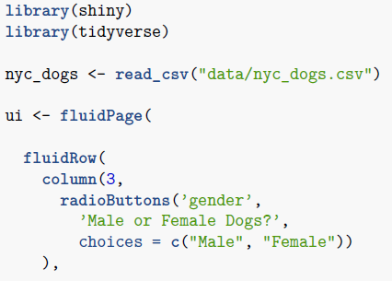
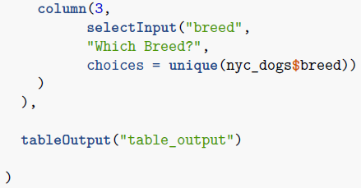
Code Along: creating a functioning Shiny app
Let’s get rid of DT and add some filtering options of our own to the data table using more Shiny functions.
Here, we introduce fluidRow() which creates a grid-like layout for our app in conjunction with the column() function.
We’ve used radioButtons() before, but now we’re also going to add a drop-down menu to select breed using the selectInput() function.
As with radioButtons(), the selectInput() function requires three arguments here:
selectInput(inputId, label, choices)
The inputId accesses the value. In this case, the breed column of the dataset.
The label argument is what we choose to name our drop-down. In this case “Which Breed?”.
The choices argument is a list of values from the input column. In this case, rather than list all breeds, we tell R to look for unique values from the breed column of our dataset: “choices = unique(nyc_dogs$breed)”

Slide 22
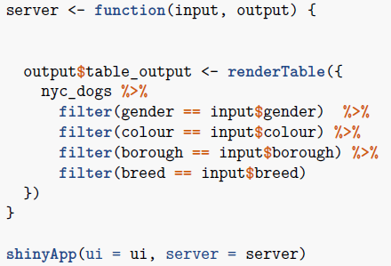
Code Along: creating a functioning Shiny app
We also have to add this new breed filter to the server side, if we want it to function on the app!

Slide 23
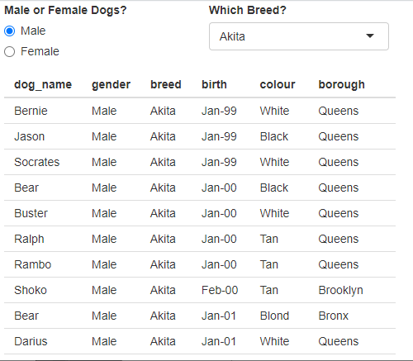
Code Along: creating a functioning Shiny app
We now have an app which displays our data table with an option to select the gender of dog, and a drop-down menu to filter by breed.

Slide 24
Exercise: creating a functioning Shiny app
Add two more drop-downs to the app we have which allow you to filter for:
Borough
Dog colour
Have a look at https://shiny.rstudio.com/gallery/widget-gallery.html to see the types of widgets available to use in Shiny apps

Slide 25
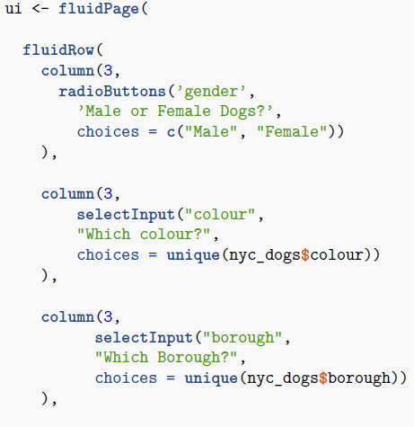
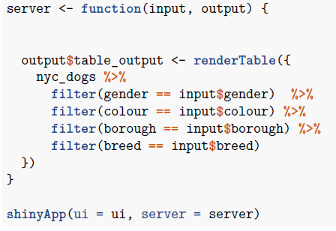
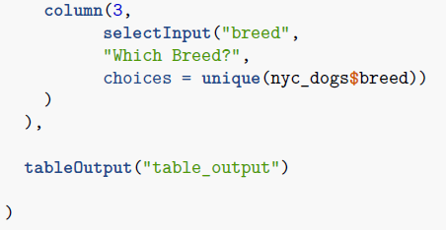
Answer: creating a functioning Shiny app
UI
Server

Slide 26
Code Along: creating a functioning Shiny app
We’re now going to add some charts to our app in order to better display the data!
We’ll be using some basic ggplot2 knowledge to create the charts.
Our app should have a radioButton for selecting gender, and a drop-down menu for selecting breed. We will aim to include bar charts for borough and dog colour, instead of displaying the data in a table.

Slide 27
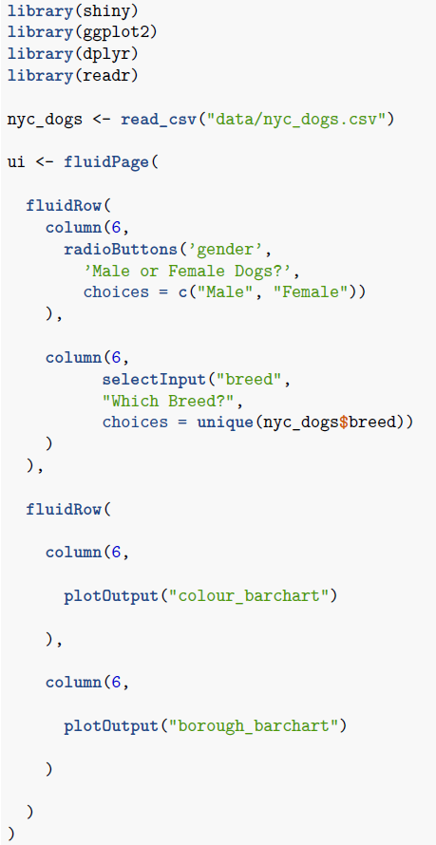

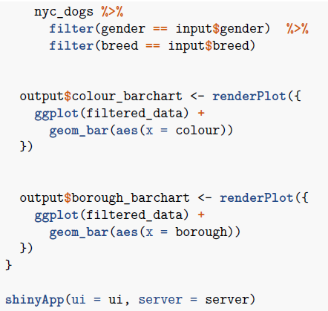
Code Along: creating a functioning Shiny app
UI
We use plotOutput() in the UI to display our charts which are created in the server using renderPlot({}). Remember the plot output labels must match in both sections.
In the server, we also create an object called “filtered_data” from our dataset, so that we do not have to repeat chunks of filtering code for each bar chart.
But what happens when we run this code?
Server

Slide 28
Reactivity
When we run the previous code, we get an error.
Do you need to wrap inside reactive() or observer()?
We’ve tried to use regular R code to filter our data so that it can be used for both plots but we need the filter for this object to be reactive depending on what the user inputs.

Slide 29
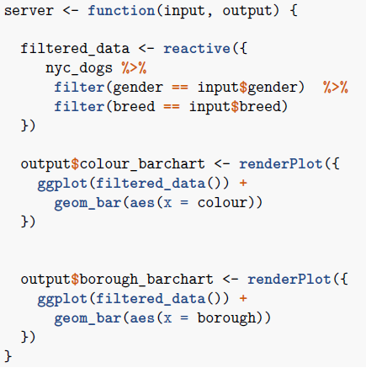
Code Along: creating a functioning Shiny app
We can fix this by wrapping our filtered data in reactive({}).
This defines our filtered_data variable as having a reactive value, and so when used later on in the code for chart creation, it must be followed by brackets:
filtered_data()

Slide 30
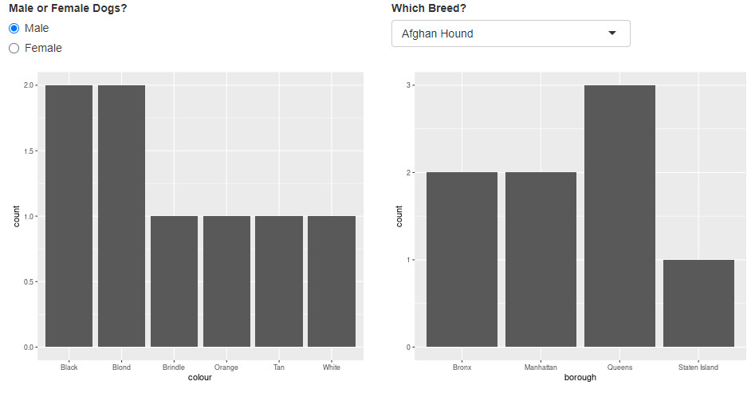
Code Along: creating a functioning Shiny app
Our app should now look like this, where the bar charts are reactive to selections made by the user either by the radioButton or the drop-down menu.

Slide 31
Code Along: creating a functioning Shiny app
So far, we’ve created an app which displays our NYC dogs data in a table, which can be filtered based on radioButtons and drop-down menus we’ve created.
We’ve also created an app which displays our NYC dogs data in bar charts, which are reactive to our selections using radioButtons and drop-down menus.
What if we want to display our data using both tables and charts? We can create a multi-tabbed dashboard!
This introduces the Shiny function navbarPage() which creates a navigation bar along the top of the app, and tabPanel() which is used to create different tabs within the navigation bar.

Slide 32
Including multiple tabs in your dashboard
When it comes to creating a dashboard with multiple tabs all displaying different information, we need to do quite a lot of nesting of functions within other functions to ensure the dashboard displays correctly.
So far we have used fluidRow() and column() to display our input selections and data displays (for charts and tables) in a grid-like pattern.
In order to have, for example, charts in one tab and the table in another, we need to wrap each of these code blocks (one for charts and one for tables) inside it’s own tabPanel() function.
These tabPanel()s then need to be nested inside the navbarPage() function which creates the overarching navigation bar along the top of the app.

Slide 33
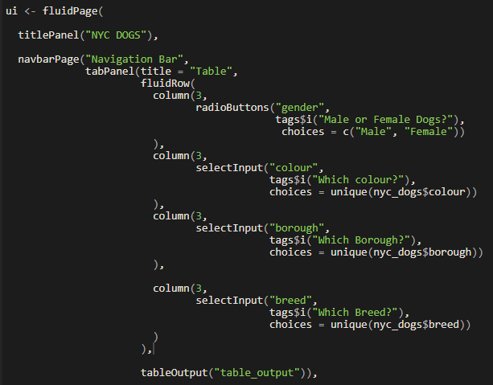
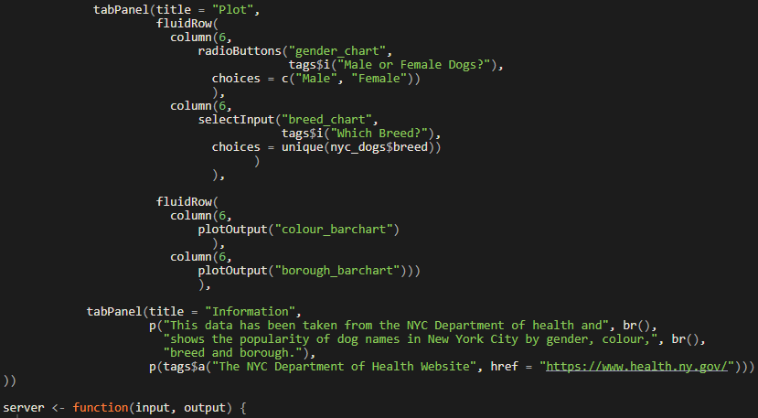
Code Along: multiple tabs UI
Within our fluidPage(), I’ve created a navbarPage() to introduce a navigation bar, and nested three tabPanel() functions within this, each containing some of the code used before. This splits our app into three separate tabs placing a table on one, charts on another, and some text information on the third.
Note these input changes for later.

Slide 34
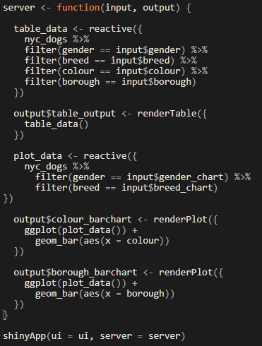
Code Along: multiple tabs Server
In our server, we’re creating a reactive object for the table called “table_data” including the relevant filters we want, and we’re using this for our table output.
Similarly we’ve created a reactive dataset for the plots called “plot_data” with the filters required which will be read into our plot outputs.
We noted in our UI that for our plots tabPanel, we had to change the inputId for our radioButton and selectInput drop-down. We’ve also changed this input name in the server.
This is because you can’t have two radioButtons or selectInputs (or any shinyWidgets) with the same inputId, the second one will simply be ignored and our charts, despite being on a separate tab, would end up changing in line with the user input on the tables tab.

Slide 35
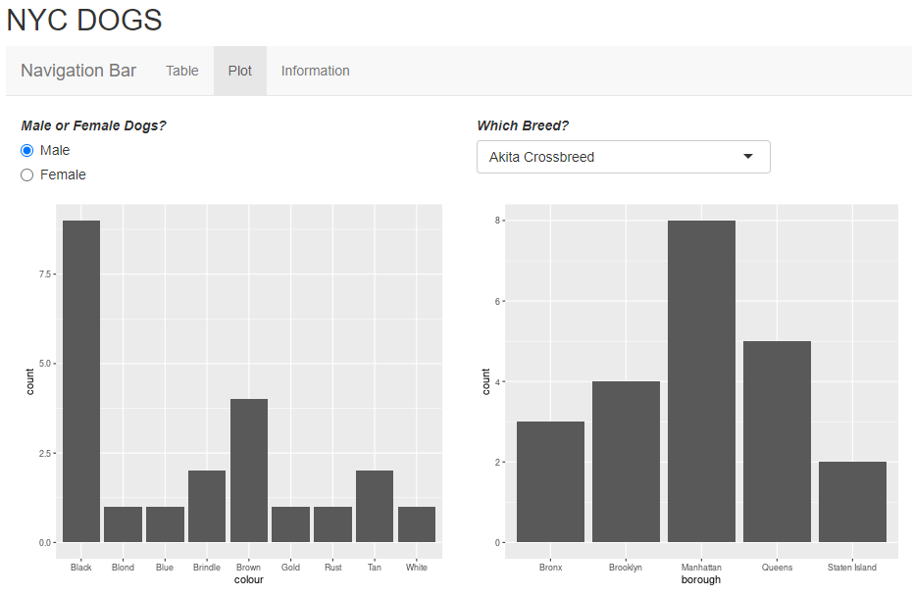
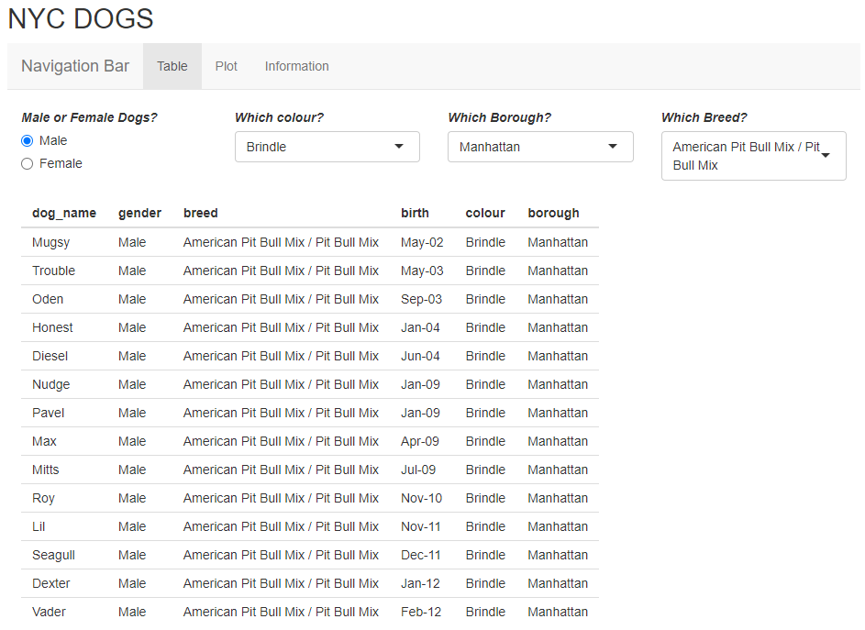
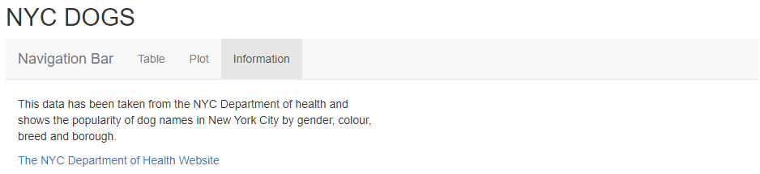
The end product

Slide 36
Shiny themes and icons
Now each of us has a functioning dashboard, but they most likely all look very similar.
Thankfully we can use basic HTML and CSS to set fonts and themes for our dashboard and insert icons in the navigation bar for each section.
Shiny has a variety of ready made themes that can be used in your dashboard, try out the theme selector: https://shiny.rstudio.com/gallery/shiny-theme-selector.html
There are also a variety of icons that can be added to your Shiny dashboard using Font Awesome and Glyphicon: https://fontawesome.com/v5.15/icons?d=gallery&p=2
(remember that some icons may be trapped behind a paywall, but many are free!)

Slide 37
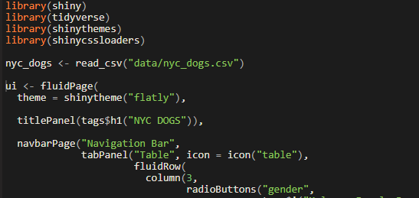
Shiny themes and icons
In order to use themes and icons, we need to load two more packages:
> library(shinythemes) > library(shinycssloaders)
Adding themes is easy, we just need a line of code at the start which sets the theme using the shinytheme() function.
See shiny theme selector link for themes.
Wrapping our “NYC DOGS” title in “tags$h1()” is basic HMTL to set the text as HEADER 1. You could also use something like “tags$i(“NYC DOGS”)” to make the text italic.
“icon =“ is an argument within the tabPanel() function we haven’t used until now. We can use this argument to add icons to each of our tab panels. For my tab displaying the table, I’ve used the icon() function to set the icon as “table”.
See Font Awesome link for icons.

Slide 38
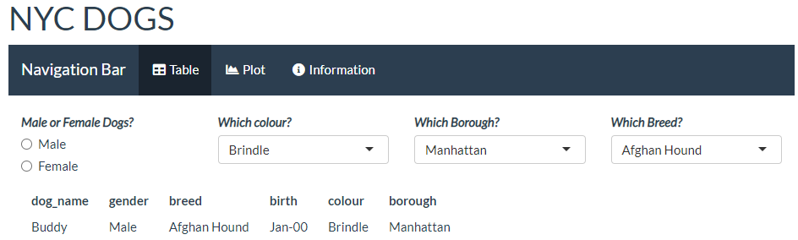
Exercise: Shiny themes and icons
Now my Shiny app looks something like this, note the text formatting, theme and icons:
Take a look at the themes and icons links. Can you make your dashboard stand out? You can also have a play about with basic HTML to make your text bold, italic, underlined or anything else you can think of. Got good ggplot2 knowledge? Play with your chart styles!

Slide 39
Practice makes perfect
Today you’ve created a Shiny dashboard from scratch which contains tabulated data, charts and information text tabs. You’ve made the data reactive to whatever the user inputs and you have used different themes, icons and text formatting to make it stand out.
If you have time before our next session, try playing around with this dashboard.
Swap your fluidRow() and column() grid layouts for something else such as sidebarLayout(), sidebarPanel() and mainPanel() to see how the layout changes.
Try adding new tabs with different charts.
Attempt to make a similar dashboard for a whole new dataset.

Slide 40
Next time
Splitting big dashboards: UI, Server and Global scripts
Using multiple Public Health Scotland datasets
Use of specific Public Health Scotland colours and logos
Modals and help buttons
Data downloads
Deploying an app
The importance of using GitHub

Slide 41
End of day 1 – any questions?

