Slide 1



Colab Bootcamp + Your First Time Series
WEEK 1 · DAY 1
Open Google Colab, load satellite-style data, draw your first time-series chart
Publica
Academy
Notes:
Welcome. By the end of today everyone has opened Colab, loaded data and drawn a chart.

Slide 2

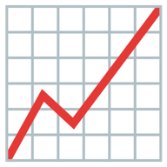
Today's mission: three moves
Open Colab
Load the data
Draw the story
Python in your browser
3 years of Ka-band availability
find the rainy-season dip
10 min hook · 30 min slides · 60 min hands-on · 20 min wrap-up
Notes:
The hands-on block is the main event.

Slide 3


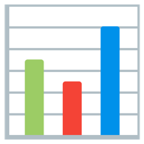
Every “Up NEPA!” is a data point
A time
A value
= a time series
every hour, 00 to 23
light on (1) or off (0)
values recorded in time order
Notes:
Ask how many hours of light they had yesterday. A time + a value in order = a time series.

Slide 4
Colab Bootcamp
PART 1
Your free Python computer inside Chrome
Notes:
Everyone opens Chrome and signs in to Google.

Slide 5

Your laptop shows the screen. Google's computer does the work
Your laptop
Google's computer
Your answers
only needs Chrome
Python + pandas ready
tables and charts
Like a cyber café computer, but free
Notes:
Nothing to install.

Slide 6



Colab's 3 golden rules
1. Save a copy first
2. Top to bottom
3. Confused? Restart
File → Save a copy in Drive
Run cells in order: Shift + Enter
Runtime → Restart session and run all
Notes:
Make everyone do Rule 1 now.

Slide 7


NameError = “I don't remember”
Colab remembers
After a restart
Every variable you created, until a restart or a long idle
Memory is wiped. Run STEP 0 and the cells above again
Notes:
Demo it live.

Slide 8


The AI button: help yes, restricted data never
OK to paste
Never paste
Course training data (synthetic), your code, error messages
Real NIGCOMSAT telemetry, RF records, network logs, customer data
Notes:
If unsure, describe the shape of the data instead of pasting it.

Slide 9
What is a time series?
PART 2
One idea that unlocks the whole course
Notes:
Section break.

Slide 10
Order carries the information
In time order: the rainy-season dip is visible
Same 36 numbers, shuffled: no story
Notes:
Same numbers, no story. That is the definition of a time series.

Slide 11
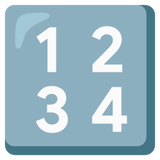

Every time series has 3 things
A timestamp
A value
A cadence
when it happened
what was measured
hourly · daily · weekly · monthly
Notes:
Timestamp, value, cadence.

Slide 12
Meet NigComSat-1R
Nigeria's communications satellite at 42.5° East
28
≈36,000 km
C·Ku·Ka·L
15 yrs
active transponders
above the Earth
frequency bands
design life (launched 2011)
Notes:
Course data is synthetic but built to behave like this satellite.

Slide 13
Today's data: Ka-band availability, monthly average
1,096 daily rows · dips every rainy season (Ka-band rain fade)
Notes:
Point at the dips. Same reason DStv freezes in heavy rain.

Slide 14
The 3-line pandas recipe
ka = pd.read_csv(data_path("ka_band_availability_daily"),
parse_dates=["timestamp"], # text -> dates
index_col="timestamp") # time = row label
ka = ka.asfreq("D") # gaps show up as NaN
.asfreq() makes missing days appear instead of silently disappearing
Notes:
Walk through each line.

Slide 15
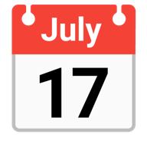

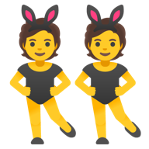

Inspect new data like a tokunbo car
Rows?
Range?
Gaps?
Duplicates?
Missing?
Notes:
The five profiling questions.

Slide 16

Satellites speak UTC. Lagos speaks WAT
21:00 UTC
22:00 WAT
telemetry: eclipse time
Lagos/Abuja: UTC + 1, no daylight saving
Notes:
Convert to one time zone before joining tables.

Slide 17



The 4 characters in every series
Trend
Seasonality
Cycle
Noise
the long direction
fixed calendar repeat
ups and downs, no fixed length
random wobble: don't react
Notes:
Seasonality has a fixed calendar; a cycle does not.

Slide 18

Your turn: 60 minutes
1
Open W1D1-exercise in Colab
2
File → Save a copy in Drive
3
Run STEP 0, then top to bottom
4
Replace every ___, run, get the green tick
Notes:
Walk the room.

Slide 19


What you now know
Colab: save a copy, run top to bottom, restart when confused
Time series: order matters (timestamp + value + cadence)
Recipe: parse_dates → index_col → .asfreq()
Next: Charts That Don't Lie
Notes:
Tease Day 2.

