Slide 1
ClaimGuard
A copilot that helps a claims officer understand a claim, decide, correct it and revalidate it, with every step on record
Mentor session
Sunday 18 October 2026. Everything built since the Phase 1 submission, measured, with what is not done said plainly.
Notes:
Open by saying the goal in the mentor's words: a trustworthy, explainable copilot for claim pre-validation, not a production RCM platform. The deck follows his workflow in section 3.

Slide 2
Your email of 16 October, point by point
# | What you asked for | Where we stand
1 | Human in the loop: confirm, dismiss with reason, request information, correct and revalidate, prioritised and traceable | Built. Lanes and a transparent score, four-eyes on high severity, full audit trail
2 | All 15 rules right; extra rules kept apart from the benchmark | F1 1.00 on 600 public claims. 8 advisory rules in a separate pack
3 | AI that helps a claims officer, grounded, with a plan for wrong output | Explainer, correction assistant, what-if, reviewer summary, feedback analysis
4 | R006 as documented; three public claims to review together | Kept as documented. Three claims to discuss (slide 22)
5 | Authorization aggregated per claim; cross-claim only as an extension | R009 per claim. Cross-claim is advisory rule E102, separate
6 | Pre-validation clearance, not payer approval | Wording fixed in the console. Auto-clear exists, off by default, audited
7 | Keep the JSONL schema; confidence null, not_probabilistic | Unchanged and enforced in the audit log
8 | One convincing end-to-end workflow | Six steps run in the console (next slide)
Notes:
Walk the table top to bottom. Points 4 and 6 contain questions for the mentor.

Slide 3
The workflow you described, running end to end
1
2
3
built this week
Claim received and validated
Errors, doubts and evidence
Copilot explains and advises
FHIR, CSV, JSONL, PDF or photo. 15 rules, 0.19 ms per claim
FAIL, or UNABLE_TO_ASSESS when data is missing. Each finding cites claim paths
Summary, what to ask or correct, never an invented value
4
5
built this week
6
Officer decides
Correct and revalidate
Traceable, with limits shown
Confirm, dismiss with a reason, request information. Seniors for high severity
What-if first, then a new version. The original stays untouched
Signed audit trail, both versions side by side, measured accuracy
All numbers in this deck come from commands you can re-run. Anything simulated says so on its slide.
Notes:
Steps 3 and 5 are what was added this week. Everything else existed and was measured earlier.

Slide 4
How the system fits together
Inputs
FHIR, CSV, JSONL, PDF, photo
Intake
validate, quarantine, reader sandbox
Rule engine
15 rules, YARA-X, 0.19 ms
MongoDB
claims and results sealed at rest
Redis Streams
consumer group, concurrency cap
New version
corrected claim, validated again
Decision
badge, reason, four-eyes
Console
inbox, copilot, what-if, recheck
Dispatcher
lanes, leases, personal inboxes
AI explanation
breaker, budget, cache, grounding guard
Records and people
Review log
hash-chained, signed
Security log
every access and decision
Ledger
Ed25519 checkpoints, Merkle proofs
Access control
4 clearance levels, pseudonymised identifiers
Notes:
Trace one claim left to right. MongoDB is the truth. Redis only carries work; losing it loses nothing because the outbox marker stays in MongoDB.

Slide 5
Rule correctness: the 15 reference rules, measured
1.00
0 of 3,015
0.19 ms
10,600
F1 on all 600 public claims (400 development, 150 validation, 50 stress)
clean results wrongly flagged. 95% bound on false-alarm claims: 1.9%
per claim in the rule engine. The model, not the engine, is the slow step
claims on which the Rust engine agrees exactly with the Python reference
Edge cases and uncertainty
Kept apart from the benchmark
Missing data gives UNABLE_TO_ASSESS, never PASS
Boundaries inclusive, ROUND_HALF_UP, 0.01 SAR tolerance
R006 exactly as documented: code, date, modifier
R009 aggregates per authorization within one claim
8 advisory rules (E001 to E005, E101 to E103) in their own pack, file and schema
Reference JSONL unchanged: confidence null, not_probabilistic
A test pins the official results to their recorded values
Public set is synthetic: a perfect score is not proof for real claims
Notes:
Be upfront: the public set is synthetic and small. Nine of fifteen rules have no failing example in the 50-claim split, which is why the 150 and 400 splits are reported beside it.

Slide 6
Claims arrive in any format, untrusted until proven
FHIR bundle
authorization record not carried, so those rules abstain
600
12,000
CSV tables
same claims as the JSONL
public claims give identical claims and reports in all three formats
randomly damaged FHIR bundles reach the same accept or quarantine verdict as the reference
JSONL
reference format
Documents: PDF and photos
PDF or photo
two readers, results shown as a draft
Reader in an isolated container, polyglot file gate, hidden-Unicode flag
240 synthetic documents: 97.4% of fields right, 1 silent error
A reading is only a draft: the clerk compares every field with the page
Real paper, handwriting and Arabic are not tested yet
A damaged record is quarantined with a reason and never stops the run.
Notes:
The document reader runs in its own container. Say plainly that handwriting and Arabic are untested.

Slide 7
Task queue: nothing lost, nothing waits on the model
Intake
claim and a publish marker, one atomic write
Outbox relay
publishes, clears the marker only after Redis accepted
Redis Stream
consumer group, pool of consumers
Process
explain and move to ready
Redis down
markers stay in MongoDB, the relay republishes. Consumers back off and keep trying
Consumer dies
its message is taken over by another after an idle time longer than the model deadline
Poison claim
parked as a dead letter after three deliveries, once, never while a person holds it
Duplicates and forgeries
processing is idempotent; a wrong hash or unknown claim changes nothing
Burst of claims
waits in the stream, never in front of the model. Concurrency is capped by a setting
Lost messages
if the stream is empty yet a claim sat 15 minutes, it is published again
Each guarantee has a test, including against a real Redis 7.4. Throughput on the target server is not measured yet (slide 20).
Notes:
You asked for Celery or ARQ. Those are Python libraries; this is the same pattern in Rust on Redis Streams. Question 2 in the mentor pack asks whether that is acceptable.

Slide 8
Who sees which claim: lanes, leases and four-eyes
Flagged finding | High | Medium
FAIL | 4 points | 2 points
UNABLE_TO_ASSESS | 2 points | 1 point
Lane | When
Green | nothing flagged
A | 1 to 3 flagged, score under 10
B | 4 or more flagged, or score of 10 or more
High severity: a senior decides, a different senior countersigns blind. A third settles a disagreement
Leases return abandoned claims to the pool
No route assigns or moves a claim
Simulated people and clock, seed 1, five seeds checked. 253 of 500 claims need a senior, so seniors are the bottleneck.
Notes:
The people and the model in the simulation are simulated. The invariants (no claim in two inboxes, nobody decides a claim they may not) are what carries over.

Slide 9
The cache, and what is never cached
What | Cached? | Why
Explanation template with {value} and {line}, keyed by rule, failure shape, prompt version, model | Yes, after the guard approved a fill | No claim value in the key or the text
Filled text, claim values, evidence | Never | Would hold identifiers
Permissions, sessions, clearance | Never | A demotion must apply at once
Rule results of a claim | In the claim document | The receipt hashes them, so replay can compare
632 of 665
5 failures
90 s
findings served from the template cache (95%), 33 model calls
in a row open the breaker. One probe after 20 s
hard deadline. A late or rejected answer leaves the engine's text
Budgets (explanations per minute and per day) are counted in the database, not in Redis. Defaults: 30 a minute, 2,000 a day.
Notes:
The cache holds text with placeholders. The grounding guard runs again on the filled text every time, cached or not.

Slide 10
The AI explains. It cannot decide or hide a finding
The model sees only the rule text
never a claim value; placeholders are filled in afterwards
When the model is wrong
1
A statement the finding cannot support is rejected before anyone reads it.
The reviewer sees the engine's own explanation instead, marked by its source.
Honest note: in one 25-case run, 17 answers fell back to the template (timeouts and server errors). The fallback worked, and the live-answer sample is small.
Its text is checked mechanically
invented values, clinical or fraud talk, approval or payment words (also disguised), garbled script, repetition
2
Failure leaves the engine's text
slow, down, over budget or rejected: the finding and its explanation stay
3
Prompt injection was red-teamed
a real model found one hole, it was closed and a test added
4
The same guard checks every cached template after it is filled. Nothing in this path can change a status.
Notes:
Be honest about the AI evaluation: in the supplied-case runs many answers fell back to the template because of provider timeouts. The fallback working is the point, but the live-answer quality sample is small.

Slide 11
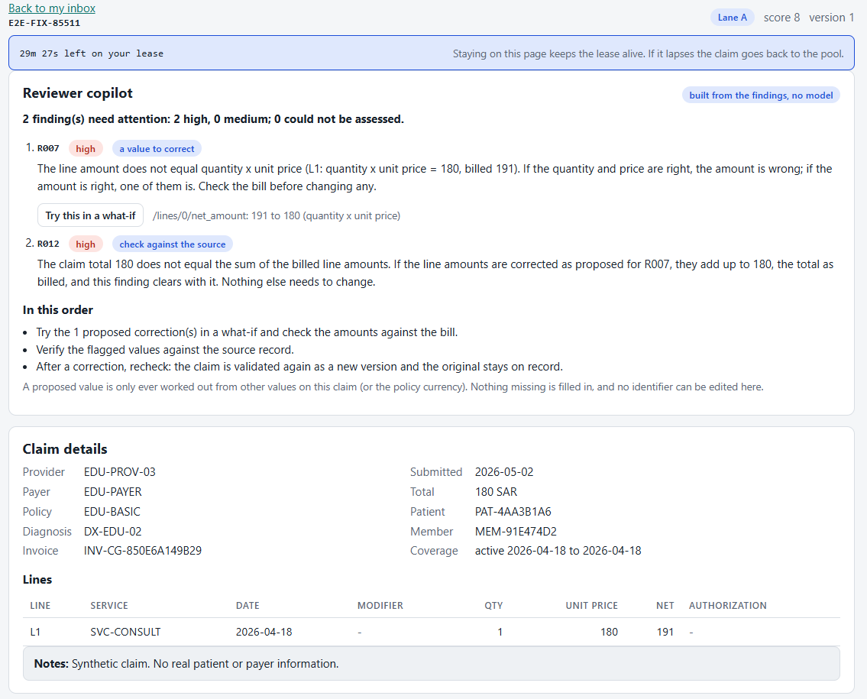
The reviewer copilot: what is wrong, what to do
new
One summary: how many findings, which severity, in the order that clears the claim fastest
One suggestion per finding: a value to correct, a value to check, or information to ask for
Built by code from the findings. No model, so nothing to hallucinate
A value is proposed only if it follows from other values on the same claim. Nothing missing is invented, no identifier can be edited
A claim with no finding reads: Pre-validation clearance, not payer approval or a promise of payment.
Notes:
No model here, on purpose. Each sentence is built from the finding and the claim, so every sentence cites a rule and claim paths. That makes grounding something we can test, not hope for.

Slide 12
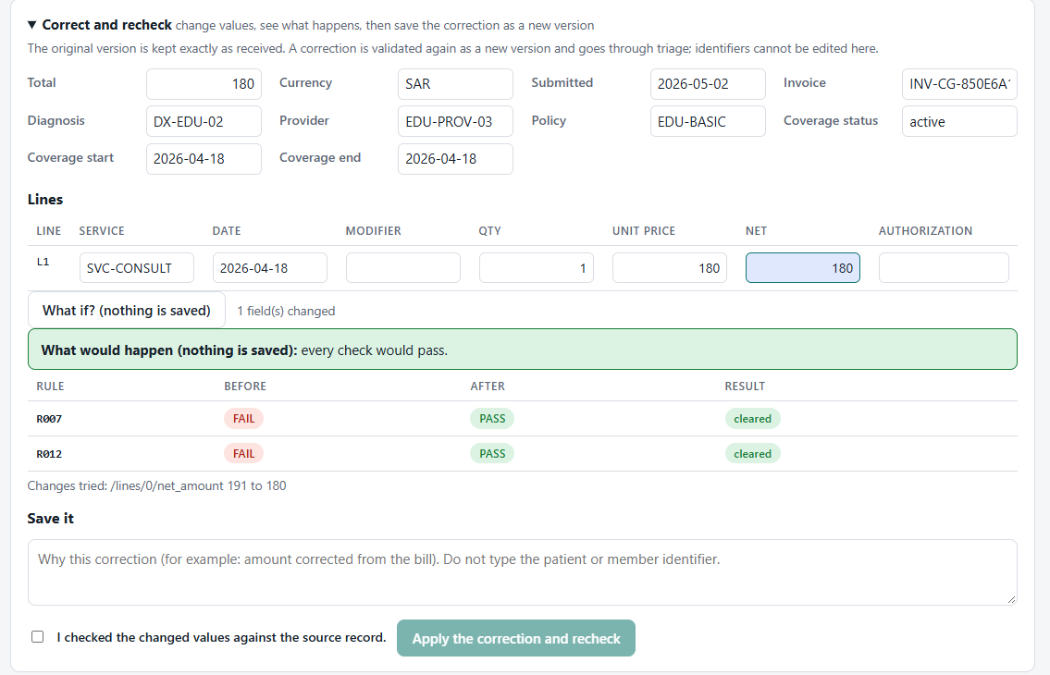
Try a correction, then save it as a new version
new
What-if
the engine runs on a copy. Nothing is saved
Recheck
the correction becomes version 2 and goes through triage
Original
version 1 is kept exactly as received and closed
Cleared findings
recorded with the reviewer's reason
Controls: only the holder of the claim can try or apply a correction. Clearing a high-severity finding needs the same senior authority as deciding it. Patient, member and claim identifiers cannot be edited. A recheck needs a reason that does not contain the identifier.
Notes:
Live: press Try this in a what-if, show the before and after table, then apply with a reason. The trace page shows both versions.

Slide 13
Do the proposals work? Measured against the real engine
777
0
flagged findings on 600 public claims, each with exactly one suggestion
cited paths missing on the claim. 0 texts with approval or payment words
0 new
4,200
findings created when all proposals on a claim are applied together
attempts to edit an identifier, all refused
Limit: only three rules have computable proposals. For the other twelve the copilot asks or checks. The reviewer still compares the figure with the bill.
Notes:
The first version proposed only the line amount and created a new R012 failure in 25 of 30 cases, because the claim total had matched the wrong line. Measuring it found that; the copilot now proposes the line and the total together.

Slide 14
Fewer decisions for a person, with the risk bounded
simulated
One-click confirm
Confirming needs no typed reason. Dismissing still does, because it overrides the engine.
-39%
0
on
findings a person decides per 500 claims: 650 to 399
wrong against the answer key
Bulk confirm
For rules reviewers almost always uphold. A random share still gets a full review. Bulk decisions never count as evidence.
off by default
Auto-clear green claims
Pre-validation clearance only, with a random audit sample and an exact bound on the miss rate.
What is not known
off by default
Time per finding has not been measured. The savings are counted in decisions, on the real pipeline with simulated reviewers. The first real step is a timed session with a few officers.
Auto-request information
For UNABLE_TO_ASSESS findings. The audit sample goes to a person.
off by default
Notes:
Everything on this slide is simulated reviewers on the real pipeline. A timed session with real reviewers is the first thing to do next.

Slide 15
Learning from feedback, and a model we set aside
Workload report (live)
Laya fine-tune (archived)
Reads reviewer confirmations and dismissals per rule
Lists rules reviewers keep overriding: candidates to retune
Lists rules almost always upheld: candidates for light review, with a bounded price
Read-only. It changes nothing by itself
Test split, 150 claims | Accuracy | Macro-F1
Zero-shot | 0.631 | 0.289
Fine-tuned | 0.971 | 0.915
Always guess PASS | 0.835 | -
It learned the rulebook, well calibrated (ECE 0.027), but finds only 64% of real FAILs
Its labels are the engine's own, so after the engine it cannot save an operator any time
Archived, not in the decision path. A confidence is never shown as a probability
In simulation both bad rules were found in 20 of 20 histories after 5,000 decisions, with 0 false alarms.
Notes:
He warned that a model trained on artificial decisions may only reproduce the rules. We tested that honestly and archived it.

Slide 16
Advisory checks that stay out of the official result
Rule | What it looks for | Severity
E001 | Procedure pair billed without an exception modifier | medium
E002 | Exception modifier on a never-bundle pair | high
E003 | Event date required by the diagnosis | medium
E004 | Route of administration missing | medium
E005 | Diagnosis cannot be the primary one | medium
E101 | A line duplicates one on an earlier claim | high
E102 | Authorization exhausted across claims | high
E103 | Daily quantity across claims | medium
Why they are separate
Own ids, file and schema. They never change an official result
E102 is the cross-claim authorization usage you described, on explicitly synthetic history
E001 to E005 cannot fire on public data by design: they use invented codes
4,800 of 4,800 results agree with an independent oracle
E102 fires only when earlier claims contributed units, so it never double-reports what R009 already fails.
Notes:
The rule logic follows published practice. The attributes the single-claim rules need are invented and labelled so.

Slide 17
Security: attacked, mutated and fuzzed before you did it
116
93
400,000
50
black-box attack checks, all passing
deliberate breakages of the security and queue rules, each caught by a test
fuzzed requests through the API
checks on the deployment: nothing but the proxy reachable
Identity
badge, password, authenticator code. Four clearance levels, enforced on the server. A hidden action is not offered, not just disabled
Privacy
reviewers see pseudonyms. Unmasking needs its own permission, a reason without the identifier, and an hourly limit
Two people
the most dangerous administrator actions need a second administrator with a fresh code
At rest
claims, results and corrections are encrypted in MongoDB. Audit logs encrypted, key rotation tested
Not done: nobody outside the team has attacked it, and a lone administrator or one person holding two accounts is logged but not prevented.
Notes:
No outside party has attacked the system. Say so.

Slide 18
Everything is on record, and an edit is caught
Moment | What is written
Claim received | input hash, rule pack hash, result hash, lane and score
A finding is decided | badge, action, reason, original status
A what-if is tried | who, which claim, how many changes (nothing else is kept)
A correction is saved | both versions linked by input hash, each change from and to, findings cleared
An identifier is unmasked | badge, claim, reason, counted against an hourly limit
Tamper evidence
Hash-chained, signed logs
An append-only mirror that refuses to follow an edited log
Ed25519 ledger with checkpoints and Merkle proofs
Demo: rewrite a row, the health panel goes red within seconds
Trace panel: both versions of a corrected claim, side by side, with their events and decisions.
Notes:
Run audit_guard_demo.py live: it rewrites a row and the health panel turns red.

Slide 19
Fully on premises, written for the hospital's own servers
Piece | State
Docker Compose stack: API, worker, MongoDB, Redis, proxy | Tested: attack test 50 of 50, backup and restore 23 of 23
Encrypted backup and restore, runbook | Tested end to end
Model server (vLLM, one model per server, offline weights) | Designed and scripted, benchmark on slide 20
Kubernetes manifests, network policies, restricted pods | Written, structurally tested, no cluster to apply them to
Host firewall and port scan from outside | Tested in throwaway containers, not on the real server
Target server: RTX 3080 10 GB, 12 GB RAM, Linux | Not run on it yet
Data protection (PDPL family): each obligation is mapped to what the system does. Two things are not built yet: subject access and erasure, and a retention period.
Notes:
Kubernetes manifests are written and structurally tested but there was no cluster to apply them to. Say so.

Slide 20
Serving the model: what this laptop measured
Parallel requests | Default: per minute | Default: median | 8 slots: per minute | 8 slots: median | 8 slots: tokens per second
1 | 52.2 | 1.17 s | 52.4 | 1.16 s | 62.7
4 | 54.5 | 4.36 s | 116.6 | 2 s | 139.9
8 | 52.8 | 8.9 s | 142.7 | 3.16 s | 171
16 | 51.3 | 18.59 s | 131.9 | 6.79 s | 158.9
143
explanations a minute with 8 slots (gemma3:4b, laptop RTX 4060). Default: 54, one at a time
vLLM is the planned production server, and it has not been run.
Ollama's downloaded model cannot be reused by vLLM, the Hugging Face cache holds no chat model, and the laptop's system drive has under 9 GB free (vLLM with a 4B model needs about 15 GB). Only 5% of findings need a model call once the template cache is warm, so 140 calls a minute can cover roughly 2,800 findings a minute. The benchmark script works against any server, so the same table can be made on the target.
Notes:
Measured on an RTX 4060 laptop with 8 GB, not the 3080 target. Ollama ran now. vLLM could not be installed here: the system drive has under 9 GB free and vLLM needs about 15 GB with a model.

Slide 21
What we have not done, said before you ask
Public data is synthetic
Perfect scores on it do not show how real claims behave.
Savings are simulated
No timed session with real reviewers yet.
1
2
No run on the target server
Throughput on an RTX 3080 and vLLM are unmeasured.
No Kubernetes cluster
Manifests are written and structurally tested only.
3
4
Documents
Real paper, handwriting and Arabic are untested.
Data subject rights
Access, erasure and retention are designed, not built.
5
6
Copilot proposals
Three rules have computable fixes. The rest ask or check.
Nobody outside the team
has attacked it.
7
8
Notes:
Read this slide out. It is the most credible slide in the deck.

Slide 22
Twelve minutes of demo, and four questions for you
The demo
For the mentor
1
A claim with a wrong amount arrives
R006 and R013: three public claims split one service into a plain line and an EDU-SEPARATE line (CG-B10B19D8A56A, CG-00348A9B1AAD, CG-EC233ACB399D). The rules pass them as documented, but the total quantity exceeds the per-line limit. Intended?
Is 'pre-validation clear' the right label for a claim a person confirmed or the system cleared?
A Redis Streams queue in Rust: acceptable in place of Celery or ARQ?
Would a timed session with a few officers be possible, to measure real time saved?
2
The senior opens it: summary and evidence
3
What-if: every check would pass
4
Apply with a reason: version 2
5
Trace: both versions, who, what, why
6
Rewrite an audit row: the alarm goes red
Notes:
Demo order follows the mentor's six steps.

