Slide 1
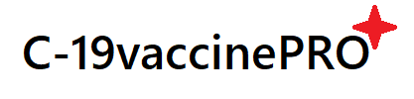

Welcome To
C-19vaccinePRO

Slide 2


C-19vaccine PRO
Developers
KADSE201F-005 Pubudu Deepamal
KADSE201F-016 Suranjith Madhushan
KADSE201F-023 Nadeesha Dilshan
KADSE201F-034 Dineshi Wettewa

Slide 3




Introduction
What is the reason?
What is the project?
What is the purpose?

Slide 4


Aims & Objectives
Issues
Suggestions
To Whom
Final Results

Slide 5

Solutions
The proposed solution is to create an online
vaccination system with new technology that will improve the entire manual system.
C-19vaccinePRO website
mainly focuses
C-19vaccinePRO application mainly focuses

Slide 6
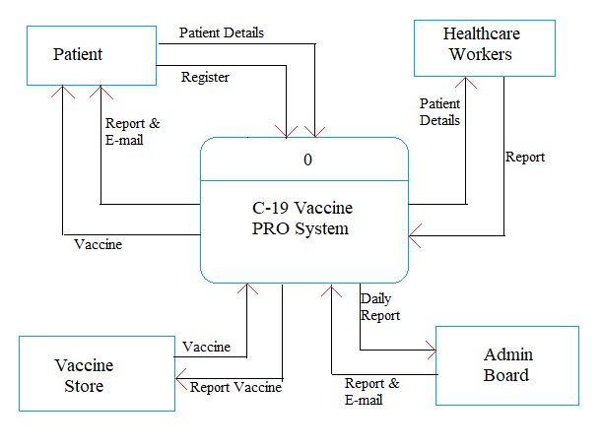
Context Diagram

Slide 7
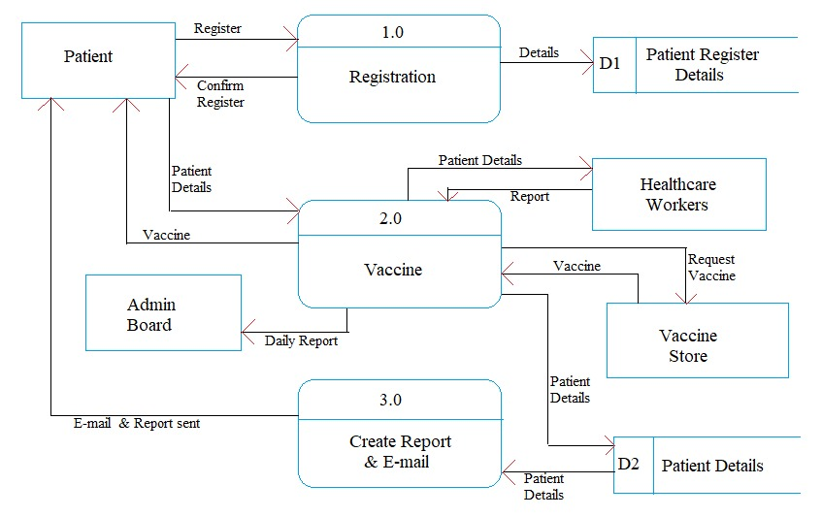
Level 0 Diagram

Slide 8
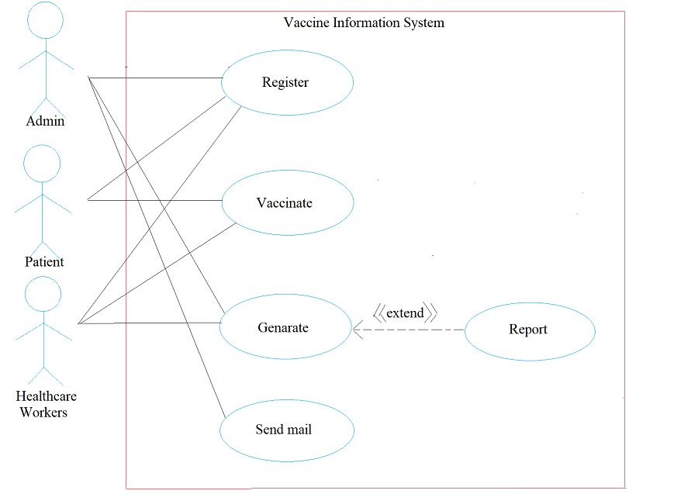
Use Case Diagram

Slide 9



Software
Visual Studio Code
Visual Studio
WAMP Server

Slide 10

Q and A

Slide 11

Thank You!

