Slide 1
Task 1 A.
30 day timeline
6 days
6 days
6 days
Create persona profile
Conduct guerrilla usability testing
Create objective usability tasks
Create a low-fidelity wireframe
Create an interactive prototype
6 days
6 days

Slide 2
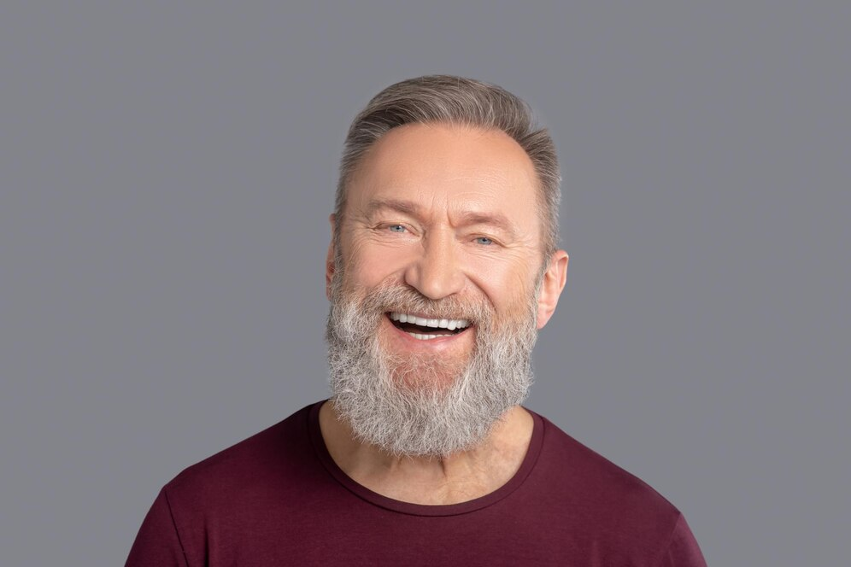



Task 1 B.
Work life:
a skilled web designer with a passion for creating visually stunning and user-friendly websites. With years of experience in front-end development and UX/UI design, he specializes in crafting digital experiences that engage and inspire. John combines creativity with technical expertise to develop responsive, modern designs that meet the needs of businesses and individuals alike.
Personal life:
When he’s not designing stunning websites, John Dawson can usually be found by the ocean, embracing his love for skimboarding. Whether gliding effortlessly over shallow waves or perfecting new tricks on the shoreline, he thrives on the energy and challenge of the sport. A true beach enthusiast, John enjoys early morning sunrises, exploring hidden coastal spots, and capturing the beauty of the sea through photography. His passion for the outdoors fuels his creativity, inspiring the fresh and dynamic approach he brings to all aspects of life.
Name: John Dawson
Occupation: Web Designer
Wage: 55,000
Age: 63
Place of Birth: USA
Means of travel: Air
Transportation on Island: Rental car
Local attractions: Not interested
Accommodation: Private Condo
Reason for visit: Vacation

Slide 3

Nav bar
The nav bar links should scroll down to the desired info.
Welcome to Taniti
For the design of this website, I chose make it a single page site. I believe this goes well with the persona I chose. The persona John is not interested in local attractions. Therefore, a single information driven site is best for John.
Book your Stay
The button would take the user to hotel booking sites.
Header
Information should be centered and have an appropriate header for easy readability.
Placeholder paragraph
Header
Placeholder paragraph
Scroll for more
Footer

Slide 4
Summer
Qualitative feedback - The navigation links are to close.
Actionable - Add space between links to allow for better identification.
Qualitative feedback - The font of the header is too close to the color of the background image.
Actionable - Change the Font color for better readability.
Logan
Qualitative feedback - The nav is not flush to the top of the page.
Actionable - Make the nav flush to the top. To eliminate the extra space
Qualitative feedback - The nav bar cuts off the other links when viewed in mobile view.
Actionable - Make the nav scrollable to so be able to see all the links.
Frankie
Qualitative feedback - Center the paragraph text for all descriptions.
Unactionable - I prefer it all aligned to the left.
Qualitative feedback - Make the font of the white paragraph under the main header stand out.
Actionable - Change font color to black.
Qualitative feedback - The website is easy to navigate.
Unactionable - No change needed.

Slide 5
Five objective usability tasks.
What is the drinking age?
What are the eating options?
What transportation is available?
What do most people enjoy on Taniti?
How many four-star resorts are on Taniti?

