Slide 1
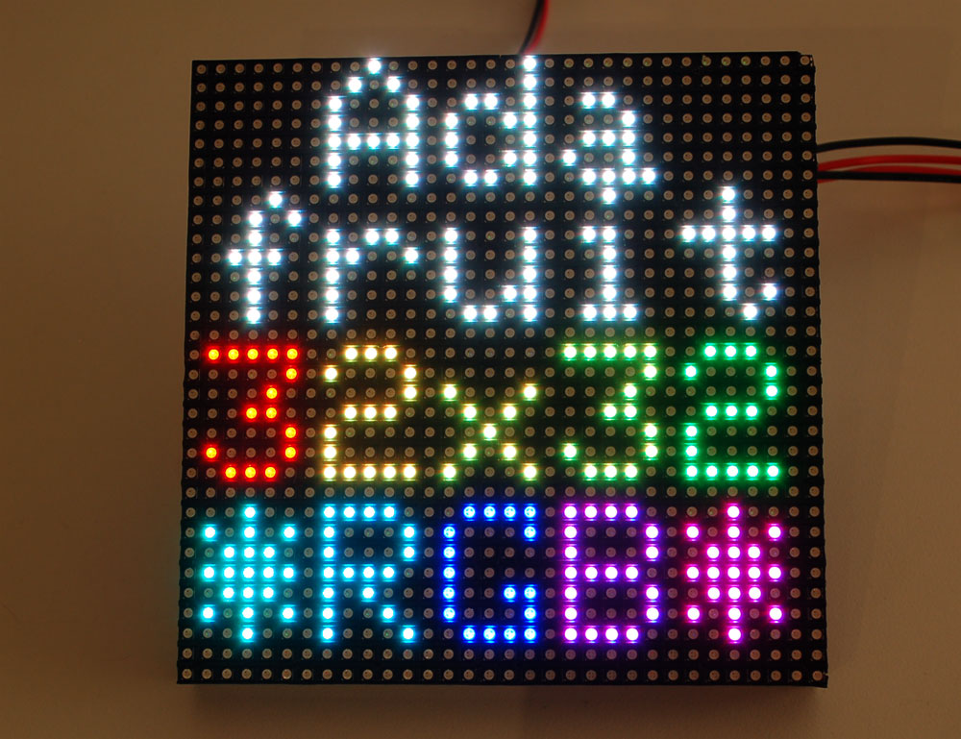
RGB-LED-Matrix-Console
Notes:
We are here to present our project: the RGB-LED-Matrix-Console

Slide 2
Team
3 people
  Vitaliy Karayanov
  Haris Mujic
  Jonas Pucher
Notes:
Our team consists of 3 people: Vitaliy Karayanov, Haris Mujic, Jonas Pucher

Slide 3

Idea
Console
A few games
4 controllers
7-segment-displays for score
32x32 LED Matrix display
Potentiometer for brightness
Notes:
We had the idea to build a console with a 32x32 led matrix as a display, 4 controllers, 2 7-segment-displays for scores and to program a few games on it.

Slide 4
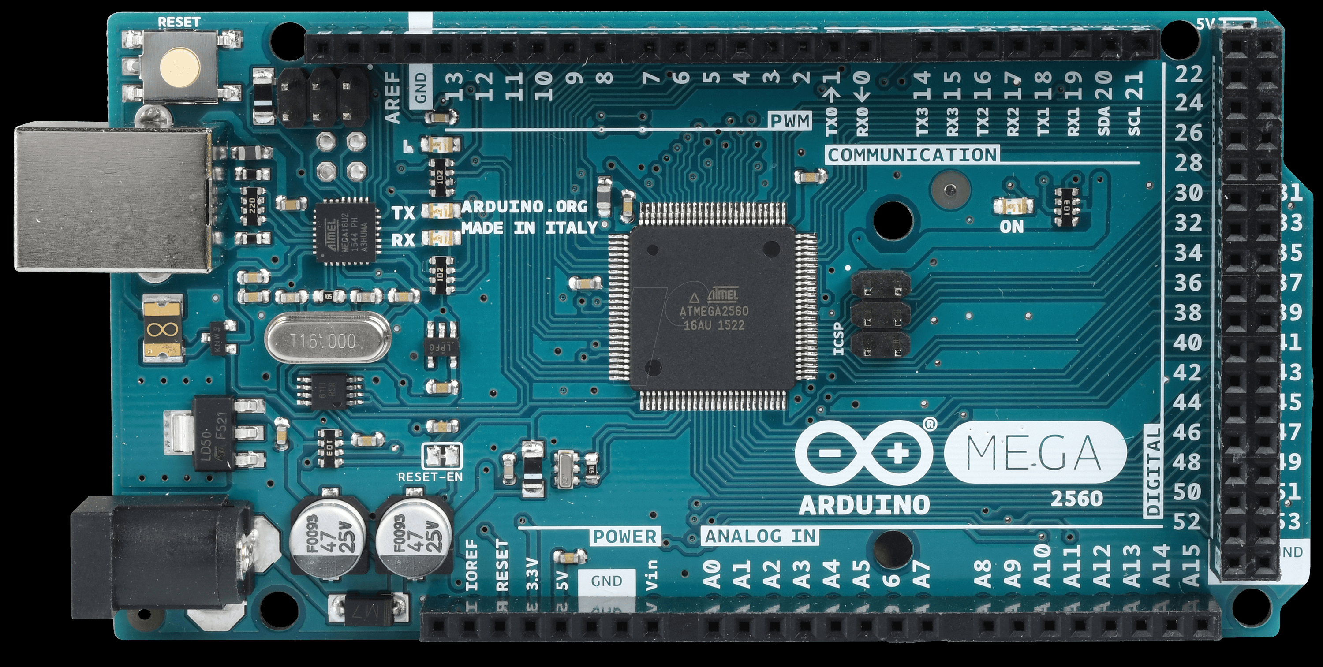
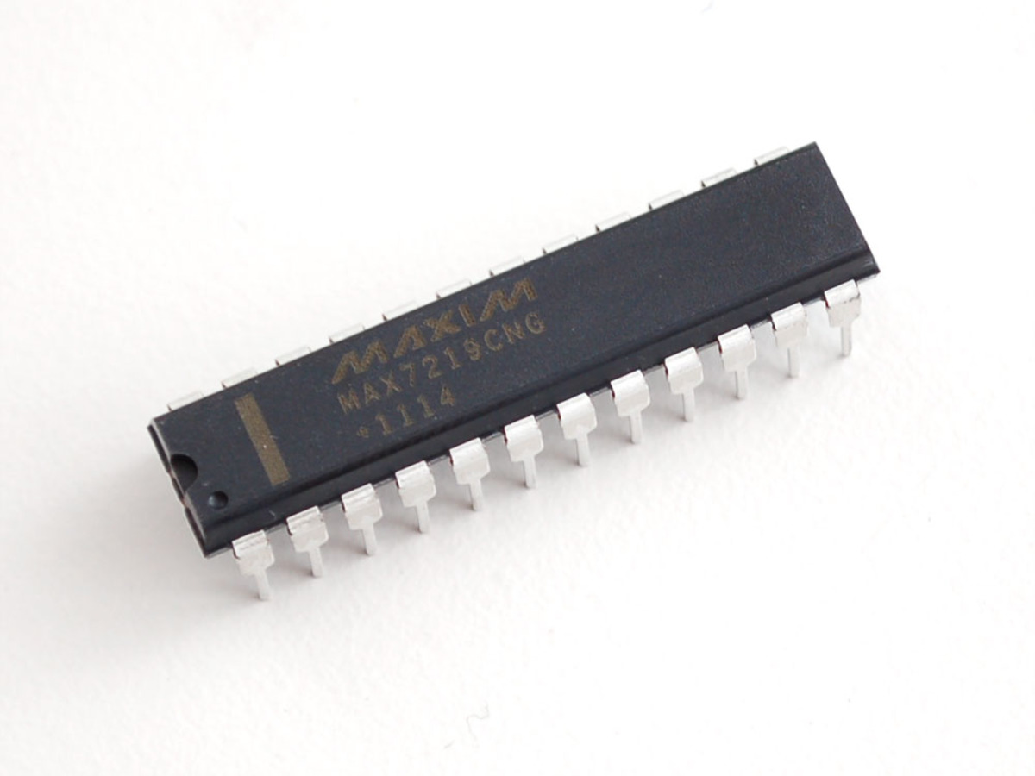
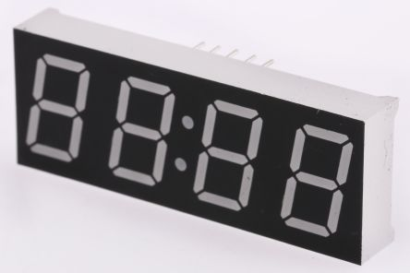
Console-Hardware
3 boards
  Connected with jumper-cables
Arduino Mega
2x4-digit-7-segement displays
  MAX7219
Voltage stabalizer for matrix supply
Notes:
The hardware of the console consists of 3 boards which are connected via jumper-cables.
To control everything we used a Arduino Mega. There are also 2 4-digit-7-segment-displays which are controlled by a MAX7219, a multiplexer, and a voltage stabalizer to supply the matrix with its 5V.

Slide 5
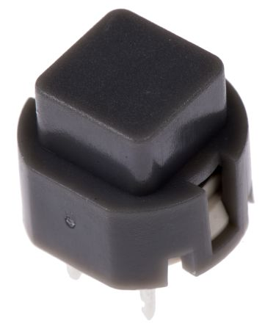
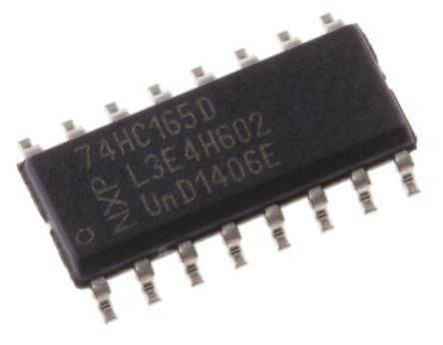
Controller-Hardware
6 Buttons
  Pull-up-resistors
  Debouncing-capacitors
74HC165
  Parallel-in-serial-out shiftregister
DIN-cables
Notes:
The hardware of the controller consists of 6 buttons each with a pull-up-resistor and debouncing-capacitors.
We use a 74HC165 parallel-in-serial-out shiftregister to gather the button states and send them to the arduino.
To connect the controller to the console-boards we use 5-pol-DIN-cables.

Slide 6
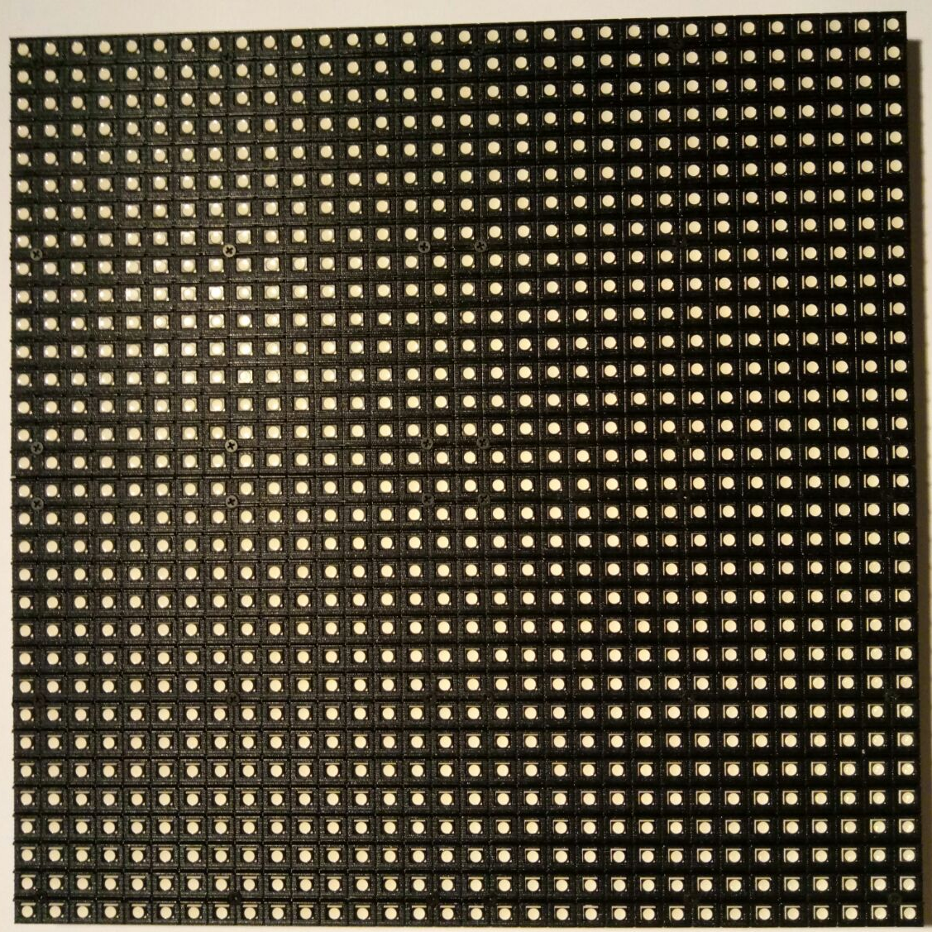
Display
32x32 LED Dot Matrix
  Adafruit
  Arduino Library
Notes:
As Display we found a 32x32 LED dot matrix from adafruit which comes with a very easy to use arduino library.

Slide 7
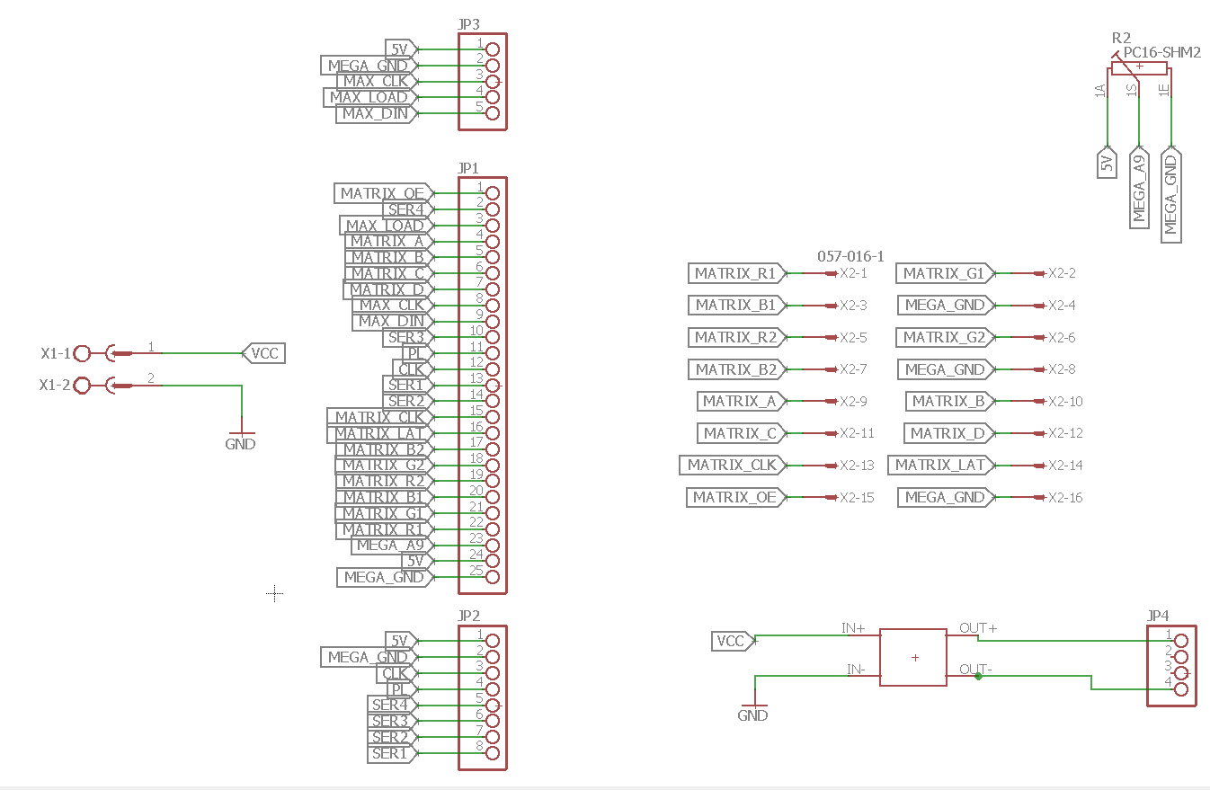
Circuit – Console - 1
Notes:
Here you can see the curcuit – diagram of the main console board. It has a power-supply a few pinheader, a potentiometer and a voltage stabalizer on it.

Slide 8
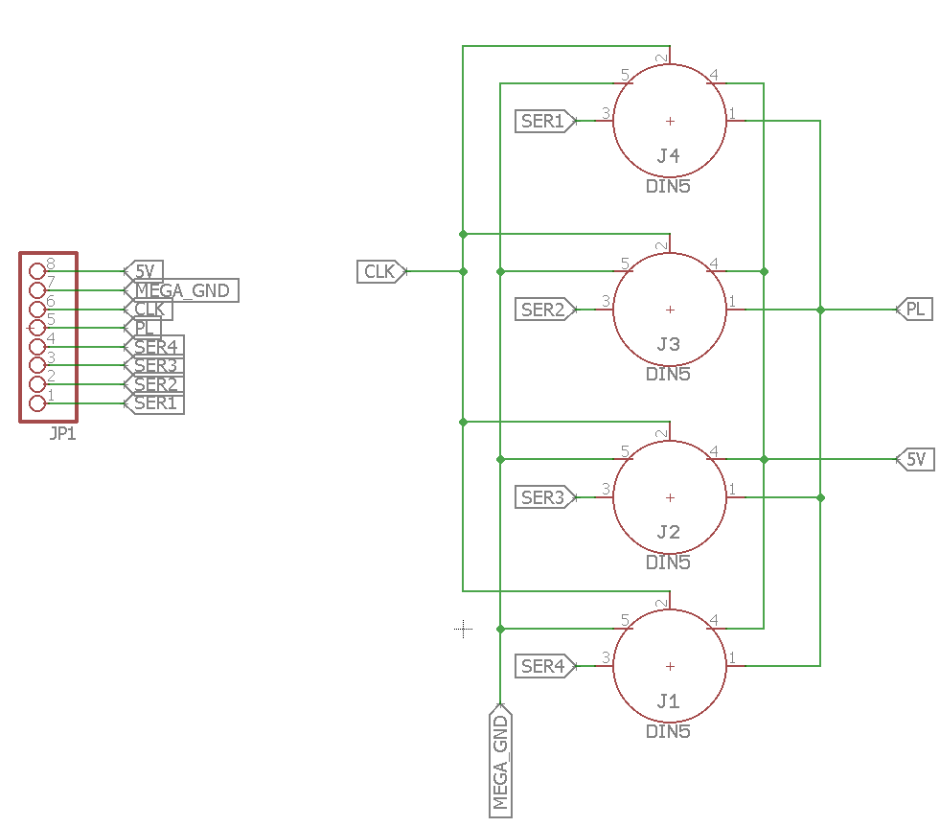
Circuit – Console - 2
Notes:
The second console board consists of the controller jacks and a pinheader to connect it with the main board.

Slide 9
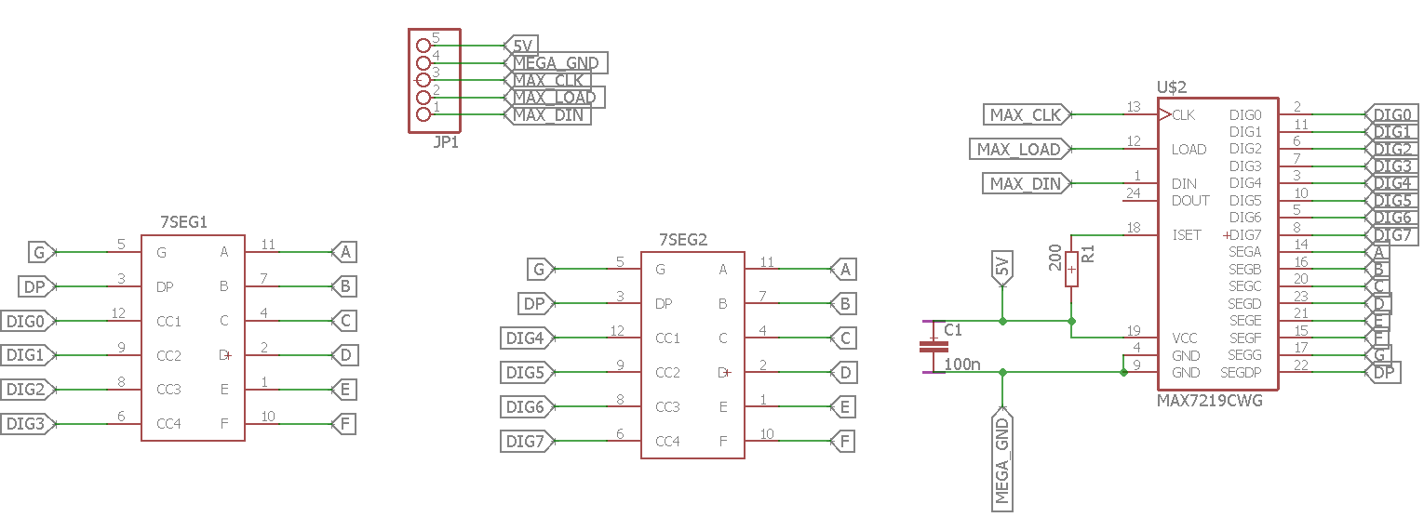
Circuit – Console - 3
Notes:
The third board has the 2 4-digit-7-segment-displays with their MAX7219 on it.

Slide 10
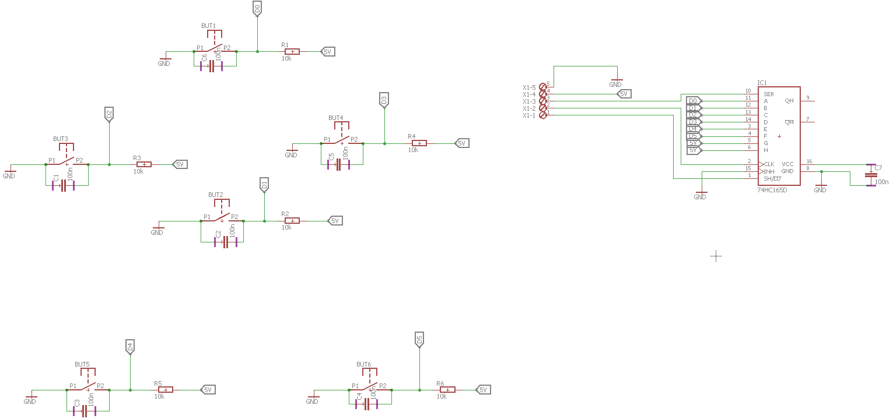
Circuit - Controller
Notes:
This is the circuit diagram of a controller. It has as we said the buttons and the shiftregister on it.

Slide 11
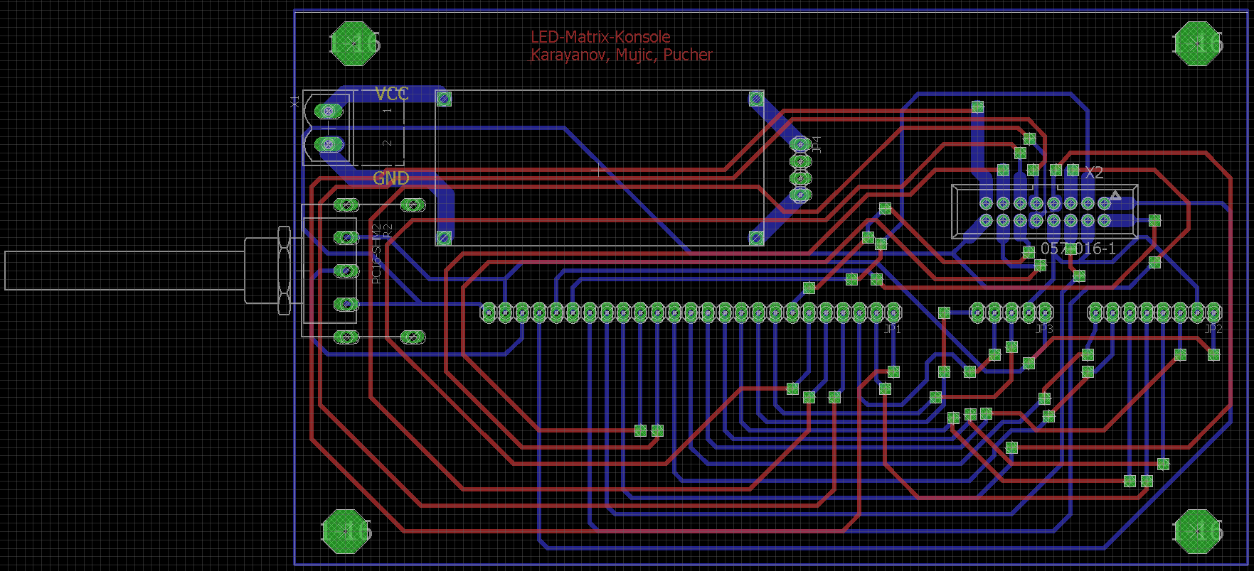
Layout – Console - 1
Notes:
Here you can see the different layouts

Slide 12
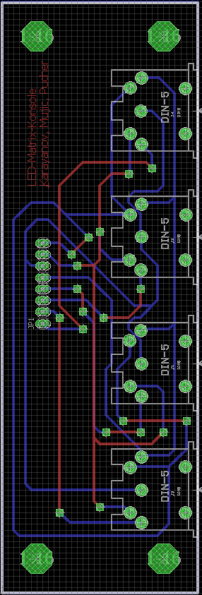
Layout – Console - 2

Slide 13
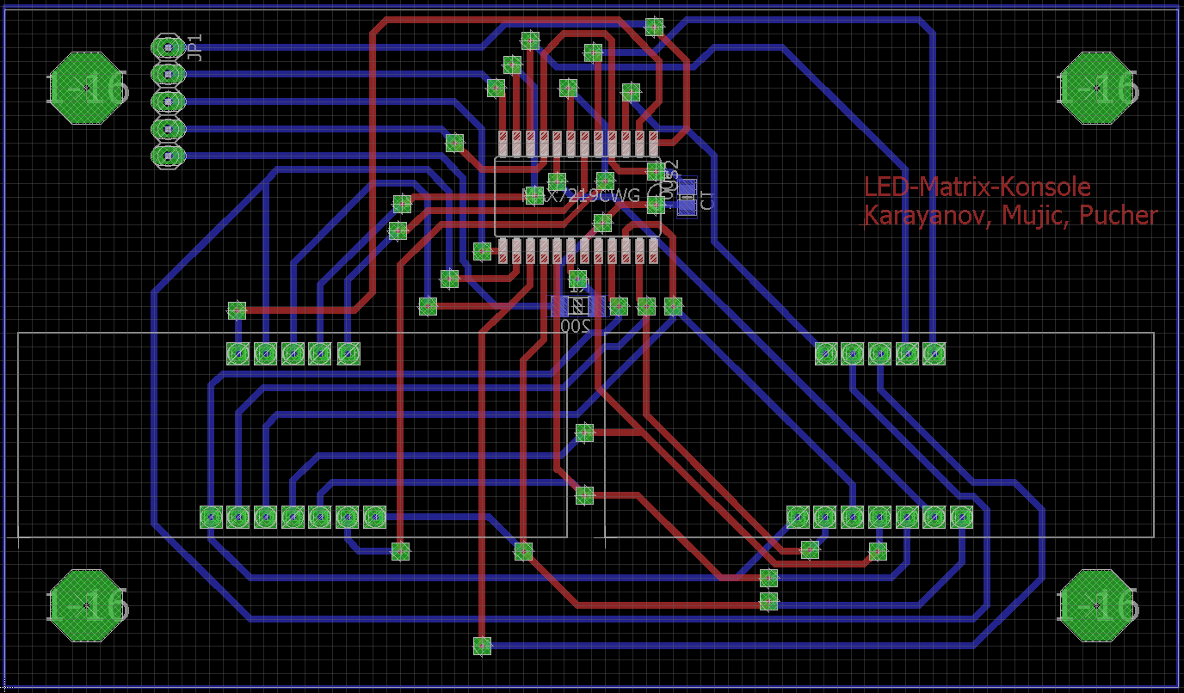
Layout – Console - 3

Slide 14
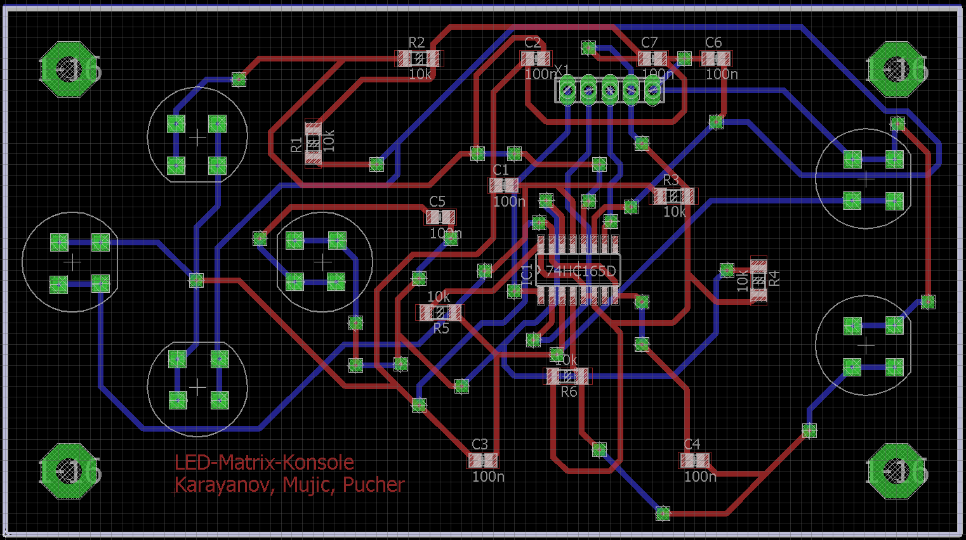
Layout - Controller

Slide 15
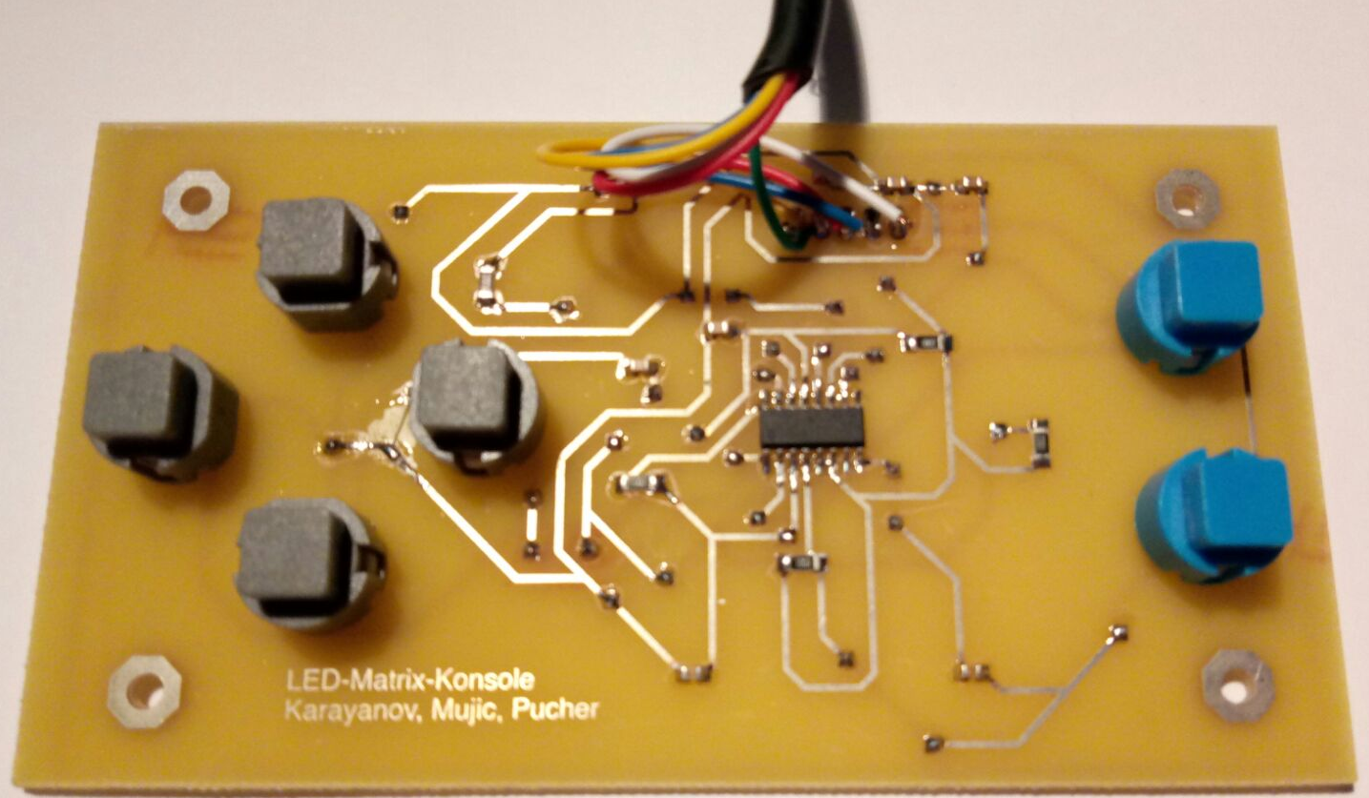
Controller
Notes:
Here you can see the board of a controller.

Slide 16
Software
Libraries
  LEDMatrixPanel
  AdafruitGFX
  LEDControl
Own Framework for games
Notes:
We programmed everything with the arduino IDE and used a few libraries. We also programmed our own framework to make it easier to put more than one game on it.

Slide 17
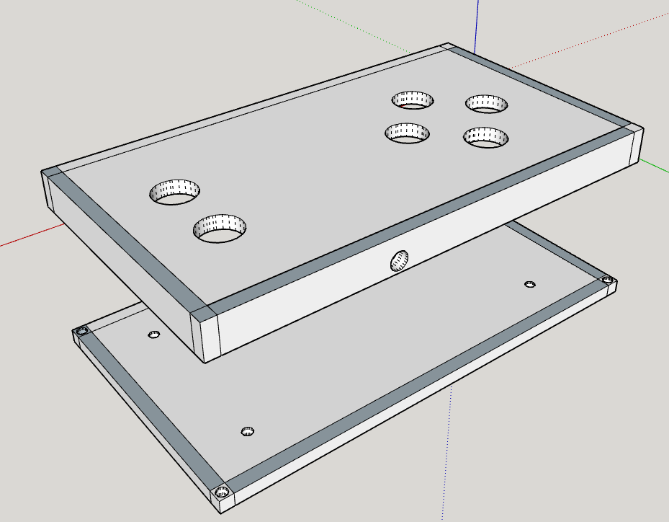
Package – Controller
Notes:
Here you can see the package of the controller as it was designed in SketchUp.

Slide 18
Final Product
7-segment-displays
  Don't work with matrix
Voltage stabalizer
  Doesn't output 5V
No package
Notes:
For the final product we couldn't make everything to work. Such as the 7-segment-displays which we can control and display different numbers, but it isn't controlable until we initialize the matrix.
The voltage stabalizer outputs almost the input voltage instead of 5V.
And we couldn't build the package in time. But we made the matrix display everything we wanted it to.

Slide 19
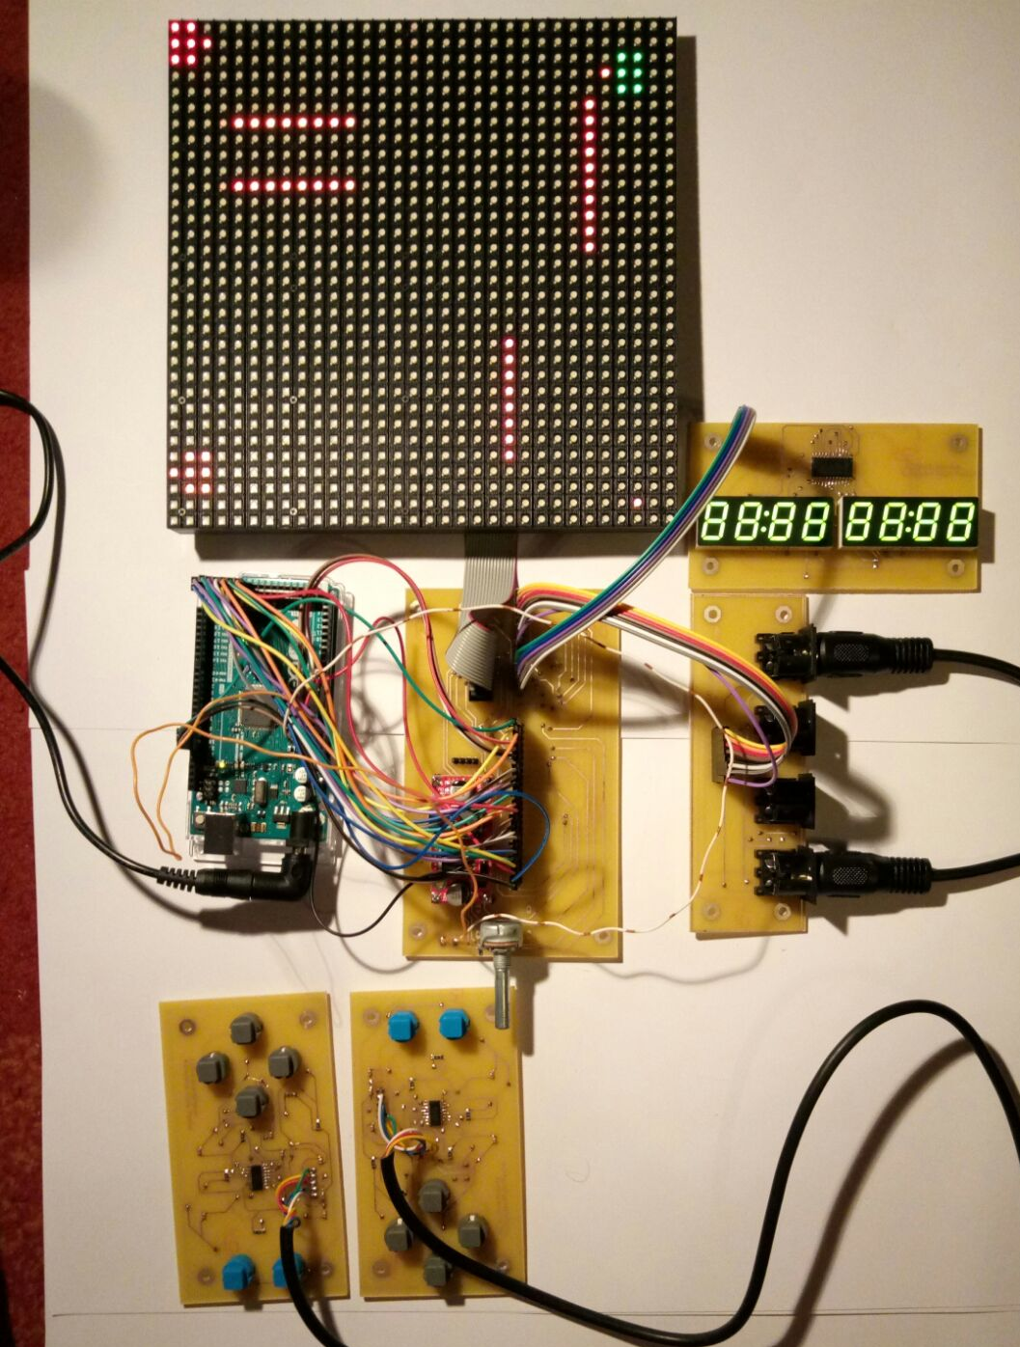
Let's show the product
Notes:
Now it's time to show the product as it is.

