Slide 1

AIAA Hover Prediction Workshop:
Overview and Future Direction
Chairman: Nathan Hariharan
Jennifer Abras, Rohit Jain, Robert Narducci, Brian Wake
AIAA SciTech Forum | 12–16 January 2026
https://www.aiaa-hpw.org/

Slide 2
The Steering Committee
Nathan Hariharan (Chair)
HPCMP CREATE: Chief Scientist & Technologist
​
Jennifer Abras
HPCMP CREATE: Helios Development Team
​
Rohit Jain
US Army Combat Capabilities Development Command Aviation & Missile Center: Aerospace Engineer
Bob Narducci
The Boeing Company: Technical Fellow
Brian Wake
Sikorsky Aircraft - A Lockheed-Martin Company: LM Fellow

Slide 3
Our main objectives
Studies and crowning achievements
More to do and what to expect next

Slide 4
HPW Vision
Our vision is to inspire collaboration among industry, governments, and academia for the development of
computational methods to predict all aspects of hovering flight efficiently, practically, and accurately

Slide 5
HPW Vision
Our vision does not imply one method!
Sophistication /
Computational Cost
Vehicle Trim
Airframe w/ Rigid Rotor
Airframe with Elastic Rotor
Isolated Rigid Rotor
Isolated Rotor
Model
Isolated Elastic Rotor
Airframe &
Rotors Model
Conceptual Design Preliminary Design Detailed Design Production Fleet Support

Slide 6


HPW Vision
Hover Analysis is often Idealized, but V never equals 0
Excursions over the average are sometimes the important aspects

Slide 7
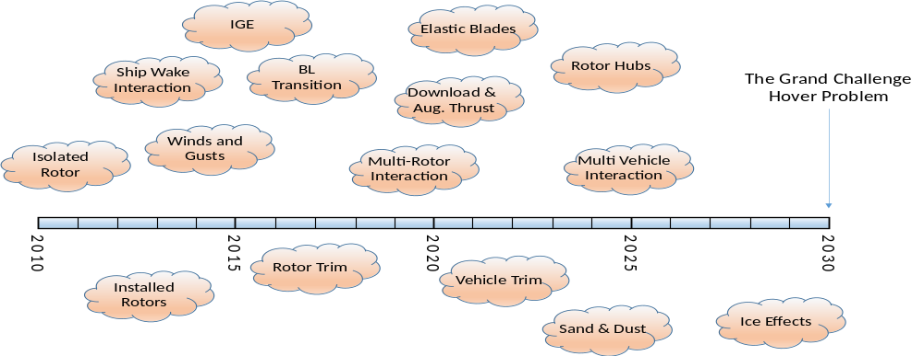
The Grand Challenge

Slide 8
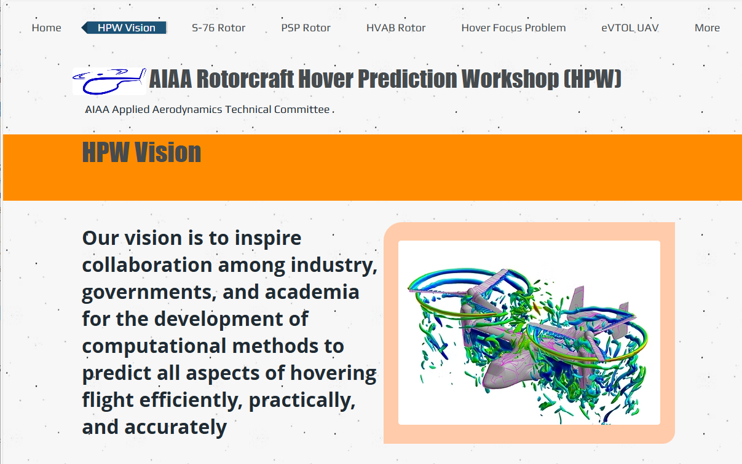
Collaboration Problems
HPW committee identified 5 challenge simulations to benchmark and advance hover prediction processes
Each simulation offers a hover focus area
S-76 Rotor PSP Rotor HVAB Rotor Hover Focus Problem eVTOL

Slide 9
Collaboration Problems
The S-76 rotor simulation has model-scale performance-quality test data for a variety of blade tip shapes
Being the first of the HPW test problems, there is a large database of results generated from participants across the world using a large variety of methods
Results include performance, distributed loads and wake structures
S-76 Rotor PSP Rotor HVAB Rotor Hover Focus Problem eVTOL

Slide 10
Collaboration Problems
The 66.5” radius PSP rotor has
well-defined blades, including the OML and structural properties
structured and unstructured surface grids are available on the file share
high-quality performance and boundary layer transition data
S-76 Rotor PSP Rotor HVAB Rotor Hover Focus Problem eVTOL

Slide 11
Collaboration Problems
The HVAB rotor:
is closely related to the PSP rotor with minor changes to the root section and TE
has a new, large, publicly available database including performance, thermography (BL transition), shadowgraphy (for wake characterization), photogrammetry (blade deformation), pressure & airloads, and PIV
has well-defined non-deformed geometry and structural properties
S-76 Rotor PSP Rotor HVAB Rotor Hover Focus Problem eVTOL

Slide 12
Collaboration Problems
The HFP attempts to coordinate results-sharing for aspects of the hover problems that are difficult to measure experimentally
It utilizes the HVAB rotor and NASA Robin-mod7 airframe for easy sharability
It addresses HOGE, HIGE, download, thrust recovery, groundwash, wind impact, and descent simulation (requiring feedback for maintaining GW)
S-76 Rotor PSP Rotor HVAB Rotor Hover Focus Problem eVTOL

Slide 13
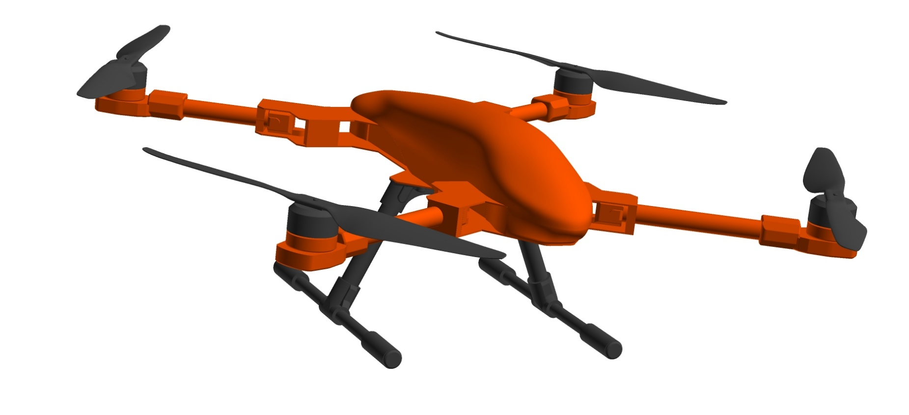
Collaboration Problems
The latest hover problem
involves the SUI Endurance
Recommended simulations include
isolated fuselage, isolated rotor, &
full-aircraft from hover upto 20 m/s
S-76 Rotor PSP Rotor HVAB Rotor Hover Focus Problem eVTOL

Slide 14
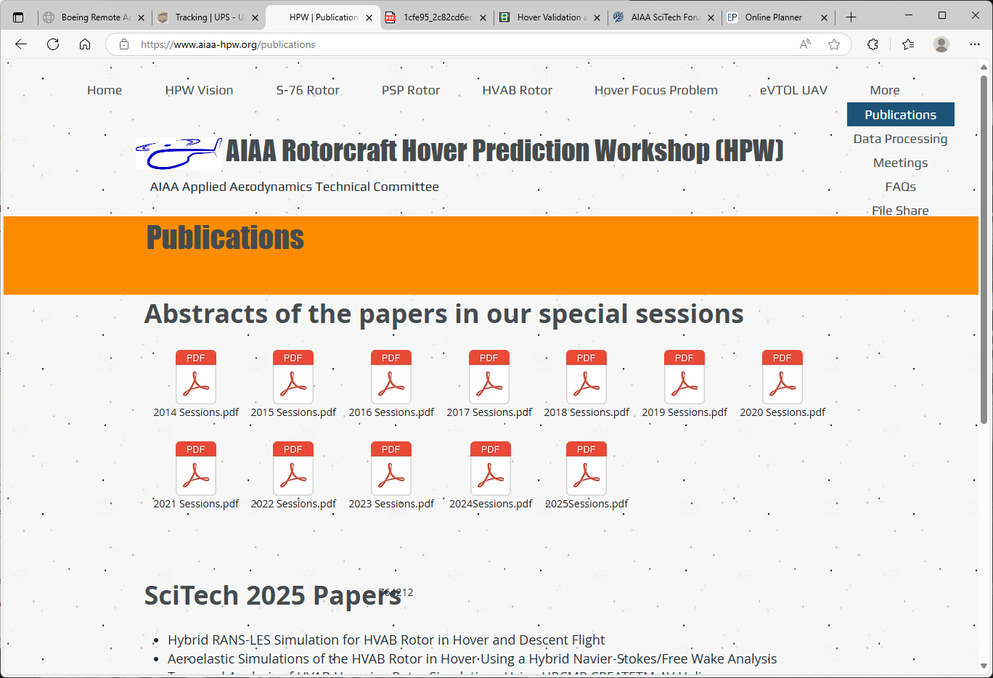
Crowning Achievements
Abstracts of all papers presented in HPWs are compiled in one place on the website: https://www.aiaa-hpw.org
Absolute and incremental performance predictions
Common post-processing recommendations
Blade geometry impacts to performance
Aeroelastic effects
Low-order approaches
Structured, unstructured, and hybrid approaches
Off-body schemes & wake refinement
Wake breakdown
Turbulence modeling
Laminar-to-turbulent transition
Model-to-full scale performance
Test facility effects
Download
Ground effects
Steady-state vs. time-accurate approaches
Uncertainty quantification
Code-to-code comparisons
Others…

Slide 15
Progress to the Grand Challenge
✓
✓
✓
✓
✓
✓
✓
✓
✓
✓

Slide 16

Up for Discussion...
Is it time for a comprehensive record of
hover prediction achievements?
Possible topics include:
Are there gaps?
Selecting an analysis approach & what to expect
Modeling wakes & turbulence
Quantifying uncertainty
Application to design & optimization
...

Slide 17
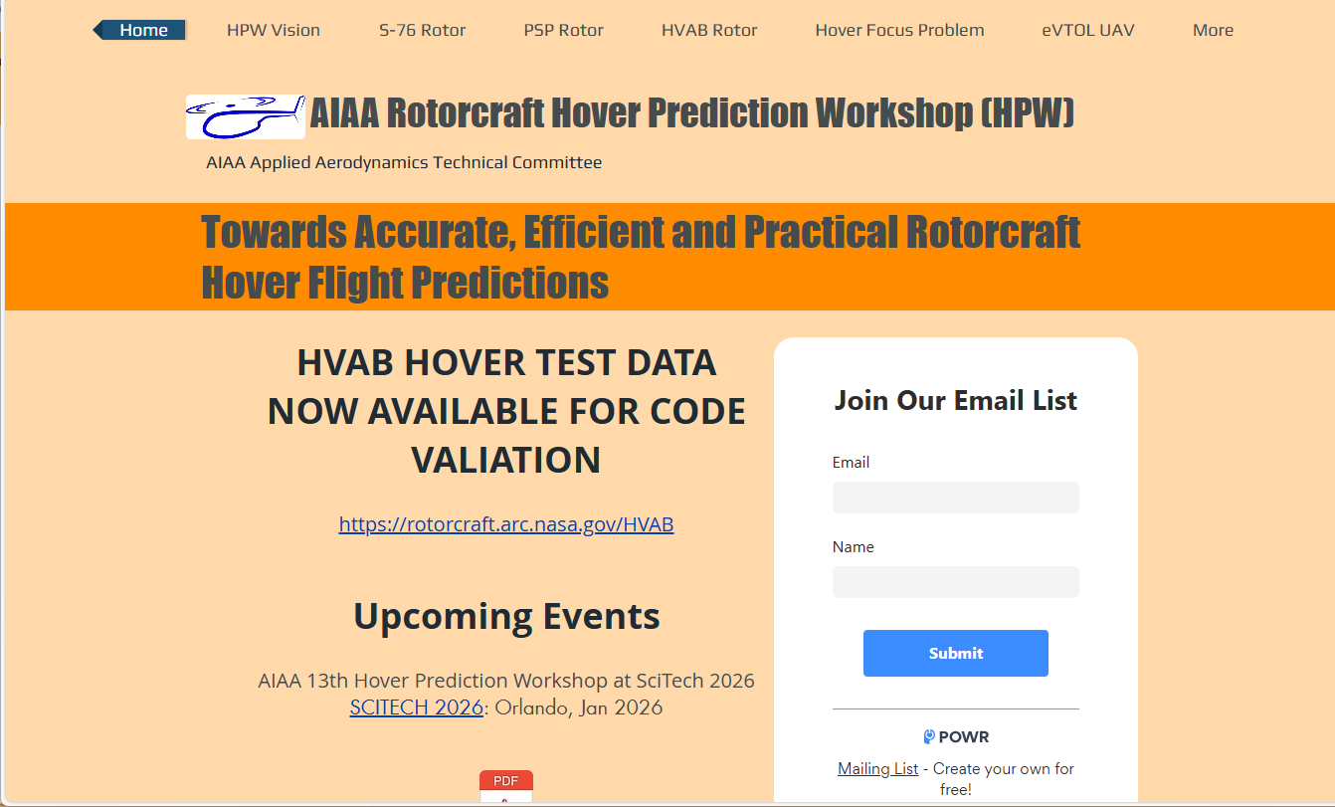
Also for Discussion: HPW Cadence & Communication
The HPW meets twice a year
  Winter: SciTech
  Summer: Aviation
www.aiaa-hpw.org
Email correspondence

Slide 18
Welcome to SciTech 2026
APA-50 Special Session: Rotor-in-Hover (Wednesday, January 14)
An Investigation of CFD Predictions for Rotor Hover Performance Near Stall Conditions Min
Enhanced Engineering Workflows in the HPCMP CREATE Ecosystem Demonstrated Abras
on the SUI Endurance UAV
Numerical Simulations of an Installed Rotor in Prescribed and Free Flight Maneuvers Sheng
Analysis of HVAB Rotor Hover Performance with Uncertainty in CFD Meshing Strategies Schaefer
Preliminary Application of Inverse Design to the HVAB Rotor Tip Nelson

Slide 19
Actions
Join our mailing list
Sit back and enjoy the special Rotorcraft in Hover Sessions
Write a paper, share your results, see you at Scitech 2027

Slide 21
Welcome
APATC Rotorcraft Simulation Discussion Group
Monday Jan 12, 6:45-8:00 PM, Bayhill 28

Slide 22
Agenda
Review of HPW vision
Introducing Endurance: The eVTOL simulation problem
Discussion topics
  Comprehensive repository of hover analysis methods, results, etc.
  Cadence for meeting
Any other business

Slide 23
The Steering Committee
Nathan Hariharan (Chair)
HPCMP CREATE: Chief Scientist & Technologist
​
Jennifer Abras
HPCMP CREATE: Helios Development Team
​
Rohit Jain
US Army Combat Capabilities Development Command Aviation & Missile Center: Aerospace Engineer
Bob Narducci
The Boeing Company: Technical Fellow
Brian Wake
Sikorsky Aircraft - A Lockheed-Martin Company: LM Fellow

Slide 24
HPW Vision
Our vision is to inspire collaboration among industry, governments, and academia for the development of
computational methods to predict all aspects of hovering flight efficiently, practically, and accurately

Slide 25
Collaboration Problems
HPW committee identified 5 challenge simulations to benchmark and advance hover prediction processes
Each simulation offers a hover focus area
S-76 Rotor PSP Rotor HVAB Rotor Hover Focus Problem eVTOL

Slide 26
Collaboration Problems
The latest hover problem
involves the SUI Endurance
Recommended simulations include
isolated fuselage, isolated rotor, &
full-aircraft from hover upto 20 m/s
S-76 Rotor PSP Rotor HVAB Rotor Hover Focus Problem eVTOL

Slide 27
Up for Discussion...
Is it time for a comprehensive record of
hover prediction achievements?
Possible topics include:
Are there gaps?
Selecting an analysis approach & what to expect
Modeling wakes & turbulence
Quantifying uncertainty
Application to design & optimization
...

Slide 28
Also for Discussion: HPW Cadence & Communication
The HPW meets twice a year
  Winter: SciTech
  Summer: Aviation
www.aiaa-hpw.org
Email correspondence

