Slide 1
Simulation of the Lindblad equation
Computational Physics (AP3082)
By: Klara Chmiel, Nico Kerkhoven and David Bakker

Slide 2
Introduction
Goal of our project
Theoretical background
Code overview
Spin ½ system
Spin echo
Two spin ½ system
Conclusion

Slide 3
Goal of the project
Study decoherence of spin systems using the Lindblad equation.
Bath
System

Slide 4
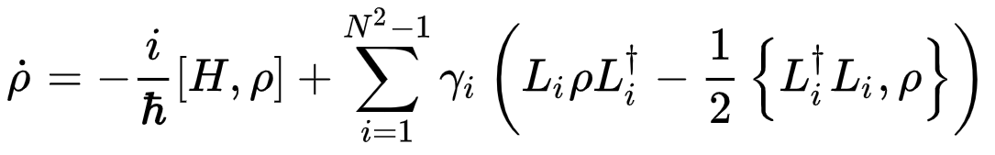
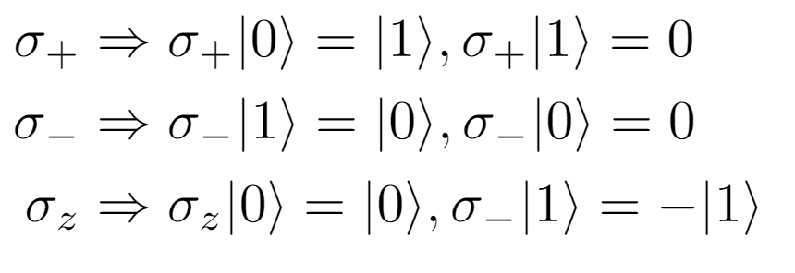
Theoretical background
Lindblad equation:
Time derivative of
density matrix
System Hamiltonian
Jump operators
Schrodinger equation

Slide 5
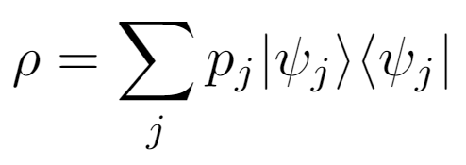
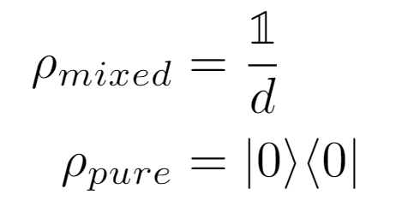
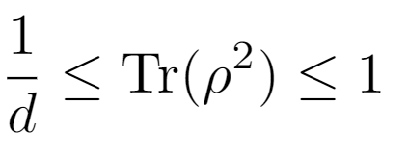
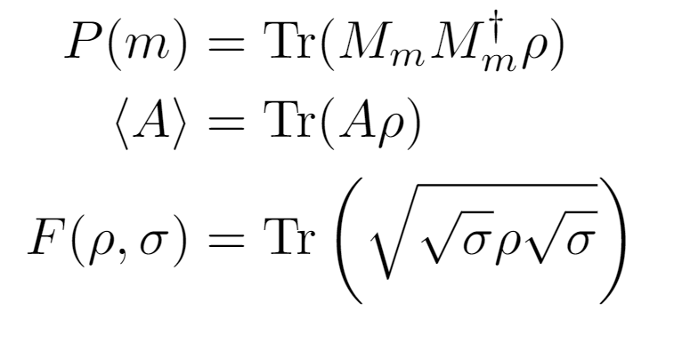
Theoretical background
Density matrix:
Purity:

Slide 6
Code overview
Hamiltonian, jump operators, pulse_sequence, etc.
state = State(rho_0, ...)
solve_lindblad()
Returns the evolved state
state = State(...)
Methods:
calc_observable()
P() (probability)
fidelity()
purity()

Slide 7
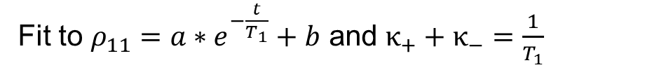
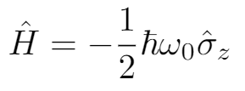
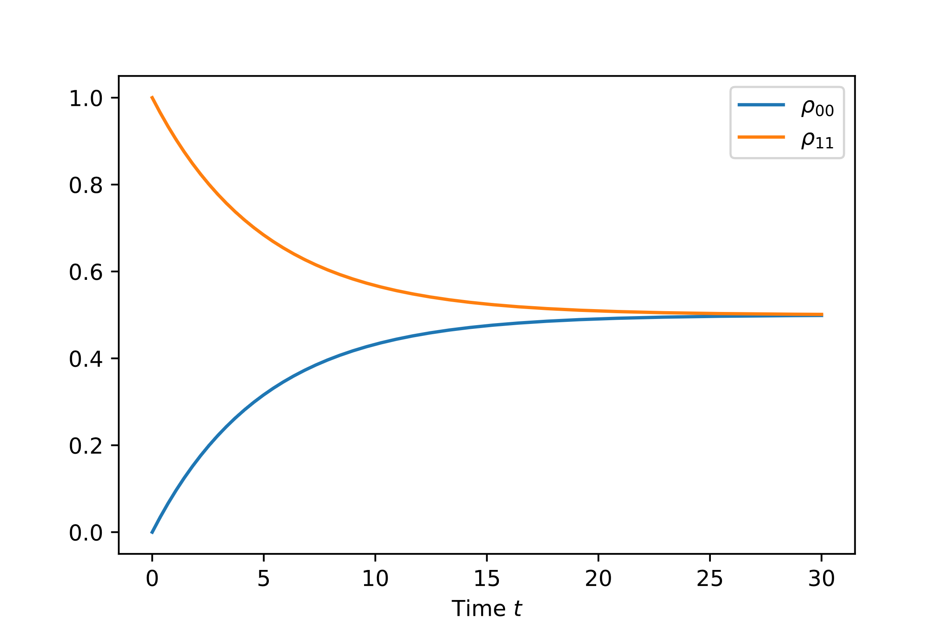

Spin ½, decay
Start in up or down state, decay with same rate

Slide 8
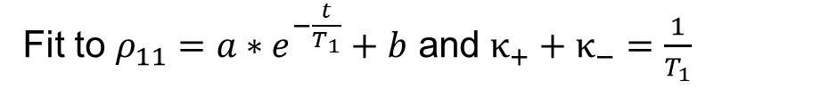
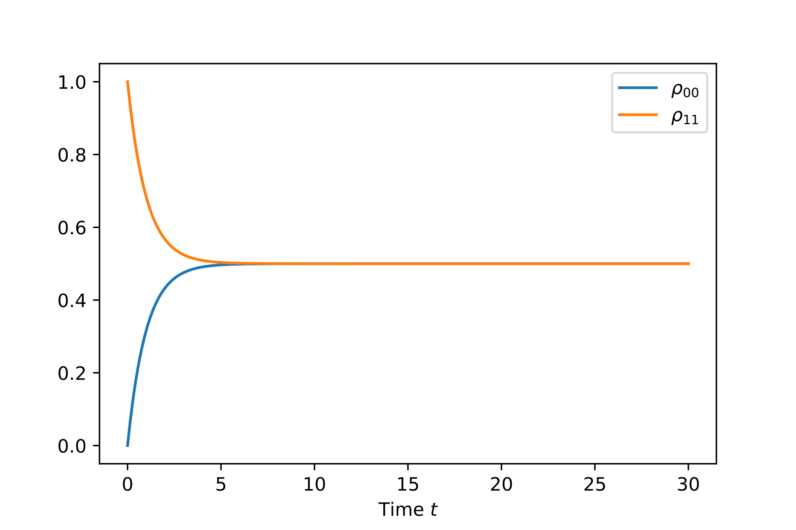


Spin ½, decay

Slide 9
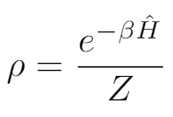
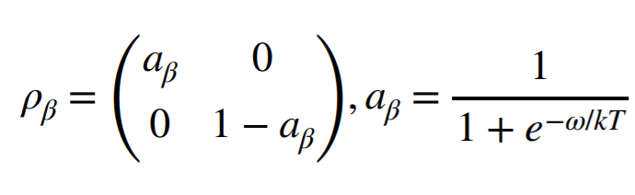
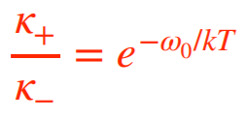

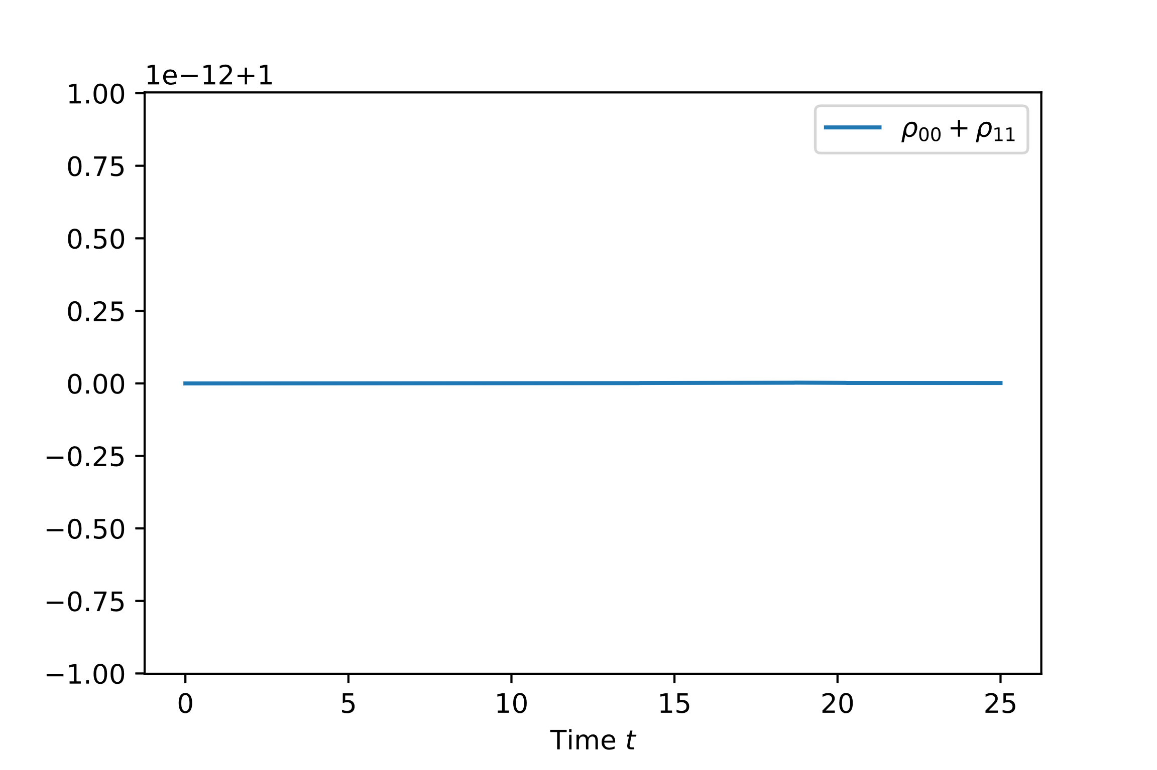
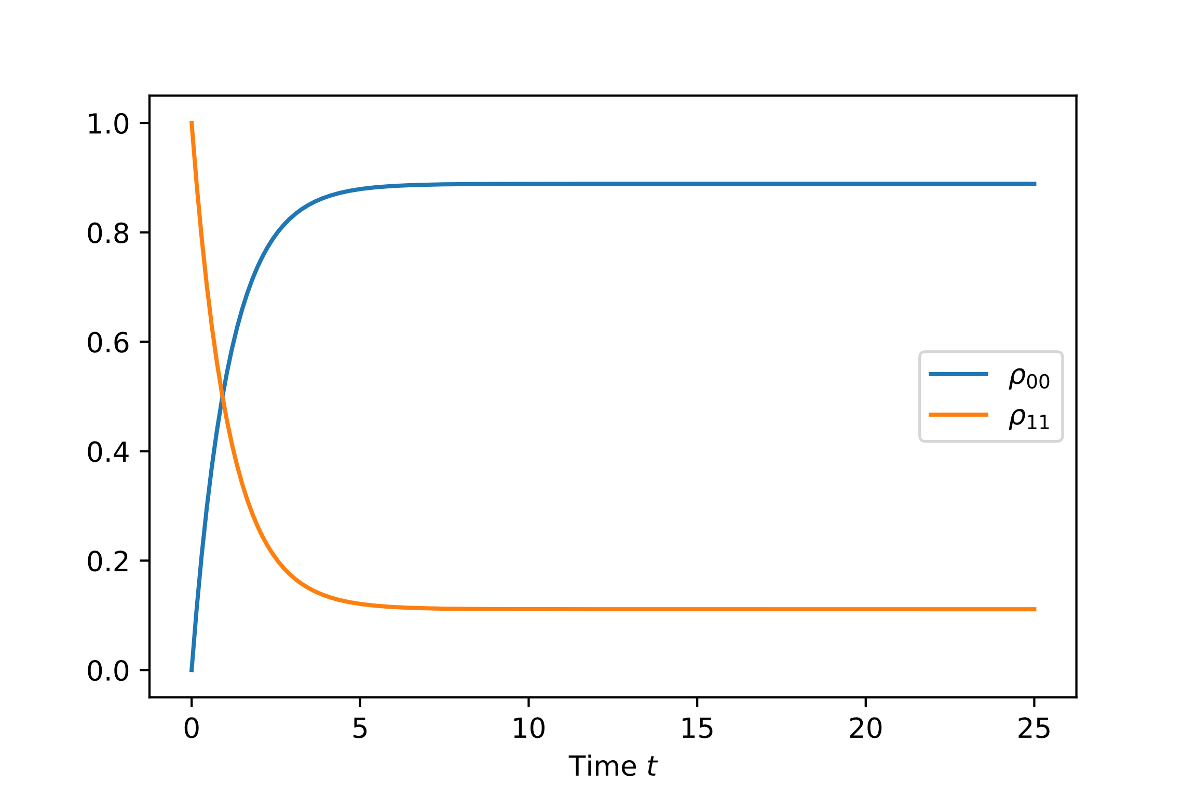


Spin ½, decay
Ref: Quantum hardware 1 (lecture 4)
Difference with respect to one

Slide 10
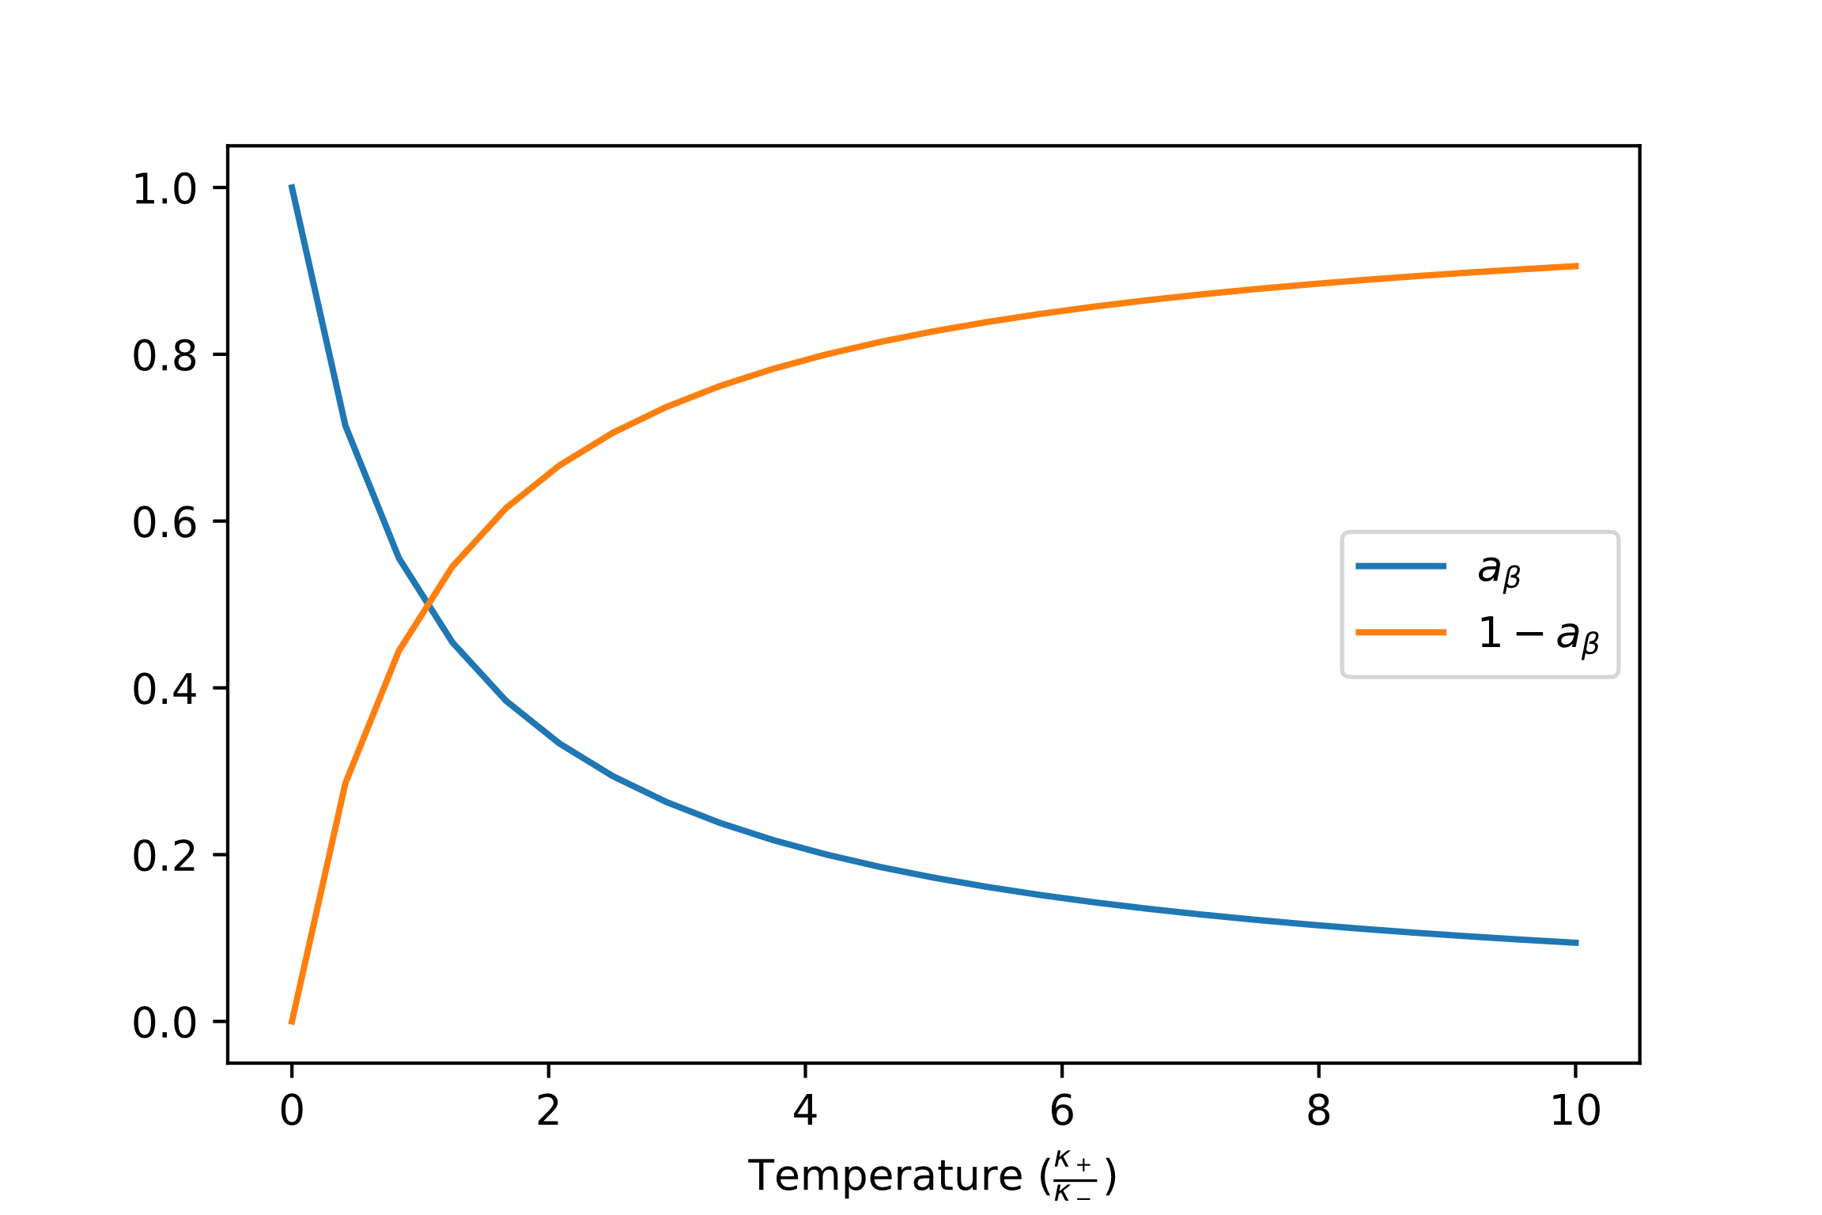
Spin ½, decay
Ref: Quantum hardware 1 (lecture 4)

Slide 11
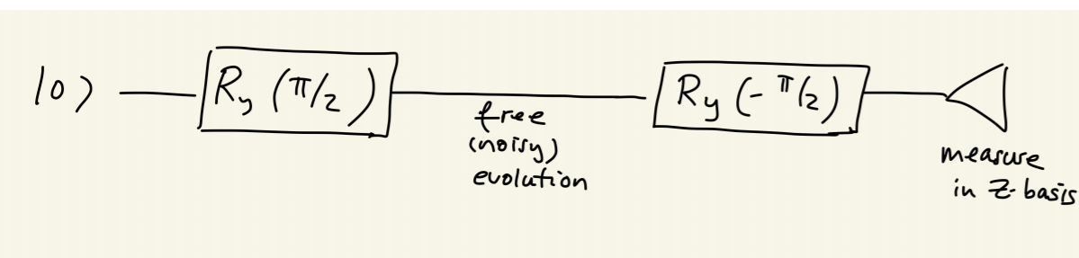
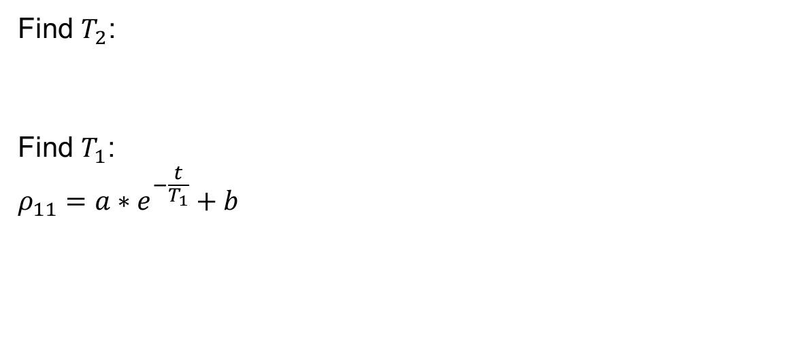
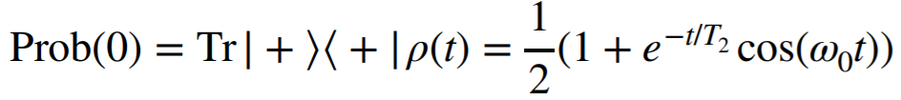

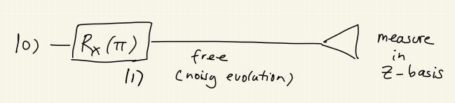
Ramsey Experiment, MRI
Ref: Quantum hardware 1 (lecture 3)

Slide 12

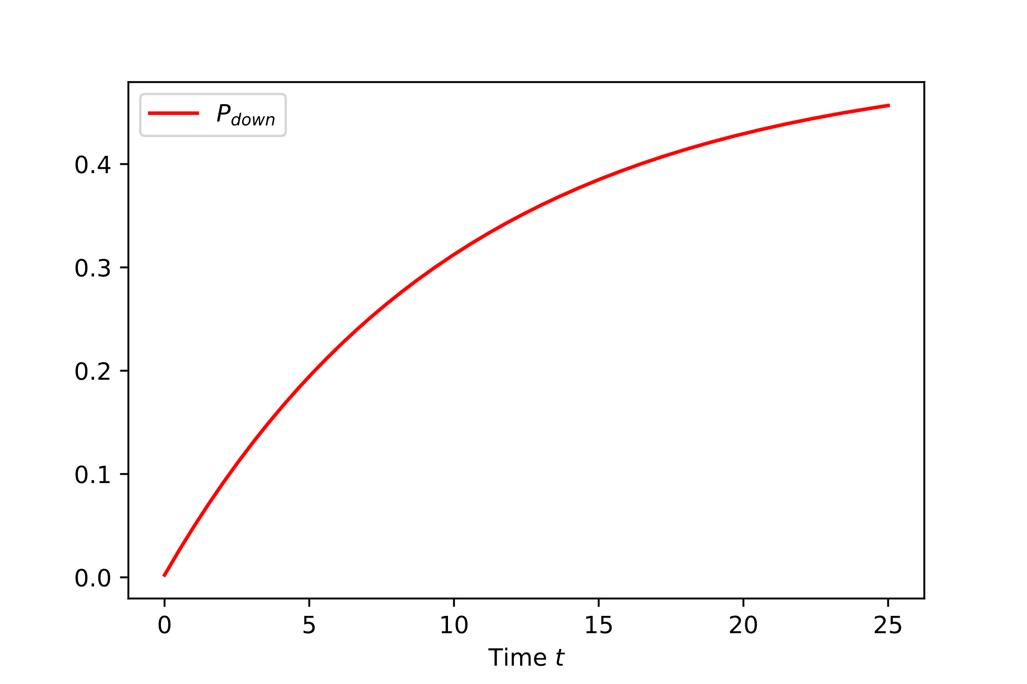
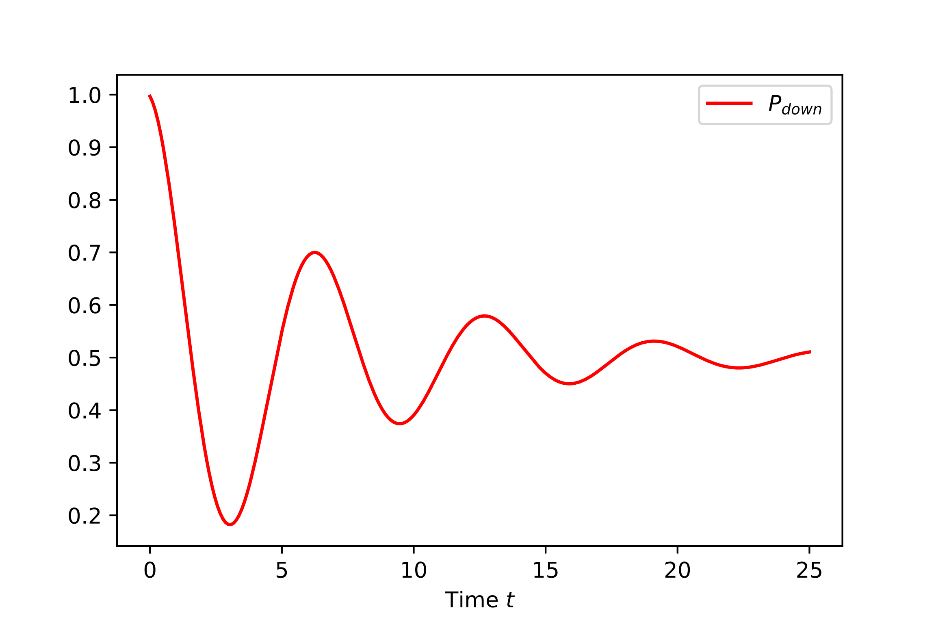

Ramsey Experiment, MRI

Slide 13
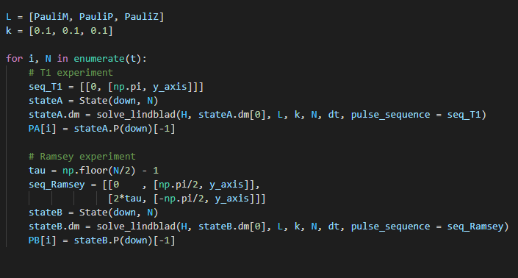
Ramsey Experiment, MRI
Our code which does the T1 and Ramsey experiment:
system parameters, initializations etc.
plotting & curve fitting

Slide 14
Spin Echo Experiment
Theory
System state decays\defocuses over time.
When a pulse sequence is applied it helps to refocus the system and regain a state similar to the initial state.
Notes:
Without a pulse sequence sent to the system the system decays (defocuses) over time. example: magnetization in nmr
When a pulse sequence is sent into the system, the system refocuses and tents back towards initial state. Probability the system will be found in the state identical to initial state is higher after pulse sequence than without it.

Slide 15
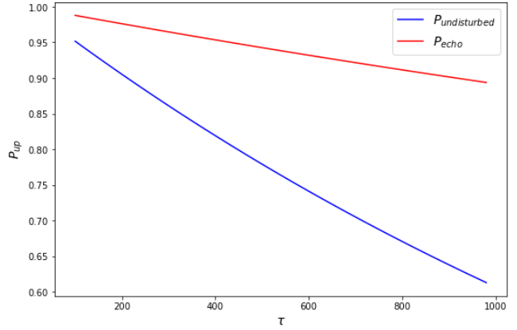
Spin Echo Experiment
Results

Slide 16
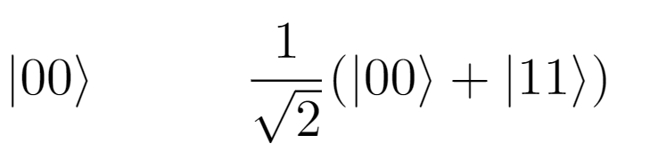
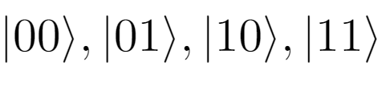
Entangled States Simulation
Theory
Entangled state: can’t be written as a product state.
When we measure in the Z-basis, the two-particle state collapses in one of these states:
not entangled
entangled

Slide 17
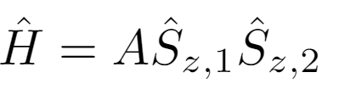
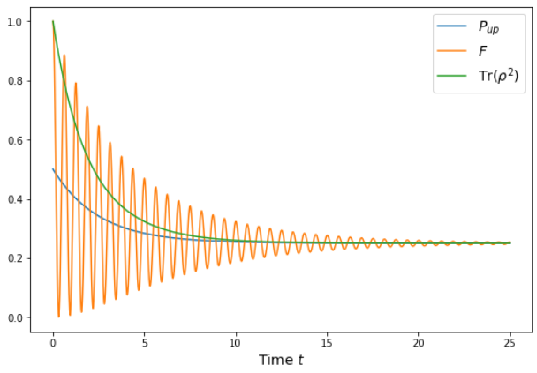
Entangled States Simulation
Results
Notes:
We start with well defined states so purity is 1 but it decays over time as states develop and decoherence occurs.
Probability state will be found in up state initially is equal to ½ by the definition of entangled states. For long time the states become completely evenly mixed so the 4x4 identity matrix is Identity matrix, meaning that the purity, fidelity and P go to 0.25.

Slide 18
Conclusion
We can solve the Lindblad equation
Spin ½
Larger systems
Time dependent Hamiltonians?
Different types of noise?
Notes:
We start with well defined states so purity is 1 but it decays over time as states develop and decoherence occurs.
Probability state will be found in up state initially is equal to ½ by the definition of entangled states. For long time the states become completely evenly mixed so the 4x4 identity matrix is Identity matrix, meaning that the purity, fidelity and P go to 0.25.

Slide 19
Questions?
Notes:
We start with well defined states so purity is 1 but it decays over time as states develop and decoherence occurs.
Probability state will be found in up state initially is equal to ½ by the definition of entangled states. For long time the states become completely evenly mixed so the 4x4 identity matrix is Identity matrix, meaning that the purity, fidelity and P go to 0.25.

