Slide 1

Student Details
Name : Pudi Abhiram Reddy
SkillsBuildEmail Id: pudiabhi@gmail.com
College Name : Sree Vidyanikethan Engineering College
State : Andhra Pradesh
Domain : Artificial Intelligence
Start and end date: 25/08/2023 – 30/09/2023

Slide 2
Project Title/Problem Statement
Title: Sentiment Analysis of Restaurant Reviews
Statement:
Sentimental reviews of customers towards the restaurant services and their like
Dislike are in 0 & 1.Python comes with a huge number of inbuilt libraries. Many of the libraries are for Artificial Intelligence, Machine Learning and Deep Learning.

Slide 3
AGENDA
Sentiment Analysis of Restaurant Reviews:
Introduction:
Prediction of the sentiment of Restaurant Reviews using the Python Libraries. The like and Dislike are in 0 and 1 in the dataset.
Exploratory Data Analysis:
Importing the Dataset.
Finding the shape of the dataset.
Printing the Info of the dataset.
Finding the different columns Labels present in the dataset.
Visualizing the Dataset.

Slide 4
AGENDA
Data Preprocessing:
Removing any special character other than letters in the Review dataset.
Converting each review in the corpus into lowercase letters.
Removing stop words which doesn’t add any meaning to the sentence.
Stemming each sentence for reducing the total number of words.
Combining all the processed texts into single corpus.
Feature Extraction:
The Vectors are obtained by CountVectorizer.
Number of max_features taken is 1600.
Obtaining Vectors for sentence in the Corpus.
Splitting the Dataset into train and test sets.

Slide 5
AGENDA
Modelling:
Selecting the suitable model for the Sentiment Analysis of the Restaurant reviews dataset.
Training the ML model with given dataset.
Obtaining the Accuracy score on the test dataset.
Fine Tuning the ML model for a better Accuracy.
Predicting
After fine tuning the model for hyperparameters, Predicting the sentiment of the sample reviews.

Slide 6
PROJECT OVERVIEW
Purpose of the Project:
The purpose of this project is to conduct sentiment analysis on restaurant reviews with the aim of understanding and categorizing customer sentiments towards restaurant services.
Analyzing and classifying reviews as positive or negative, this project seeks to provide valuable insights to both restaurant owners and potential customers.
This will enable restaurant owners to enhance their services based on feedback and help customers make informed dining choices.
Scope of the Project:
Sentiment analysis will be applied to restaurant reviews, specifically those available in text format (e.g., online reviews).
Data preprocessing, feature extraction, and sentiment classification will be within the project's scope.

Slide 7
PROJECT OVERVIEW
The project will employ natural language processing (NLP) techniques for sentiment analysis.
Objectives:
To classify restaurant reviews into two categories: positive and negative sentiments.
To develop a practical sentiment analysis model that can be applied to new restaurant reviews, facilitating real-time analysis and decision-making.
To provide insights into customer preferences, identifying what they like and dislike about restaurant services.

Slide 8
WHO ARE THE END USERS of this project?
1. Restaurant Owners/Managers:
Characteristics:
Business owners or managers of restaurants.
Typically interested in improving their restaurant's services and overall customer experience.
May have varying levels of technical expertise.
Needs:
Valuable insights into customer feedback and sentiment.
Actionable information to make data-driven decisions.
Efficient and automated sentiment analysis tools.
Access to real-time feedback and sentiment trends.

Slide 9
WHO ARE THE END USERS of this project?
Benefits:
Improved Customer Experience: They can identify areas that need improvement based on customer feedback, leading to a better dining experience.
Competitive Advantage: Understanding customer sentiment can help them stand out in the highly competitive restaurant industry.
Efficient Resource Allocation: They can allocate resources more effectively to address specific issues mentioned in reviews.
Real-time Feedback: Access to real-time sentiment analysis allows for prompt response to customer concerns and issues.

Slide 10
WHO ARE THE END USERS of this project?
2. Restaurant Customers:
Characteristics:
Individuals or groups who dine at restaurants.
May rely on online reviews and ratings to make dining choices.
Varying preferences and expectations when dining out.
Needs:
Reliable and trustworthy restaurant recommendations.
Information on the quality of restaurant services.
A platform to share their experiences and feedback.
Benefits:
Informed Dining Choices: They can make more informed decisions when choosing restaurants based on the sentiment analysis of reviews.
Enhanced Dining Experience: The project helps customers select restaurants that align with their preferences and expectations.
Opportunity to Share Feedback: Customers can easily share their experiences and provide feedback to restaurants.

Slide 11
YOUR SOLUTION AND ITS VALUE PROPOSITION
Solution:
Data Collection and Processing: Gather restaurant reviews from various online sources and preprocess the data. Data preprocessing steps include tokenization, lowercasing, removal of punctuation, handling of stopwords, and potentially stemming or lemmatization.
Sentiment Analysis Model: Implement a state-of-the-art sentiment analysis model, such as Natural Language Processing (NLP) techniques, to analyze and classify restaurant reviews based on sentiment. This model will have been trained on a dataset of reviews to accurately determine whether a review expresses a positive or negative sentiment.
Real-time Analysis: Ensure that the sentiment analysis system can perform real-time analysis, allowing restaurant owners to receive immediate insights into customer feedback as new reviews are posted.

Slide 12
YOUR SOLUTION AND ITS VALUE PROPOSITION
How the Solution Addresses the Needs of the End User:
Valuable Insights: The sentiment analysis model provides restaurant owners with valuable insights into customer feedback, helping them understand the sentiments expressed in reviews.
Data-Driven Decisions: By categorizing reviews into positive and negative sentiments, the solution assists owners in making data-driven decisions to improve their restaurant services.
Efficiency: The real-time analysis feature ensures that owners can respond promptly to customer concerns and feedback, enhancing the efficiency of addressing issues.
Competitive Advantage: Access to sentiment trends and insights gives restaurants a competitive advantage by allowing them to proactively improve services and stand out in the market.

Slide 13
How did I customize the project and make it my own
Highlights of my Project:
I have used GradientBoostClassifier which is a powerful ML model.
I have tuned the hyperparameters for the GradientBoostClassifier.
As the max_features parameters increases the Accuracy of the model also increased.
I got 79% accuracy after tuning hyperparameters. At max_features = 10 for the GradientBoostClassifier.
I got precision score of 85%.

Slide 14
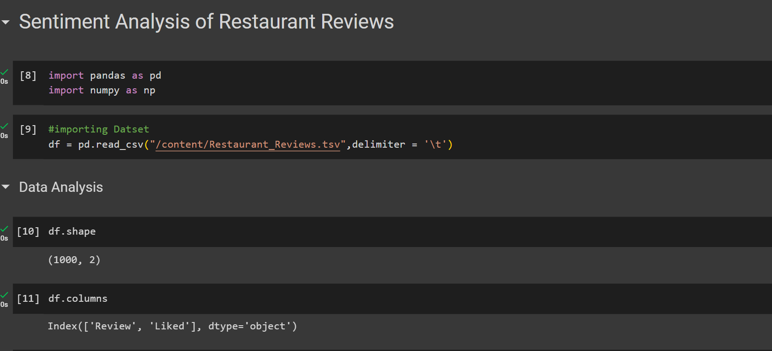
MODELLING
Data Analysis:

Slide 15
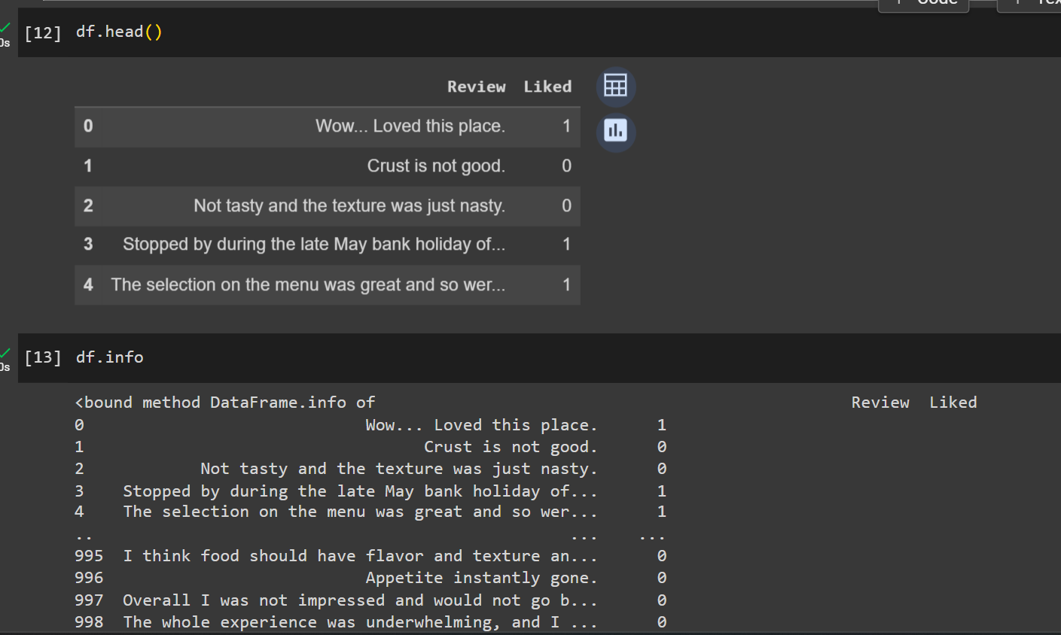
Modelling Data Analysis:

Slide 16
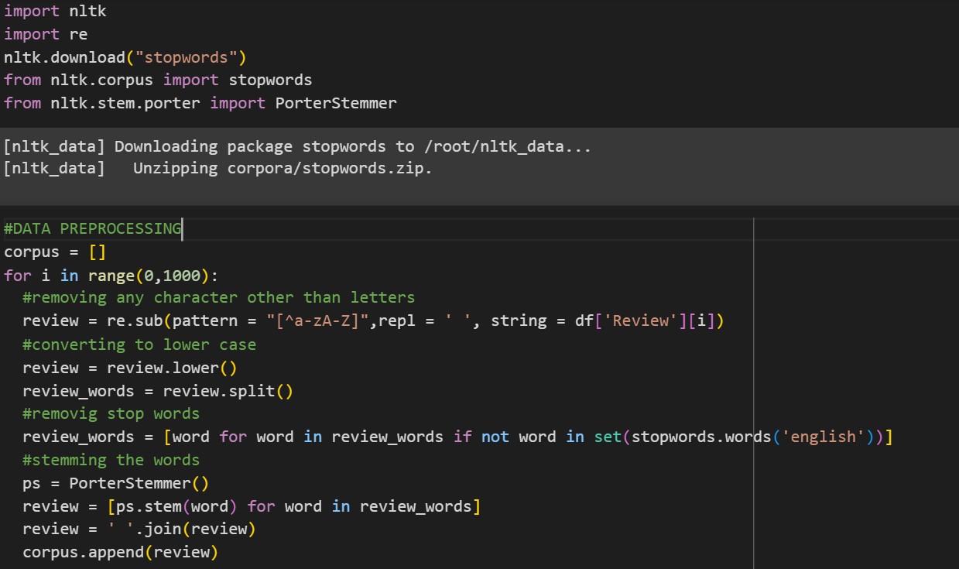
Modelling: Data Preprocessing:

Slide 17
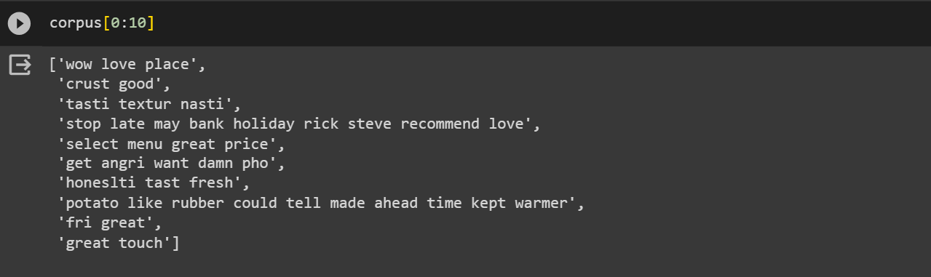
Modelling: Data after preprocessing:

Slide 18
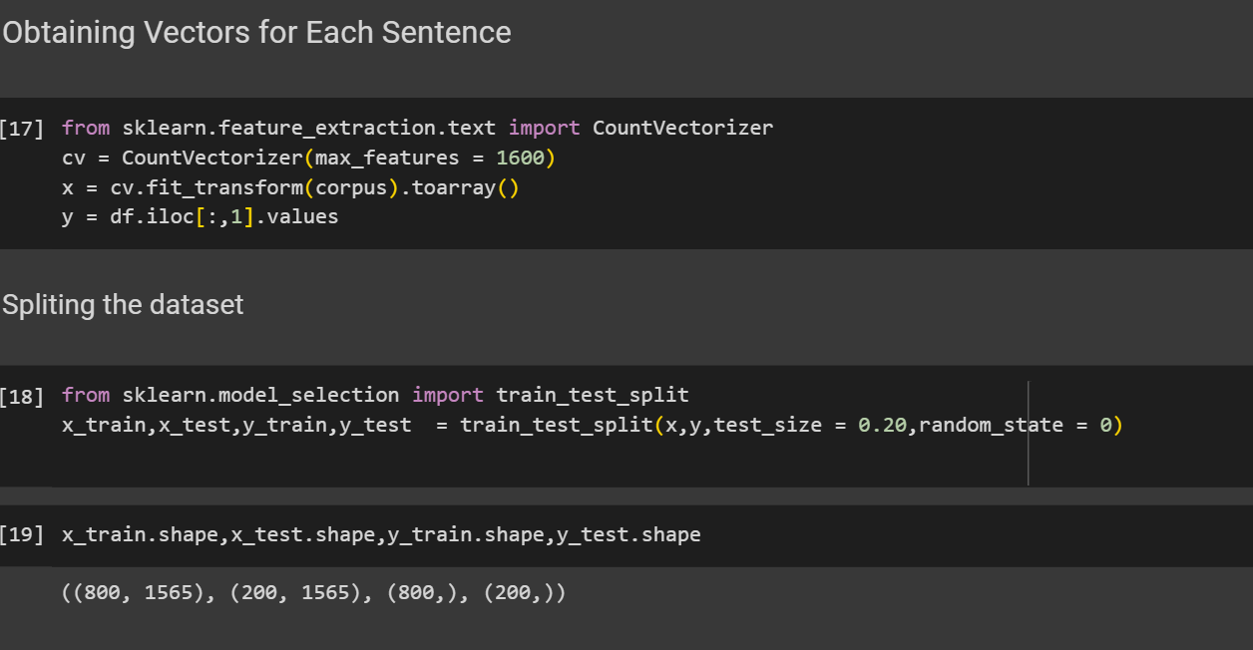
Modelling: Obtaining Vectors and Splitting:

Slide 19
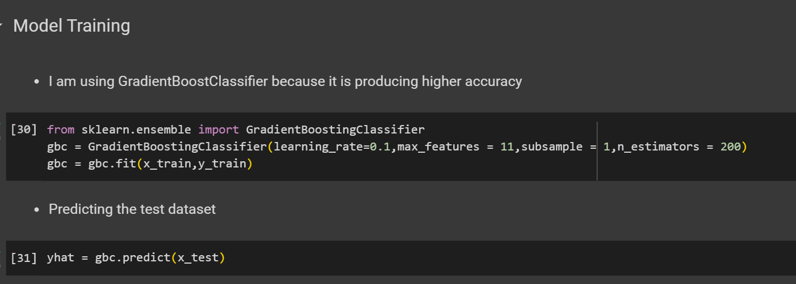
Modelling: GradientBoostClassifier training and Predicting test data:

Slide 20
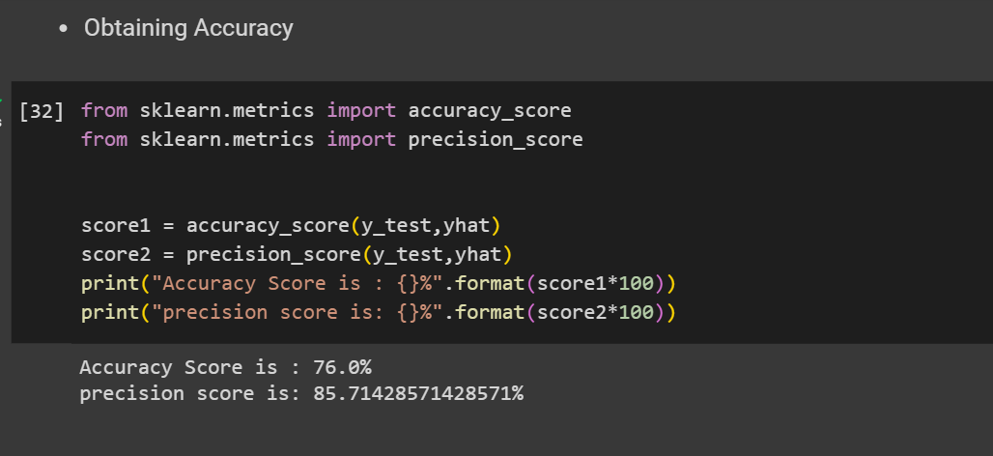
Modelling Obtaining Accuracy:

Slide 21
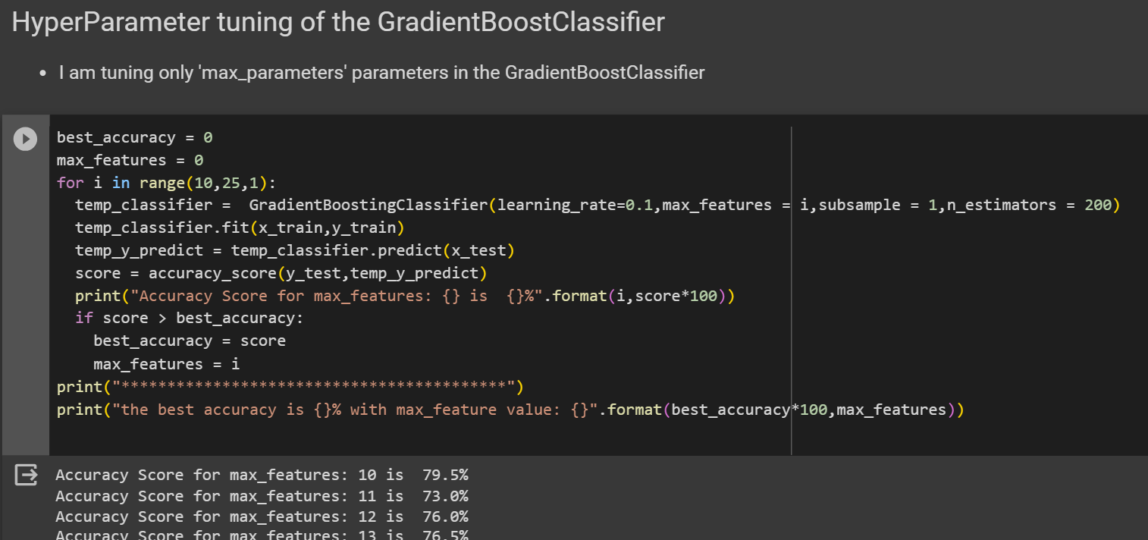
Modelling: Hyperparameter tuning:

Slide 22
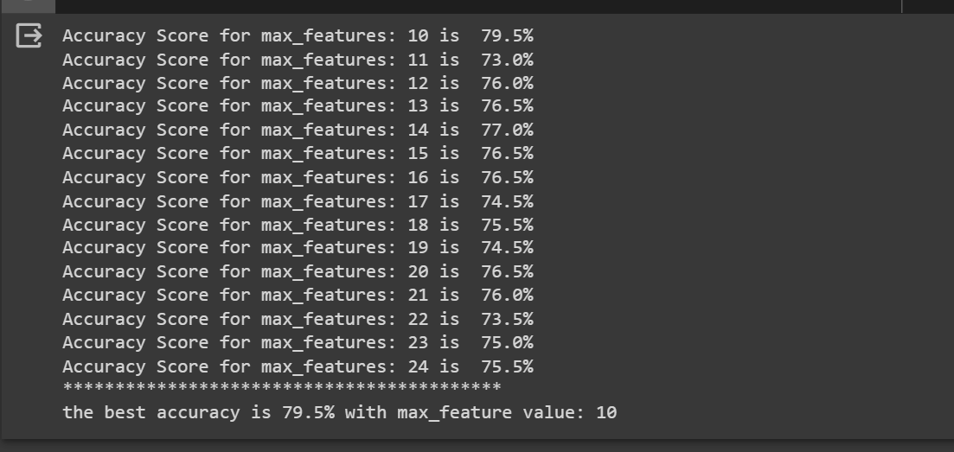
Modelling Output of Hyperparameter tuning:

Slide 23
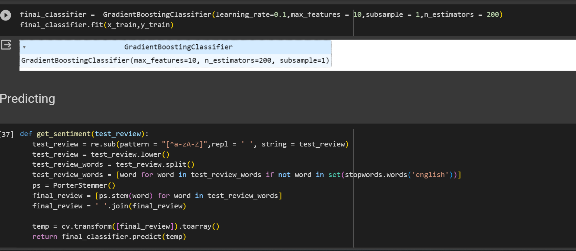
Modelling Function for Predicting sample reviews:

Slide 24
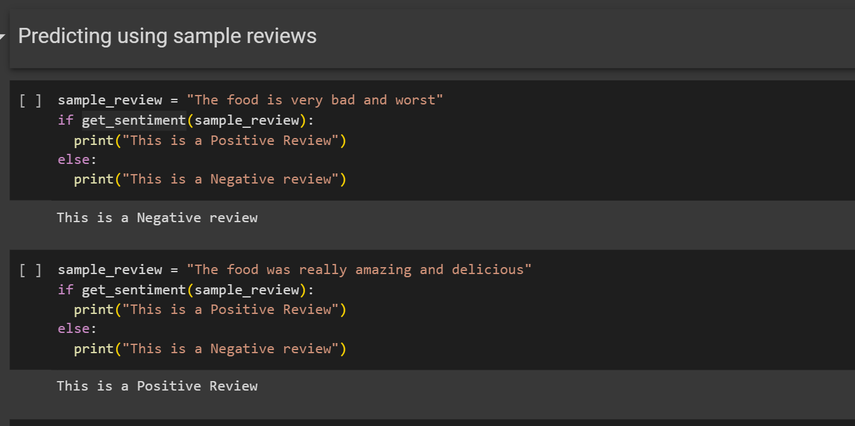
Results Predictions:

Slide 25
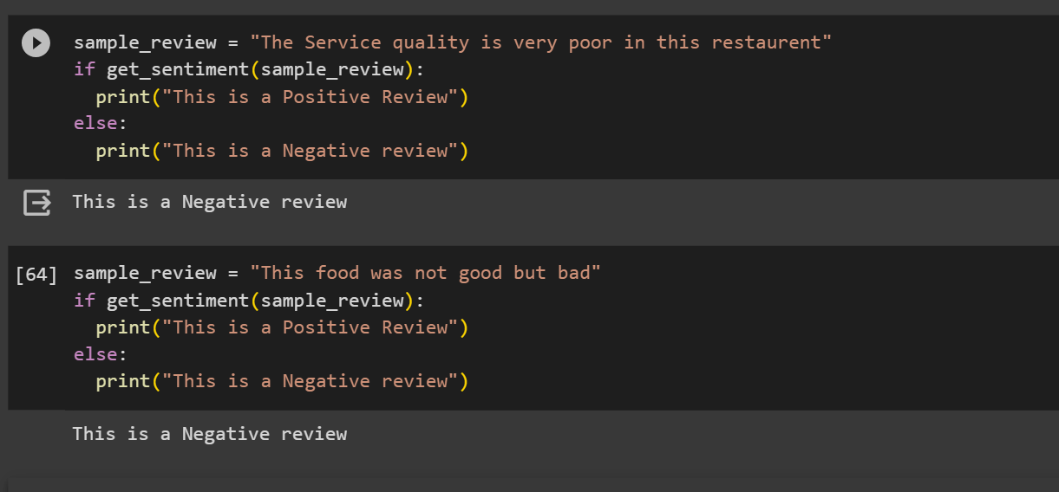
Results Predictions:

Slide 26
links
Project Github Link:
https://github.com/PudiAbhiramReddy/review_sentiment_analysis.git

Slide 27
Thank you

