Slide 1

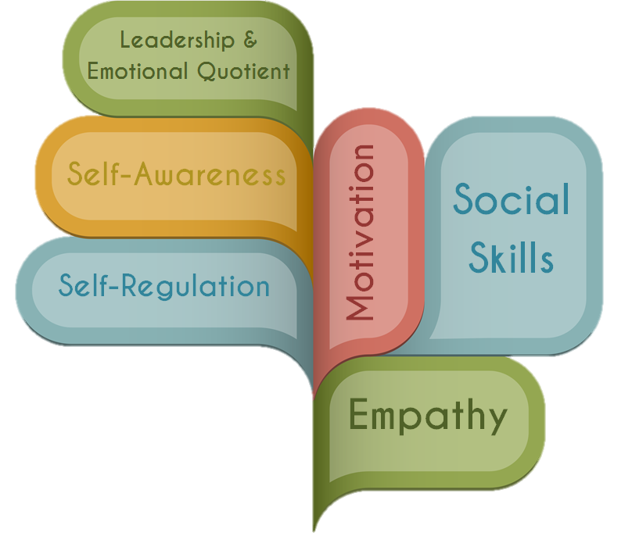
Sage Advice & Observations

Slide 2
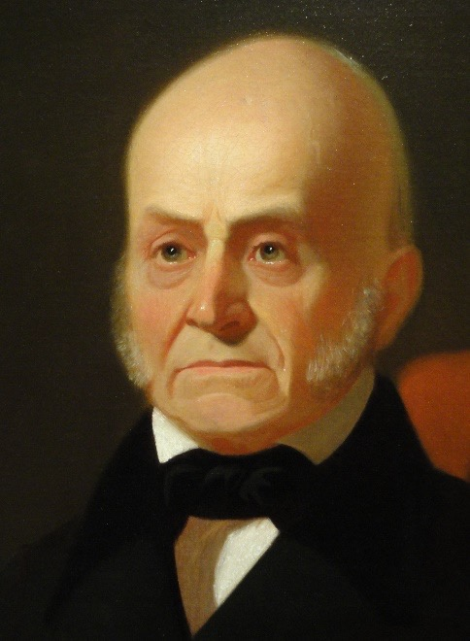
“If your actions inspire others to dream more, learn more, do more and become more, you are a leader.”
—John Quincy Adams
American Statesman; Diplomat; Congressman; Senator; 6th President of the United States 1767-1848
APPLIED EMOTIONAL INTELLIGENCE FOR MEASURABLE, MEANINGFUL RESULTS

Slide 3
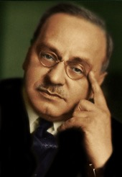
“Empathy: seeing with the eyes of another, listening with the ears of another, and feeling with the heart of another.”
— Alfred Adler
Austrian Medical Doctor; Psychotherapist; Founder of the School of Individual Psychology.
1870-1937
APPLIED EMOTIONAL INTELLIGENCE FOR MEASURABLE, MEANINGFUL RESULTS

Slide 4
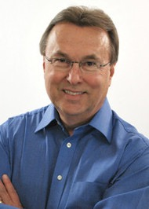
“The relationships we have with the world are largely determined by the relationships we have with ourselves.”
— Greg Anderson
Founder and chairman of the Cancer Recovery Foundation; Founder of the American Wellness Project; Wellness Authority.
1947-current
APPLIED EMOTIONAL INTELLIGENCE FOR MEASURABLE, MEANINGFUL RESULTS

Slide 5
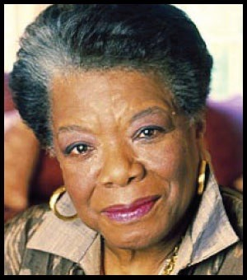
“I’ve learned that people will forget what you said, people will forget what you did, but people will never forget how you made them feel.”
—Maya Angelou
American Author; Poet; Sage.
1928-2014
APPLIED EMOTIONAL INTELLIGENCE FOR MEASURABLE, MEANINGFUL RESULTS

Slide 6
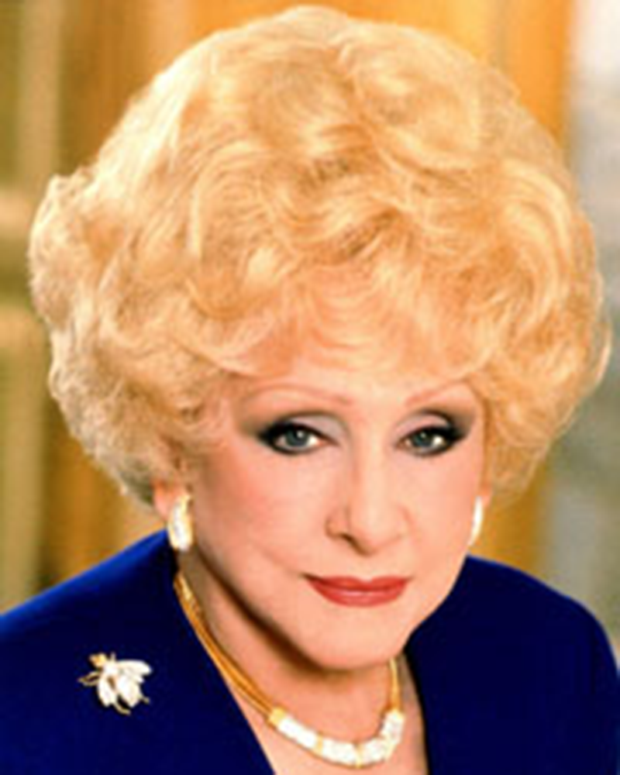
“Pretend that every single person you meet has a sign around his or her neck that says, “Make me feel important.” Not only will you succeed in sales, you will succeed in life.”
— Mary Kay Ash
American Businesswoman; Entrepreneur; Motivator.
1918-2001
APPLIED EMOTIONAL INTELLIGENCE FOR MEASURABLE, MEANINGFUL RESULTS

Slide 7
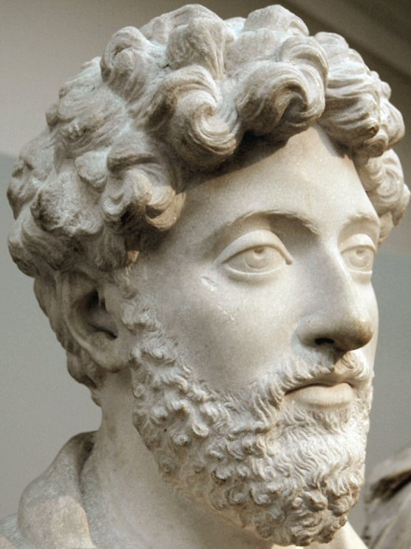
“The happiness of your life depends on the quality of your thoughts.”
— Marcus Aurelius
Roman Emperor; Last of the Five Good Emperors; Stoic Philosopher.
121-180
APPLIED EMOTIONAL INTELLIGENCE FOR MEASURABLE, MEANINGFUL RESULTS

Slide 8
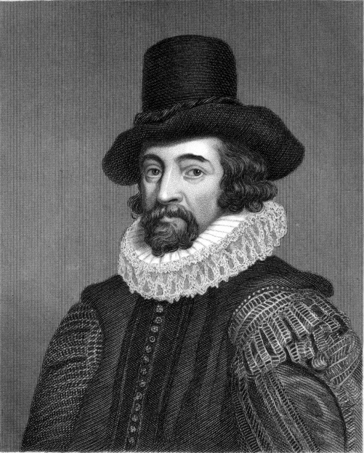
“Imagination was given to man to compensate him for what he is not; a sense of humor to console him for what he is.”
— Sir Francis Bacon
English Philosopher; Statesman; Scientist; Jurist; Orator; Author.
1561-1626
APPLIED EMOTIONAL INTELLIGENCE FOR MEASURABLE, MEANINGFUL RESULTS

Slide 9
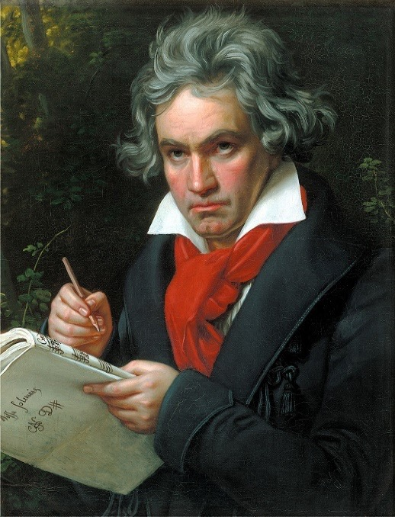
“To play a wrong note is insignificant; to play without passion is inexcusable.”
— Ludwig van Beethoven
German Composer; Pianist.
1770-1827
APPLIED EMOTIONAL INTELLIGENCE FOR MEASURABLE, MEANINGFUL RESULTS

Slide 10
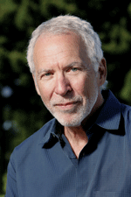
“Stating your own feelings is being authentic and acts to encourage a like response from others.”
— Peter Block
American Author; Consultant; Speaker in the Areas of Organization Development; Community Building; and Civic Engagement.
1940-current
APPLIED EMOTIONAL INTELLIGENCE FOR MEASURABLE, MEANINGFUL RESULTS

Slide 11
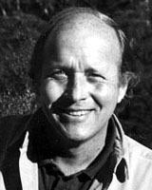
“Remember that the happiest people are not those getting more but those giving more.”
— H. Jackson Brown, Jr.
American Author; Pop Philosopher.
1940-current
APPLIED EMOTIONAL INTELLIGENCE FOR MEASURABLE, MEANINGFUL RESULTS

Slide 12
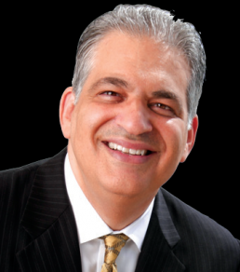
“First help your prospect to identify their joy. Only then have you earned the right in their mind to help them identify their pain, which you can then help them fix with your product, service, or opportunity.”
—Bob Burg
American Author, Speaker, Entrepreneur
1958-Current
APPLIED EMOTIONAL INTELLIGENCE FOR MEASURABLE, MEANINGFUL RESULTS

Slide 13
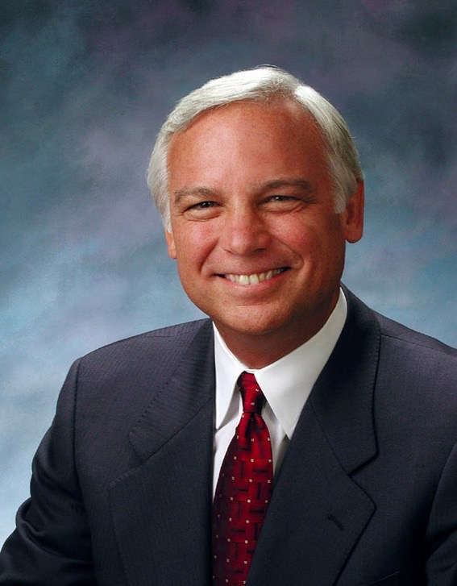
“Decide what you want. Believe you can have it. Believe you deserve it and believe it’s possible for you.”
— Jack Canfield
American Author of Chicken Soup for the Soul Series; Motivational Speaker.
1944-current
APPLIED EMOTIONAL INTELLIGENCE FOR MEASURABLE, MEANINGFUL RESULTS

Slide 14
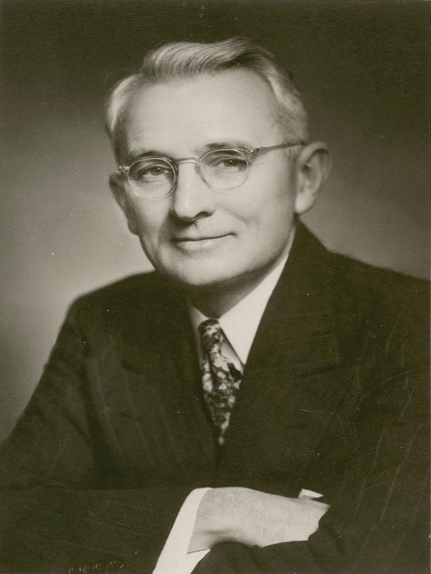
“When dealing with people remember you are not dealing with creatures of logic, but with creatures of emotion, creatures bristling with prejudice, and motivated by pride and vanity.”
— Dale Carnegie
American Writer, Lecturer, Self-Improvement Expert
1888-1955
APPLIED EMOTIONAL INTELLIGENCE FOR MEASURABLE, MEANINGFUL RESULTS

Slide 15
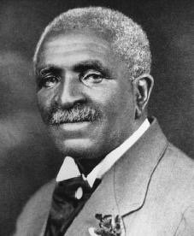
“How far you go in life depends on you being tender with the young, compassionate with the aged, sympathetic with the striving and tolerant of the weak and the strong. Because someday in life you will have been all of these.”
—George Washington Carver
American Botanist; Inventor; Christian; Author.
1860-1943
APPLIED EMOTIONAL INTELLIGENCE FOR MEASURABLE, MEANINGFUL RESULTS

Slide 16
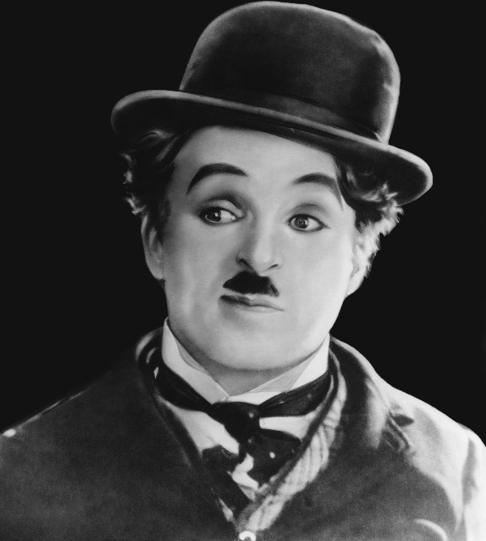
“We think too much and feel too little. More than machinery, we need humanity. More than cleverness, we need kindness and gentleness. ”
—Charlie Chaplin
English Comic Actor; Filmmaker; Star of Silent Movies.
1889-1977
APPLIED EMOTIONAL INTELLIGENCE FOR MEASURABLE, MEANINGFUL RESULTS

Slide 17
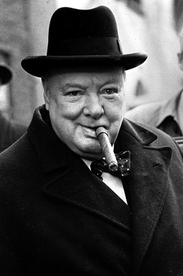
“We make a living by what we get, we make a life by what we give.”
— Winston Churchill
British Politician; Statesman; Prime Minister.
1874-1965
APPLIED EMOTIONAL INTELLIGENCE FOR MEASURABLE, MEANINGFUL RESULTS

Slide 18
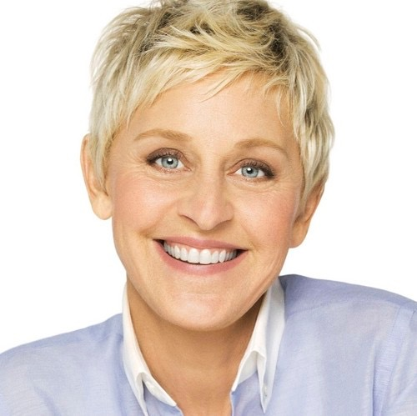
“Why do they say ‘We’re over the hill?’ I don’t even know what that means and why it’s a bad thing. When I go hiking and I get over the hill that means I’m past the hard part and there’s a snack in my future.”
— Ellen Degeneres
American Comedian; Television Host; Actress; Writer; Producer.
1958-current
APPLIED EMOTIONAL INTELLIGENCE FOR MEASURABLE, MEANINGFUL RESULTS

Slide 19
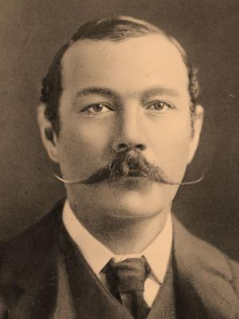
“I consider that a man’s brain originally is like a little empty attic, and you have to stock it with such furniture as you choose.”
— Arthur Conan Doyle
Scottish Writer; Physician; Author; Creator of Sherlock Holmes.
1859-1930
APPLIED EMOTIONAL INTELLIGENCE FOR MEASURABLE, MEANINGFUL RESULTS

Slide 20
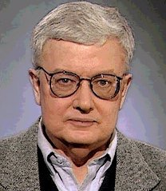
“Your intellect may be confused, but your emotions will never lie to you.”
—Roger Ebert
American Film Critic; Journalist; Screen Writer.
1942-2013
APPLIED EMOTIONAL INTELLIGENCE FOR MEASURABLE, MEANINGFUL RESULTS

