Slide 1
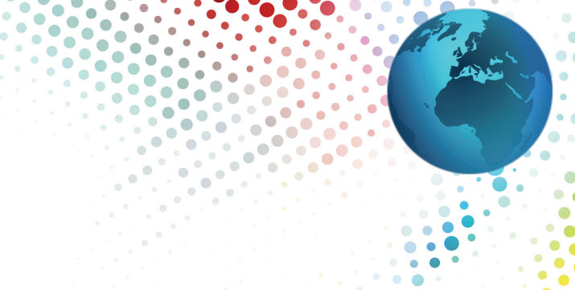
Motivators Activities
In partnership with
BehavioralResourceGroup.com
leaders in people intelligence

Slide 2
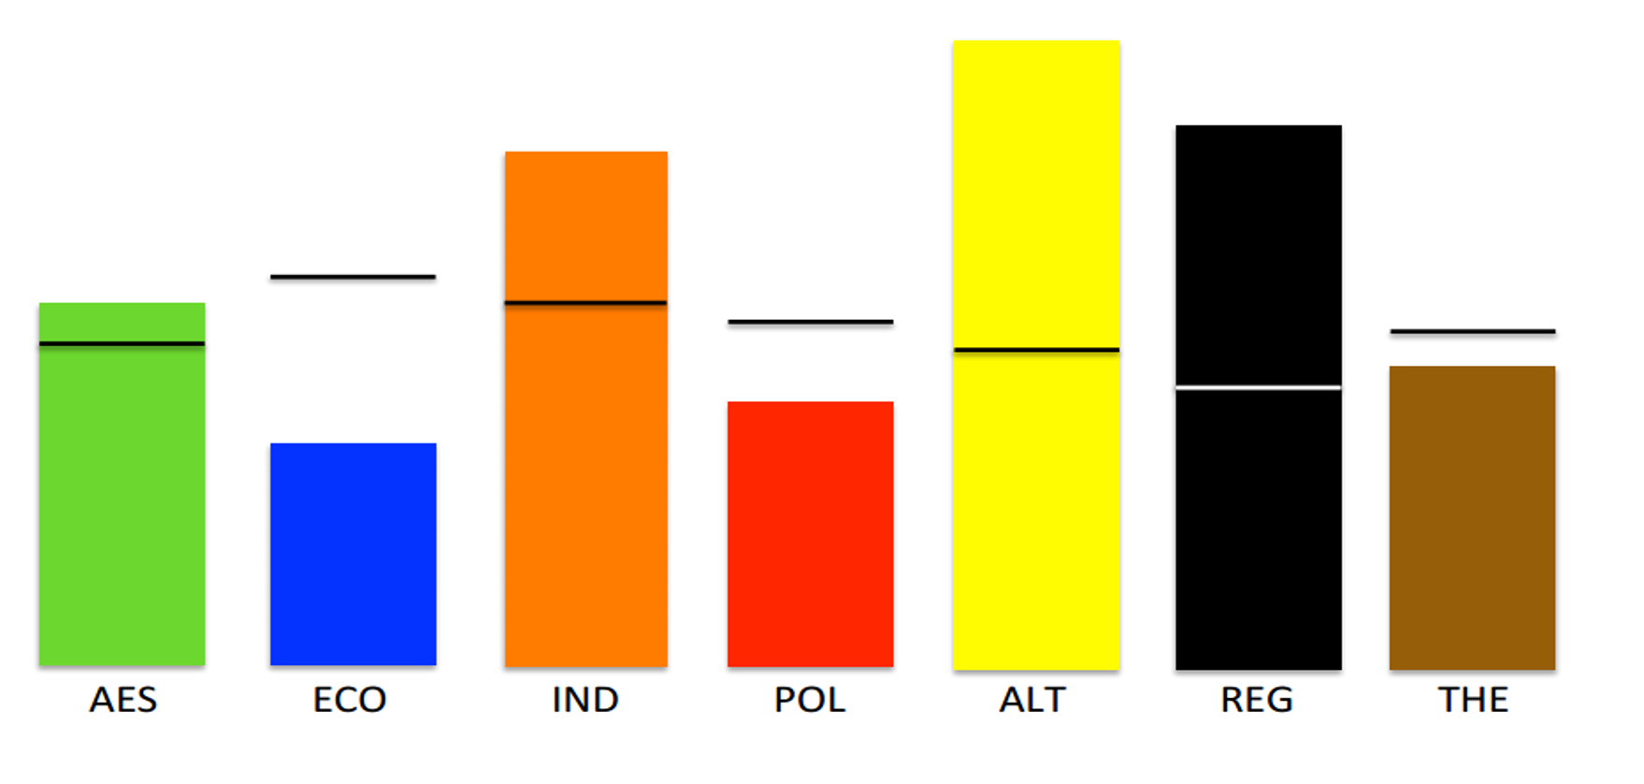
Discussion - Different Motivators
Why is it important to know if someone has different motivators than you do?
55%
45%
45%
25%
30%
53%
47%
Notes:
Ask each table to brainstorm and provide a few answers to this question.
ASK: Why is it important to know if someone has different motivators than you do?
Example answers
We all see others as we are, not as they are. We all have our own needs and desires, and we all express them differently through our actions.
If we have different Motivators, we make different choices. Motivators are the reasons that drive us to WANT to act.

Slide 3
Activity – Describe the Dimension
Using your assigned Dimension, create a list of characteristics for high scores and low scores in that area.
Identify 2 potential strengths and 2 potential limitations for high and low scores.
Notes:
Assign each group a specific dimension.
Have them complete the activity based on these definitions:
Aesthetic - a drive for balance, harmony, and form – alternative thinking versus standardized thinking – standardized values functionality not balance
Economic - a drive for economic or practical returns – competitiveness drives the desire for ROI, what’s in it for me, how do I win?
Individualistic - a drive to stand out as independent – a desire to be unique
Political - a drive to be in control or have influence - the desire to have control and power over a situation or environment
Altruistic - a drive for humanitarian efforts or to help others selflessly –to understand or experience the feelings of others
Regulatory - a drive to establish order, routine, and structure –to value system and structure
Theoretical - a drive for knowledge, learning, and understanding – a need to investigate, know and understand
Debrief with following slides.

Slide 4
Strengths and Limitations
Aesthetic - High
Strengths
Limitations
Expression of creativity
Appreciation of environment
Values personal fulfillment and peace
Intuitive insight
May have head in clouds
Avoid disharmony and pain
Can be unrealistic
Struggle with practicality
Aesthetic - Low
Strengths
Limitations
Practical results focus
Less emotional, straightforward
Values Functionality
No need for frill and enhancement
May seem impersonal, too businesslike
May put too much focus on results
May be unimaginative, resist the uncommon
Hyper aware of “wasting time”
Notes:
Review Slide: Note animations to reveal High and Low

Slide 5
Strengths and Limitations
Economic - High
Strengths
Limitations
Focus on achievement and winning
Driven by competition, challenges, money
Efficient, no nonsense, value time
Ultimate outcome or results oriented
Potential workaholic
Lack of concern for others
Can be too financially motivated
Always expects something in return
Economic - Low
Strengths
Limitations
Focused on others, less on self
Sensitive to others
Values personal contribution over gain
Quality-oriented
Avoids conflict
High concern for others, overlooks self
Undervalues self
Tends to overcommit
Notes:
Review Slide: Note animations to reveal High and Low

Slide 6
Strengths and Limitations
Individualistic - High
Strengths
Limitations
Independent, Unique
Tolerant of others’ differences
Autonomous
Variety of outstanding ideas
Resists authority
Dislikes structure and uniformity
Likely to do things their way
May be inefficient or ineffective
Individualistic - Low
Strengths
Limitations
Don’t need credit for work
Value servant leadership
Good at helping others
Sees value in others easily
May not speak up, share opinions openly
May settle for less
May not desire being directive leader
May be less innovative, more disciplined
Notes:
Review Slide: Note animations to reveal High and Low

Slide 7
Strengths and Limitations
Political - High
Strengths
Limitations
Determined and competitive
Driven toward success
Good at leading others
Implement projects and plans
Controlling
Use relationships to advance position
Appears selfish
Values self over others
Political - Low
Strengths
Limitations
Mission-driven
Helper, doesn’t expect credit
Will notice/point out other’s efforts
Don’t need recognition and power
Want to avoid conflict, problems
May settle for less, not fight for wants
May not feel confident in own ideas/self
May wait for opportunity, rather than seek it
Notes:
Review Slide: Note animations to reveal High and Low

Slide 8
Strengths and Limitations
Altruistic - High
Strengths
Limitations
Generous with time and resources
Focusing on others
Selfless support of causes
Genuine concern for others
Values others over self
Impractical with own resources
Hard to say no
May be taken advantage of
Altruistic- Low
Strengths
Limitations
Can make hard people decisions
Can separate emotions from actions
Face difficult decisions head on
Difficult to take advantage of
May forget that helping others helps self
May appear selfish and self-absorbed
May seem closed off and reserved
May have little patience
Notes:
Review Slide: Note animations to reveal High and Low

Slide 9
Strengths and Limitations
Regulatory - High
Strengths
Limitations
Structured
Follows rules
Lives by set of principles
Works for a cause
May be unreceptive to new ideas
Sacrifices self for beliefs or cause
May break rules and justify it
Judgmental towards other viewpoints
Regulatory - Low
Strengths
Limitations
Many ways to get the job done
Will always have an opinion and like to share
Mistakes are part of learning and normal
Very adaptable, open to change
May not be patient or respect differences
May be risky and innovative
May break rules and justify it
May disregard procedures and systems
Notes:
Review Slide: Note animations to reveal High and Low

Slide 10
Strengths and Limitations
Theoretical - High
Strengths
Limitations
Gaining expertise, learning
Being objective
Problem solving
Developing solutions
Getting bogged down in details
Too slow to act
Impractical pursuits
Wasting time and resources
Theoretical - Low
Strengths
Limitations
Quick decision maker
Practical, hands-on learner
Will always find a way
Trail and error learning
May not pay attention to instructions
May rush through projects, miss details
May quickly reach information overload
May struggle to connect the dots
Notes:
Review Slide: Note animations to reveal High and Low

Slide 11
Activity – Guessing our influences
Notes:
Assign a table or area of the room to each Motivation. Have participants hypothesize their greatest areas of influence, and move about the room according to what they anticipate as their most influential motivator, second most influential, and least influential motivator.
Have participants note if there are groupings that seem more common than others and discuss the impact of having motivations that are similar and different for people.
Return to original seats.

Slide 12
Activity – Team Assessment
Notes:
TWO OPTIONS:
1. Each person individually - List the members of the team, including yourself, and identify each person’s primary and secondary motivator based on your own guess.
Then make a list of ways to better engage each team member based on his or her primary and secondary drivers.
2. As a team, identify each person’s most influential motivators (noting where there may be supporting motivators that strengthen another dimension i.e. High ECO and High POL) . The work as a team to identify the ways to best engage other team members, either individually or as a full group, to be sure that the needs of each person are met, and that each person has the opportunity to embrace their motivators/values within the team.

Slide 13
Activity – Quotes
Notes:
Find one quote for each Motivator that exemplifies the HIGH scores of each style. Place around the room, and have the participants take a moment to review all quotes and choose the quote that best “fits” or resonates the most with them. Talk about each of the quotes, how they represent that motivator and what characteristics can be seen in the quote for each motivator.
Example Quotes:
Aesthetic - A time for everything: A time to relax and a time to be busy, a time to frolic and a time to labor, a time to receive and a time to give, a time to begin and a time to finish. Jonathan Lockwood Huie
Economic - Investment is crucial. Because the truth is, you only get jobs and growth in the economy when people invest money, at their own risk, in setting up a business or expanding an existing business. John Key
Individualistic - …every single person is unique, and every single person has special things to offer, and it's about embracing it and not being afraid of the fact that maybe you're different or quirky, but it's okay to be different, and it can be a wonderful thing. Lindsey Stirling
Political - Leadership is a matter of having people look at you and gain confidence, seeing how you react. If you're in control, they're in control. Tom Landry
Altruistic - Beginning today, treat everyone you meet as if they were going to be dead by midnight. Extend to them all the care, kindness and understanding you can muster, and do it with no thought of any reward. Your life will never be the same again. Og Mandino
Regulatory - I am sure there is a right way and a wrong way and in today's life, there are many different rules… Mike Singletary
Theoretical –An investment in knowledge pays the best interest. Benjamin Franklin

